Slide 1
Weekly Report
2020.11.06
Hongsik Kim
Mobile & Network Intelligence Laboratory

Slide 2
AI Explanable AI
Kaggle 진행 상황
논문: Black Box Attacks on Explainable Artificial Intelligence (XAI) methods in Cyber Security
특허 구현 (Not Available for Public)

Slide 3
Current Status
주간 진행 사항
Kaggle 진행
Conway’s Reverse Game of Life
https://www.kaggle.com/c/conway-s-reverse-game-of-life/overview
논문 학습
Black Box Attacks on Explainable Artificial Intelligence (XAI) methods in Cyber Security
https://ieeexplore.ieee.org/stamp/stamp.jsp?arnumber=9206780
특허 구현 (Not Available for Public)

Slide 4
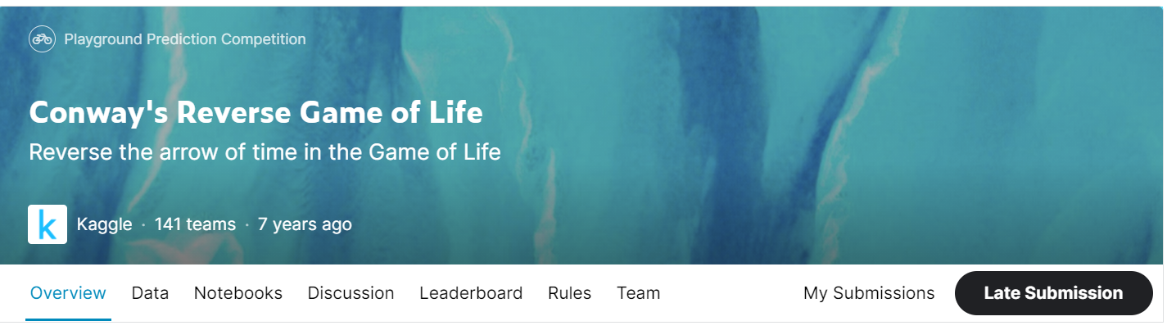
Kaggle Competition
Conway’s Reverse Game of Life
https://www.kaggle.com/c/conway-s-reverse-game-of-life/overview

Slide 5
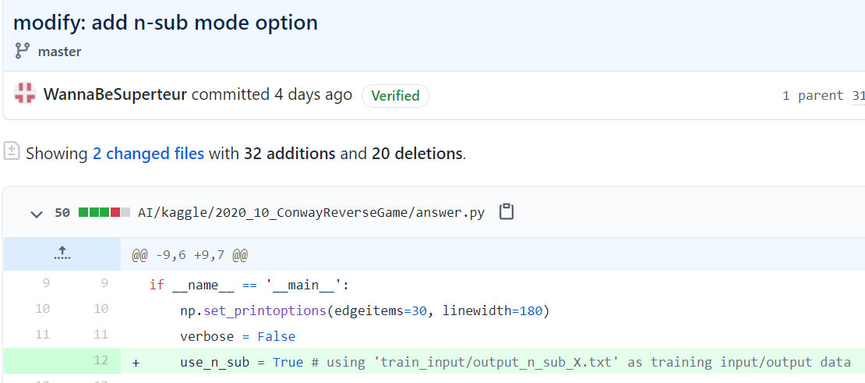
Kaggle Competition
Conway’s Reverse Game of Life
n-sub mode 옵션 추가

Slide 6
Kaggle Competition
Conway’s Reverse Game of Life
n-sub mode 옵션 추가 - 학습 (실제로는 -1 padding을 둠)
…
Training input
(original)
Training output
(original)
input
output

Slide 7
Kaggle Competition
Conway’s Reverse Game of Life
n-sub mode 옵션 추가 - 테스트 (실제로는 -1 padding을 둠)
…
Test input
(original)
Test output
input
output

Slide 8
Kaggle Competition
Conway’s Reverse Game of Life
n-sub mode 옵션 추가 - 테스트 (실제로는 -1 padding을 둠)
threshold
Test output

Slide 9
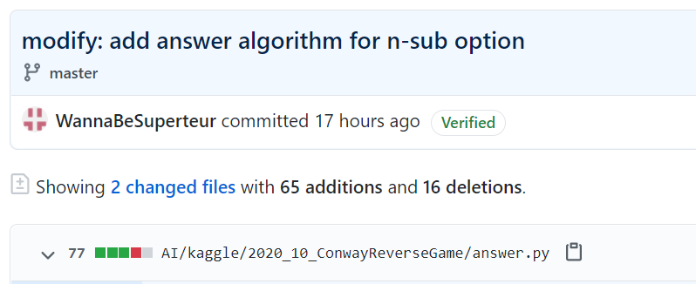
Kaggle Competition
Conway’s Reverse Game of Life
n-sub mode에서 test data를 그대로 저장하려면 많은 용량이 필요하고, 각각의 test data에 대하여 알고리즘을 실행하면 되므로 각 test data를 입력받아 출력을 도출하고 그것을 취합하는 방법 이용

Slide 10
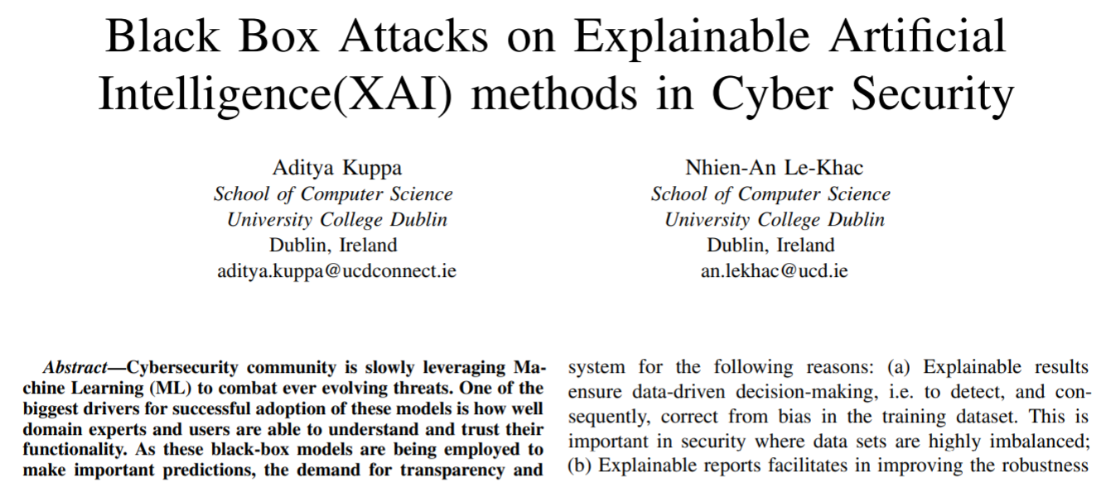
Paper: Black Box Attacks on XAI methods in Cyber Security
논문 소개
Black Box Attacks on Explainable Artificial Intelligence (XAI) methods in Cyber Security
https://ieeexplore.ieee.org/stamp/stamp.jsp?arnumber=9206780

Slide 11
Paper: Black Box Attacks on XAI methods in Cyber Security
논문 소개
Taxonomy of XAI in Security Domain
X-PLAIN | 예측 또는 데이터 그 자체에 대한 설명
XSP-PLAIN | 예측 또는 데이터의 security와 privacy policy들을 포함하는 설명 (confidentiality, integrity, privacy 속성)
XT-PLAIN | 예측 또는 데이터의 threat model을 포함하는 설명 (correctness, consistency, transferability, confidence, fairness, privacy)

Slide 12
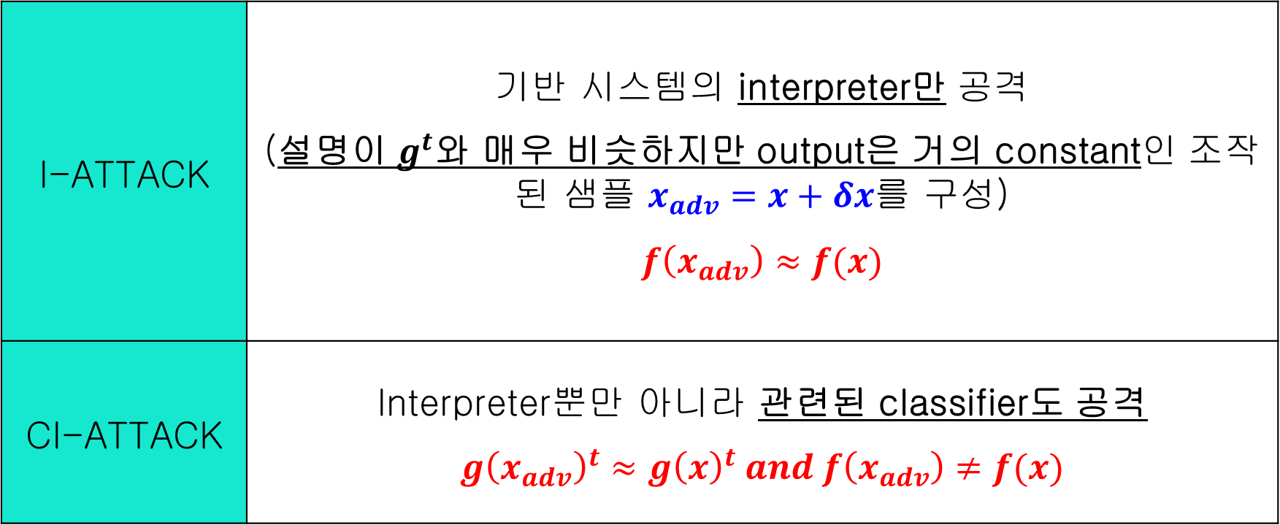
Paper: Black Box Attacks on XAI methods in Cyber Security
논문 소개
Proposed methods
I-ATTACK | 기반 시스템의 interpreter만 공격 (설명이 $g^{t}$와 매우 비슷하지만 output은 거의 constant인 조작된 샘플 $x_{adv}=x+δx$를 구성) $$f\left(x_{adv}\right)≈f(x)$$
CI-ATTACK | Interpreter뿐만 아니라 관련된 classifier도 공격 $$g{\left(x_{adv}\right)}^{t}≈g{\left(x\right)}^{t} and f\left(x_{adv}\right)≠f(x)$$

Slide 13
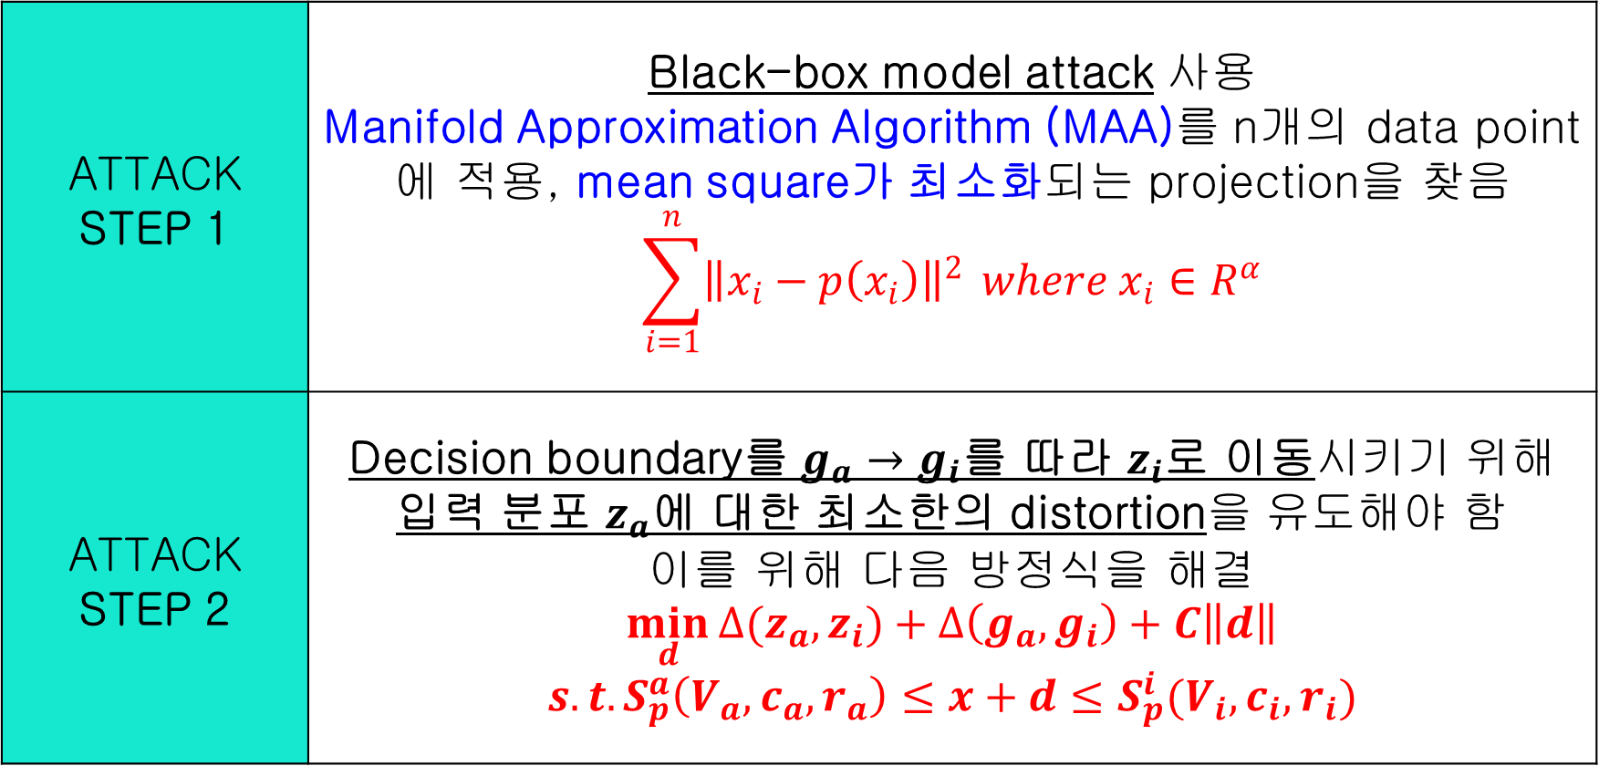
Paper: Black Box Attacks on XAI methods in Cyber Security
논문 소개
Proposed methods
ATTACK STEP 1 | Black-box model attack 사용 Manifold Approximation Algorithm (MAA)를 n개의 data point에 적용, mean square가 최소화되는 projection을 찾음 $$\sum_{i=1}^{n}{{\left\|x_{i}−p\left(x_{i}\right)\right\|}^{2}} where x_{i}∈R^{α}$$
ATTACK STEP 2 | Decision boundary를 $g_{a}→g_{i}$를 따라 $z_{i}$로 이동시키기 위해 입력 분포 $z_{a}$에 대한 최소한의 distortion을 유도해야 함 이를 위해 다음 방정식을 해결 $$\min_{d}{∆(z_{a}, z_{i})}+∆\left(g_{a}, g_{i}\right)+C\left\|d\right\|$$ $$s.t. S_{p}^{a}\left(V_{a}, c_{a}, r_{a}\right)≤x+d≤S_{p}^{i}(V_{i}, c_{i}, r_{i})$$

Slide 14
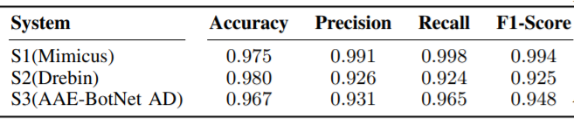
Paper: Black Box Attacks on XAI methods in Cyber Security
논문 소개
Evaluation and Discussion - SYSTEM
Mimicus | 해로운 PDF 문서를 탐지할 수 있는 multilayer perceptron
Drebin | Android Malware를 identify하기 위한 multilayer perceptron
AAE-BotNet AD | AAE(Adversarial Auto Encoder)를 이용하는 Intrusion Detection System

Slide 15
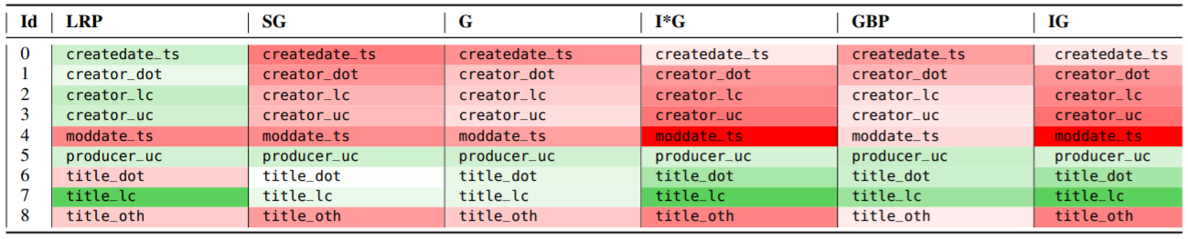
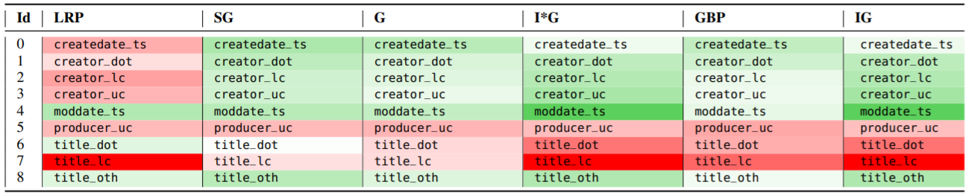
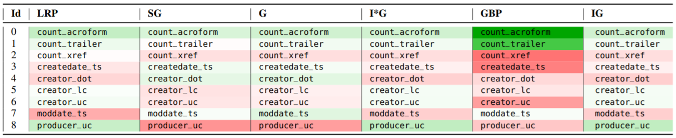
Paper: Black Box Attacks on XAI methods in Cyber Security
논문 소개
Evaluation and Discussion (PDF file, on Mimicus System)
Malicious (original)
Malicious -> Benign
Malicious -> Malicious

Slide 16
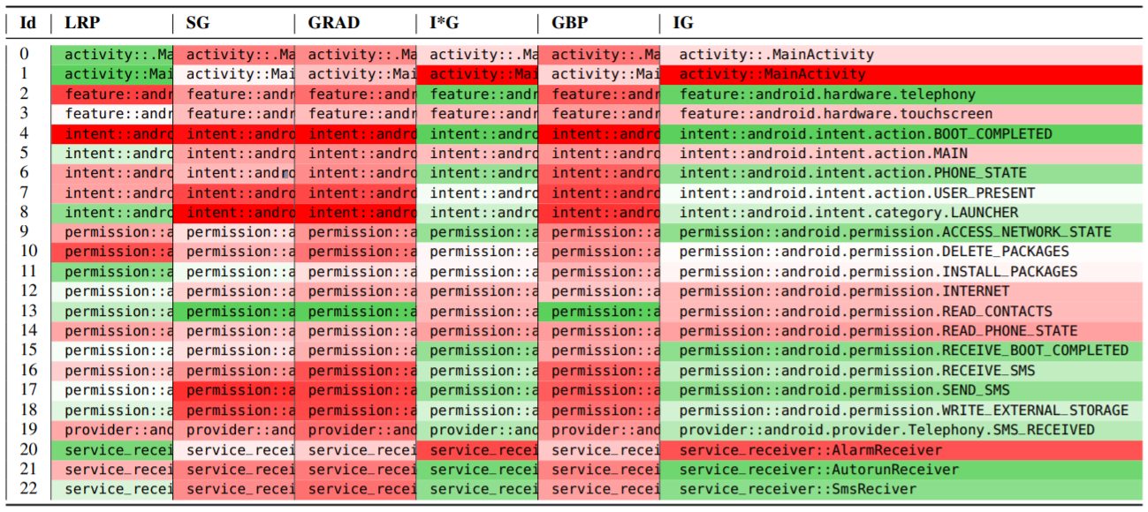
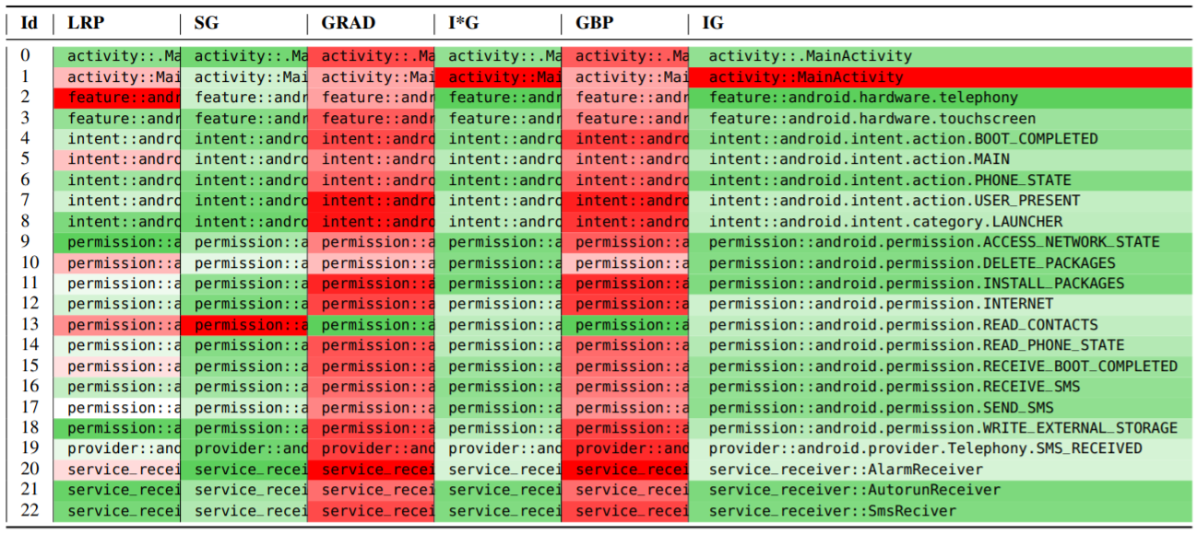
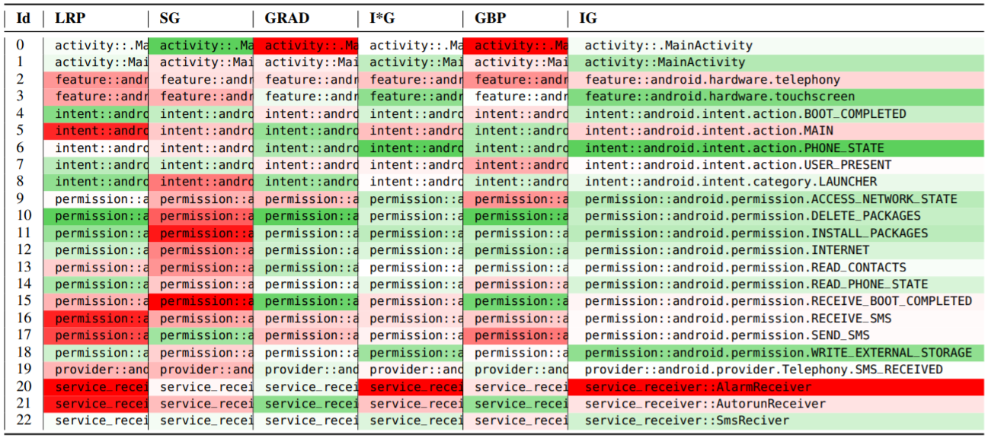
Paper: Black Box Attacks on XAI methods in Cyber Security
논문 소개
Evaluation and Discussion (Android file, on Drebin System)
Malicious (original)
Malicious -> Benign
Malicious -> Malicious

Slide 17
Github
https://github.com/WannaBeSuperteur/2020/tree/master/

