Slide 1
Weekly Report
2020.12.30
Hongsik Kim
Mobile & Network Intelligence Laboratory

Slide 2
WPCN: Paper
Deep Learning-Based Optimal Placement of a Mobile HAP for Common Throughput Maximization in Wireless Powered Communication Networks

Slide 3
Current Status
주간 진행 사항
논문 수정: Deep Learning-Based Optimal Placement of a Mobile HAP for Common Throughput Maximization in Wireless Powered Communication Networks
HAP Placement Model에 대한 설명 순서 변경
이미지 순서 변경
Physical HAP Channel Model에 대한 가정 추가
목차 표시 방법 변경

Slide 4
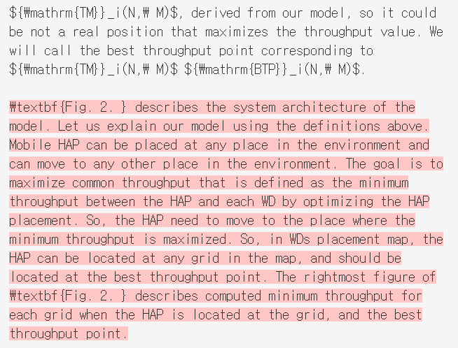
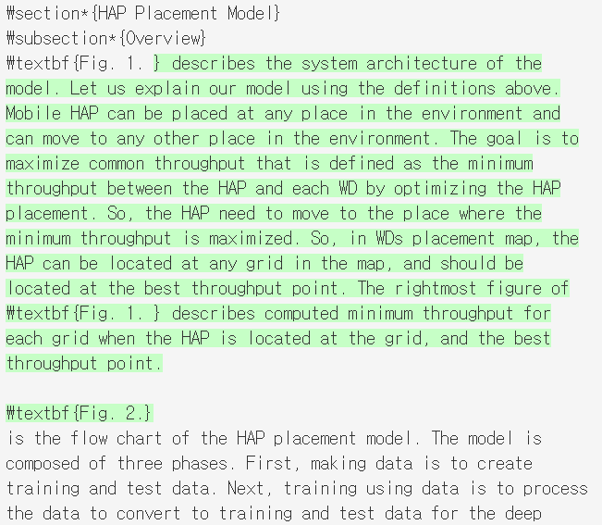
Current Status
For HAP Placement Model
문단 순서 변경: System Architecture를 map 구조보다 먼저 설명하여 HAP Placement Model의 이해를 쉽게 함

Slide 5
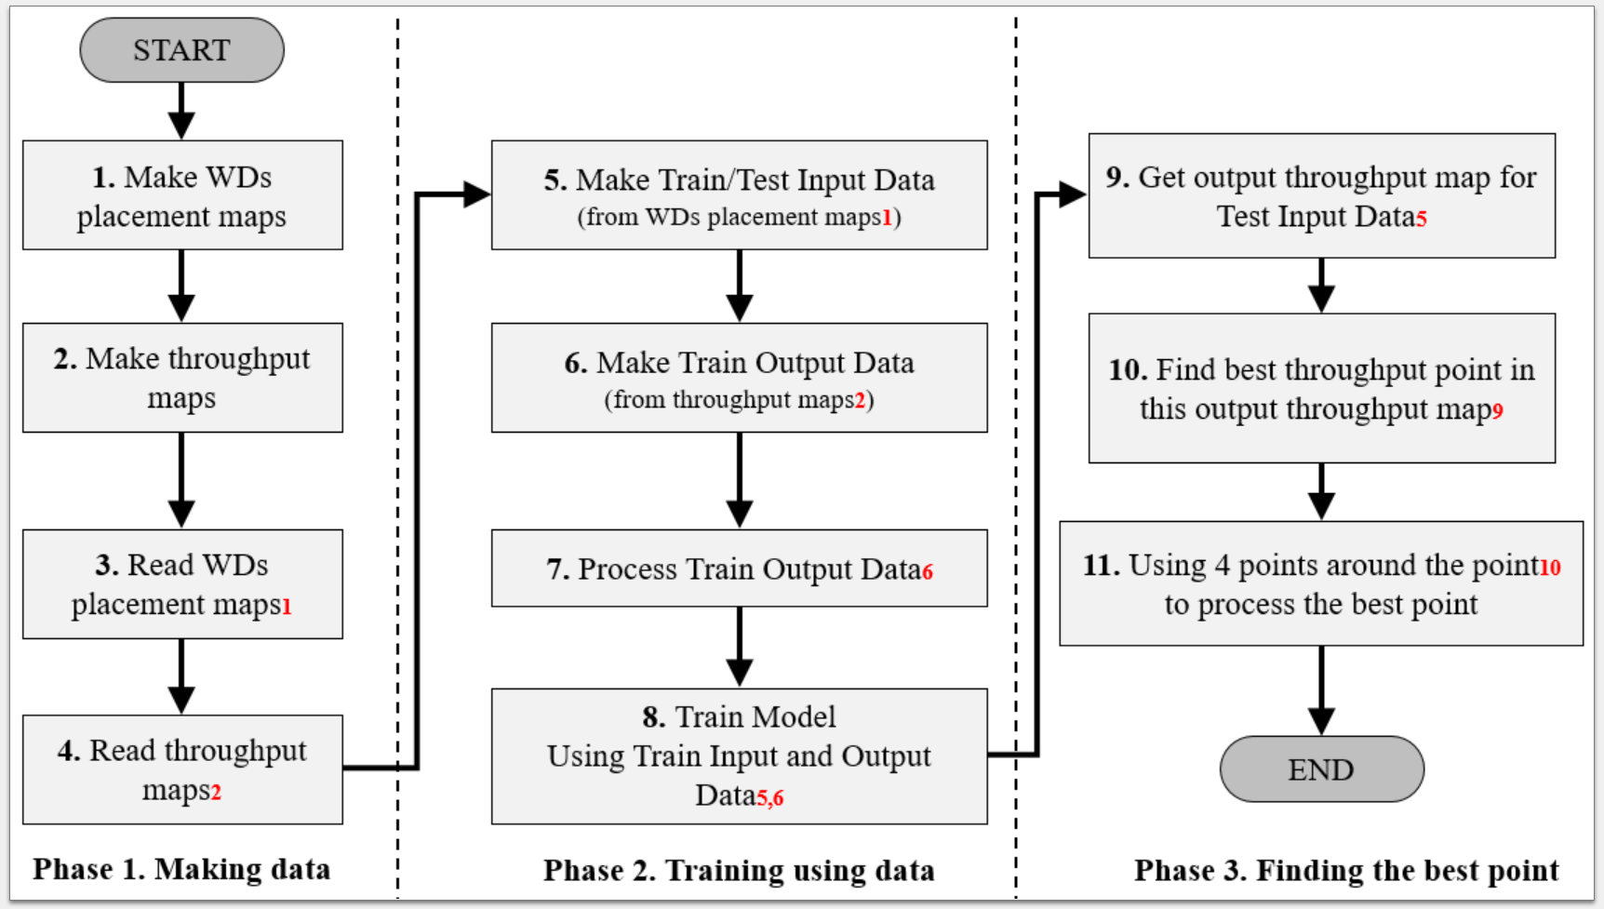
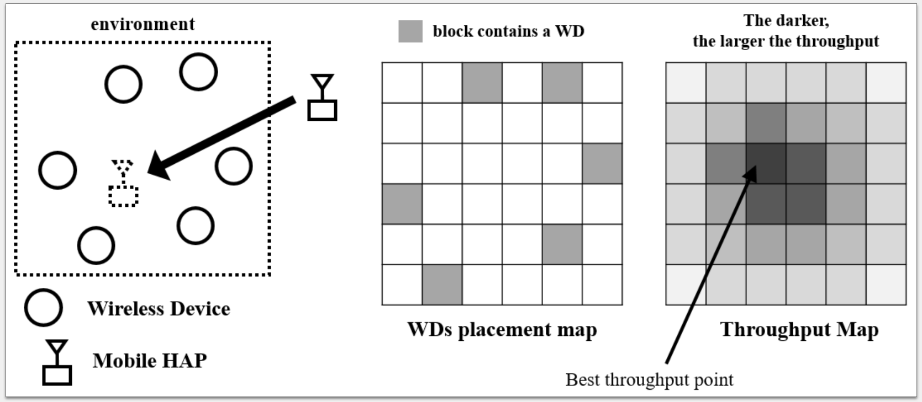
Current Status
For HAP Placement Model
문단 순서 변경에 따른 이미지 순서 변경
이미지 | fig01.png (flow chart) | fig02.png (describe system architecture)
기존 | Fig. 1. | Fig. 2.
변경 후 | Fig. 2. | Fig. 1.

Slide 6
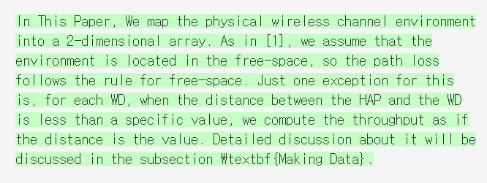
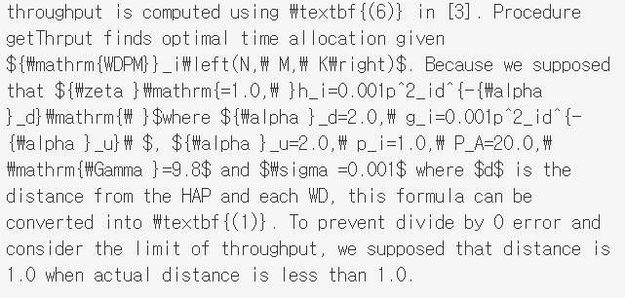
Current Status
Assumption About Physical HAP Channel Model
HAP Placement Model > Overview
HAP Placement Model > Making Data

Slide 7
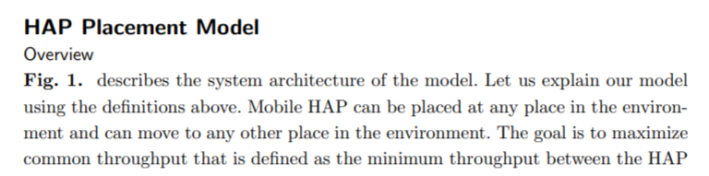
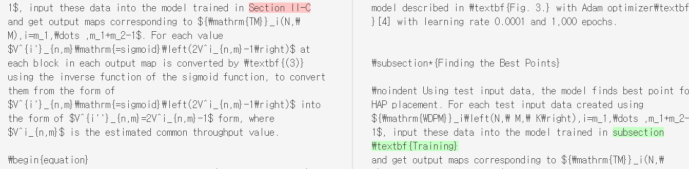
Current Status
How to Display Table of Contents (for reference)
Section
Subsection
Section II -> Section HAP Placement Model
Section II-A -> Subsection Overview

Slide 8
Github
https://github.com/WannaBeSuperteur/2020/tree/master/WPCN

