Slide 1
Weekly Report
2021.01.15
Hongsik Kim
Mobile & Network Intelligence Laboratory

Slide 2
AI Explanable AI
Implementation of Patent (non-public)
Kaggle Competition

Slide 3
Current Status
주간 진행 사항
특허 구현 (non-public)
자체 개발한 Convolutional Neural Network을 이용
실험 결과 분석에 초점
Kaggle Competition
Conway’s Reverse Game of Life 2020
https://www.kaggle.com/c/conways-reverse-game-of-life-2020

Slide 4
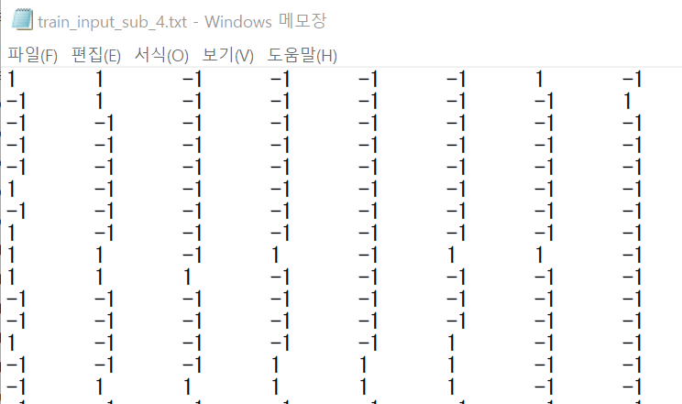
Kaggle Competition
Conway’s Game of Life 2020
입력, 출력 데이터 (board) 의 모든 0을 -1로 교체

Slide 5
Kaggle Competition
Conway’s Game of Life 2020
실험 결과
 | N-sub mode | Not-n-sub mode
(0, 1) | Improvement = 0.0140 (2020.12.10) | Improvement = 0.0118 (2020.12.18) relatively efficient when delta=1
(-1, 1) | Improvement = 0.0142 (2021.01.08) | Improvement = 0.0000 (2021.01.15)

Slide 6
Github
https://github.com/WannaBeSuperteur/2020/tree/master/

