Slide 1
Weekly Report
2020.09.18
Hongsik Kim
Mobile & Network Intelligence Laboratory

Slide 2
AI Explanable AI
Kaggle 진행 상황

Slide 3
Current Status
주간 진행 사항
Kaggle 진행 – Random Acts of Pizza
Data를 읽을 때 먼저 log를 이용하여 변환하는 옵션 추가
Frequently appeared word의 등장 여부를 학습 데이터(열)로 지정하는 옵션 추가
Frequently appeared word를 지정할 수 있도록 각 word의 등장 빈도를 파악할 수 있게 함
xgBoost 적용
K-fold를 이용한 validation 적용
kNN에서 most frequent value of neighbors 대신 average value of neighbors를 이용할 수 있게 함
$$x→\log_{2}{(x+a)} where a is a constant$$

Slide 4
Kaggle Competition
Random Acts of Pizza
https://www.kaggle.com/c/random-acts-of-pizza
Log 이용
Frequently appeared word 데이터 학습
xgBoost 적용
kNN에서 이웃한 값들의 평균값 적용

Slide 5
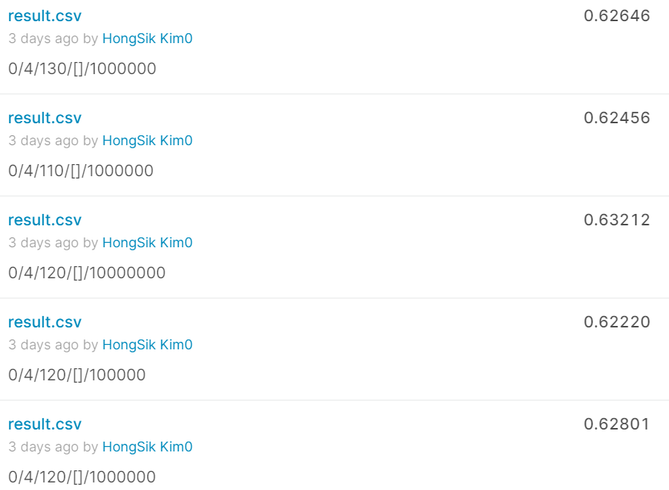
Kaggle Competition
Random Acts of Pizza - TEST
Log 이용
$$x→\log_{2}{(x+10^{6})} and k=130$$
$$x→\log_{2}{(x+10^{6})}and k=110$$
$$x→\log_{2}{(x+10^{7})}and k=120$$
$$x→\log_{2}{(x+10^{5})}and k=120$$
$$x→\log_{2}{(x+10^{6})}and k=120$$

Slide 6
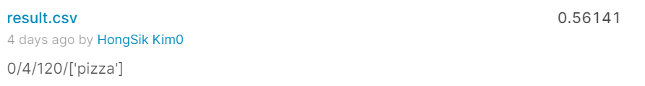
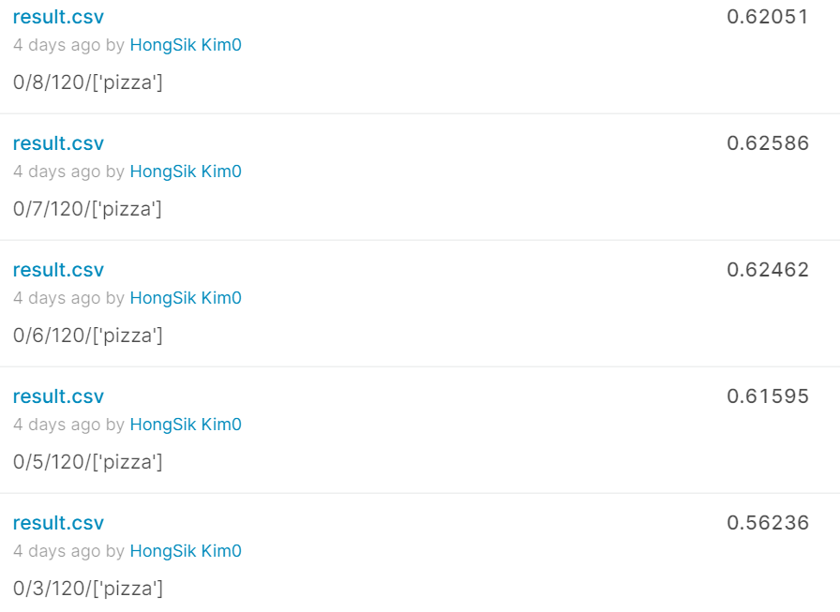
Kaggle Competition
Random Acts of Pizza - TEST
Frequent appeared word 데이터 이용
word list [‘pizza’] with dim=4 and $k=120$
word list [‘pizza’] with dim=8 and $k=120$
word list [‘pizza’] with dim=7 and $k=120$
word list [‘pizza’] with dim=6 and $k=120$
word list [‘pizza’] with dim=5 and $k=120$
word list [‘pizza’] with dim=3 and $k=120$

Slide 7
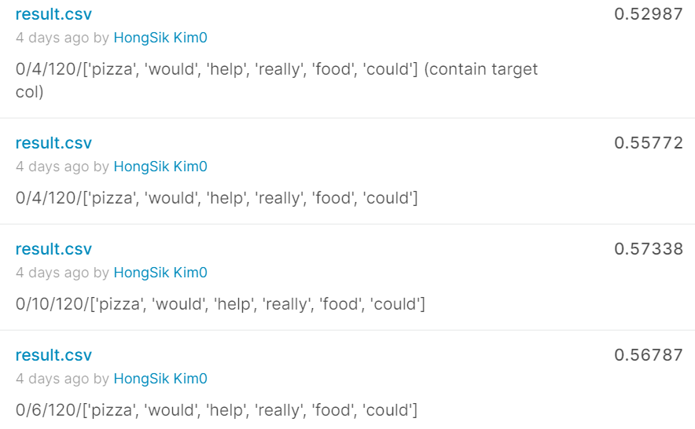
Kaggle Competition
Random Acts of Pizza - TEST
Frequent appeared word 데이터 이용
word list [‘pizza’, ‘would’, ‘help’,
‘really’, ‘food’, ‘could’] with dim=4
(contain target column)
word list [‘pizza’, ‘would’, ‘help’,
‘really’, ‘food’, ‘could’] with dim=4
word list [‘pizza’, ‘would’, ‘help’,
‘really’, ‘food’, ‘could’] with dim=10
word list [‘pizza’, ‘would’, ‘help’,
‘really’, ‘food’, ‘could’] with dim=6

Slide 8
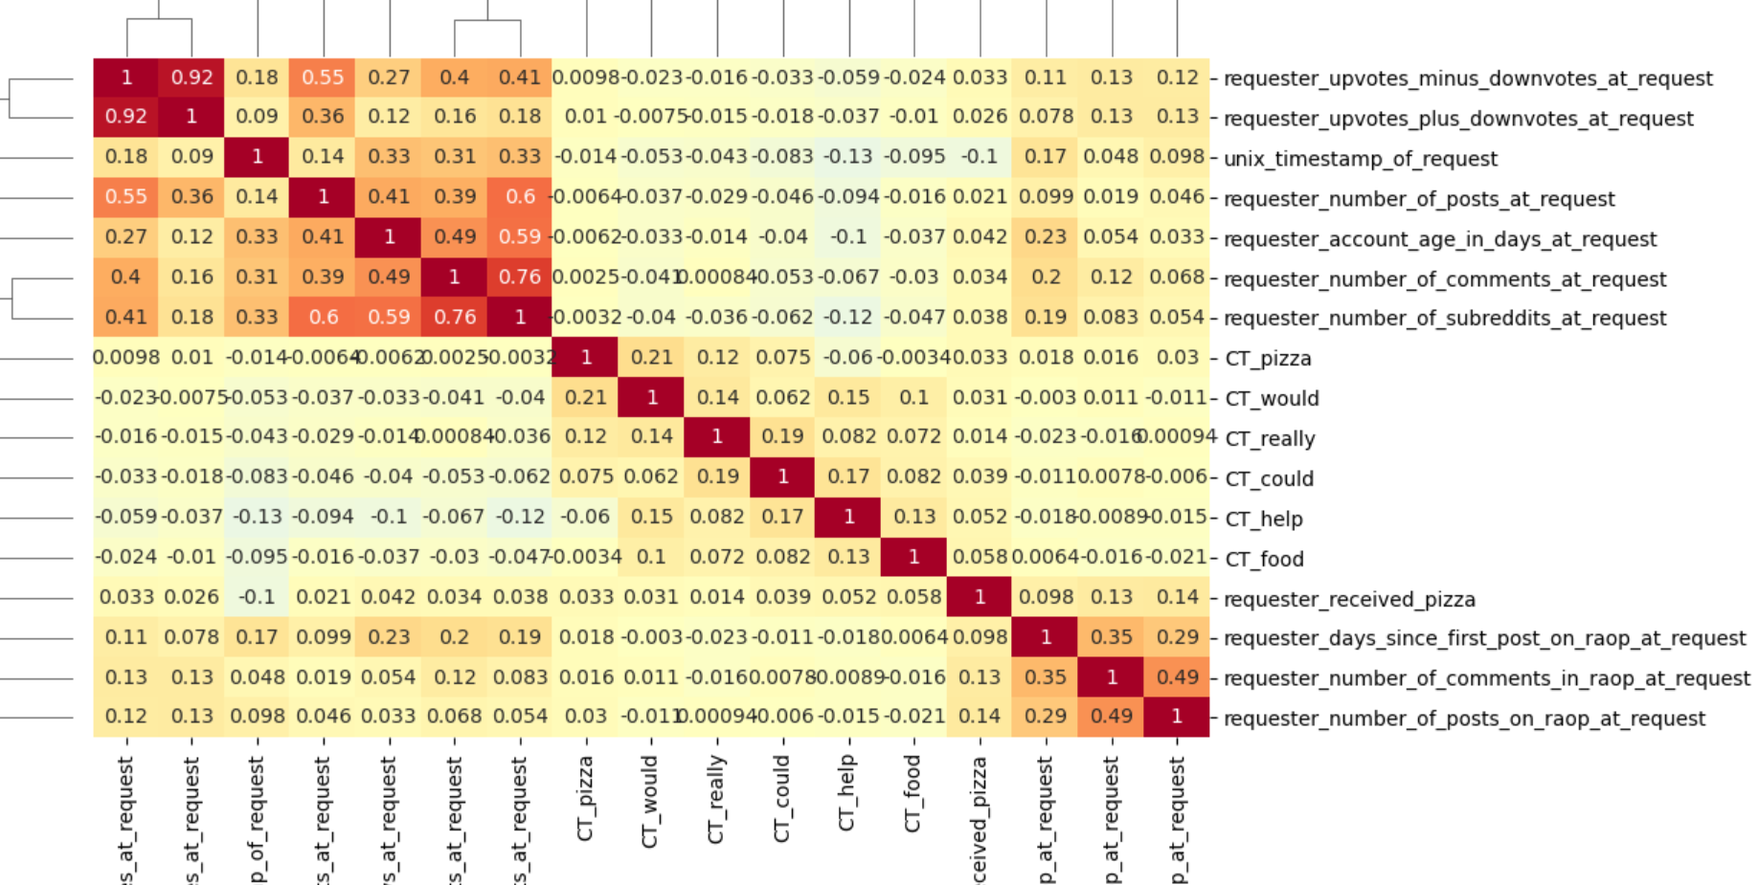
Kaggle Competition
Random Acts of Pizza - TEST
Frequent appeared word 데이터 이용 : 상관관계 분석

Slide 9
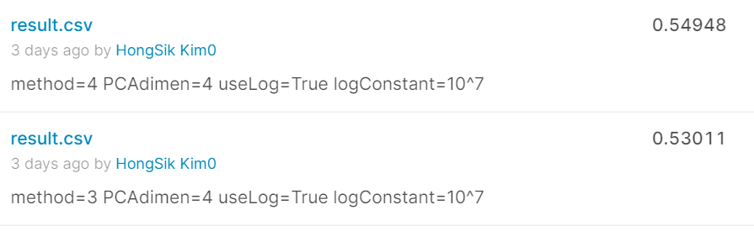
Kaggle Competition
Random Acts of Pizza - TEST
xgBoost 적용
method 3: PCA + xgBoost
method 4: xgBoost only

Slide 10
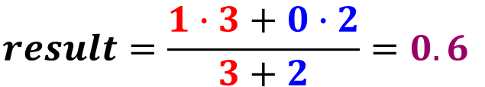
Kaggle Competition
Random Acts of Pizza - TEST
kNN에서 이웃한 값들의 평균값 적용
0
0
1
1
1
0.6
1
1
0
0
1
1
n(1)=3, n(0)=2
n(1)=3, n(0)=2 -> result=1
$$result=\frac{1∙3+0∙2}{3+2}=0.6$$

Slide 11
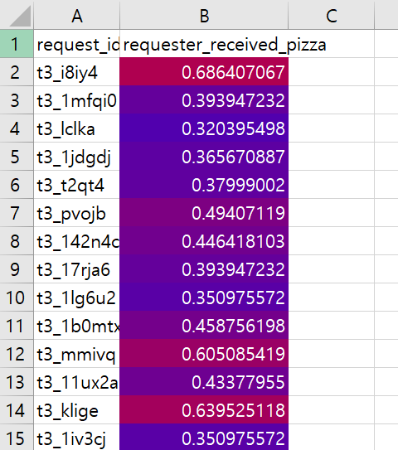
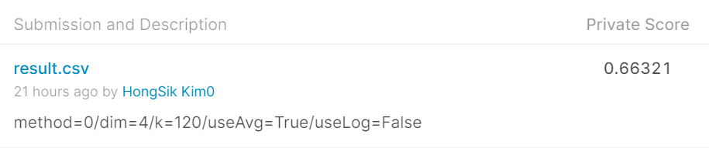
Kaggle Competition
Random Acts of Pizza - TEST
kNN에서 이웃한 값들의 평균값 적용

Slide 12
Kaggle Competition
Random Acts of Pizza - TEST
RANKING (0.66321 : 129/462, 27.92%)

Slide 13
Github
https://github.com/WannaBeSuperteur/2020/tree/master/

