Slide 1
Weekly Report
2020.11.10
Hongsik Kim
Mobile & Network Intelligence Laboratory

Slide 2
WPCN: Paper
Revising: Deep Learning-Based Optimal Placement of a Mobile HAP for Common Throughput Maximization in Wireless Powered Communication Networks
Implementation: Minimum Throughput Maximization for Multi-UAV Enabled WPCN: A Deep Reinforcement Learning Method

Slide 3
Current Status
주간 진행 사항
논문 수정: Deep Learning-Based Optimal Placement of a Mobile HAP for Common Throughput Maximization in Wireless Powered Communication Networks
논문을 IEEE Access 형식으로 변경
논문 구현: Minimum Throughput Maximization for Multi-UAV Enabled WPCN: A Deep Reinforcement Learning Method
각종 함수 작성

Slide 4
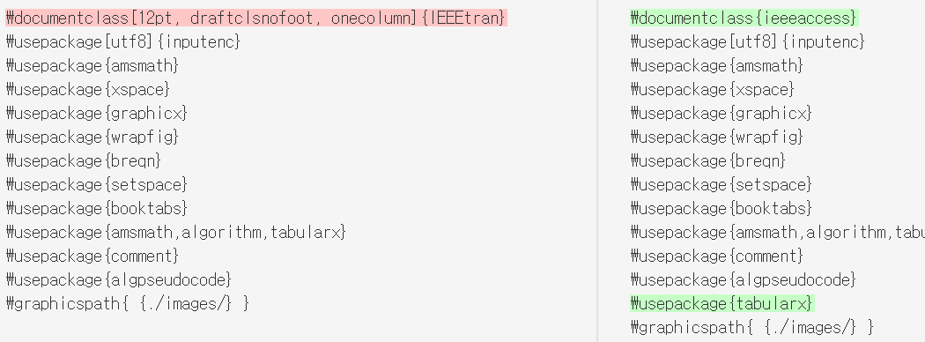
Current Status
논문 수정: Deep Learning-Based Optimal Placement of a Mobile HAP for Common Throughput Maximization in Wireless Powered Communication Networks
논문을 IEEE Access 형식으로 변경

Slide 5
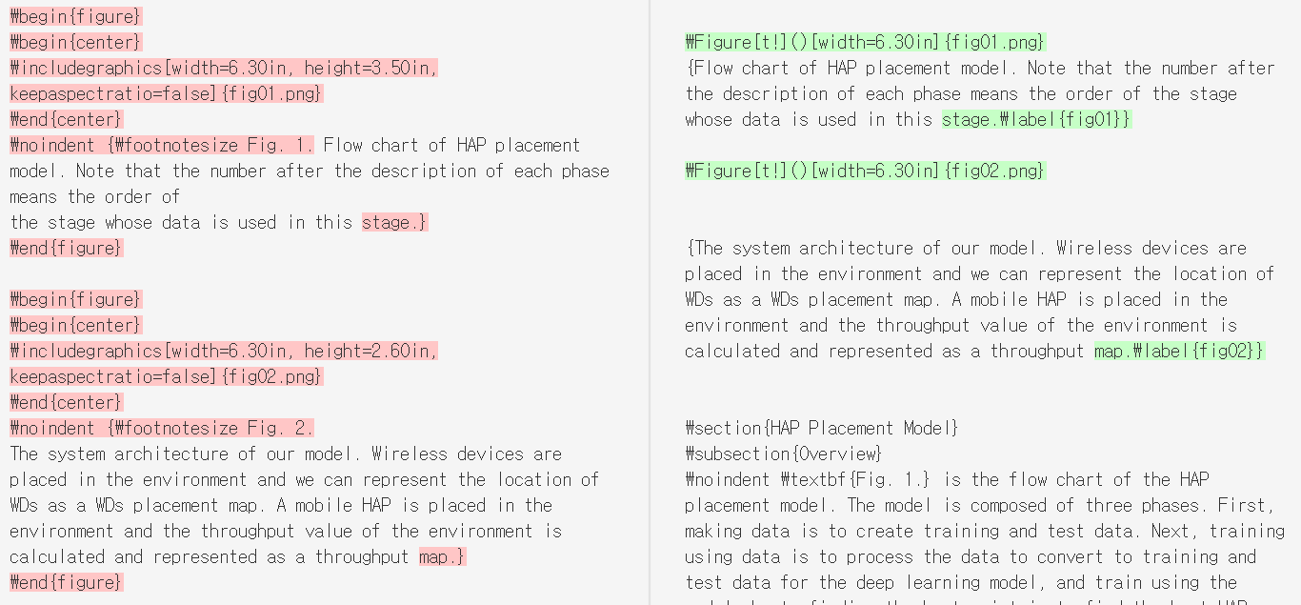
Current Status
논문 수정: Deep Learning-Based Optimal Placement of a Mobile HAP for Common Throughput Maximization in Wireless Powered Communication Networks
논문을 IEEE Access 형식으로 변경

Slide 6
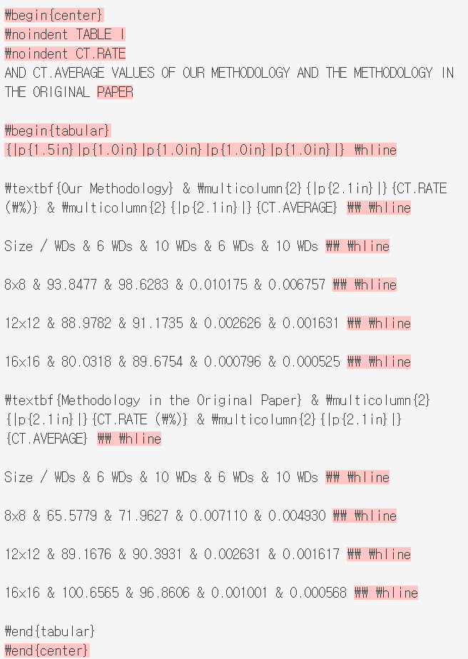
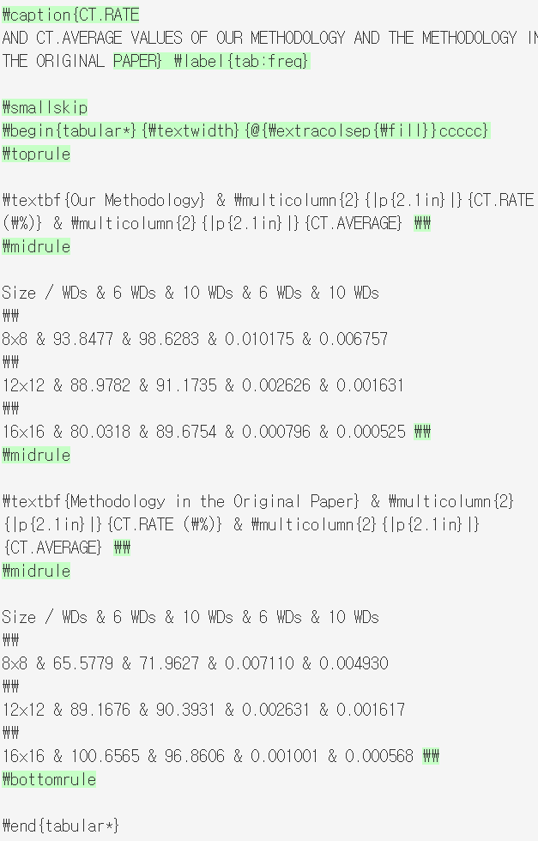
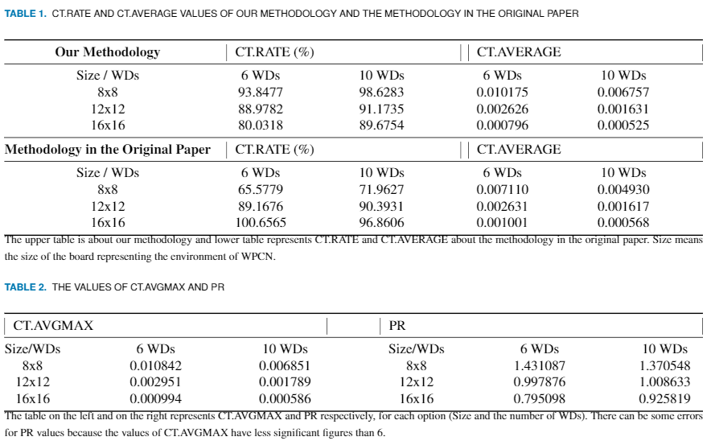
Current Status
논문 수정: Deep Learning-Based Optimal Placement of a Mobile HAP for Common Throughput Maximization in Wireless Powered Communication Networks
논문을 IEEE Access 형식으로 변경

Slide 7
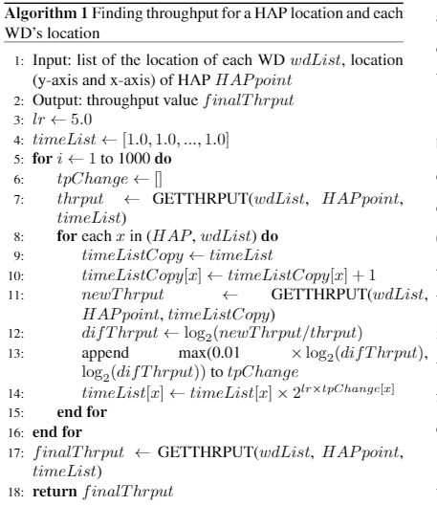
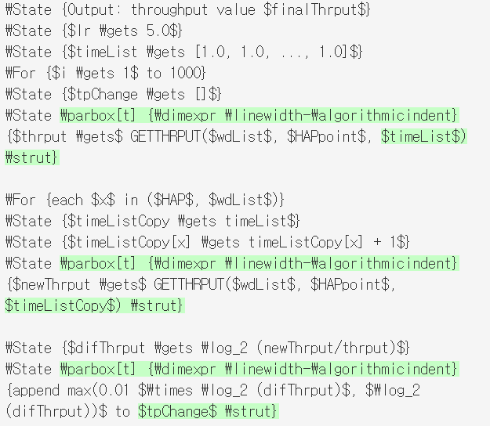
Current Status
논문 수정: Deep Learning-Based Optimal Placement of a Mobile HAP for Common Throughput Maximization in Wireless Powered Communication Networks
논문을 IEEE Access 형식으로 변경

Slide 8
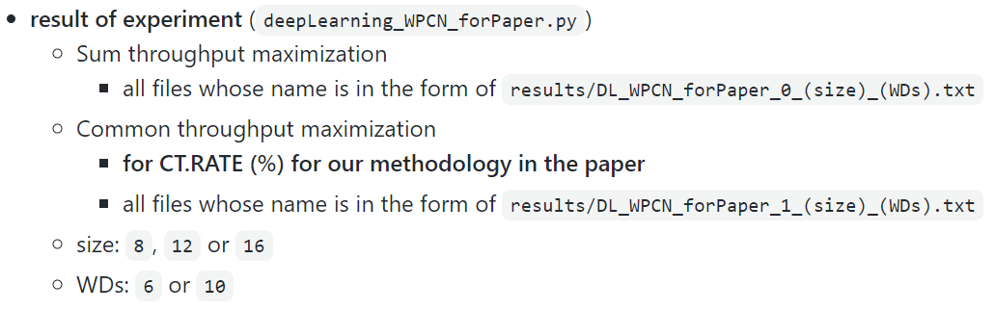
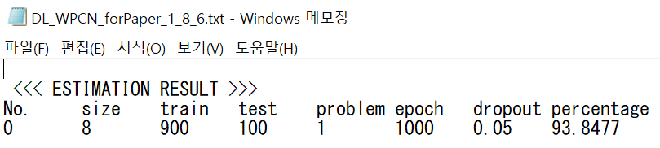
Current Status
논문 수정: Deep Learning-Based Optimal Placement of a Mobile HAP for Common Throughput Maximization in Wireless Powered Communication Networks
논문 내용 추가 (결과에 대한 분석) 관련: 자료 부족으로 추가 분석 불가능

Slide 9
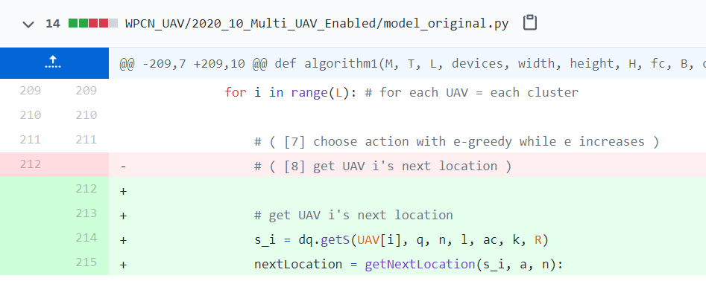
Current Status
논문 구현: Minimum Throughput Maximization for Multi-UAV Enabled WPCN: A Deep Reinforcement Learning Method
함수 작성: UAV i의 다음 위치를 구하는 함수

Slide 10
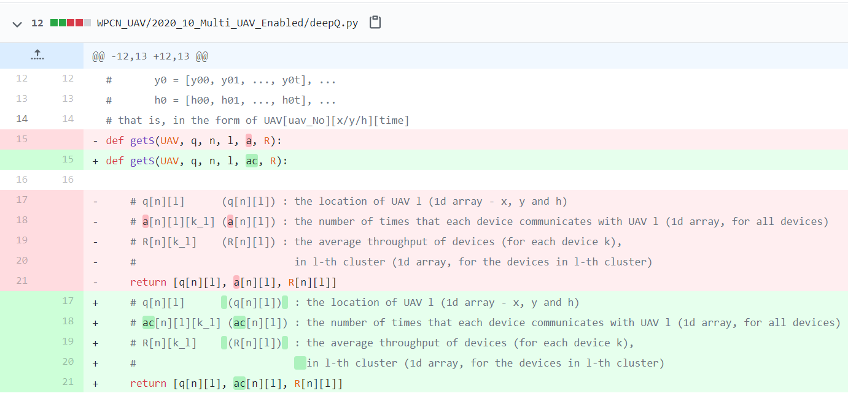
Current Status
논문 구현: Minimum Throughput Maximization for Multi-UAV Enabled WPCN: A Deep Reinforcement Learning Method
함수 작성: action의 a와 구분하기 이해 getS 함수의 a를 ac로 수정

Slide 11
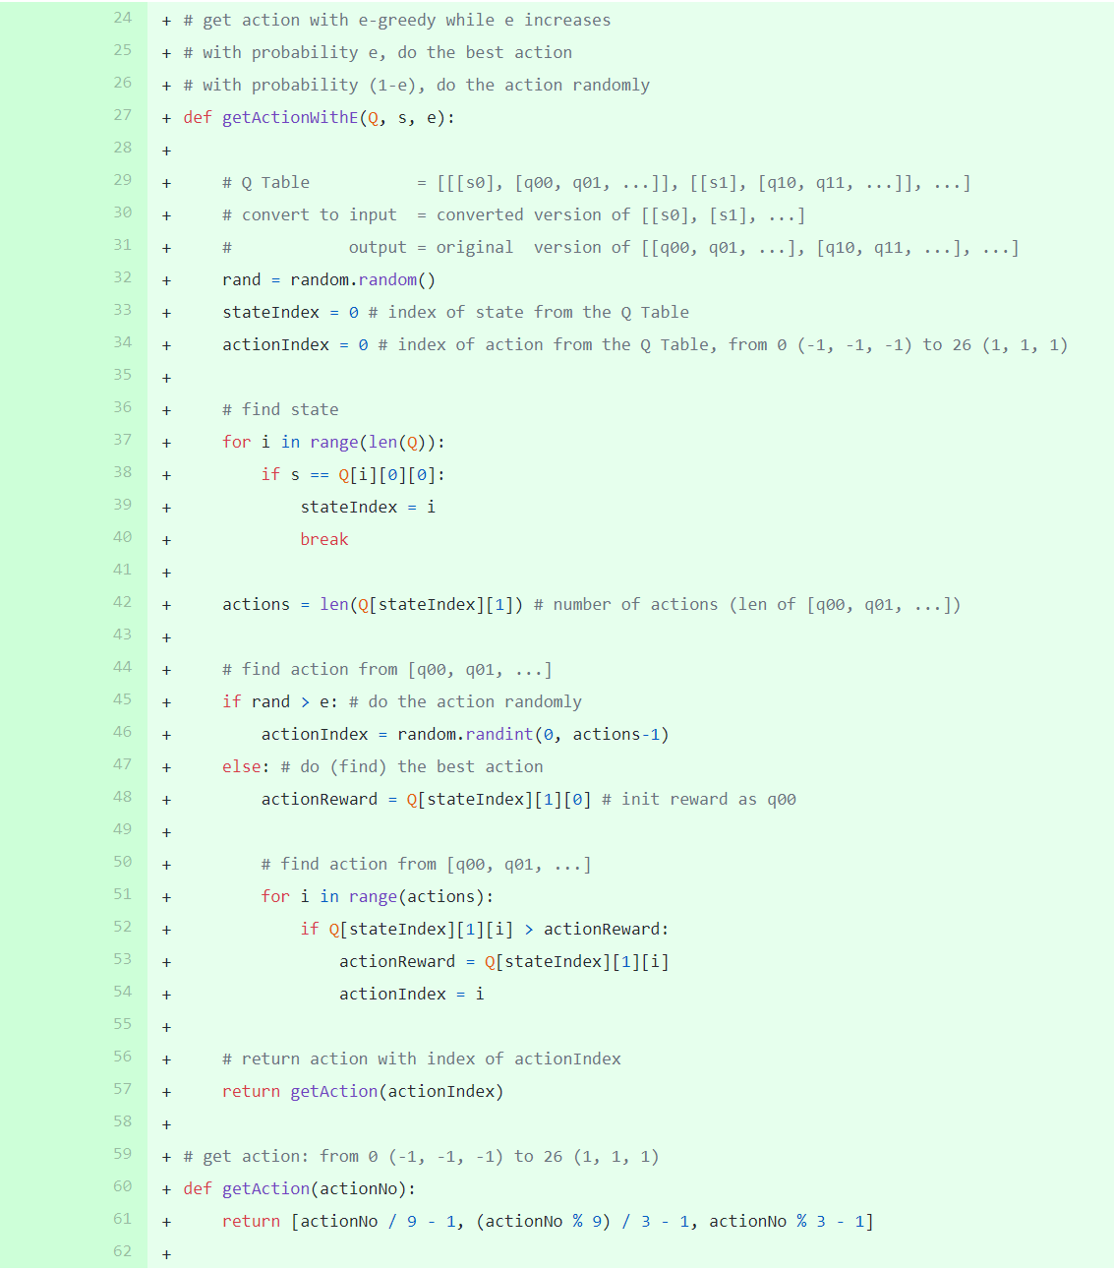
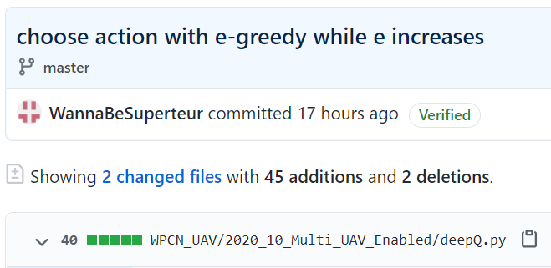
Current Status
논문 구현: Minimum Throughput Maximization for Multi-UAV Enabled WPCN: A Deep Reinforcement Learning Method
함수 작성: e-greedy 방법으로 action 선택

Slide 12
Github
https://github.com/WannaBeSuperteur/2020/tree/master/WPCN

