Slide 1
Weekly Report
2020.12.01
Hongsik Kim
Mobile & Network Intelligence Laboratory

Slide 2
WPCN: Paper
Submission: Deep Learning-Based Optimal Placement of a Mobile HAP for Common Throughput Maximization in Wireless Powered Communication Networks
Implementation: Minimum Throughput Maximization for Multi-UAV Enabled WPCN: A Deep Reinforcement Learning Method

Slide 3
Current Status
주간 진행 사항
논문 제출: Deep Learning-Based Optimal Placement of a Mobile HAP for Common Throughput Maximization in Wireless Powered Communication Networks
데이터 분석 결과 추가
Author Bios 추가
논문 제출 (IEEE Access)
논문 구현: Minimum Throughput Maximization for Multi-UAV Enabled WPCN: A Deep Reinforcement Learning Method
코드 작성 완료
오류 수정

Slide 4
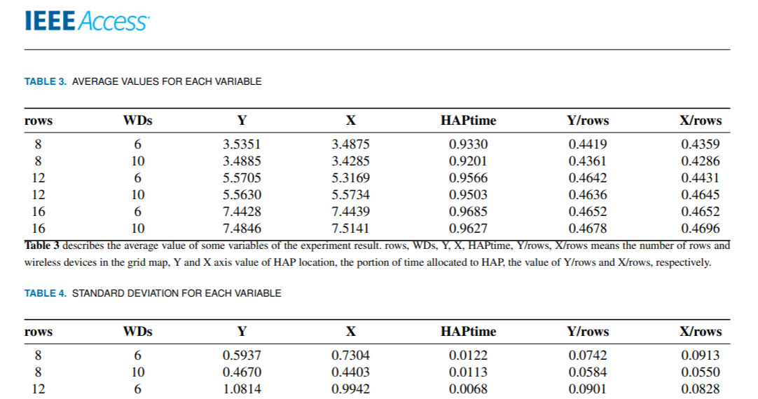
Current Status
Deep Learning-Based Optimal Placement of a Mobile HAP for Common Throughput Maximization in Wireless Powered Communication Networks
데이터 분석 결과 추가

Slide 5
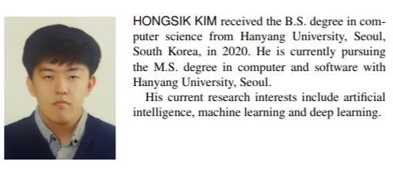
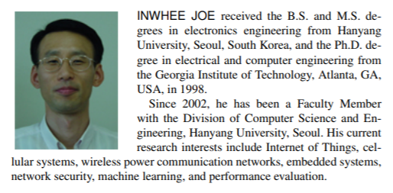
Current Status
Deep Learning-Based Optimal Placement of a Mobile HAP for Common Throughput Maximization in Wireless Powered Communication Networks
Author Bios 추가

Slide 6
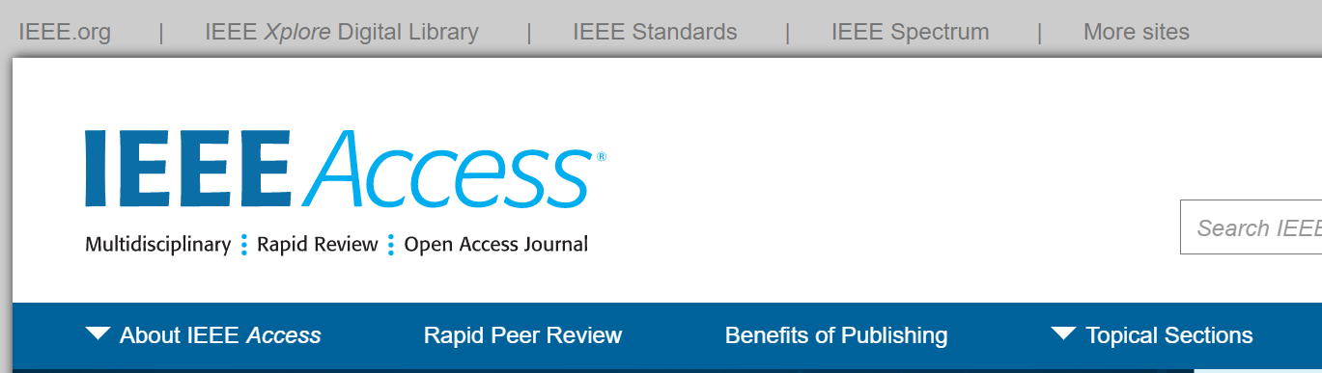
Current Status
Deep Learning-Based Optimal Placement of a Mobile HAP for Common Throughput Maximization in Wireless Powered Communication Networks
논문 제출: IEEE Access

Slide 7
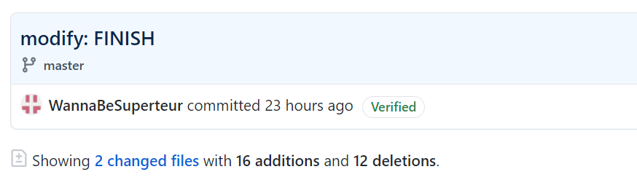
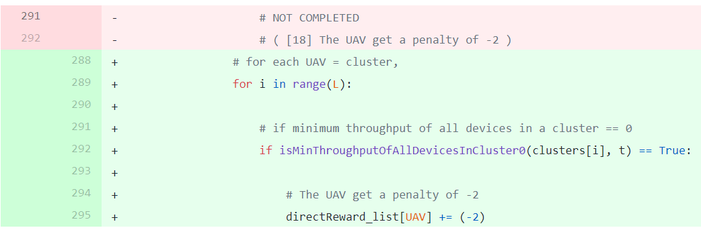
Current Status
Minimum Throughput Maximization for Multi-UAV Enabled WPCN: A Deep Reinforcement Learning Method
코드의 나머지 부분 작성 완료

Slide 8
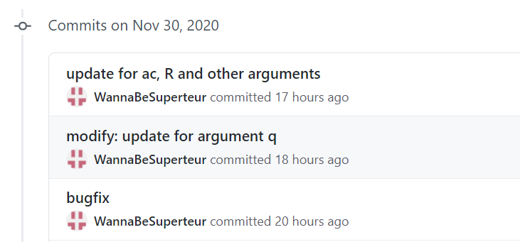
Current Status
Minimum Throughput Maximization for Multi-UAV Enabled WPCN: A Deep Reinforcement Learning Method
오류 수정 (현재 진행 중)

Slide 9
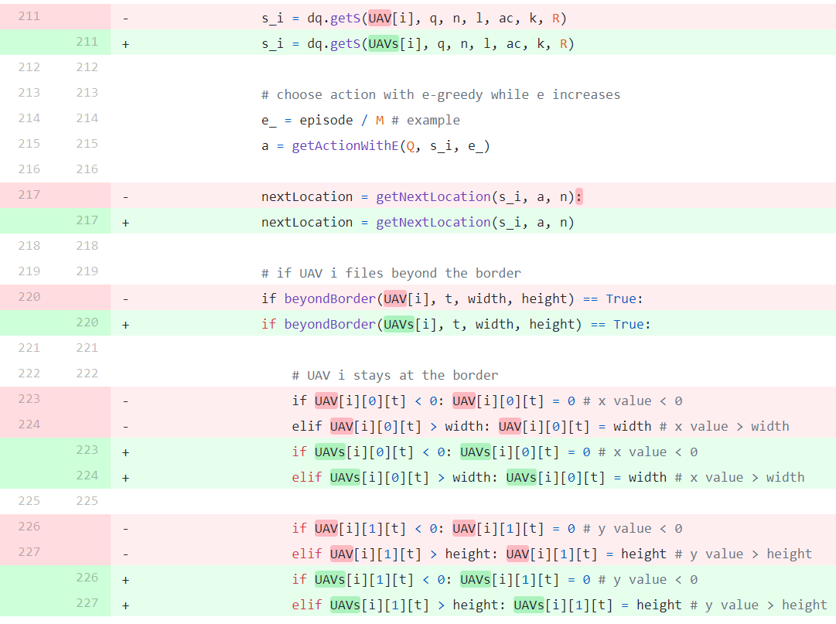
Current Status
Minimum Throughput Maximization for Multi-UAV Enabled WPCN: A Deep Reinforcement Learning Method
오류 수정 (현재 진행 중)
UAV[i] -> UAVs[i]

Slide 10
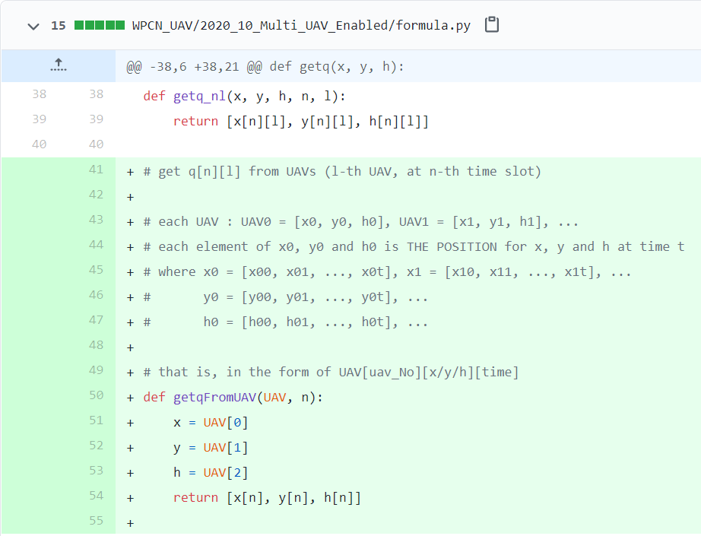

Current Status
Minimum Throughput Maximization for Multi-UAV Enabled WPCN: A Deep Reinforcement Learning Method
UAV의 위치로부터 논문에서의 q의 값을 구하는 함수 작성
UAV -> get x, y and z -> merge them and return q

Slide 11
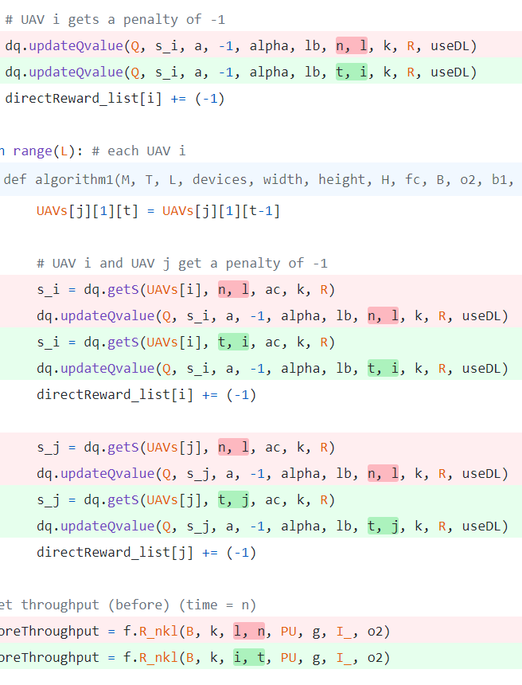
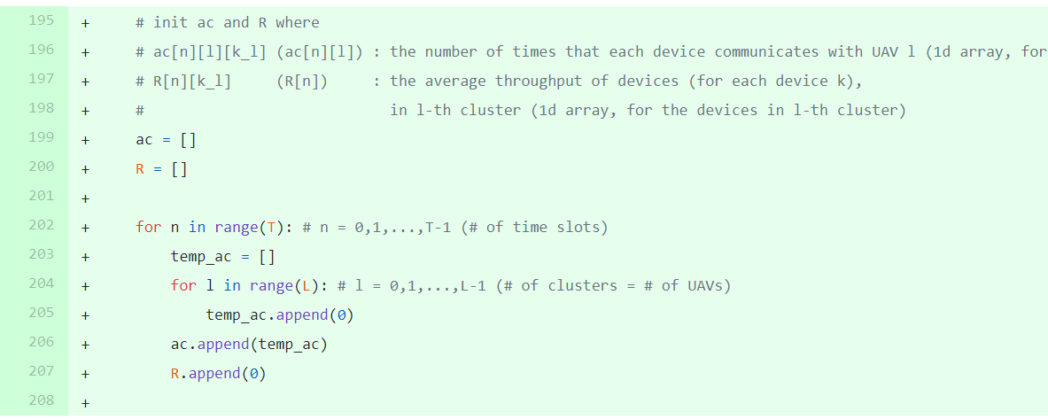
Current Status
Minimum Throughput Maximization for Multi-UAV Enabled WPCN: A Deep Reinforcement Learning Method
논문의 ac, R 등의 argument 관련 업데이트 및 기타 오류 수정
논문의 변수 ac, R을 초기화

Slide 12
Github
https://github.com/WannaBeSuperteur/2020/tree/master/WPCN

