Slide 1
Weekly Report
2020.08.25
Hongsik Kim
Mobile & Network Intelligence Laboratory

Slide 2
WPCN: Implementation of UAV
UAV-Aided Wireless Powered Communication Networks: Trajectory Optimization and Resource Allocation for Minimum Throughput Maximization 논문 구현

Slide 3
Current Status
주간 진행 사항
UAV-Aided Wireless Powered Communication Networks: Trajectory Optimization and Resource Allocation for Minimum Throughput Maximization 논문 구현

Slide 4
Current Status
UAV-Aided Wireless Powered Communication Networks: Trajectory Optimization and Resource Allocation for Minimum Throughput Maximization 논문 구현
https://ieeexplore.ieee.org/stamp/stamp.jsp?tp=&arnumber=8836548

Slide 5
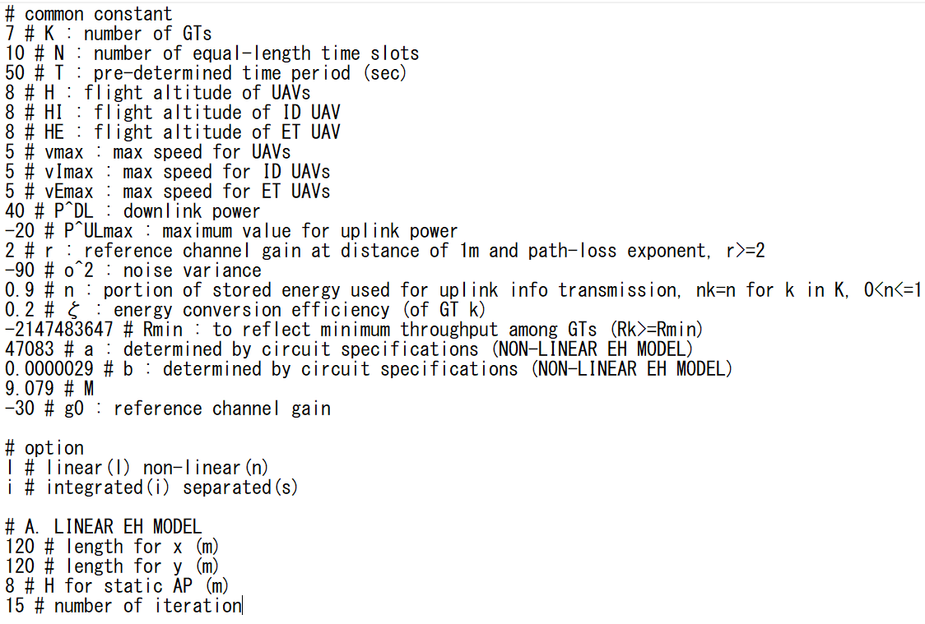
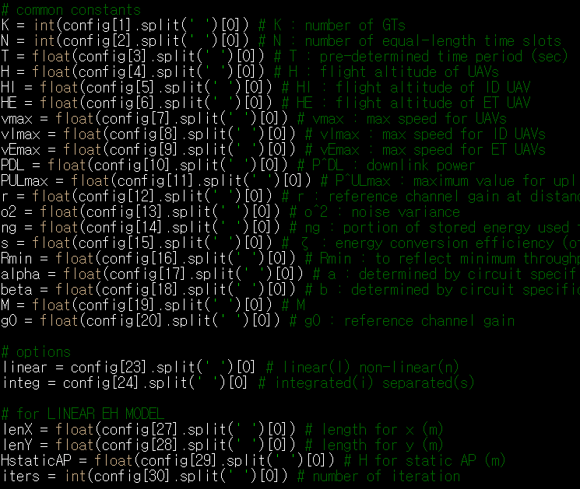
Current Status
Variables

Slide 6
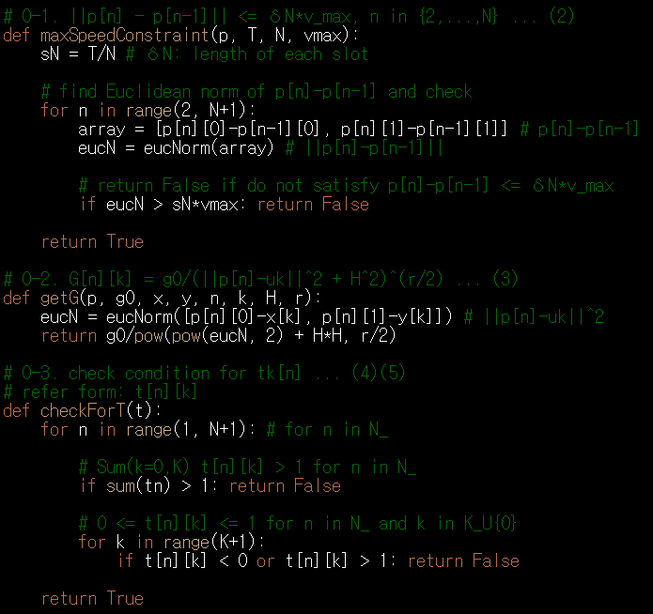

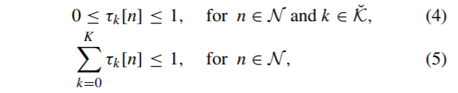
Current Status
Formula

Slide 7
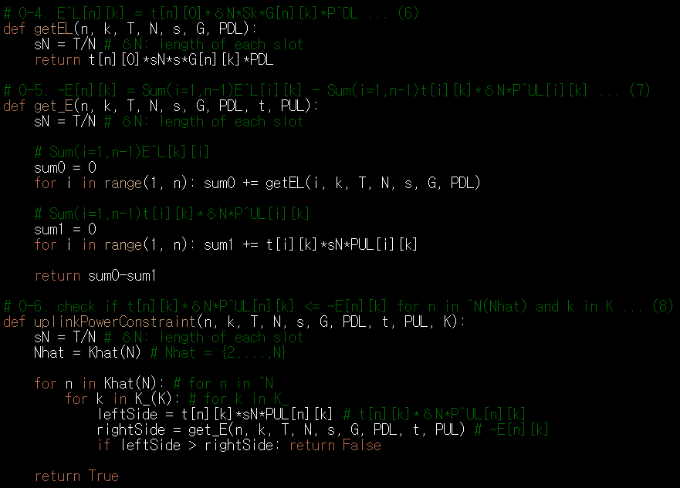


Current Status
Formula

Slide 8
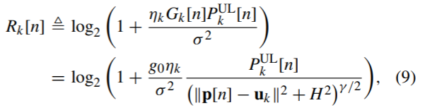
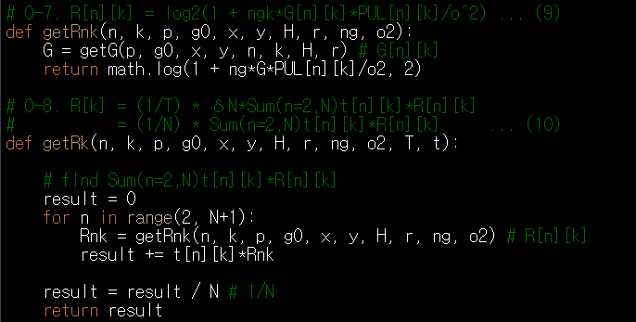
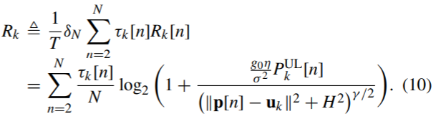
Current Status
Formula

Slide 9
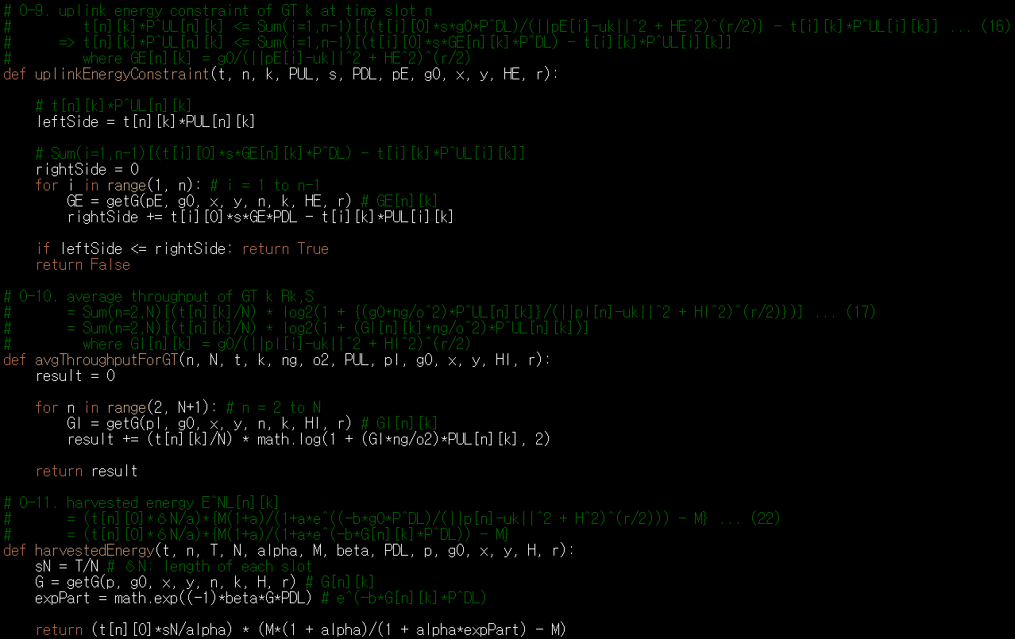
Current Status
Formula

Slide 10
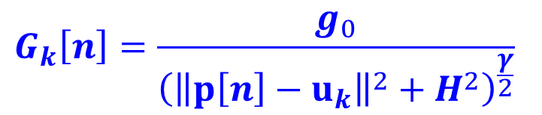
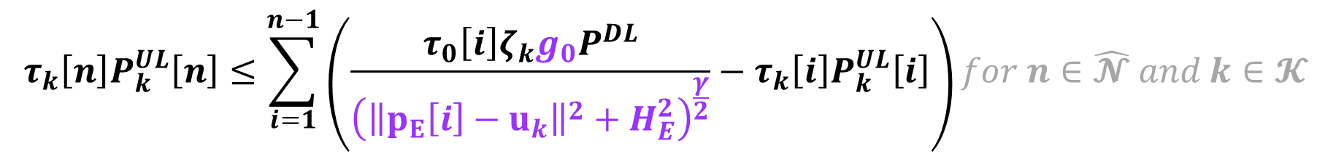
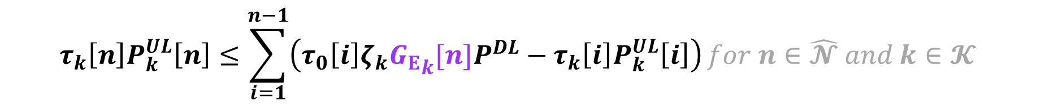
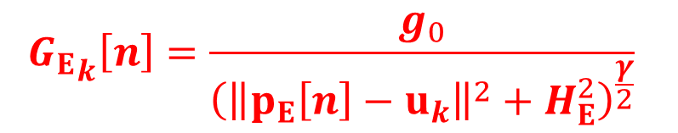
Current Status
Formula
여기서 수식을 이용하자.
따라서 이면 다음과 같이 변형됨
$$τ_{k}\left[n\right]P_{k}^{UL}\left[n\right]≤\sum_{i=1}^{n−1}{\left(\frac{τ_{0}\left[i\right]ζ_{k}g_{0}P^{DL}}{{\left({\left\|p_{E}\left[i\right]−u_{k}\right\|}^{2}+H_{E}^{2}\right)}^{\frac{γ}{2}}}−τ_{k}\left[i\right]P_{k}^{UL}\left[i\right]\right)}for n∈\hat{𝓝} and k∈𝓚$$
$$G_{k}\left[n\right]=\frac{g_{0}}{{\left({\left\|p\left[n\right]−u_{k}\right\|}^{2}+H^{2}\right)}^{\frac{γ}{2}}}$$
$${G_{E}}_{k}\left[n\right]=\frac{g_{0}}{{\left({\left\|p_{E}\left[n\right]−u_{k}\right\|}^{2}+H_{E}^{2}\right)}^{\frac{γ}{2}}}$$
$$τ_{k}\left[n\right]P_{k}^{UL}\left[n\right]≤\sum_{i=1}^{n−1}{\left(τ_{0}\left[i\right]ζ_{k}{G_{E}}_{k}[n]P^{DL}−τ_{k}\left[i\right]P_{k}^{UL}\left[i\right]\right)}for n∈\hat{𝓝} and k∈𝓚$$

Slide 11


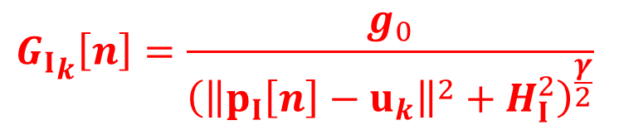
Current Status
Formula
여기서 수식을 이용하자.
따라서 이면 다음과 같이 변형됨
$$R_{k,S}≜\sum_{n=2}^{N}{\frac{τ_{k}\left[n\right]}{N}}\log_{2}\left(1+\frac{\frac{g_{0}η}{σ^{2}}P_{k}^{UL}\left[n\right]}{{\left({\left\|p_{I}\left[i\right]−u_{k}\right\|}^{2}+H_{I}^{2}\right)}^{\frac{γ}{2}}}\right)$$
$$G_{k}\left[n\right]=\frac{g_{0}}{{\left({\left\|p\left[n\right]−u_{k}\right\|}^{2}+H^{2}\right)}^{\frac{γ}{2}}}$$
$${G_{I}}_{k}\left[n\right]=\frac{g_{0}}{{\left({\left\|p_{I}\left[n\right]−u_{k}\right\|}^{2}+H_{I}^{2}\right)}^{\frac{γ}{2}}}$$
$$R_{k,S}≜\sum_{n=2}^{N}{\frac{τ_{k}\left[n\right]}{N}}\log_{2}\left(1+\frac{{G_{I}}_{k}\left[n\right]η}{σ^{2}}P_{k}^{UL}\left[n\right]\right)$$

Slide 12

Current Status
Formula
여기서 수식을 이용하자.
따라서 다음과 같이 변형됨
$$E_{k}^{NL}\left[n\right]≜\frac{τ_{0}\left[n\right]δ_{N}}{α}\left(\frac{M(1+α)}{1+α∙\exp\left(\frac{−βg_{0}P^{DL}}{{\left({\left\|p\left[n\right]−u_{k}\right\|}^{2}+H^{2}\right)}^{\frac{γ}{2}}}\right)}−M\right)$$
$$G_{k}\left[n\right]=\frac{g_{0}}{{\left({\left\|p\left[n\right]−u_{k}\right\|}^{2}+H^{2}\right)}^{\frac{γ}{2}}}$$
$$E_{k}^{NL}\left[n\right]≜\frac{τ_{0}\left[n\right]δ_{N}}{α}\left(\frac{M(1+α)}{1+α∙\exp\left(−βG_{k}[n]P^{DL}\right)}−M\right)$$

Slide 13
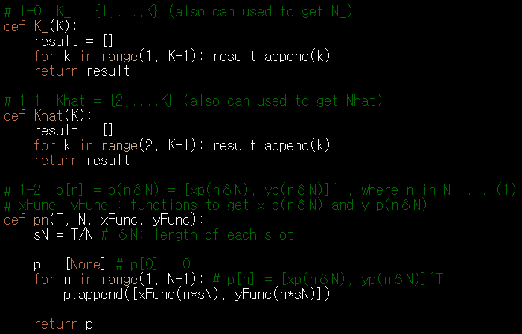
Current Status
Functions to create arrays and sets

Slide 14
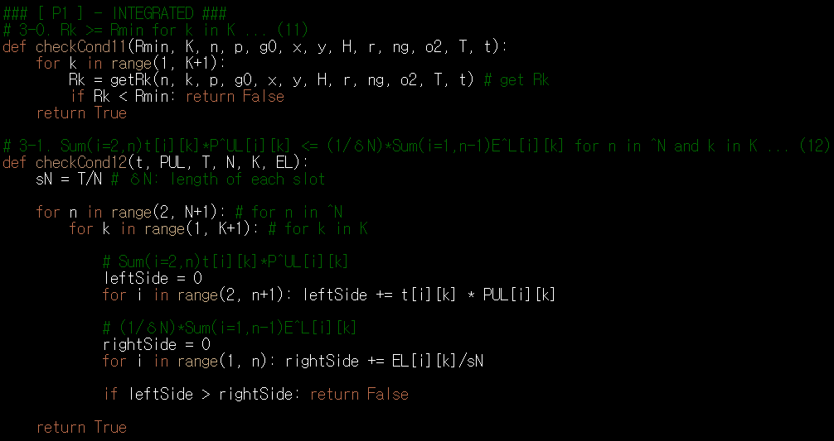
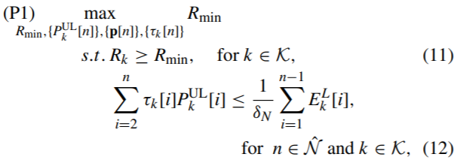
Current Status
Formula about the problems

Slide 15
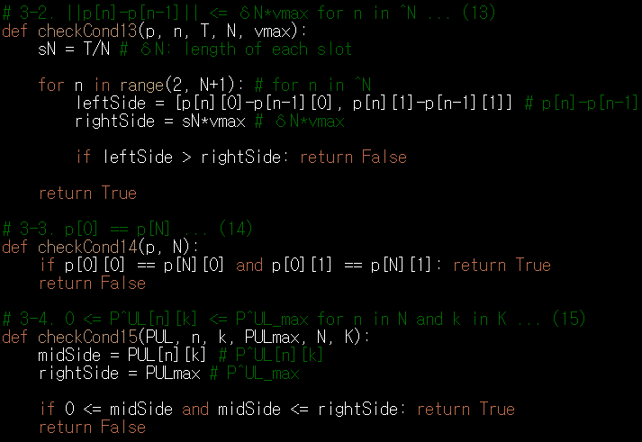
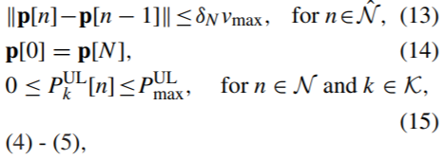
Current Status
Formula about the problems

Slide 16
Github
https://github.com/WannaBeSuperteur/2020/tree/master/WPCN

