Slide 1
Weekly Report
2021.02.05
Hongsik Kim
Mobile & Network Intelligence Laboratory

Slide 2
AI Explanable AI
Implementation of Patent (non-public)
Kaggle Competition

Slide 3
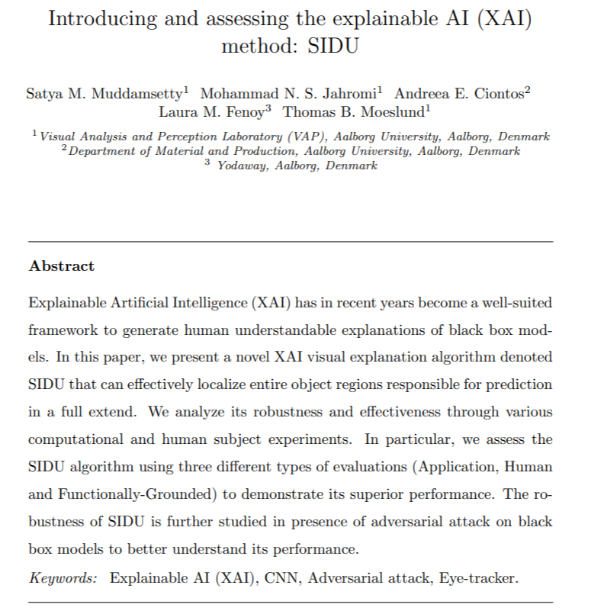
Paper: Introducing and assessing the explainable AI (XAI) method: SIDU
CNN용 XAI method인 SIDU에 대한 논문
https://arxiv.org/pdf/2101.10710.pdf

Slide 4
Github
https://github.com/WannaBeSuperteur/2020/tree/master/

