Slide 1
Weekly Report
2020.08.26
Hongsik Kim
Mobile & Network Intelligence Laboratory

Slide 2
WPCN: Implementation of UAV
UAV-Aided Wireless Powered Communication Networks: Trajectory Optimization and Resource Allocation for Minimum Throughput Maximization 논문 구현

Slide 3
Current Status
주간 진행 사항
UAV-Aided Wireless Powered Communication Networks: Trajectory Optimization and Resource Allocation for Minimum Throughput Maximization 논문 구현

Slide 4
Current Status
UAV-Aided Wireless Powered Communication Networks: Trajectory Optimization and Resource Allocation for Minimum Throughput Maximization 논문 구현
https://ieeexplore.ieee.org/stamp/stamp.jsp?tp=&arnumber=8836548

Slide 5
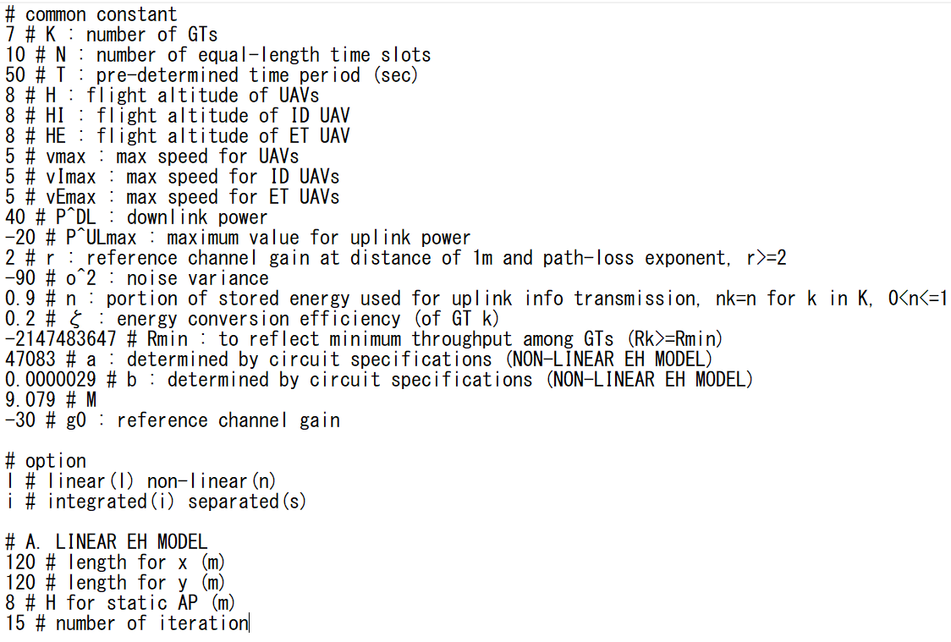
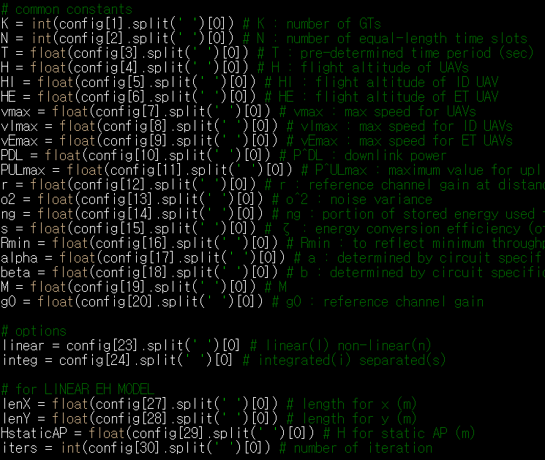
Current Status
Variables

Slide 6
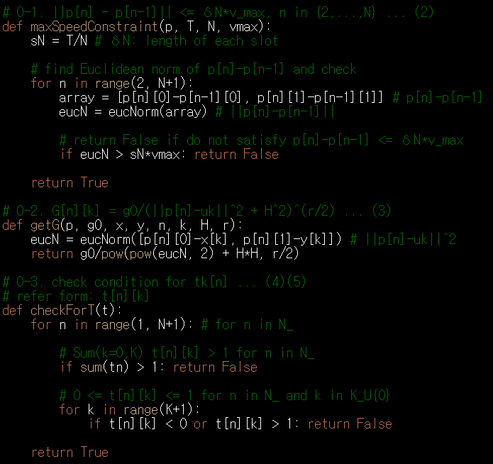

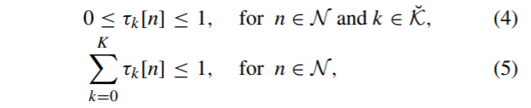
Current Status
Formula

Slide 7
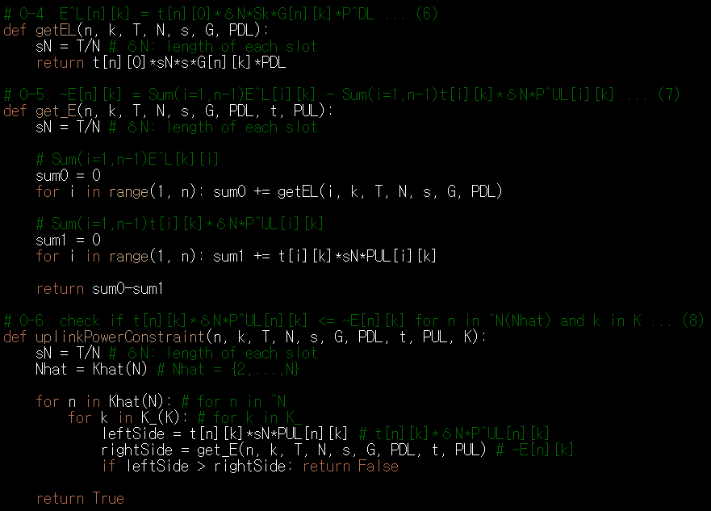


Current Status
Formula

Slide 8
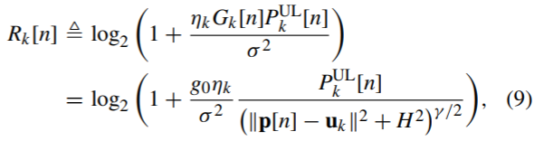
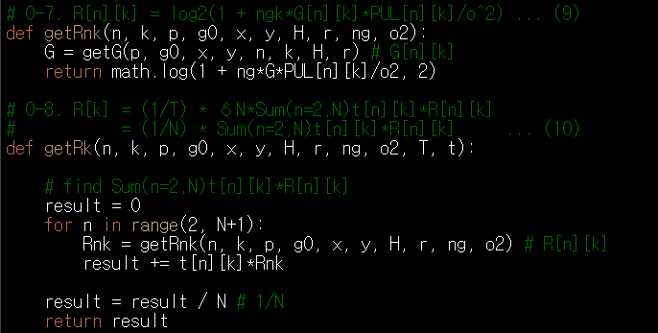
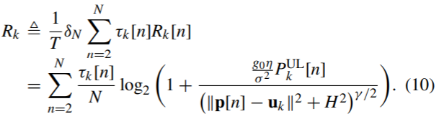
Current Status
Formula

Slide 9
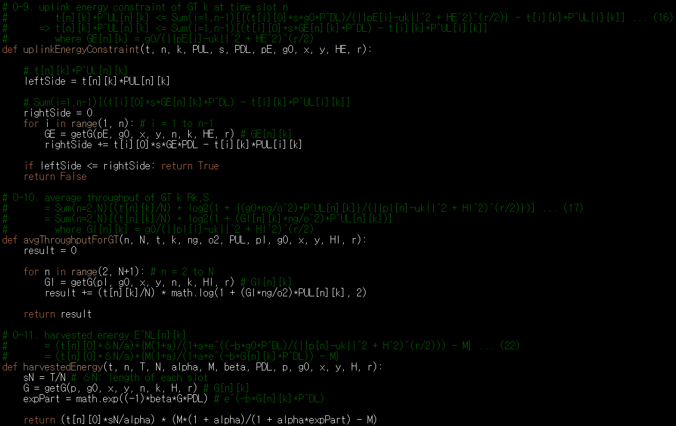
Current Status
Formula

Slide 10
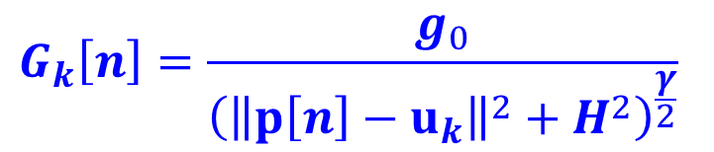
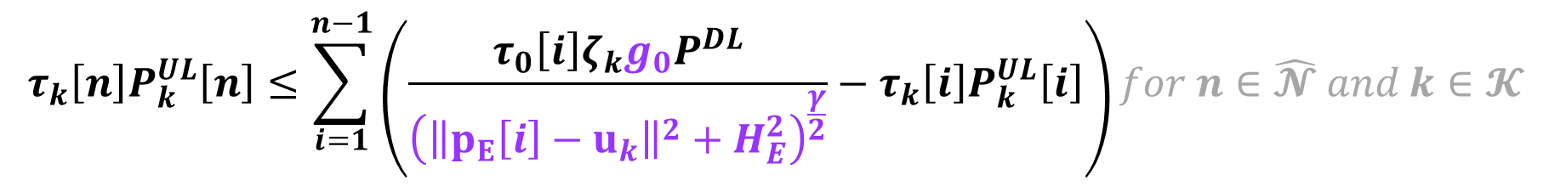
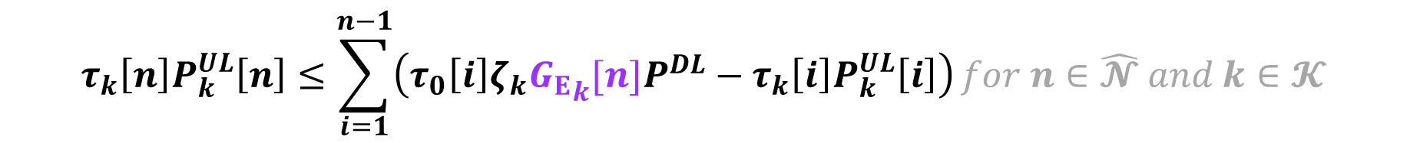
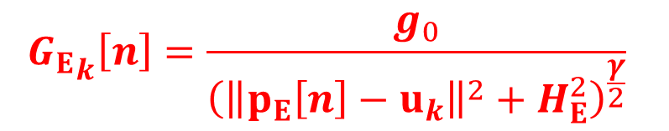
Current Status
Formula
여기서 수식을 이용하자.
따라서 이면 다음과 같이 변형됨
$$τ_{k}\left[n\right]P_{k}^{UL}\left[n\right]≤\sum_{i=1}^{n−1}{\left(\frac{τ_{0}\left[i\right]ζ_{k}g_{0}P^{DL}}{{\left({\left\|p_{E}\left[i\right]−u_{k}\right\|}^{2}+H_{E}^{2}\right)}^{\frac{γ}{2}}}−τ_{k}\left[i\right]P_{k}^{UL}\left[i\right]\right)}for n∈\hat{𝓝} and k∈𝓚$$
$$G_{k}\left[n\right]=\frac{g_{0}}{{\left({\left\|p\left[n\right]−u_{k}\right\|}^{2}+H^{2}\right)}^{\frac{γ}{2}}}$$
$${G_{E}}_{k}\left[n\right]=\frac{g_{0}}{{\left({\left\|p_{E}\left[n\right]−u_{k}\right\|}^{2}+H_{E}^{2}\right)}^{\frac{γ}{2}}}$$
$$τ_{k}\left[n\right]P_{k}^{UL}\left[n\right]≤\sum_{i=1}^{n−1}{\left(τ_{0}\left[i\right]ζ_{k}{G_{E}}_{k}[n]P^{DL}−τ_{k}\left[i\right]P_{k}^{UL}\left[i\right]\right)}for n∈\hat{𝓝} and k∈𝓚$$

Slide 11


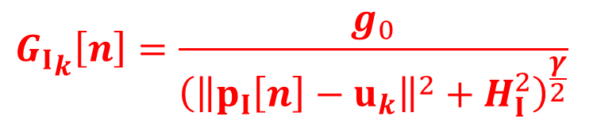
Current Status
Formula
여기서 수식을 이용하자.
따라서 이면 다음과 같이 변형됨
$$R_{k,S}≜\sum_{n=2}^{N}{\frac{τ_{k}\left[n\right]}{N}}\log_{2}\left(1+\frac{\frac{g_{0}η}{σ^{2}}P_{k}^{UL}\left[n\right]}{{\left({\left\|p_{I}\left[i\right]−u_{k}\right\|}^{2}+H_{I}^{2}\right)}^{\frac{γ}{2}}}\right)$$
$$G_{k}\left[n\right]=\frac{g_{0}}{{\left({\left\|p\left[n\right]−u_{k}\right\|}^{2}+H^{2}\right)}^{\frac{γ}{2}}}$$
$${G_{I}}_{k}\left[n\right]=\frac{g_{0}}{{\left({\left\|p_{I}\left[n\right]−u_{k}\right\|}^{2}+H_{I}^{2}\right)}^{\frac{γ}{2}}}$$
$$R_{k,S}≜\sum_{n=2}^{N}{\frac{τ_{k}\left[n\right]}{N}}\log_{2}\left(1+\frac{{G_{I}}_{k}\left[n\right]η}{σ^{2}}P_{k}^{UL}\left[n\right]\right)$$

Slide 12

Current Status
Formula
여기서 수식을 이용하자.
따라서 다음과 같이 변형됨
$$E_{k}^{NL}\left[n\right]≜\frac{τ_{0}\left[n\right]δ_{N}}{α}\left(\frac{M(1+α)}{1+α∙\exp\left(\frac{−βg_{0}P^{DL}}{{\left({\left\|p\left[n\right]−u_{k}\right\|}^{2}+H^{2}\right)}^{\frac{γ}{2}}}\right)}−M\right)$$
$$G_{k}\left[n\right]=\frac{g_{0}}{{\left({\left\|p\left[n\right]−u_{k}\right\|}^{2}+H^{2}\right)}^{\frac{γ}{2}}}$$
$$E_{k}^{NL}\left[n\right]≜\frac{τ_{0}\left[n\right]δ_{N}}{α}\left(\frac{M(1+α)}{1+α∙\exp\left(−βG_{k}[n]P^{DL}\right)}−M\right)$$

Slide 13
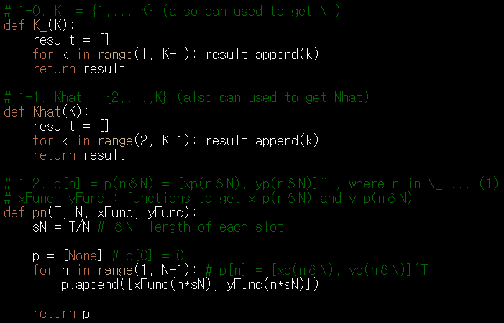
Current Status
Functions to create arrays and sets

Slide 14
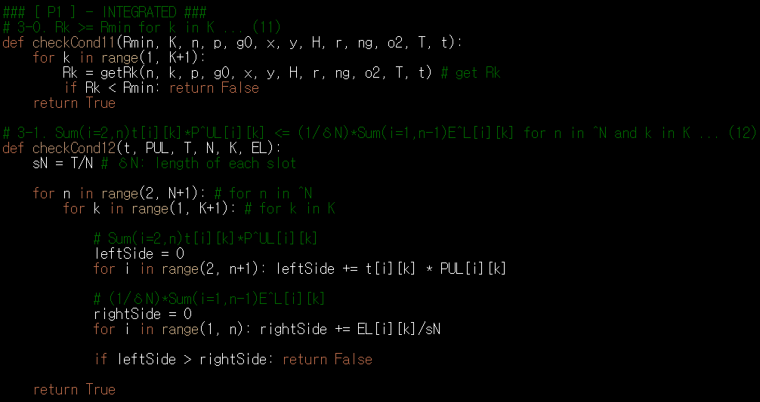
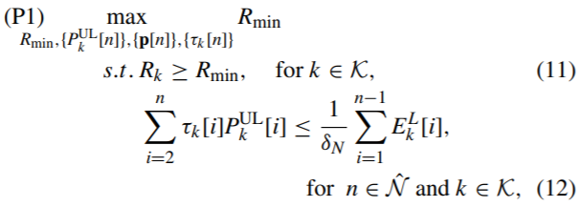
Current Status
Formula about the problems

Slide 15
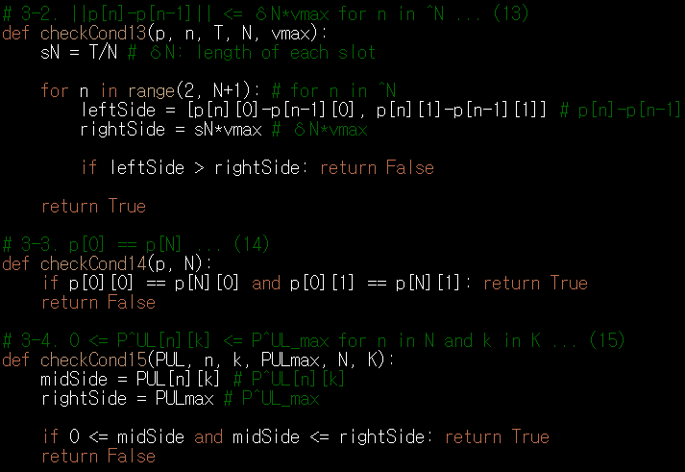
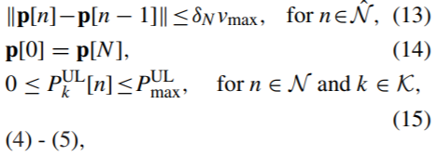
Current Status
Formula about the problems

Slide 16
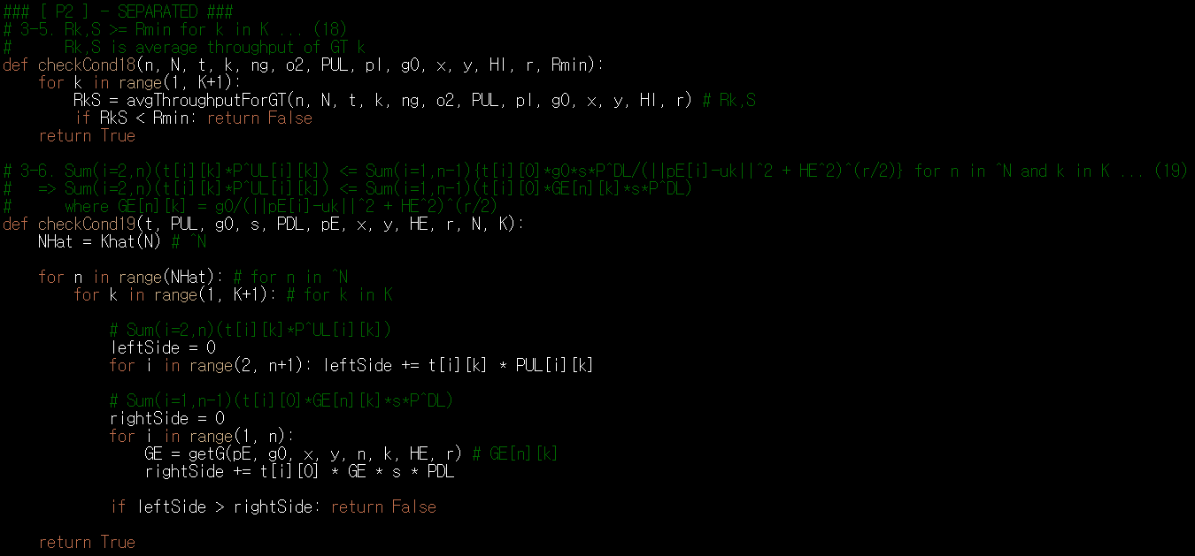
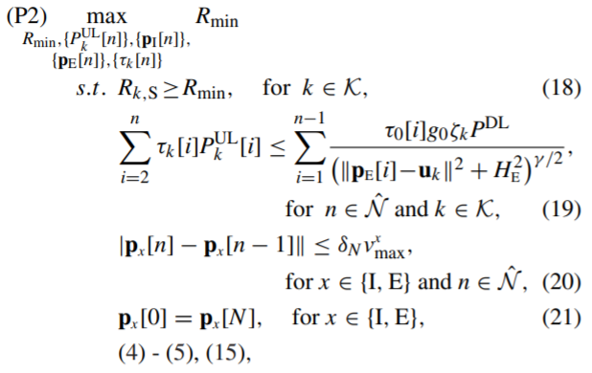
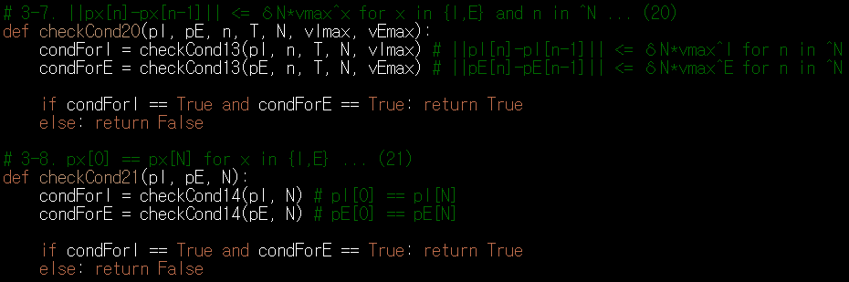
Current Status
Formula about the problems

Slide 17
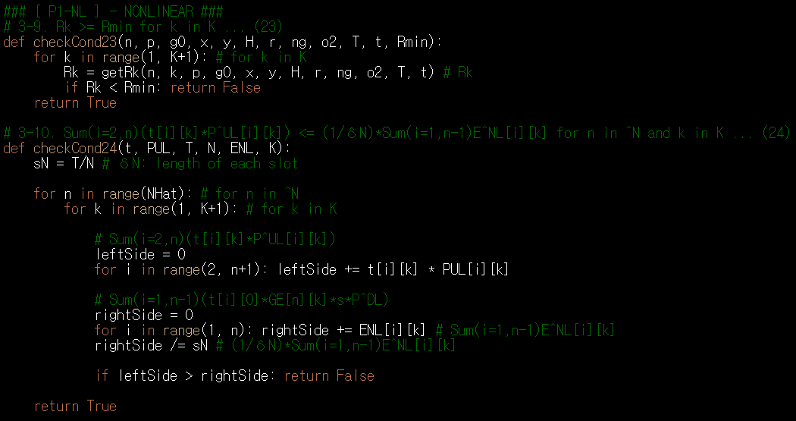
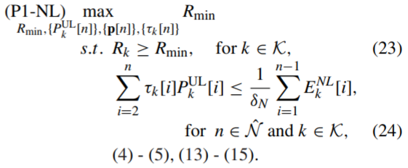
Current Status
Formula about the problems

Slide 18
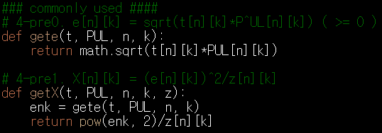

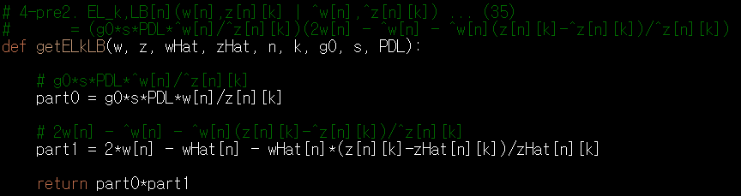

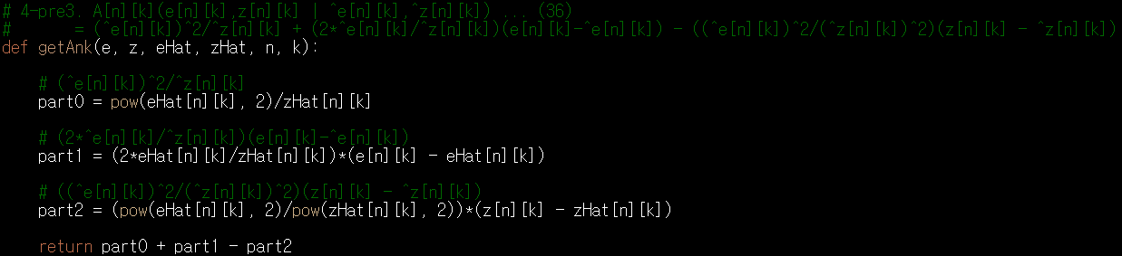
Current Status
Formula about the solutions (Commonly Used에 있는 것)
between (24) and (25)
between (34) and (35)
(35)
(36)

Slide 19
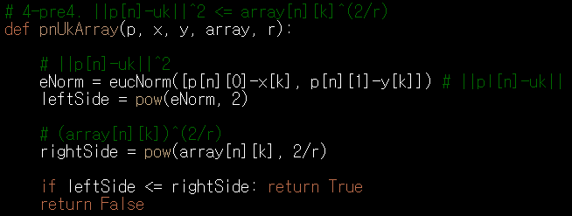
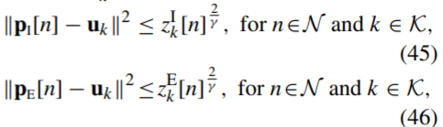
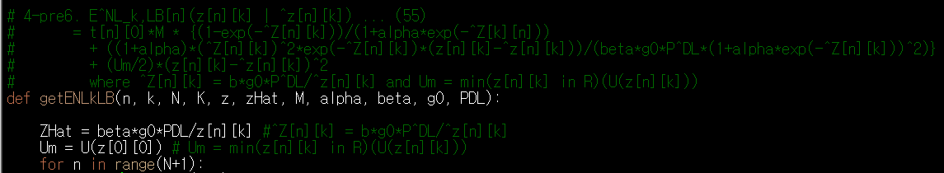
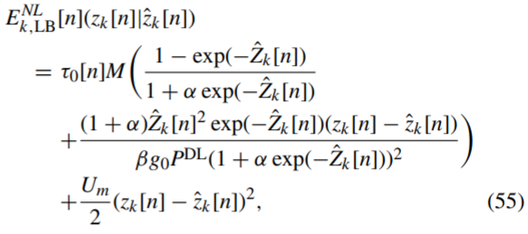
Current Status
Formula about the solutions (Commonly Used에 있는 것)
(미완성)
(55)

Slide 20
Github
https://github.com/WannaBeSuperteur/2020/tree/master/WPCN

