Slide 1
Weekly Report
2020.08.19
Hongsik Kim
Mobile & Network Intelligence Laboratory

Slide 2
WPCN: Paper
Weighted Harvest-Then-Transmit: UAV-Enabled Wireless Powered Communication Networks 논문 학습

Slide 3
Current Status
주간 진행 사항
Weighted Harvest-Then-Transmit: UAV-Enabled Wireless Powered Communication Networks 논문 학습

Slide 4
Current Status
Weighted Harvest-Then-Transmit: UAV-Enabled Wireless Powered Communication Networks 논문 학습
https://ieeexplore.ieee.org/stamp/stamp.jsp?arnumber=8540379

Slide 5
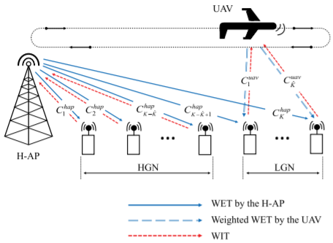
Current Status
Weighted Harvest-Then-Transmit: UAV-Enabled Wireless Powered Communication Networks 논문 학습
UAV-enabled WPCN은 1개의 HAP, 1개의 UAV, 여러 개의 node로 구성

Slide 6
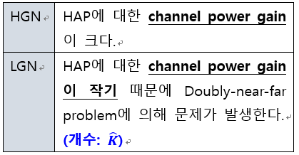
Current Status
Weighted Harvest-Then-Transmit: UAV-Enabled Wireless Powered Communication Networks 논문 학습
Channel power gain에 따라 node를 HGN과 LGN으로 구분

Slide 7
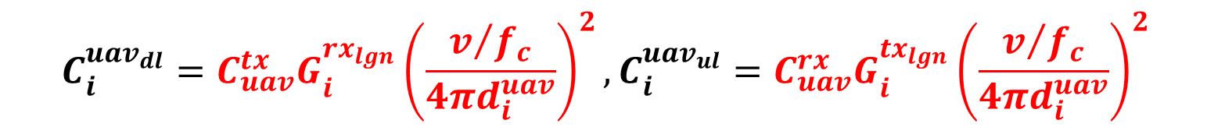
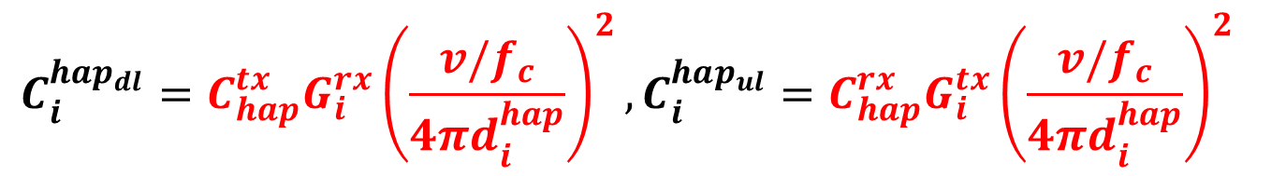
Current Status
Weighted Harvest-Then-Transmit: UAV-Enabled Wireless Powered Communication Networks 논문 학습
HAP과 node i 간의 DL channel power gain과 reversed UL channel power gain은
UAV와 LGN에 대해서도 마찬가지로 정의할 수 있음
$$C_{i}^{hap_{dl}}=C_{hap}^{tx}G_{i}^{rx}{\left(\frac{v/f_{c}}{4πd_{i}^{hap}}\right)}^{2}, C_{i}^{hap_{ul}}=C_{hap}^{rx}G_{i}^{tx}{\left(\frac{v/f_{c}}{4πd_{i}^{hap}}\right)}^{2}$$
$$C_{i}^{uav_{dl}}=C_{uav}^{tx}G_{i}^{rx_{lgn}}{\left(\frac{v/{f_{c}}}{4πd_{i}^{uav}}\right)}^{2}, C_{i}^{uav_{ul}}=C_{uav}^{rx}G_{i}^{tx_{lgn}}{\left(\frac{v/{f_{c}}}{4πd_{i}^{uav}}\right)}^{2}$$

Slide 8
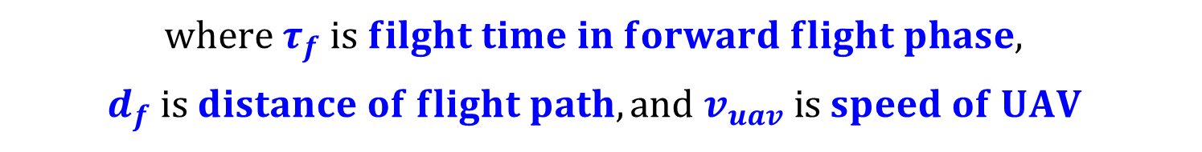
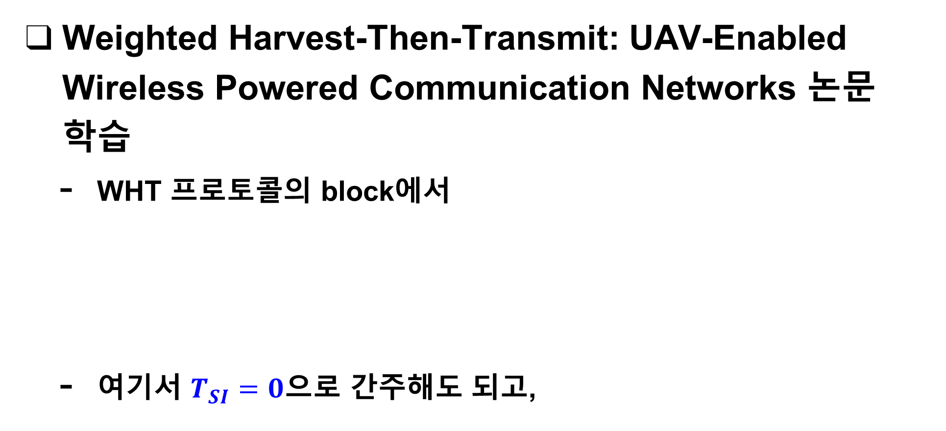
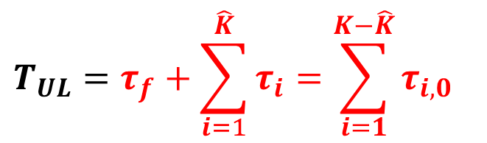
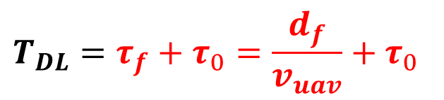

Current Status
Weighted Harvest-Then-Transmit: UAV-Enabled Wireless Powered Communication Networks 논문 학습
WHT 프로토콜의 block에서
여기서 $T_{SI}=0$으로 간주해도 되고,
$$T=T_{SI}+T_{DL}+T_{UL} \left(T=1 for convenience\right)$$
$T_{SI}$: state information (SI) transmission period / $T_{DL}$: DL period / $T_{UL}$: UL period
$$T_{DL}=τ_{f}+τ_{0}=\frac{d_{f}}{v_{uav}}+τ_{0}$$
$$T_{UL}=τ_{f}+\sum_{i=1}^{\hat{K}}{τ_{i}}=\sum_{i=1}^{K−\hat{K}}{τ_{i,0}}$$
$$where τ_{f} is filght time in forward flight phase,$$
$$d_{f} is distance of flight path,and v_{uav} is speed of UAV$$

Slide 9

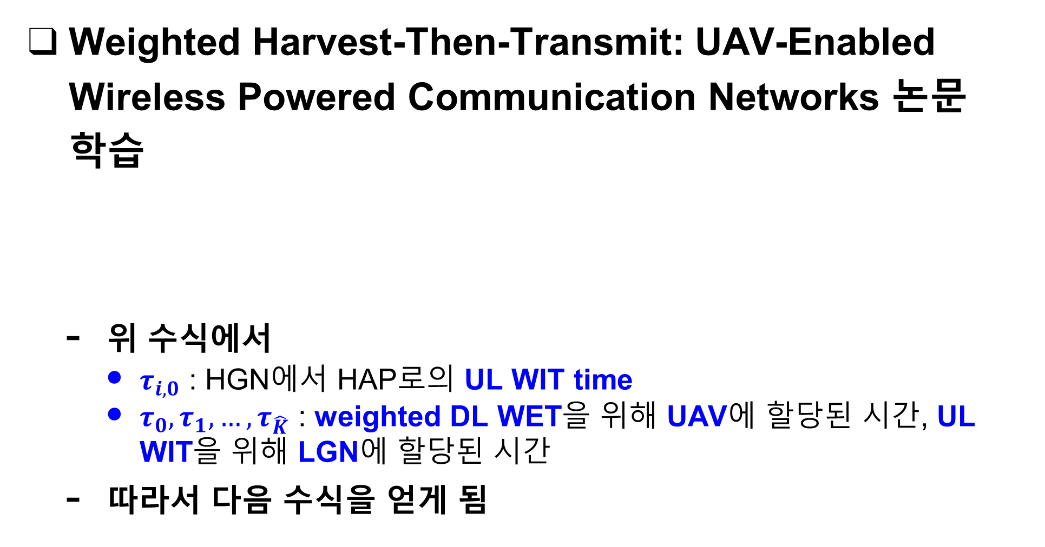
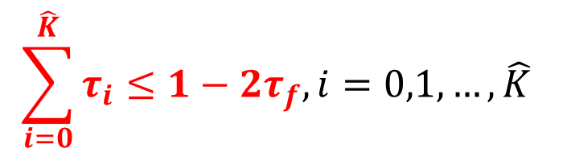
Current Status
Weighted Harvest-Then-Transmit: UAV-Enabled Wireless Powered Communication Networks 논문 학습
위 수식에서
$τ_{i,0}$ : HGN에서 HAP로의 UL WIT time
$τ_{0},τ_{1}, …,τ_{\hat{K}}$ : weighted DL WET을 위해 UAV에 할당된 시간, UL WIT을 위해 LGN에 할당된 시간
따라서 다음 수식을 얻게 됨
$$T_{UL}=τ_{f}+\sum_{i=1}^{\hat{K}}{τ_{i}}=\sum_{i=1}^{K−\hat{K}}{τ_{i,0}}$$
$$\sum_{i=0}^{\hat{K}}{τ_{i}}≤1−2τ_{f}, i=0,1,…,\hat{K}$$

Slide 10

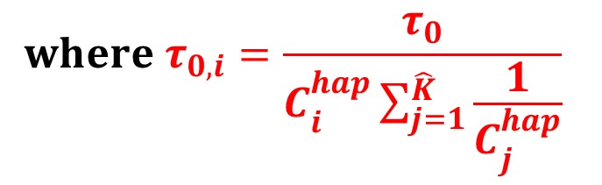
Current Status
Weighted Harvest-Then-Transmit: UAV-Enabled Wireless Powered Communication Networks 논문 학습
DL period에서 HAP은 모든 node에 에너지를 broadcast하는데, 이때 node i에서의 harvested energy는
LGN에서의 harvested energy는
$$E_{i}^{hap}=ξ_{i}^{hap}C_{i}^{hap}P_{H}T_{DL}=ξ_{i}^{hap}C_{i}^{hap}P_{H}\left(\frac{d_{f}}{v_{uav}}+τ_{0}\right)$$
$0≤ξ_{i}^{hap}≤1$은 node i에서의 energy harvesting efficiency
$$E_{i}^{uav}=ξ_{i}^{uav}C_{i}^{uav}P_{U}τ_{0,i}, i=1,2,…,\hat{K}…$$
$$where τ_{0,i}=\frac{τ_{0}}{C_{i}^{hap}\sum_{j=1}^{\hat{K}}{\frac{1}{C_{j}^{hap}}}}$$

Slide 11
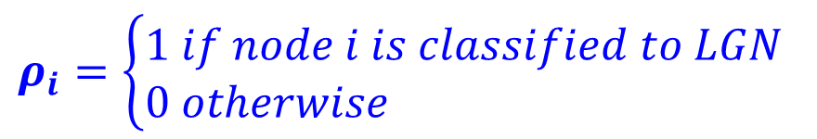
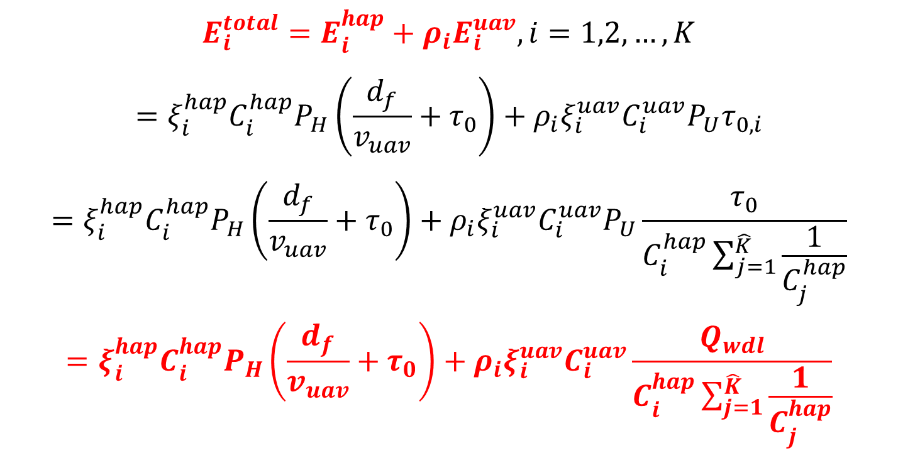
Current Status
Weighted Harvest-Then-Transmit: UAV-Enabled Wireless Powered Communication Networks 논문 학습
따라서 전체 harvested energy는 다음과 같음
$$E_{i}^{total}=E_{i}^{hap}+ρ_{i}E_{i}^{uav}, i=1,2,…,K$$
$$=ξ_{i}^{hap}C_{i}^{hap}P_{H}\left(\frac{d_{f}}{v_{uav}}+τ_{0}\right)+ρ_{i}ξ_{i}^{uav}C_{i}^{uav}P_{U}τ_{0,i}$$
$$=ξ_{i}^{hap}C_{i}^{hap}P_{H}\left(\frac{d_{f}}{v_{uav}}+τ_{0}\right)+ρ_{i}ξ_{i}^{uav}C_{i}^{uav}P_{U}\frac{τ_{0}}{C_{i}^{hap}\sum_{j=1}^{\hat{K}}{\frac{1}{C_{j}^{hap}}}}$$
$$=ξ_{i}^{hap}C_{i}^{hap}P_{H}\left(\frac{d_{f}}{v_{uav}}+τ_{0}\right)+ρ_{i}ξ_{i}^{uav}C_{i}^{uav}\frac{Q_{wdl}}{C_{i}^{hap}\sum_{j=1}^{\hat{K}}{\frac{1}{C_{j}^{hap}}}}$$
$$ρ_{i}=\left\{\begin{aligned}&1 if node i is classified to LGN \\ &0 otherwise\end{aligned}\right.$$

Slide 12
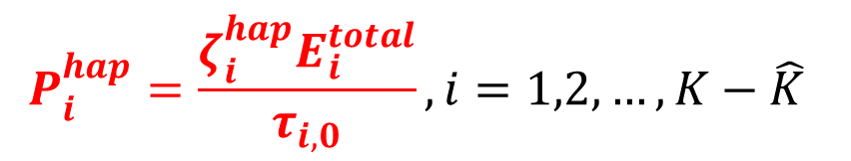
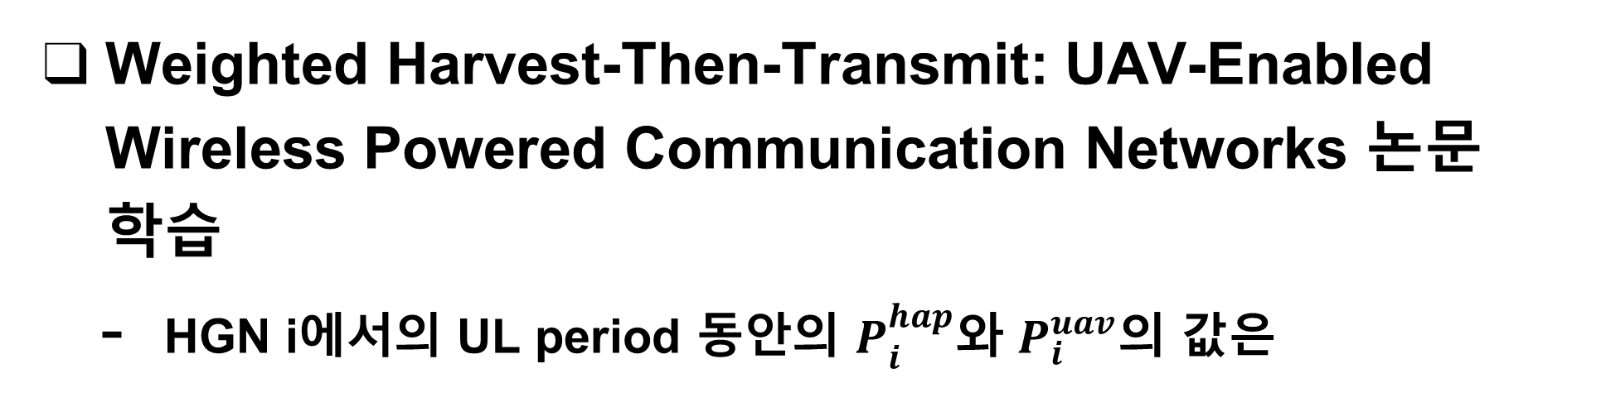
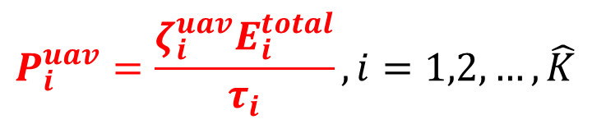
Current Status
Weighted Harvest-Then-Transmit: UAV-Enabled Wireless Powered Communication Networks 논문 학습
HGN i에서의 UL period 동안의 $P_{i}^{hap}$와 $P_{i}^{uav}$의 값은
$$P_{i}^{hap}=\frac{ζ_{i}^{hap}E_{i}^{total}}{τ_{i,0}}, i=1,2,…,K−\hat{K}$$
$$P_{i}^{uav}=\frac{ζ_{i}^{uav}E_{i}^{total}}{τ_{i}}, i=1,2,…,\hat{K}$$
$0≤ξ_{i}^{hap}≤1$은 steady state의 HGN에서 UL WIT에 사용된 전체 harvest energy의 비율
$0≤ξ_{i}^{uav}≤1$은 steady state의 LGN에서 UL WIT에 사용된 전체 harvest energy의 비율

Slide 13
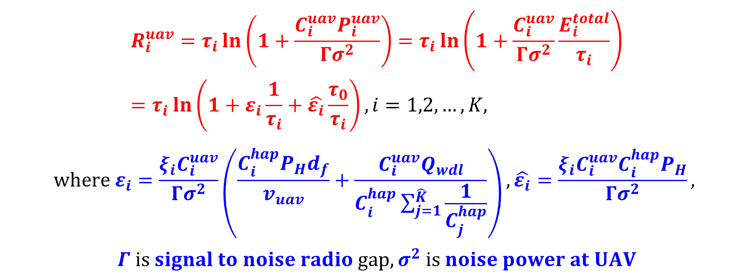
Current Status
Weighted Harvest-Then-Transmit: UAV-Enabled Wireless Powered Communication Networks 논문 학습
따라서 LGN i의 achievable UL throughput은
$$R_{i}^{uav}=τ_{i}\ln\left(1+\frac{C_{i}^{uav}P_{i}^{uav}}{Γσ^{2}}\right)=τ_{i}\ln\left(1+\frac{C_{i}^{uav}}{Γσ^{2}}\frac{E_{i}^{total}}{τ_{i}}\right)=τ_{i}\ln\left(1+ε_{i}\frac{1}{τ_{i}}+\hat{ε_{i}}\frac{τ_{0}}{τ_{i}}\right), i=1,2,…,K,$$
$$where ε_{i}=\frac{ξ_{i}C_{i}^{uav}}{Γσ^{2}}\left(\frac{C_{i}^{hap}P_{H}d_{f}}{v_{uav}}+\frac{C_{i}^{uav}Q_{wdl}}{C_{i}^{hap}\sum_{j=1}^{\hat{K}}{\frac{1}{C_{j}^{hap}}}}\right), \hat{ε_{i}}=\frac{ξ_{i}C_{i}^{uav}C_{i}^{hap}P_{H}}{Γσ^{2}},$$
$$Γ is signal to noise radio gap, σ^{2} is noise power at UAV$$

Slide 14
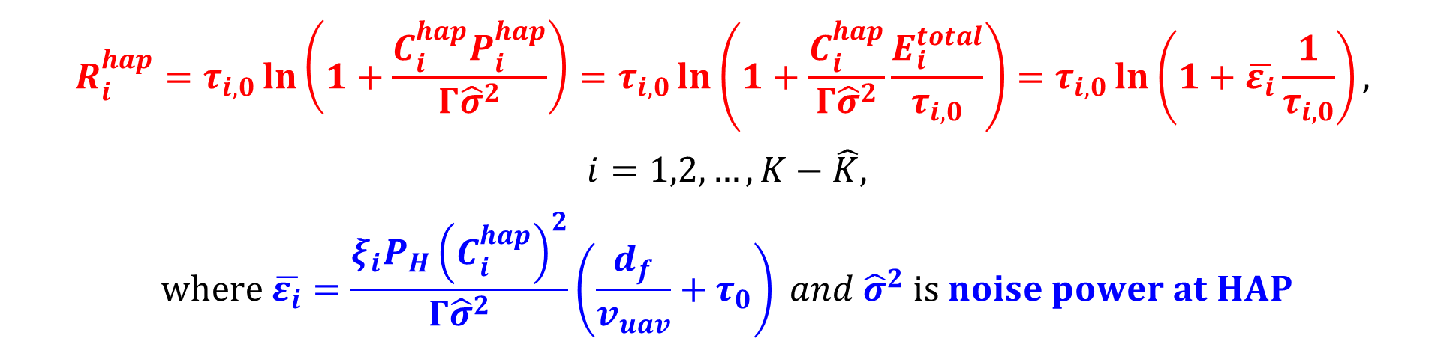
Current Status
Weighted Harvest-Then-Transmit: UAV-Enabled Wireless Powered Communication Networks 논문 학습
따라서 HGN i의 achievable UL throughput은
$$R_{i}^{hap}=τ_{i,0}\ln\left(1+\frac{C_{i}^{hap}P_{i}^{hap}}{Γ{\hat{σ}}^{2}}\right)=τ_{i,0}\ln\left(1+\frac{C_{i}^{hap}}{Γ{\hat{σ}}^{2}}\frac{E_{i}^{total}}{τ_{i,0}}\right)=τ_{i,0}\ln\left(1+\overline{ε_{i}}\frac{1}{τ_{i,0}}\right),$$
$$i=1,2,…,K−\hat{K},$$
$$where \overline{ε_{i}}=\frac{ξ_{i}P_{H}{\left(C_{i}^{hap}\right)}^{2}}{Γ{\hat{σ}}^{2}}\left(\frac{d_{f}}{v_{uav}}+τ_{0}\right) and {\hat{σ}}^{2} is noise power at HAP$$

Slide 15
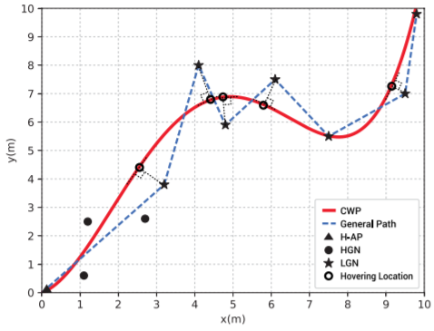
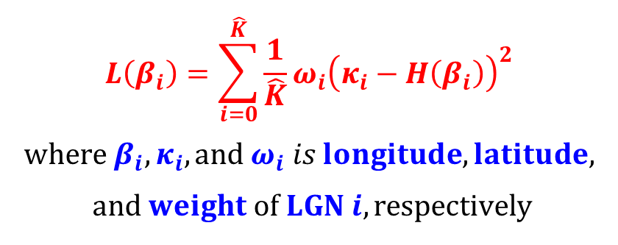
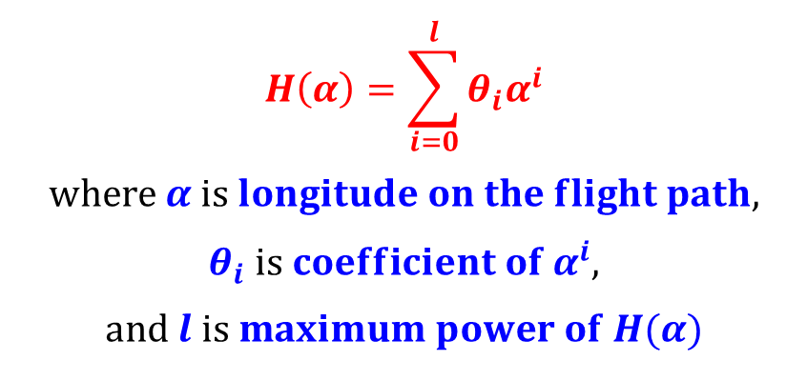
Current Status
Weighted Harvest-Then-Transmit: UAV-Enabled Wireless Powered Communication Networks 논문 학습
Channel-weighted path (CWP) planning: UAV의 flight path를 energy efficiency 관점에서 최적화하는 것
$$H\left(α\right)=\sum_{i=0}^{l}{θ_{i}α^{i}}$$
$$where α is longitude on the flight path,$$
$$θ_{i} is coefficient of α^{i},$$
$$and l is maximum power of H(α)$$
$$L\left(β_{i}\right)=\sum_{i=0}^{\hat{K}}{\frac{1}{\hat{K}}}ω_{i}{\left(κ_{i}−H\left(β_{i}\right)\right)}^{2}$$
$$where β_{i}, κ_{i}, and ω_{i} is longitude, latitude,$$
$$and weight of LGN i, respectively$$

Slide 16
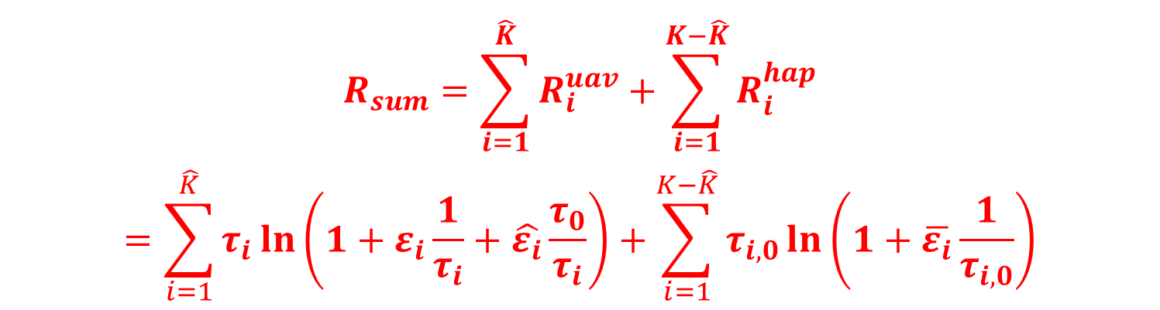
Current Status
Weighted Harvest-Then-Transmit: UAV-Enabled Wireless Powered Communication Networks 논문 학습
HGN은 HAP에 정보를 전송하고 LGN은 UAV에 정보를 전송할 수 있는데, 이때 모든 node의 sum-throughput은
$$R_{sum}=\sum_{i=1}^{\hat{K}}{R_{i}^{uav}}+\sum_{i=1}^{K−\hat{K}}{R_{i}^{hap}}$$
$$=\sum_{i=1}^{\hat{K}}{τ_{i}\ln\left(1+ε_{i}\frac{1}{τ_{i}}+\hat{ε_{i}}\frac{τ_{0}}{τ_{i}}\right)}+\sum_{i=1}^{K−\hat{K}}{τ_{i,0}\ln\left(1+\overline{ε_{i}}\frac{1}{τ_{i,0}}\right)}$$

Slide 17
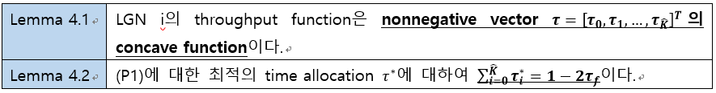
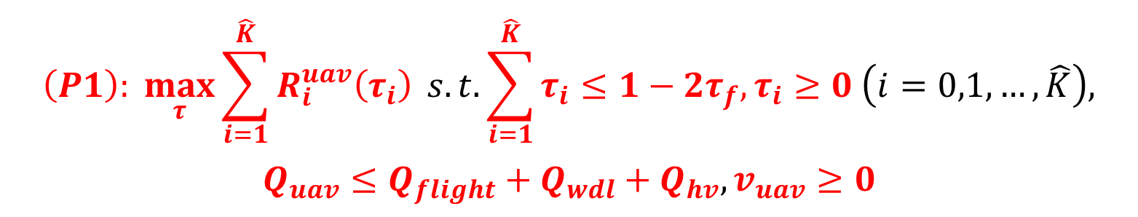
Current Status
Weighted Harvest-Then-Transmit: UAV-Enabled Wireless Powered Communication Networks 논문 학습
Problem 1: Sum-throughput Maximization
이것을 convex optimization으로 해결하기 위해 (P1)의 목적함수는 concave function이고 모든 constraint는 affine이어야 함
$$\left(P1\right): \max_{τ}{\sum_{i=1}^{\hat{K}}{R_{i}^{uav}\left(τ_{i}\right)}} s.t. \sum_{i=1}^{\hat{K}}{τ_{i}}≤1−2τ_{f}, τ_{i}≥0 \left(i=0,1,…,\hat{K}\right),$$
$$Q_{uav}≤Q_{flight}+Q_{wdl}+Q_{hv}, v_{uav}≥0$$

Slide 18
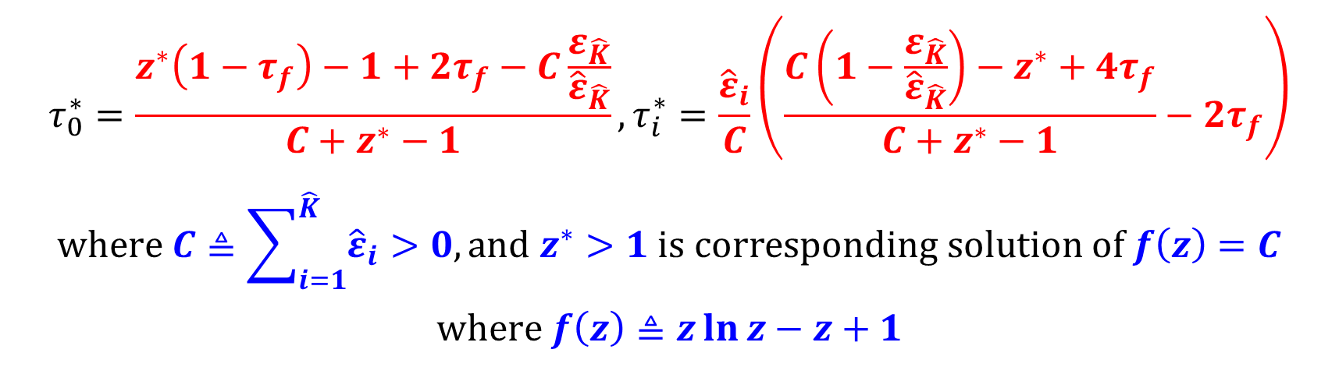
Current Status
Weighted Harvest-Then-Transmit: UAV-Enabled Wireless Powered Communication Networks 논문 학습
Proposition 4.1. (P1)의 optimal time allocation
$$τ_{0}^{∗}=\frac{z^{∗}\left(1−τ_{f}\right)−1+2τ_{f}−C\frac{ε_{\hat{K}}}{{\hat{ε}}_{\hat{K}}}}{C+z^{∗}−1}, τ_{i}^{∗}=\frac{{\hat{ε}}_{i}}{C}\left(\frac{C\left(1−\frac{ε_{\hat{K}}}{{\hat{ε}}_{\hat{K}}}\right)−z^{∗}+4τ_{f}}{C+z^{∗}−1}−2τ_{f}\right)$$
$$where C≜\sum_{i=1}^{\hat{K}}{{\hat{ε}}_{i}}>0, and z^{∗}>1 is corresponding solution of f\left(z\right)=C$$
$$where f\left(z\right)≜z\ln{z}−z+1$$

Slide 19
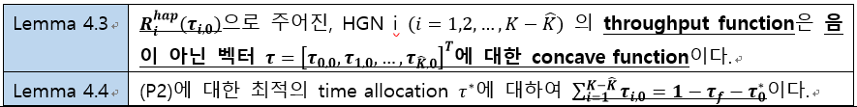
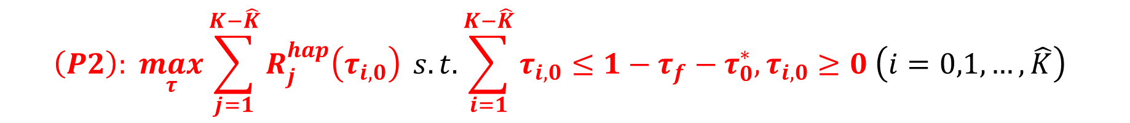
Current Status
Weighted Harvest-Then-Transmit: UAV-Enabled Wireless Powered Communication Networks 논문 학습
Problem 2:
이것을 convex optimization으로 해결하기 위해 다음의 2가지 lemma를 이용함
$$\left(P2\right): \max_{τ}{\sum_{j=1}^{K−\hat{K}}{R_{j}^{hap}\left(τ_{i,0}\right)}} s.t. \sum_{i=1}^{K−\hat{K}}{τ_{i,0}}≤1−τ_{f}−τ_{0}^{∗}, τ_{i,0}≥0 \left(i=0,1,…,\hat{K}\right)$$

Slide 20
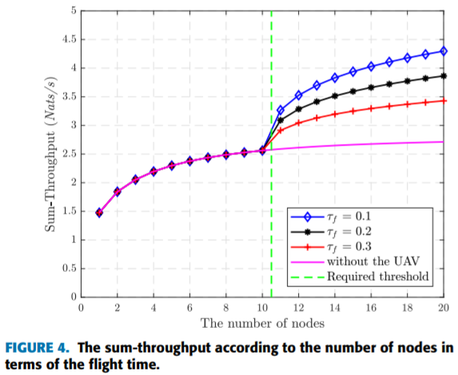
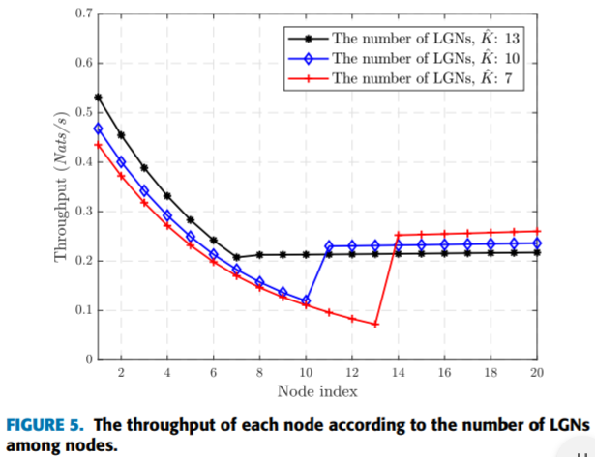
Current Status
Weighted Harvest-Then-Transmit: UAV-Enabled Wireless Powered Communication Networks 논문 학습

Slide 21
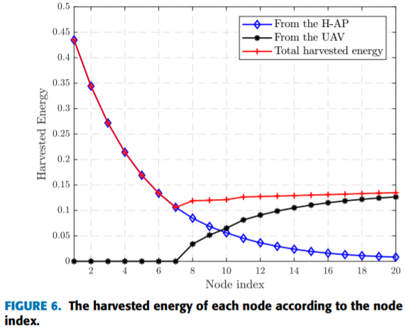
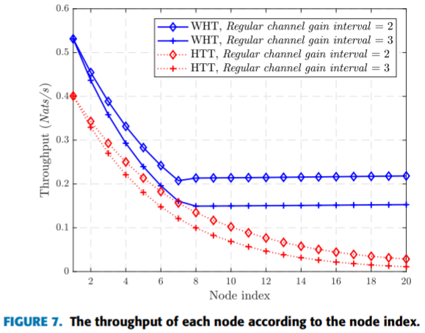
Current Status
Weighted Harvest-Then-Transmit: UAV-Enabled Wireless Powered Communication Networks 논문 학습

Slide 22
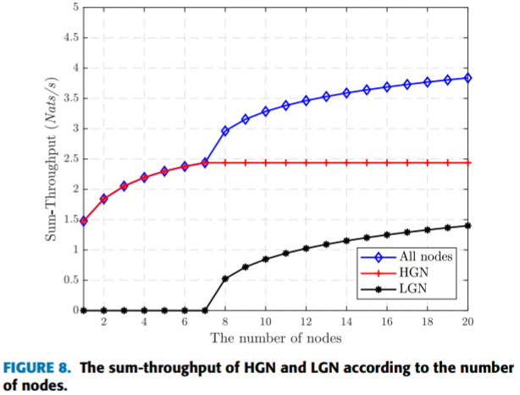
Current Status
Weighted Harvest-Then-Transmit: UAV-Enabled Wireless Powered Communication Networks 논문 학습

Slide 23
Github
https://github.com/WannaBeSuperteur/2020/tree/master/WPCN

