Slide 1
Weekly Report
2020.11.20
Hongsik Kim
Mobile & Network Intelligence Laboratory

Slide 2
AI Explanable AI
Kaggle 진행 상황

Slide 3
Current Status
주간 진행 사항
Kaggle 진행
Conway’s Reverse Game of Life
https://www.kaggle.com/c/conway-s-reverse-game-of-life/overview

Slide 4
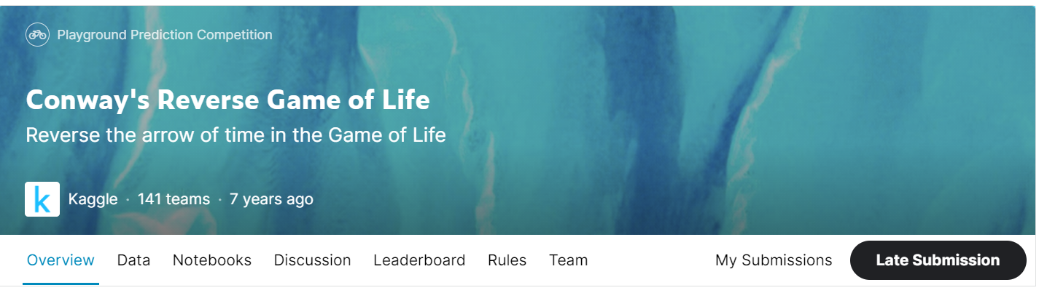
Kaggle Competition
Conway’s Reverse Game of Life
https://www.kaggle.com/c/conway-s-reverse-game-of-life/overview

Slide 5
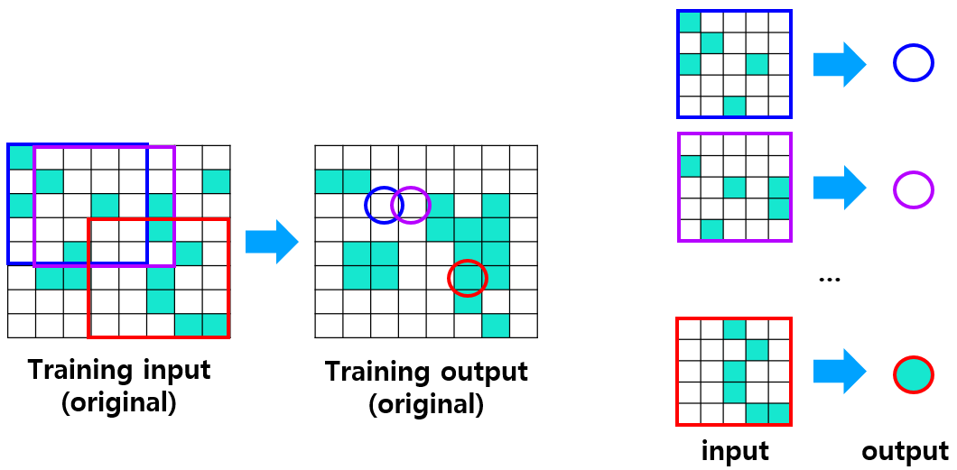
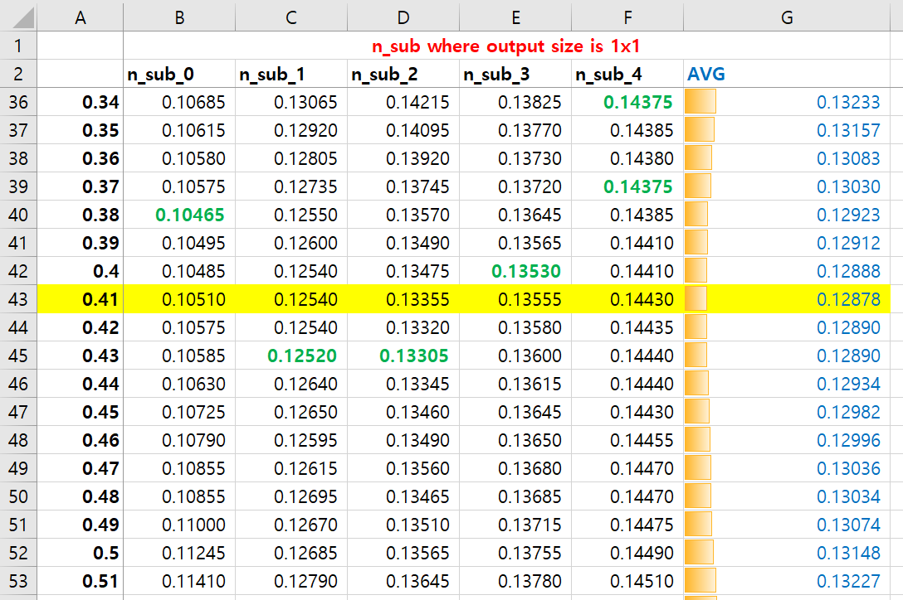
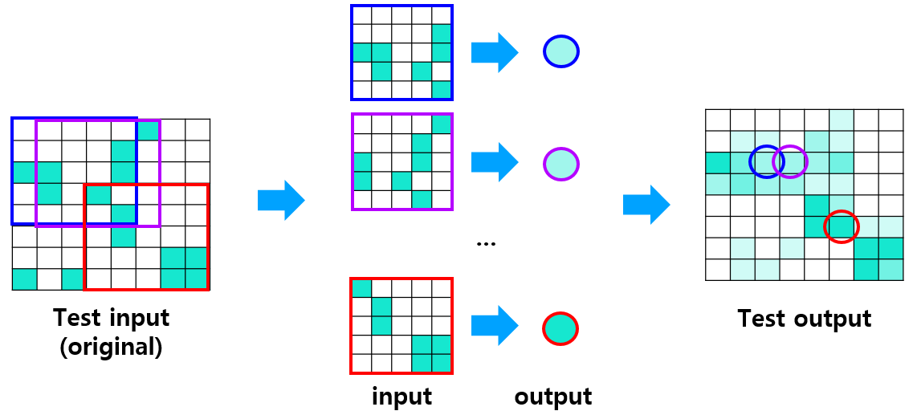
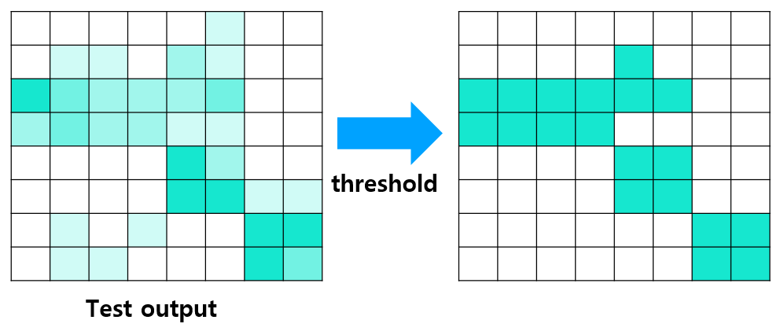
Kaggle Competition
Conway’s Reverse Game of Life
방법 1: n-sub mode (refer to 201106_AI.pptx)
(학습)
(테스트)
(threshold)

Slide 6
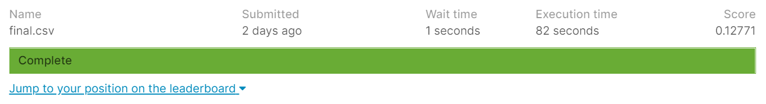
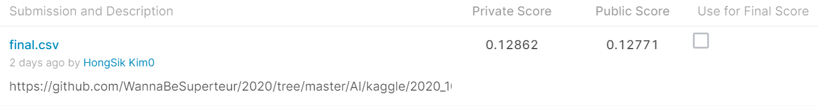
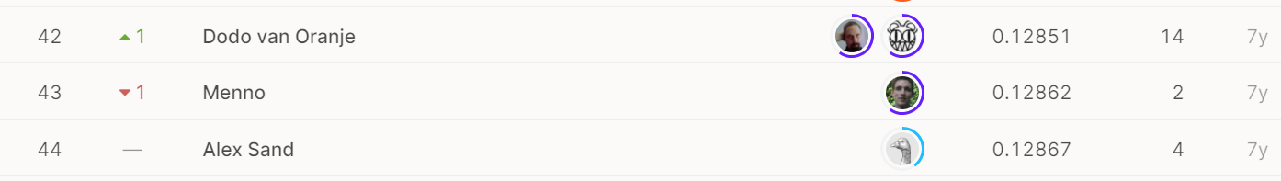
Kaggle Competition
Conway’s Reverse Game of Life
방법 1: n-sub mode (refer to 201106_AI.pptx)
(about -0.015 when compared to Everything Dead Benchmark)
Public: 44/141 (31.21%)
Private: 44/141 (31.21%)

Slide 7
Kaggle Competition
Conway’s Reverse Game of Life
방법 2: n-sub mode with 3x3 output, predict as the center of output - TRAINING
…
Training input
(original)
Training output
(original)
input
output

Slide 8
Kaggle Competition
Conway’s Reverse Game of Life
방법 2: n-sub mode with 3x3 output, predict as the center of output - TEST
…
Test input
(original)
Test output
input
output

Slide 9
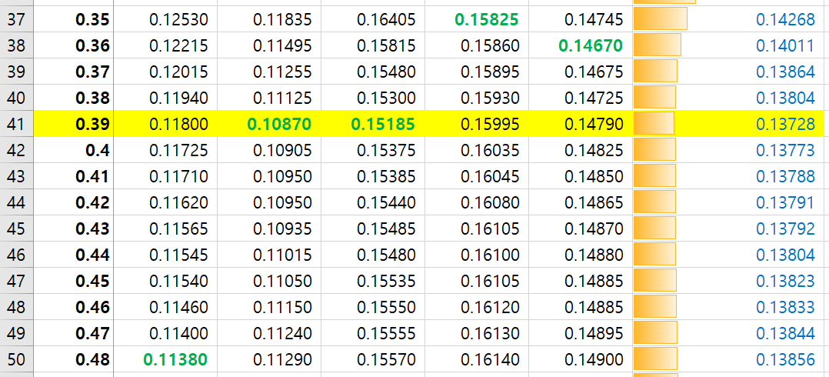
Kaggle Competition
Conway’s Reverse Game of Life
방법 2: n-sub mode with 3x3 output, predict as center of output – RESULT (0.14643 – 0.13728 = 0.0915)

Slide 10
Kaggle Competition
Conway’s Reverse Game of Life
방법 3: n-sub mode with 3x3 output, predict as the average of predicted value - TEST
Test input
(original)
Test output
The value to predict (blue)

Slide 11
Kaggle Competition
Conway’s Reverse Game of Life
방법 3: n-sub mode with 3x3 output, predict as the average of predicted value - TEST
(w=0.1)
(w=0.1)
(w=0.1)
(w=0.1)
(w=0.2)
(w=0.1)
Test input
(original)
(w=0.1)
(w=0.1)
(w=0.1)
input
output
input
output
input
output

Slide 12
Kaggle Competition
Conway’s Reverse Game of Life
방법 3: n-sub mode with 3x3 output, predict as the average of predicted value - TEST
+
+
+
+
+
+
+
+
=
9
Test input
(original)
Test output
The value to predict

Slide 13
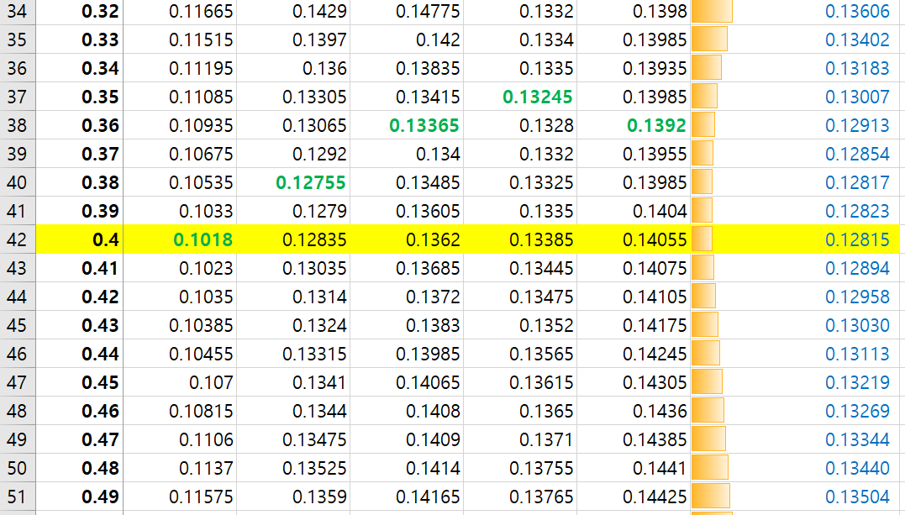
Kaggle Competition
Conway’s Reverse Game of Life
방법 3: n-sub mode with 3x3 output, predict as the average of predicted value – RESULT (0.14111 – 0.12815 = 0.01297)

Slide 14
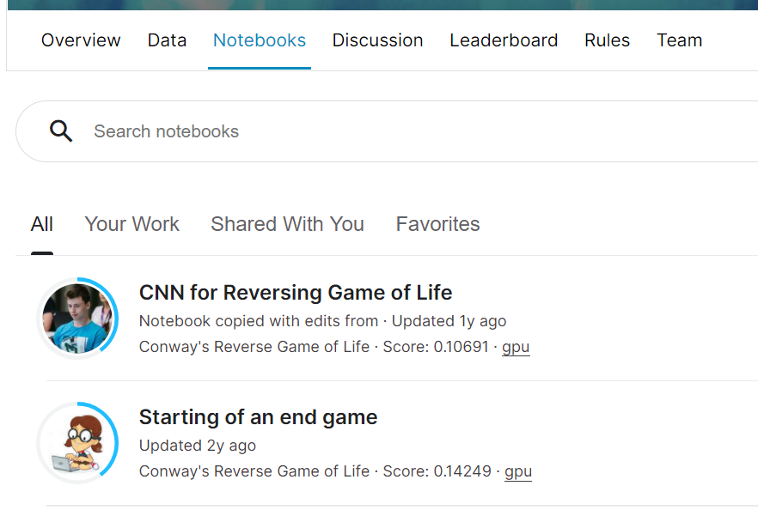
Kaggle Competition
Conway’s Reverse Game of Life
Future Plan
해당 competition의 notebook을 참고하여 상위 5% 이내로 성능 개선

Slide 15
Github
https://github.com/WannaBeSuperteur/2020/tree/master/

