Slide 1
Weekly Report
2020.12.11
Hongsik Kim
Mobile & Network Intelligence Laboratory

Slide 2
AI Explanable AI
Kaggle 진행 상황
논문: Black Box Attacks on Explainable Artificial Intelligence (XAI) methods in Cyber Security
특허 구현 (Not Available for Public)

Slide 3
Current Status
주간 진행 사항
Kaggle 진행
Conway’s Reverse Game of Life 2020
https://www.kaggle.com/c/conways-reverse-game-of-life-2020
논문 학습
XNAP: Making LSTM-based Next Activity Predictions Explainable by Using LRP
https://arxiv.org/pdf/2008.07993.pdf
특허 구현 (Not Available for Public)

Slide 4
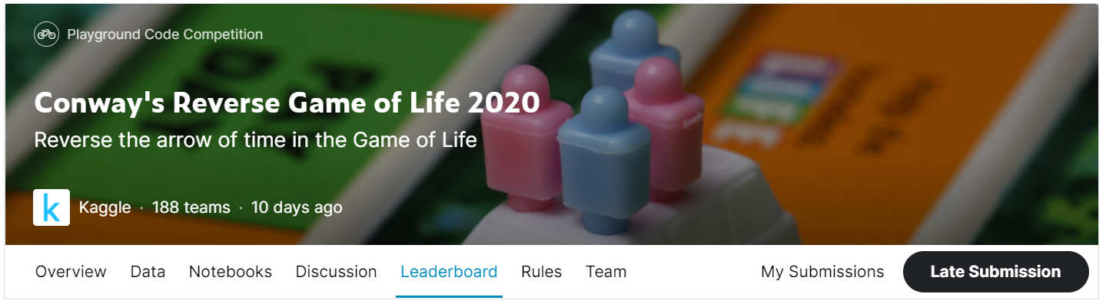
Kaggle Competition
Conway’s Reverse Game of Life 2020
https://www.kaggle.com/c/conways-reverse-game-of-life-2020

Slide 5

Kaggle Competition
Conway’s Reverse Game of Life 2020
n-sub mode 적용
가장자리에 있는 cell에서 주변 cell의 값을 적용할 때 wrap around로 적용
1 | 0 | 0 | 0 | 0 | 1 | 1
1 | 0 | 0 | 0 | 0 | 0 | 1
1 | 0 | 0 | 0 | 1 | 1 | 0
0 | 1 | 0 | 0 | 0 | 1 | 0
1 | 0 | 0 | 0 | 0 | 0 | 1
0 | 0 | 0 | 1 | 0 | 0 | 0
0 | 0 | 1 | 1 | 0 | 1 | 1
0 | 0 | 0 | 0 | 0
0 | 1 | 1 | 0 | 0
0 | 1 | 1 | 1 | 0
0 | 0 | 1 | 1 | 0
1 | 1 | 0 | 1 | 0

Slide 6
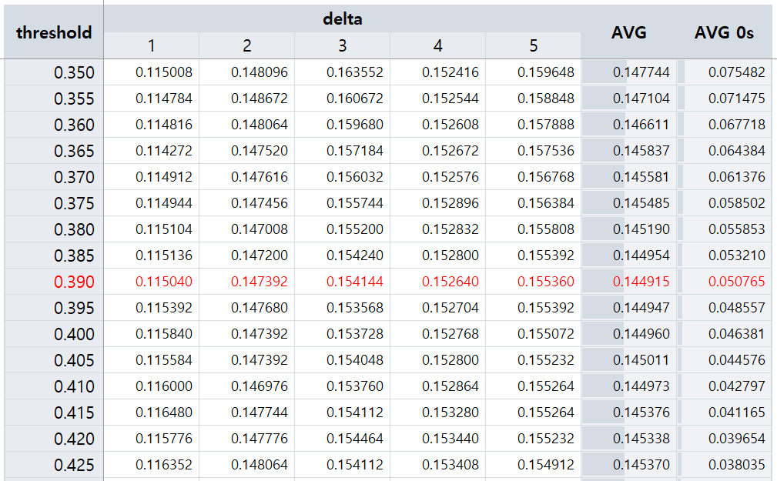
Kaggle Competition
Conway’s Reverse Game of Life 2020
Threshold 0.390에서 0.144915로 최소

Slide 7
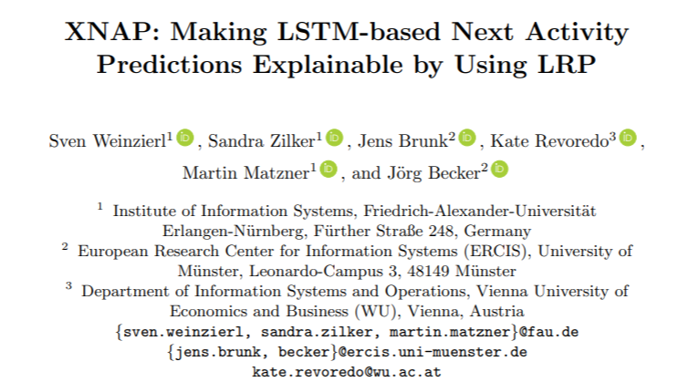
Paper: XNAP: Making LSTM-based Next Activity Predictions Explainable by Using LRP
논문 소개
XNAP: Making LSTM-based Next Activity Predictions Explainable by Using LRP
https://arxiv.org/pdf/2008.07993.pdf

Slide 8
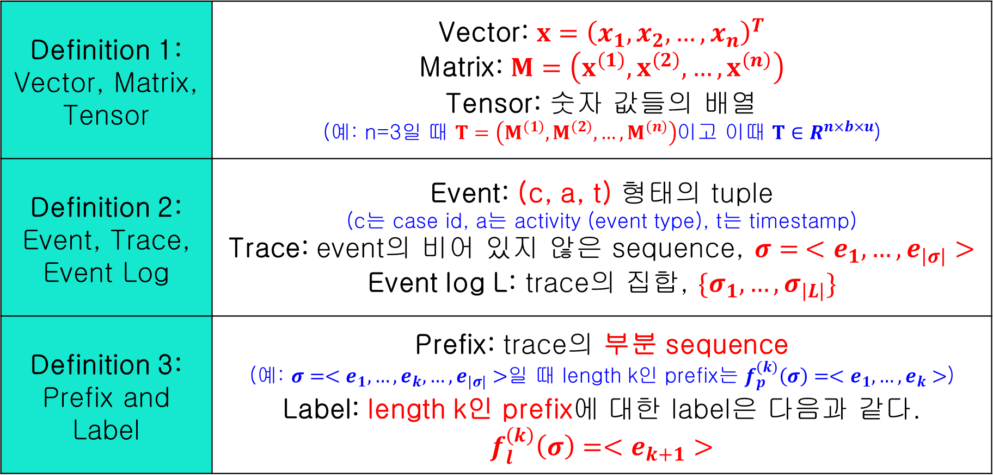
Paper: XNAP: Making LSTM-based Next Activity Predictions Explainable by Using LRP
논문 소개
DEFINITIONS
Definition 1: Vector, Matrix, Tensor | Vector: $x={\left(x_{1},x_{2},…, x_{n}\right)}^{T}$ Matrix: $M=\left(x^{\left(1\right)},x^{\left(2\right)},…,x^{\left(n\right)}\right)$ Tensor: 숫자 값들의 배열 (예: n=3일 때 $T=\left(M^{\left(1\right)},M^{\left(2\right)},…,M^{\left(n\right)}\right)$이고 이때 $T∈R^{n×b×u}$)
Definition 2: Event, Trace, Event Log | Event: (c, a, t) 형태의 tuple (c는 case id, a는 activity (event type), t는 timestamp) Trace: event의 비어 있지 않은 sequence, $σ= <e_{1},…, e_{\left|σ\right|}>$ Event log L: trace의 집합, $\{σ_{1},…, σ_{\left|L\right|}\}$
Definition 3: Prefix and Label | Prefix: trace의 부분 sequence (예: $σ=<e_{1},…, e_{k}, …, e_{\left|σ\right|}>$일 때 length k인 prefix는 $f_{p}^{\left(k\right)}\left(σ\right)=<e_{1},…, e_{k}>$) Label: length k인 prefix에 대한 label은 다음과 같다. $$f_{l}^{\left(k\right)}\left(σ\right)=<e_{k+1}>$$

Slide 9
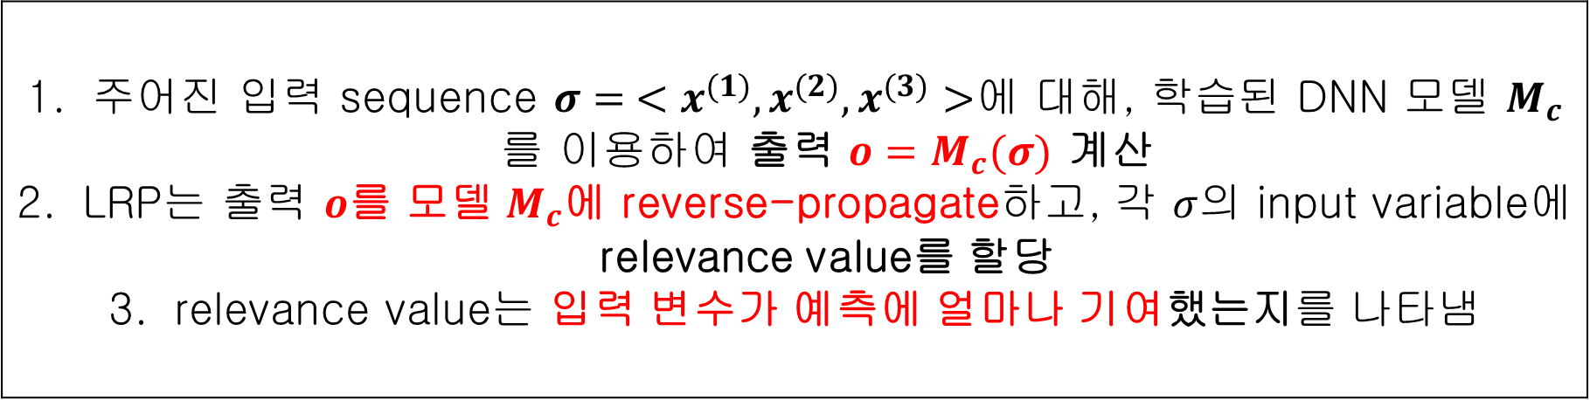
Paper: XNAP: Making LSTM-based Next Activity Predictions Explainable by Using LRP
논문 소개
Layer-wise Relevance Propagation for LSTMs
LRP (Layer-wise Relevance Propagation)은 Deep Neural Network의 예측에 대해 설명하기 위한 기술로, 다음과 같이 작동함
주어진 입력 sequence $σ= <x^{(1)}, x^{(2)}, x^{(3)}>$에 대해, 학습된 DNN 모델 $M_{c}$를 이용하여 출력 $o=M_{c}(σ)$ 계산 LRP는 출력 $o$를 모델 $M_{c}$에 reverse-propagate하고, 각 $σ$의 input variable에 relevance value를 할당 relevance value는 입력 변수가 예측에 얼마나 기여했는지를 나타냄

Slide 10
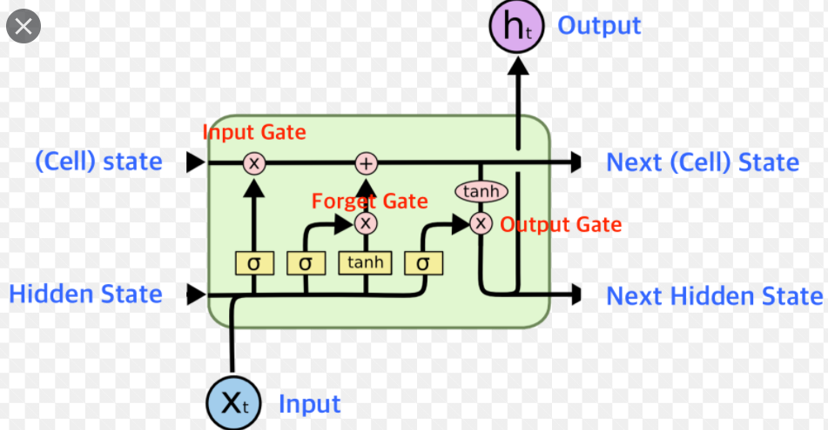
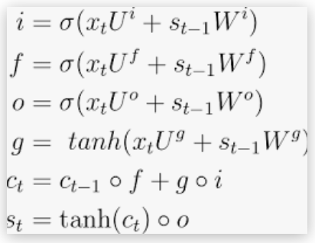
Paper: XNAP: Making LSTM-based Next Activity Predictions Explainable by Using LRP
논문 소개
Layer-wise Relevance Propagation for LSTMs
LSTM에서는 신경망의 연결이 다음 2가지 중 한 가지임
Many-to-one weighted linear connections
Two-to-one multiplicative connections

Slide 11
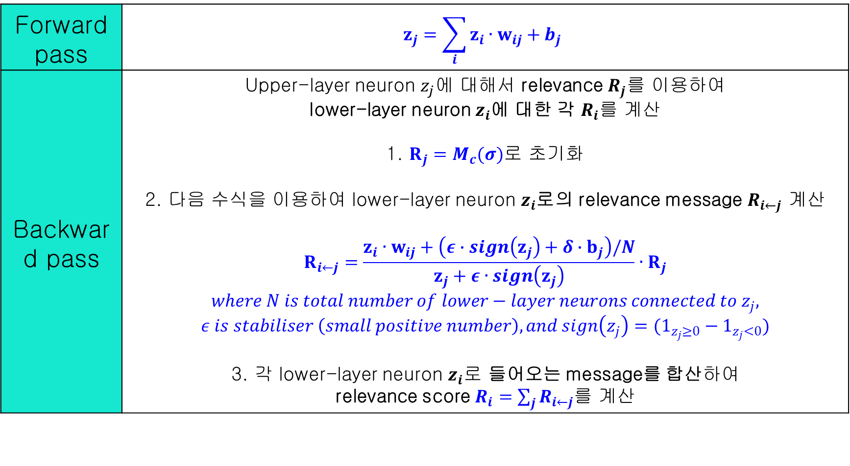
Paper: XNAP: Making LSTM-based Next Activity Predictions Explainable by Using LRP
논문 소개
Layer-wise Relevance Propagation for LSTMs
Many-to-one weighted linear connections
Forward pass | $$z_{j}=\sum_{i}{z_{i}∙w_{ij}+b_{j}}$$
Backward pass | Upper-layer neuron $z_{j}에$ 대해서 relevance $R_{j}를$ 이용하여 lower-layer neuron $z_{i}$에 대한 각 $R_{i}를$ 계산 1. $R_{j}=M_{c}(σ)$로 초기화 2. 다음 수식을 이용하여 lower-layer neuron $z_{i}$로의 relevance message $R_{i←j}$ 계산 $$R_{i←j}=\frac{z_{i}∙w_{ij}+\left(ε∙sign\left(z_{j}\right)+δ∙b_{j}\right)/N}{z_{j}+ε∙sign\left(z_{j}\right)}∙R_{j}$$ $$where N is total number of lower−layer neurons connected to z_{j},$$ $$ε is stabiliser \left(small positive number\right), and sign\left(z_{j}\right)=(1_{z_{j}≥0}−1_{z_{j}<0})$$ 3. 각 lower-layer neuron $z_{i}로$ 들어오는 message를 합산하여 relevance score $R_{i}=\sum_{j}{R_{i←j}}$를 계산

Slide 12
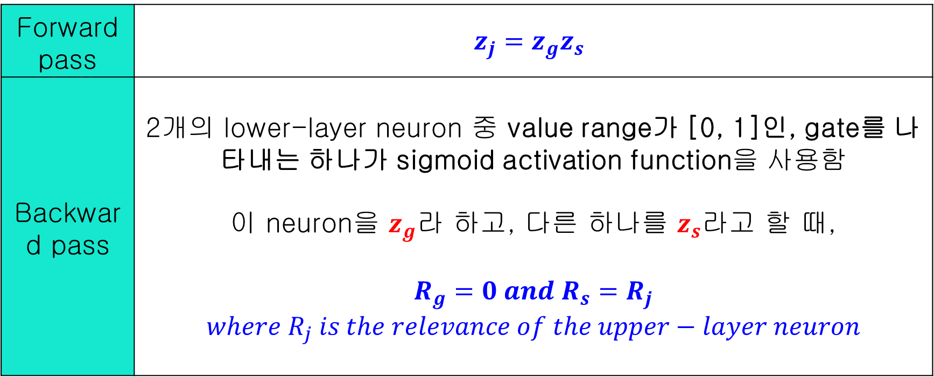
Paper: XNAP: Making LSTM-based Next Activity Predictions Explainable by Using LRP
논문 소개
Layer-wise Relevance Propagation for LSTMs
Two-to-one weighted linear connections
Forward pass | $$z_{j}=z_{g}z_{s}$$
Backward pass | 2개의 lower-layer neuron 중 value range가 [0, 1]인, gate를 나타내는 하나가 sigmoid activation function을 사용함 이 neuron을 $z_{g}$라 하고, 다른 하나를 $z_{s}$라고 할 때, $$R_{g}=0 and R_{s}=R_{j}$$ $$where R_{j} is the relevance of the upper−layer neuron$$

Slide 13
Paper: XNAP: Making LSTM-based Next Activity Predictions Explainable by Using LRP
논문 소개
XNAP: Explainable Next Activity Prediction
Offline component: 예측 모델은 과거의 event log로부터 Bi-LSTM DNN을 적용하여 학습
Online component: 학습된 모델은 다음 행동에 대한 예측에 쓰임
학습된 예측 모델에서 LRP는 각 activity의 relevance 값을 결정

Slide 14
Paper: XNAP: Making LSTM-based Next Activity Predictions Explainable by Using LRP
논문 소개
XNAP: Explainable Next Activity Prediction
Offline component
Pre-processing | Event log L을 data tensor X와 label matrix Y로 변환
Model Learning | Bi-LSTM model을 이용하여 학습 이 모델은 전처리 단계에서의 data tensor X와 label matrix Y에 기반하여 prefix들을 next activity label들로 mapping시킴

Slide 15
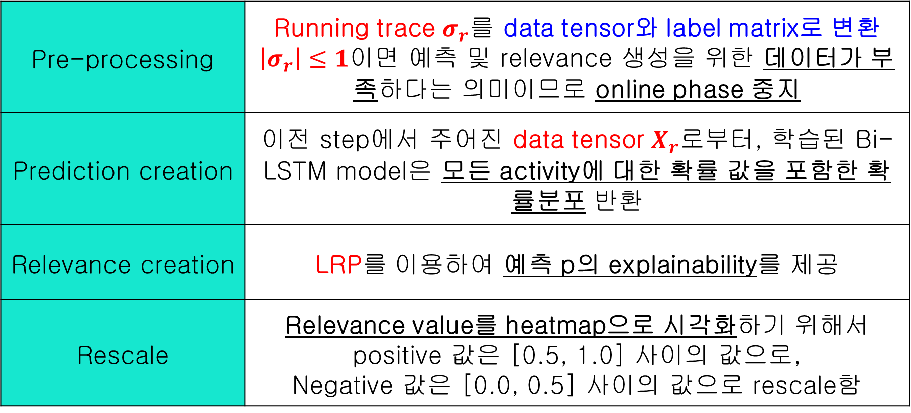
Paper: XNAP: Making LSTM-based Next Activity Predictions Explainable by Using LRP
논문 소개
XNAP: Explainable Next Activity Prediction
Online component
Pre-processing | Running trace $σ_{r}를$ data tensor와 label matrix로 변환 $\left|σ_{r}\right|≤1$이면 예측 및 relevance 생성을 위한 데이터가 부족하다는 의미이므로 online phase 중지
Prediction creation | 이전 step에서 주어진 data tensor $X_{r}로$부터, 학습된 Bi-LSTM model은 모든 activity에 대한 확률 값을 포함한 확률분포 반환
Relevance creation | LRP를 이용하여 예측 p의 explainability를 제공
Rescale | Relevance value를 heatmap으로 시각화하기 위해서 positive 값은 [0.5, 1.0] 사이의 값으로, Negative 값은 [0.0, 0.5] 사이의 값으로 rescale함

Slide 16
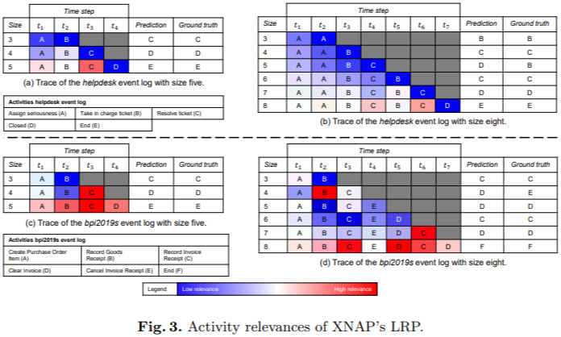
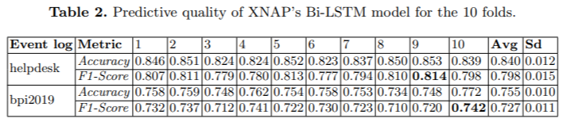
Paper: XNAP: Making LSTM-based Next Activity Predictions Explainable by Using LRP
논문 소개
XNAP: Explainable Next Activity Prediction
실험 결과

Slide 17
Github
https://github.com/WannaBeSuperteur/2020/tree/master/

