Slide 1
Weekly Report
2021.01.13
Hongsik Kim
Mobile & Network Intelligence Laboratory

Slide 2
WPCN: Paper
Deep Learning-Based Optimal Placement of a Mobile HAP for Common Throughput Maximization in Wireless Powered Communication Networks
Implementation: WPCN-UAV

Slide 3
Current Status
주간 진행 사항
논문 제출: Deep Learning-Based Optimal Placement of a Mobile HAP for Common Throughput Maximization in Wireless Powered Communication Networks
논문 제출 (Eurasip JWCN)
구현: WPCN-UAV
Minimum Throughput Maximization for Multi-UAV Enabled WPCN: A Deep Reinforcement Learning Method
https://ieeexplore.ieee.org/stamp/stamp.jsp?arnumber=8950047&tag=1
오류 해결

Slide 4
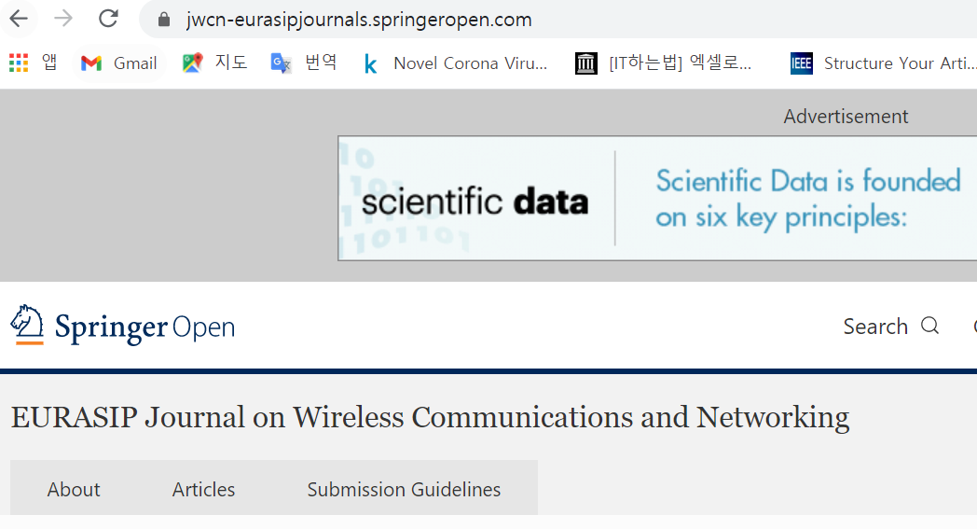
Current Status
Paper Submission
Eurasip JWCN:
https://jwcn-eurasipjournals.springeropen.com/

Slide 5
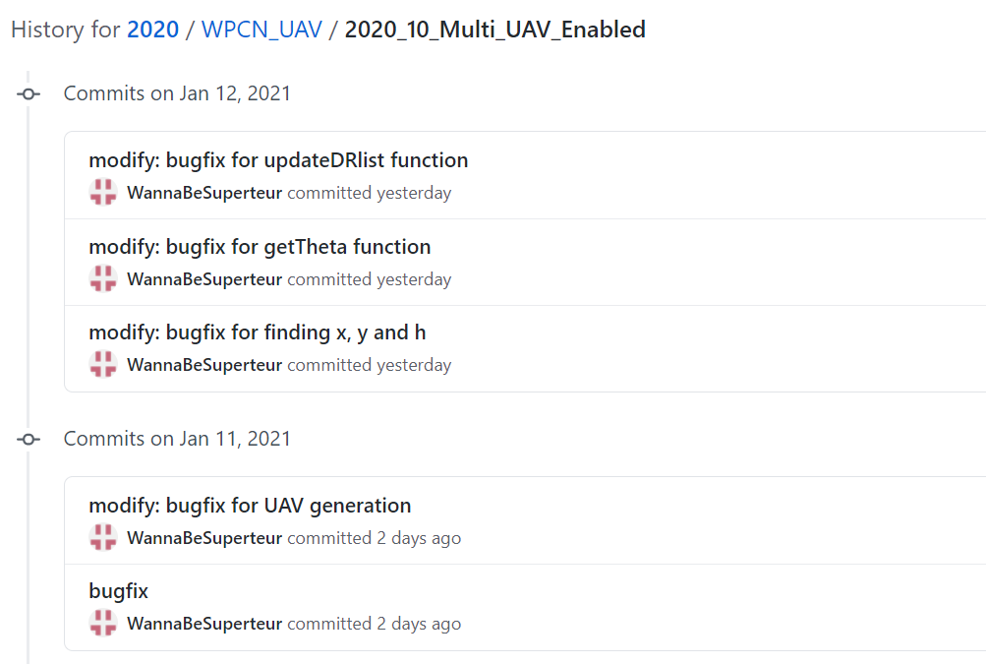
Current Status
Implementation of WPCN-UAV (bugfix)

Slide 6
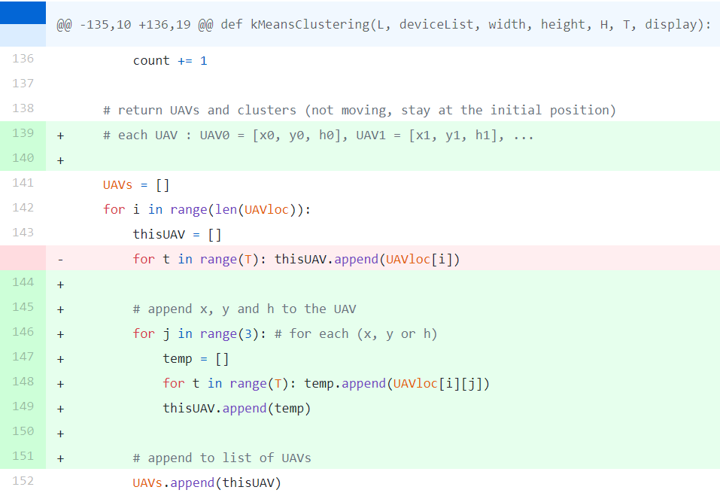
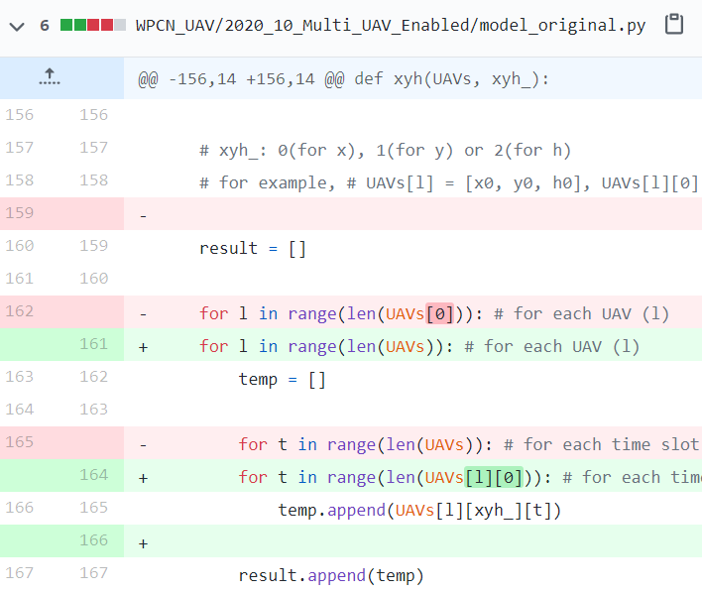
Current Status
Implementation of WPCN-UAV
UAV generation (K-means clustering) 함수에 대한 bugfix

Slide 7
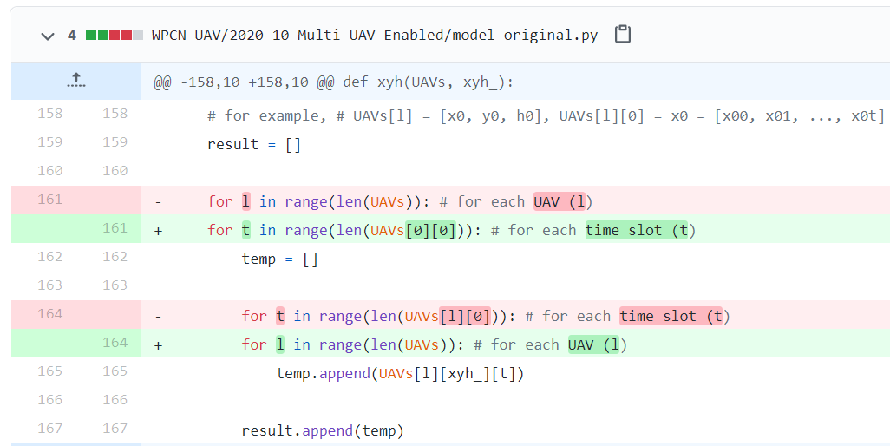
Current Status
Implementation of WPCN-UAV
UAV의 x, y, h 좌표를 가져오는 함수 (xyh) 의 bugfix

Slide 8
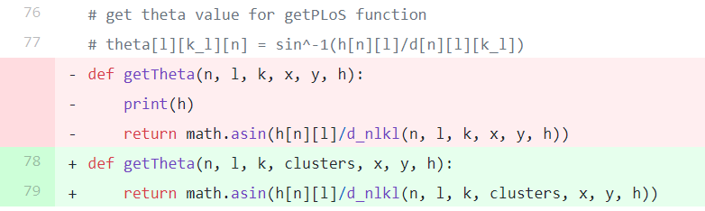
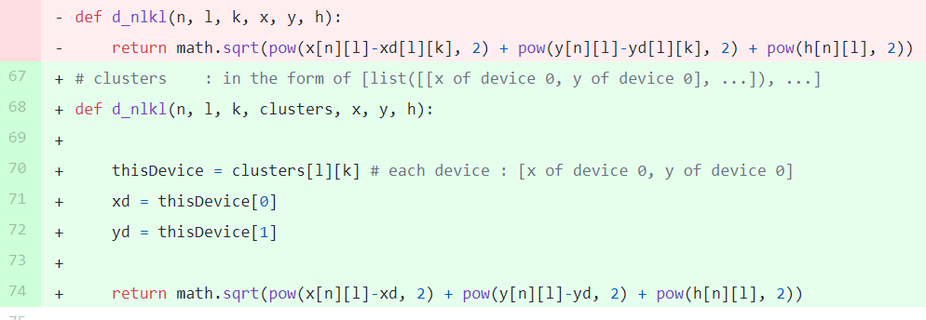
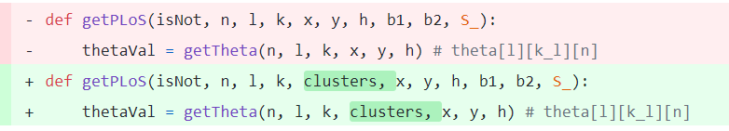
Current Status
Implementation of WPCN-UAV
getTheta 함수 관련 오류 해결

Slide 9
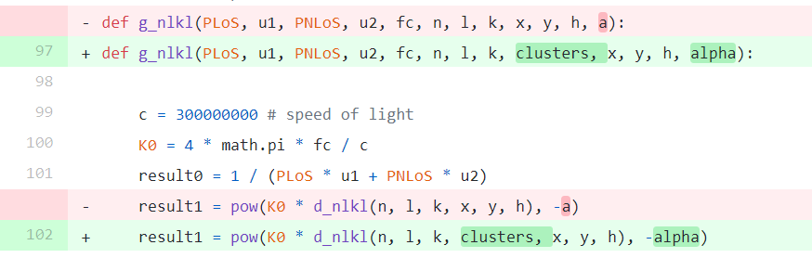
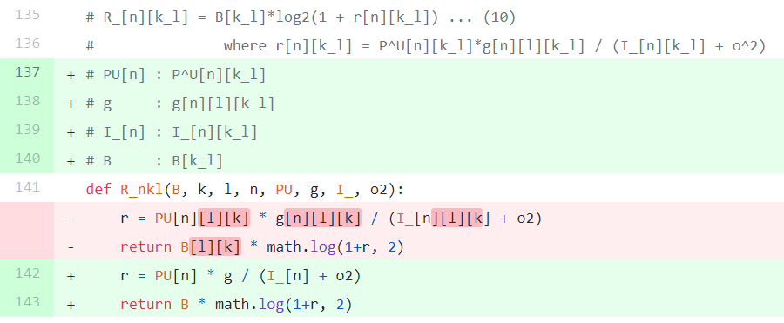
Current Status
Implementation of WPCN-UAV
updateDRlist 함수 관련 오류 해결

Slide 10
Github
https://github.com/WannaBeSuperteur/2020/tree/master/WPCN

