Slide 1
Weekly Report
2020.11.13
Hongsik Kim
Mobile & Network Intelligence Laboratory

Slide 2
AI Explanable AI
Kaggle 진행 상황
논문: Black Box Attacks on Explainable Artificial Intelligence (XAI) methods in Cyber Security

Slide 3
Current Status
주간 진행 사항
Kaggle 진행
Conway’s Reverse Game of Life
https://www.kaggle.com/c/conway-s-reverse-game-of-life/overview
논문 학습
Black Box Attacks on Explainable Artificial Intelligence (XAI) methods in Cyber Security
https://ieeexplore.ieee.org/stamp/stamp.jsp?arnumber=9206780

Slide 4
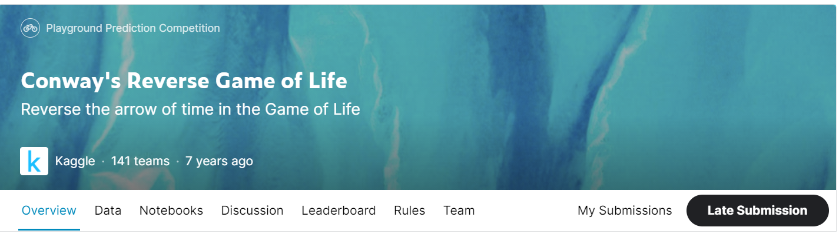
Kaggle Competition
Conway’s Reverse Game of Life
https://www.kaggle.com/c/conway-s-reverse-game-of-life/overview

Slide 5
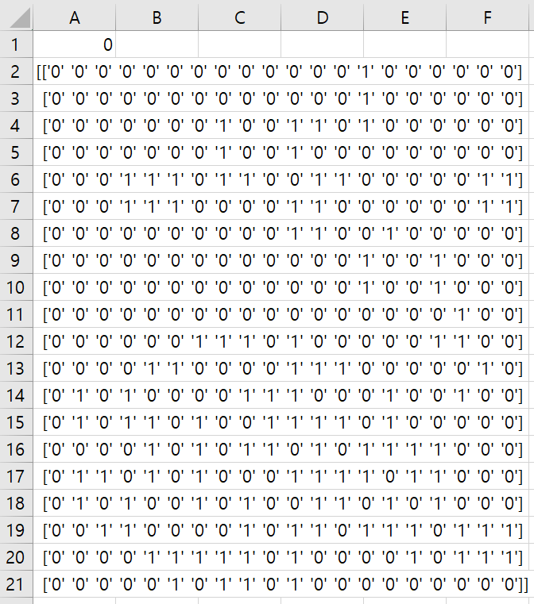
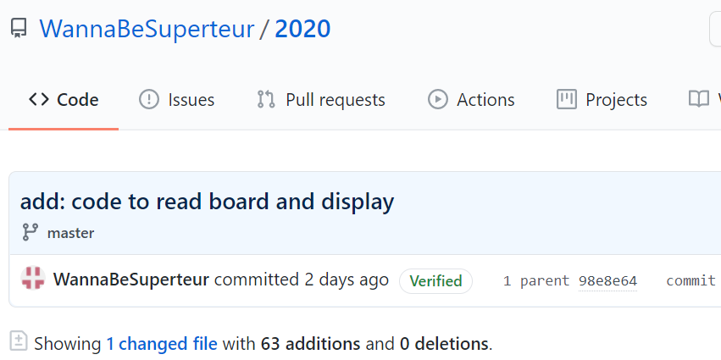
Kaggle Competition
배열이 저장된 text 파일로부터 배열 읽기
텍스트 파일 shape (400) -> 표시할 때 shape (20, 20)으로 변환

Slide 6
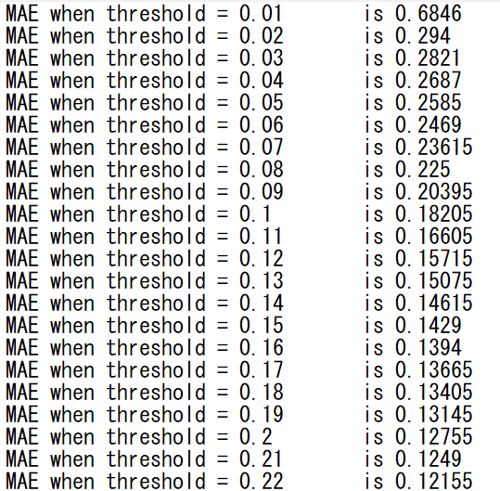
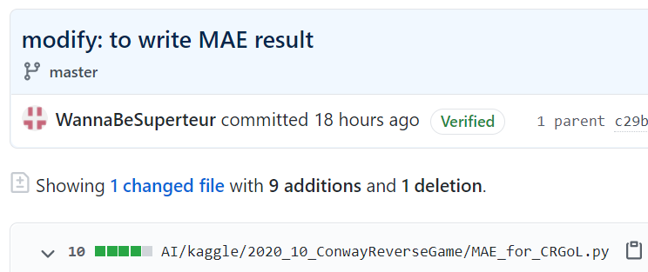
Kaggle Competition
배열이 저장된 text 파일로부터 배열 읽기
MAE 측정 결과를 파일로 쓰는 코드 작성

Slide 7
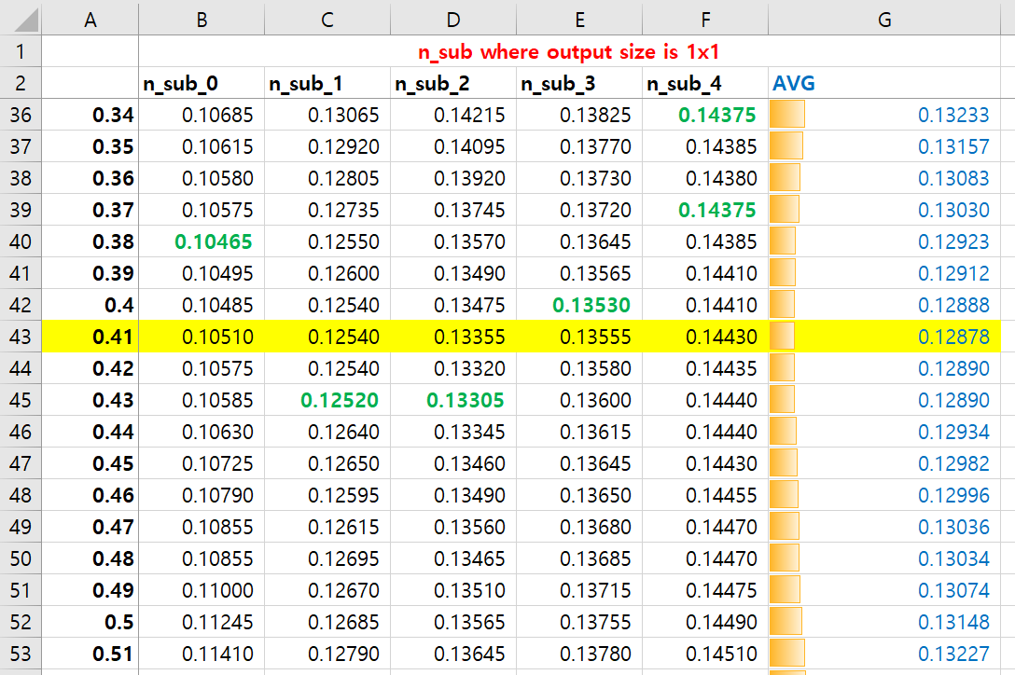
Kaggle Competition
배열이 저장된 text 파일로부터 배열 읽기
MAE 측정 결과 분석
X
Result >= X
Then live
Result < X
Then dead

Slide 8
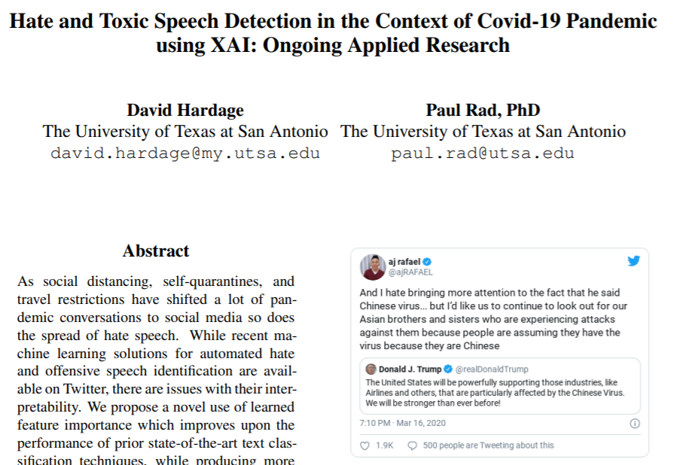
Paper: Hate and Toxic Speech Detection in the Context of Covid-19 using XAI
논문 소개
Hate and Toxic Speech Detection in the Context of Covid-19 Pandemic using XAI: Ongoing Applied Research https://openreview.net/pdf?id=OLoP-Q2Wu4o

Slide 9
Paper: Hate and Toxic Speech Detection in the Context of Covid-19 using XAI
Explanability and Text Classification
다음과 같은 연구에서 integrated gradient를 통해 explanability를 유도함
(Sundararajan et al., 2017), (Liu and Avci, 2019)
SHAP은 더 많이 쓰이는 explainability method로, feature contribution에 대한 프레임워크를 모델의 출력으로 제공
(Lundberg and Lee, 2017)
SHAP의 Gradient Explainer

Slide 10
Paper: Hate and Toxic Speech Detection in the Context of Covid-19 using XAI
Datasets
목표: 라벨링되지 않은 COVID-19 관련 트윗에 점수를 매기는 것
사용한 dataset:
the collection of racist and sexist tweets presented by Waseem and Hovy (Waseem and Hovy, 2016)
the Offensive Language Identification Dataset (OLID) (Zampieri et al., 2019)
Multilingual Detection of Hate Speech Against Immigrants and Women in Twitter (HatEval) (Basile et al., 2019)
사용한 COVID-19 관련 트윗:
Texas Advanced Computing Center (TAAC) at the University of Texas at Austin
Georgia State University’s Panacea Lab (Banda et al., 2020)

Slide 11
Paper: Hate and Toxic Speech Detection in the Context of Covid-19 using XAI
Experiment Design – Text Classifier
Hate speech classification을 위해서 증명된 방법론 사용
모든 tweet은 Glove Twitter Embedding으로 변환됨
Random Search를 통한 Parameter Tuning 가능
모델의 용도
Baseline model
XAI를 이용하여 향상된 prediction의 input prediction

Slide 12
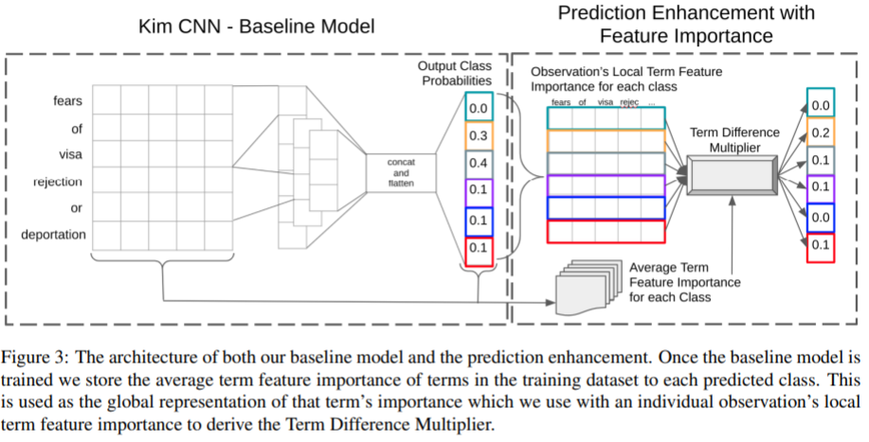
Paper: Hate and Toxic Speech Detection in the Context of Covid-19 using XAI
Experiment Design – Text Classifier
75개의 fliter를 갖는 kernel size 3, 4, 6의 CNN
1d max pooling, dropout rate=0.4
Output layer는 L2 regularization 0.029의 softmax layer

Slide 13
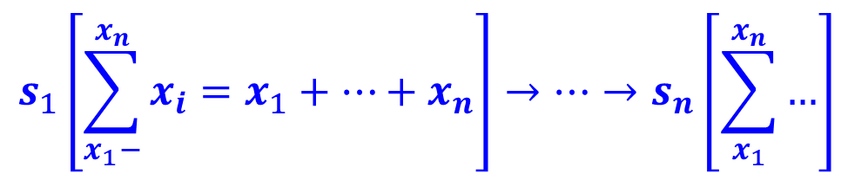
Paper: Hate and Toxic Speech Detection in the Context of Covid-19 using XAI
Experiment Design – Calculating Global Average Feature Importance
SHAP의 Gradient Explainer를 Baseline Model에 적용
Gradient Explainer의 출력은 Glove Embedded Data와 차원이 같으므로, 축소하여 input text sequence와 차원 일치 가능
따라서 expected gradient를 각 sequence의 term에 대응되는 axis를 이용하여 summation 가능
$$s_{1}\left[\sum_{x_{1}−}^{x_{n}}{x_{i}}=x_{1}+…+x_{n}\right]→…→s_{n}\left[\sum_{x_{1}}^{x_{n}}{…}\right]$$
S: 각 sequence에 대한 token
X: embedding dimension에 대한 모든 expected gradient의 합

Slide 14

Paper: Hate and Toxic Speech Detection in the Context of Covid-19 using XAI
Experiment Design – Enhancing Predictions with Term Difference Multiplier
각 용어의 local feature importance와 global feature importance의 percentage difference를 각 class에 대해 계산
각 sequence에 의해 average되고, 각 class에 의해 예측된 확률에는 local term difference multiplier가 곱해짐
Local attribution 값이 global mean과의 거리에 의해 penalize된, probability score에 대한 예측값 출력
$$1−\left(\frac{\left|s_{g}−s_{l}\right|}{\left[\frac{s_{g}+s_{l}}{2}\right]}\right)$$
$$where s_{l} is local feature importance$$
$$and s_{g} is global feature importance$$

Slide 15
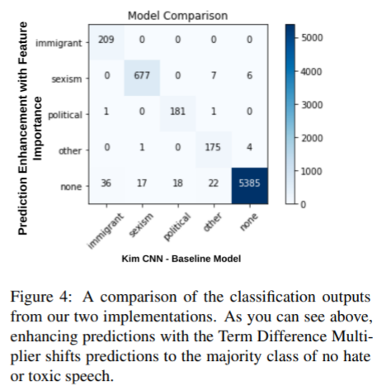
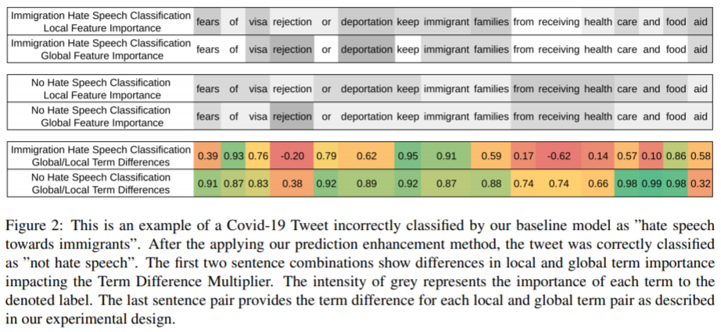
Paper: Hate and Toxic Speech Detection in the Context of Covid-19 using XAI
Results and Applications to COVID-19 tweets
(Global, Local feature importance score에 대한
Relative neutrality)

Slide 16
Github
https://github.com/WannaBeSuperteur/2020/tree/master/

