Slide 1
Weekly Report
2020.08.04
Hongsik Kim
Mobile & Network Intelligence Laboratory

Slide 2
WPCN: Paper
Placement Optimization of Energy and Information Access Points in Wireless Powered Communication Networks Suzhi Bi, Member, IEEE and Rui Zhang, Senior Member, IEEE 개선 논문 작성

Slide 3
Current Status
주간 진행 사항
Placement Optimization of Energy and Information Access Points in Wireless Powered Communication Networks 개선 논문 최종 완성
(UAV WPCN 관련 논문 요약)

Slide 4
Current Status
논문 최종 작성
https://journals.ieeeauthorcenter.ieee.org/create-your-ieee-journal-article/create-the-text-of-your-article/structure-your-article/#keywords 를 참고하여 논문 최종 수정
논문 최종 작성 1: (~2020.07.28)
https://github.com/WannaBeSuperteur/2020/commit/2ca27b985cfc380c60694b92619ad9c9126a6001#diff-e3266338e0688f1cd64accfa4bc5d4cb
논문 최종 작성 2: (~2020.07.30)
https://github.com/WannaBeSuperteur/2020/commit/6d5d9401e0ea13bd9f7db58e39a57819da85e259#diff-e3266338e0688f1cd64accfa4bc5d4cb

Slide 5
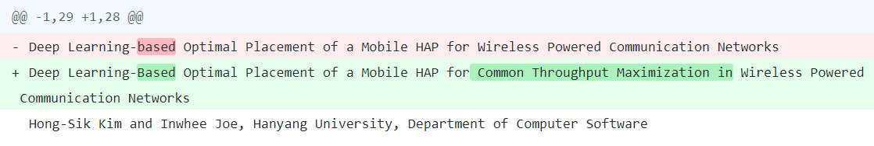
Current Status
논문 최종 작성 1 (~2020.07.28)
제목 변경
키워드 추가

Slide 6
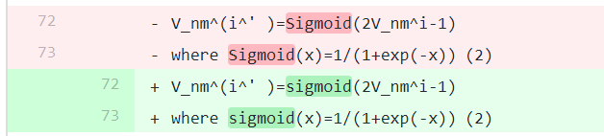
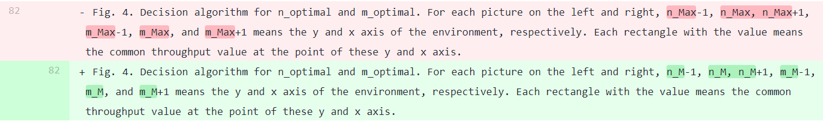
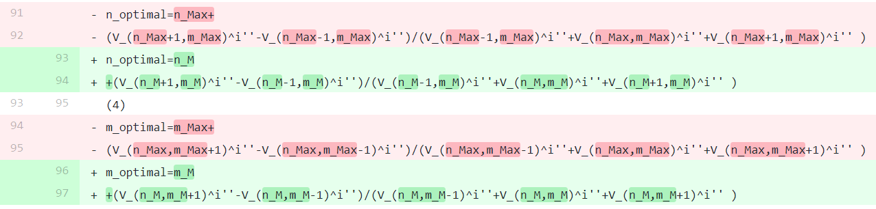
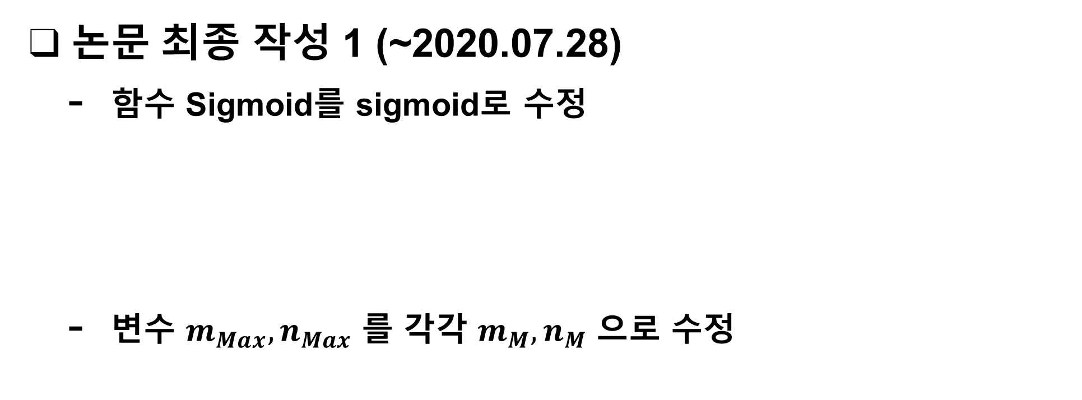
Current Status
논문 최종 작성 1 (~2020.07.28)
함수 Sigmoid를 sigmoid로 수정
변수 $m_{Max}, n_{Max}$ 를 각각 $m_{M}, n_{M}$ 으로 수정

Slide 7
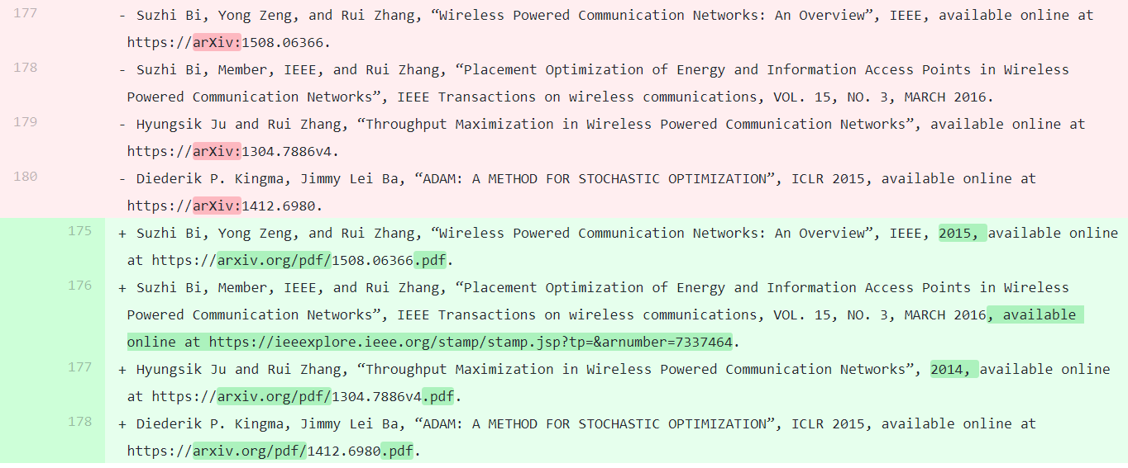
Current Status
논문 최종 작성 1 (~2020.07.28)
참고문헌 표기 일부 변경

Slide 8



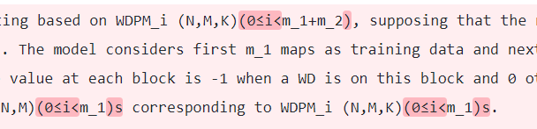
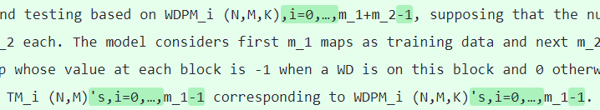
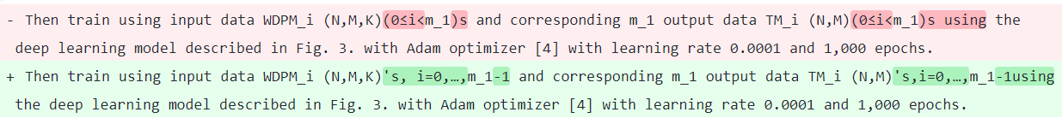
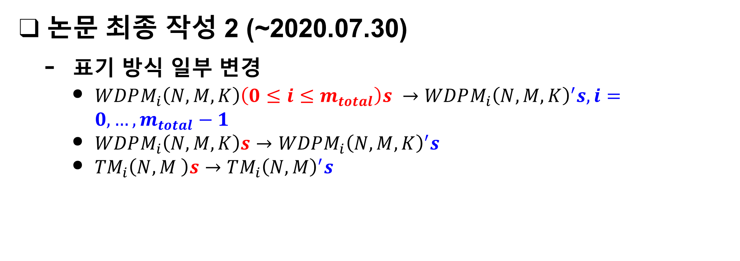
Current Status
논문 최종 작성 2 (~2020.07.30)
표기 방식 일부 변경
$WDPM_{i}\left(N,M,K\right)\left(0≤i≤m_{total}\right)s →WDPM_{i}{\left(N,M,K\right)}^{′}s, i=0,…,m_{total}−1$
$WDPM_{i}\left(N,M,K\right)s→WDPM_{i}{\left(N,M,K\right)}^{′}s$
${TM}_{i}\left(N,M \right)s→TM_{i}{\left(N,M\right)}^{′}s$

Slide 9
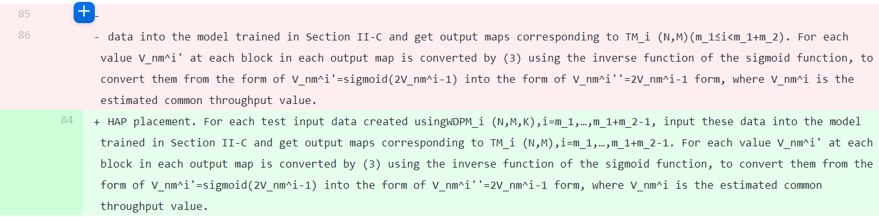
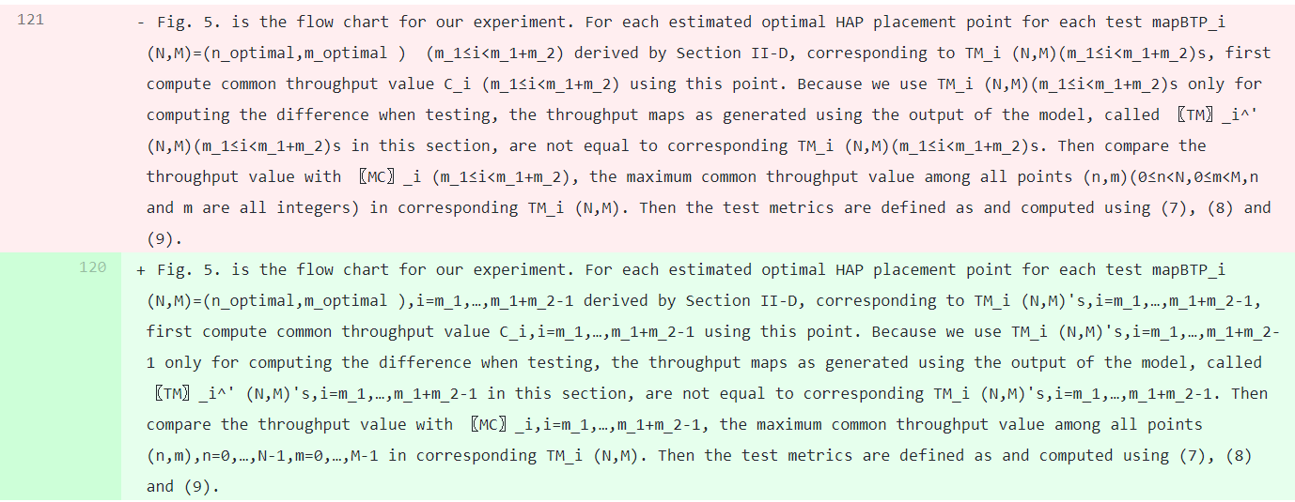
Current Status
논문 최종 작성 2 (~2020.07.30)
표기 방식 일부 변경 (Cont.)

Slide 10
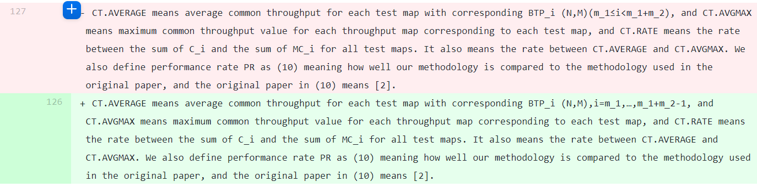
Current Status
논문 최종 작성 2 (~2020.07.30)
표기 방식 일부 변경 (Cont.)

Slide 11
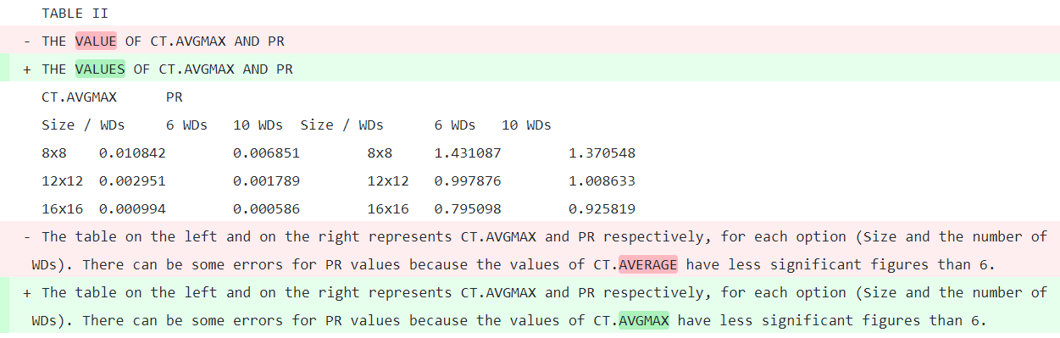
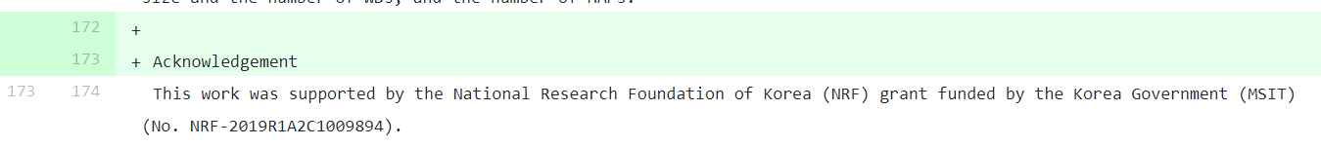
Current Status
논문 최종 작성 2 (~2020.07.30)
일부 추가적인 수정

Slide 12
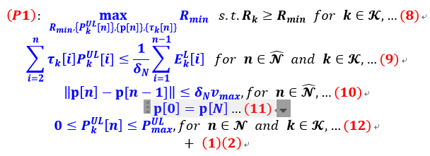
Current Status
UAV-Aided WPCN 관련 논문 요약
Problem 1. minimum throughput performance for INTEGRATED UAV WPCN

Slide 13
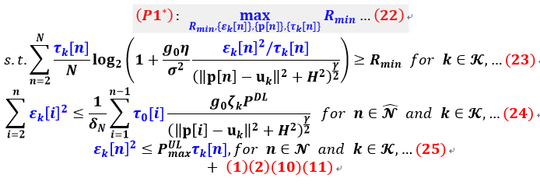
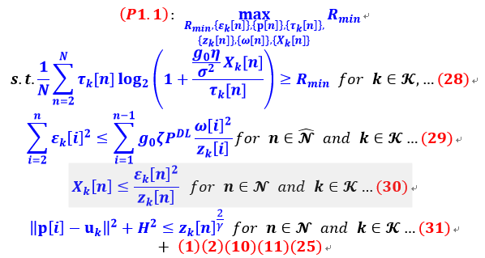
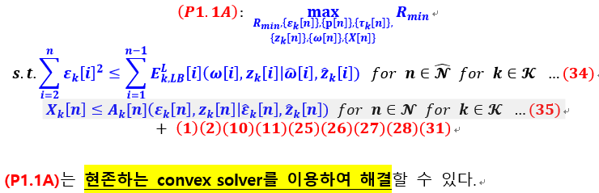
Current Status
UAV-Aided WPCN 관련 논문 요약
Problem 1. minimum throughput performance for INTEGRATED UAV WPCN - Solutions

Slide 14
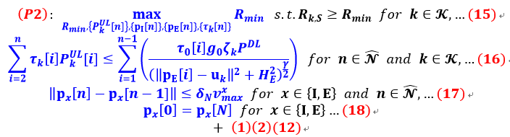
Current Status
UAV-Aided WPCN 관련 논문 요약
Problem 2. minimum throughput performance for SEPARATED UAV WPCN

Slide 15
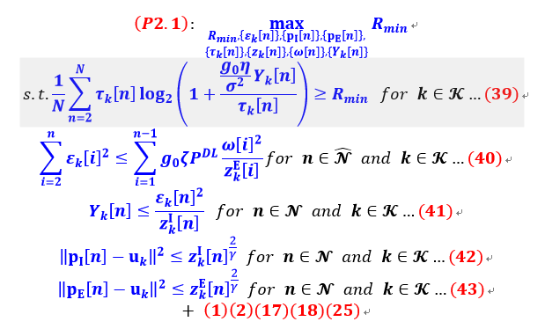
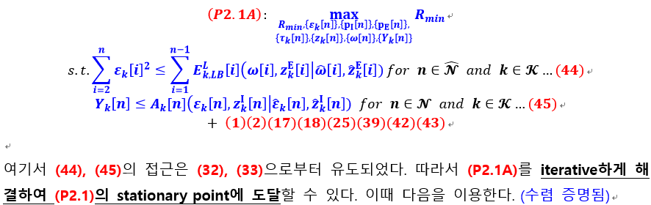
Current Status
UAV-Aided WPCN 관련 논문 요약
Problem 2. minimum throughput performance for SEPARATED UAV WPCN - Solutions

Slide 16
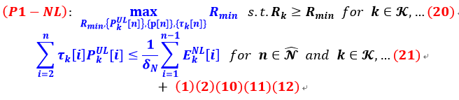
Current Status
UAV-Aided WPCN 관련 논문 요약
Problem 1-NL. minimum throughput performance for NON-LINEAR EH MODEL-BASED SYSTEM

Slide 17
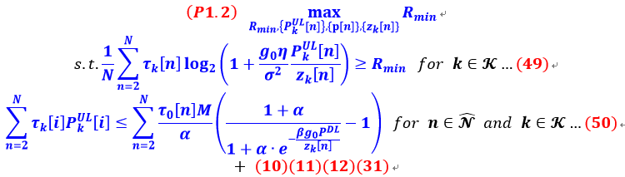
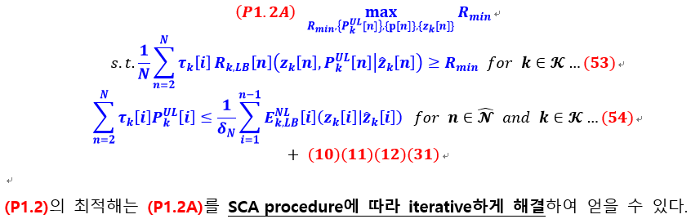
Current Status
UAV-Aided WPCN 관련 논문 요약
Problem 1-NL. minimum throughput performance for NON-LINEAR EH MODEL-BASED SYSTEM - Solutions

Slide 18

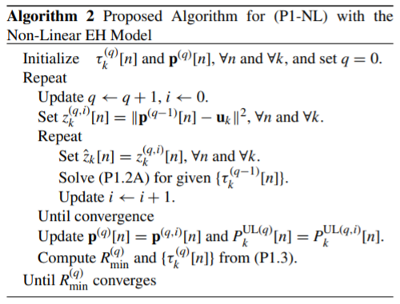
Current Status
UAV-Aided WPCN 관련 논문 요약
Time Resource Allocation Problem
이미 convex LP이므로 standard LP 최적화 알고리즘으로 해결

Slide 19
Github
https://github.com/WannaBeSuperteur/2020/tree/master/WPCN

