Slide 1
Weekly Report
2020.11.03
Hongsik Kim
Mobile & Network Intelligence Laboratory

Slide 2
WPCN: Paper
Revising: Deep Learning-Based Optimal Placement of a Mobile HAP for Common Throughput Maximization in Wireless Powered Communication Networks
Implementation: Minimum Throughput Maximization for Multi-UAV Enabled WPCN: A Deep Reinforcement Learning Method

Slide 3
Current Status
주간 진행 사항
논문 수정: Deep Learning-Based Optimal Placement of a Mobile HAP for Common Throughput Maximization in Wireless Powered Communication Networks
논문의 reject 메일 확인 및 원인 파악
해결 가능한 사항에 대한 해결
해결하기 어려운 사항의 경우 관련 논문에서 해당 부분을 파악
ORCID 등록
논문 구현: Minimum Throughput Maximization for Multi-UAV Enabled WPCN: A Deep Reinforcement Learning Method
각종 함수 작성

Slide 4
Current Status
논문 수정: Deep Learning-Based Optimal Placement of a Mobile HAP for Common Throughput Maximization in Wireless Powered Communication Networks
논문의 reject 메일 확인 및 reject 원인 파악
원인 | 해결 가능성
연구 깊이의 부족 일부 경우에서만 성능 향상 | 낮음
모델링과 수학적 엄밀성 부족 | 복잡한 수학적 모델 – 낮음 변수의 정의 및 설명 부족 – 높음 Wireless Channel Model 설명 부족 - 높음
Presentation의 부족 | 수학적 변수의 정의 부족 – 높음 Variable의 형식의 consistency 부족 – 높음
분석의 부족 | 관련 논문 탐색 필요

Slide 5
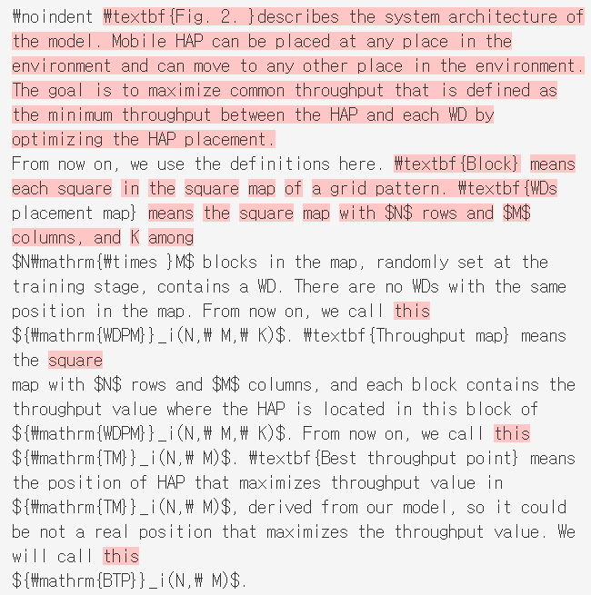
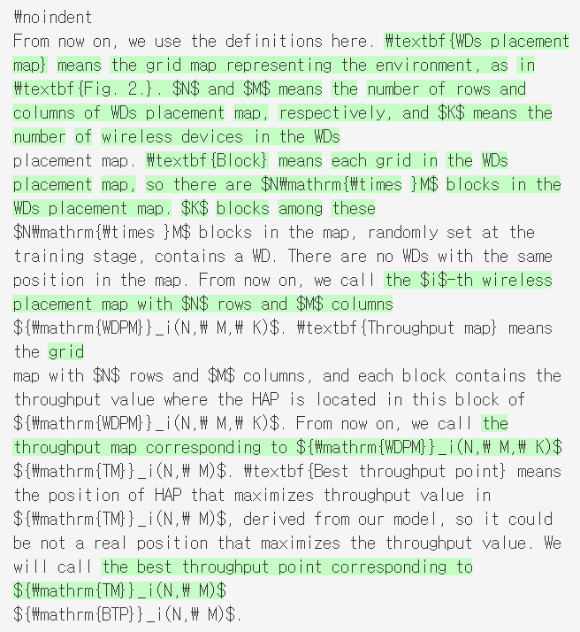
Current Status
논문 수정: Deep Learning-Based Optimal Placement of a Mobile HAP for Common Throughput Maximization in Wireless Powered Communication Networks
해결 가능한 사항에 대한 해결 : 수학적 변수의 정의(엄밀성) 및 설명 부족

Slide 6
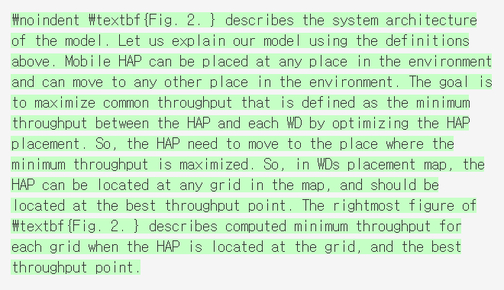
Current Status
논문 수정: Deep Learning-Based Optimal Placement of a Mobile HAP for Common Throughput Maximization in Wireless Powered Communication Networks
해결 가능한 사항에 대한 해결 : Wireless Channel Model 설명 부족

Slide 7
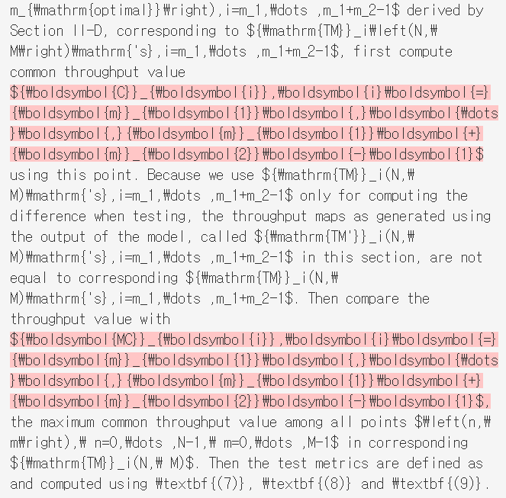
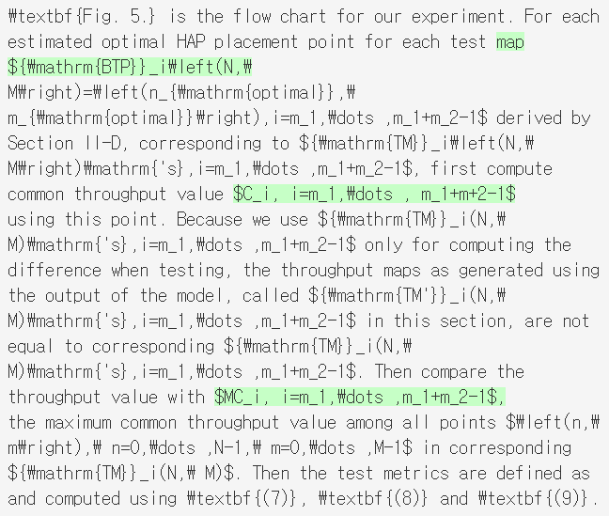
Current Status
논문 수정: Deep Learning-Based Optimal Placement of a Mobile HAP for Common Throughput Maximization in Wireless Powered Communication Networks
해결 가능한 사항에 대한 해결 : Variable의 형식의 consistency 부족

Slide 8
Current Status
논문 수정: Deep Learning-Based Optimal Placement of a Mobile HAP for Common Throughput Maximization in Wireless Powered Communication Networks
분석의 부족 – 관련 논문 탐색
Ultra-Dense LEO Satellite Offloading for Terrestrial Networks: How Much to Pay the Satellite Operator?
https://ieeexplore.ieee.org/stamp/stamp.jsp?tp=&arnumber=9120329&tag=1
Power Allocation in Multi-User Cellular Networks: Deep Reinforcement Learning Approaches
https://ieeexplore.ieee.org/stamp/stamp.jsp?tp=&arnumber=9120241

Slide 9
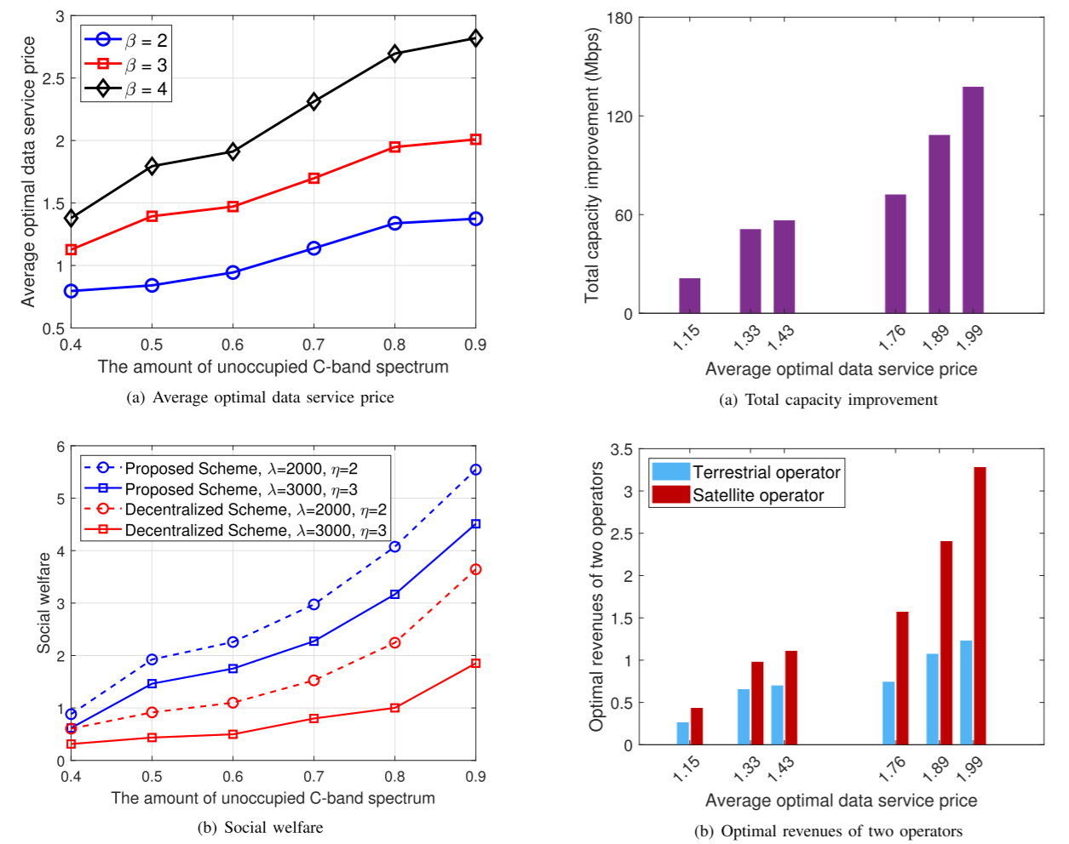
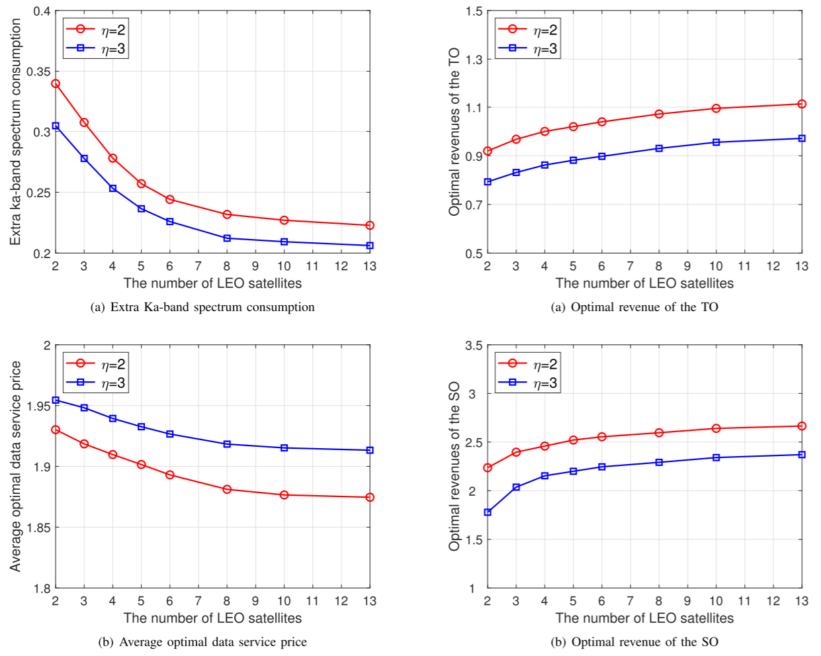
Current Status
논문 수정: Deep Learning-Based Optimal Placement of a Mobile HAP for Common Throughput Maximization in Wireless Powered Communication Networks
Ultra-Dense LEO Satellite Offloading for Terrestrial Networks: How Much to Pay the Satellite Operator?

Slide 10
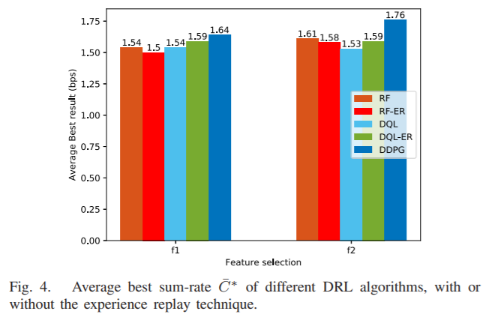
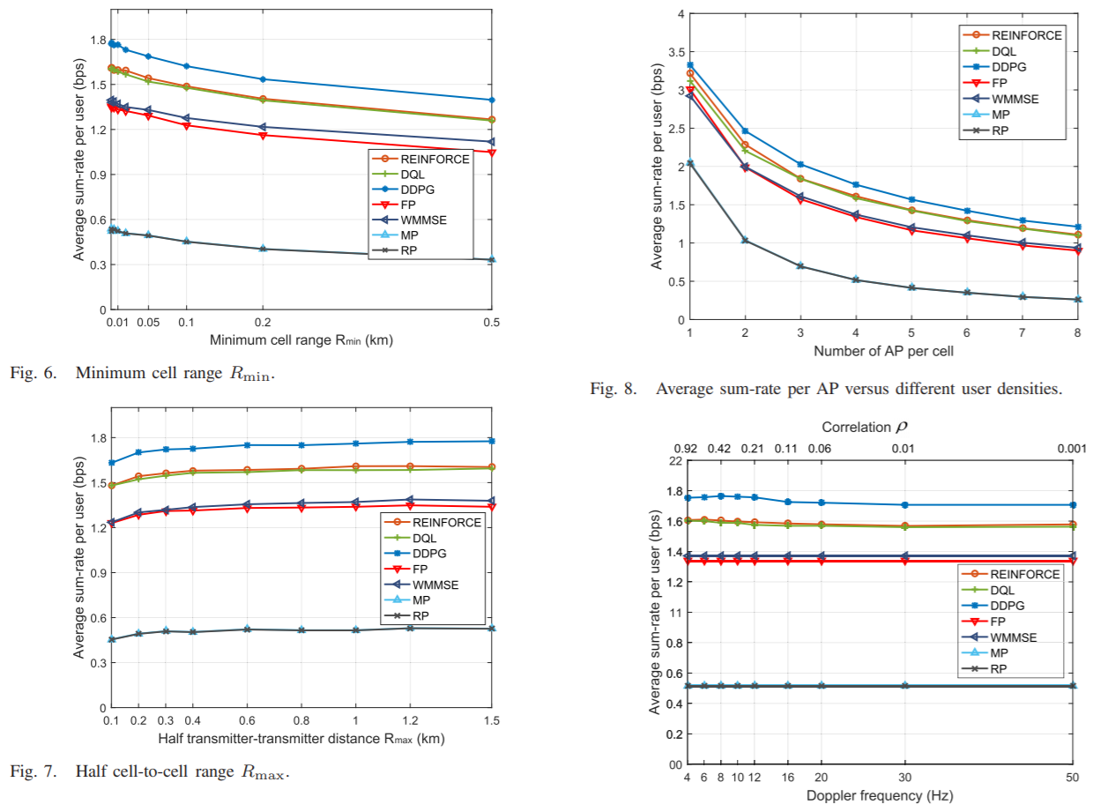
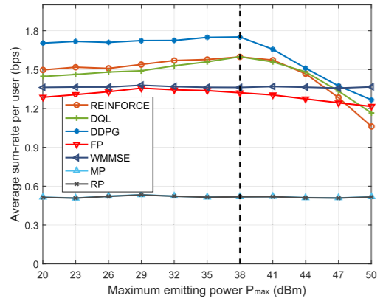
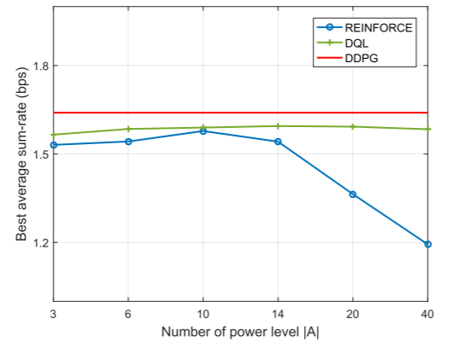
Current Status
논문 수정: Deep Learning-Based Optimal Placement of a Mobile HAP for Common Throughput Maximization in Wireless Powered Communication Networks
Power Allocation in Multi-User Cellular Networks: Deep Reinforcement Learning Approaches

Slide 11

Current Status
ORCID 등록
https://orcid.org/my-orcid

Slide 12
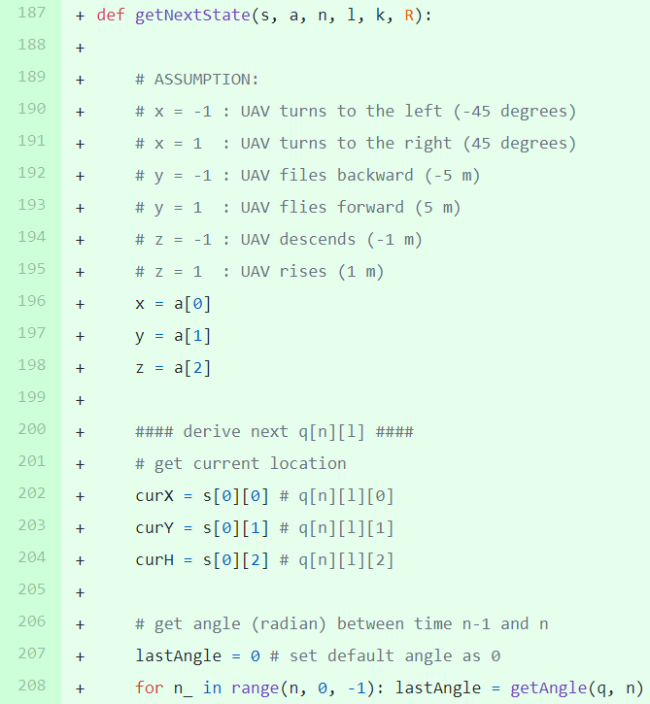
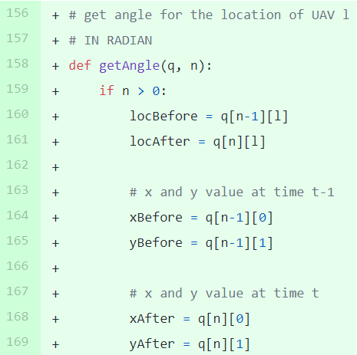
Current Status
논문 구현: Minimum Throughput Maximization for Multi-UAV Enabled WPCN: A Deep Reinforcement Learning Method
함수 작성: 다음 상태(next state)를 찾는 함수

Slide 13
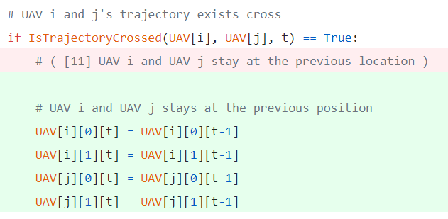
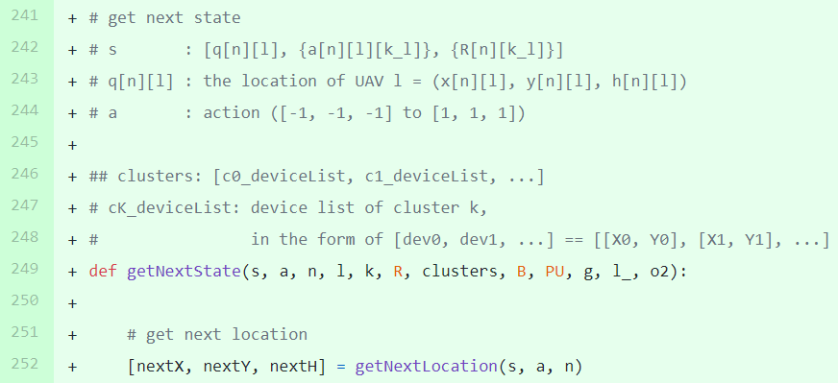
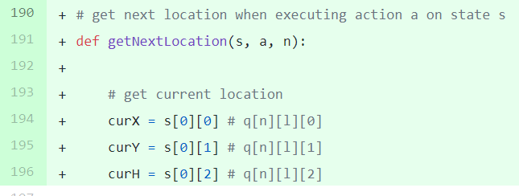
Current Status
논문 구현: Minimum Throughput Maximization for Multi-UAV Enabled WPCN: A Deep Reinforcement Learning Method
UAV i, UAV j의 trajectory가 교차하는 경우 직전 지점으로 이동
getNextState 함수의 일부를 getNextLocation 함수로 분리

Slide 14
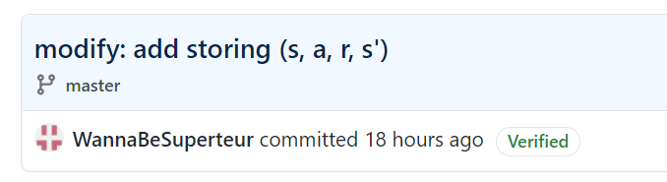
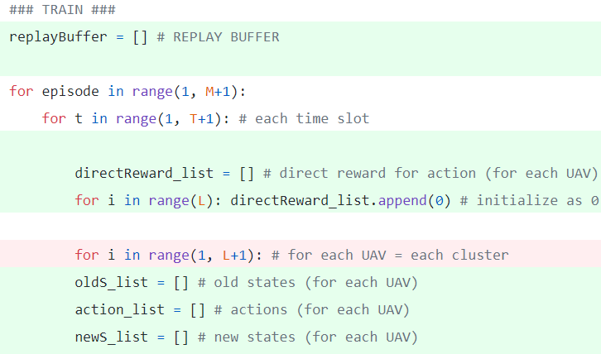
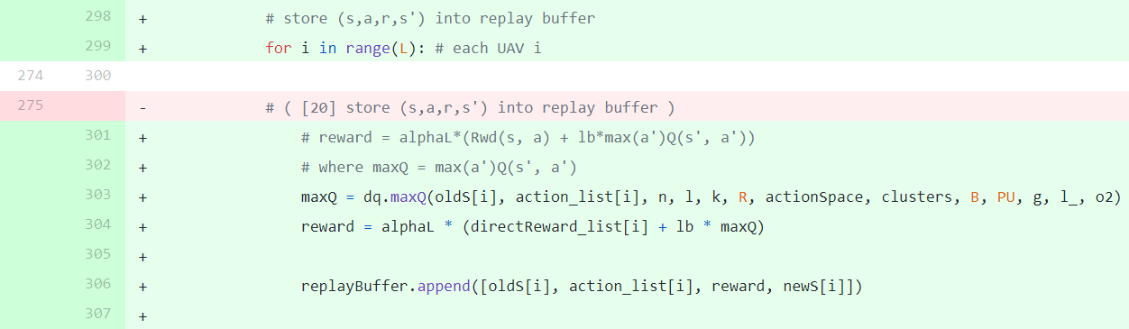
Current Status
논문 구현: Minimum Throughput Maximization for Multi-UAV Enabled WPCN: A Deep Reinforcement Learning Method
(s, a, r, s’)를 저장하는 부분 추가

Slide 15
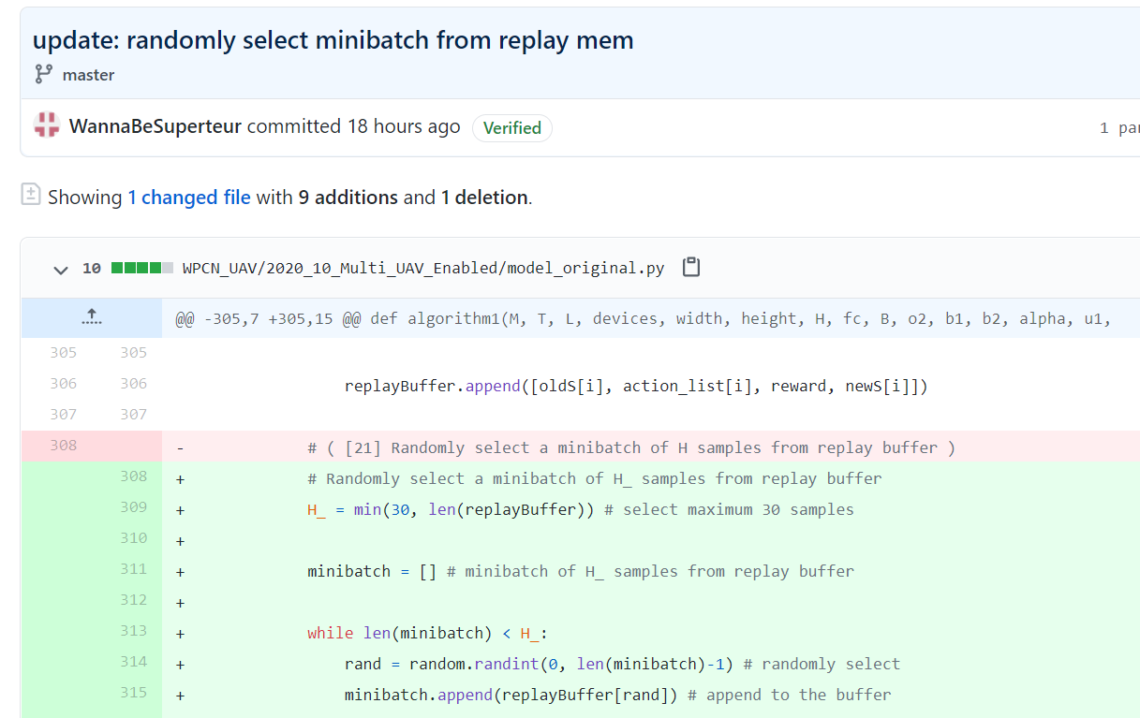
Current Status
논문 구현: Minimum Throughput Maximization for Multi-UAV Enabled WPCN: A Deep Reinforcement Learning Method
Replay memory (Replay buffer)에서 랜덤하게 minibatch를 선택하는 부분 추가

Slide 16
Github
https://github.com/WannaBeSuperteur/2020/tree/master/WPCN

