Slide 1
Weekly Report
2020.04.14
Hongsik Kim
Mobile & Network Intelligence Laboratory

Slide 2
DTN Security using AI
Trust based Intelligent Routing Algorithm for Delay Tolerant Network using Artificial Neural Network
Design of efficient lightweight strategies to combat DoS attack in delay tolerant network routing
APPLICATION OF MACHINE LEARNING TECHNIQUES TO DELAY TOLERANT NETWORK ROUTING

Slide 3
Current Status
주간 진행 사항
논문 읽기: Trust based Intelligent Routing Algorithm for Delay Tolerant Network using Artificial Neural Network, 8 Jan 2016
논문 읽기: Design of efficient lightweight strategies to combat DoS attack in delay tolerant network routing, 29 Jun 2016
논문 읽기: APPLICATION OF MACHINE LEARNING TECHNIQUES TO DELAY TOLERANT NETWORK ROUTING, December 5, 2018

Slide 4
Trust based Intelligent Routing …
DTN에서 각 node의 Trust (신뢰성) 값에 기반하여, 딥 러닝을 이용하여 라우팅을 하는 알고리즘에 대한 논문
Trust Function:
$$f\left(a_{1}\right)= <Time Difference between Recent and Last Connection P_{1},$$
$$Frequency of Calls P_{2}, Total Duration P_{3}>$$

Slide 5
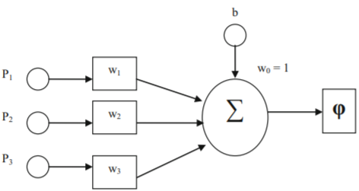
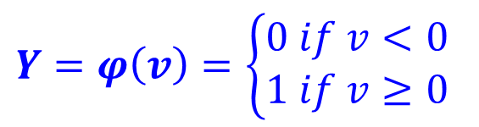





Trust based Intelligent Routing …
신경망 학습 알고리즘:
$$P_{1}W_{1}$$
$$Y=φ\left(v\right)=\left\{\begin{aligned}&0 if v<0 \\ &1 if v≥0\end{aligned}\right.$$
$$P_{2}W_{2}$$
$$v=u+b$$
$$P_{3}W_{3}$$
$$f\left(u\right)=\sum_{i=1}^{3}{P_{i}W_{i}}$$

Slide 6
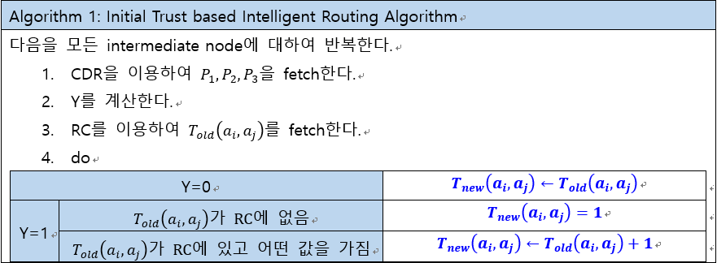
Trust based Intelligent Routing …
관련 알고리즘:

Slide 7
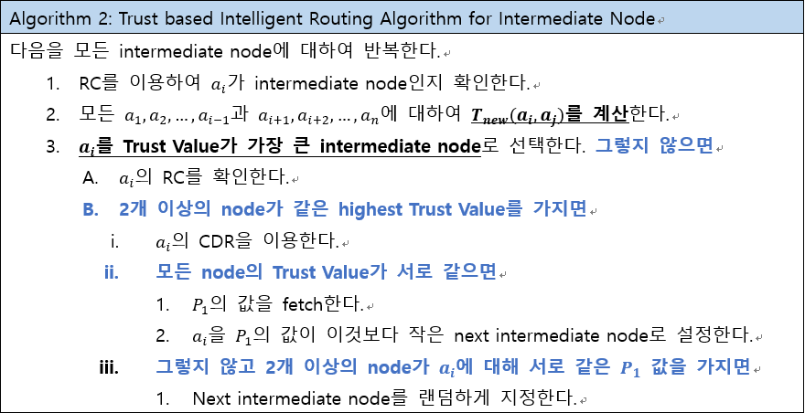
Trust based Intelligent Routing …
관련 알고리즘:

Slide 8
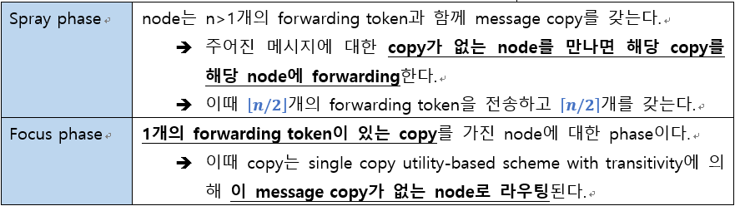
Design of efficient lightweight …
Spray & Focus Routing Protocol을 이용하여 DTN에서 메시지를 전달하는 것에 대한 논문
T
T
T
MC
T
T
MC
node A
node B

Slide 9

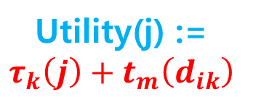
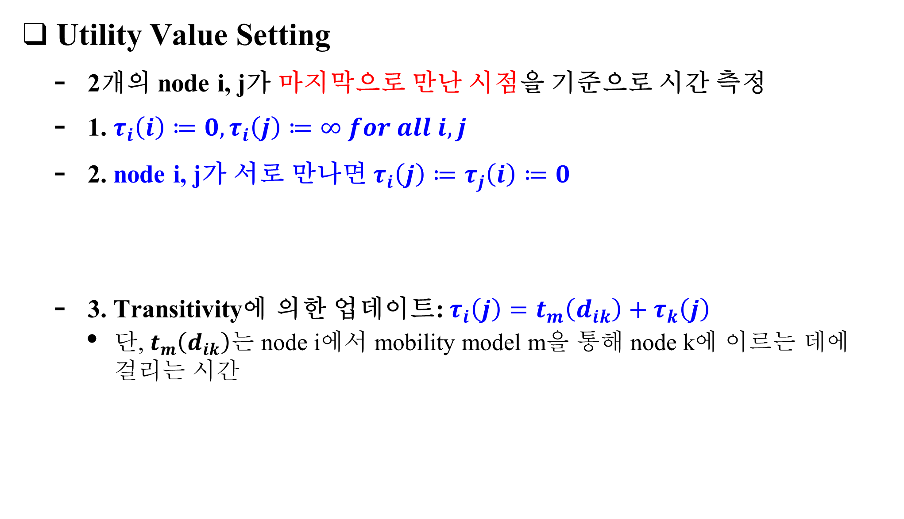



Design of efficient lightweight …
Utility Value Setting
2개의 node i, j가 마지막으로 만난 시점을 기준으로 시간 측정
1. $τ_{i}\left(i\right)≔0, τ_{i}\left(j\right)≔∞ for all i, j$
2. node i, j가 서로 만나면 $τ_{i}\left(j\right)≔τ_{j}\left(i\right)≔0$
3. Transitivity에 의한 업데이트: $τ_{i}\left(j\right)=t_{m}\left(d_{ik}\right)+τ_{k}\left(j\right)$
단, $t_{m}\left(d_{ik}\right)$는 node i에서 mobility model m을 통해 node k에 이르는 데에 걸리는 시간
Utility(j) := 0
Utility(i) := 0
node i
node j
Utility(j) = $τ_{k}\left(j\right)$
node k
Utility(j) :=
$$τ_{k}\left(j\right)+t_{m}\left(d_{ik}\right)$$
mobility modem m
$$τ_{k}\left(j\right)$$
Utility(k) = $τ_{k}\left(j\right)$
$$t_{m}\left(d_{ik}\right)$$
node i
node j

Slide 10
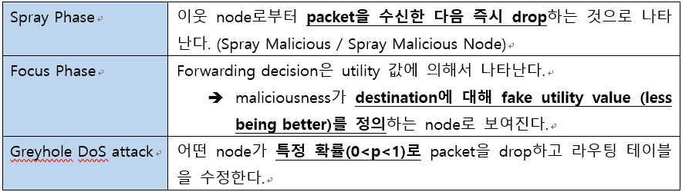
Design of efficient lightweight …
Thread model
Black Hole Denial-of-Service (DoS) 공격
Malicious node는 수신하는 모든 packet을 drop하기 때문에 packet이 더 이상 전송되지 않음
Peer node checking으로 malicious node를 탐지하면 오버헤드가 크므로 Trusted node를 이용

Slide 11
APPLICATION OF MACHINE LEARNING …
Q-routing: 패킷 라우팅을 위해 개발된 Q-learning 방법
Q-table 기반
Estimate된 end-to-end packet delivery time 계산
Classification Based Routing: 라우팅 문제를 분류를 위한 머신러닝 문제로 간주하고 해결
Clustering: 거대한 dataset에서 패턴 인식
여기서는 K-means Clustering을 이용

Slide 12
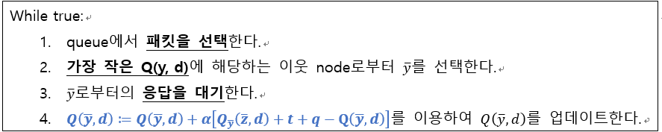
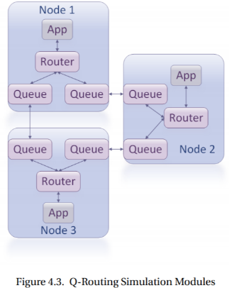
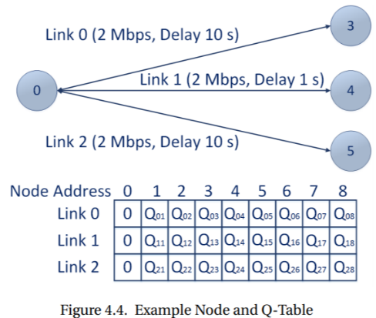
APPLICATION OF MACHINE LEARNING …
Q-routing

Slide 13
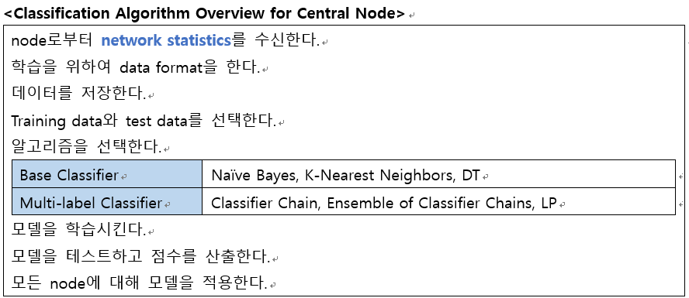
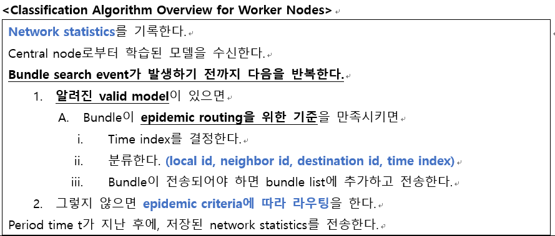
APPLICATION OF MACHINE LEARNING …
머신러닝 알고리즘

Slide 14
Github
https://github.com/WannaBeSuperteur/2020

