Slide 1
Weekly Report
2020.04.29
Hongsik Kim
Mobile & Network Intelligence Laboratory

Slide 2
WPCN: Paper
Placement Optimization of Energy and Information Access Points in Wireless Powered Communication Networks Suzhi Bi, Member, IEEE and Rui Zhang, Senior Member, IEEE 논문 정리
WPCN Simulation 실험 및 그 결과

Slide 3
Current Status
주간 진행 사항
Deep Neural Network를 이용한 WPCN 시뮬레이션 구현 및 실험
Placement Optimization of Energy and Information Access Points in Wireless Powered Communication Networks 논문 학습

Slide 4
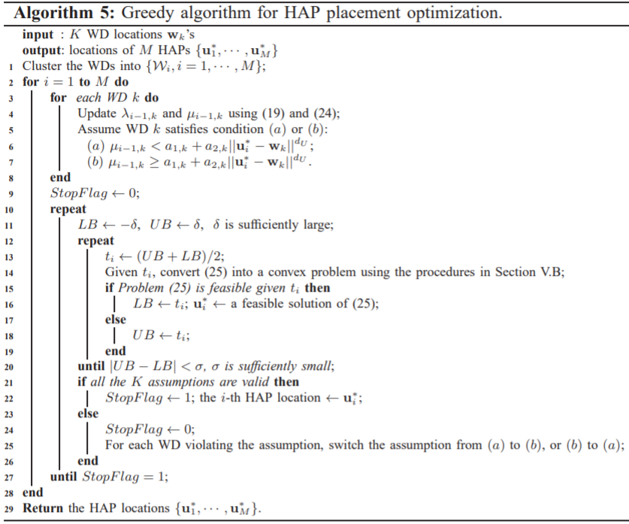
Placement Optimization of Energy and Information Access Points in WPCN
해결해야 할 문제

Slide 5
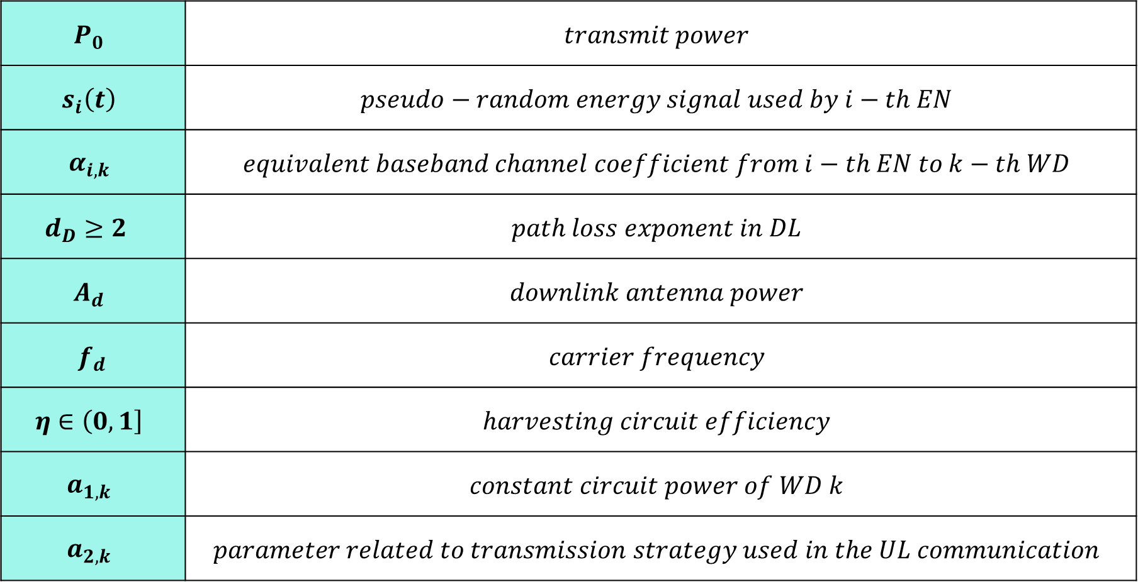
Placement Optimization of Energy and Information Access Points in WPCN
Notation 설명
$$P_{0}$$ | $$transmit power$$
$$s_{i}\left(t\right)$$ | $$pseudo−random energy signal used by i−th EN$$
$$α_{i,k}$$ | $$equivalent baseband channel coefficient from i−th EN to k−th WD$$
$$d_{D}≥2$$ | $$path loss exponent in DL$$
$$A_{d}$$ | $$downlink antenna power$$
$$f_{d}$$ | $$carrier frequency$$
$$η∈\left(0,1\right]$$ | $$harvesting circuit efficiency$$
$$a_{1,k}$$ | $$constant circuit power of WD k$$
$$a_{2,k}$$ | $$parameter related to transmission strategy used in the UL communication$$

Slide 6

Placement Optimization of Energy and Information Access Points in WPCN
Update using (19) and (24)
19. HAP이 있는 환경에서의 Placement Optimization 수식
k번째 WD가 (i-1)에 의해 획득한 누적 RF power $λ_{i−1, k}$는 다음과 같다.
$$λ_{i−1,k}=\left\{\begin{aligned}0 (i=1) \\ φ∙\sum_{j=1}^{i−1}{{\left\|u_{j}^{∗}−w_{k}\right\|}^{−d_{D}}}(i>1)\end{aligned}\right. …(19)$$

Slide 7
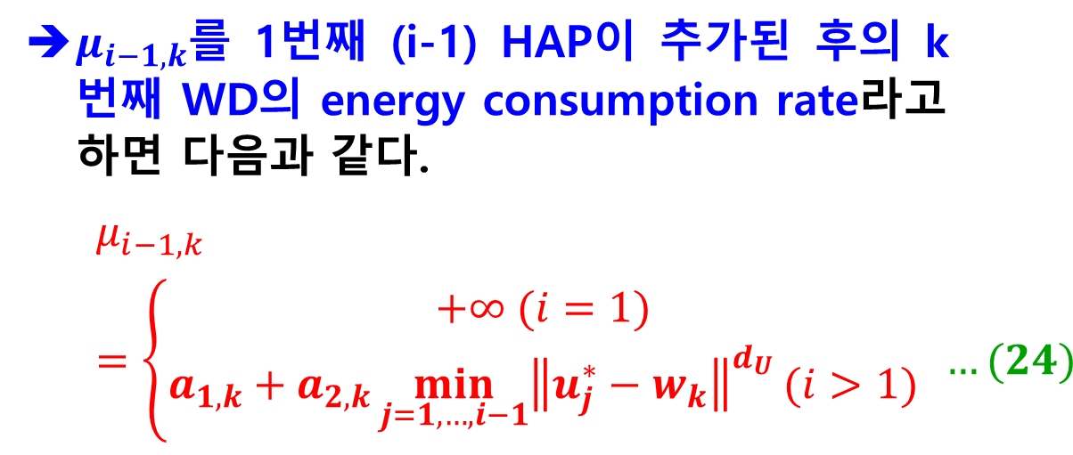
Placement Optimization of Energy and Information Access Points in WPCN
Update using (19) and (24)
24. HAP이 추가된 후의 k번째 WD의 energy consumption rate
$μ_{i−1,k}$를 1번째 (i-1) HAP이 추가된 후의 k번째 WD의 energy consumption rate라고 하면 다음과 같다.
$$μ_{i−1,k}=\left\{\begin{aligned}+∞ (i=1) \\ a_{1,k}+a_{2,k}\min_{j=1,…,i−1}{{\left\|u_{j}^{∗}−w_{k}\right\|}^{d_{U}}}(i>1)\end{aligned}\right. …(24)$$

Slide 8
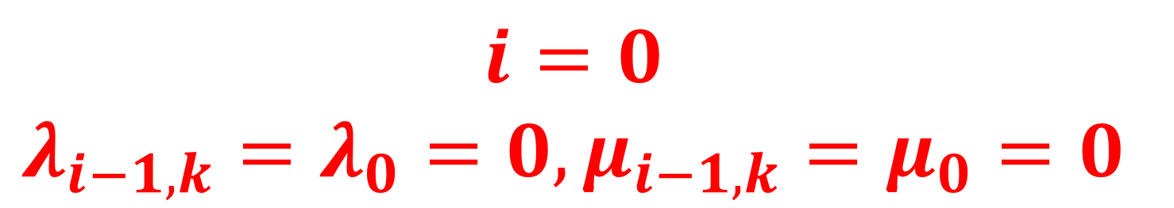
Placement Optimization of Energy and Information Access Points in WPCN
Update using (19) and (24)
여기서 HAP이 오직 1개뿐이므로
$$i=0$$
$$λ_{i−1,k}=λ_{0}=0,μ_{i−1,k}=μ_{0}=0$$

Slide 9

Placement Optimization of Energy and Information Access Points in WPCN
Convert (25) into a convex problem using procedures in Section V.B
25. i번째 HAP의 최적 위치를 찾는 수식
i번째 HAP의 최적 위치는 다음 문제를 해결하여 찾을 수 있다는 것을 알 수 있다.
$$\max_{t_{i}, u_{i}}{t_{i}} …\left(25a\right)$$
$$s.t. \left(t_{i}+μ_{i,k}−λ_{i−1,k}\right)∙{\left\|u_{i}−w_{k}\right\|}^{d_{D}}≤φ, k∈\{W_{1}∪W_{2}∪…∪W_{i}\} …(25b)$$
$$u^{l}≤u_{i}≤u^{h} …(25c)$$
$$where μ_{i,k}=\min\left(μ_{i−1,k}, a_{1,k}, a_{2,k}{\left\|u_{i}−w_{k}\right\|}^{d_{U}}\right) …(26)$$
(26)에서 WD는 자신과 연관된 HAP를 바꿀 수 있다는 것을 알 수 있다. (즉, 가장 가까이 있는 HAP과 새롭게 연관)

Slide 10

Placement Optimization of Energy and Information Access Points in WPCN
Convert (25) into a convex problem using procedures in Section V.B
Procedures in Section V.B
Problem (25)를 해결하는 feasible solution을 구하는 아이디어는 $t_{i}$에 대한 convex problem으로 변환하고, 이것에 대해 simple bisection을 이용하여 해를 찾는 것이다.
(25)의 convexification은 feasible한 WD-AP association을 찾는 trial-and-error method인 Algorithm 3을 이용하여 달성된다. 즉, WD-AP association에 대해 반복적으로 가정하고, i번째 HAP의 optimal placement를 (25)를 이용하여, 현재 iteration의 가정에 따라 업데이트한다.
WD가 i번째 HAP이 추가된 후 association을 변경할 것인지에 대한 가정 (즉, 각각의 k에 대하여 $μ_{i−1,k}<a_{1,k}+a_{2,k}{\left\|u_{i}^{∗}−w_{k}\right\|}^{d_{U}} or μ_{i−1,k}≥a_{1,k}+a_{2,k}{\left\|u_{i}^{∗}−w_{k}\right\|}^{d_{U}}$)을 추가하면 정해진 t에 대하여 (25b)의 k에 대한 각 제약 조건은 다음 4가지 경우 중 하나가 된다.

Slide 11
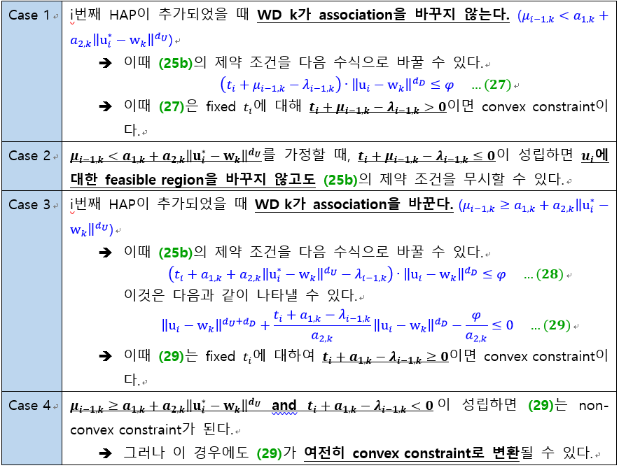
Placement Optimization of Energy and Information Access Points in WPCN
Procedures in Section V.B

Slide 12
WPCN Simulation Experiment
Experiment 1 (Sum Throughput Maximization)
deepLearning_WPCN_REAL_GPU_200409.py
Experiment 2 (Sum Throughput Maximization)
deepLearning_WPCN_REAL_GPU_200412.py

Slide 13
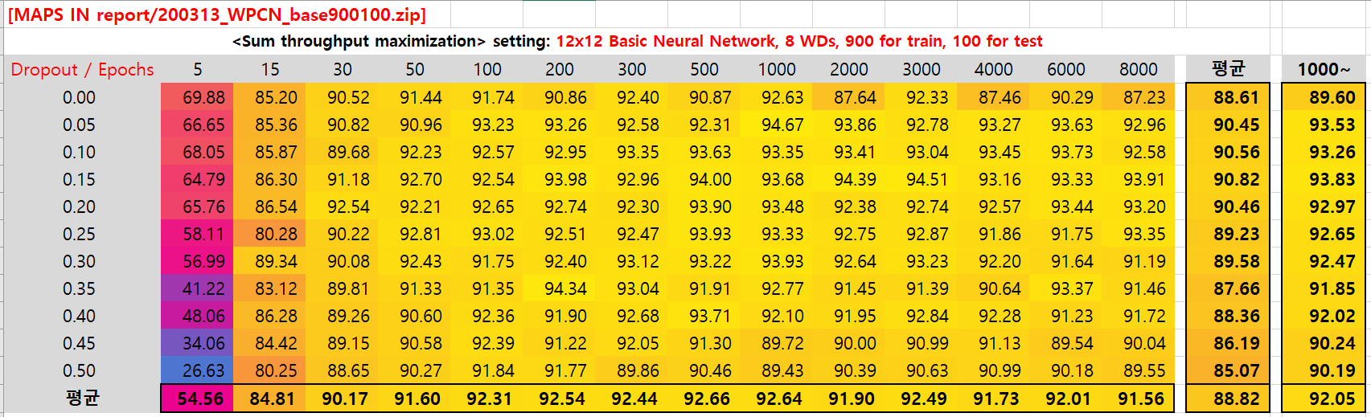
WPCN Simulation Experiment
Experiment 1 (Sum Throughput Maximization)
deepLearning_WPCN_REAL_GPU_200409.py
88.82% (over 1000 epochs: 92.05%)

Slide 14
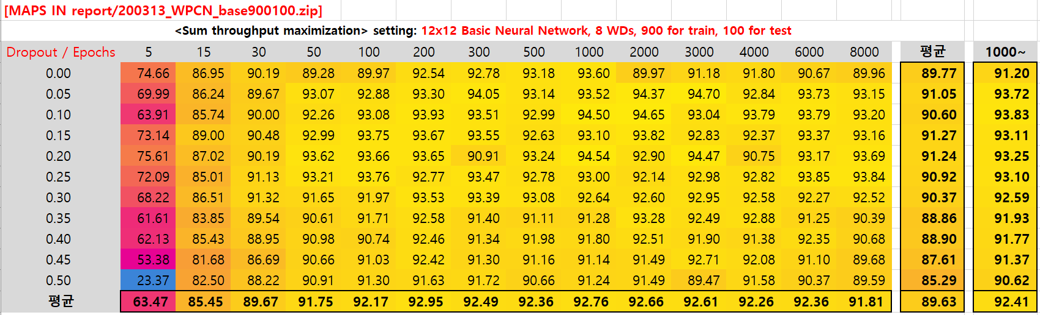
WPCN Simulation Experiment
Experiment 2 (Sum Throughput Maximization)
deepLearning_WPCN_REAL_GPU_200412.py
89.63% (over 1000 epochs: 92.41%)

Slide 15
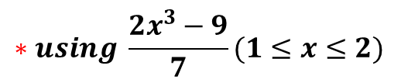
WPCN Simulation Experiment
정리
$$∗using \frac{2x^{3}−9}{7}(1≤x≤2)$$
 | Activation Function | X range | Sum Throughput Maximization | Common Throughput Maximization
Experiment 1 in 200324_WPCN.pptx | Sigmoid | [0, 1] | 90.06% (92.28%) | 76.30% (85.72%)
Experiment 2 in 200324_WPCN.pptx |  |  | 86.15% (86.23%) | 75.11% (82.43%)
Exp1 in 200331 Exp1 in 200421 | Sigmoid | [-1, 1] | 89.36% (92.32%) | 77.11% (87.20%)
Exp2 in 200331 Exp2 in 200421 | Sigmoid | [-1, 1]* | 86.91% (92.83%) | 75.47% (85.41%)
Exp1 in 200407 Exp3 in 200421 | Sigmoid | [-2, 2] | 88.08% (90.65%) | 77.59% (87.90%)
Exp2 in 200407 Exp4 in 200421 | Tanh | [-1, 1] | 88.85% (90.58%) | 77.59% (87.45%)
Exp1 in 200414 Exp1 in This File | Sigmoid | [-1.5, 1.5] | 88.82% (92.05%) | 77.54% (87.77%)
Exp2 in 200414 Exp2 in This File | Tanh | [-0.75, 0.75] | 89.63% (92.41%) | 76.70% (87.02%)

Slide 16
Github
https://github.com/WannaBeSuperteur/2020/tree/master/WPCN

