Slide 1
Weekly Report
2020.05.06
Hongsik Kim
Mobile & Network Intelligence Laboratory

Slide 2
WPCN: Paper
Placement Optimization of Energy and Information Access Points in Wireless Powered Communication Networks Suzhi Bi, Member, IEEE and Rui Zhang, Senior Member, IEEE 논문 구현

Slide 3
Current Status
주간 진행 사항
Placement Optimization of Energy and Information Access Points in Wireless Powered Communication Networks 논문 구현

Slide 4
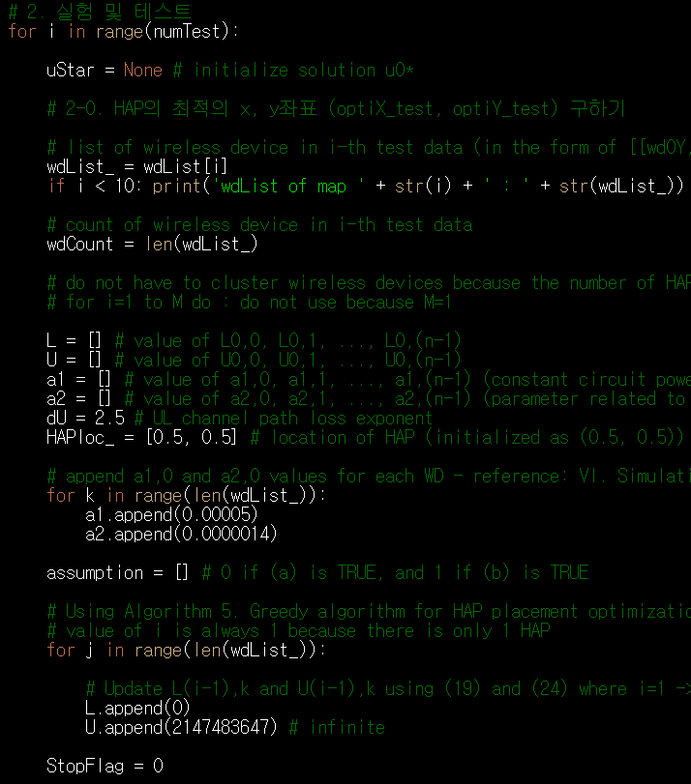
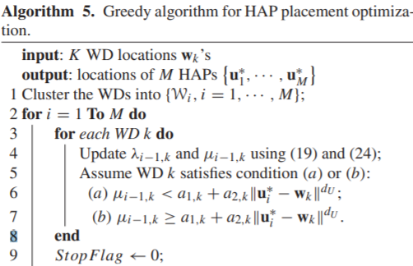


Implementation of the paper
WPCN/WPCN_paper.py

Slide 5
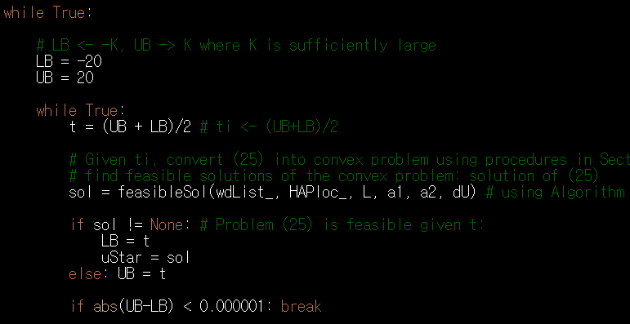
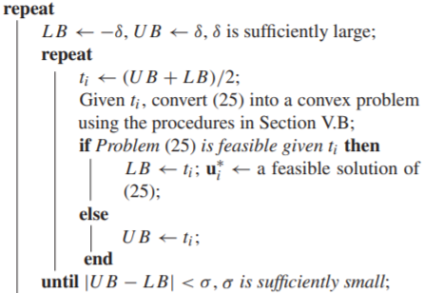
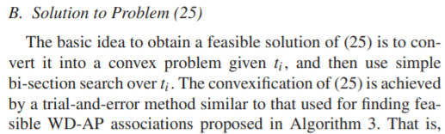

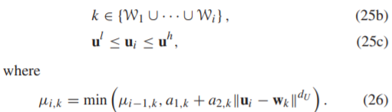

Implementation of the paper
WPCN/WPCN_paper.py

Slide 6
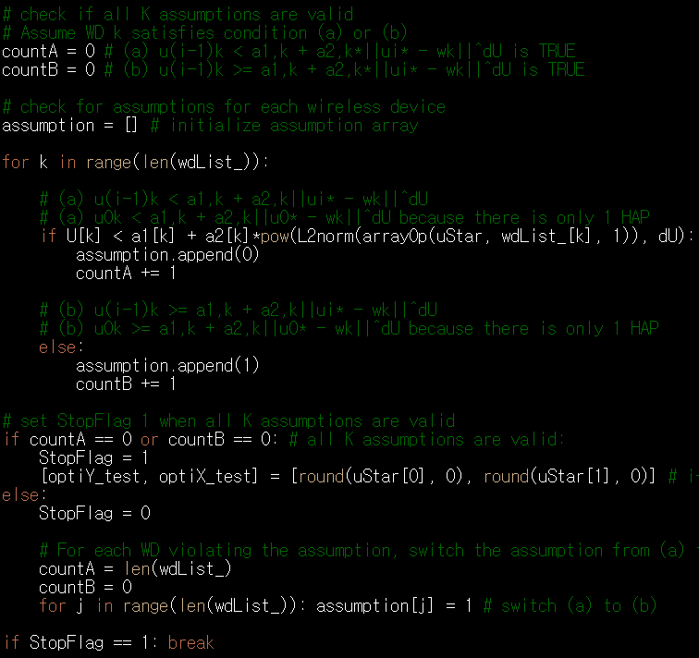
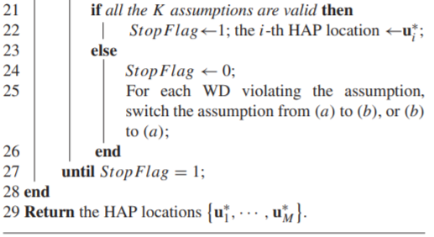
Implementation of the paper
WPCN/WPCN_paper.py

Slide 7
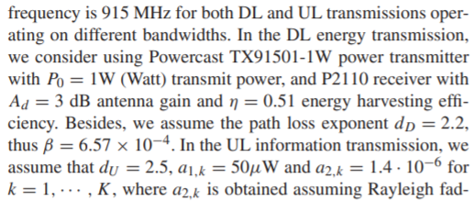
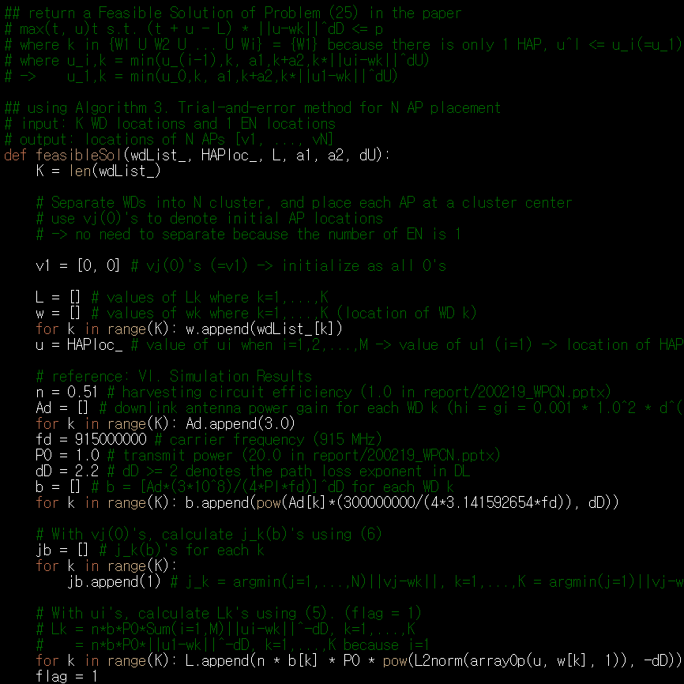



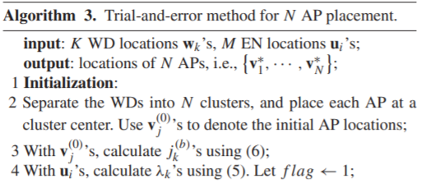
Implementation of the paper
WPCN/WPCN_paper.py

Slide 8

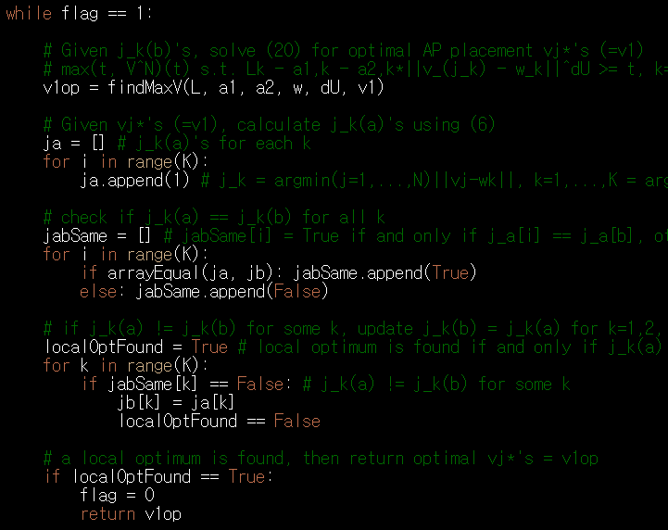
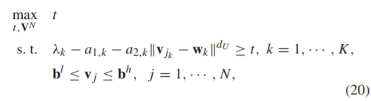
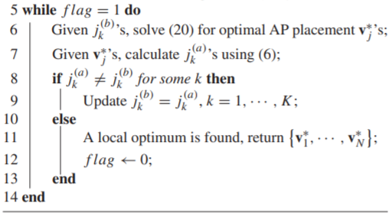
Implementation of the paper
WPCN/WPCN_paper.py

Slide 9
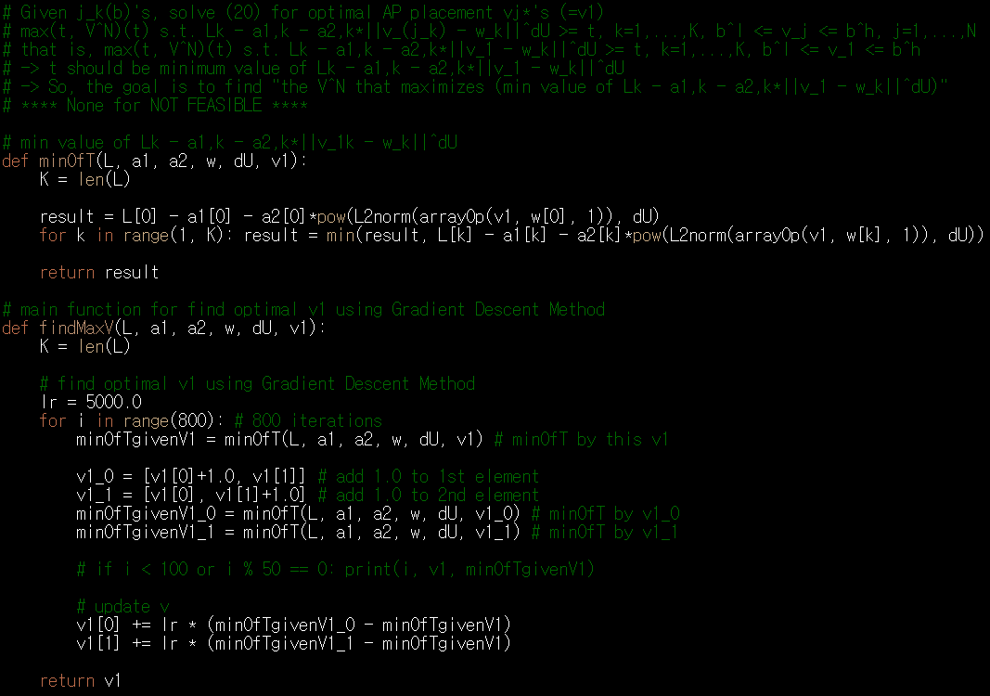
Implementation of the paper
WPCN/WPCN_paper.py
Gradient Descent Method를 이용,
최적의 v1 값을 찾음
이 값을 정수로 반올림한 좌표에
HAP를 배치하여
그 결과를 테스트

Slide 10
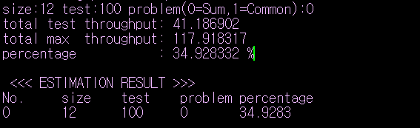
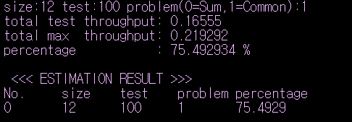
Implementation of the paper
실험 결과
Sum Throughput Maximization (34.9283% << 92.83%)
Common Throughput Maximization (75.4929% < 87.90%)

Slide 11

WPCN Simulation Experiment
이전 실험 결과
$$∗using \frac{2x^{3}−9}{7}(1≤x≤2)$$
 | Activation Function | X range | Sum Throughput Maximization | Common Throughput Maximization
Experiment 1 in 200324_WPCN.pptx | Sigmoid | [0, 1] | 90.06% (92.28%) | 76.30% (85.72%)
Experiment 2 in 200324_WPCN.pptx |  |  | 86.15% (86.23%) | 75.11% (82.43%)
Exp1 in 200331 Exp1 in 200421 | Sigmoid | [-1, 1] | 89.36% (92.32%) | 77.11% (87.20%)
Exp2 in 200331 Exp2 in 200421 | Sigmoid | [-1, 1]* | 86.91% (92.83%) | 75.47% (85.41%)
Exp1 in 200407 Exp3 in 200421 | Sigmoid | [-2, 2] | 88.08% (90.65%) | 77.59% (87.90%)
Exp2 in 200407 Exp4 in 200421 | Tanh | [-1, 1] | 88.85% (90.58%) | 77.59% (87.45%)
Exp1 in 200414 Exp1 in 200429 | Sigmoid | [-1.5, 1.5] | 88.82% (92.05%) | 77.54% (87.77%)
Exp2 in 200414 Exp2 in 200429 | Tanh | [-0.75, 0.75] | 89.63% (92.41%) | 76.70% (87.02%)

Slide 12
WPCN Simulation Experiment
향후 논문을 바르게 구현했는지 검토 필요
논문을 바르게 구현한 경우, 딥 러닝을 이용한 방법론이 기존 논문의 방법론보다 우수하다고 판단, 논문 작성 시작

Slide 13
Github
https://github.com/WannaBeSuperteur/2020/tree/master/WPCN

