Slide 1
Unit 3 Multiple Linear Regression
EE-uy 4563/EL-GY 6143: Introduction to machine learning
Prof. Sundeep rangan
(with modification by Yao Wang)

Slide 2
Learning Objectives
Formulate a machine learning model as a multiple linear regression model.
Identify prediction vector and target for the problem.
Write the regression model in matrix form. Write the feature matrix
Compute the least-squares solution for the regression coefficients on training data.
Derive the least-squares formula from minimization of the RSS
Manipulate 2D arrays in python (indexing, stacking, computing shapes, …)
Compute the LS solution using python linear algebra and machine learning packages

Slide 3
Pre-Requisites for this Lecture
Undergraduate students:
We will cover Unit 2 (Simple Linear Regression) in class first
Some of the material in this lecture is a duplicate of Lecture 2
I will go through this lecture more slowly, esp. for the linear algebra
Graduate students:
We will can skip Lecture 2 and start this lecture directly after Lecture 1.
Do lecture 2 at home.
Will not review basic linear algebra in class. You should review this on your own.
Pre-requisites for this lecture (graduate or undergraduate): You should know how to:
Install python and run python notebooks
Describe simple linear models mathematically
Derive equations for fitting simple linear models
Perform basic manipulations and plotting of data in python

Slide 4
Outline
Motivating Example: Understanding glucose levels in diabetes patients
Multiple variable linear models
Least squares solutions
Computing the solutions in python
Special case: Simple linear regression
Extensions

Slide 5
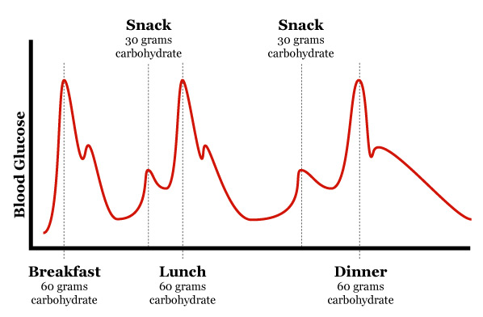
Example: Blood Glucose Level
Diabetes patients must monitor glucose level
What causes blood glucose levels to rise and fall?
Many factors
We know mechanisms qualitatively
But, quantitative models are difficult to obtain
Hard to derive from first principles
Difficult to model physiological process precisely
Can machine learning help?

Slide 6
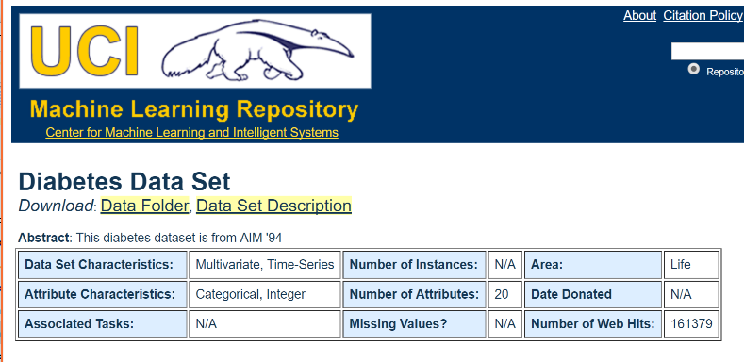
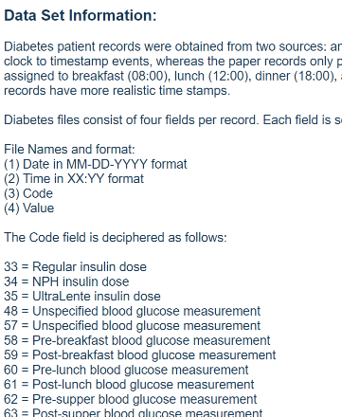
Data from AIM 94 Experiment
Data collected as series of events
Eating
Exercise
Insulin dosage
Target variable glucose level monitored

Slide 7
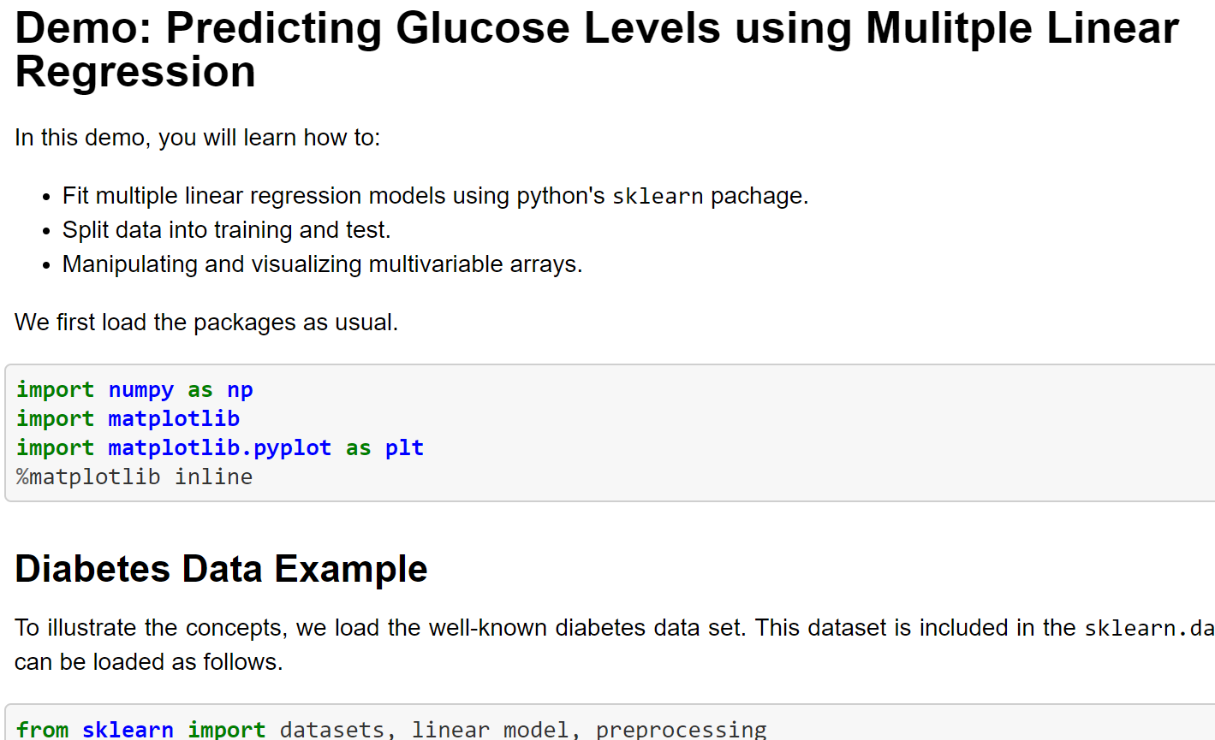
Demo on GitHub
All code is available in github: https://github.com/sdrangan/introml/blob/master/unit03_mult_lin_reg/demo2_glucose.ipynb

Slide 8

Using Google Colaboratory
Two options for running the demos:
Option 1:
Clone the github repository to your local machine and run it using jupyter notebook
Need to install all the software correctly
Option 2: Run on the cloud in Google Colaboratory
For Option 2:
Go to https://colab.research.google.com/
File->Open Notebook
Select GitHub tab
Enter github URL: https://github.com/sdrangan/introml
Select the unit03_mult_lin_reg/demo1_glucose.ipynb

Slide 9
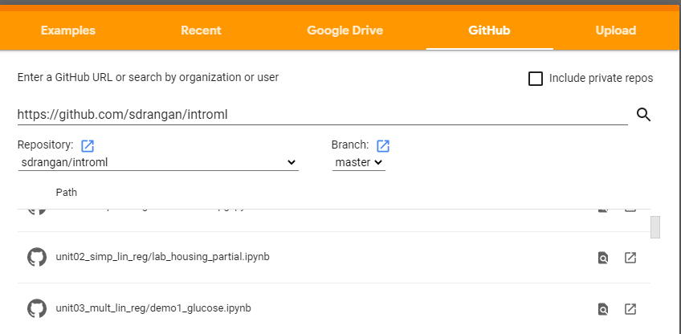
Demo on Google Colab

Slide 10
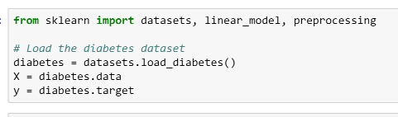
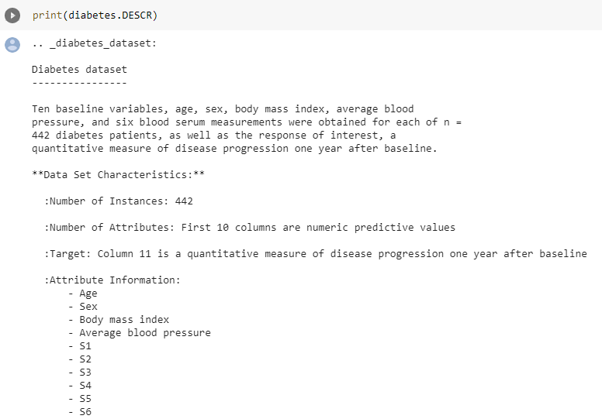
Loading the Data
Sklearn package:
Many methods for machine learning
Datasets
Will use throughout this class
Diabetes dataset is one example

Slide 11


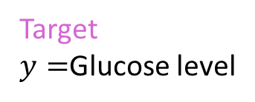
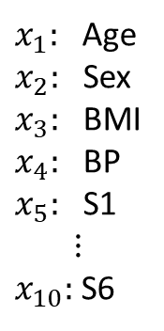
Finding a Mathematical Model
Attributes
Target $y=$Glucose level
$x_{1}:$ Age $x_{2}:$ Sex
$x_{3}:$ BMI
$x_{4}:$ BP $x_{5}:$ S1 $$⋮$$ $x_{10}:$ S6
$$y≈\hat{y}=f(x_{1},…,x_{10})$$
Goal: Find a function to predict glucose level from the 10 attributes
Problem: Several attributes
Need a multi-variable function

Slide 12

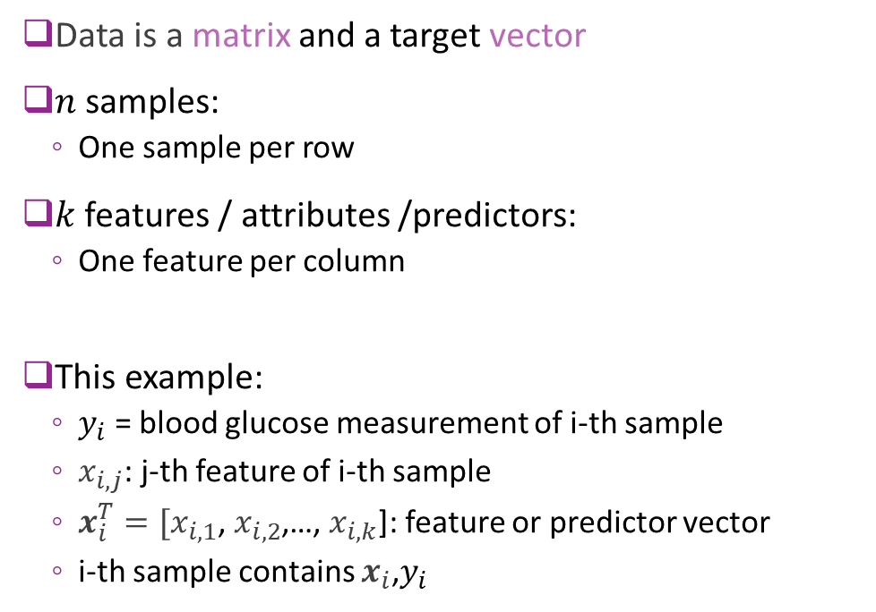
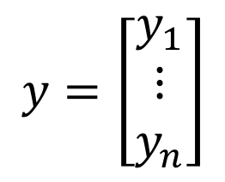
Matrix Representation of Data
Data is a matrix and a target vector
$n$ samples:
One sample per row
$k$ features / attributes /predictors:
One feature per column
This example:
$y_{i}$ = blood glucose measurement of i-th sample
$x_{i,j}$: j-th feature of i-th sample
$x_{i}^{T}=[x_{i,1}$, $x_{i,2}$,…, $x_{i,k}$]: feature or predictor vector
i-th sample contains $x_{i}$,$y_{i}$
Attributes
Target vector
$$X=\left[\begin{matrix}x_{11} & ⋯ & x_{1k} \\ ⋮ & ⋱ & ⋮ \\ x_{n1} & ⋯ & x_{nk}\end{matrix}\right]$$
$$y=\left[\begin{matrix}y_{1} \\ ⋮ \\ y_{n}\end{matrix}\right]$$
Samples

Slide 13
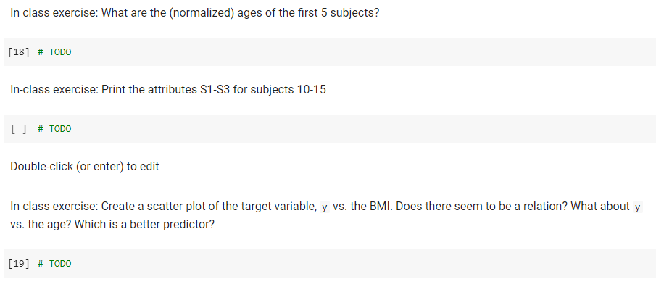
In class exercise

Slide 14
Outline
Motivating Example: Understanding glucose levels in diabetes patients
Multiple variable linear models
Least squares solutions
Computing the solutions in python
Special case: Simple linear regression
Extensions

Slide 15
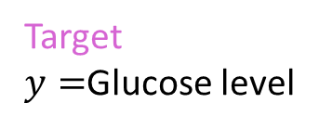
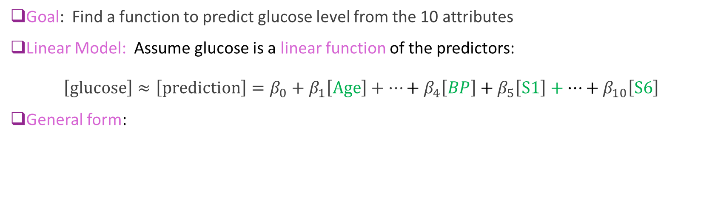
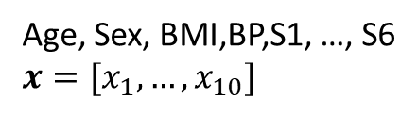

Multivariable Linear Model for Glucose
Attributes
$$y≈\hat{y}=f(x_{1},…,x_{10})$$
Target $y=$Glucose level
Age, Sex, BMI,BP,S1, …, S6
$x=[x_{1}, …, x_{10}]$
Goal: Find a function to predict glucose level from the 10 attributes
Linear Model: Assume glucose is a linear function of the predictors:
$$\left[\text{glucose}\right]≈\left[\text{prediction}\right]=β_{0}+β_{1}\left[\text{Age}\right]+⋯+β_{4}\left[BP\right]+β_{5}\left[\text{S}1\right]+⋯+β_{10}\left[\text{S}6\right]$$
General form:
$$y ≈ \hat{y} =β_{0}+ β_{1}x_{1} +⋯+ β_{4}x_{4} + β_{5}x_{5} +⋯+ β_{10}x_{10}$$
Target
Intercept
10 Features

Slide 16
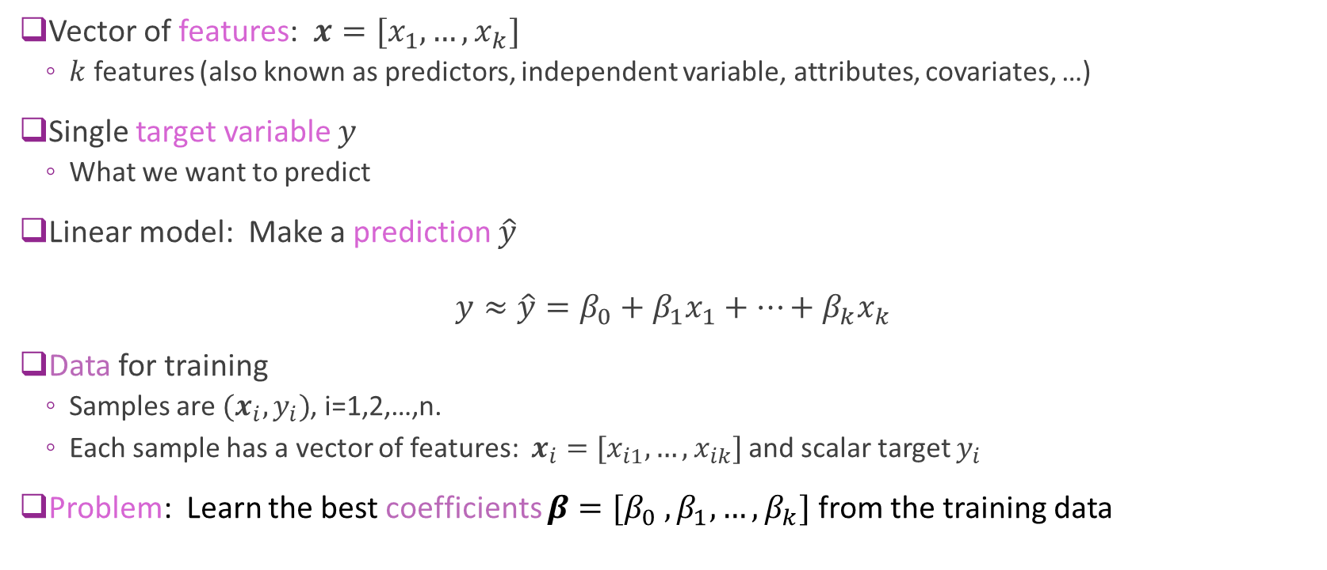
Multiple Variable Linear Model
Vector of features: $x=[x_{1},…,x_{k}]$
$k$ features (also known as predictors, independent variable, attributes, covariates, …)
Single target variable $y$
What we want to predict
Linear model: Make a prediction $\hat{y}$
$$y≈\hat{y}=β_{0}+β_{1}x_{1}+⋯+β_{k}x_{k}$$
Data for training
Samples are $(x_{i},y_{i})$, i=1,2,…,n.
Each sample has a vector of features: $x_{i}=[x_{i1},…,x_{ik}]$ and scalar target $y_{i}$
Problem: Learn the best coefficients ${{β=[β}_{0} , β}_{1},…,β_{k}]$ from the training data

Slide 17
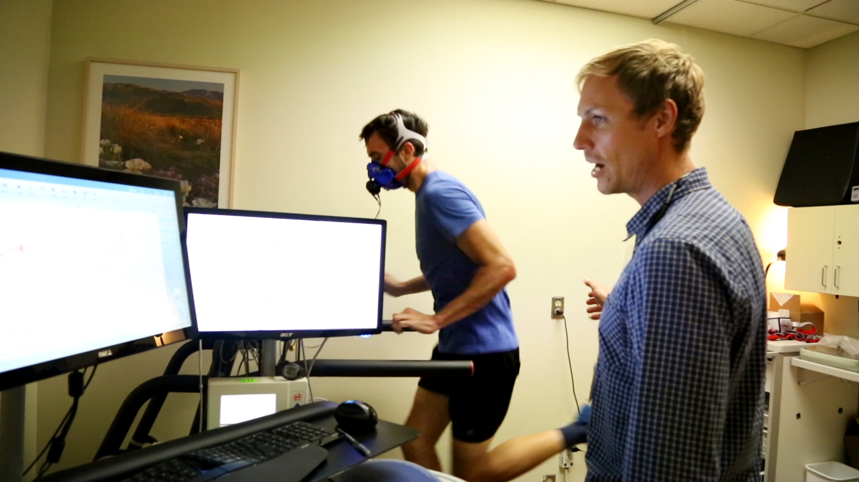

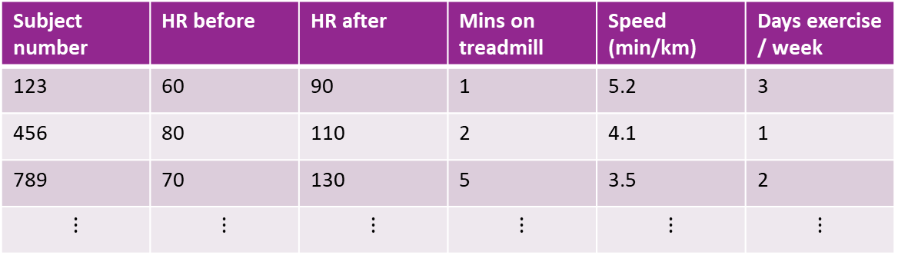
Example: Heart Rate Increase
Linear Model: $\left[\text{HR} \text{increase}\right]≈ β_{0}+β_{1}\left[\text{mins} \text{exercise}\right]+β_{2}\left[\text{exercise} \text{intensity}\right]$
Data:
Subject number | HR before | HR after | Mins on treadmill | Speed (min/km) | Days exercise / week
123 | 60 | 90 | 1 | 5.2 | 3
456 | 80 | 110 | 2 | 4.1 | 1
789 | 70 | 130 | 5 | 3.5 | 2
$$⋮$$ | $$⋮$$ | $$⋮$$ | $$⋮$$ | $$⋮$$ | $$⋮$$
Measuring fitness of athletes
https://www.mercurynews.com/2017/10/29/4851089/

Slide 18
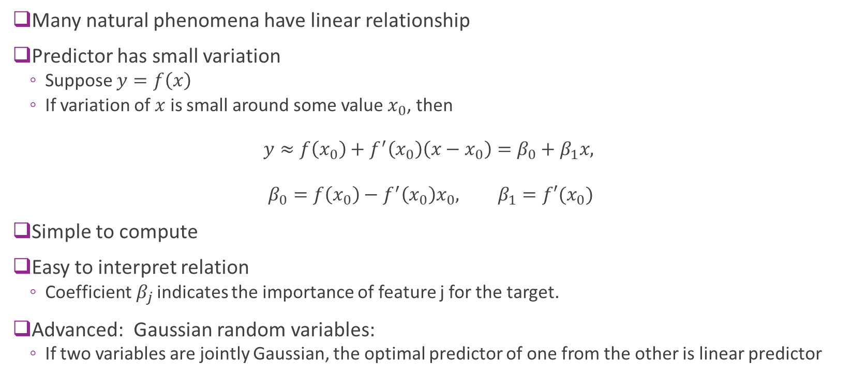
Why Use a Linear Model?
Many natural phenomena have linear relationship
Predictor has small variation
Suppose $y=f\left(x\right)$
If variation of $x$ is small around some value $x_{0}$, then
$$y≈f\left(x_{0}\right)+f^{′}\left(x_{0}\right)\left(x−x_{0}\right)=β_{0}+β_{1}x,$$
$$β_{0}=f\left(x_{0}\right)−f^{′}\left(x_{0}\right)x_{0}, β_{1}=f′(x_{0})$$
Simple to compute
Easy to interpret relation
Coefficient${ β}_{j}$ indicates the importance of feature j for the target.
Advanced: Gaussian random variables:
If two variables are jointly Gaussian, the optimal predictor of one from the other is linear predictor

Slide 19

Matrix Review
Consider $A=\left[\begin{matrix}1 & 2 \\ 3 & 4 \\ 5 & 6\end{matrix}\right], B=\left[\begin{matrix}2 & 0 \\ 3 & 2\end{matrix}\right], x=\left[\begin{matrix}2 \\ 3\end{matrix}\right],$
Compute (computations on the board):
Matrix vector multiply: $Ax$
Transpose: $A^{T}$
Matrix multiply: $AB$
Solution to linear equations: Solve for $u$: $x=Bu$
Matrix inverse: $B^{−1}$

Slide 20
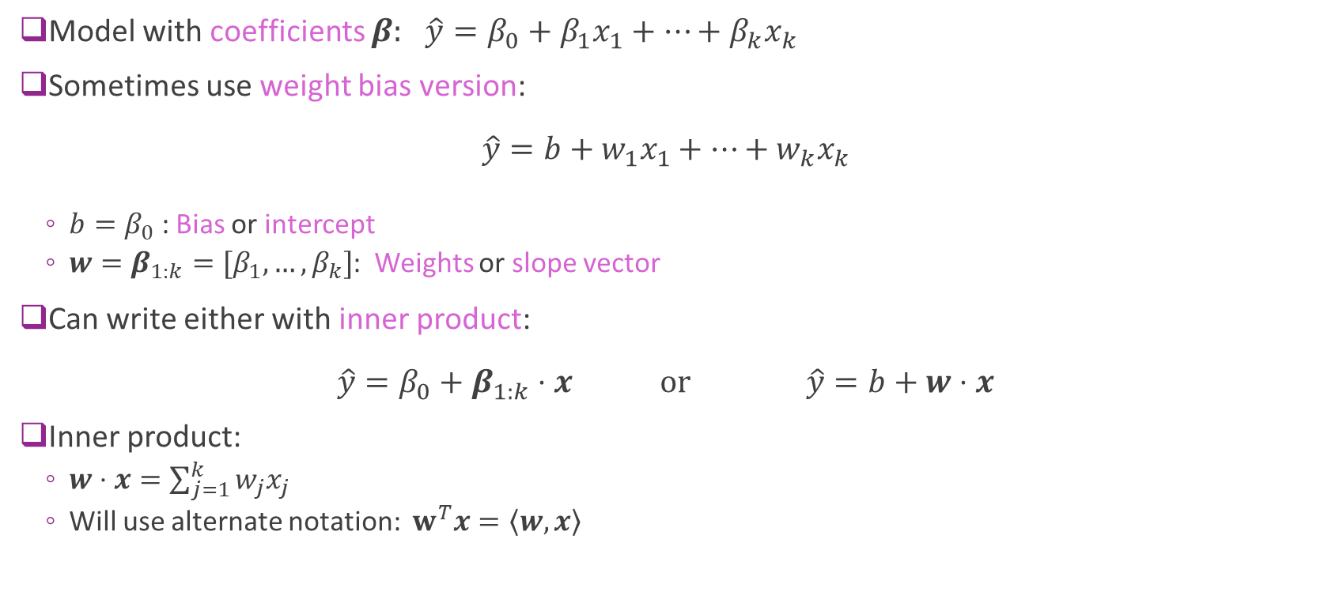
Slopes, Intercept and Inner Products
Model with coefficients $β:$ $\hat{y}=β_{0}+β_{1}x_{1}+⋯+β_{k}x_{k}$
Sometimes use weight bias version: $\hat{y}=b+w_{1}x_{1}+⋯+w_{k}x_{k}$
$b=β_{0}$ : Bias or intercept
$w=β_{1:k}=[β_{1},…,β_{k}]$: Weights or slope vector
Can write either with inner product: $\hat{y}=β_{0}+β_{1:k}⋅x \text{or} \hat{y}=b+w⋅x$
Inner product:
$w⋅x=\sum_{j=1}^{k}{w_{j}x_{j}}$
Will use alternate notation: $w^{T}x=\left\langle w,x\right\rangle$

Slide 21




Matrix Form of Linear Regression
Data: $\left(x_{i},y_{i}\right), i=1,…, n$
Predicted value for $i$-th sample: ${\hat{y}}_{i}=β_{0}+β_{1}x_{i1}+⋯+β_{k}x_{ik}$
Matrix form $\left[\begin{matrix}{\hat{y}}_{1} \\ {\hat{y}}_{2} \\ \begin{matrix}⋮ \\ {\hat{y}}_{n}\end{matrix}\end{matrix}\right]=\left[\begin{matrix}\begin{matrix}1 \\ 1\end{matrix} & \begin{matrix}\begin{matrix}x_{11} \\ x_{21}\end{matrix} & \begin{matrix}⋯ \\ ⋯\end{matrix} & \begin{matrix}x_{1k} \\ x_{2k}\end{matrix}\end{matrix} \\ ⋮ & \begin{matrix}⋮ & ⋯ & ⋮\end{matrix} \\ 1 & \begin{matrix}x_{n1} & ⋯ & x_{nk}\end{matrix}\end{matrix}\right] \left[\begin{matrix}β_{0} \\ β_{1} \\ \begin{matrix}⋮ \\ β_{k}\end{matrix}\end{matrix}\right]$
Matrix equation: $\hat{y}=A β$
$β$with $p=k+1$coefficient vector
$\hat{y}$ a $n$ predicted values
$A$ a $n×p$ feature matrix

Slide 22
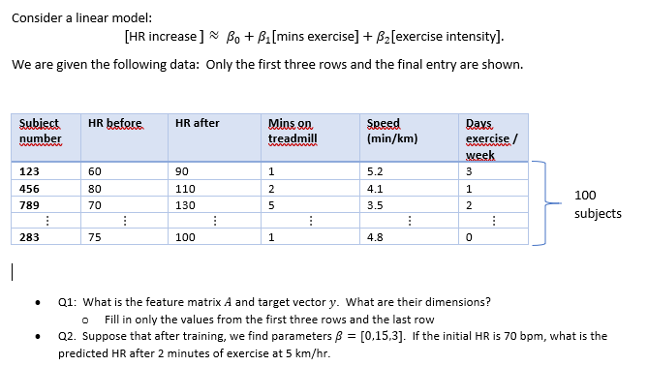
In-Class Exercise

Slide 23
Outline
Motivating Example: Understanding glucose levels in diabetes patients
Multiple variable linear models
Least squares solutions
Computing the solutions in python
Special case: Simple linear regression
Extensions

Slide 24
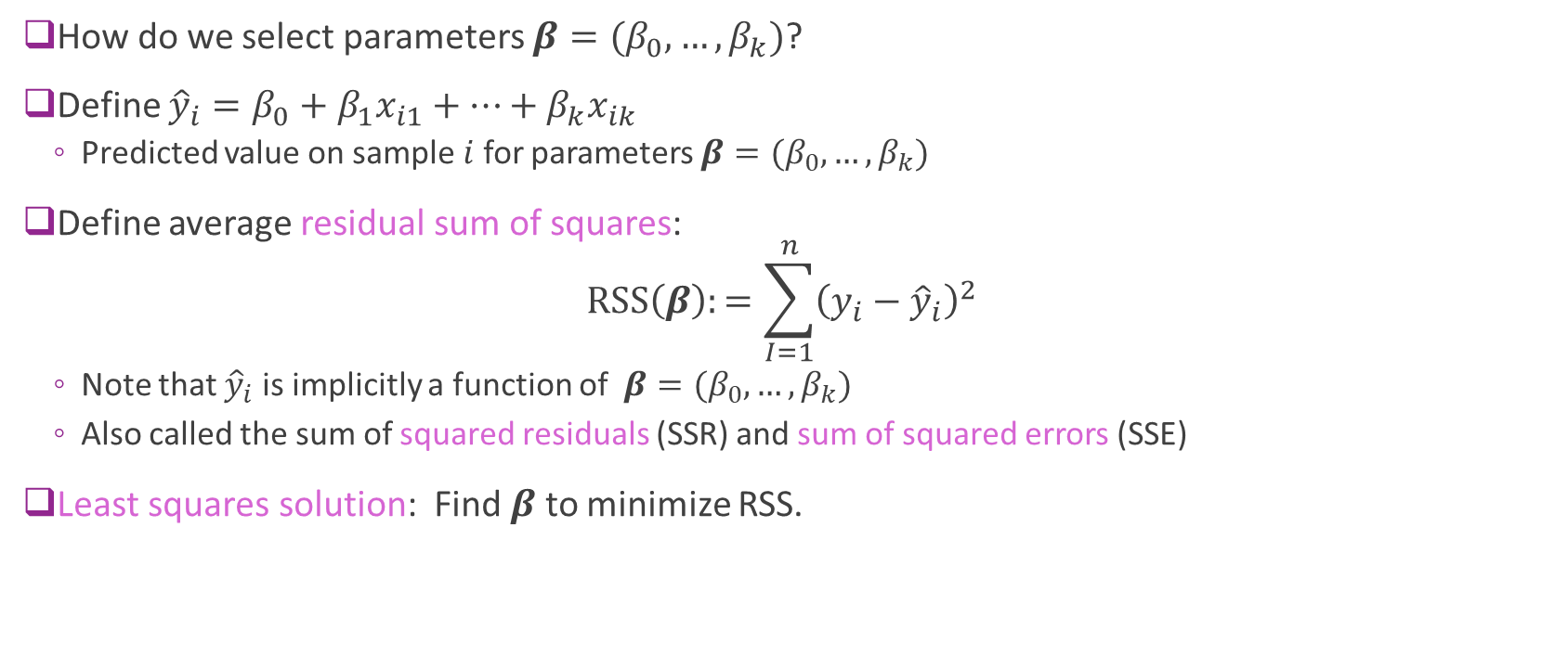
Least Squares Model Fitting
How do we select parameters $β=(β_{0},…,β_{k})$?
Define ${\hat{y}}_{i}=β_{0}+β_{1}x_{i1}+…+β_{k}x_{ik}$
Predicted value on sample $i$ for parameters $β=(β_{0},…,β_{k})$
Define average residual sum of squares: $RSS\left(β\right):=\sum_{I=1}^{n}{{\left(y_{i}−{\hat{y}}_{i}\right)}^{2}}$
Note that ${\hat{y}}_{i}$ is implicitly a function of $β=(β_{0},…,β_{k})$
Also called the sum of squared residuals (SSR) and sum of squared errors (SSE)
Least squares solution: Find $β$ to minimize RSS.

Slide 25
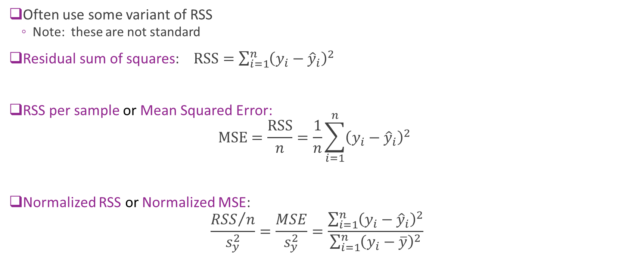
Variants of RSS
Often use some variant of RSS
Note: these are not standard
Residual sum of squares: $\text{RSS}=\sum_{i=1}^{n}{{\left(y_{i}−{\hat{y}}_{i}\right)}^{2}}$
RSS per sample or Mean Squared Error: $MSE=\frac{\text{RSS}}{n}=\frac{1}{n}\sum_{i=1}^{n}{{\left(y_{i}−{\hat{y}}_{i}\right)}^{2}}$
Normalized RSS or Normalized MSE:
$$\frac{{RSS}/n}{s_{y}^{2}}=\frac{MSE}{s_{y}^{2}}=\frac{\sum_{i=1}^{n}{{\left(y_{i}−{\hat{y}}_{i}\right)}^{2}}}{\sum_{i=1}^{n}{{\left(y_{i}−\overline{y}\right)}^{2}}}$$

Slide 26
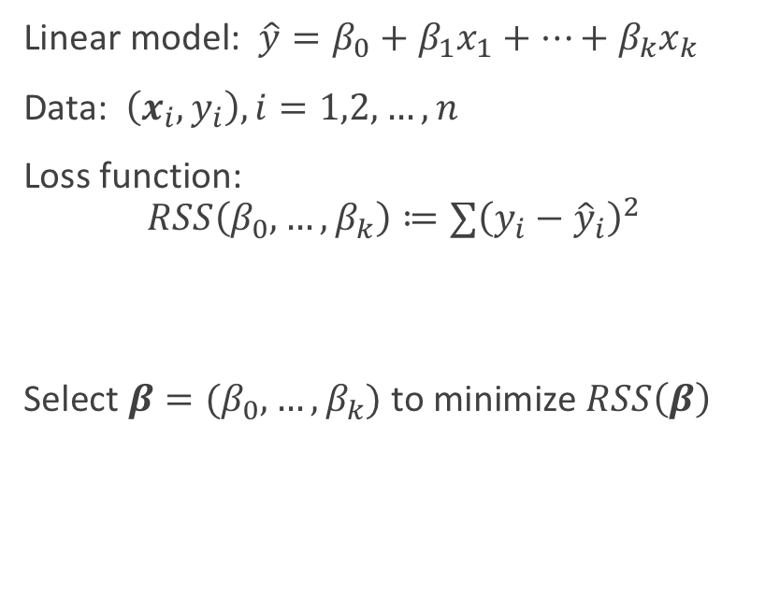
Finding Parameters via Optimization A general ML recipe
General ML problem
Multiple linear regression
Pick a model with parameters
Get data
Pick a loss function
Measures goodness of fit model to data
Function of the parameters
Find parameters that minimizes loss
Linear model: $\hat{y}=β_{0}+β_{1}x_{1}+⋯+β_{k}x_{k}$
Data: $\left(x_{i},y_{i}\right),i=1,2,…,n$
Loss function: $$RSS\left(β_{0},…,β_{k}\right)≔∑{\left(y_{i}−{\hat{y}}_{i}\right)}^{2}$$
Select $β=(β_{0},…,β_{k})$ to minimize $RSS\left(β\right)$

Slide 27
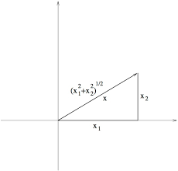

RSS as a Vector Norm
RSS is given by sum: $\text{RSS}=\sum_{i=1}^{n}{{\left(y_{i}−{\hat{y}}_{i}\right)}^{2}}$
Define norm of a vector:
$\left\|x\right\|={\left(x_{1}^{2}+⋯+x_{r}^{2}\right)}^{1/2}$
Standard Euclidean norm.
Sometimes called $ℓ$-2 norm. $ℓ$ is for Lebesque
Write RSS in vector form: $\text{RSS}={\left\|y−\hat{y}\right\|}^{2}$

Slide 28
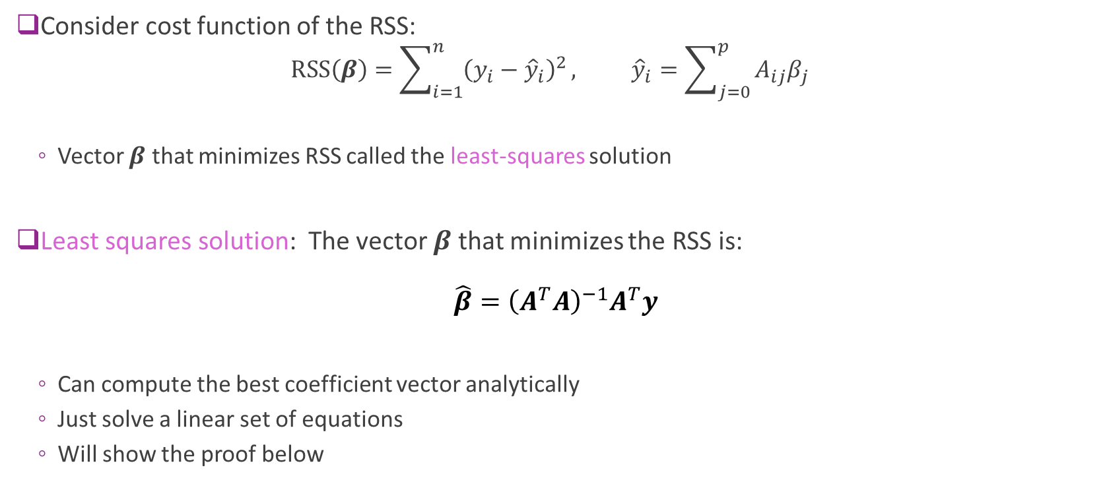
Least Squares Solution
Consider cost function of the RSS:
$$\text{RSS}\left(β\right)=\sum_{i=1}^{n}{{\left(y_{i}−{\hat{y}}_{i}\right)}^{2}}, {\hat{y}}_{i}=\sum_{j=0}^{p}{A_{ij}β_{j}}$$
Vector $β$ that minimizes RSS called the least-squares solution
Least squares solution: The vector $β$ that minimizes the RSS is: $\hat{β}={\left(A^{T}A\right)}^{−1}A^{T}y$
Can compute the best coefficient vector analytically
Just solve a linear set of equations
Will show the proof below

Slide 29

Proving the LS Formula
Least squares formula: The vector $β$ that minimizes the RSS is: $\hat{β}={\left(A^{T}A\right)}^{−1}A^{T}y$
To prove this formula, we will:
Review gradients of multi-variable functions
Compute gradient $∇RSS\left(β\right)$
Solve $∇RSS\left(β\right)=0$

Slide 30
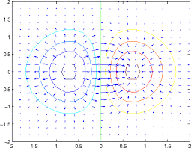
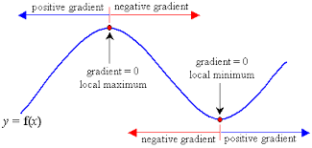
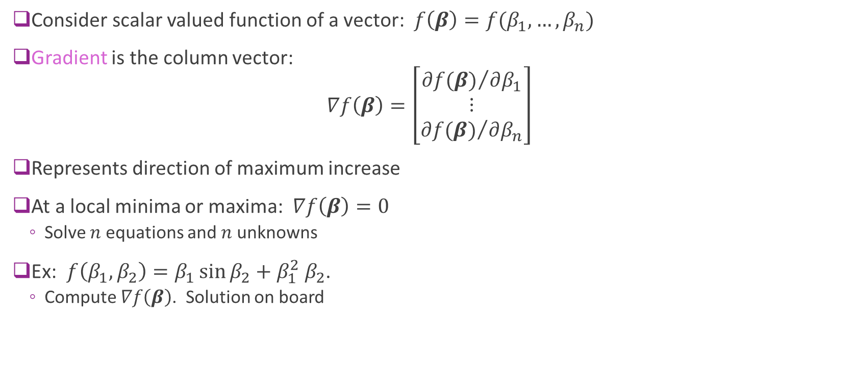
Gradients of Multi-Variable Functions
Consider scalar valued function of a vector: $f\left(β\right)=f(β_{1},…,β_{n})$
Gradient is the column vector: $∇f\left(β\right)=\left[\begin{matrix}{∂f(β)}/{∂β_{1}} \\ ⋮ \\ {∂f(β)}/{∂β_{n}}\end{matrix}\right]$
Represents direction of maximum increase
At a local minima or maxima: $∇f\left(β\right)=0$
Solve $n$ equations and $n$ unknowns
Ex: $f\left(β_{1},β_{2}\right)=β_{1}\sin{β_{2}}+β_{1}^{2} β_{2}$.
Compute $∇f\left(β\right)$. Solution on board

Slide 31
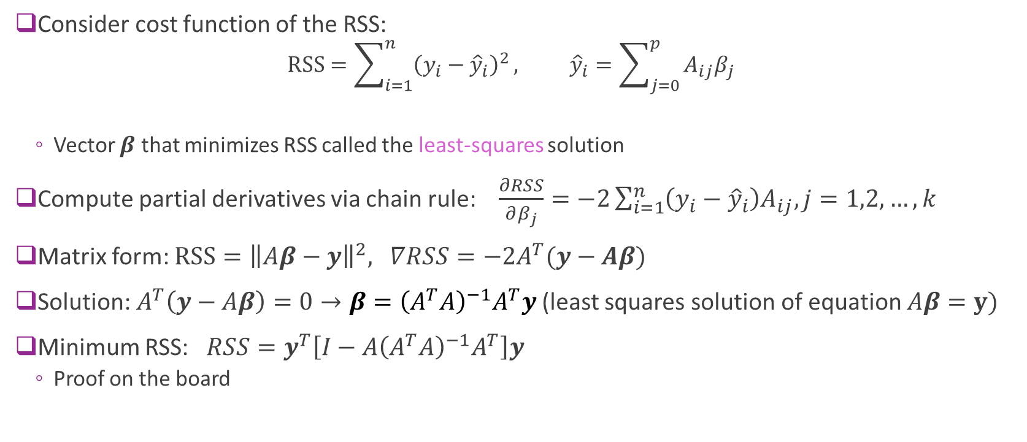
Proof of the LS Formula
Consider cost function of the RSS:
$$\text{RSS}=\sum_{i=1}^{n}{{\left(y_{i}−{\hat{y}}_{i}\right)}^{2}}, {\hat{y}}_{i}=\sum_{j=0}^{p}{A_{ij}β_{j}}$$
Vector $β$ that minimizes RSS called the least-squares solution
Compute partial derivatives via chain rule: $\frac{∂RSS}{∂β_{j}}=−2\sum_{i=1}^{n}{\left(y_{i}−{\hat{y}}_{i}\right)A_{ij}, j=1,2,…,k}$
Matrix form: $RSS={\left\|Aβ−y\right\|}^{2},$ $∇RSS=−2A^{T}(y−Aβ)$
Solution: $A^{T}\left(y−Aβ\right)=0→β={\left(A^{T}A\right)}^{−1}A^{T}y$(least squares solution of equation $Aβ=y)$
Minimum RSS: $RSS=y^{T}\left[I−A{\left(A^{T}A\right)}^{−1}A^{T}\right]y$
Proof on the board

Slide 32
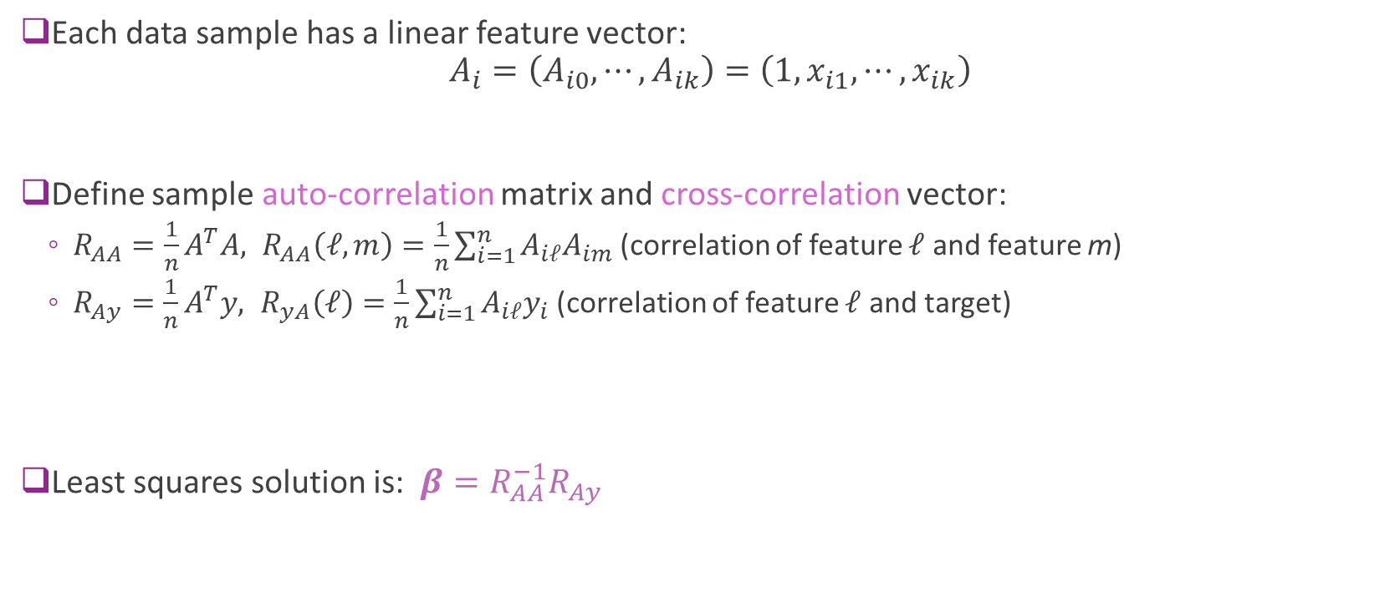
LS Solution via Auto-Correlation Functions
Each data sample has a linear feature vector: $A_{i}=\left(A_{i0},⋯,A_{ik}\right)=\left(1,x_{i1},⋯,x_{ik}\right)$
Define sample auto-correlation matrix and cross-correlation vector:
$R_{AA}=\frac{1}{n}A^{T}A, R_{AA}\left(ℓ,m\right)=\frac{1}{n}\sum_{i=1}^{n}{A_{iℓ}A_{im}}$ (correlation of feature $ℓ$ and feature m)
$R_{Ay}=\frac{1}{n}A^{T}y, R_{yA}\left(ℓ\right)=\frac{1}{n}\sum_{i=1}^{n}{A_{iℓ}y_{i}}$ (correlation of feature $ℓ$ and target)
Least squares solution is: $β=R_{AA}^{−1}R_{Ay}$

Slide 33
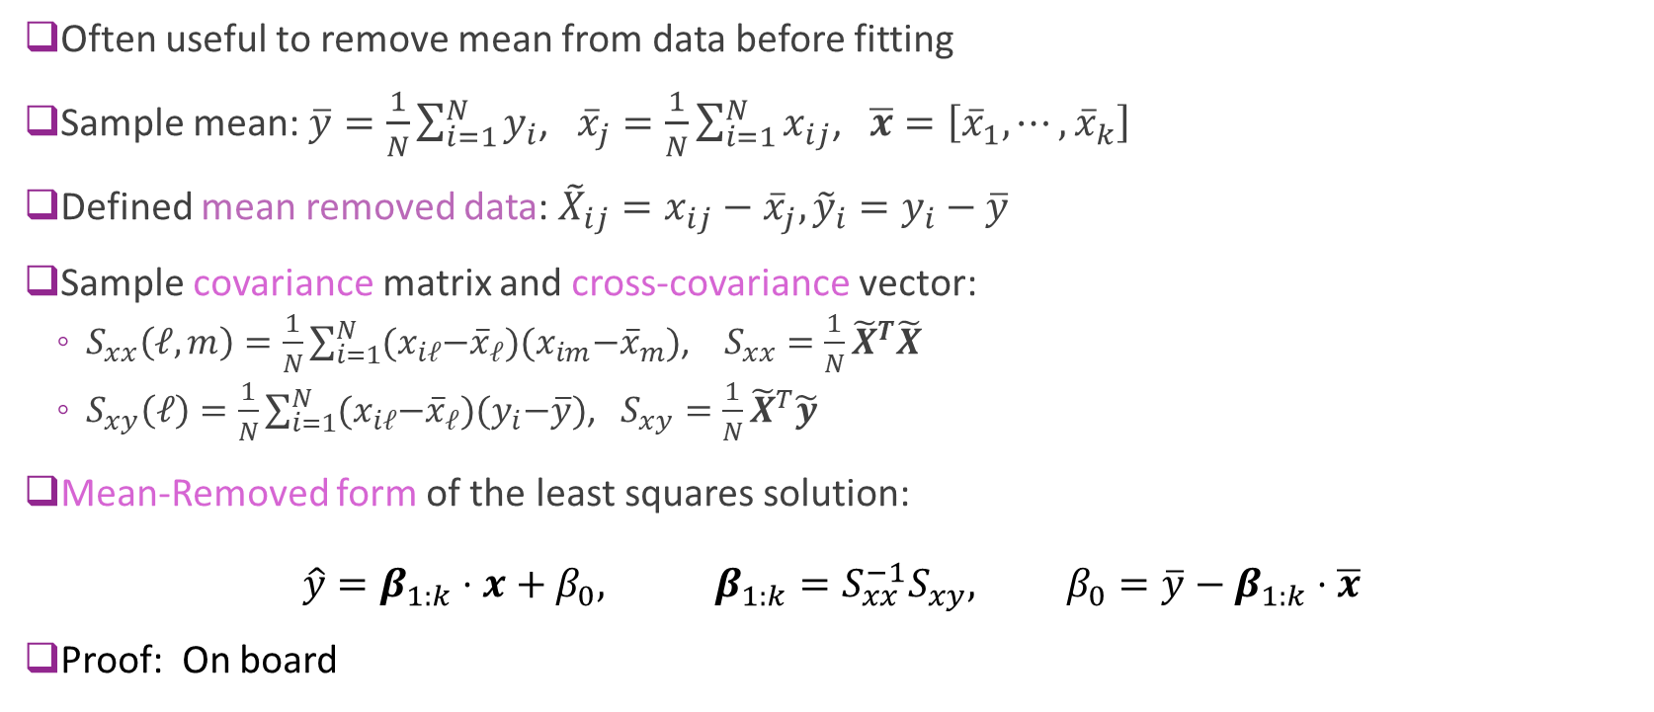
Mean Removed Form of the LS Solution
Often useful to remove mean from data before fitting
Sample mean: $\overline{y}=\frac{1}{N}\sum_{i=1}^{N}{y_{i}}$, ${\overline{x}}_{j}=\frac{1}{N}\sum_{i=1}^{N}{x_{ij}}$, $\overline{x}=\left[{\overline{x}}_{1},⋯,{\overline{x}}_{k}\right]$
Defined mean removed data: ${\tilde{X}}_{ij}=x_{ij}−{\overline{x}}_{j},{\tilde{y}}_{i}=y_{i}−$ $\overline{y}$
Sample covariance matrix and cross-covariance vector:
$S_{xx}\left(ℓ,m\right)=\frac{1}{N}\sum_{i=1}^{N}{{(x}_{iℓ}−{\overline{x}}_{ℓ}){(x}_{im}−{\overline{x}}_{m})}$, $S_{xx}=\frac{1}{N}{\tilde{X}}^{T}\tilde{X}$
$S_{xy}\left(ℓ\right)=\frac{1}{N}\sum_{i=1}^{N}{{(x}_{iℓ}−{\overline{x}}_{ℓ}){(y}_{i}−\overline{y})}$, $S_{xy}={\frac{1}{N}\tilde{X}}^{T}\tilde{y}$
Mean-Removed form of the least squares solution: $\hat{y}={β_{1:k}⋅x+β}_{0}, β_{1:k}=S_{xx}^{−1}S_{xy}, β_{0}=\overline{y}−β_{1:k}⋅\overline{x}$
Proof: On board

Slide 34
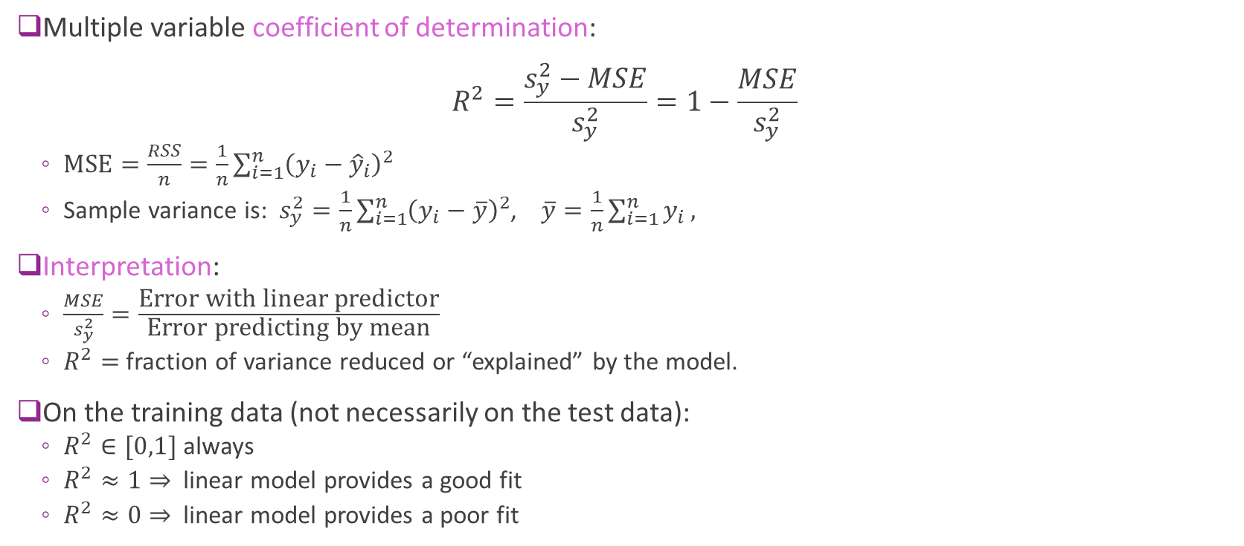
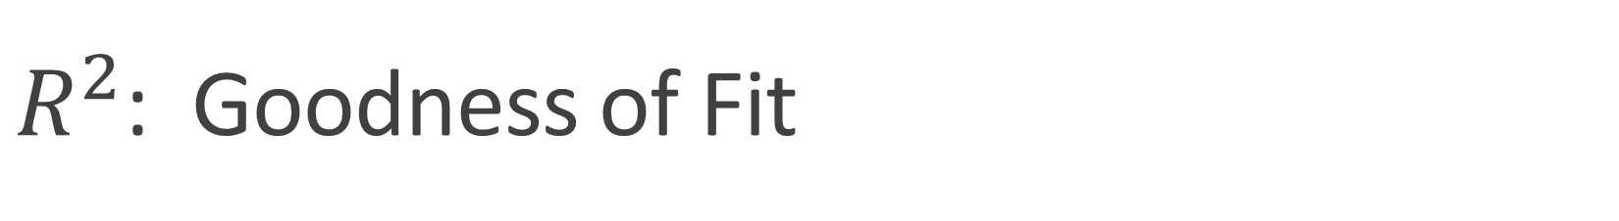
$R^{2}$: Goodness of Fit
Multiple variable coefficient of determination: $R^{2}=\frac{s_{y}^{2}−MSE}{s_{y}^{2}}=1−\frac{MSE}{s_{y}^{2}}$
$MSE=\frac{RSS}{n}=\frac{1}{n}\sum_{i=1}^{n}{{\left(y_{i}−{\hat{y}}_{i}\right)}^{2}}$
Sample variance is: $s_{y}^{2}=\frac{1}{n}\sum_{i=1}^{n}{{\left(y_{i}−\overline{y}\right)}^{2}}$, $\overline{y}=\frac{1}{n}\sum_{i=1}^{n}{y_{i}},$
Interpretation:
$\frac{MSE}{s_{y}^{2}}=\frac{\text{Error} \text{with} \text{linear} \text{predictor}}{\text{Error} \text{predicting} \text{by} \text{mean}}$
$R^{2}=$ fraction of variance reduced or “explained” by the model.
On the training data (not necessarily on the test data):
$R^{2}∈[0,1]$ always
$R^{2}≈1⇒$linear model provides a good fit
$R^{2}≈0⇒$linear model provides a poor fit

Slide 35
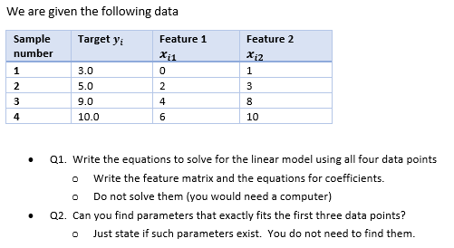
In-Class Exercise

Slide 36
Outline
Motivating Example: Understanding glucose levels in diabetes patients
Multiple variable linear models
Least squares solutions
Computing the solutions in python
Special case: Simple linear regression
Extensions

Slide 37
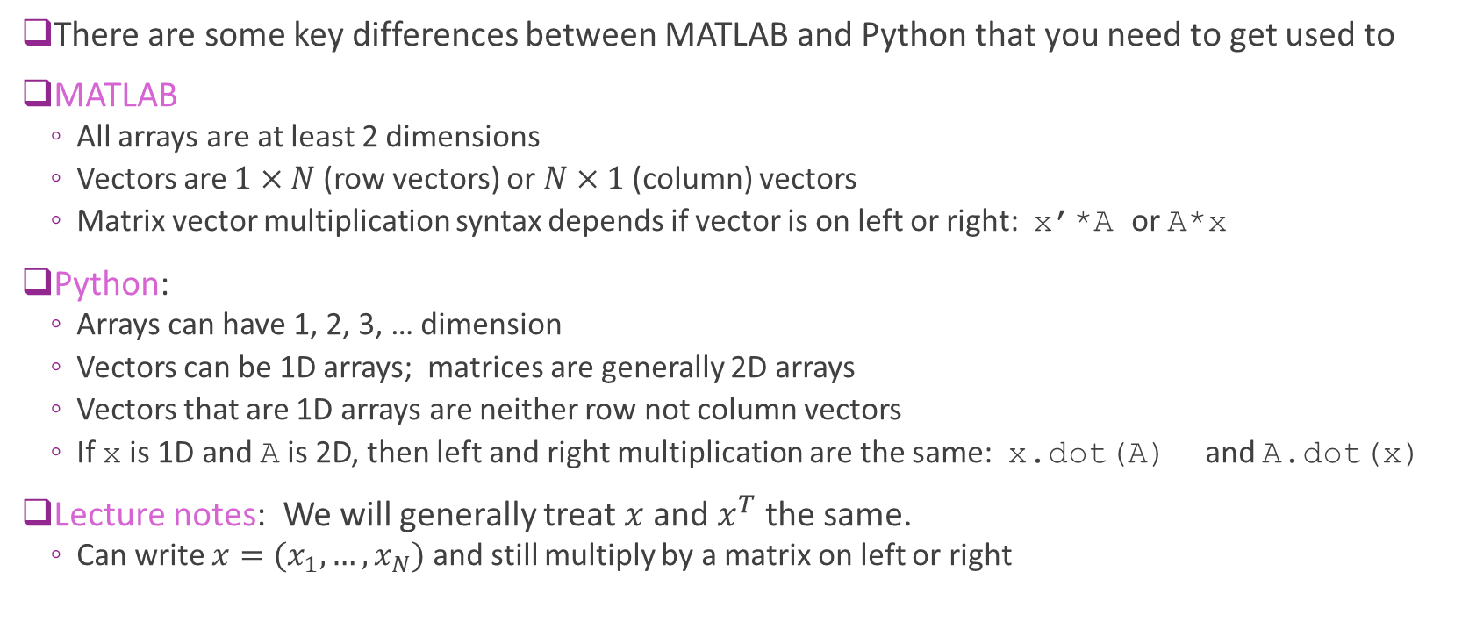
Arrays and Vector in Python and MATLAB
There are some key differences between MATLAB and Python that you need to get used to
MATLAB
All arrays are at least 2 dimensions
Vectors are $1×N$ (row vectors) or $N×1$(column) vectors
Matrix vector multiplication syntax depends if vector is on left or right: x’*A or A*x
Python:
Arrays can have 1, 2, 3, … dimension
Vectors can be 1D arrays; matrices are generally 2D arrays
Vectors that are 1D arrays are neither row not column vectors
If x is 1D and A is 2D, then left and right multiplication are the same: x.dot(A) and A.dot(x)
Lecture notes: We will generally treat $x$ and $x^{T}$the same.
Can write $x=(x_{1},…,x_{N})$ and still multiply by a matrix on left or right

Slide 38
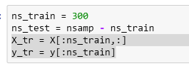
Fitting Using sklearn
Return to diabetes data example
All code in demo
Divide data into two portions:
Training data: First 300 samples
Test data: Remaining 142 samples
Train model on training data.
Test model (i.e. measure RSS) on test data
Reason for splitting data discussed next lecture.

Slide 39

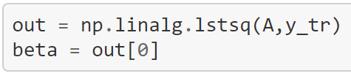
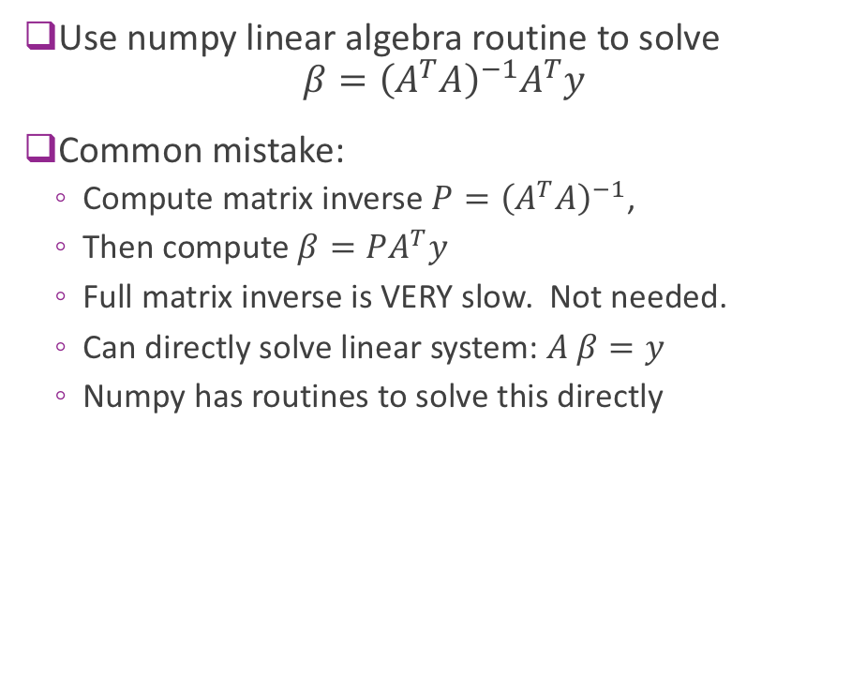
Manually Computing the Solution
Use numpy linear algebra routine to solve $β={\left(A^{T}A\right)}^{−1}A^{T}y$
Common mistake:
Compute matrix inverse ${P=\left(A^{T}A\right)}^{−1}$,
Then compute $β=PA^{T}y$
Full matrix inverse is VERY slow. Not needed.
Can directly solve linear system: $A β=y$
Numpy has routines to solve this directly

Slide 40

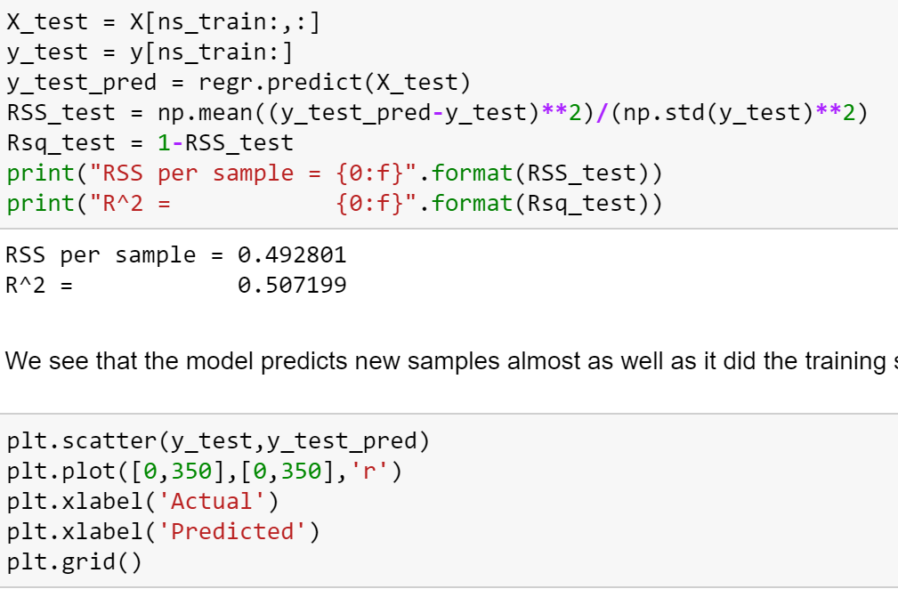
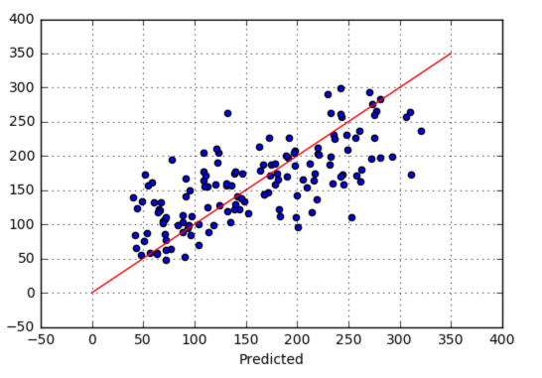
Calling the sklearn Linear Regression method
Construct a linear regression object
Run it on the training data
Predict values on the test data

Slide 41
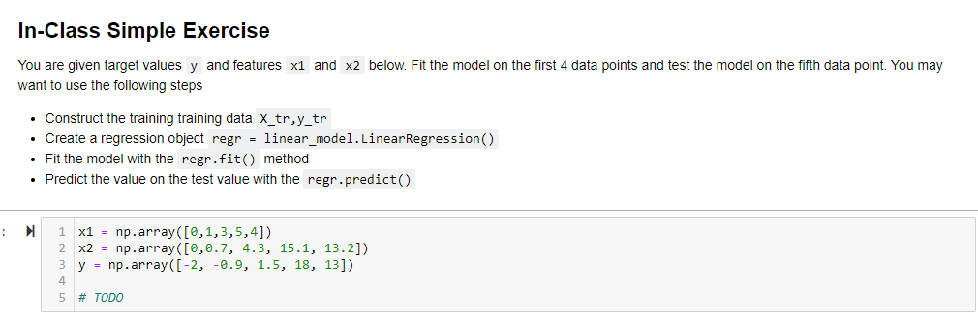
In-Class Exercise

Slide 42
Outline
Motivating Example: Understanding glucose levels in diabetes patients
Multiple variable linear models
Least squares solutions
Computing the solutions in python
Special case: Simple linear regression
Extensions

Slide 43
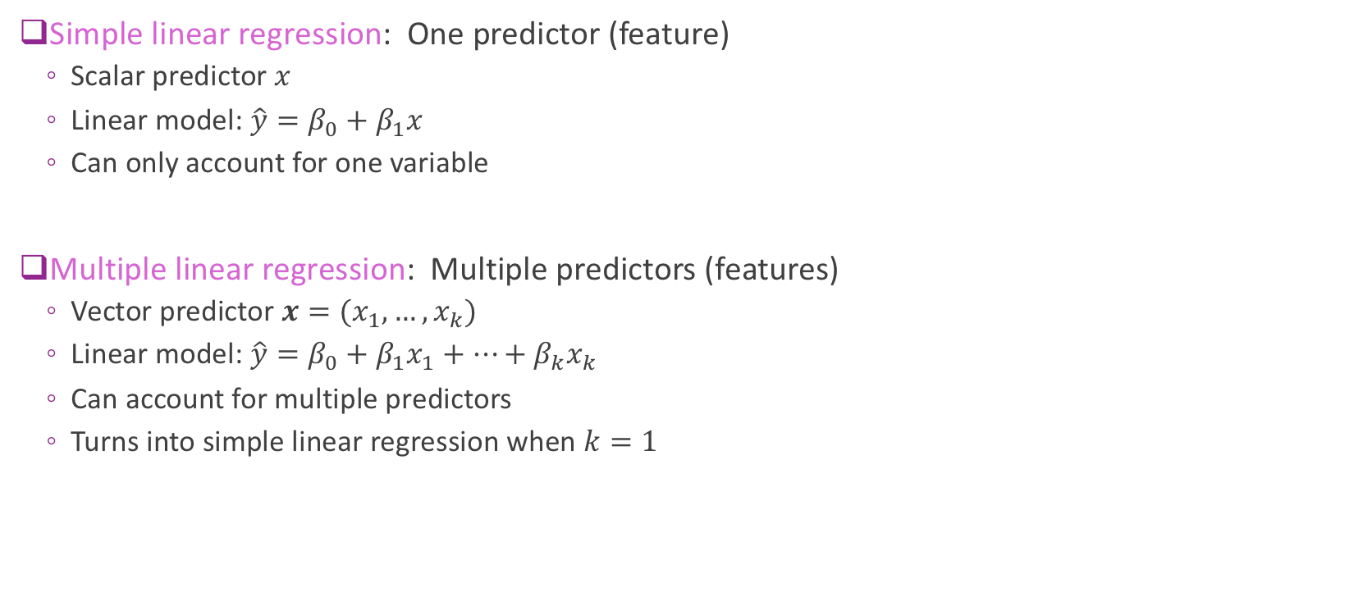
Simple vs. Multiple Regression
Simple linear regression: One predictor (feature)
Scalar predictor $x$
Linear model: $\hat{y}=β_{0}+β_{1}x$
Can only account for one variable
Multiple linear regression: Multiple predictors (features)
Vector predictor $x=(x_{1},…,x_{k})$
Linear model: $\hat{y}=β_{0}+β_{1}x_{1}+⋯+β_{k}x_{k}$
Can account for multiple predictors
Turns into simple linear regression when $k=1$

Slide 44
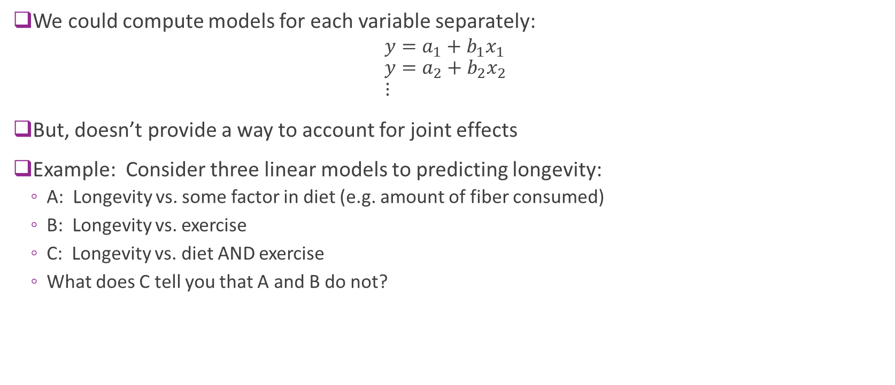
Comparison to Single Variable Models
We could compute models for each variable separately:
$$y=a_{1}+b_{1}x_{1} \\ y=a_{2}+b_{2}x_{2} \\ ⋮$$
But, doesn’t provide a way to account for joint effects
Example: Consider three linear models to predicting longevity:
A: Longevity vs. some factor in diet (e.g. amount of fiber consumed)
B: Longevity vs. exercise
C: Longevity vs. diet AND exercise
What does C tell you that A and B do not?

Slide 45

Special Case: Single Variable
Suppose $k=1$ predictor.
Feature matrix and coefficient vector: $A=\left[\begin{matrix}1 & x_{1} \\ ⋮ & ⋮ \\ 1 & x_{n}\end{matrix}\right], β=\left[\begin{matrix}β_{0} \\ β_{1}\end{matrix}\right]$
LS soln: $β={\left(\frac{1}{N}A^{T}A\right)}^{−1}\left(\frac{1}{N}A^{T}y\right)=P^{−1}r$ $P=\left[\begin{matrix}1 & \overline{x} \\ \overline{x} & \overline{x^{2}}\end{matrix}\right], r=\left[\begin{matrix}\overline{y} \\ \overline{xy}\end{matrix}\right]$
Obtain single variable solutions for coefficients (after some algebra): $β_{1}=\frac{s_{xy}}{s_{x}^{2}}, β_{0}=\overline{y}−β_{1}\overline{x}, R^{2}=\frac{s_{xy}^{2}}{s_{x}^{2}s_{y}^{2}}$

Slide 46


Simple Linear Regression for Diabetes Data
Try a fit of each variable individually
Compute $R_{k}^{2}$ coefficient for each variable
Use formula on previous slide
“Best” individual variable is a poor fit
$R_{k}^{2}≈0.34$
Best individual variable

Slide 47


Scatter Plot
No one variable explains glucose well
Multiple linear regression is much better

Slide 48
Outline
Motivating Example: Understanding glucose levels in diabetes patients
Multiple variable linear models
Least squares solutions
Computing in python
Extensions

Slide 49




Transformed Linear Models
Standard linear model: $\hat{y}=β_{0}+β_{1}x_{1}+⋯+β_{d}x_{d}$
Linear model may be too restrictive
Relation between $x$ and $y$ can be nonlinear
Useful to look at models in transformed form: $\hat{y}=β_{1}φ_{1}\left(x\right)+⋯+β_{p}φ_{p}\left(x\right)$
Each function $φ_{j}\left(x\right)=φ_{j}(x_{1},…,x_{d})$ is called a basis function
Each basis function may be nonlinear and a function of multiple variables
Can write in vector form: $\hat{y}=φ\left(x\right)⋅β$
$φ\left(x\right)=\left[φ_{1}\left(x\right),…,φ_{p}\left(x\right)\right], β=[β_{1},…,β_{p}]$
$$y$$
$$x$$

Slide 50

Fitting Transformed Linear Models
Consider transformed linear model $\hat{y}=β_{1}φ_{1}\left(x\right)+⋯+β_{p}φ_{p}\left(x\right)$
We can fit this model exactly as before
Given data $\left(x_{i},y_{i}\right), i=1,…,N$
Then, fit the model from the transformed variables $φ_{j}\left(x\right)$ to target $y$
Define the transformed matrix:
$$A=\left[\begin{matrix}φ_{1}(x_{1}) & ⋯ & φ_{p}(x_{1}) \\ ⋮ & ⋮ & ⋮ \\ φ_{1}(x_{N}) & ⋯ & φ_{p}(x_{N})\end{matrix}\right]$$
Least squares fit $\hat{β}={\left(A^{T}A\right)}^{−1}A^{T}y$

Slide 51


Example: Polynomial Fitting
Suppose $y$ only depends on a single variable $x$,
Want to fit a polynomial model
$y≈β_{0}+β_{1}x+⋯β_{d}x^{d}$
Given data $\left(x_{i},y_{i}\right), i=1,…, n$
Take basis functions $φ_{j}\left(x\right)=x^{j},j=0,…,d$
Transformed model: $\hat{y}=β_{0}φ_{0}\left(x\right)+⋯+β_{d}φ_{d}\left(x\right)$
Transformed matrix is:
$$A=\left[\begin{matrix}1 & x_{1} & \begin{matrix}⋯ & x_{1}^{d}\end{matrix} \\ ⋮ & ⋮ & \begin{matrix}⋯ & ⋮\end{matrix} \\ 1 & x_{n} & \begin{matrix}⋯ & x_{n}^{d}\end{matrix}\end{matrix}\right], β=\left[\begin{matrix}β_{0} \\ ⋮ \\ β_{d}\end{matrix}\right]$$
$p=d+1$ transformed features from 1 original feature
Will discuss how to select $d$ in the next lecture

Slide 52

Other Nonlinear Examples
Multinomial model: $\hat{y}=a+b_{1}x_{1}+b_{2}x_{2}+c_{1}x_{1}^{2}+c_{2}x_{1}x_{2}+c_{3}x_{2}^{2}$
Contains all second order terms
Define parameter vector $β=\left[a,b_{1},b_{2},c_{1},c_{2},c_{3}\right]$
Transformed vector $φ\left(x_{1},x_{2}\right)=[1,x_{1},x_{2},x_{1}^{2},x_{1}x_{2},x_{2}^{2}]$
Note that the features are nonlinear functions of $x=[x_{1},x_{2}]$
Exponential model: $\hat{y}=a_{1}e^{−b_{1}x}+⋯+a_{d}e^{−b_{d}x}$
If the parameters $b_{1},…,b_{d}$ are fixed, then the model is linear in the parameters $a_{1},…,a_{d}$
Parameter vector $β=\left[a_{1},…,a_{d}\right]$
Transformed vector $φ\left(x\right)=[e^{−b_{1}x},…,e^{−b_{d}x}]$
But, if the parameters $b_{1},…,b_{d}$ are not fixed, the model is nonlinear in $b_{1},…,b_{d}$

Slide 53

Linear Models via Re-Parametrization
Sometimes models can be made into a linear model via re-parametrization
Example: Consider the model: $\hat{y}=Ax_{1}(1+Be^{−x_{2}})$
Parameters $(A,B)$
This is nonlinear in $(A,B)$ due to the product $AB:$ $\hat{y}=Ax_{1}+ABx_{1}e^{−x_{2}}$
But, we can define a new set of parameters:
$β_{1}=A$ and $β_{2}=AB$
Then, $\hat{y}=β_{1}x_{1}+β_{2}x_{1}e^{−x_{2}}$
Basis functions: $φ\left(x_{1},x_{2}\right)=[x_{1},x_{1}e^{−x_{2}}]$
After we solve for $β_{1},β_{2}$ we can recover $A,B$ via inverting the equations: $A=β_{1}, B=\frac{β_{2}}{A}$

Slide 54


Example: Learning Linear Systems
Linear system: $y_{k}=a_{1}y_{k−1}+⋯+a_{m}y_{k−m }+b_{0}x_{k}+⋯+b_{n}x_{k−n}$ $+w_{k}$
Transfer function: $H\left(z\right)=\frac{b_{0}+⋯+b_{n}z^{−n}}{1−a_{1}z^{−1}−⋯−a_{m}z^{−m}}$
Given input sequence and output sequence for T samples,
How do we determine $β={\left(a_{1},⋯, a_{m},b_{0},⋯,b_{n}\right)}^{T}$?
Can be solved using linear regression!
Write $y=Aβ+w$ and define $A$, y
See homework problem
Many applications
Learning dynamics in robots / mechanical systems
Modeling responses in neural systems
Stock market time series
Speech modeling. Fit a model each 25 ms.

Slide 55


One Hot Coding
Suppose that $one feature x_{j}$ is a categorical variable
Ex: Predict the price of a car, $y,$ given model ${ x}_{1}$ and interior space ${ x}_{2}$
Suppose there are 3 different models of a car (Ford, BMW, GM)
Bad idea: Arbitrarily assign an index to each possible car model
Can give unreasonable relations
One-hot coding example:
With 3 possible categories, represent ${ x}_{1}$ using 3 binary features ($φ_{1}$, $φ_{2},φ_{3}$)
Model: $y=β_{0}+β_{1}φ_{1}+β_{2}φ_{2}+{β_{3}φ_{3}+β}_{4}x_{2}$
Essentially obtain $3$ different models:
Ford: $y=β_{0}+β_{1}+$ $β_{4}x_{2}$
BMW: $y=β_{0}+β_{2}+β_{4}x_{2}$
GM: $y=β_{0}+β_{3}+β_{4}x_{2}$
Allows different intercepts (or mean values) for different categories!
Model | $φ_{1}$ | $$φ_{2}$$ | $$φ_{3}$$
Ford | 1 | 0 | 0
BMW | 0 | 1 | 0
GM | 0 | 0 | 1

Slide 56
Lab: Robot Calibration
Predict the current draw
Needed to predict power consumption
Predictors:
Joint angles, velocity and acceleration
Strain gauge readings (measure of load)
Full website at TU Dortmund, Germany
http://www.rst.e-technik.tu-dortmund.de/cms/en/research/robotics/TUDOR_engl/index.html

Slide 57

In-Class Exercise
Go to github: https://github.com/sdrangan/introml
Notebook: unit03_mult_lin_reg/linreg_inclass.ipynb
You can do this on Google colaboratory or on your local machine

