Slide 1
Multiple Antennas and Beamforming
EL-GY 6023. Wireless Communications
Prof. Sundeep rangan

Slide 2
Outline
Antenna arrays and the Spatial Signature
Receive Beamforming and SNR Gain
Array Factor
Multiple paths and Diversity
Transmit Beamforming

Slide 3
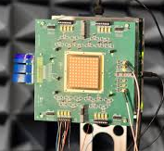
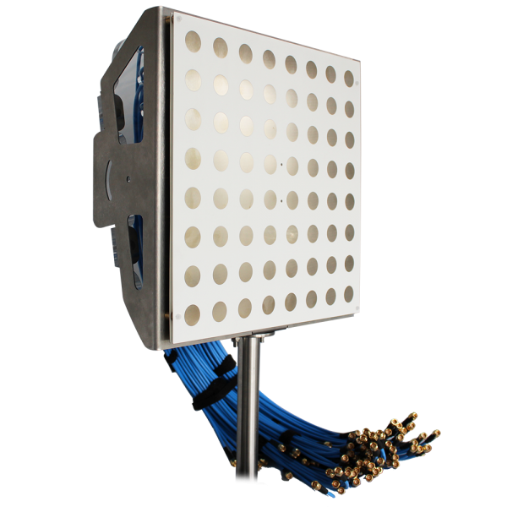
Antenna Arrays
Antenna arrays: Structure with multiple antennas
At TX and/or RX
Key to 5G mmWave and massive MIMO
Two key benefits
Beamforming: This lecture
Concentrate power in particular directions
Increases SNR and may enable spatial diversity
Requires arrays at either TX or RX
Spatial multiplexing: Next lecture
Enables transmission in multiple virtual paths
Increases degrees of freedom
Requires multiple antennas at both TX and RX
IBM 28 GHz array
32 element dual polarized array Sadhu et al, ISSCC 2017
Aurora C-Band Massive MIMO array
64 elements, 5-6 GHz
https://www.taoglas.com/

Slide 4
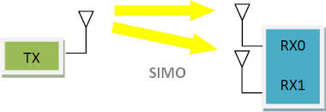

Multiple Receive Antennas
Single Input Multiple Output
One TX antenna
$M$ RX antennas
Transmit a scalar signal $x(t)$
Receive a vector of signals:
$r\left(t\right)={\left(r_{1}\left(t\right),…,r_{M}\left(t\right)\right)}^{T}$
What is the channel from $x(t)$ to $r\left(t\right)$?
Want channel in complex baseband

Slide 5



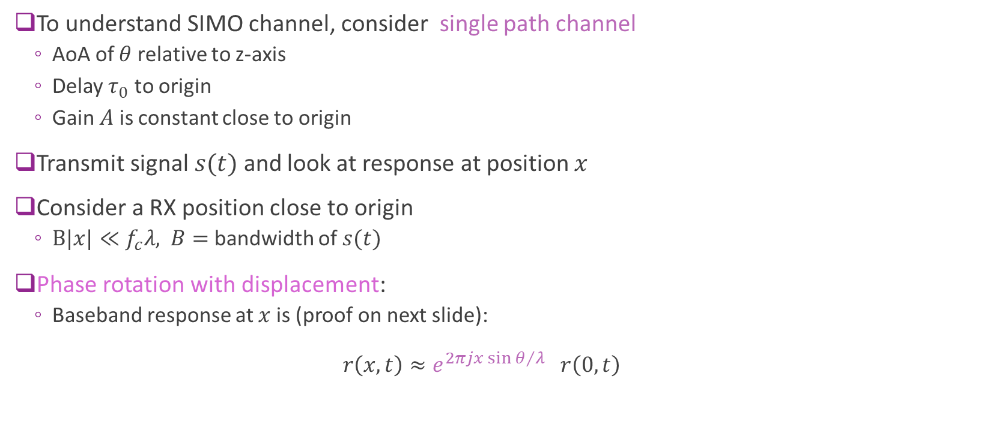





Channel vs. Position
$$z$$
$s(t)$
To understand SIMO channel, consider single path channel
AoA of $θ$ relative to z-axis
Delay $τ_{0}$ to origin
Gain $A$ is constant close to origin
Transmit signal $s(t)$ and look at response at position $x$
Consider a RX position close to origin
$B|x|≪f_{c}λ,$ $B=$ bandwidth of $s(t)$
Phase rotation with displacement:
Baseband response at $x$is (proof on next slide): $r\left(x,t\right)≈e^{2πj{x\sin{θ}}/λ} r\left(0,t\right)$
$$θ$$
RX position
$$0$$
$$x$$
$$r\left(x,t\right)$$
Phase rotation with $x$
Response at $x=0$

Slide 6

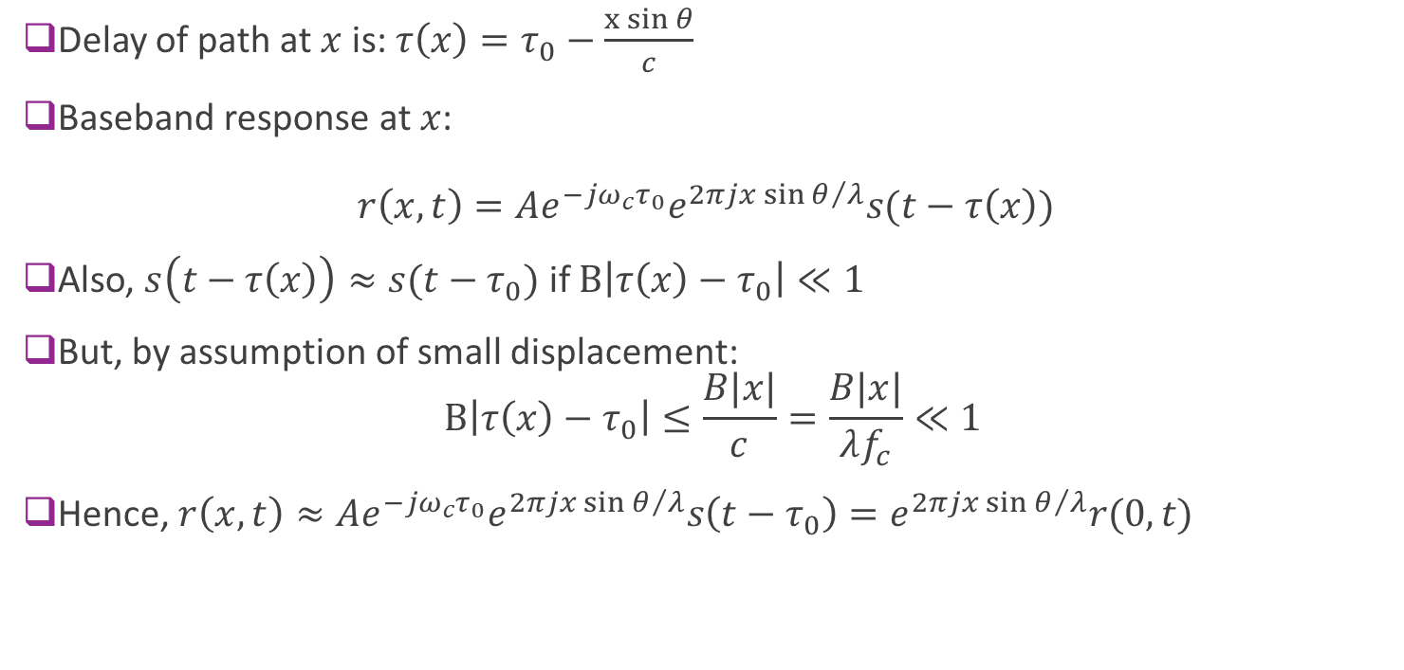


Proof of Phase Rotation with Displacement
Delay of path at $x$ is: $τ\left(x\right)=τ_{0}−\frac{x{\sin{θ}}}{c}$
Baseband response at $x$: $r\left(x,t\right)=Ae^{−j{ω_{c}τ}_{0}}e^{2πj{x\sin{θ}}/λ}s(t−τ\left(x\right))$
Also, $s\left(t−τ\left(x\right)\right)≈s(t−τ_{0})$ if $B\left|τ\left(x\right)−τ_{0}\right|≪1$
But, by assumption of small displacement: $B\left|τ\left(x\right)−τ_{0}\right|≤\frac{B|x|}{c}=\frac{B|x|}{λf_{c}}≪1$
Hence, $r\left(x,t\right)≈Ae^{−j{ω_{c}τ}_{0}}e^{2πj{x\sin{θ}}/λ}s\left(t−τ_{0}\right)=e^{2πj{x\sin{θ}}/λ}r(0,t)$
$$θ$$
$$0$$
$$x$$
RX position

Slide 7
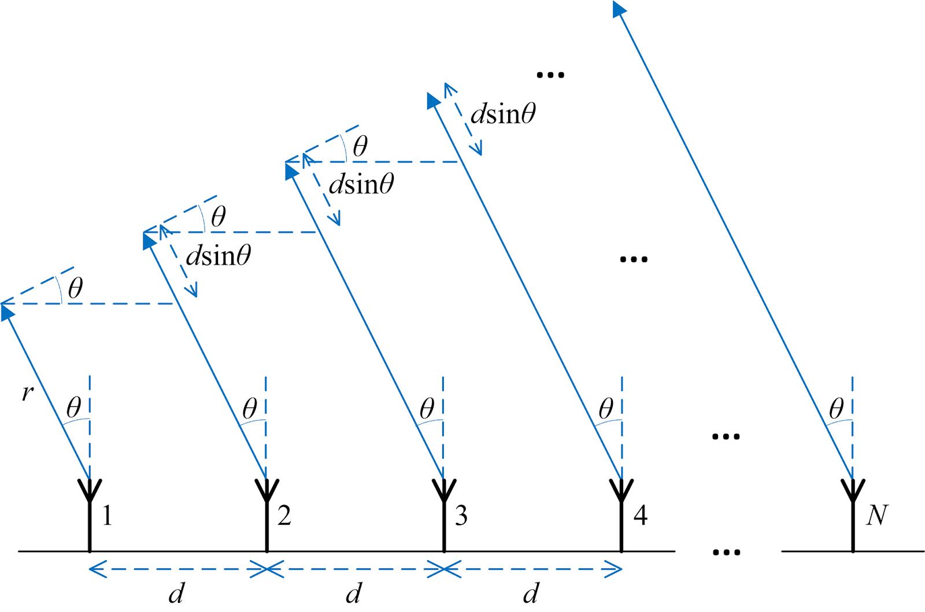

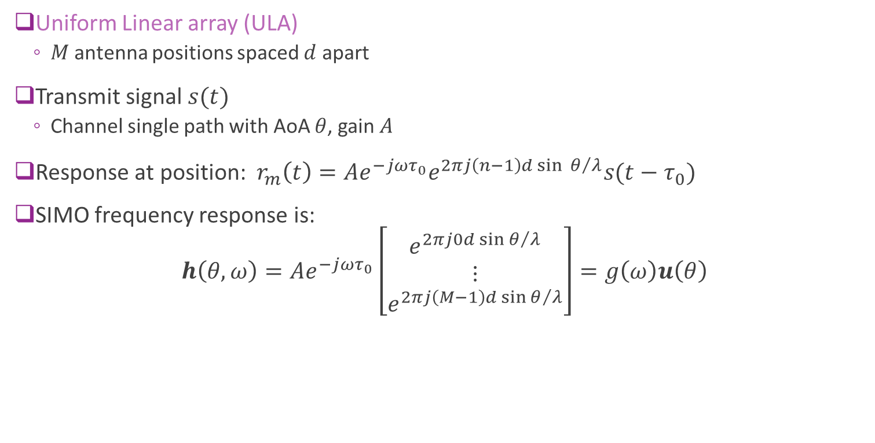
Response for a ULA
Uniform Linear array (ULA)
$M$antenna positions spaced $d$ apart
Transmit signal $s(t)$
Channel single path with AoA $θ$, gain $A$
Response at position: $r_{m}\left(t\right)=Ae^{−j{ωτ}_{0}}e^{2πj{\left(n−1\right)d\sin{θ}}/λ}s(t−τ_{0})$
SIMO frequency response is:
$$h\left(θ,ω\right)=Ae^{−j{ωτ}_{0}}\left[\begin{matrix}e^{2πj{0d\sin{θ}}/λ} \\ ⋮ \\ e^{2πj{\left(M−1\right)d\sin{θ}}/λ}\end{matrix}\right]=g\left(ω\right)u\left(θ\right)$$
Scalar response at $x=0$
Phase shifts across elements

Slide 8
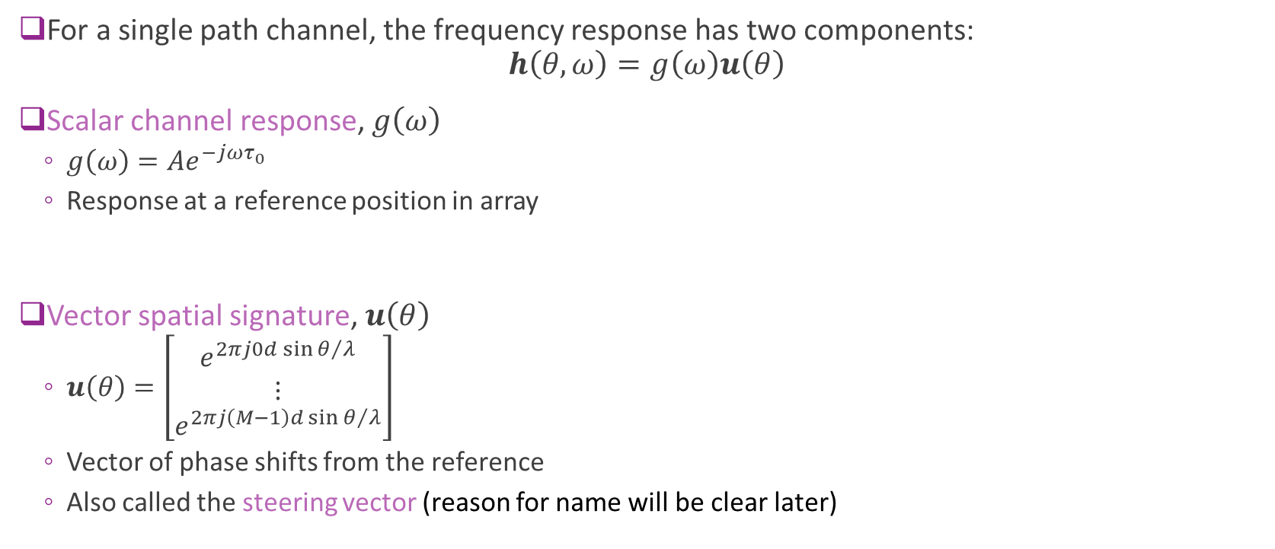
Response Decomposition
For a single path channel, the frequency response has two components: $h\left(θ,ω\right)=g\left(ω\right)u\left(θ\right)$
Scalar channel response, $g\left(ω\right)$
$g\left(ω\right)=Ae^{−j{ωτ}_{0}}$
Response at a reference position in array
Vector spatial signature, $u\left(θ\right)$
$u\left(θ\right)=\left[\begin{matrix}e^{2πj{0d\sin{θ}}/λ} \\ ⋮ \\ e^{2πj{\left(M−1\right)d\sin{θ}}/λ}\end{matrix}\right]$
Vector of phase shifts from the reference
Also called the steering vector (reason for name will be clear later)

Slide 9
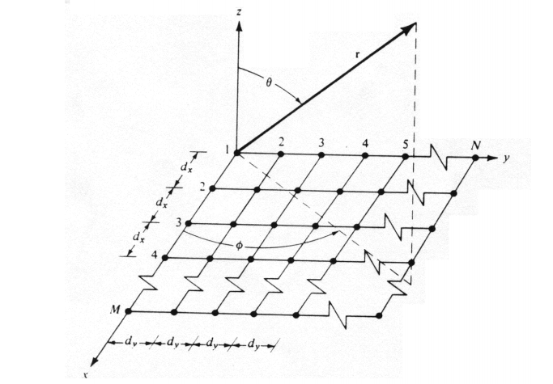
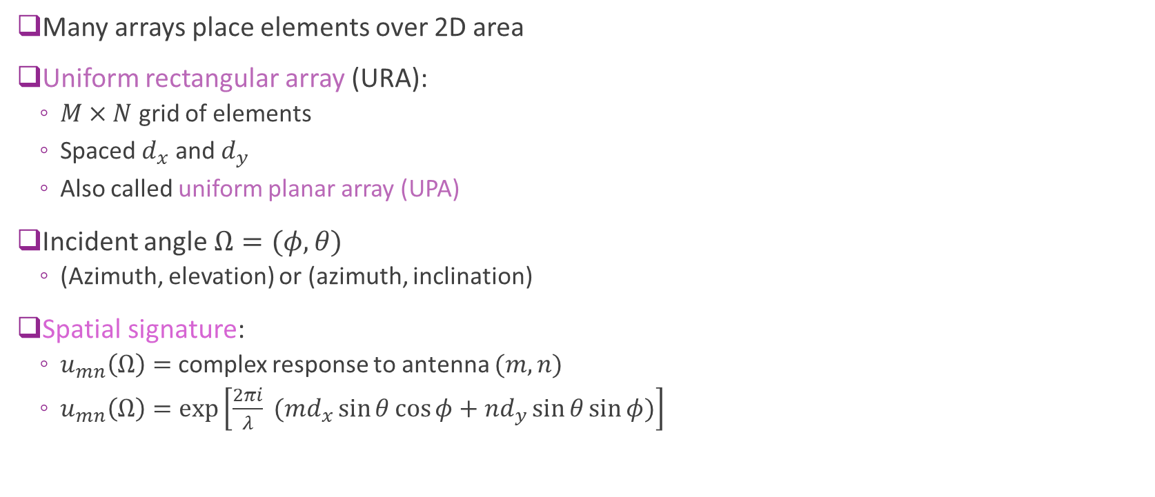
Array Response in 3D
Many arrays place elements over 2D area
Uniform rectangular array (URA):
$M×N$ grid of elements
Spaced $d_{x}$ and $d_{y}$
Also called uniform planar array (UPA)
Incident angle $Ω=(φ, θ)$
(Azimuth, elevation) or (azimuth, inclination)
Spatial signature:
$u_{mn}\left(Ω\right)=$ complex response to antenna $(m,n)$
$u_{mn}\left(Ω\right)=\exp\left[\frac{2πi}{λ} (md_{x}\sin{θ}\cos{φ}+nd_{y}\sin{θ}\sin{φ})\right]$

Slide 10
Outline
Antenna arrays and the Spatial Signature
Receive Beamforming and SNR Gain
Array Factor
Multiple paths and Diversity
Transmit Beamforming

Slide 11
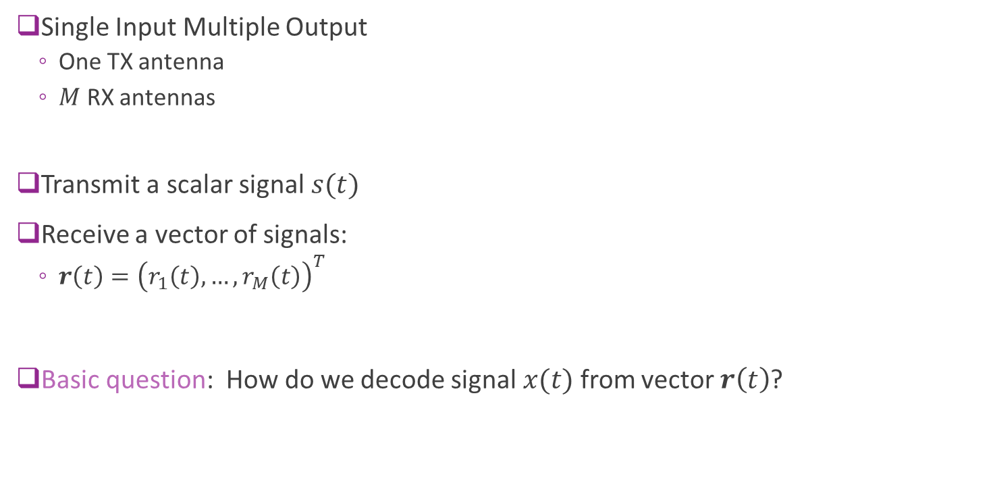



Multiple Receive Antennas
Single Input Multiple Output
One TX antenna
$M$ RX antennas
Transmit a scalar signal $s(t)$
Receive a vector of signals:
$r\left(t\right)={\left(r_{1}\left(t\right),…,r_{M}\left(t\right)\right)}^{T}$
Basic question: How do we decode signal $x(t)$ from vector $r\left(t\right)$?
$$r_{1}(t)$$
$$s(t)$$
$$r_{2}(t)$$

Slide 12
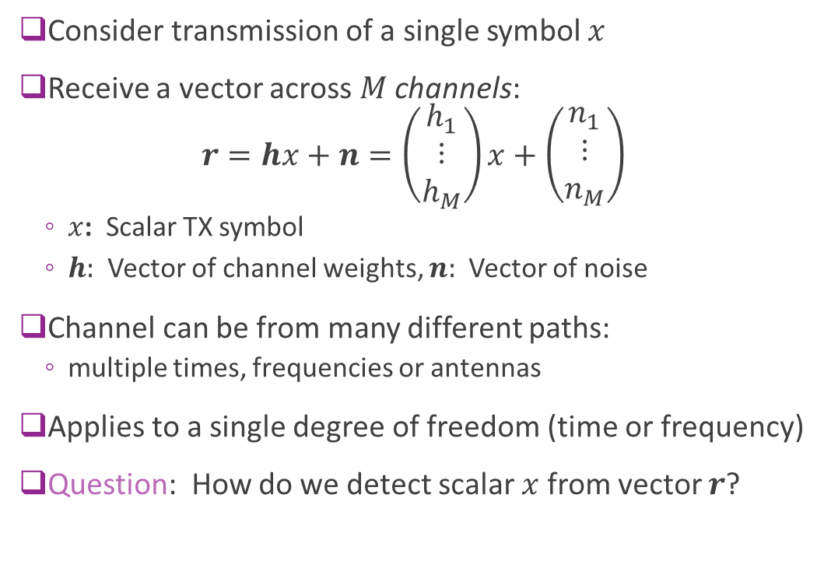


Scalar Multiple Channel Problem
Consider transmission of a single symbol $x$
Receive a vector across $M$ channels: $r=hx+n=\left(\begin{matrix}h_{1} \\ ⋮ \\ h_{M}\end{matrix}\right)x+\left(\begin{matrix}n_{1} \\ ⋮ \\ n_{M}\end{matrix}\right)$
$x$: Scalar TX symbol
$h:$ Vector of channel weights, $n:$ Vector of noise
Channel can be from many different paths:
multiple times, frequencies or antennas
Applies to a single degree of freedom (time or frequency)
Question: How do we detect scalar $x$ from vector $r$?
$$h_{1}$$
$$h_{2}$$

Slide 13
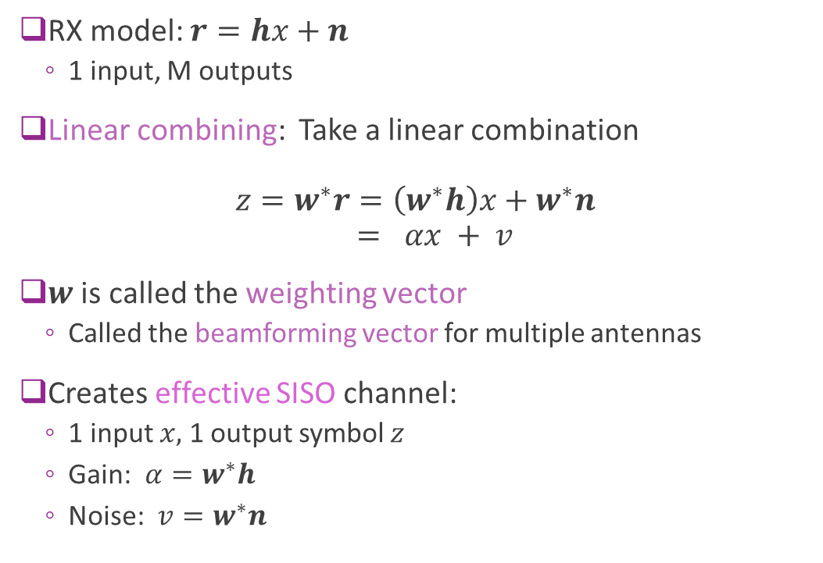
Linear Combining
RX model: $r=hx+n$
1 input, M outputs
Linear combining: Take a linear combination $z=w^{∗}r=\left(w^{∗}h\right)x+w^{∗}n$ $= αx + v$
$w$ is called the weighting vector
Called the beamforming vector for multiple antennas
Creates effective SISO channel:
1 input $x,$ 1 output symbol $z$
Gain: $α=w^{∗}h$
Noise: $v=w^{∗}n$
$$h_{1}$$
$$h_{2}$$

Slide 14
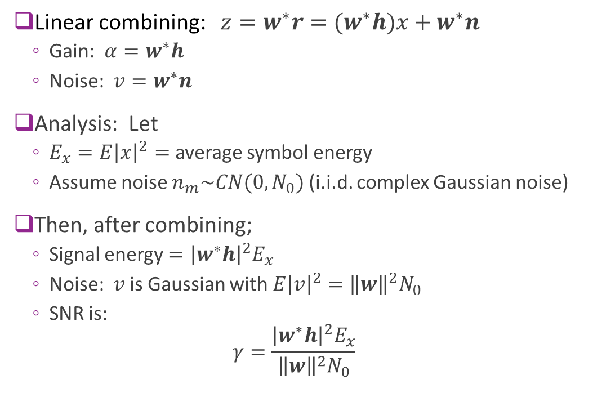
Linear Combining Analysis
Linear combining: $z=w^{∗}r=(w^{∗}h)x+w^{∗}n$
Gain: $α=w^{∗}h$
Noise: $v=w^{∗}n$
Analysis: Let
$E_{x}=E{\left|x\right|}^{2}=$ average symbol energy
Assume noise $n_{m}\sim CN(0,N_{0})$ (i.i.d. complex Gaussian noise)
Then, after combining;
Signal energy $={\left|w^{∗}h\right|}^{2}E_{x}$
Noise: $v$ is Gaussian with $E{\left|v\right|}^{2}={\left\|w\right\|}^{2}N_{0}$
SNR is: $γ=\frac{{\left|w^{∗}h\right|}^{2}E_{x}}{{\left\|w\right\|}^{2}N_{0}}$
$$h_{1}$$
$$h_{2}$$

Slide 15

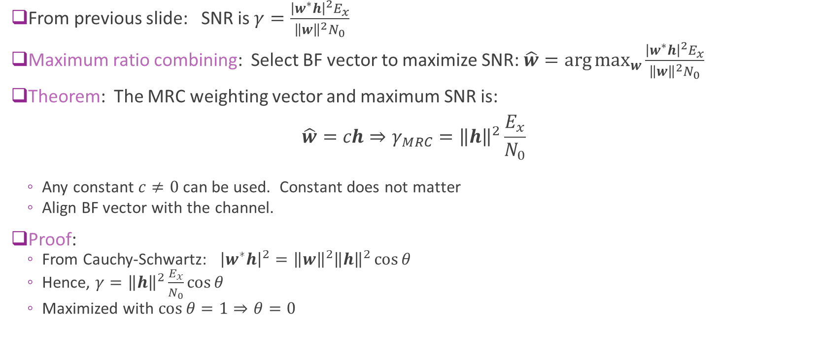


Maximum Ratio Combining
From previous slide: SNR is $γ=\frac{{\left|w^{∗}h\right|}^{2}E_{x}}{{\left\|w\right\|}^{2}N_{0}}$
Maximum ratio combining: Select BF vector to maximize SNR: $\hat{w}=\arg{\max_{w}{\frac{{\left|w^{∗}h\right|}^{2}E_{x}}{{\left\|w\right\|}^{2}N_{0}}}}$
Theorem: The MRC weighting vector and maximum SNR is: $\hat{w}=ch⇒γ_{MRC}={\left\|h\right\|}^{2}\frac{E_{x}}{N_{0}}$
Any constant $c≠0$ can be used. Constant does not matter
Align BF vector with the channel.
Proof:
From Cauchy-Schwartz: ${\left|w^{∗}h\right|}^{2}={\left\|w\right\|}^{2}{\left\|h\right\|}^{2}\cos{θ}$
Hence, $γ={\left\|h\right\|}^{2}\frac{E_{x}}{N_{0}}\cos{θ}$
Maximized with $\cos{θ}=1⇒θ=0$
$$w$$
$$θ$$
$$h$$

Slide 16
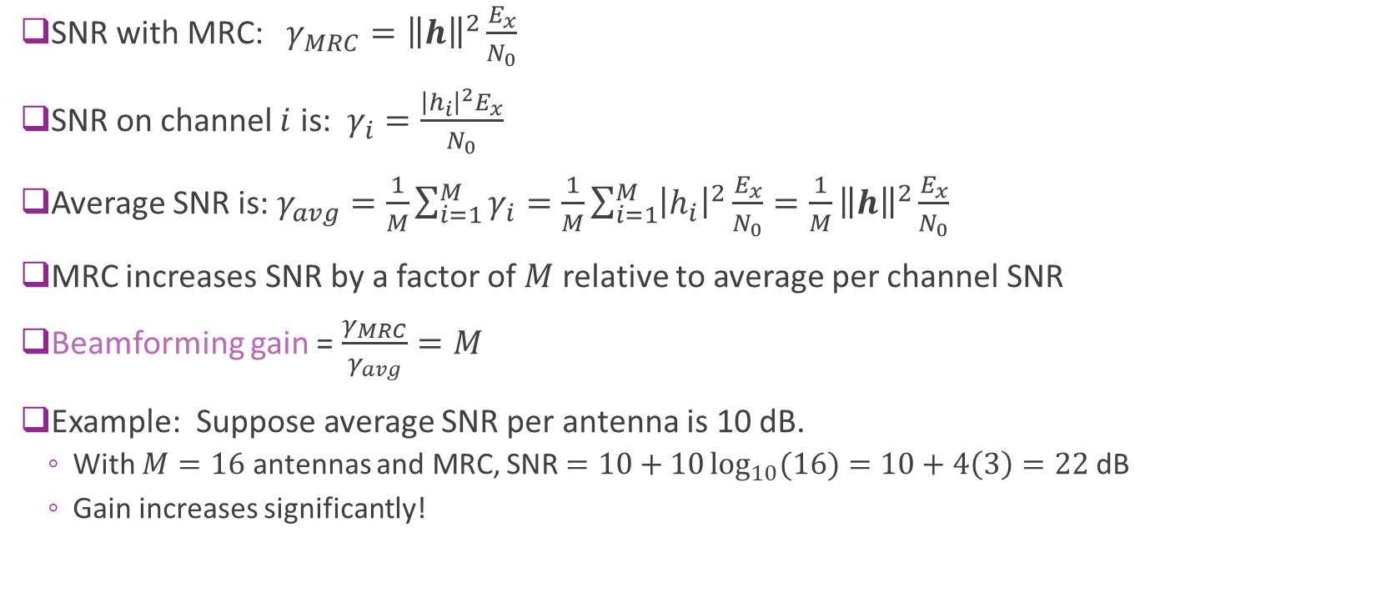
MRC Gain
SNR with MRC: $γ_{MRC}={\left\|h\right\|}^{2}\frac{E_{x}}{N_{0}}$
SNR on channel $i$ is: $γ_{i}=\frac{{\left|h_{i}\right|}^{2}E_{x}}{N_{0}}$
Average SNR is: $γ_{avg}=\frac{1}{M}\sum_{i=1}^{M}{γ_{i}}=\frac{1}{M}\sum_{i=1}^{M}{{\left|h_{i}\right|}^{2}}\frac{E_{x}}{N_{0}}=\frac{1}{M}{\left\|h\right\|}^{2}\frac{E_{x}}{N_{0}}$
MRC increases SNR by a factor of $M$ relative to average per channel SNR
Beamforming gain = $\frac{γ_{MRC}}{γ_{avg}}=M$
Example: Suppose average SNR per antenna is 10 dB.
With $M=16$ antennas and MRC, SNR $=10+10\log_{10}{(16)}=10+4\left(3\right)=22$ dB
Gain increases significantly!

Slide 17
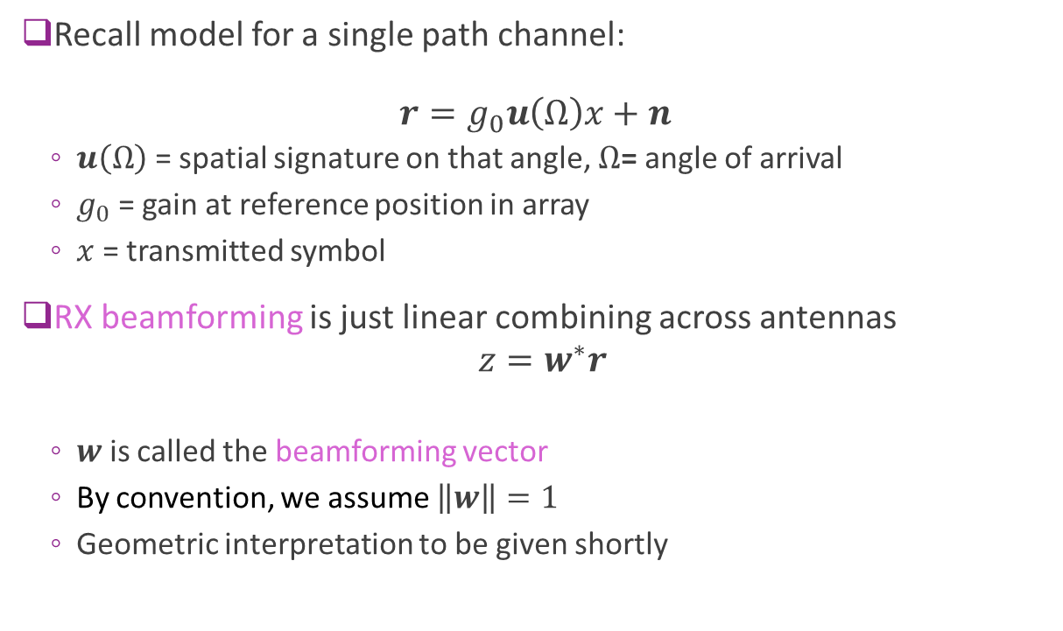
RX Beamforming
Recall model for a single path channel: $r=g_{0}u\left(Ω\right)x+n$
$u\left(Ω\right)$ = spatial signature on that angle, $Ω$= angle of arrival
$g_{0}$ = gain at reference position in array
$x$ = transmitted symbol
RX beamforming is just linear combining across antennas
$$z=w^{∗}r$$
$w$ is called the beamforming vector
By convention, we assume $\left\|w\right\|=1$
Geometric interpretation to be given shortly

Slide 18
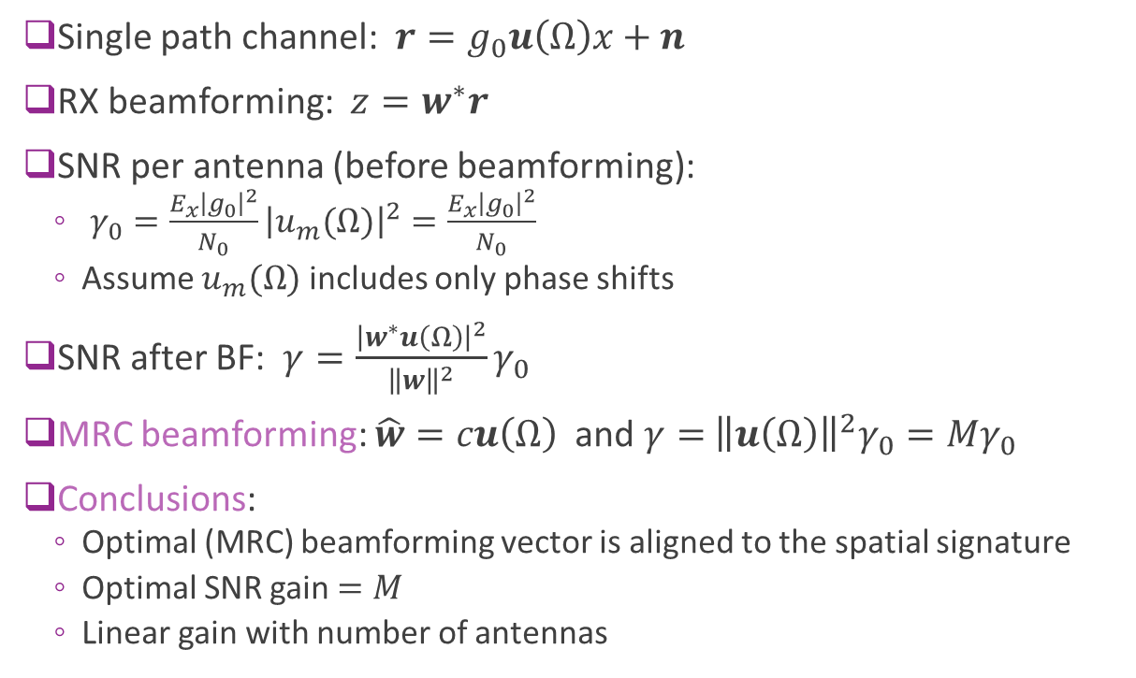
MRC Beamforming
Single path channel: $r=g_{0}u\left(Ω\right)x+n$
RX beamforming: $z=w^{∗}r$
SNR per antenna (before beamforming):
$γ_{0}=\frac{E_{x}{\left|g_{0}\right|}^{2}}{N_{0}}{\left|u_{m}(Ω)\right|}^{2}=\frac{E_{x}{\left|g_{0}\right|}^{2}}{N_{0}}$
Assume $u_{m}(Ω)$ includes only phase shifts
SNR after BF: $γ=\frac{{\left|w^{∗}u\left(Ω\right)\right|}^{2}}{{\left\|w\right\|}^{2}}γ_{0}$
MRC beamforming: $\hat{w}=cu\left(Ω\right)$ and $γ=$ ${\left\|u\left(Ω\right)\right\|}^{2}γ_{0}=Mγ_{0}$
Conclusions:
Optimal (MRC) beamforming vector is aligned to the spatial signature
Optimal SNR gain $=M$
Linear gain with number of antennas

Slide 19

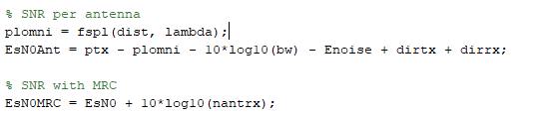
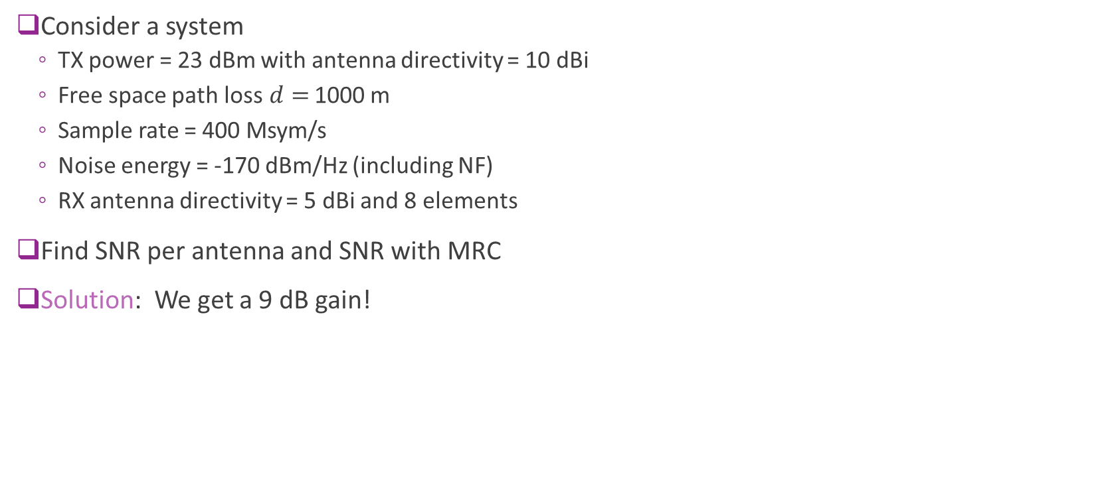
Example Problem
Consider a system
TX power = 23 dBm with antenna directivity = 10 dBi
Free space path loss$d=$ 1000 m
Sample rate = 400 Msym/s
Noise energy = -170 dBm/Hz (including NF)
RX antenna directivity = 5 dBi and 8 elements
Find SNR per antenna and SNR with MRC
Solution: We get a 9 dB gain!

Slide 20

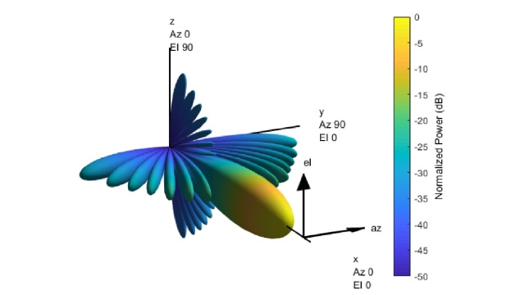
MATLAB Phased Array Toolbox
Powerful toolbox
Routines for:
Defining and visualizing arrays
Computing beam patterns
Beamforming
MIMO
Radar
…

Slide 21
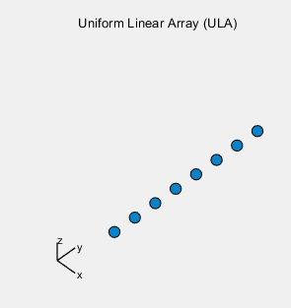
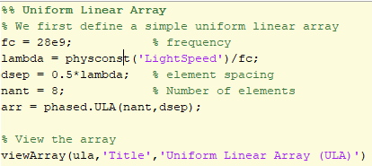
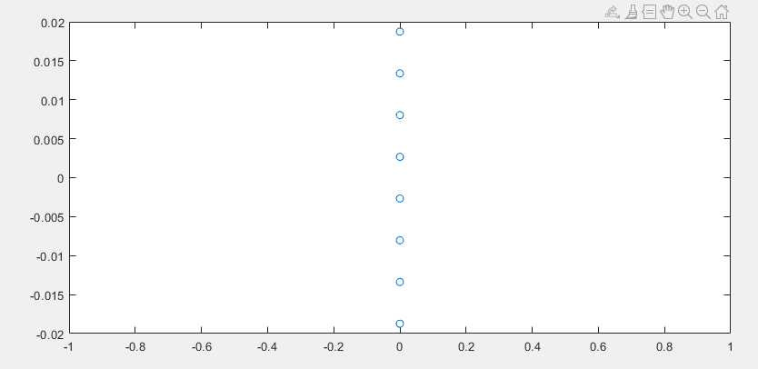

Example: Defining a ULA
Define and view the array
Can display array:
Using viewArray command
Or, manually

Slide 22
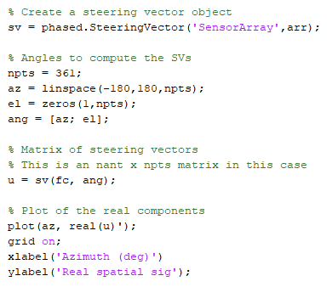
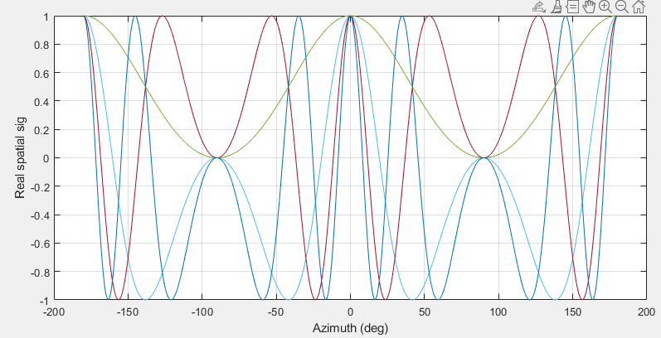
Computing the Spatial Signature
Compute the spatial signature with the SteeringVector object

Slide 23
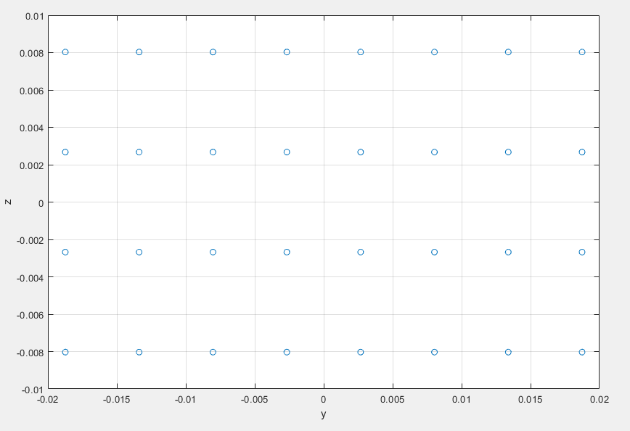
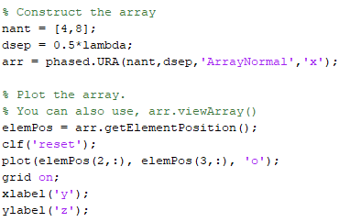
Example: Defining a URA
Define and view the array
Use the phased.URA class
Can compute steering vector similarly
A 4 x 8 URA with normal axis aligned on x

Slide 24
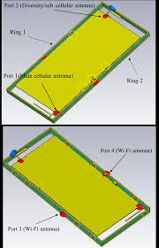
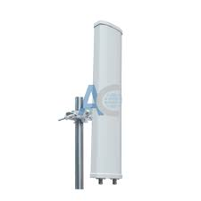
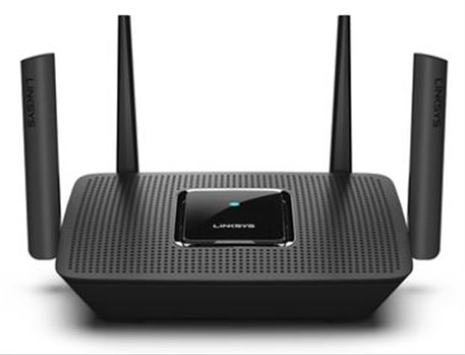
Multiple Antennas in Commercial Systems
Sub 6 GHz systems: Mostly 1 to 4 antennas on base stations or smart phones
Form factor restricts larger number of antennas
WiFi Router
Linksys AC2200 with 4TX/RX
2x2 LTE base station antenna
Cros-polarization
16 dBi element gain, 90 deg sector 750x120x60mm
K. Zhao, S. Zhang, K. Ishimiya, Z. Ying and S. He, "Body-Insensitive Multimode MIMO Terminal Antenna of Double-Ring Structure," in IEEE Transactions on Antennas and Propagation, vol. 63, no. 5, pp. 1925-1936, May 2015.

Slide 25
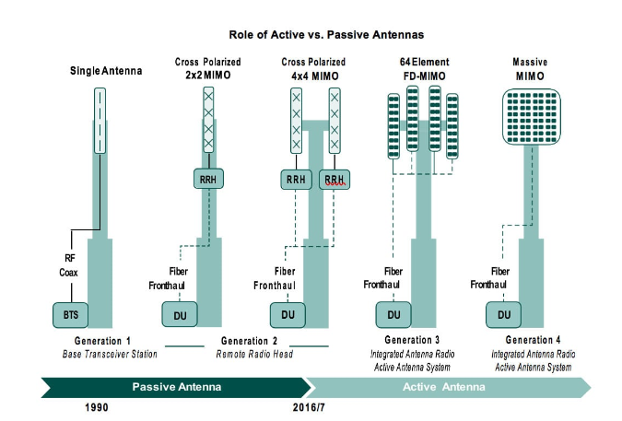
Massive MIMO
Massive MIMO:
Many base station antennas
64 to 128 in many systems today
Significant capacity increase
Typically 8x by most estimates
Use SDMA
Will discuss this later

Slide 26
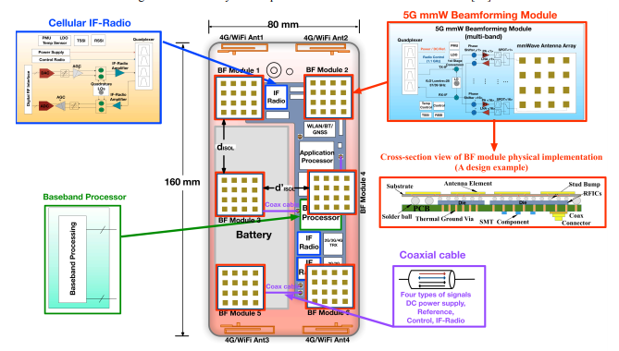
Beamforming and MmWave
To compensate for high isotropic path loss, mmWave systems need large number of antennas
5G handsets: Multiple arrays with 4 to 8 antennas each
5G base stations: 64 to 256 elements
IBM 28 GHz array
32 element dual polarized array Sadhu et al, ISSCC 2017
Huo, Yiming, et al. "Cellular and WiFi co-design for 5G user equipment." 2018 IEEE 5G World Forum (5GWF). IEEE, 2018.

Slide 27
In-Class Problem: Simple QPSK simulation
Simulate QPSK transmission over a single path channel

Slide 28
Outline
Antenna arrays and the Spatial Signature
Receive Beamforming and SNR Gain
Array Factor
Multiple Paths and Diversity
Transmit Beamforming

Slide 29

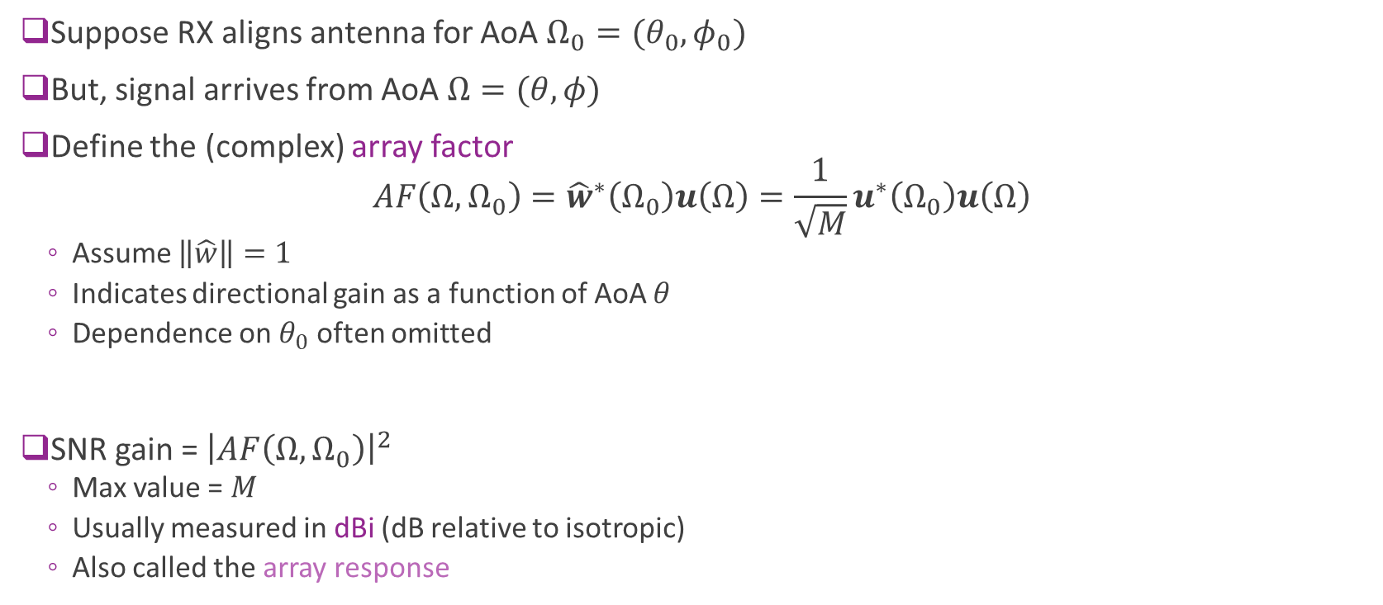

Array Factor
Suppose RX aligns antenna for AoA $Ω_{0}=(θ_{0},φ_{0})$
But, signal arrives from AoA $Ω=(θ,φ)$
Define the (complex) array factor $AF\left(Ω,Ω_{0}\right)={\hat{w}}^{∗}\left(Ω_{0}\right)u\left(Ω\right)=\frac{1}{\sqrt{M}}u^{∗}\left(Ω_{0}\right)u\left(Ω\right)$
Assume $\left\|\hat{w}\right\|=1$
Indicates directional gain as a function of AoA $θ$
Dependence on $θ_{0}$ often omitted
SNR gain = ${\left|AF\left(Ω,Ω_{0}\right)\right|}^{2}$
Max value = $M$
Usually measured in dBi (dB relative to isotropic)
Also called the array response
Actual arrival
$$Ω$$
BF direction
$$Ω_{0}$$
Array

Slide 30

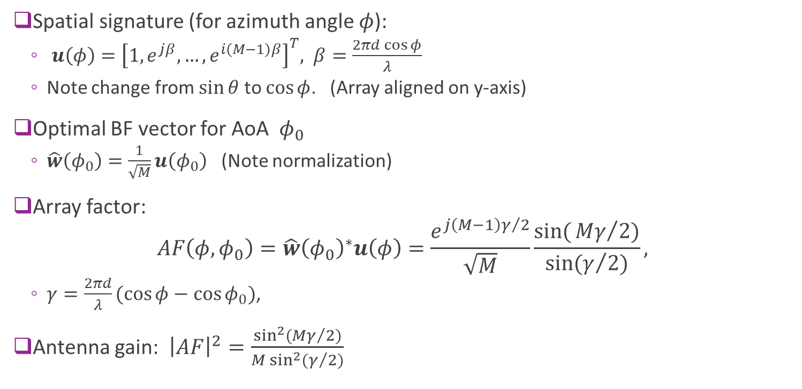



Uniform Linear Array
$$y$$
Spatial signature (for azimuth angle $φ$):
$u\left(φ\right)={\left[1, e^{jβ},…,e^{i\left(M−1\right)β}\right]}^{T}, β=\frac{2πd\cos{φ}}{λ}$
Note change from $\sin{θ}$ to $\cos{φ}$. (Array aligned on y-axis)
Optimal BF vector for AoA $φ_{0}$
$\hat{w}\left(φ_{0}\right)=\frac{1}{\sqrt{M}}u\left(φ_{0}\right)$ (Note normalization)
Array factor: $AF\left(φ,φ_{0}\right)=\hat{w}{\left(φ_{0}\right)}^{∗}u\left(φ\right)=\frac{e^{j\left(M−1\right)γ/2}}{\sqrt{M}}\frac{sin({{Mγ}/{2)}}}{\sin{(γ/2)}},$
$γ=\frac{2πd}{λ}(\cos{φ}−\cos{φ_{0}})$,
Antenna gain: ${\left|AF\right|}^{2}=\frac{\sin^{2}({{Mγ}/{2)}}}{M\sin^{2}{(γ/2)}}$
Arrival
$$φ$$
BF direction
$$φ_{0}$$
$$x$$

Slide 31
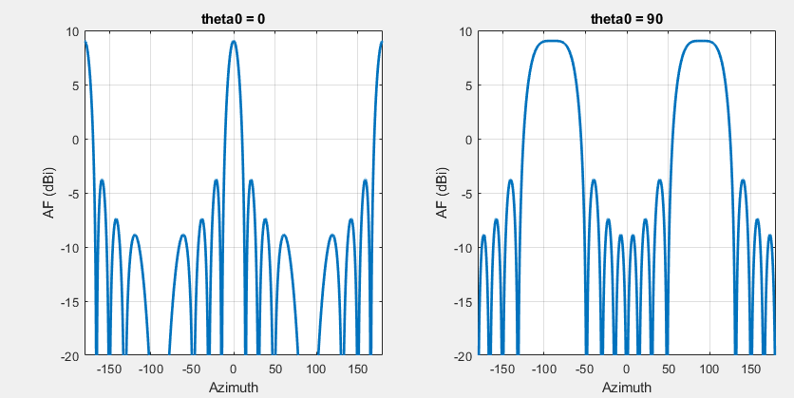
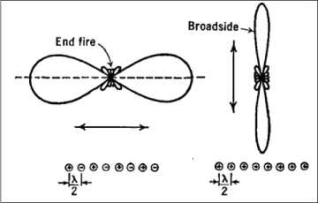
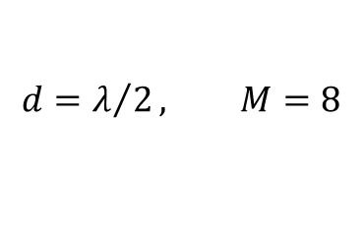
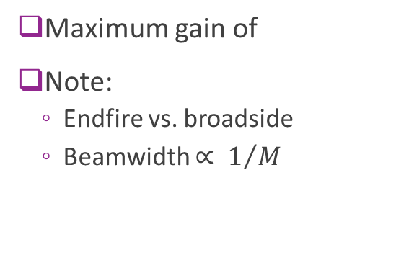


Antenna Gain for ULA
$$d=λ/2, M=8$$
Broadside: $θ_{0}=0$
Endfire: $θ_{0}=90$
Maximum gain of
Note:
Endfire vs. broadside
Beamwidth $∝ 1/M$

Slide 32
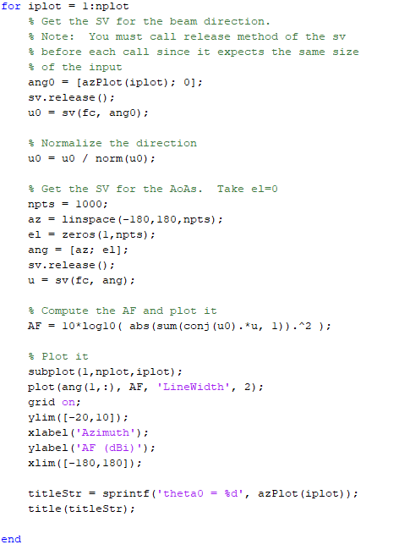
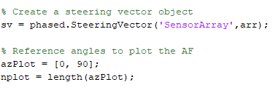
Plotting the Array Factor
Create a SteeringVector object
Get steering vectors
Compute inner products

Slide 33
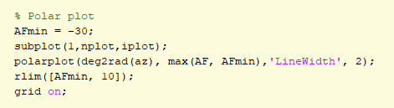
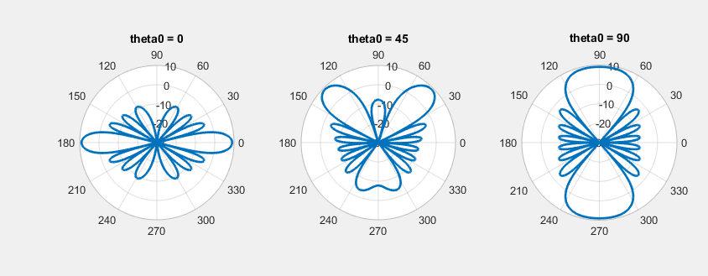
Polar Plot
Useful to visualize in polar plot
Note key features:
Direction of maximum gain
Sidelobes
Pattern repeated on reverse side

Slide 34

Key Statistics
Full null beamwidth (zero to zero)
Half power beamwidth (-3dB to -3dB)
First sidelobe level
From Jacobs University slides
Values in () for: $d=λ/2, M=8$

Slide 35
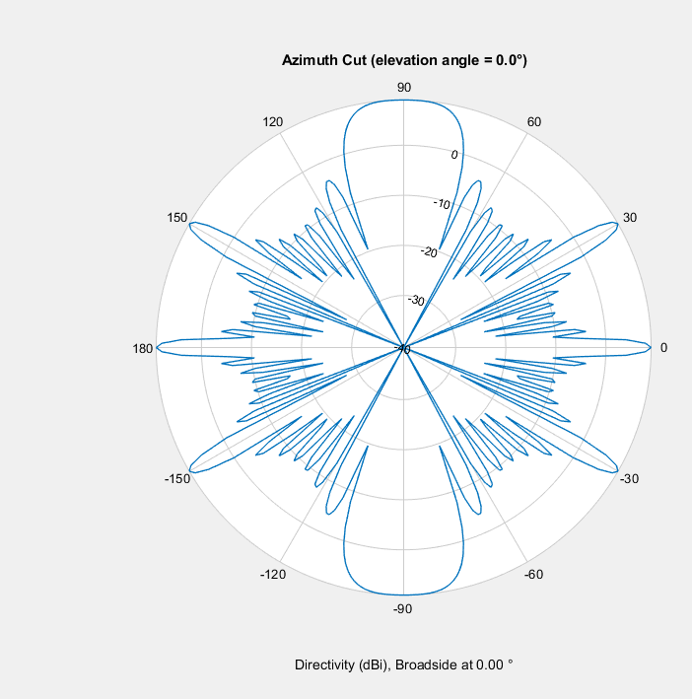
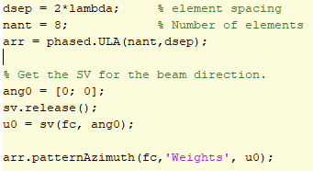
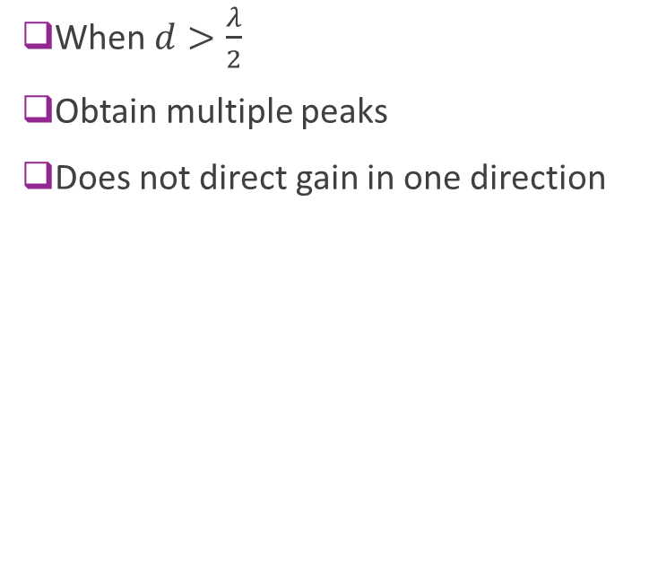
Grating Lobes
When $d>\frac{λ}{2}$
Obtain multiple peaks
Does not direct gain in one direction

Slide 36
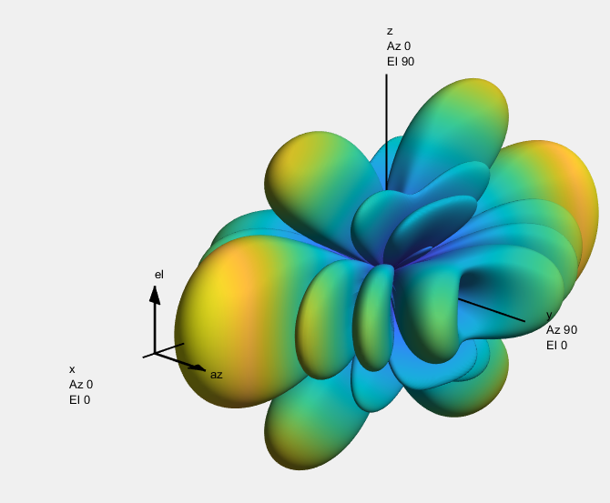
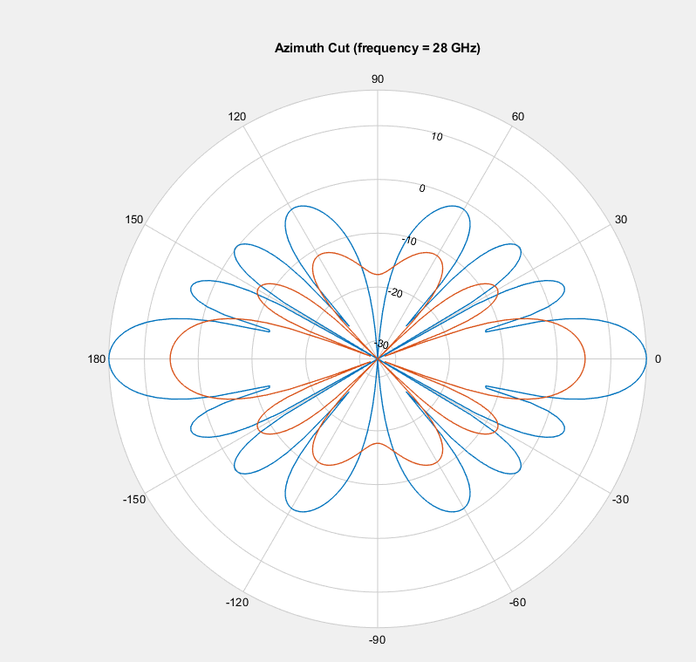


Plotting the Patterns
MATLAB has excellent routines for 3D patterns
Note that this plots directivity not array factor

Slide 37

Element Gain
Above analysis assumes each element is omni-directional
Each antenna element may also have gain.
Assume all elements of an array are identical and have same orientation
Pattern multiplication theorem: The frequency response of a single path channel is: $h\left(ω\right)=g(ω)A_{E}\left(Ω\right)u(Ω)$
Resulting array factor (in linear scale): $AF\left(Ω, Ω_{0}\right)=AF_{\text{iso}}\left(Ω, Ω_{0}\right)A_{E}\left(Ω\right)$
$AF_{\text{iso}}\left(Ω, Ω_{0}\right)=\frac{1}{\sqrt{M}}u^{∗}\left(Ω_{0}\right)u\left(Ω\right)=$ array factor with isotropic elements
Freq response @reference
Element gain
Spatial signature

Slide 38





Example: URA with Patch Elements
Example 4x8 URA
Add patch element
Element normal in +x direction
Peak element gain $≈8$ dBi
Adds to the total array gain
Isotropic elements
4 x 8 URA
Peak directivity $≈15$ dB
Gain in both positive and negative x direction
Patch elements
4 x 8 URA
Peak directivity $≈21$ dB
Gain low in negative x direction
Element pattern

Slide 39

Example: URA with Patch Elements in 2D
Pattern multiplication in 2D
Element gain increases directivity
Note: MATLAB plots directivity
Does not plot array gain
Directivity is array gain normalized to one

Slide 40
In-Class Problem: Simulating BF Mismatch
Continue simulation but with BF mismatch

Slide 41
Outline
Antenna arrays and the Spatial Signature
Receive Beamforming and SNR Gain
Array Factor
Multiple paths and Diversity
Transmit Beamforming

Slide 42


Multiple Paths
Easy to extend channel response to multiple paths
Each path adds a term with a spatial signature
Time-domain model $r\left(t\right)=\sum_{ℓ=1}^{L}{g_{ℓ}e^{jω_{ℓ}t}}u\left(Ω_{ℓ}\right)x\left(t−τ_{ℓ}\right)+n(t)$
Doppler shift
Delay
Complex gain
AoA

Slide 43

Time-Varying Frequency Response
Apply input $x\left(t\right)=e^{jωt}$
RX vector is $r\left(t\right)=h\left(t,ω\right)x(t)$
Time-varying frequency response
$h\left(t,ω\right)=\sum_{ℓ=1}^{L}{g_{ℓ}e^{jω_{ℓ}t−jωτ_{ℓ}}}u\left(Ω_{ℓ}\right)$
Vector channel response

Slide 44

Time-Varying Frequency Response
Multipath channel: $r\left(t\right)=\sum_{ℓ=1}^{L}{g_{ℓ}e^{jω_{ℓ}t}u(Ω_{ℓ}) x(t−τ_{ℓ})}$
Consider exponential scalar input: $x\left(t\right)=e^{jωt}$
Vector output is: $r\left(t\right)=h\left(t,ω\right)x\left(t\right)$
Time-varying frequency response $h\left(t,ω\right)=\sum_{ℓ=1}^{L}{g_{ℓ}e^{j(ω_{ℓ}t−ωτ_{ℓ})}u(Ω_{ℓ})}$
May also write: $h\left(t,f\right)=h(t,2πf)$

Slide 45



OFDM Time-Frequency Grid
Subcarrier spacing $Δf=\frac{1}{T}$
Recall OFDM from earlier lecture
Divide channel into sub-carriers and OFDM symbols
Resource element: One time-frequency point
Data is transmitted is an array: $X\left[n,k\right]$
$k=$ OFDM symbol index, $n$ = subcarrier index
One complex value per RE.
Receive a vector: $Y\left[n,k\right]={\left[Y_{1}\left[n,k\right], …, Y_{M}\left[n,k\right]\right]}^{T}$
One complex symbol per antenna per RE
Frequency
OFDM symbol $T_{sym}$
Time

Slide 46

OFDM Channel with Multiple RX Antennas
OFDM channel acts as multiplication: Under normal operation (delay spread is contained in CP): $Y\left[k,n\right]=H\left[k,n\right] X[k,n]$
OFDM channel gains can be computed from the multi-path components $H\left[k,n\right]=\sum_{ℓ=1}^{L}{\sqrt{E_{ℓ}}e^{−2πj \left(Tkf_{ℓ}+Snτ_{ℓ}+φ_{ℓ}\right)}}u(Ω_{ℓ})$
$T=$ OFDM symbol time, $S=$ sub-carrier spacing
For each path: $f_{ℓ}=$Doppler shift, $τ_{ℓ}=$Delay, $φ_{ℓ}=$ phase of path, $E_{ℓ}=$ path received energy
RX symbol vectors
Vector channel
TX symbols

Slide 47

Time Scales
Consider vector channel response $h\left(t,ω\right)=\sum_{ℓ=1}^{L}{g_{ℓ}e^{jω_{ℓ}t−jωτ_{ℓ}}}u\left(Ω_{ℓ}\right)$
Large scale parameters: Change slowly
Gain $g_{ℓ}$ and angles $Ω_{ℓ}$
Depend on geometry and large obstacles.
Small scale parameters: Change rapidly
${ωτ}_{ℓ}$: Changes over frequency on order of inverse delay spread
$ω_{ℓ}t$: Changes over time on order of Doppler spread

Slide 48

RX Correlation
How correlated are two different antennas?
Related to diversity gain
Covariance matrix $Q=cov\left[h\left(t,ω\right)\right]=E\left(h\left(t,ω\right)−μ\right){\left(h\left(t,ω\right)−μ\right)}^{∗}$
Typically fix AoA and path gains, average over $ω$ and $t$
Averaging over time and frequency: $Eh\left(t,ω\right)=0$ and $Q=\sum_{ℓ=1}^{L}{{\left|g_{ℓ}\right|}^{2}u\left(Ω_{ℓ}\right)u{\left(Ω_{ℓ}\right)}^{∗}}$
Proof on board

Slide 49

Correlation with Random AoAs
Suppose:
ULA with $M$ elements
$L$ large. Total power gain $G$
AoAs spread $θ$ had pdf $p(θ)$
Then: $Q_{km}=G\int_{0}^{2π}{p(θ)e^{ikd\left(k−m\right)\cos{θ}}dθ}$

Slide 50

Correlation with Uniform AoAs
If $θ$ uniform $[0,2π]$
Then: $Q_{jm}=\frac{G}{2π}\int_{0}^{2π}{e^{ikd\left(j−m\right)\cos{θ}}dθ}=J_{0}\left(\frac{2πd_{jm}}{λ}\right)$
$d_{jm}=d(j−m)$ distance between antennas
$J_{0}\left(x\right)=$Bessel function
Become uncorrelated when $d_{jm}≫λ$
Need more spacing for smaller range of angles

Slide 51

Diversity Gain
Peak gain does not depend on antenna size
High diversity gain requires wide separation
Example:
$f_{c}=3$ GHz
$λ=10$ cm
Antenna separation $10λ=1$m
Possible in a cellular tower.
Not possible in a handset

Slide 52
Outline
Antenna arrays and the Spatial Signature
Receive Beamforming and SNR Gain
Array Factor
Multiple paths and Diversity
Transmit Beamforming

Slide 53


Multiple TX antennas
MISO channel
Multiple input single output
$M$ TX antennas, 1 RX antennas
Transmit vector: $x\left(t\right)={\left(x_{1}\left(t\right),…,x_{M}\left(t\right)\right)}^{T}$
Scalar RX: $r(t)$
Most of the theory is identical to the SIMO channel

Slide 54


Single Path Channel
First consider single path channel
Similar to SIMO case, RX signal is: $r\left(t\right)=g_{0}u^{∗}\left(Ω\right)x(t−τ)$
$g_{0}$ path gain
$Ω$= angle of departure
$τ$ = path delay
$u^{∗}\left(Ω\right)$ spatial signature
TX and RX spatial signatures are identical
Except you apply the conjugate transpose
$$Ω$$
TX array
RX with single antenna

Slide 55





TX Beamforming
RX signal is: $r\left(t\right)=g_{0}u^{∗}\left(Ω\right)x\left(t−τ\right)+n(t)$
TX beamforming
Input scalar information signal $s\left(t\right)$
Create vector signal to antennas: $x\left(t\right)=w s\left(t\right)$
$w$ is called the TX beamforming vector
Also called pre-coding
$$w$$ TX BF vector
RX
TX array
$$Ω$$
$$s\left(t\right)$$
Scalar
$$x(t)$$
$N$ signals

Slide 56

MRC TX Beamforming
RX signal is: $r\left(t\right)=g_{0}u^{∗}\left(Ω\right)x\left(t−τ\right)+n(t)$
Analysis is identical to SIMO case
MRC TX BF vector: $\hat{w}=\frac{1}{\sqrt{N}}u\left(Ω\right)$
Align with AoD
SNR gain $=N$
Define and compute Array Factor similarly
Also define multi-path channel
$$w$$ TX BF vector
RX
TX array
$$Ω$$
$$s\left(t\right)$$
Scalar
$$x(t)$$
$N$ signals

Slide 57


Beamforming and Channel Estimation
Key issue for beamforming: Channel estimation
TX and RX beamforming require that channel is known
We will discuss many of these concepts later
Reference signals
Channel feedback
Channel tracking
Beam management
Spatial equalization
$$Ω^{tx}$$
RX array
$$Ω^{rx}$$
TX array

Slide 58


Friis’ Law and MmWave
Recall Friis’ Law: $\frac{P_{r}}{P_{t}}=D_{1}D_{2}{\left(\frac{λ}{4πR}\right)}^{2}$
Isotropic path loss decreases with $λ^{2}$
Millimeter Wave systems: Increases $f_{c}^{2}$
Decreases $λ^{2}⇒$ Increase path loss
Compensate isotropic path loss with directivity, $D_{i}$
Fix aperture $A_{1}$ on TX side, $A_{2}$ on receiver side
Can fit $N_{i}=\frac{cA_{i}}{λ^{2}}$ antennas on each side
Leads to directivity: $D_{i}∝N_{i}∝\frac{A_{i}}{λ^{2}}$
Can compensate isotropic path loss with directivity

Slide 59


Friis’ Law and MmWave
Condition | Directivity scaling | Path loss scaling
No beamforming | $D_{i}$ constant | $PL∝f_{c}^{2}$
Beamforming on one side (TX or RX) | $D_{1}∝f_{c}^{2}, D_{2}$ constant | $PL$ constant
Beamforming on both sides (TX and RX) | $D_{1}, D_{2}∝f_{c}^{2}$ | $PL$ $∝f_{c}^{−2}$
Friis’ Law: $\frac{P_{r}}{P_{t}}=D_{1}D_{2}{\left(\frac{λ}{4πR}\right)}^{2}$
Conclusions: With a fixed aperture and beamforming
Isotropic path loss can be overcome
But systems need very directive beams
Raises many other issues. E.g. Channel tracking, processing, …

