Slide 1
Antennas and Free Space Propagation
Wireless short course
Prof. Sundeep rangan

Slide 2
Learning Objectives
Mathematically describe an EM wave:
Direction of motion, wavenumber, frequency, polarization, …
Identify radio spectrum and power levels used in common commercial wireless products
Perform basic mathematical operations in polar coordinates
Conversions to cartesian coordinates, rotations, integrals, averages, …
Use tools from MATLAB to compute and plot key antenna parameters
Directivity, gain, efficiency, …
Compute received power in an angular region using the radiation density and intensity.
Compute the free-space path loss using Friis Law
Derive Friis Law

Slide 3
Outline
Basics of Electromagnetic Waves
Basics of Antennas
Free Space Propagation

Slide 4
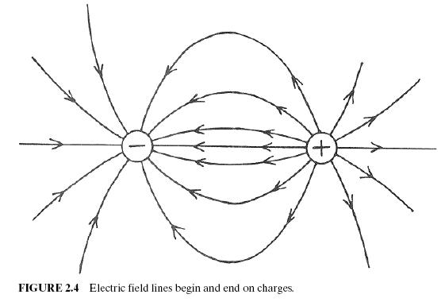
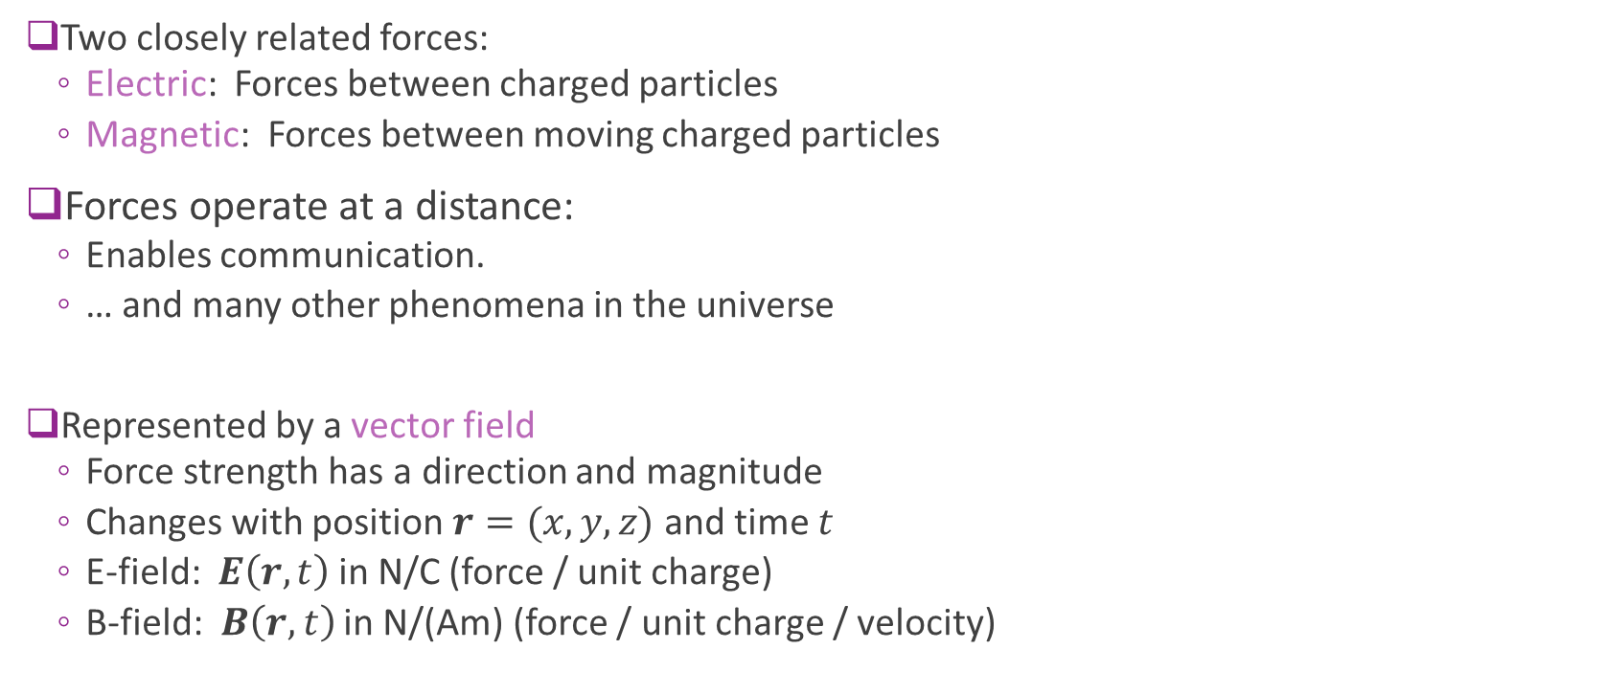
Electric and Magnetic Forces
Two closely related forces:
Electric: Forces between charged particles
Magnetic: Forces between moving charged particles
Forces operate at a distance:
Enables communication.
… and many other phenomena in the universe
Represented by a vector field
Force strength has a direction and magnitude
Changes with position $r=(x,y,z)$ and time $t$
E-field: $E\left(r,t\right)$ in N/C (force / unit charge)
B-field: $B\left(r,t\right)$ in N/(Am) (force / unit charge / velocity)

Slide 5
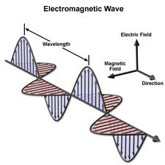
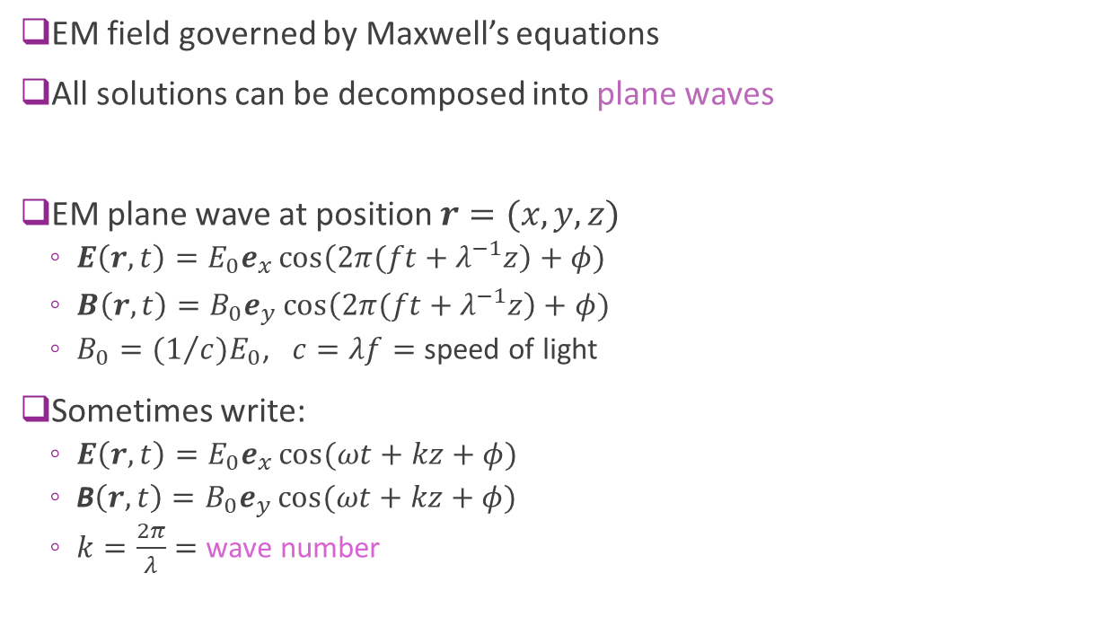
Plane Waves
EM field governed by Maxwell’s equations
All solutions can be decomposed into plane waves
EM plane wave at position $r=(x,y,z)$
$E\left(r,t\right)=E_{0}e_{x}\cos\left(2π(ft+λ^{−1}z\right)+φ)$
$B\left(r,t\right)=B_{0}e_{y}\cos\left(2π(ft+λ^{−1}z\right)+φ)$
$B_{0}={(1}/c)E_{0}$, $c=λf=$ speed of light
Sometimes write:
$E\left(r,t\right)=E_{0}e_{x}\cos{(ωt+kz+φ)}$
B$\left(r,t\right)=B_{0}e_{y}\cos{(ωt+kz+φ)}$
$k=\frac{2π}{λ}=$ wave number

Slide 6
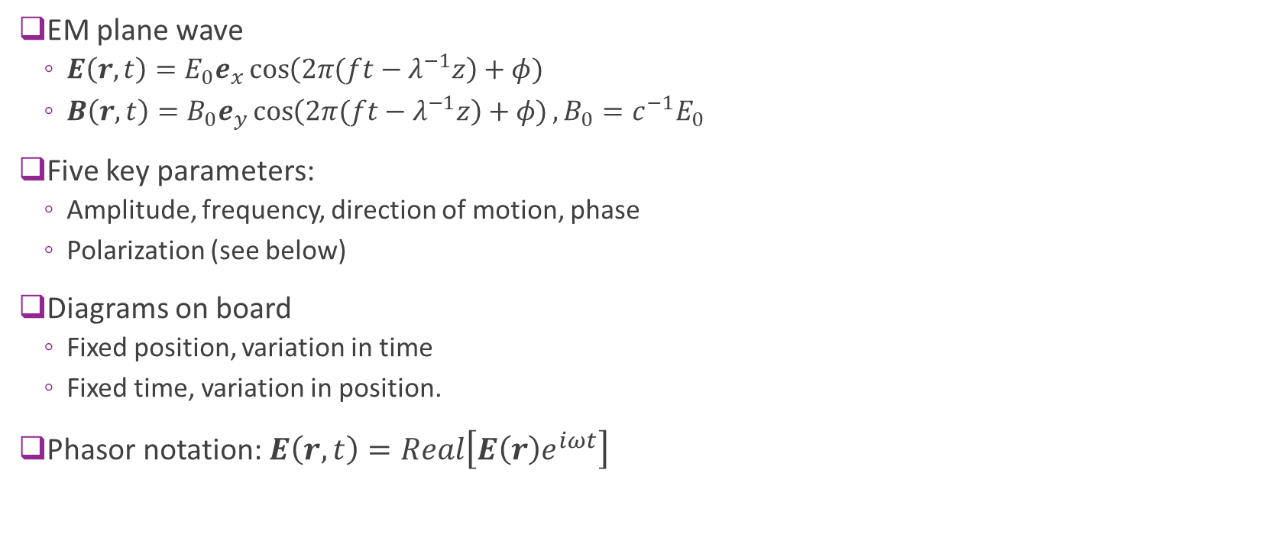
Plane Waves Illustrated
EM plane wave
$E\left(r,t\right)=E_{0}e_{x}\cos\left(2π(ft−λ^{−1}z\right)+φ)$
$B\left(r,t\right)=B_{0}e_{y}\cos\left(2π(ft−λ^{−1}z\right)+φ), B_{0}=c^{−1}E_{0}$
Five key parameters:
Amplitude, frequency, direction of motion, phase
Polarization (see below)
Diagrams on board
Fixed position, variation in time
Fixed time, variation in position.
Phasor notation: $E\left(r,t\right)=Real\left[E\left(r\right)e^{iωt}\right]$

Slide 7
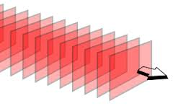
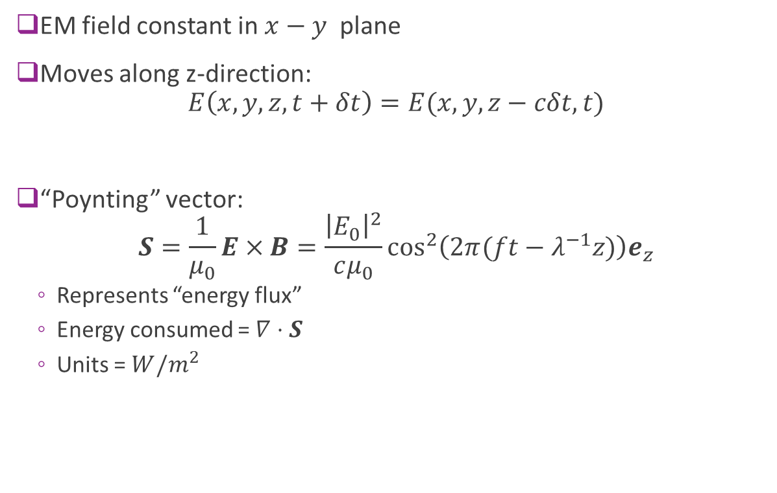
Plane Wave Direction of Motion
EM field constant in $x−y$ plane
Moves along z-direction: $E\left(x,y,z,t+δt\right)=E(x,y,z−cδt,t)$
“Poynting” vector: $S=\frac{1}{μ_{0}}E×B=\frac{{\left|E_{0}\right|}^{2}}{cμ_{0}}\cos^{2}\left(2π(ft−λ^{−1}z)\right)e_{z}$
Represents “energy flux”
Energy consumed = $∇⋅S$
Units = $W/m^{2}$

Slide 8
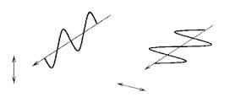
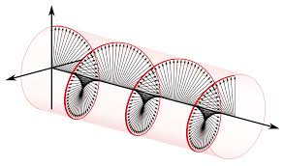
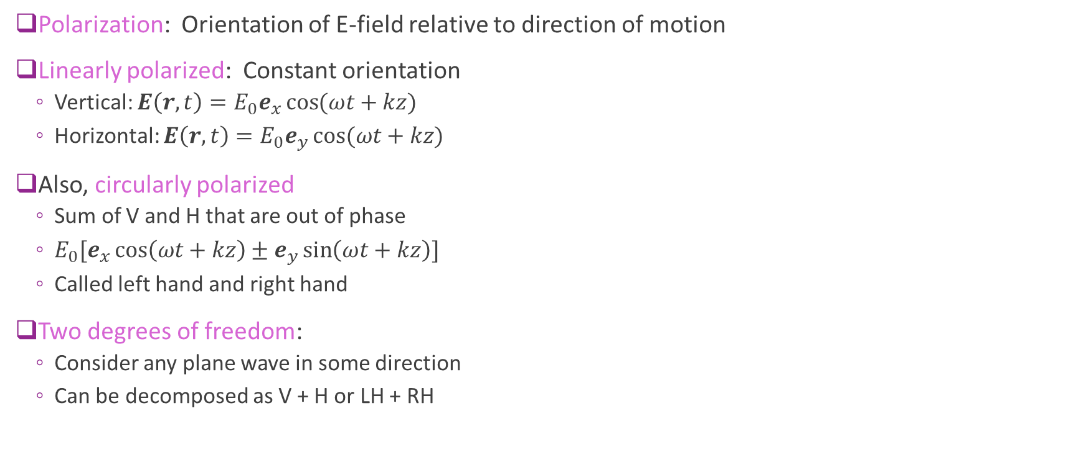
Polarization
Polarization: Orientation of E-field relative to direction of motion
Linearly polarized: Constant orientation
Vertical: $E\left(r,t\right)=E_{0}e_{x}\cos{(ωt+kz)}$
Horizontal: $E\left(r,t\right)=E_{0}e_{y}\cos{(ωt+kz)}$
Also, circularly polarized
Sum of V and H that are out of phase
$E_{0}[e_{x}\cos\left(ωt+kz\right)±e_{y}\sin\left(ωt+kz\right)]$
Called left hand and right hand
Two degrees of freedom:
Consider any plane wave in some direction
Can be decomposed as V + H or LH + RH

Slide 9
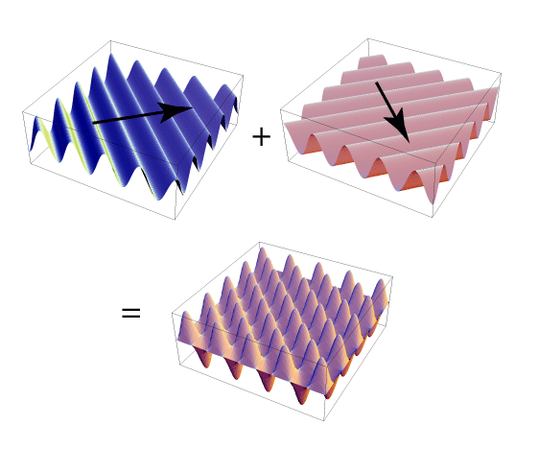
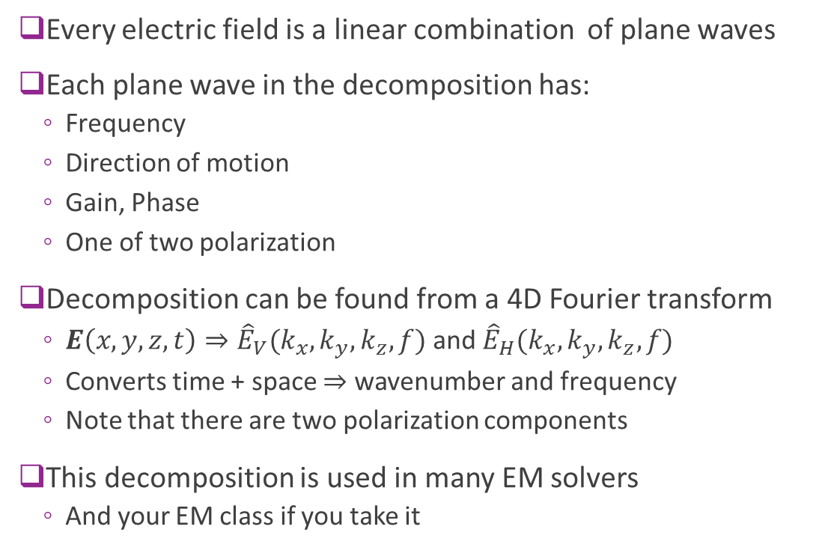
Plane Wave Decomposition
Every electric field is a linear combination of plane waves
Each plane wave in the decomposition has:
Frequency
Direction of motion
Gain, Phase
One of two polarization
Decomposition can be found from a 4D Fourier transform
$E\left(x,y,z,t\right)⇒{\hat{E}}_{V}(k_{x},k_{y},k_{z},f)$ and ${\hat{E}}_{H}(k_{x},k_{y},k_{z},f)$
Converts time + space $⇒$ wavenumber and frequency
Note that there are two polarization components
This decomposition is used in many EM solvers
And your EM class if you take it

Slide 10
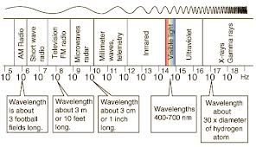
EM Spectrum
Frequency of EM radiation has wide range
Encompasses many forms of radiation
Radio waves are uniquely valuable since they can propagate far

Slide 11
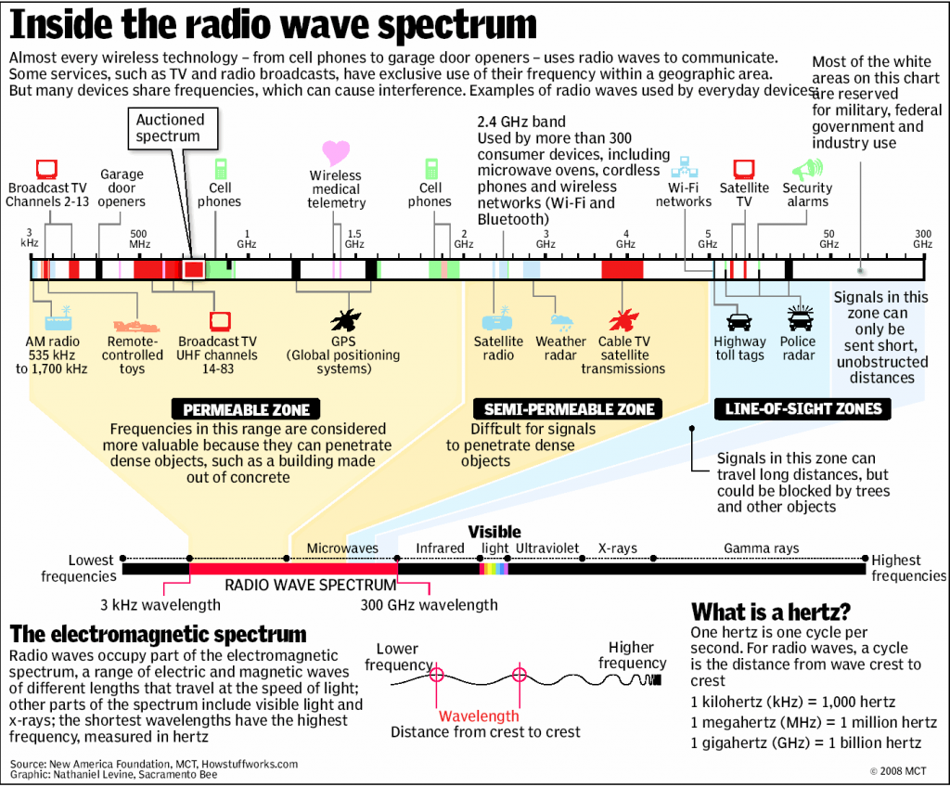
Radio Spectrum

Slide 12
Outline
Basics of Electromagnetic Waves
Basics of Antennas
Free Space Propagation

Slide 13
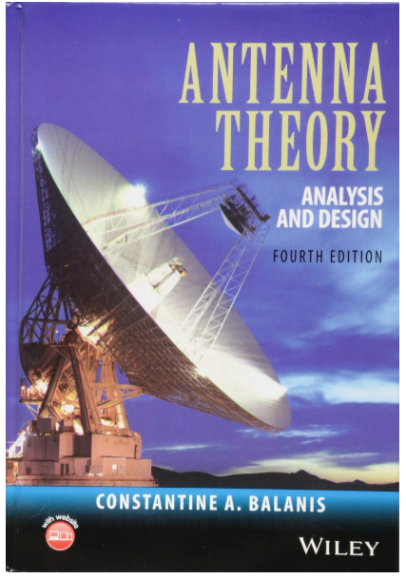
Excellent Text for Antennas
This section based on classic text
Figures are from this text
Balanis, “Antenna Theory”
Full EM theory
Many excellent problems and examples
Designed for RF engineers
We will use only a small portion here
Take an EM class for more!

Slide 14
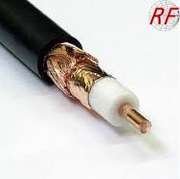


Waveguides and Transmission Lines
Transmission lines and waveguides: Any structure to guide waves with minimal loss
Some texts:
Transmission lines refer to conductors and waveguides to hollow structures
Many examples
PCB traces
Microstrip: External layer
Stripline: Internal layer
Coaxial cable
Waveguide

Slide 15
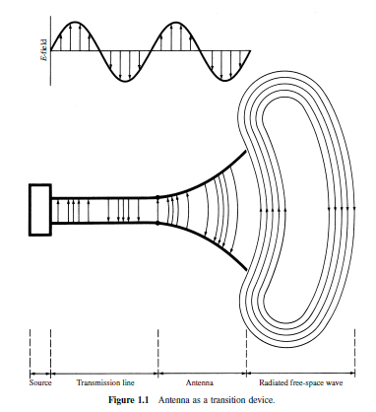
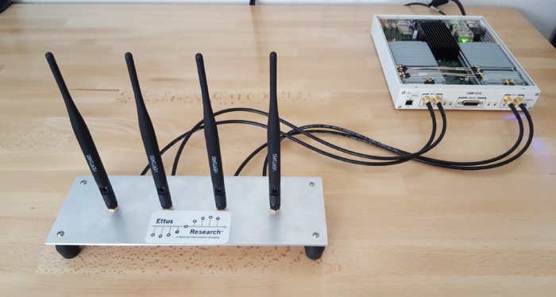
Antenna
Transmit antenna: Radiates electromagnetic waves
Converts signals:
From guided signals in transmission lines to
To radiation in free space
Receive antenna: Collects EM wave
USRP with four vertical antenas

Slide 16
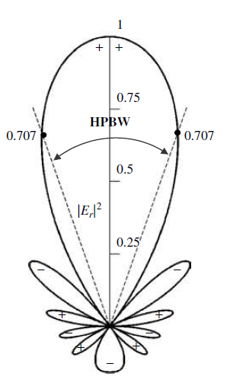
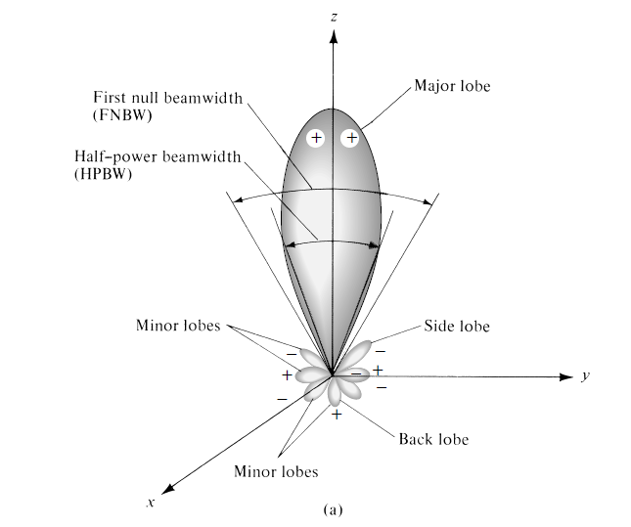
Radiation Patterns
Aantenna radiation typically shown via a pattern
Value of scalar as a function of position
Antenna usually at origin
Orientation of the antenna is important
Many possible quantities:
Power, electric field, …
Normalized or un-normalized
Can be 2D or 3D
2D
3D

Slide 17
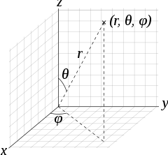
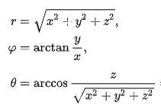

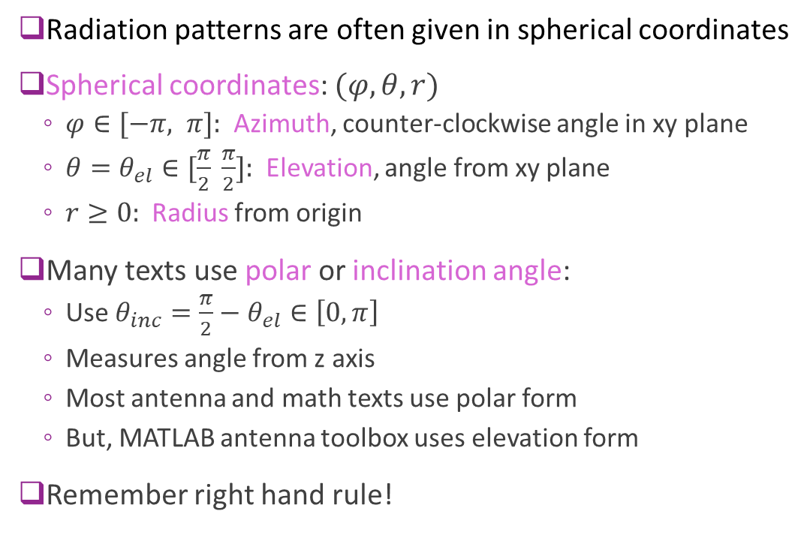

Spherical Coordinates
Radiation patterns are often given in spherical coordinates
Spherical coordinates: $(φ, θ, r)$
$φ∈[−π, π]:$ Azimuth, counter-clockwise angle in xy plane
$θ=θ_{el}∈[\frac{π}{2} \frac{π}{2}]:$ Elevation, angle from xy plane
$r≥0:$ Radius from origin
Many texts use polar or inclination angle:
Use $θ_{inc}=\frac{π}{2}−θ_{el}∈\left[0,π\right]$
Measures angle from z axis
Most antenna and math texts use polar form
But, MATLAB antenna toolbox uses elevation form
Remember right hand rule!
Polar coordinates
Spherical (polar form) $⇔$ Cartesian

Slide 18
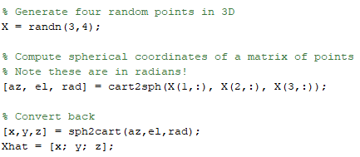
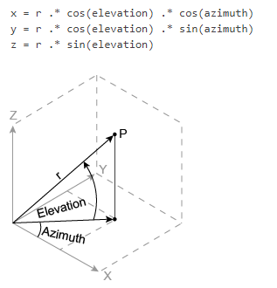
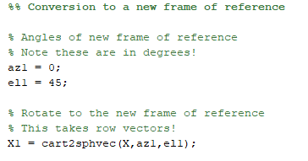
Spherical Coordinates in MATLAB
Conversion between spherical and cartesian
Conversion to a coordinate system

Slide 19
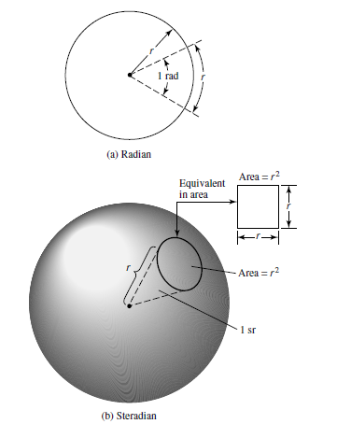


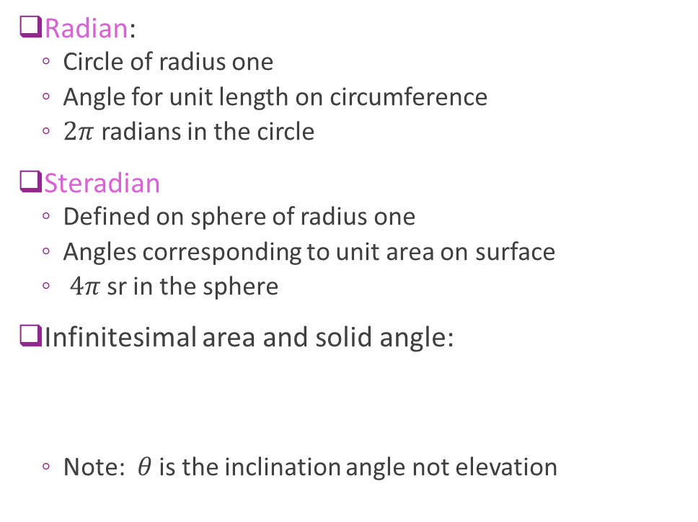
Radians and Steradians
Radian:
Circle of radius one
Angle for unit length on circumference
$2π$ radians in the circle
Steradian
Defined on sphere of radius one
Angles corresponding to unit area on surface
$4π$ sr in the sphere
Infinitesimal area and solid angle:
Note: $θ$ is the inclination angle not elevation

Slide 20
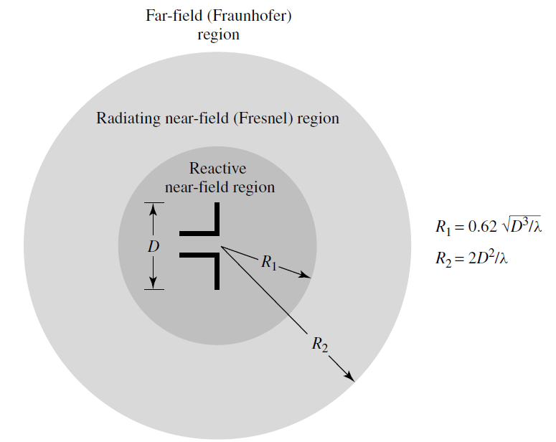
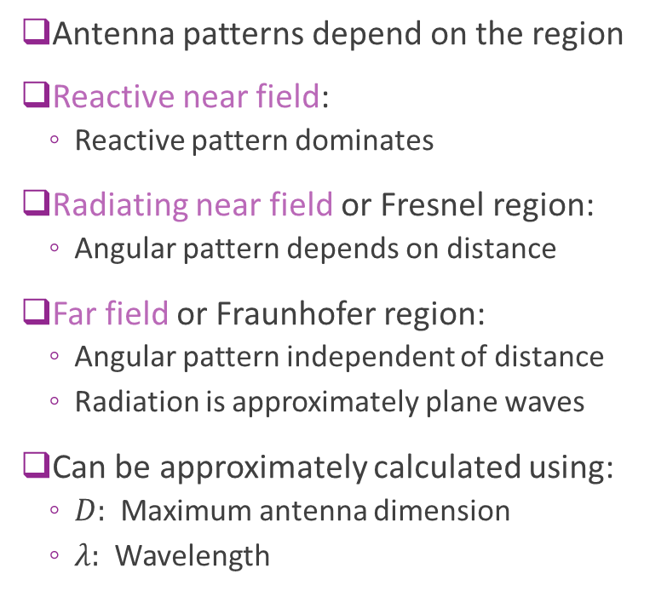
Field Regions
Antenna patterns depend on the region
Reactive near field:
Reactive pattern dominates
Radiating near field or Fresnel region:
Angular pattern depends on distance
Far field or Fraunhofer region:
Angular pattern independent of distance
Radiation is approximately plane waves
Can be approximately calculated using:
$D:$ Maximum antenna dimension
$λ:$ Wavelength

Slide 21
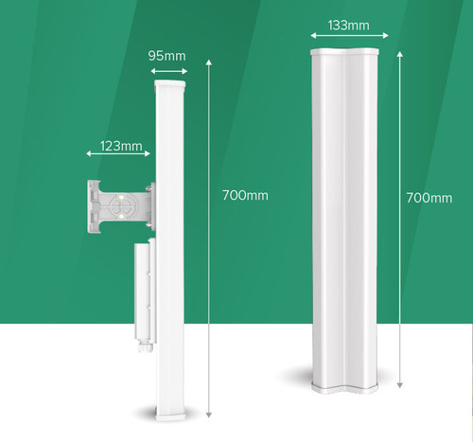
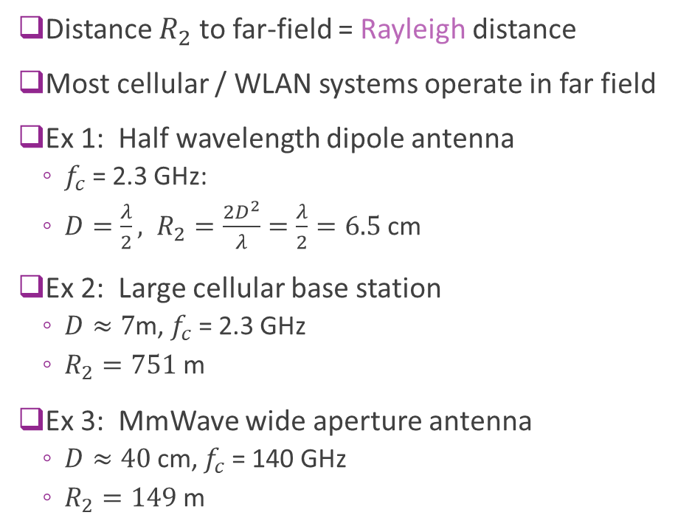
Rayleigh Distance
Distance $R_{2}$ to far-field = Rayleigh distance
Most cellular / WLAN systems operate in far field
Ex 1: Half wavelength dipole antenna
$f_{c}$ = 2.3 GHz:
$D=\frac{λ}{2}, R_{2}=\frac{2D^{2}}{λ}=\frac{λ}{2}=6.5$ cm
Ex 2: Large cellular base station
$D≈7$m, $f_{c}$ = 2.3 GHz
$R_{2}=751$ m
Ex 3: MmWave wide aperture antenna
$D≈40$ cm, $f_{c}$ = 140 GHz
$R_{2}=149$ m

Slide 22
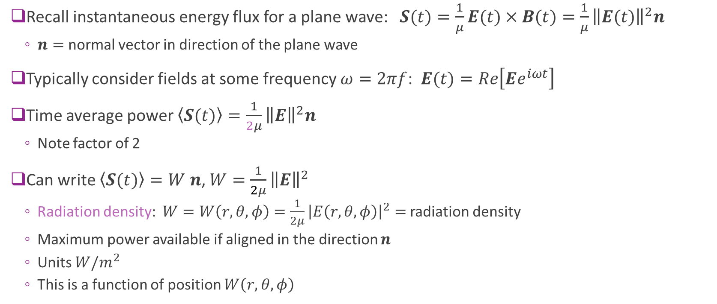
Radiation Density
Recall instantaneous energy flux for a plane wave: $S(t)=\frac{1}{μ}E(t)×B(t)=\frac{1}{μ}{\left\|E(t)\right\|}^{2}n$
$n=$ normal vector in direction of the plane wave
Typically consider fields at some frequency $ω=2πf$: $E(t)=Re\left[Ee^{iωt}\right]$
Time average power $\left\langle S(t)\right\rangle =\frac{1}{2μ}{\left\|E\right\|}^{2}n$
Note factor of 2
Can write $\left\langle S(t)\right\rangle =W$ $n$, $W=\frac{1}{2μ}{\left\|E\right\|}^{2}$
Radiation density: $W=W\left(r,θ,φ\right)=\frac{1}{2μ}{\left|E\left(r,θ,φ\right)\right|}^{2}=$ radiation density
Maximum power available if aligned in the direction $n$
Units $W/m^{2}$
This is a function of position $W\left(r,θ,φ\right)$

Slide 23
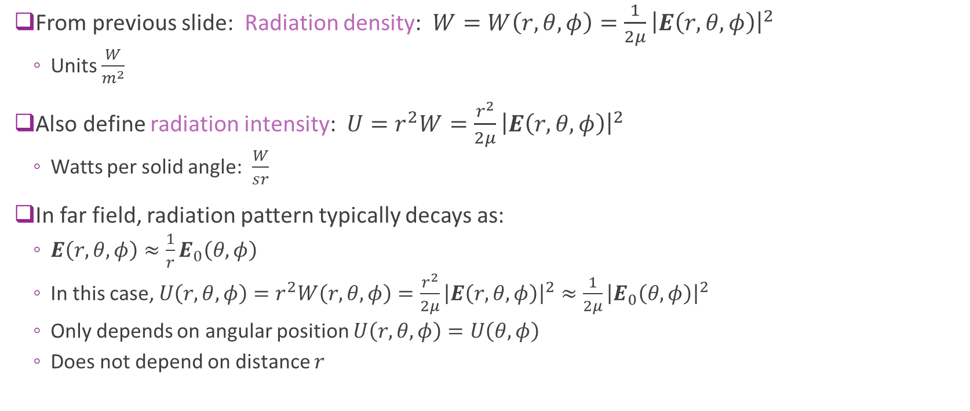
Radiation Intensity
From previous slide: Radiation density: $W=W\left(r,θ,φ\right)=\frac{1}{2μ}{\left|E\left(r,θ,φ\right)\right|}^{2}$
Units $\frac{W}{m^{2}}$
Also define radiation intensity: $U=r^{2}W=\frac{r^{2}}{2μ}{\left|E\left(r,θ,φ\right)\right|}^{2}$
Watts per solid angle: $\frac{W}{sr}$
In far field, radiation pattern typically decays as:
$E\left(r,θ,φ\right)≈\frac{1}{r}E_{0}\left(θ,φ\right)$
In this case, $U\left(r,θ,φ\right)=r^{2}W\left(r,θ,φ\right)=\frac{r^{2}}{2μ}{\left|E\left(r,θ,φ\right)\right|}^{2}≈\frac{1}{2μ}{\left|E_{0}\left(θ,φ\right)\right|}^{2}$
Only depends on angular position $U\left(r,θ,φ\right)=U\left(θ,φ\right)$
Does not depend on distance $r$

Slide 24
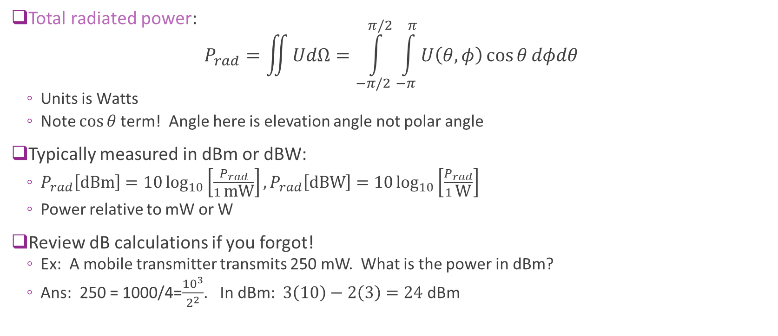
Total Radiated Power
Total radiated power: $P_{rad}=\iint{UdΩ}=\int_{−π/2}^{π/2}{\int_{−π}^{π}{U\left(θ,φ\right)\cos{θ}dφdθ}}$
Units is Watts
Note $\cos{θ}$term! Angle here is elevation angle not polar angle
Typically measured in dBm or dBW:
$P_{rad}\left[\text{dBm}\right]=10\log_{10}\left[\frac{P_{rad}}{1 \text{mW}}\right],P_{rad}\left[\text{dB}\text{W}\right]=10\log_{10}\left[\frac{P_{rad}}{1 \text{W}}\right]$
Power relative to mW or W
Review dB calculations if you forgot!
Ex: A mobile transmitter transmits 250 mW. What is the power in dBm?
Ans: 250 = 1000/4=$\frac{{10}^{3}}{2^{2}}$. In dBm: $3\left(10\right)−2\left(3\right)=24$ dBm

Slide 25
Typical Wireless Power Transmit Levels
100 kW = 80 dBm: Typical FM radio transmission with 50 km radius
1 kW = 60 dBm: Microwave oven element (most of this doesn’t escape)
~300 W = 55 dBm: Geostationary satellite
250 mW = 24 dBm: Cellular phone maximum power (class 2)
200 mW = 23 dBm: WiFi access point
32 mW = 15 dBm: WiFi transmitter in a laptop
4 mW = 6 dBm: Bluetooth 10 m range
1 mW = 0 dBm: Bluetooth, 1 m range

Slide 26
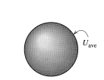
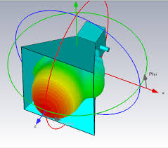
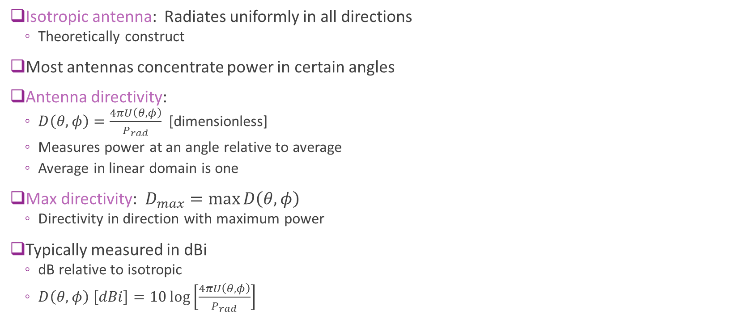
Antenna Directivity
Isotropic antenna: Radiates uniformly in all directions
Theoretically construct
Most antennas concentrate power in certain angles
Antenna directivity:
$D\left(θ,φ\right)=\frac{4πU\left(θ,φ\right)}{P_{rad}}$ [dimensionless]
Measures power at an angle relative to average
Average in linear domain is one
Max directivity: $D_{max}=\max{D\left(θ,φ\right)}$
Directivity in direction with maximum power
Typically measured in dBi
dB relative to isotropic
$D\left(θ,φ\right) \left[dBi\right]=10\log\left[\frac{4πU\left(θ,φ\right)}{P_{rad}}\right]$
Theoretical isotropic antenna
Horn antenna with directivity

Slide 27
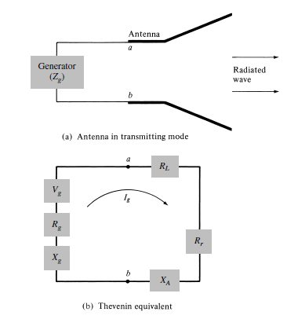
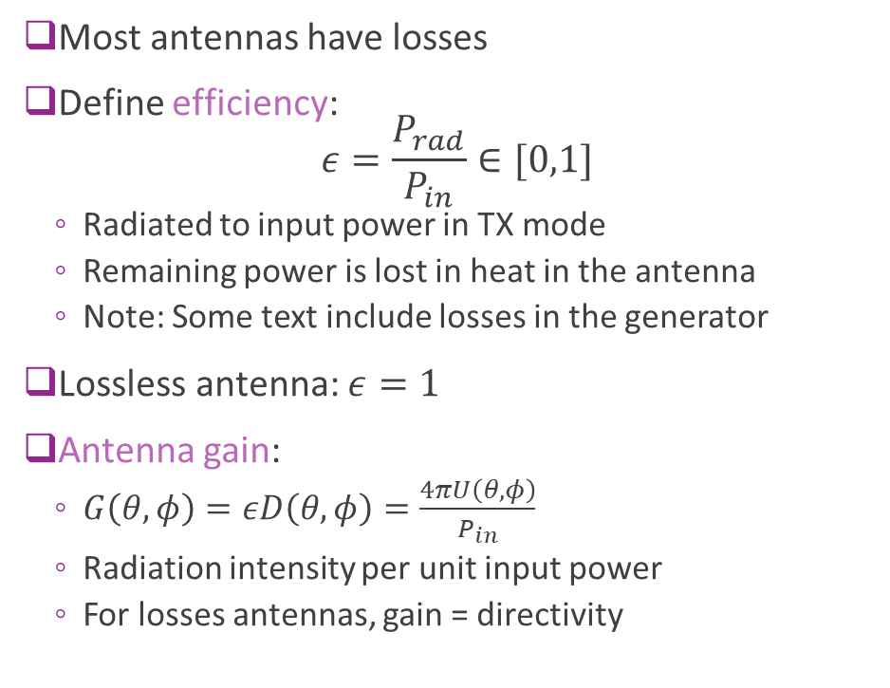


Antenna Gain and Efficiency
Most antennas have losses
Define efficiency: $ε=\frac{P_{rad}}{P_{in}}∈[0,1]$
Radiated to input power in TX mode
Remaining power is lost in heat in the antenna
Note: Some text include losses in the generator
Lossless antenna: $ε=1$
Antenna gain:
$G\left(θ,φ\right)=εD\left(θ,φ\right)=\frac{4πU\left(θ,φ\right)}{P_{in}}$
Radiation intensity per unit input power
For losses antennas, gain = directivity
Losses / heat
$$P_{rad}$$
Radiated power
$$P_{in}$$
Input power

Slide 28
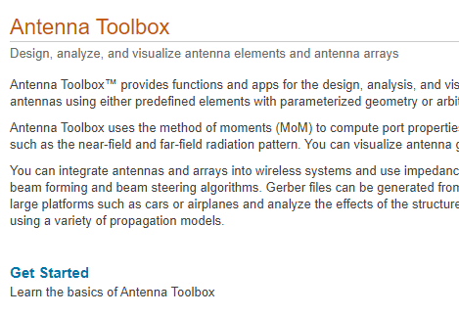
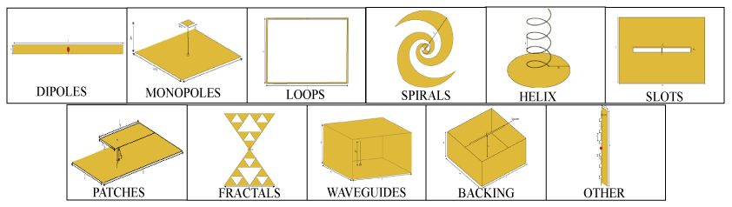
Antenna Toolbox in MATLAB
Powerful routines for:
Design and analysis of antennas
Radiation patterns
Supports many antennas
Accurate EM modeling
Free to NYU students
Just download it with your MATLAB

Slide 29
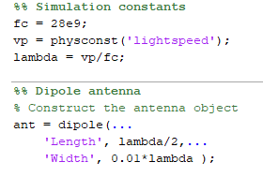
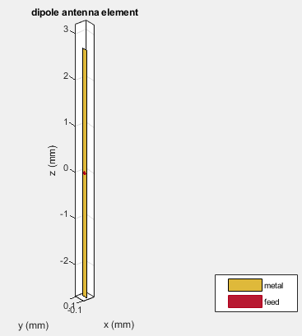
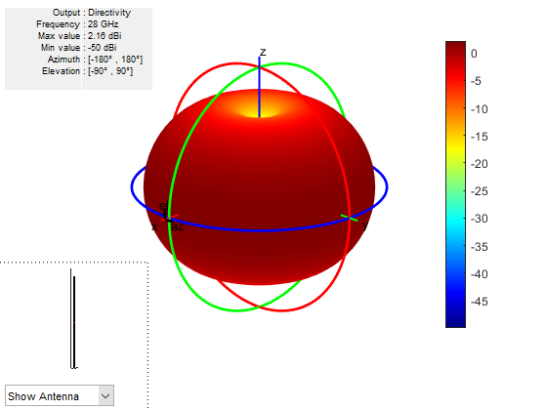

Patterns in MATLAB: Dipole Example
MATLAB has powerful tools for calculating antenna patterns

Slide 30
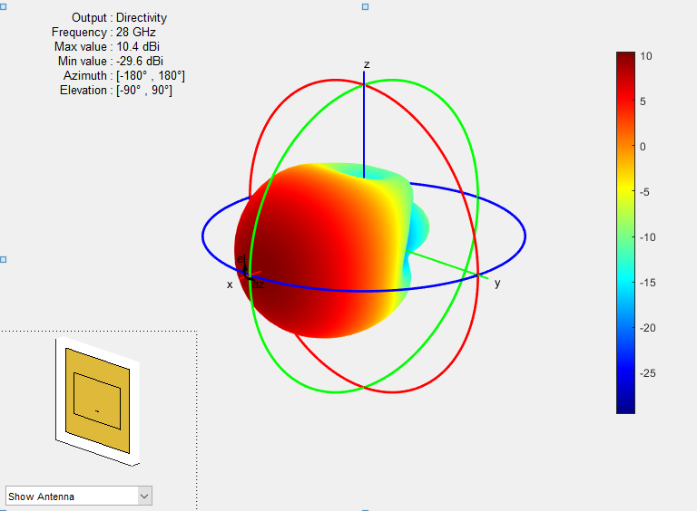
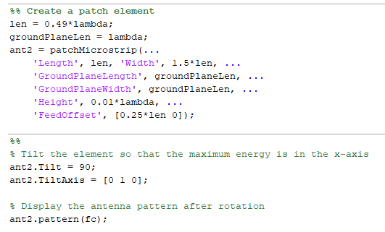
Microstrip Patch Example
A more complex antenna
Many other parameters
Substrate selection (e.g. FR4, Rogers)
Shapes, notches, …

Slide 31
Outline
Basics of Electromagnetic Waves
Basics of Antennas
Free Space Propagation

Slide 32
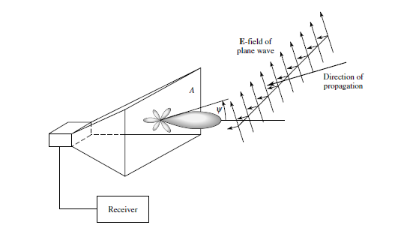
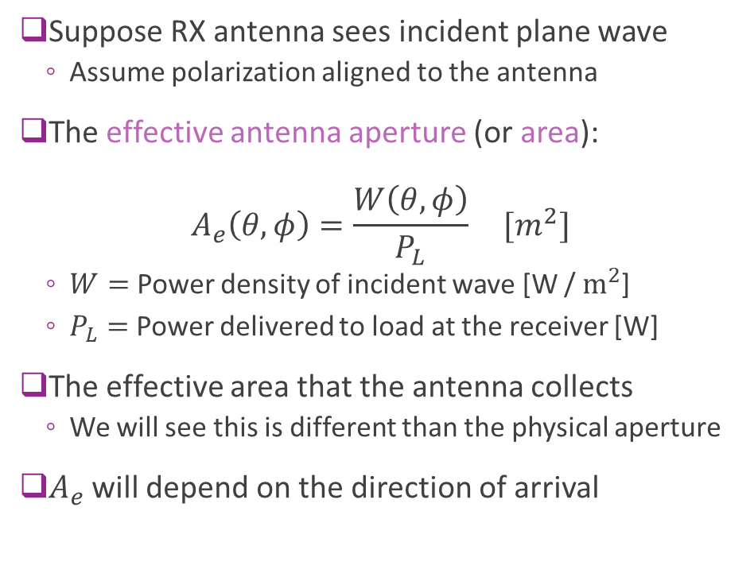
Antenna Effective Aperture
Suppose RX antenna sees incident plane wave
Assume polarization aligned to the antenna
The effective antenna aperture (or area): $A_{e}\left(θ,φ\right)=\frac{W\left(θ,φ\right)}{P_{L}} [m^{2}]$
$W=$ Power density of incident wave [W / $m^{2}$]
$P_{L}=$ Power delivered to load at the receiver [W]
The effective area that the antenna collects
We will see this is different than the physical aperture
$A_{e}$ will depend on the direction of arrival

Slide 33
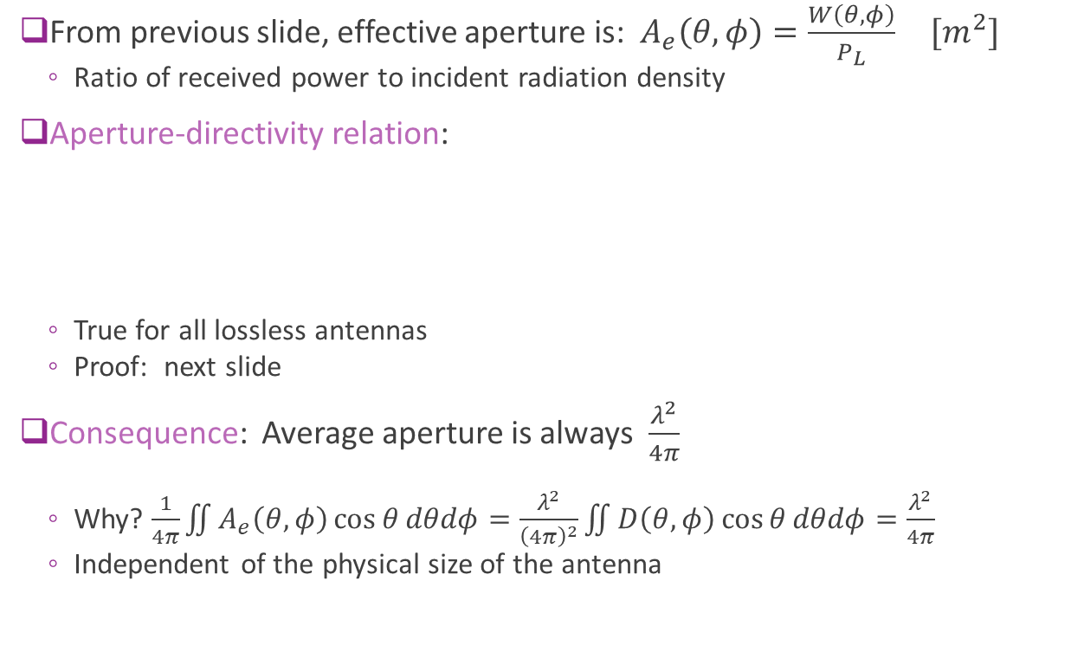

Aperture and Directivity
From previous slide, effective aperture is: $A_{e}\left(θ,φ\right)=\frac{W\left(θ,φ\right)}{P_{L}} [m^{2}]$
Ratio of received power to incident radiation density
Aperture-directivity relation:
True for all lossless antennas
Proof: next slide
Consequence: Average aperture is always $\frac{λ^{2}}{4π}$
Why? $\frac{1}{4π}\iint{A_{e}\left(θ,φ\right)}\cos{θ}dθdφ=\frac{λ^{2}}{{\left(4π\right)}^{2}}\iint{D\left(θ,φ\right)}\cos{θ}dθdφ=\frac{λ^{2}}{4π}$
Independent of the physical size of the antenna
$$A_{e}\left(θ,φ\right)=D\left(θ,φ\right) \frac{λ^{2}}{4π}$$

Slide 34


Proof of the Aperture-Directivity Relation
Suppose Ant 1 transmits power $P_{t}$
Radiation density is: $W=\frac{D_{1}P_{t}}{4πR^{2}}$
Received power at Ant 2: $P_{r}=A_{2}W=\frac{A_{2}D_{1}P_{t}}{4πR^{2}}⇒\frac{P_{r}}{P_{t}}=\frac{A_{2}D_{1}}{4πR^{2}}$
TX from Ant 2, the gain must be the same: $\frac{P_{r}}{P_{t}}=\frac{A_{1}D_{2}}{4πR^{2}}$
This is a consequence of reciprocity
Hence, for any two antennas: $\frac{D_{1}}{A_{1}}=\frac{D_{2}}{A_{2}}$
From simple antenna calculations for a short dipole:
$D_{2}=\frac{3}{2}, A_{2}=\frac{3λ^{2}}{8π}⇒\frac{D_{2}}{A_{2}}=\frac{4π}{λ^{2}}$ (Needs basic EM theory)

Slide 35



Friis’ Law
Consider two lossless antennas in free space
From previous slide: $\frac{P_{r}}{P_{t}}=\frac{A_{1}D_{2}}{4πR^{2}}$
From aperture-directivity relation: $A_{1}=D_{1}\frac{λ^{2}}{4π}$
This leads to Friis’ Law (for lossless antennas):
Path loss is proportional to $R^{2}$
Path loss Inversely proportional to $λ^{2}⇒$ proportional to $f_{c}^{2}$
$$\frac{P_{r}}{P_{t}}=D_{1}D_{2}{\left(\frac{λ}{4πR}\right)}^{2}$$

Slide 36



Polarization Loss
Friis’ Law assumes incident wave is aligned in polarization
In general, need to consider polarization loss
Recall: polarization vector for a plane wave:
Direction of the E-field in phasor notation
A complex vector in 3-dim
Polarization loss factor: $PLF={\left|ρ_{a}⋅ρ_{w}\right|}^{2}=\cos^{2}{ψ_{p}}$
$ρ_{a}$: Polarization vector of the TX wave from antenna
$ρ_{w}$: Polarization vector of the RX incident wave
$ψ_{p}$: Angle between them

Slide 37



Antenna Impedance and Matching
Not all power from radio may be delivered to antenna
Some is reflected back
Described by reflection coefficient $Γ$
Also referred to as $S_{11}$
Complex ratio of forward to reverse wave
Also described by impedance mismatch:
$Γ=$ $\frac{Z_{in}−Z_{0}}{Z_{in}+Z_{0}}$
Fraction of power transferred: $1−{\left|Γ\right|}^{2}$
Also given as voltage standing wave ratio (VSWR) $=\frac{1+\left|Γ\right|}{1−\left|Γ\right|}$
Ali et al, Small Form Factor PIFA Antenna Design at 28 GHz for 5G Applications, 2019

Slide 38


Friis’ Law with Losses
Three losses in practice:
Polarization loss
conductive / dielectric loss
Impedance mismatch
Friis’ Law with lossy antennas:
$$\frac{P_{r}}{P_{t}}=ε_{1}ε_{2}(1−{\left|Γ_{1}\right|}^{2})(1−{\left|Γ_{2}\right|}^{2})D_{1}D_{2}{\left(\frac{λ}{4πR}\right)}^{2}\cos^{2}{θ_{POL}}$$
$ε_{i}$: Efficiency of antenna
$θ_{POL}$: Angle between the polarization vectors
Note that gain is: $G_{i}=ε_{i}D_{i}$

