Slide 1
Non-LOS Propagation and Link Budget Analysis
Wireless short course
Prof. Sundeep rangan

Slide 2
Learning Objectives
Compute the noise power density given a noise figure
Compute noise figure in a cascade of elements
Relate key parameters of a communication system:
Bandwidth, coding rate, modulation
Describe communication requirements and perform simple link budget calculations
Qualitatively describe various propagation mechanisms in real world settings
Qualitatively determine which propagation mechanisms are dominant
Compute probabilities of outage from a statistical channel model

Slide 3
Outline
Noise and Noise Figure
Communication Requirements and Link Budget Analysis
Non-LOS Propagation
Statistical Models for Path Loss

Slide 4
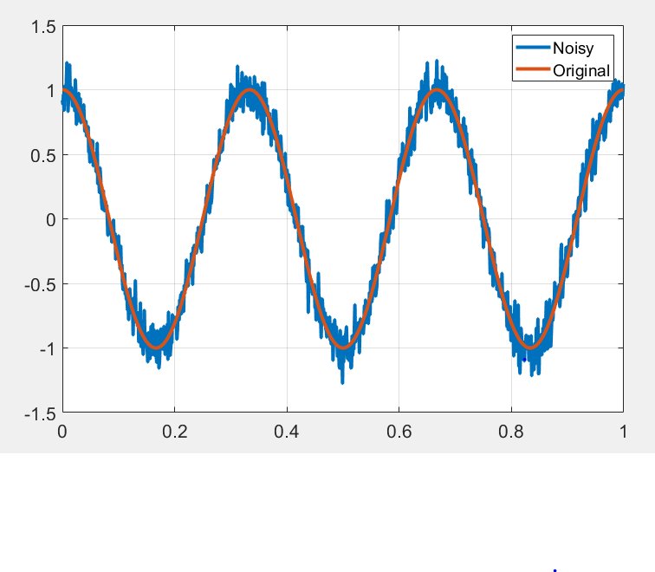
What is Noise?
Noise: Any unwanted component of the signal
Key challenge in communication:
Estimate the transmitted signal in the presence of noise

Slide 5
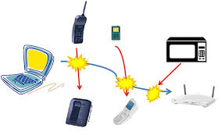
Types of “Noise”
Internal / thermal noise:
From imperfections in the receiver
Thermal noise: From random fluctuations of electrons
Other imperfections: Phase noise, quantization, channel estimation errors
External Interference
Signals from other sources
In-band: Transmitters in the same frequency Ex: Multiple devices in a cellular band
Out-of-band: From leakage out of carrier
Some texts do not consider “interference” as noise

Slide 6
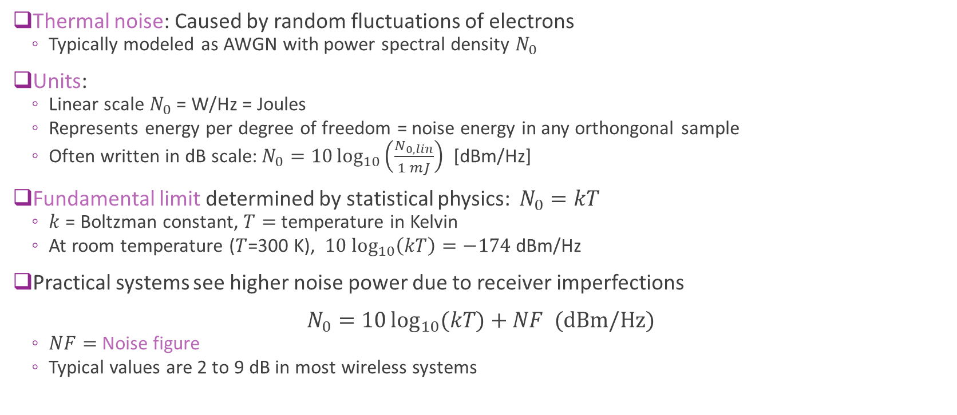
Thermal Noise
Thermal noise: Caused by random fluctuations of electrons
Typically modeled as AWGN with power spectral density $N_{0}$
Units:
Linear scale $N_{0}$ = W/Hz = Joules
Represents energy per degree of freedom = noise energy in any orthongonal sample
Often written in dB scale: $N_{0}=10\log_{10}\left(\frac{N_{0,lin}}{1 mJ}\right)$ [dBm/Hz]
Fundamental limit determined by statistical physics: $N_{0}=kT$
$k$ = Boltzman constant, $T=$ temperature in Kelvin
At room temperature ($T$=300 K), $10 \log_{10}\left(kT\right)=−174$dBm/Hz
Practical systems see higher noise power due to receiver imperfections $N_{0}=10\log_{10}{(kT)}+NF \text{(}\text{dBm}\text{/}\text{Hz}\text{)}$
$NF=$Noise figure
Typical values are 2 to 9 dB in most wireless systems

Slide 7
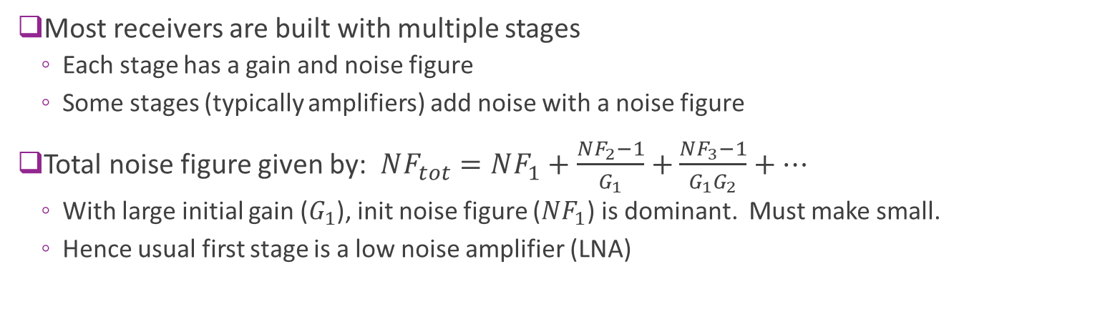
NF for Cascade of Elements
Gain stage 1
Stage 2
Stage 3
Output power
P_{out}
Input power
P_{in}
Gain G₁
G₂
G₃
Thermal noise 1
kTB x NF₁
Additional noise
kTB (NF₂-1)
Additional noise
kTB (NF₃-1)
Most receivers are built with multiple stages
Each stage has a gain and noise figure
Some stages (typically amplifiers) add noise with a noise figure
Total noise figure given by: $NF_{tot}=NF_{1}+\frac{NF_{2}−1}{G_{1}}+$ $\frac{NF_{3}−1}{G_{1}G_{2}}+…$
With large initial gain ($G_{1}$), init noise figure ($NF_{1}$) is dominant. Must make small.
Hence usual first stage is a low noise amplifier (LNA)

Slide 8
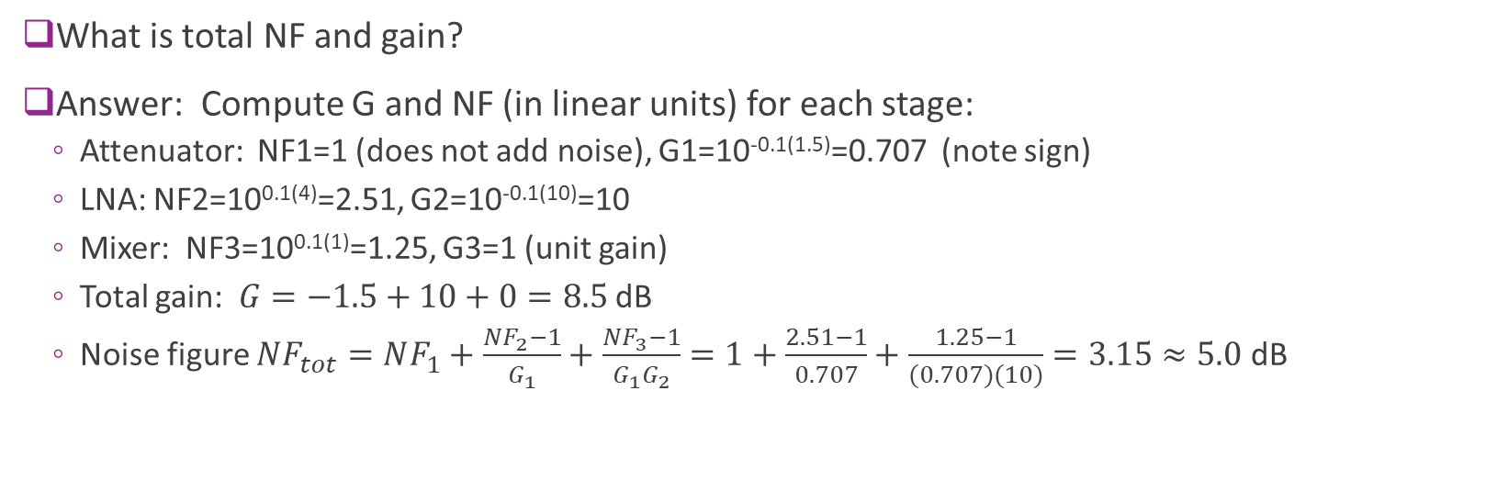
Example Problem Molisch 3.1
Attn connector
Loss = 1.5 dB
Low noise amp
Gain = 10 dB, NF = 4 dB
Mixer
Unit gain, NF = 1 dB
Gain G₁
Gain G₂
Gain G₃
NF₁
NF₂
NF₃
What is total NF and gain?
Answer: Compute G and NF (in linear units) for each stage:
Attenuator: NF1=1 (does not add noise), G1=10^{-0.1(1.5)}=0.707 (note sign)
LNA: NF2=10^{0.1(4)}=2.51, G2=10^{-0.1(10)}=10
Mixer: NF3=10^{0.1(1)}=1.25, G3=1 (unit gain)
Total gain: $G=−1.5+10+0=8.5$ dB
Noise figure $NF_{tot}=NF_{1}+\frac{NF_{2}−1}{G_{1}}+$ $\frac{NF_{3}−1}{G_{1}G_{2}}=1+\frac{2.51−1}{0.707}+\frac{1.25−1}{(0.707)(10)}=3.15≈5.0$dB

Slide 9
Outline
Noise and Noise Figure
Communication Requirements and Link Budget Analysis
Non-LOS Propagation
Statistical Models for Path Loss

Slide 10






Communication Requirements
TX power $P_{tx}$, BW $B$
Noise PSD $N_{0}$
RX power $P_{rx}$
Info rate $R$
TX
$+$
RX
Channel gain $G$
Basic questions:
How does TX and RX power effect achievable rate for a communication system?
What level of path loss can a system sustain?
How much rate can be reliably transmitted?
Answer: We review some basic concepts from Digital Communications

Slide 11
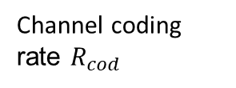
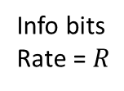

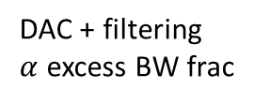
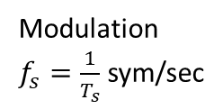
Typical Transmitter Steps
Coded bits
Complex symbols
Baseband
analog
Power $P_{tx}$
Info bits Rate = $R$
Channel coding rate $R_{cod}$
Modulation $f_{s}=\frac{1}{T_{s}}$ sym/sec
DAC + filtering $α$ excess BW frac
Upconversion
+ Power amp
Communication systems typically use three stages
Channel coding: ex. Convolutional, turbo, LDPC
Modulation: QPSK, 16-QAM, 64-QAM, …
Pulse shaping
Determines modulation + coding scheme (MCS)

Slide 12
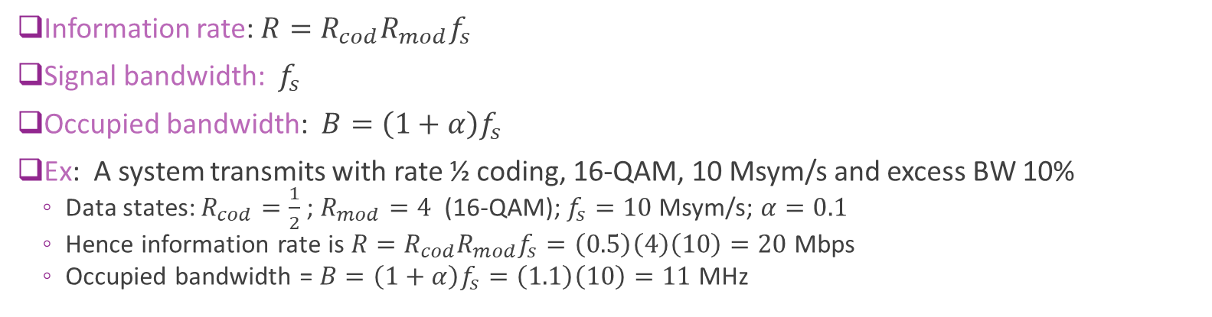
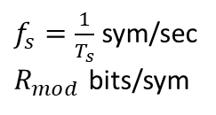
Key Transmitter Relations
Coded bits
Complex symbols
Baseband
analog
Power $P_{tx}$
Info bits Rate = $R$
Channel coding rate $R_{cod}$
$f_{s}=\frac{1}{T_{s}}$ sym/sec $R_{mod}$ bits/sym
DAC + filtering $α$ excess BW frac
Upconversion
+ Power amp
Information rate: $R=R_{cod}R_{mod}f_{s}$
Signal bandwidth: $f_{s}$
Occupied bandwidth: $B=\left(1+α\right)f_{s}$
Ex: A system transmits with rate ½ coding, 16-QAM, 10 Msym/s and excess BW 10%
Data states: $R_{cod}=\frac{1}{2}$ ; $R_{mod}=4$ (16-QAM); $f_{s}=10$ Msym/s; $α=0.1$
Hence information rate is $R=R_{cod}R_{mod}f_{s}=\left(0.5\right)\left(4\right)\left(10\right)=20$ Mbps
Occupied bandwidth = $B=\left(1+α\right)f_{s}=\left(1.1\right)\left(10\right)=11$MHz

Slide 13


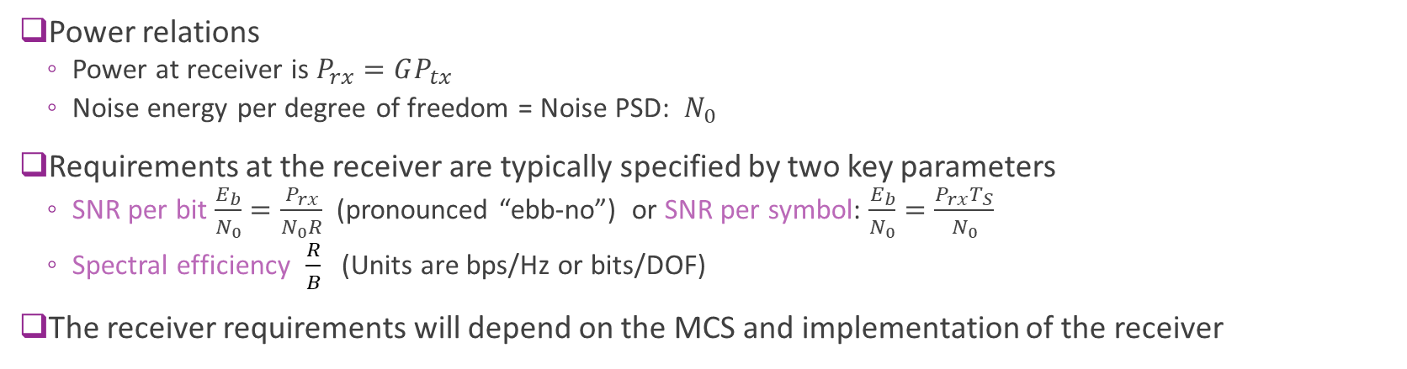
Receiver Requirements
TX power $P_{tx}$, BW $B$
Noise PSD $N_{0}$
RX power $P_{rx}$
Info rate $R$
TX
$+$
RX
Channel gain $G$
Power relations
Power at receiver is $P_{rx}=GP_{tx}$
Noise energy per degree of freedom = Noise PSD: $N_{0}$
Requirements at the receiver are typically specified by two key parameters
SNR per bit $\frac{E_{b}}{N_{0}}=\frac{P_{rx}}{N_{0}R}$ (pronounced “ebb-no”) or SNR per symbol: $\frac{E_{b}}{N_{0}}=\frac{P_{rx}T_{S}}{N_{0}}$
Spectral efficiency $\frac{R}{B}$ (Units are bps/Hz or bits/DOF)
The receiver requirements will depend on the MCS and implementation of the receiver

Slide 14
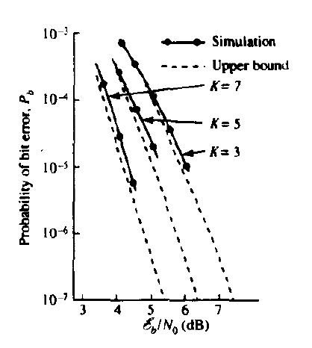
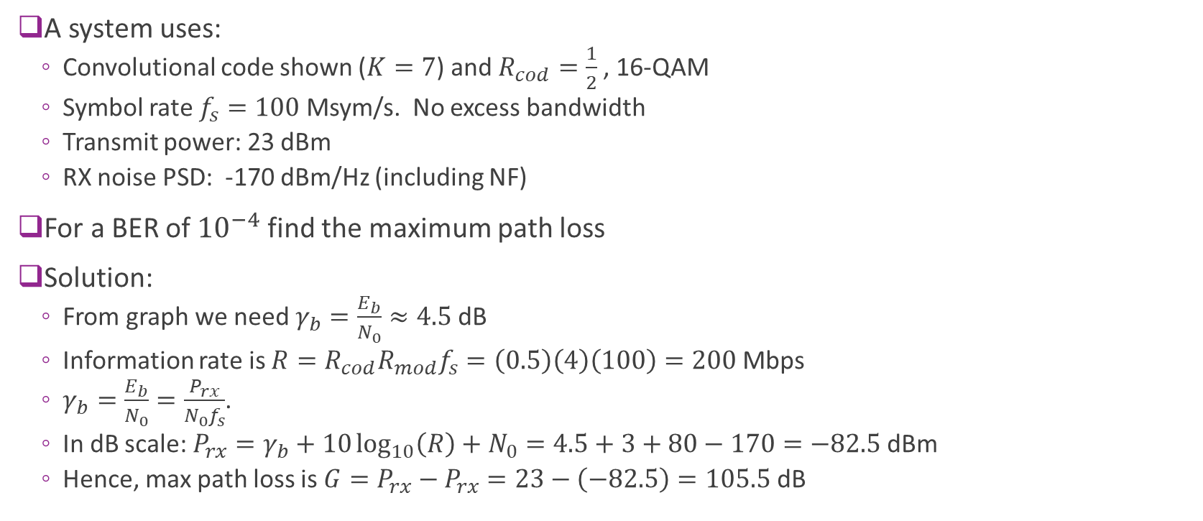
Example Problem
A system uses:
Convolutional code shown ($K=7$) and $R_{cod}=\frac{1}{2}$, 16-QAM
Symbol rate $f_{s}=100$ Msym/s. No excess bandwidth
Transmit power: 23 dBm
RX noise PSD: -170 dBm/Hz (including NF)
For a BER of ${10}^{−4}$ find the maximum path loss
Solution:
From graph we need $γ_{b}=\frac{E_{b}}{N_{0}}≈4.5$dB
Information rate is $R=R_{cod}R_{mod}f_{s}=\left(0.5\right)\left(4\right)\left(100\right)=200$Mbps
$γ_{b}=\frac{E_{b}}{N_{0}}=\frac{P_{rx}}{N_{0}f_{s}}$.
In dB scale: $P_{rx}=γ_{b}+10\log_{10}\left(R\right)+N_{0}=4.5+3+80−170=−82.5$dBm
Hence, max path loss is $G=P_{rx}−P_{rx}=23−\left(−82.5\right)=105.5$ dB

Slide 15
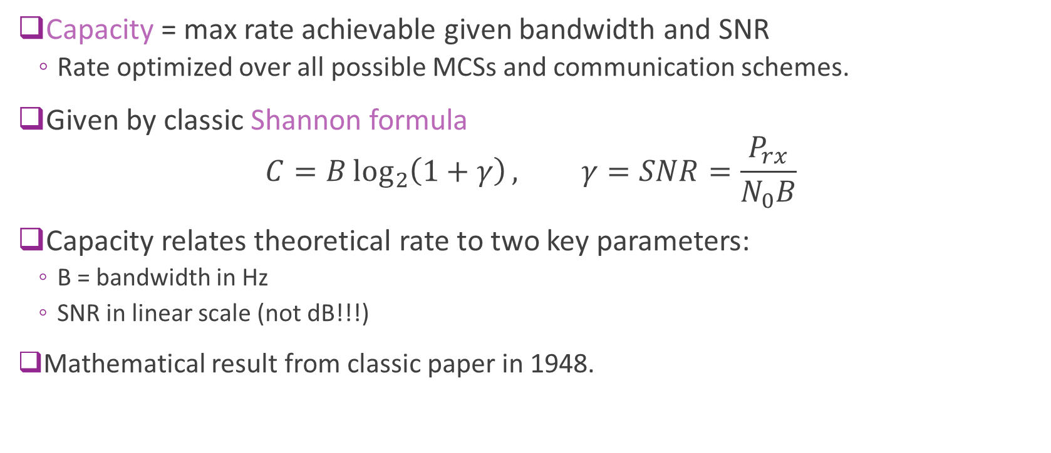
Shannon Capacity
Capacity = max rate achievable given bandwidth and SNR
Rate optimized over all possible MCSs and communication schemes.
Given by classic Shannon formula $C=B\log_{2}\left(1+γ\right), γ=SNR=\frac{P_{rx}}{N_{0}B}$
Capacity relates theoretical rate to two key parameters:
B = bandwidth in Hz
SNR in linear scale (not dB!!!)
Mathematical result from classic paper in 1948.

Slide 16
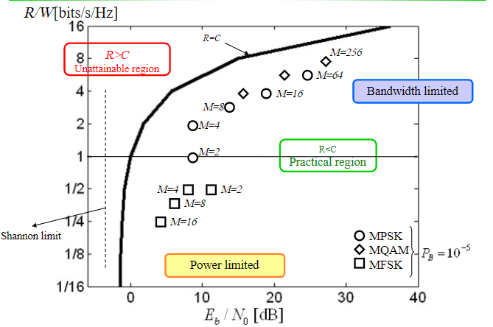
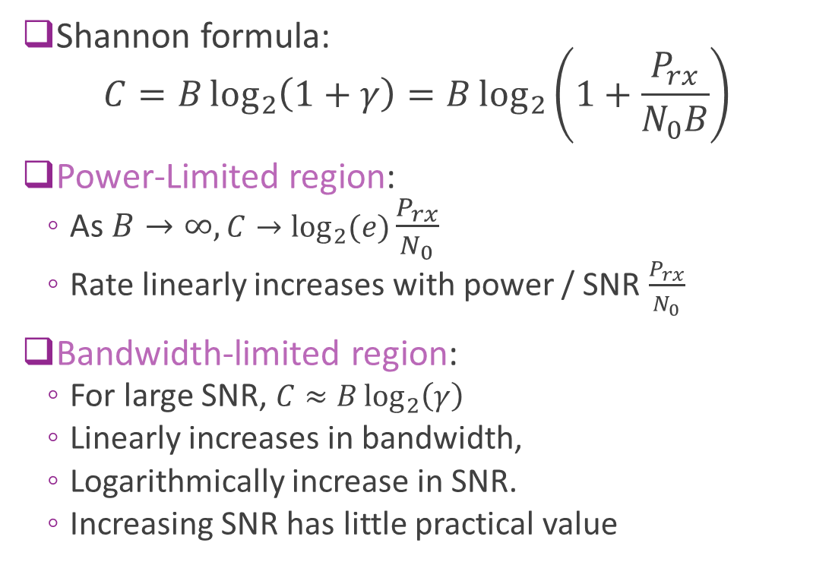
Bandwidth and Power-Limited Regions
Shannon formula: $C=B\log_{2}\left(1+γ\right)=B\log_{2}\left(1+\frac{P_{rx}}{N_{0}B}\right)$
Power-Limited region:
As $B→∞, C→\log_{2}{(e)}\frac{P_{rx}}{N_{0}}$
Rate linearly increases with power / SNR $\frac{P_{rx}}{N_{0}}$
Bandwidth-limited region:
For large SNR, $C≈B\log_{2}\left(γ\right)$
Linearly increases in bandwidth,
Logarithmically increase in SNR.
Increasing SNR has little practical value

Slide 17
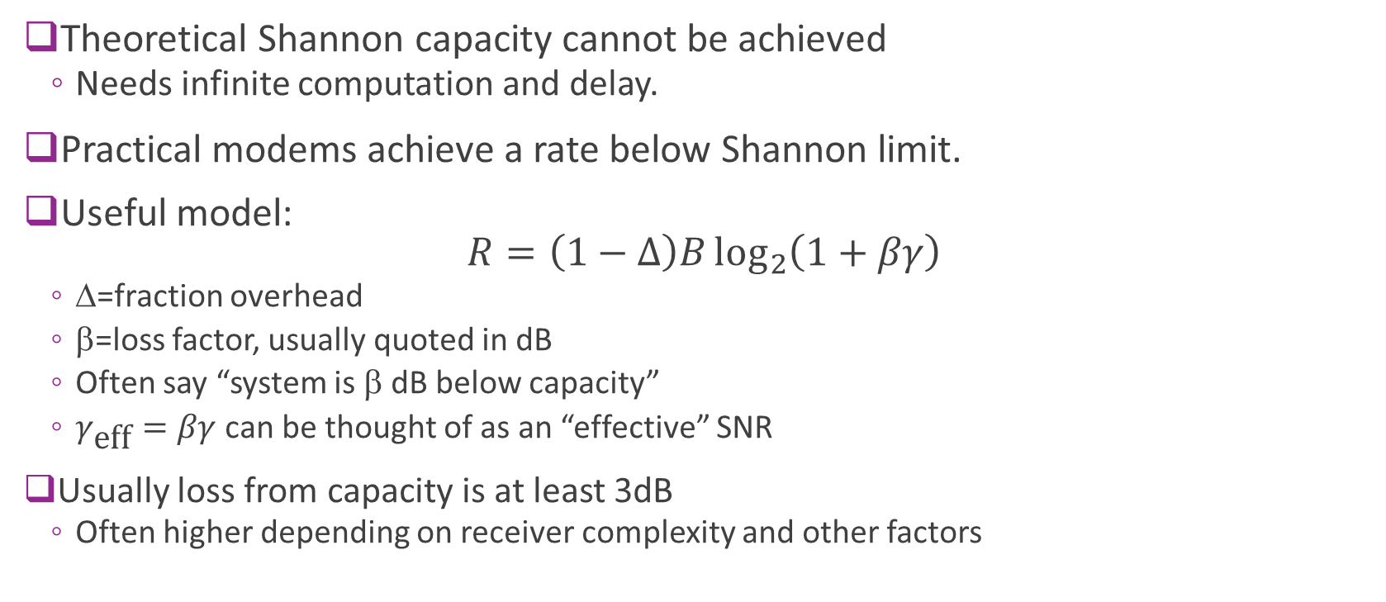
Actual Rate vs. Shannon Capacity
Theoretical Shannon capacity cannot be achieved
Needs infinite computation and delay.
Practical modems achieve a rate below Shannon limit.
Useful model: $R=\left(1−Δ\right)B\log_{2}\left(1+βγ\right)$
Δ=fraction overhead
β=loss factor, usually quoted in dB
Often say “system is β dB below capacity”
$γ_{\text{eff}}=βγ$ can be thought of as an “effective” SNR
Usually loss from capacity is at least 3dB
Often higher depending on receiver complexity and other factors

Slide 18
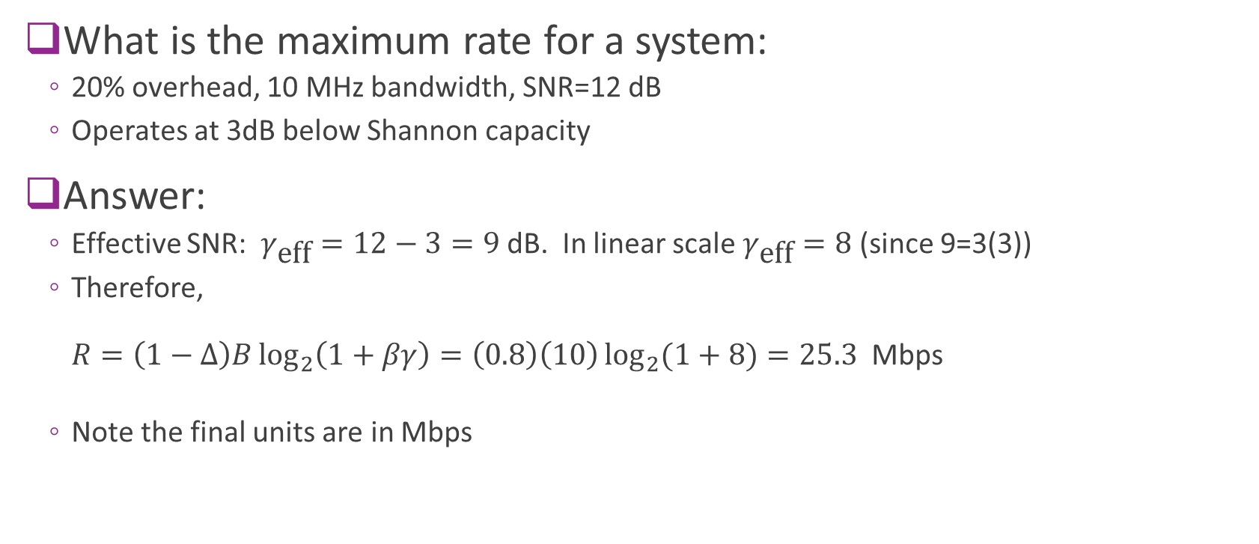
Rate vs. Capacity Example
What is the maximum rate for a system:
20% overhead, 10 MHz bandwidth, SNR=12 dB
Operates at 3dB below Shannon capacity
Answer:
Effective SNR: $γ_{\text{eff}}=12−3=9$dB. In linear scale $γ_{\text{eff}}=8$(since 9=3(3))
Therefore, $R=\left(1−Δ\right)B\log_{2}\left(1+βγ\right)=\left(0.8\right)\left(10\right)\log_{2}{(1+8)}=25.3$ Mbps
Note the final units are in Mbps

Slide 19


Communication Requirements
$$s[n]$$
$$r[n]$$
Info bits
TX symbols
RX symbols
Estimated bits
Upconversion
Pathloss
Down-conversion
Equalization, demod,
decoding
Coding + modulation
DAC+ TX filter
ADC +
RX filter
Basic questions:
How does TX and RX power effect achievable rate for a communication system?
What level of path loss can a system sustain?
Can review in the digital communications class

Slide 20
Example Link Budget
Item | Value | Remarks
Transmit power (dBm) | 23.0 | 200 mW transmitter
Distanced based path loss (dB) | 90.0 | Will depend on propagation model
Shadowing (dB) | 20.0 | Will depend on obstructions
Receive power (dBm) | -87.0 | TX power - path loss - shadowing
Bandwidth (MHz) | 20.0 | BW of 802.11 signal
Noise figure | 5.0 | Will depend of implementation of receiver
Noise power (dBm) | -96.0 | -174 +10log(BW) + NF
SNR (dB) | 9.0 | RX pow - Noise pow
Link budget: Measures final SNR as a function of TX power and all impairments

Slide 21
Outline
Noise and Noise Figure
Communication Requirements and Link Budget Analysis
Non-LOS Propagation
Statistical Models for Path Loss

Slide 22
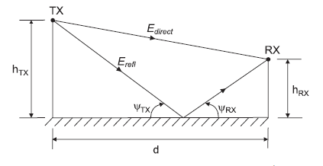
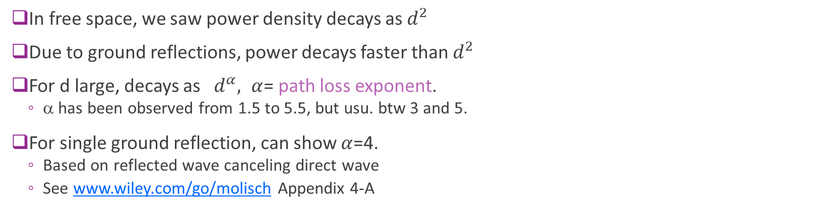
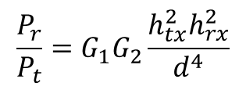
Propagation Loss with Reflections
$$\frac{P_{r}}{P_{t}}=G_{1}G_{2}\frac{h_{tx}^{2}h_{rx}^{2}}{d^{4}}$$
In free space, we saw power density decays as $d^{2}$
Due to ground reflections, power decays faster than $d^{2}$
For d large, decays as $d^{α}, α$= path loss exponent.
α has been observed from 1.5 to 5.5, but usu. btw 3 and 5.
For single ground reflection, can show $α$=4.
Based on reflected wave canceling direct wave
See www.wiley.com/go/molisch Appendix 4-A

Slide 23
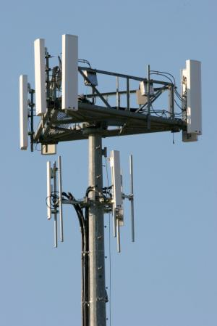

Path Loss Exponent, Coverage & Interference
For coverage-limited systems, low α is good
Power decays slower => signals have greater range
For interference-limited systems, high α is good
Ex: If thermal noise is negligible: $SINR=\frac{P_{1}}{P_{noise}+P_{2}}≈\frac{P_{1}}{P_{2}}={\left(\frac{d_{2}}{d_{1}}\right)}^{α}$
Desired signal
Dist = d1
Interfering signal
Dist = d2
P1
P2

Slide 24
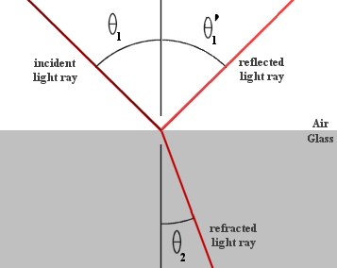
Transmission & Reflection
At any discontinuity in refractive index, incident wave will be transmitted and reflected.
Angle of incidence = angle of reflection
Refraction angle determined by Snell’s Law
Amount of reflected and transmitted power:
Depends on refractive indices of two mediums, angle of incidence and wave’s polarization
Conducting materials may also result in absorption of power

Slide 25
Transmission Through Typical Materials
Building Material | 2.4 GHz Attenuation
Solid Wood Door1. 75" | 6 dB
Steel Fire/Exit Door 1.75" | 13 dB
Steel Fire/Exit Door 2.5" | 19 dB
Brick 3.5" | 6 dB
Concrete Wall 18" | 18 dB
Glass Divider 0.5" | 12 dB
Interior Solid Wall 5" | 14 dB
Marble 2" | 6 dB
Exterior Double Pane Coated Glass 1" | 13 dB
Exterior Single Pane Window 0.5" | 7 dB
Radio waves can transmit through materials, but with attenuation
Source: City of Cumberland, Maryland WiFi study

Slide 26
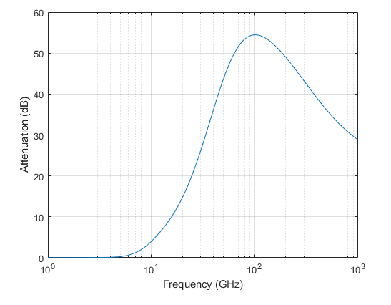
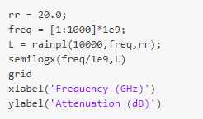
Attenuation Models in MATLAB
MATLAB Phased Array Toolbox has many models atmospheric attenuation
Commands for free space path loss, and attenuation for fog, gas and rain
Based on well-studied measurements
Note: Rain fades are particularly important to model for mmWave!
Rain attenuation vs. Freq
10 km distance
Rate rate = 20 mm/hr (very heavy rain)

Slide 27
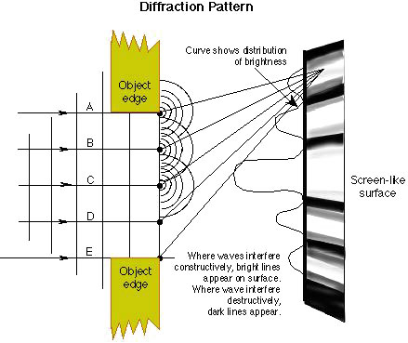
Diffraction
Interfering objects (IOs) do not result in sharp shadows.
Due to wave nature of EM radiation
Simple ray model is not correct.
Waves diffract at IO boundaries,
Intensity after IO can be stronger in parts than with no IO!

Slide 28
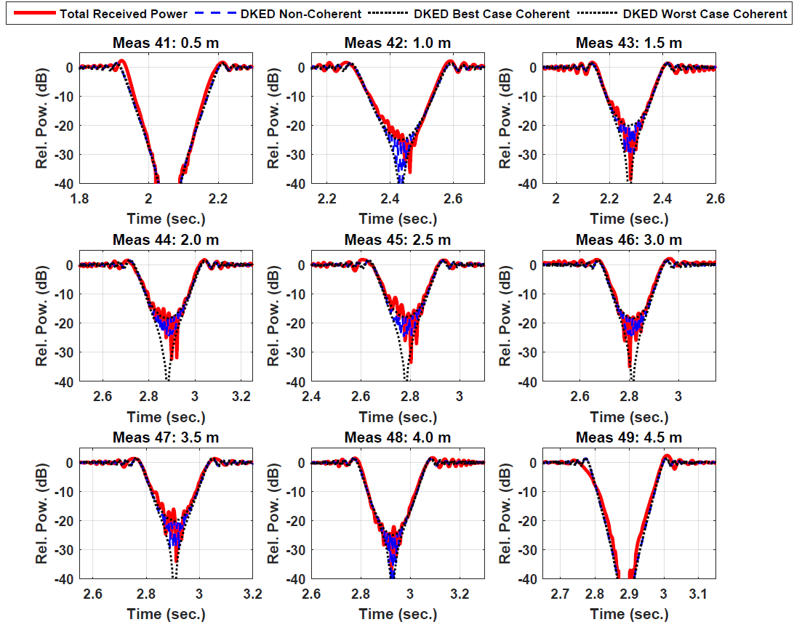

Human Blocking at 73GHz Example
5 m
41
42
43
44
45
46
47
48
49
TX
0.5 m
1.0 m
1.5 m
2.0 m
2.5 m
3.0 m
3.5 m
4.0 m
4.5 m
RX
Between 25 and 40 dB blockage
Depends on distance
Total power predicted by knife edge diffraction
Piecewise linear model used by 3GPP
G. R. MacCartney, Jr., S. Deng, S. Sun, and T. S. Rappaport, “73 GHz Millimeter-Wave Human Blockage and Dynamic Measurements,” IEEE VTC 2016

Slide 29
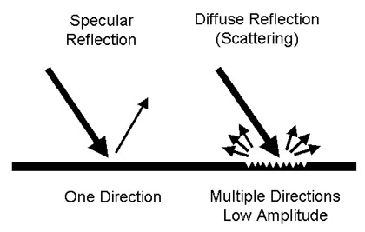
Specular Reflections & Scattering
Due to surface roughness, reflected radio waves can be scattered in many directions.
Amount of power loss in specular component related to height of surface irregularities.
Texts provides probabilistic models to estimate power loss based on random height variations.

Slide 30
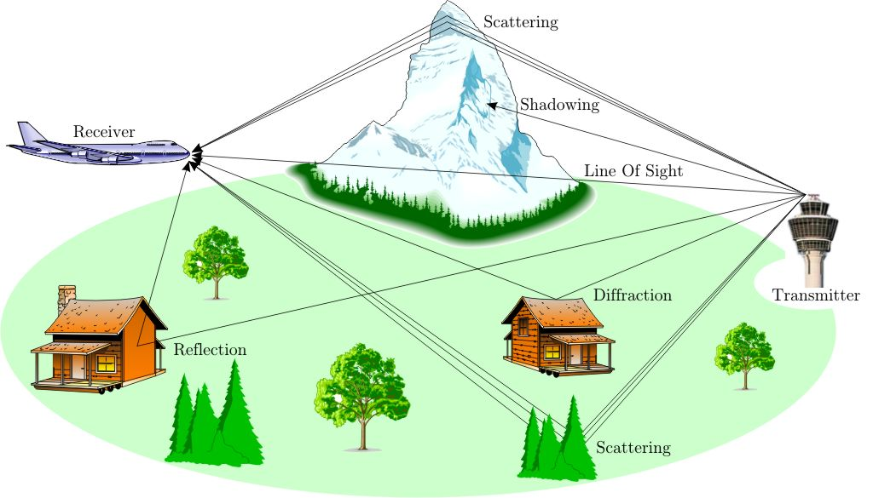
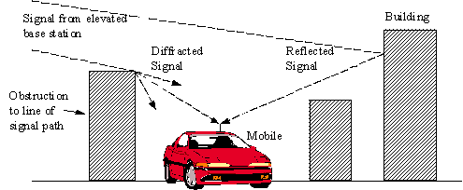
Radio Waves Have Many Paths

Slide 31
Outline
Noise and Noise Figure
Communication Requirements and Link Budget Analysis
Non-LOS Propagation
Statistical Models for Path Loss

Slide 32
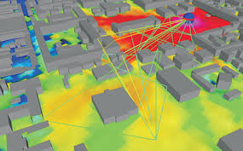
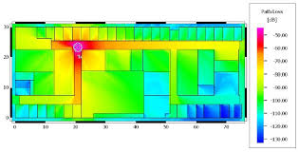
Real Path Loss
Path loss is a complex function of environment
Varies with distance, obstacles, reflections …
Site specific path loss can be predicted with ray tracing
Outputs of commercial WinProp ray tracer

Slide 33
Statistical Path Loss Models
Model path loss as a random variable
Environmental effects are modeled as random
Model fit for a type of environment
Eg. Urban, suburban, indoor, … Not site-specific
Based on data
Used for evaluation of performance statistics
Coverage, rate distribution, …

Slide 34
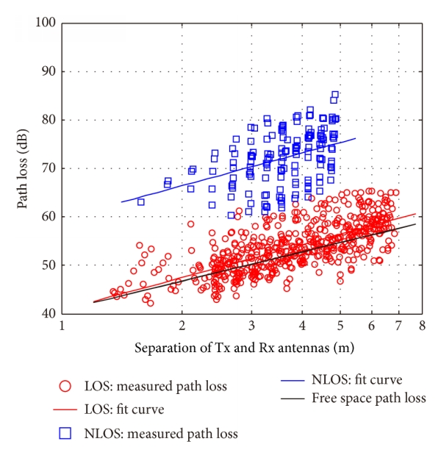
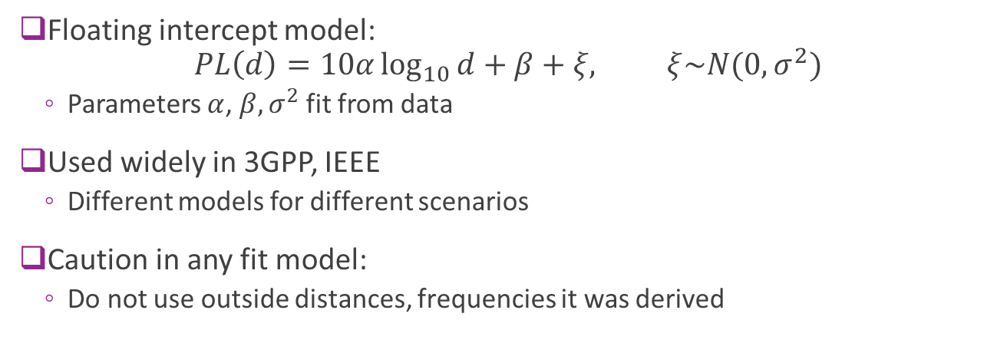
Linear Models
Floating intercept model: $PL\left(d\right)=10α\log_{10}{d}+β+ξ, ξ\sim N(0,σ^{2})$
Parameters $α$, $β, σ^{2}$ fit from data
Used widely in 3GPP, IEEE
Different models for different scenarios
Caution in any fit model:
Do not use outside distances, frequencies it was derived
NLOS
LOS
Path loss (dB)
Distance (log scale)

Slide 35
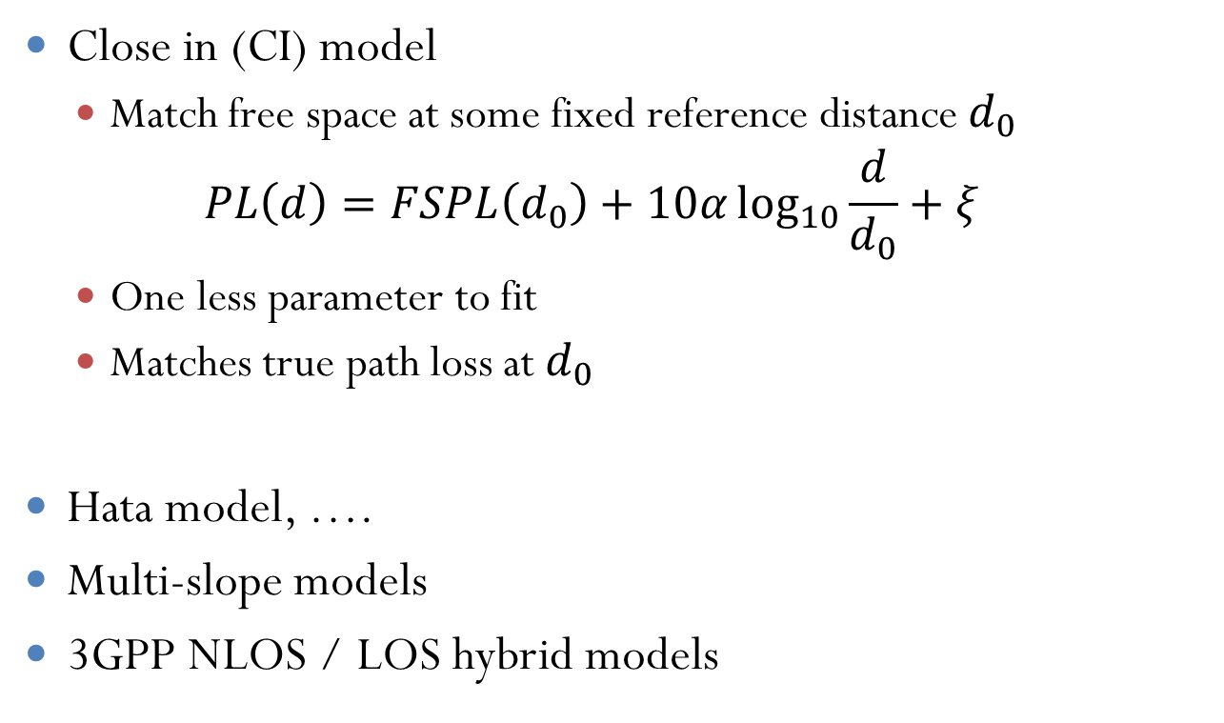
Related Models
Close in (CI) model
Match free space at some fixed reference distance $d_{0}$ $PL\left(d\right)=FSPL\left(d_{0}\right)+10α\log_{10}{\frac{d}{d_{0}}}+ξ$
One less parameter to fit
Matches true path loss at $d_{0}$
Hata model, ….
Multi-slope models
3GPP NLOS / LOS hybrid models

Slide 36
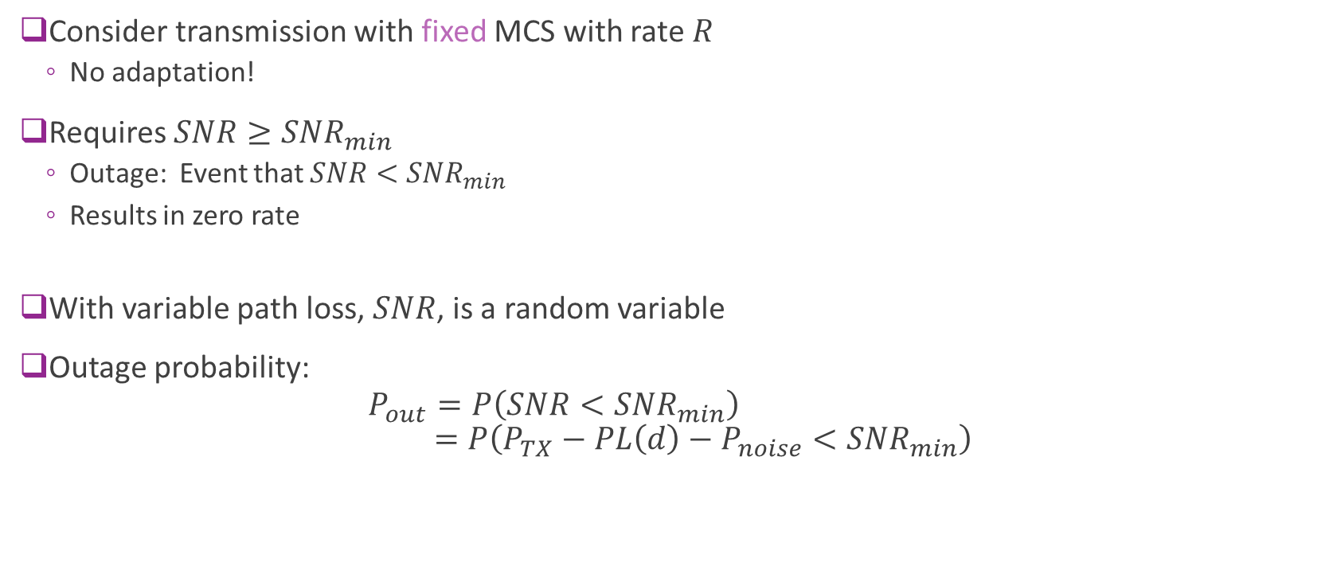
Outage Probability
Consider transmission with fixed MCS with rate $R$
No adaptation!
Requires $SNR≥SNR_{min}$
Outage: Event that $SNR<SNR_{min}$
Results in zero rate
With variable path loss, $SNR$, is a random variable
Outage probability: $P_{out}=P\left(SNR<SNR_{min}\right)$ $=P\left(P_{TX}−PL\left(d\right)−P_{noise}<SNR_{min}\right)$

