Slide 1
Smart Egyptian League Simulation
Khaled Wael
Eslam Eldewany
Khaled Mousa
Khaled Gamal
Khaled Gamal Mamoon
Khaled Elnaqib

Slide 2
Description:
A web platform that simulates the Egyptian Premier League using dynamic algorithms to schedule matches, calculate results, and update team standings automatically. Users can choose their favorite team and play matches through a mini‑game, while the system simulates the rest of the league in real time.

Slide 3
Functional Requirements:
Data Storage | The system shall store data (results, rankings, user progress) securely.
Team Registration | The system shall allow adding, editing, and deleting teams.
Match Scheduling | The system shall dynamically generate match schedules for all teams and rounds.
Match Results | The system shall record match results manually or automatically.
Points Calculation | The system shall calculate points after each match according to results.
League Standings | The system shall automatically update team rankings based on total points and goal difference.
Auto Simulation | The system shall simulate other matches automatically while the user plays their match.
Team Selection | The system shall allow the user to select a favorite team to play with.
Mini Game | The system shall provide an interactive mini-game for the user’s match.
Statistics Display | The system shall display standings, match history, and performance stats.

Slide 4
Non Functional Requirements:
Performance | Pages should load within 3 seconds.
Scalability | The system should support adding new teams or rounds easily.
Usability | The interface should be user-friendly and intuitive.
Accuracy | All match calculations and standings must be correct.
Security | User and match data must be protected from unauthorized access.
Compatibility | The system should work on all major browsers and devices.
Responsiveness | The design should adapt to mobile, tablet, and desktop screens.
Interactivity | The mini-game should respond smoothly to user input.
Maintainability | The codebase should be easy to update and extend.

Slide 5
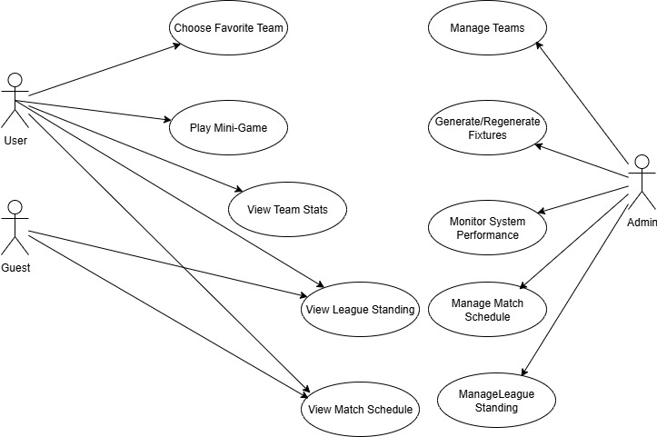
Use case:

Slide 6
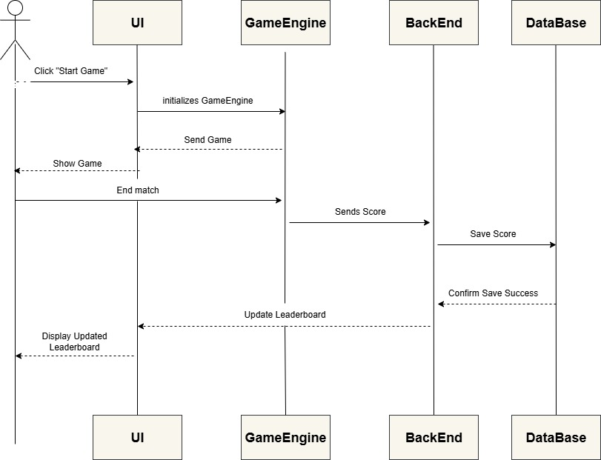
Game Sequence:

Slide 7
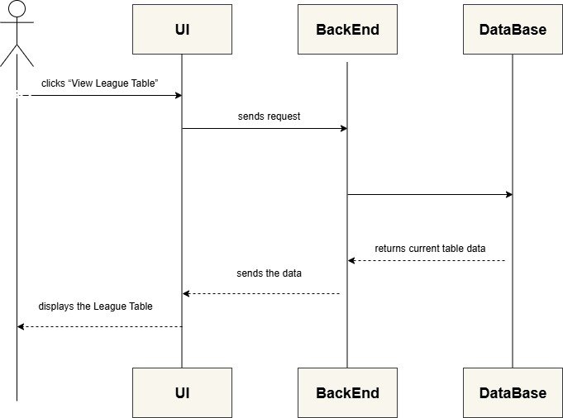
League Table Request:

Slide 8
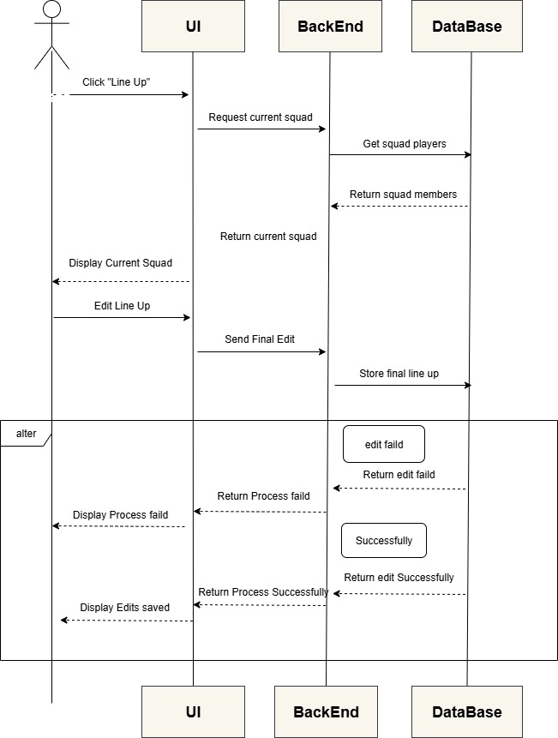
Line-up:

Slide 9
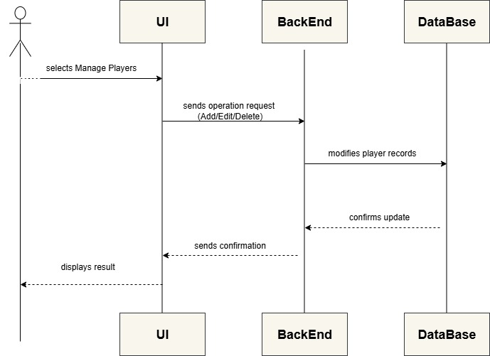
Manage Players:

Slide 10
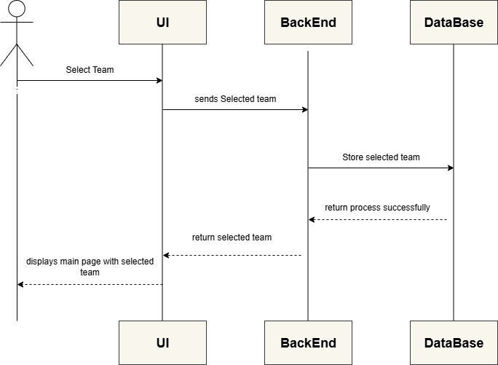
Select Team:

Slide 11
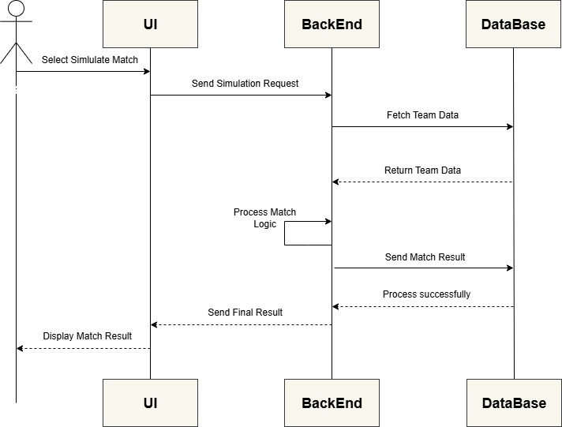
Simulate Match:

Slide 12
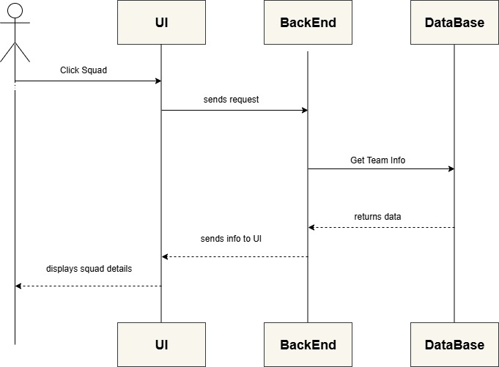
Team Details:

Slide 13
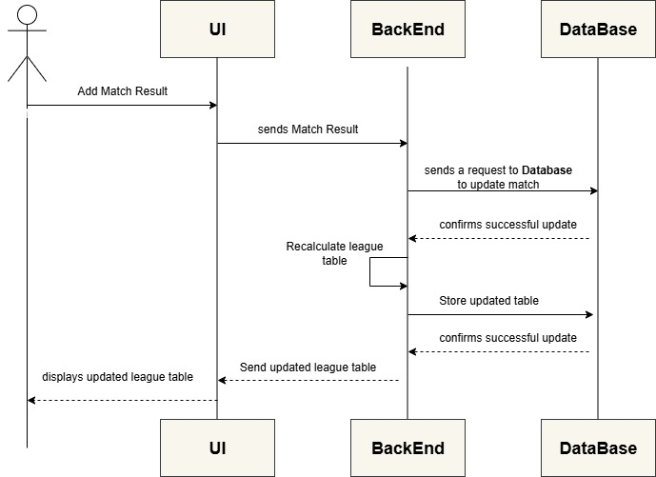
Updated league table:

Slide 14
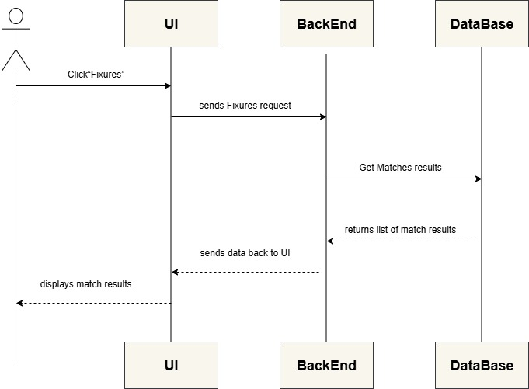
View Match Results:

Slide 15
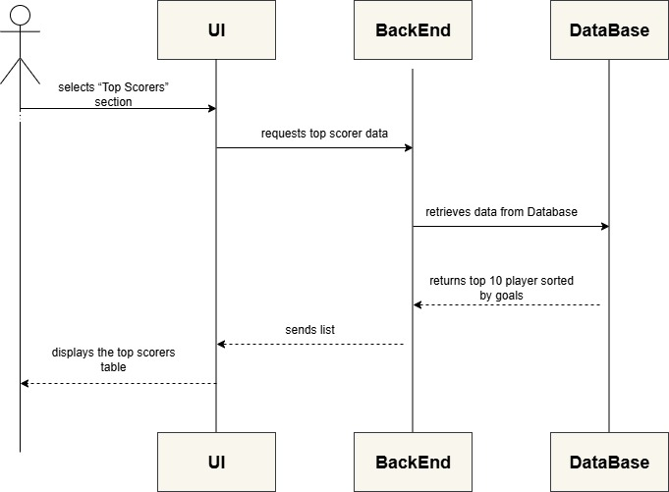
View Top Scorers:

Slide 16
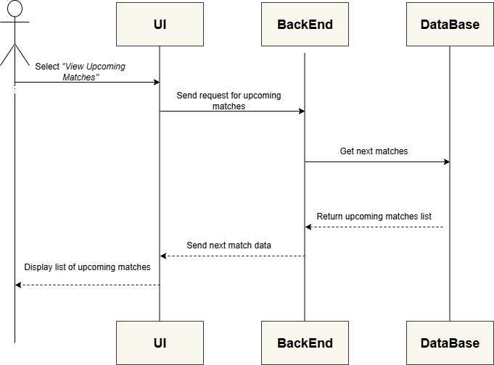
View Upcoming Matches:

