Slide 1


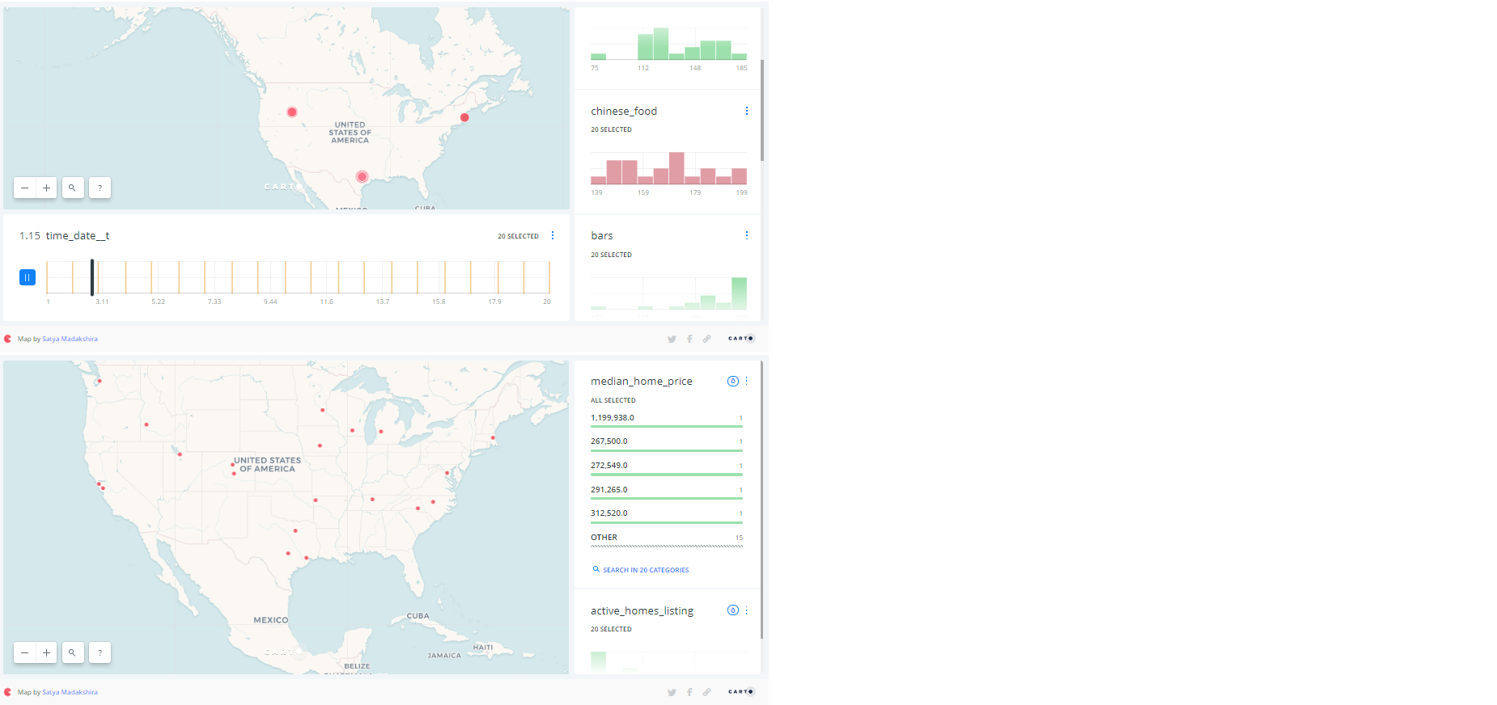

Living after graduation
Choices….choices…choices……..
DEVELOPMENT.
1
--WIP--
SOURCE DATA
3
--WIP--
4
6
DATA PREP.
REALTOR.COM
2
HOUSING DATA
DATA PREP.
DICE.COM
CSV FILES
--WIP--
JOBS DATA
GOOGLE
5
RECREATION DATA

