Slide 1
Team Members
Sharal Stanley
Jessie Luk
Ronald Martis
Satya Madakshira

Slide 2



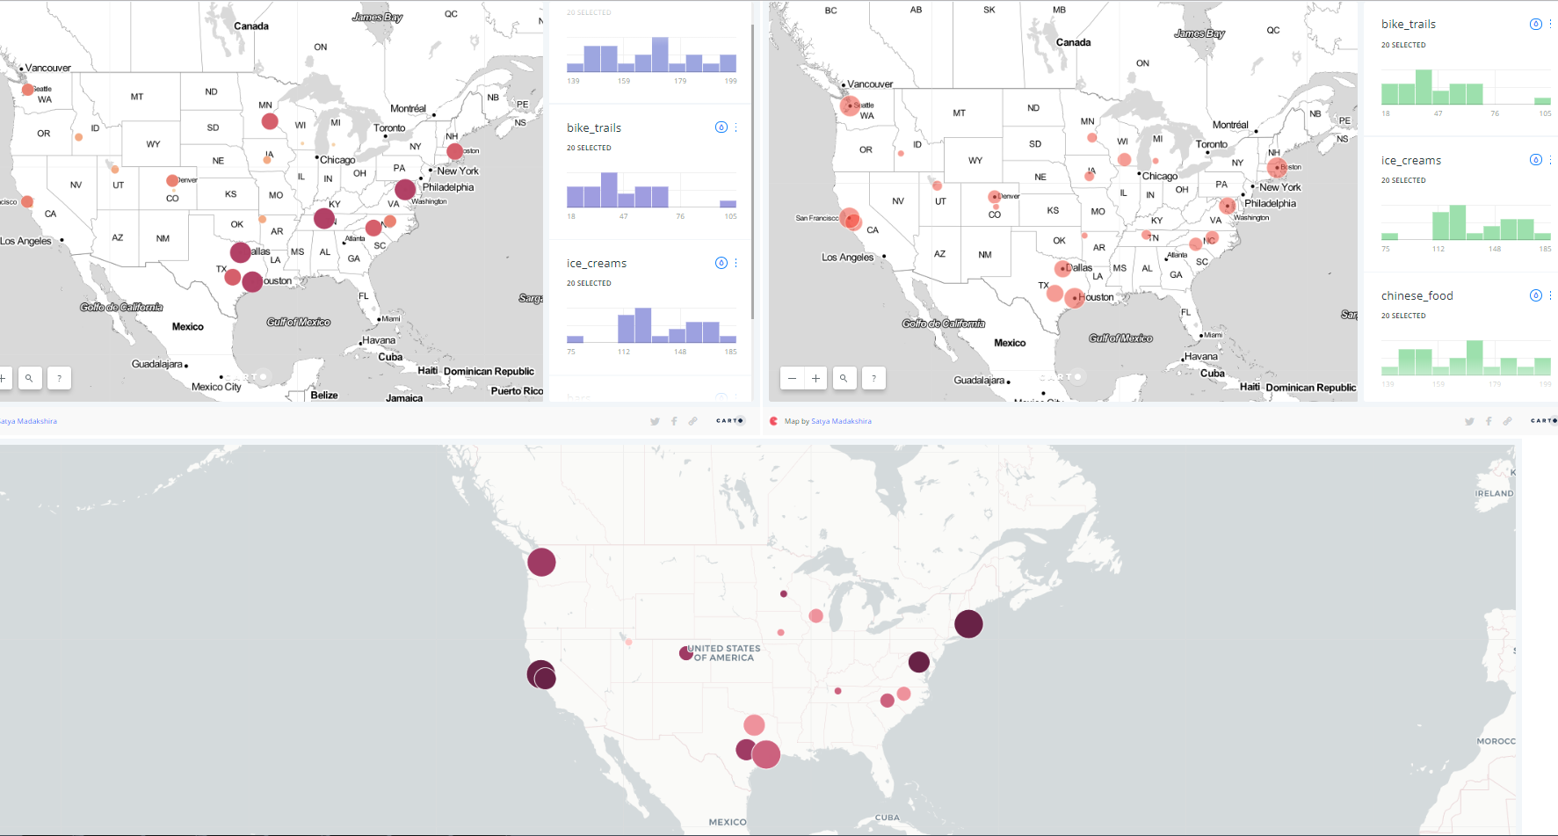

Living after graduation
Choices….choices…choices……..
7
DASHBOARD.
DEVELOPMENT.
Bar Chart
1
SOURCE DATA
5
6
WORK IN PROGRESS
REALTOR.COM
2
3
DATA PREP.
DATABASE.
HOUSING DATA
DICE.COM
CSV FILES
Housing.
Jobs.
JOBS DATA
GOOGLE
4
RECREATION DATA
Cost of Living

