Slide 1
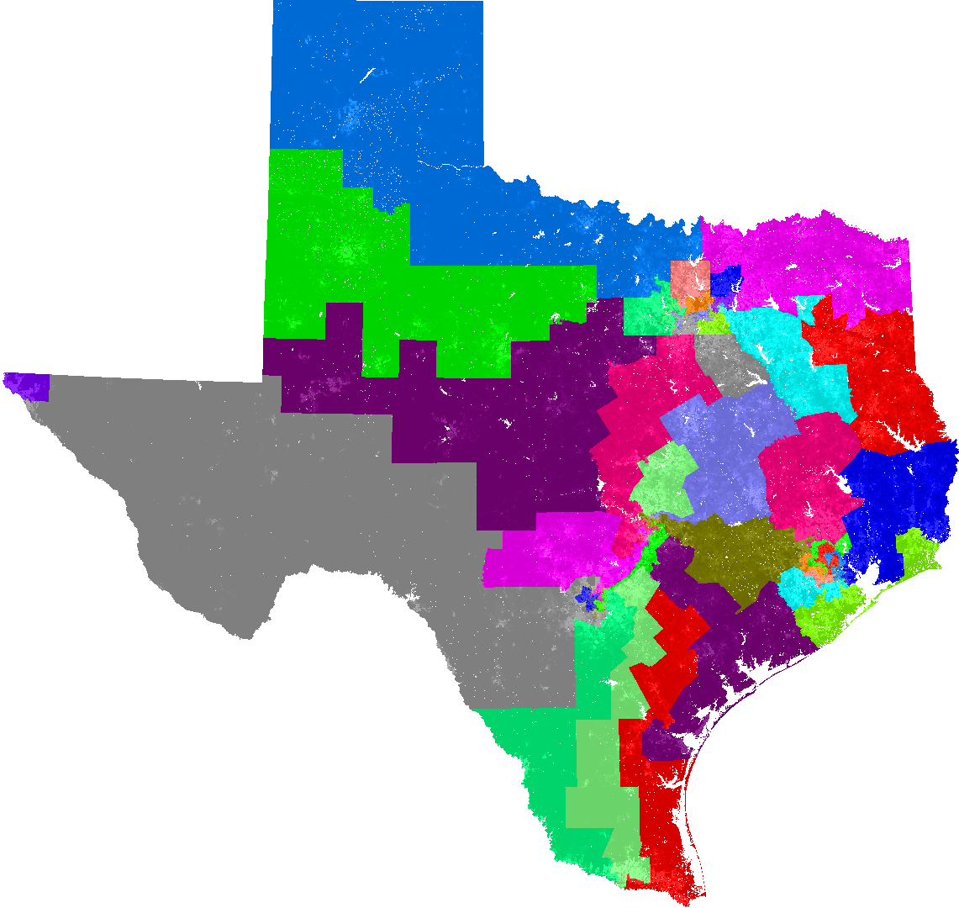
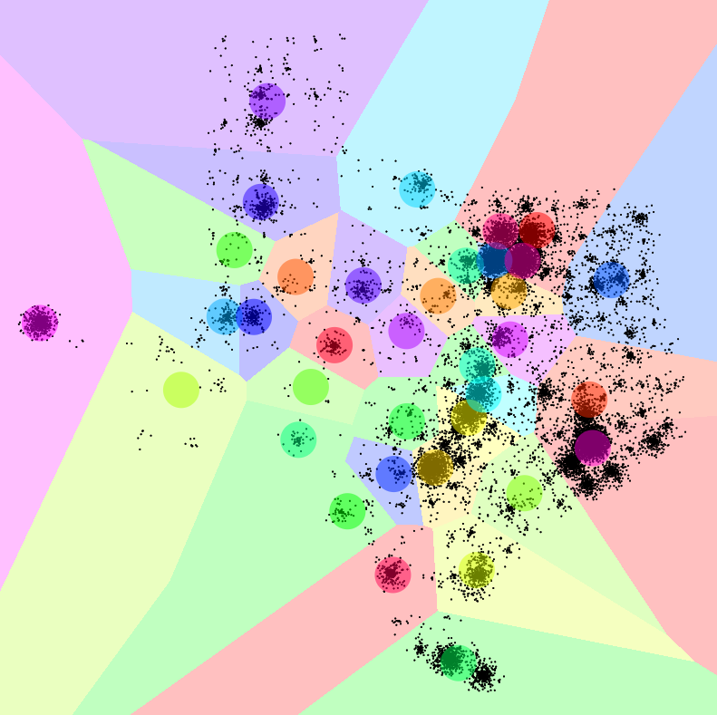
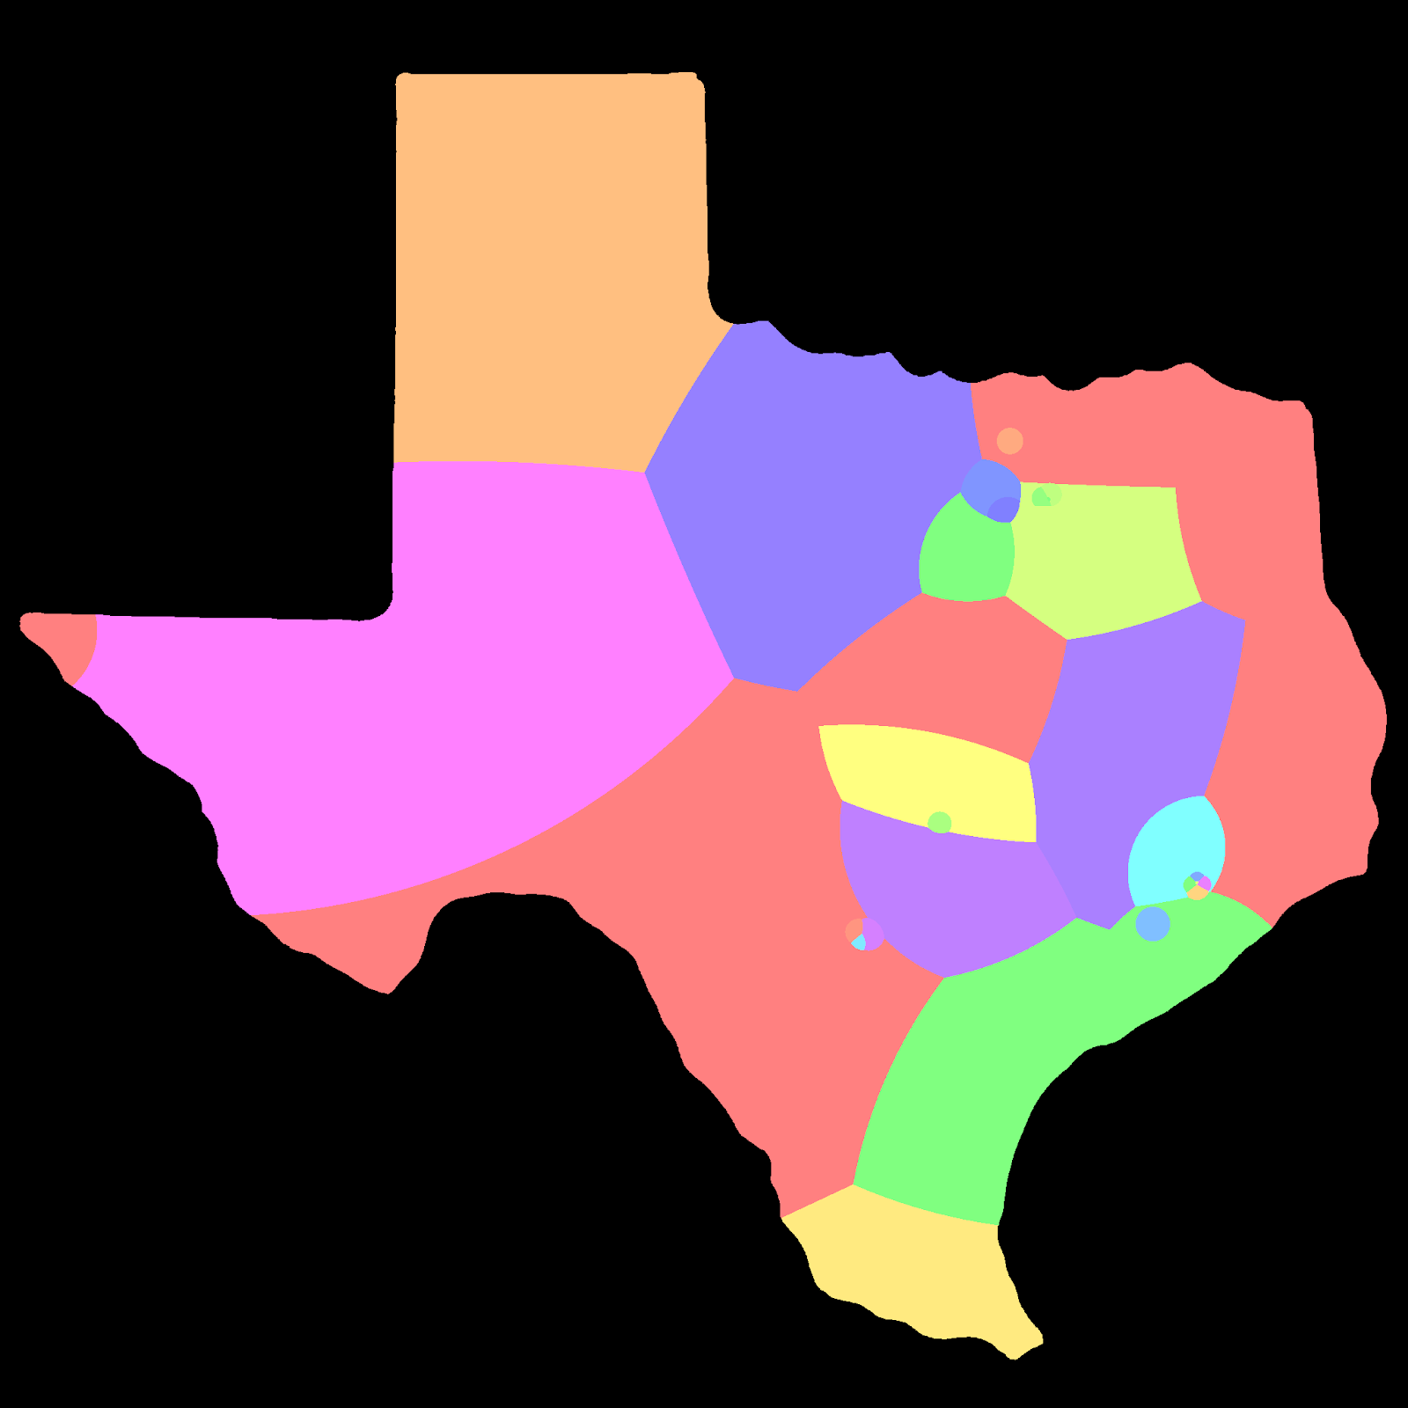
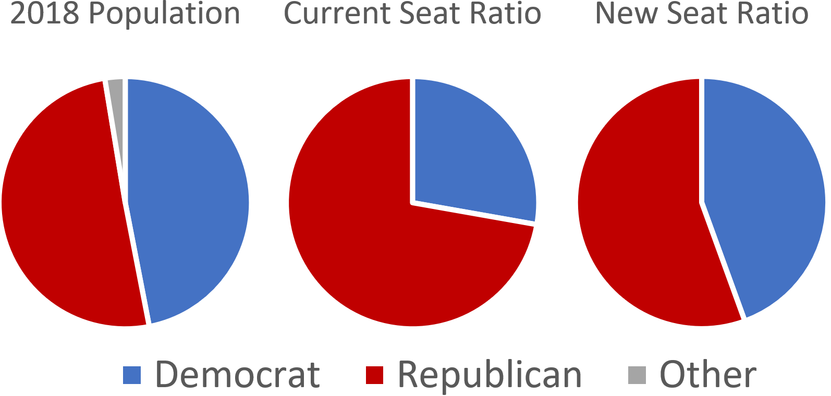
Using Machine Learning to Counteract Gerrymandering
Alan Shen, University of New Mexico, Computer Science (B.S. Expected: May 2021), alshen@unm.edu
Mentor: Dr. Soraya Abad-Mota, Department of Computer Science, University of New Mexico
Introduction
The goal of my research is to determine if using machine learning is a viable option for generating fair maps during the process of drawing congressional districts.
Gerrymandering describes the process of drawing districts that skew elections to favor one party over the other.
Results
I generated congressional district maps for the state of Texas because of its large population and its currently heavily gerrymandered districts. The generated map (with equal populations of districts) is not too dissimilar from the current map but is much more representative of the population.
Upon using 2016 election voting data to simulate
elections, the results are 20 republican districts to
16 democratic districts (55.55% republican). This
is much more representative of the population,
which voted 50.4 % Republican in the 2018
general election. The current ratio is 26 republic
districts to 10 democratic districts (72.22%
republican).
Current Congressional District Map of Texas
Current congressional district map has far fewer “compact” districts, which is typically a sign of gerrymandering.
Methods
I used the k-means clustering algorithm to generate “fair” maps.
Every centroid in my model represents one congressional district, with the data points representing the population.
I added weights to the centroids to ensure that all districts had roughly equal populations.
Conclusions
Using k-means clustering to generate maps is an effective method.
Weights do need to be added to the centroids to ensure that federal laws are met, most notably the equal-populations rule.
More weights could be added to ensure that various other district drawing rules are met, such as grouping people of common interest together.
A map generated without population-correcting weights on the centroids. Populations of each district vary too much to satisfy federal district drawing laws.
A map generated with population-correcting weights on the centroids. The centroids all have roughly equal populations.
Acknowledgements
NSSP/CTSP programs

