Slide 1
TASK 2
Task 2: Analyze a Phishing Email Sample.
Tools- Virus Total
Objective:
To identify phishing characteristics in a suspicious email using sender analysis, header evaluation, link inspection, and language cues.
If you see any suspicious link cop it and paste on a website name- virus total
It will check it automatically that Phishing email or not ..
~For example URL- https://login3.id.hp.com/login3/verification?otp=tsnwsunf9h8ts9zib3t5kn1fwnt35e4u
login3.id.hp.com

Slide 2
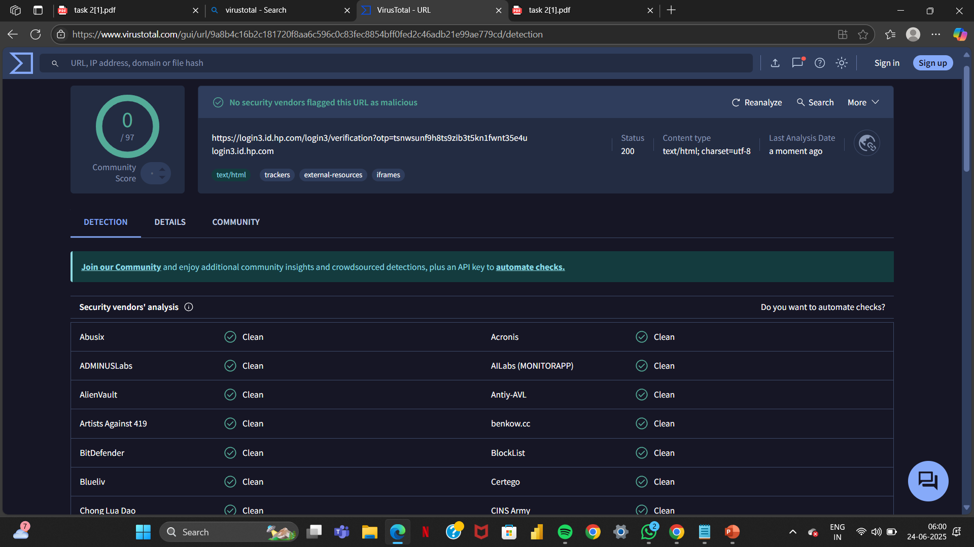
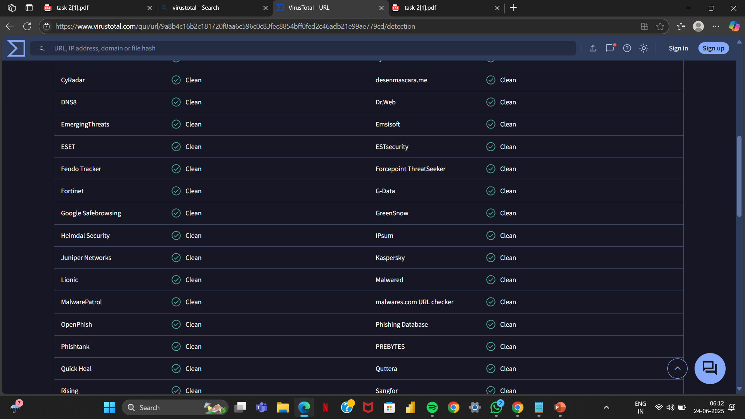

Slide 3
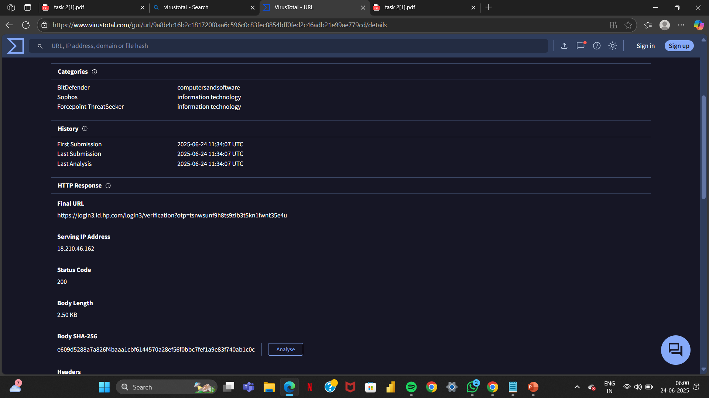

Slide 4
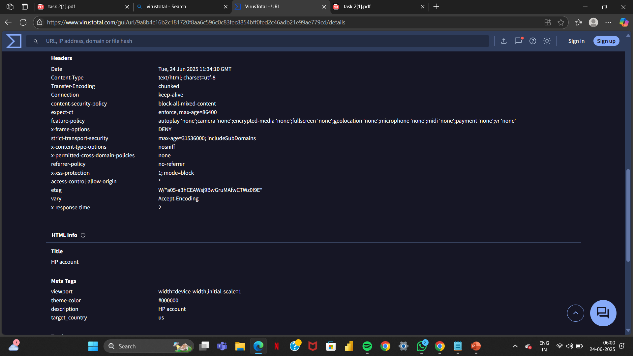

Slide 5
🔍 Sample Phishing Email Content
Subject:
"Account Notice: Suspicious Login Attempt Detected – Immediate Verification Required"
From:
"Microsoft Support" support@m1crosoft-alert.com
Body:
Dear User,
We detected a login attempt from an unknown location. For your safety, your account access is limited. Please confirm your identity immediately.
🔒 Click here to verify your account
If you do not verify within 24 hours, your account will be permanently suspended.
Regards,
Microsoft Security Team

Slide 6
1. Sender Email Address Analysis
Displayed Address: support@paypal.com
Actual Address: support@paypalsecure-info.com
Issue Identified: The domain appears legitimate at first glance, but it’s spoofed (paypalsecure-info.com is not PayPal’s domain).
2. Email Header Discrepancies
(Using an online header analyzer like Mx Toolbox)
SPF/DMARC Failures: The header indicates SPF failed – domain not authorized to send on behalf of PayPal.
Return Path: mailer@phishyserver.ru
Issue Identified: Mismatch between sending domain and return path, signs of spoofing.
3. Suspicious Links/Attachments
Visible Link: https://paypal.com/login
Actual Link (hovered): http://malicious-site.ru/paypal-login
Attachment: PDF named InvoiceDetails.pdf (contains macro script)
Issue Identified: Mismatched URL, and unsolicited attachment with macro payload.
4. Language and Tone
Language Used: “Your account will be permanently suspended in 24 hours unless you confirm your identity.”
Urgency: High urgency and fear-based tactic.
Issue Identified: Psychological pressure, a hallmark of phishing.

Slide 7
5. Spelling and Grammar
Errors Found: “We noticed unusual activities on you account.”
Issue Identified: Grammatical mistakes, unprofessional tone.
6. Other Phishing Traits
Generic Greeting: “Dear Customer”
Lack of Branding Consistency: Poorly formatted logo, mismatched colors.
No Personalization: No account name or partial details.
✅ Summary of Phishing Traits Found
Phishing Indicator Description
Spoofed Email Address Domain mimics PayPal, but is clearly fake
Header Discrepancy SPF and DMARC failures, fake return path
Malicious Link Mismatched link redirects to Russian domain
Urgent/Threatening Language Creates panic to pressure immediate action
Grammar & Spelling Errors Poor writing, a common phishing trait
Generic Greetings No personalization; lacks recipient-specific data
Suspicious Attachment Unrequested file with macro; potential malware

Slide 8
💡 Recommendations
Never click on links or open attachments from unknown or suspicious sources.
Always verify sender details and hover over links before clicking.
Report the email to the legitimate company (e.g., phishing@paypal.com).
Use spam filters and antivirus tools regularly.
Thanks

