Slide 1
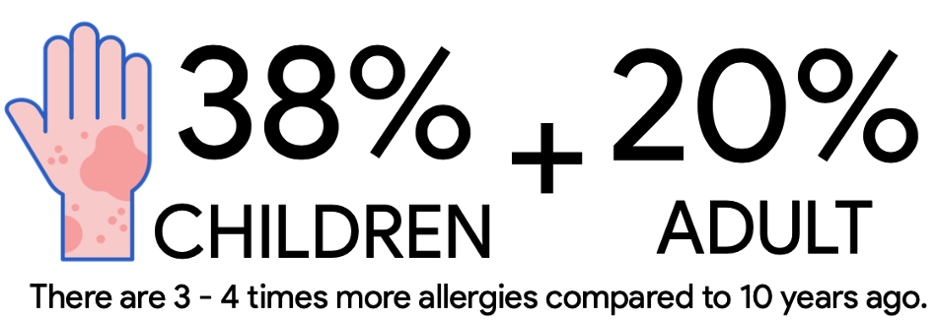
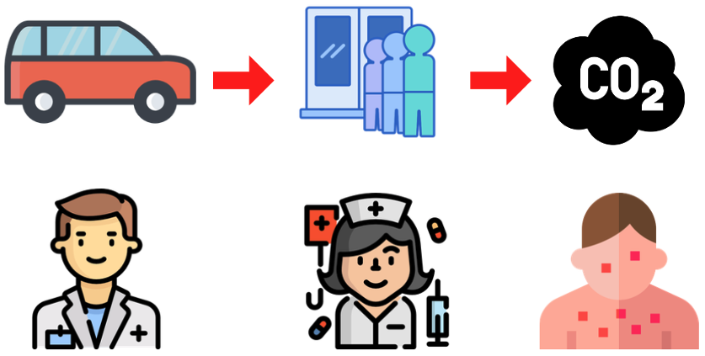

Slide 2
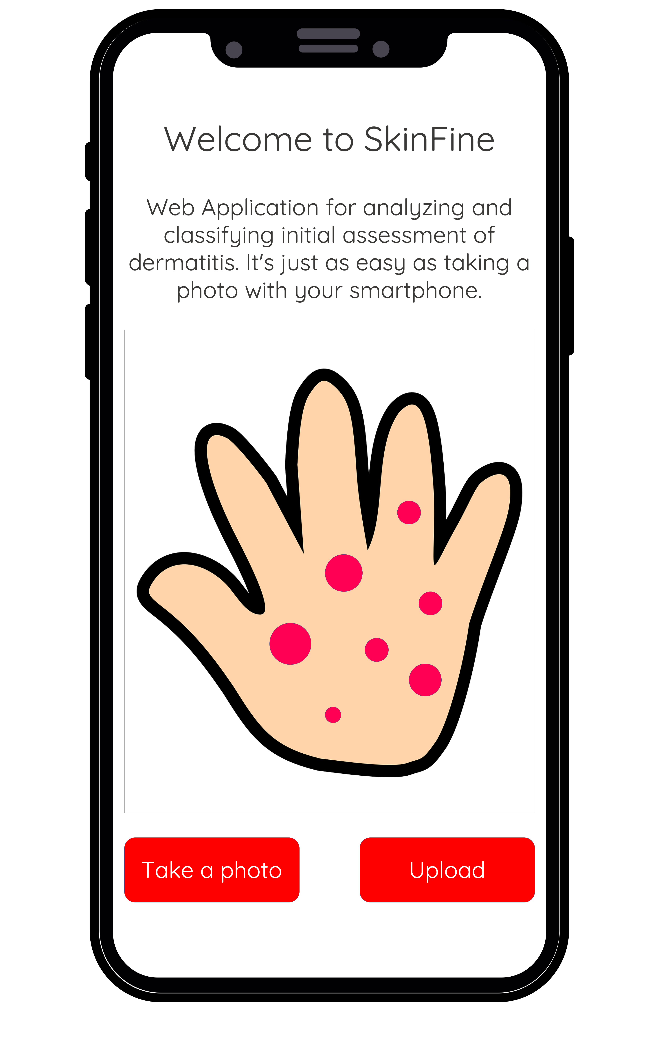

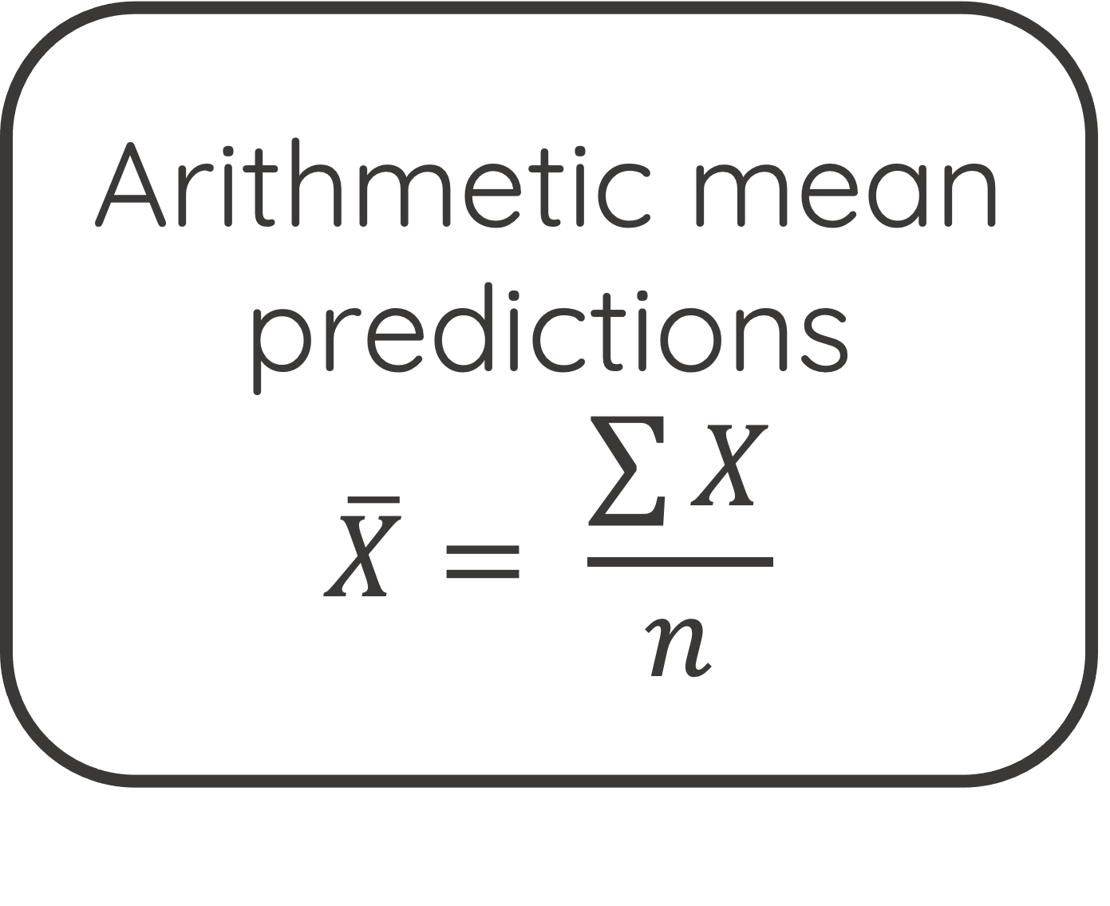
DenseNet121
+
HAM10000weights with Oversampling
DenseNet121
+
HAM10000weights with Class Weights adjusment
Arithmetic mean predictions
$$\overline{X}= \frac{\sum{X}}{n}$$
Take or select photos of skin diseases you want to categorize.
DenseNet121
+
HAM10000weights with Focal Loss
Wait for the analysis result with advice.

Slide 3
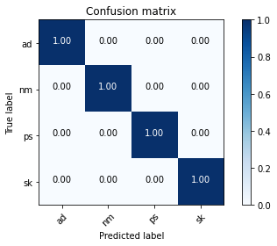
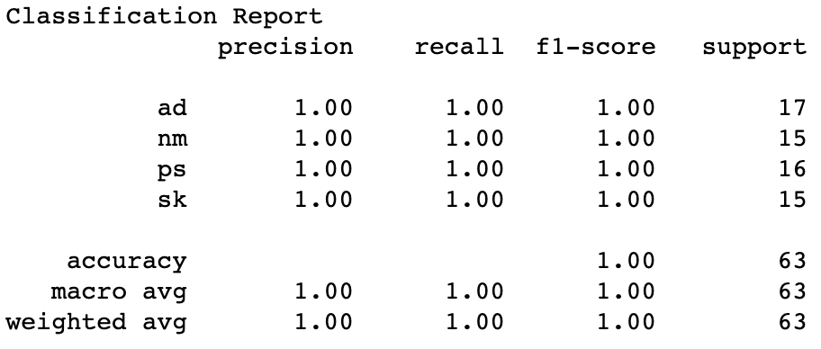
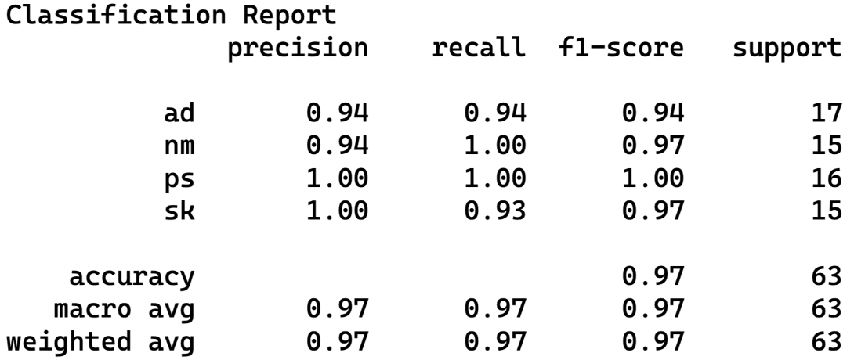

Slide 4
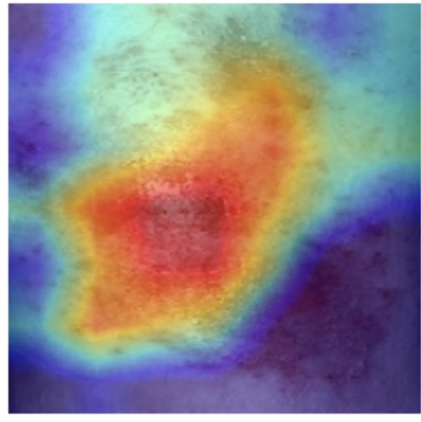
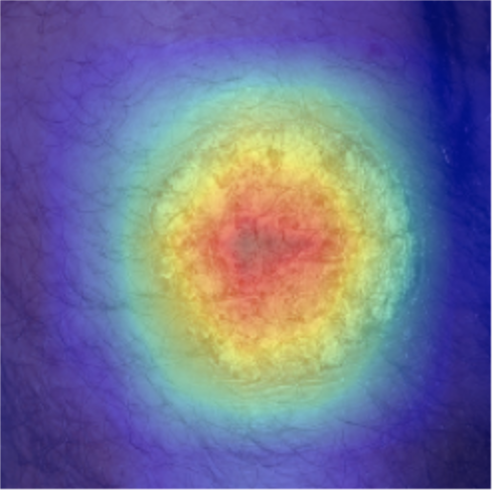
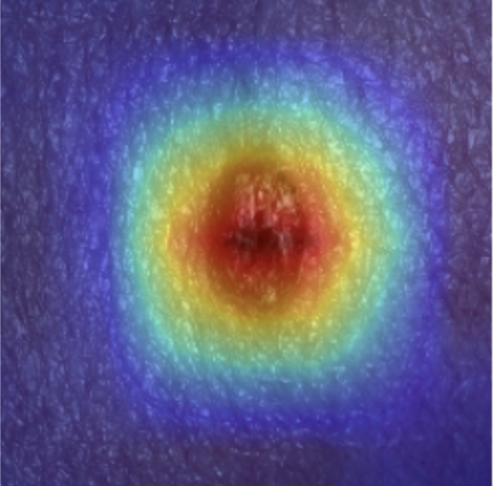
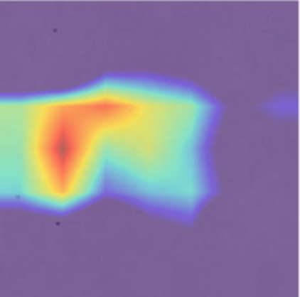
Atopic Dermatitis
(AD)
Psoriasis
(PS)
Seborrheic Keratosis (SK)
Normal Skin
(NM)

