Slide 1

source: https://www.gartner.com

Slide 2
source: https://www.gartner.com

Slide 3
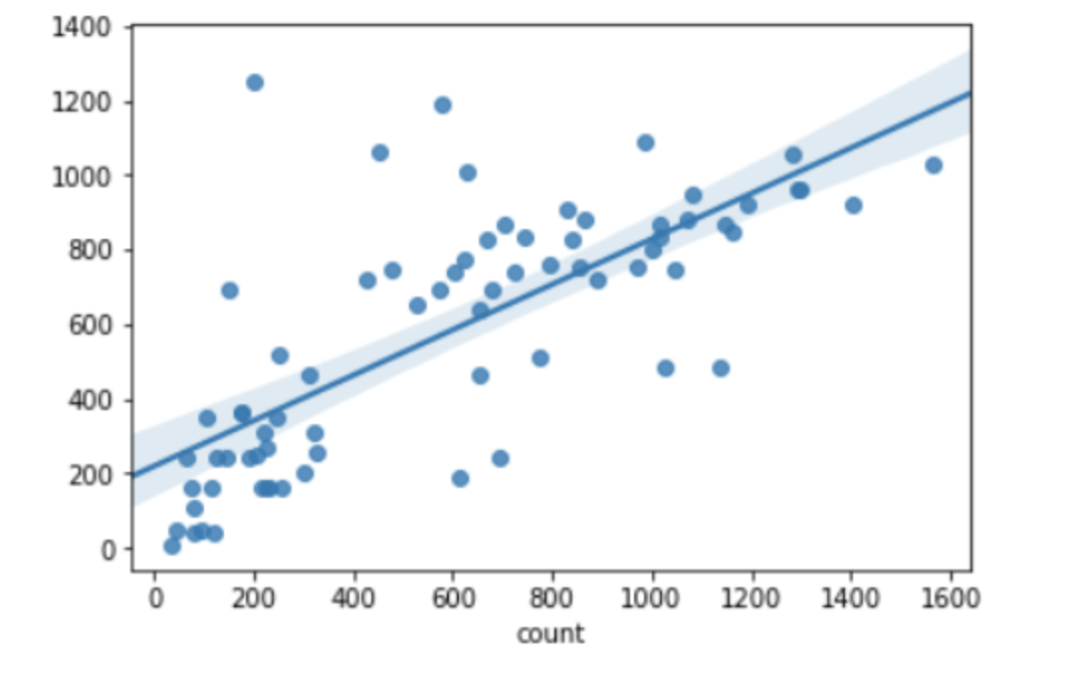
acc : 0.82
R^2 : 0.54

