Slide 1
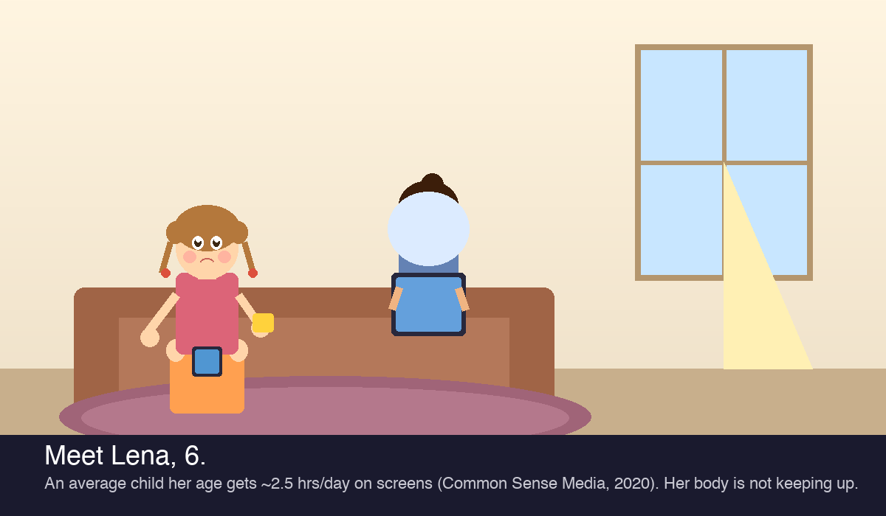
A Story About
Lena.
Age 6. Loves drawing — but her hand gives out after two minutes. Her mom Maya has no idea why.
The iPad was never designed for a 6-year-old's body. MotionMind is the layer that changes how kids interact with the screens they already use.
MotionMind
Wearable Development System
Stanford CIM206 — Biodesign for Digital Health · March 2026
MotionMind · Confidential · March 2026
1 / 10

Slide 2
CHAPTER 1 — THE FAMILY
Meet Lena.
Age 6. Lives in San Jose.
Loves drawing — but her hand gives out after 2 minutes.
Her family is one of millions navigating screens
without a tool to understand what her body actually needs.
"She should be holding her pencil better by now."
Meet Maya.
Age 34. Product manager. Two kids.
Lena's mom.
71% of parents are concerned their child spends
too much time on screens — and have no idea when
it becomes clinical or who to call. (Pew Research, 2020)
— Maya, composite parent persona grounded in field research
MotionMind · Confidential · March 2026
2 / 10

Slide 3
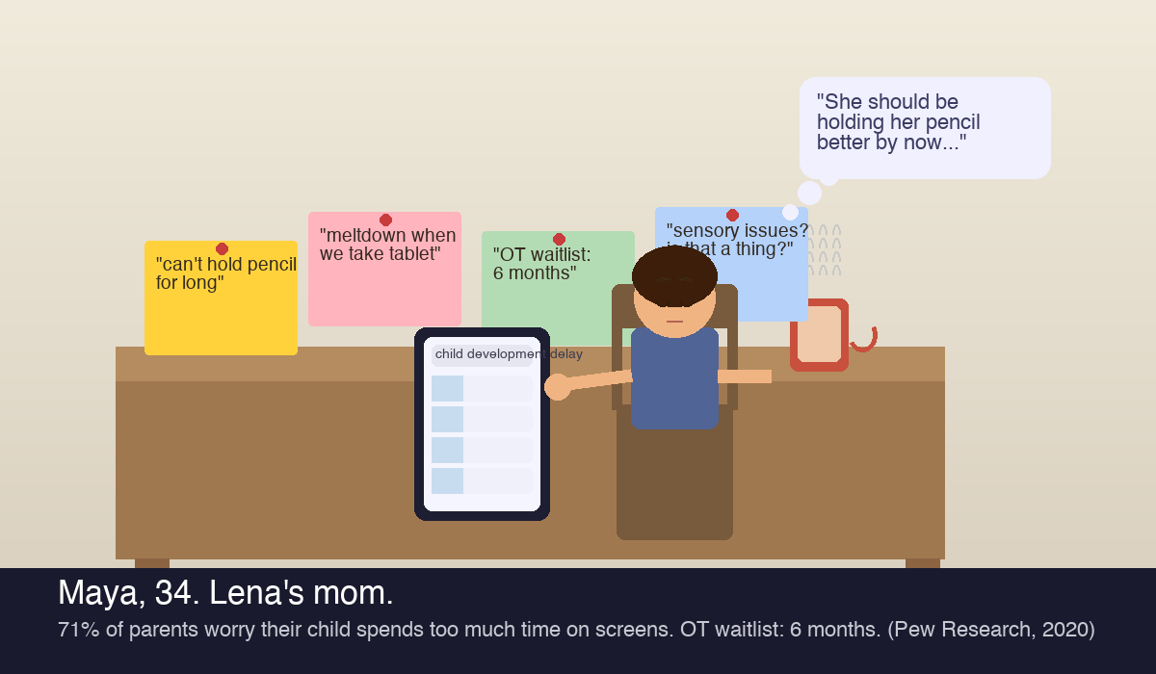
CHAPTER 2 — THE WORRY
Maya sees it. The screen isn't the problem.
iPads & tablets were designed for adults — not developing hands
Touchscreen interaction requires pinch/swipe → skips grip, fine motor, posture
54% of parents say their child is addicted to screens
Source: cited in Stanford CIM206 source deck
93% of screen-off moments trigger conflict
37% say it almost always ends in a fight (Hiniker et al., 2016)
28% of parents give in to screens to avoid meltdowns — multiple times/week
Source: Lurie Children's Hospital, 2025
OT waitlist: 6 months in most US metro areas
Field observation — no centralized data; consistent across parent reports
MotionMind · Confidential · March 2026
3 / 10

Slide 4
CHAPTER 2.5 — THE MARKET GAP
The screen isn't the enemy. The interaction design is.
📱 Standard Tablet Apps
🔇 Screen Time Management
🕹️ Motion Games (Kinect, Nex)
📚 Osmo / Tablet + Accessories
🏥 Pediatric OT
Every tool below was designed for adults — or for entertainment. None was built around how a child's body actually develops.
Designed for adults
Controls quantity
Gross motor only
Visual-spatial only
Best clinical tool
Tap & swipe only
Ignores interaction quality
No handgrip data
No body sensing
But: 6-month wait
No grip or posture
No skill building
No fine motor
No wearable layer
$150–$300/session
No motor output
Increases conflict
No prescription
No gap scoring
Insurance barriers
Score: 0/8 dev gaps
Score: 0/8 dev gaps
Score: 3/8 dev gaps
Score: 2/8 dev gaps
Score: 8/8 (inaccessible)
MotionMind = Wearable band (grip + EMG) + Camera hand-tracking + AI layer → Transforms every screen session into developmental therapy. 7/8 gaps. At home.
MotionMind · Confidential · March 2026
4 / 10

Slide 5
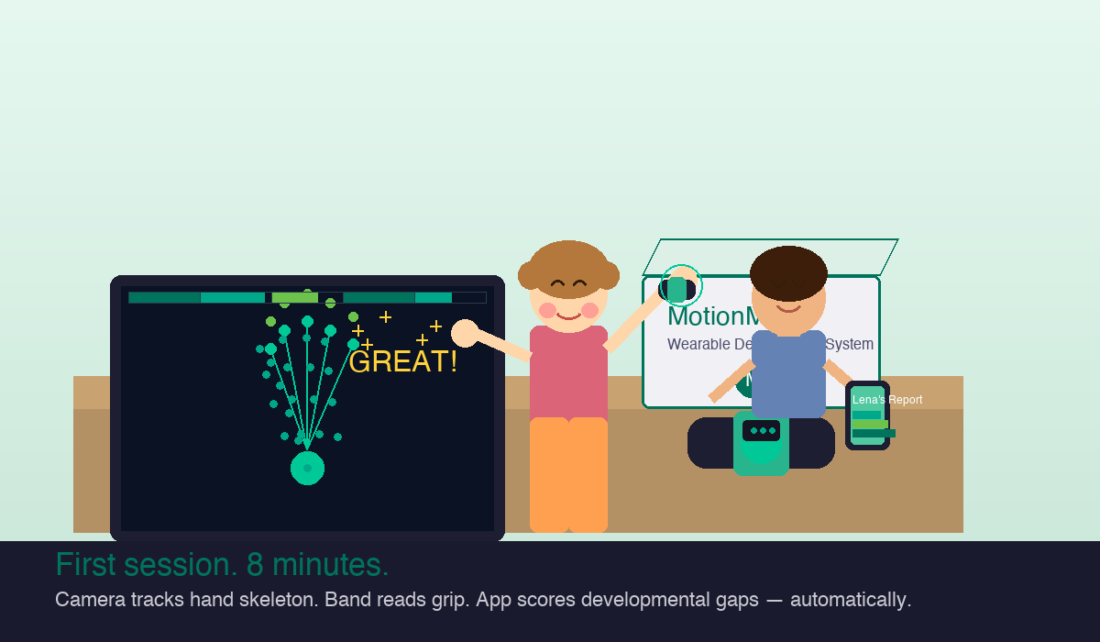
CHAPTER 3 — THE DISCOVERY
First session.
Lena wears the MotionMind band on her wrist.
The hand-tracking game activates on the tablet.
Google MediaPipe reads 21 hand skeleton points
at <10ms latency — no special hardware needed.
The band logs grip force and wrist movement live.
The app scores 7 developmental gaps automatically.
"93% of parents report screen-off conflicts at least occasionally. 37% say it almost always ends in a fight."
— Hiniker et al., 2016 (why engagement matters from minute one)
MotionMind · Confidential · March 2026
5 / 10

Slide 6
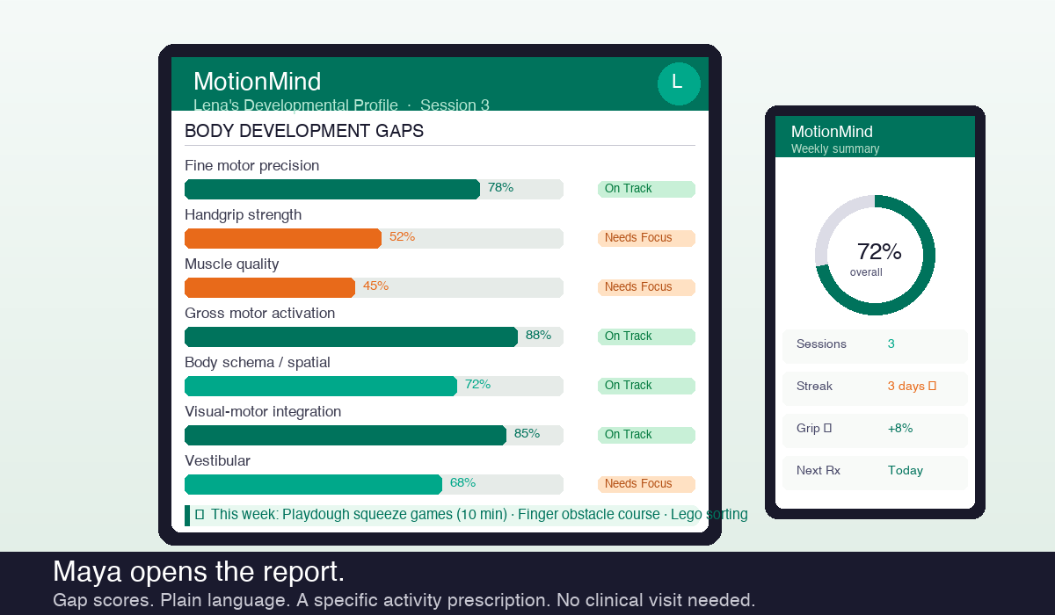
CHAPTER 4 — THE INSIGHT
Maya opens the report.
After the first session, the app generates Lena's developmental gap profile — automatically. No clinical visit. No questionnaire.
Illustrative gap profile — pending OT field validation:
Fine motor precision
On Track
Handgrip strength
Needs Focus
Muscle quality
Needs Focus
Gross motor
On Track
Visual-motor
On Track
Vestibular
On Track
Persona narrative: "I finally have a name for it. And a next step."
Gap-matched Rx: Playdough squeeze · Finger obstacle course · Lego sorting (OT-designed, household objects)
MotionMind · Confidential · March 2026
6 / 10

Slide 7
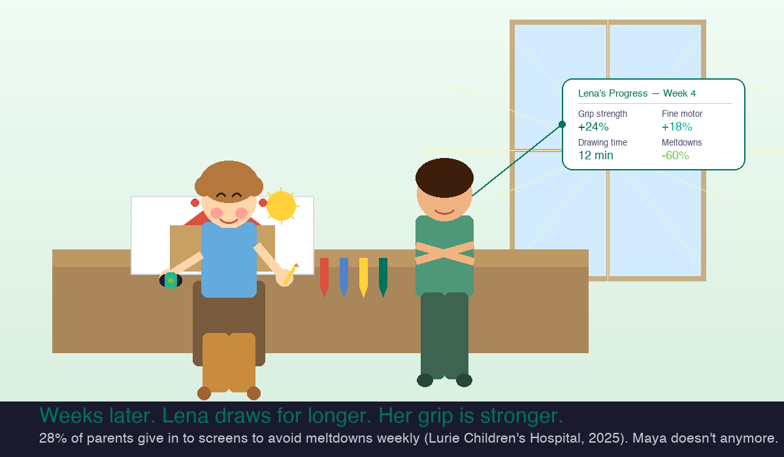
CHAPTER 5 — THE TRANSFORMATION
Week 4.
Pilot outcomes — target Q3 2026
↑ Improving
Grip strength
↑ Improving
Fine motor
↑ Engaged
Drawing sessions
↓ Reducing
Screen conflicts
↑ Consistent
Completed tasks
Persona narrative: "She asked to draw instead of the tablet. For the first time."
— Maya (composite persona)
MotionMind · Confidential · March 2026
7 / 10

Slide 8
HOW MOTIONMIND WORKS
Three layers. One complete system.
⌚ WEARABLE BAND
📷 CAMERA SYSTEM
🤖 AI PLATFORM
$49 · Wrist sensor
No extra hardware needed
Cloud + on-device
Handgrip force sensor
Google MediaPipe — 21-point hand skeleton
Fuses band + camera in real time
Surface EMG (muscle activity)
Full body pose landmarks
Scores 7/8 developmental gaps
3-axis accelerometer + gyroscope
Gesture quality scoring
Generates activity prescription
Skin conductance (arousal)
Visual-motor reaction timing
Tracks progress week-over-week
→ Captures what camera CAN'T
→ Works on any tablet/phone
→ Parent report + clinician PDF
Zero clinical expertise required from parents. COPPA 2025 compliant. FDA General Wellness (Jan 2026).
MotionMind · Confidential · March 2026
8 / 10

Slide 9
THE NUMBERS
8M kids. Billions of screen hours. Zero tools designed for their bodies.
8M+
82%
6 hrs
US children 0–11 showing symptoms (CDC / Boyle et al.)
of adolescents don't meet movement guidelines (WHO, Lancet 2019)
average daily screen time for children (source deck)
$103B
7–12×
7/8
child rehab + digital health market by 2034, 7% CAGR (source deck)
ROI on early intervention (Heckman, heckmanequation.org)
developmental gaps MotionMind closes (product claim)
MotionMind · Confidential · March 2026
9 / 10

Slide 10
THE OPPORTUNITY
The screen isn't leaving. Let's fix what it does.
iPads and tablets were designed for adults. MotionMind is the first system built around how a child's body actually develops — turning every screen session into a chance to grow, not just consume.
Lena & Maya are composite personas. All statistics sourced from CIM206_Biodesign_Deck(3).pptx.
Seed Round
$750K–$1.2M · Band v1 + App launch
Pilot Sites
3–5 OT practices + schools · Q3 2026
Advisors
Pediatric OT · FDA counsel · HW engineer
MotionMind · Stanford CIM206 · March 2026 contact@motionmind.com
MotionMind · Confidential · March 2026
10 / 10

