Slide 1
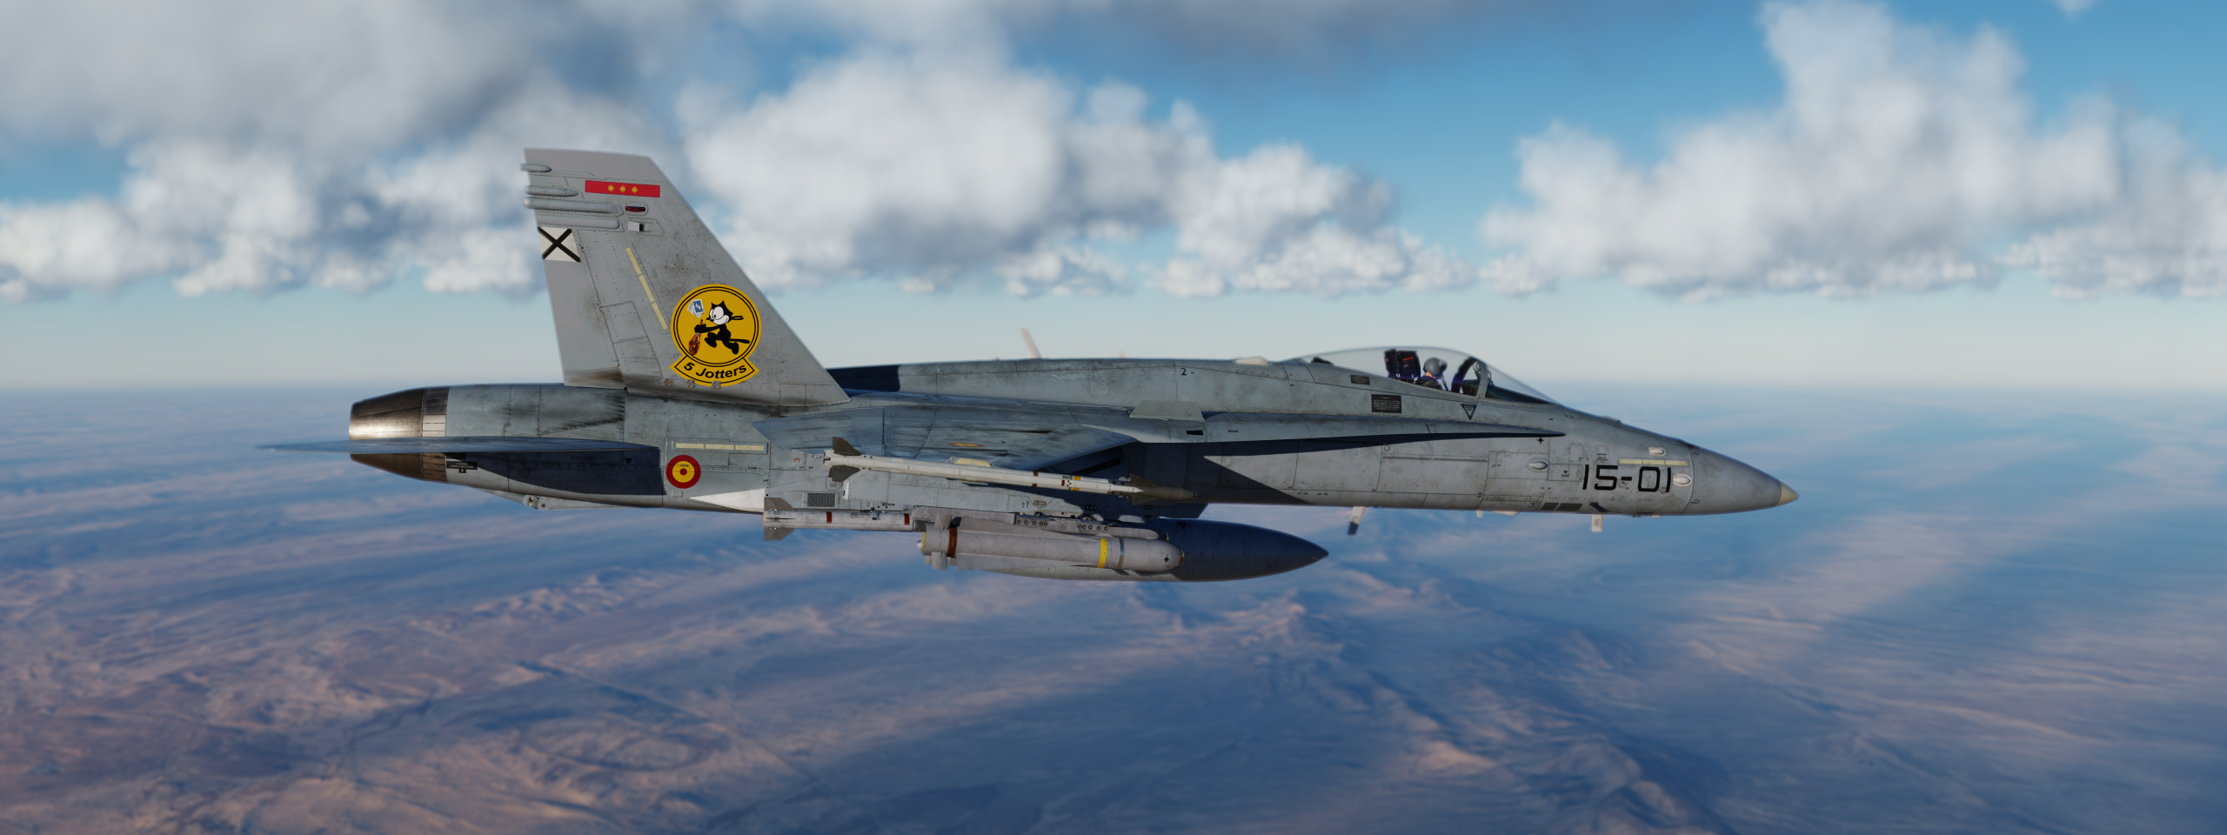
Liberation Syria invasion
MISSION 7

Slide 2
ROLL CALL
PILOT
ASTILES
RAUS
ENDER
XIFU

Slide 3
FORCE
COMPOSITION
HORNET 1 (MC) (2 F/A-18) ESCORT + SEAD
(6,0,2,+), 2GM88
RAMAT DAVID
STEP 17:00
TAXI 17:10
T.O. 17:20:00
VIPER 1 (2 F-16) STRIKE
(4,0,2,+), 4M84
RAMAT DAVID
STEP 17:00
TAXI 17:12
T.O. 17:22:00
OVERLORD (E3) C2
ARCO (KC-130) AAR
TEXACO (KC-135) AAR

Slide 4
COMMAND
INTENT
PRIMARY:
  DESTROY CATERPILLAR FACILITIES
SECONDARY:
  DEGRADE/DESTROY AIR DEFENSE FACILITES
    CASTOR SA-11
    HARRIER SA-2

Slide 5
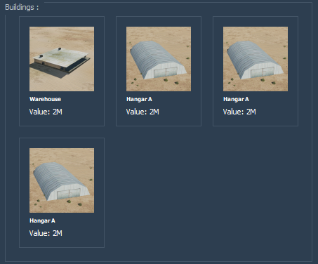
TARGET
OVERVIEW

Slide 6
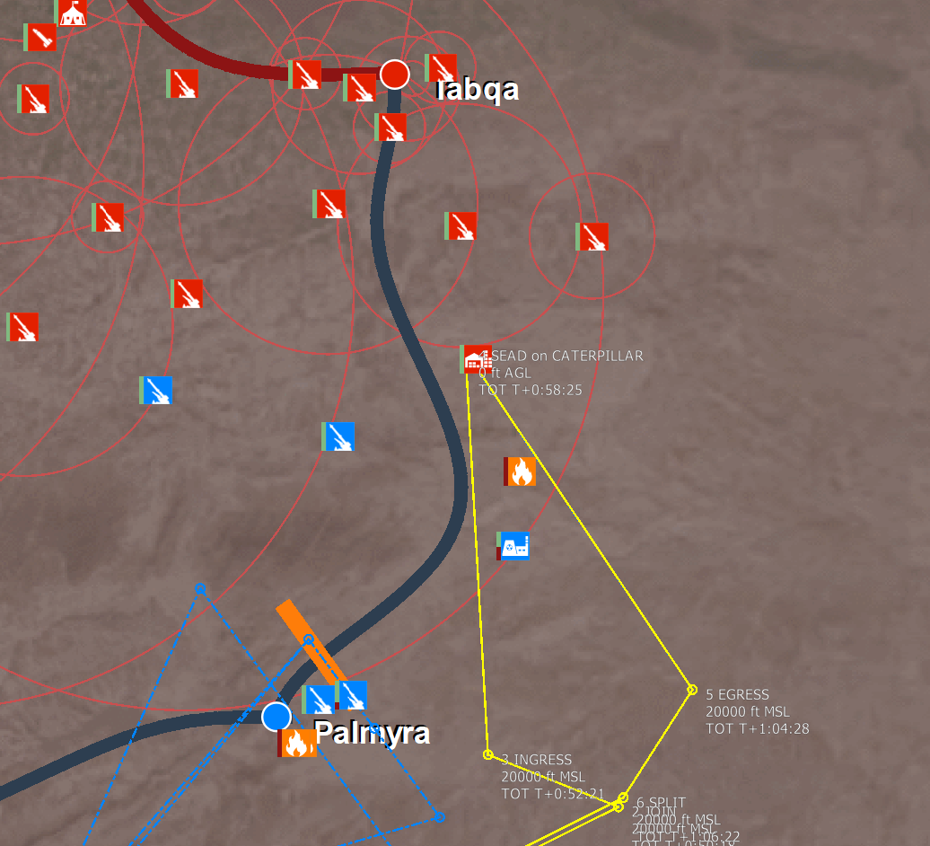
TARGET
AREA

Slide 7
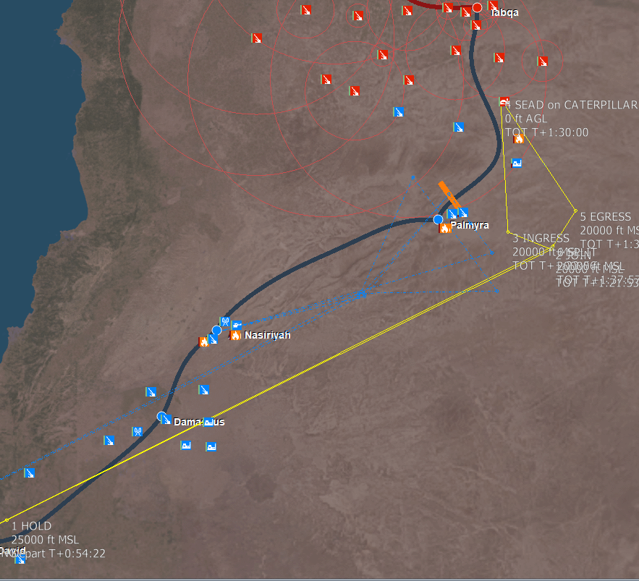
ROUTE
OVERVIEW

Slide 8
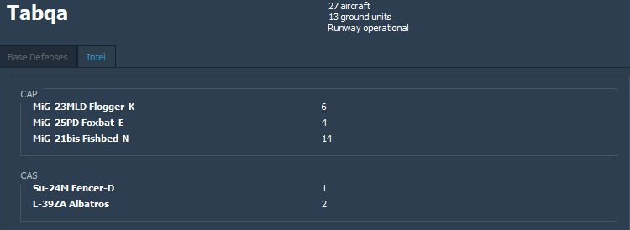
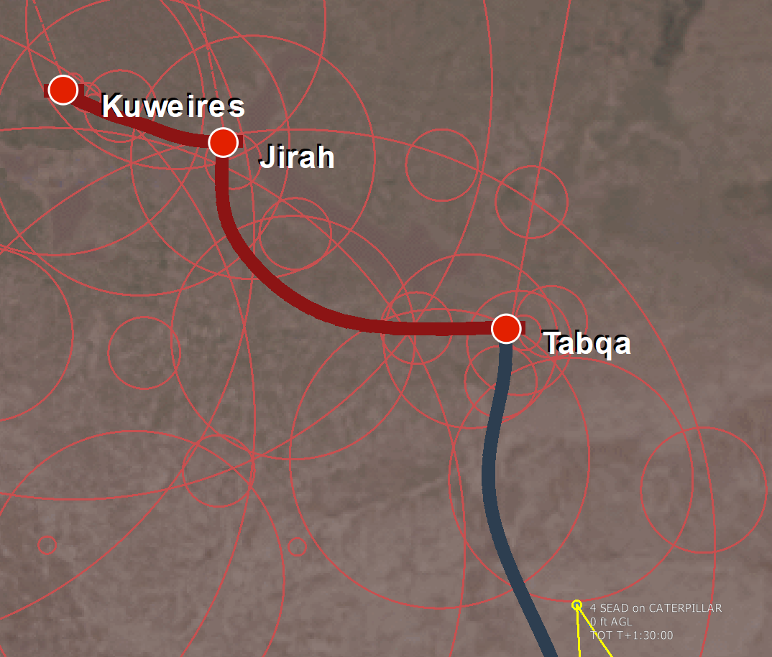
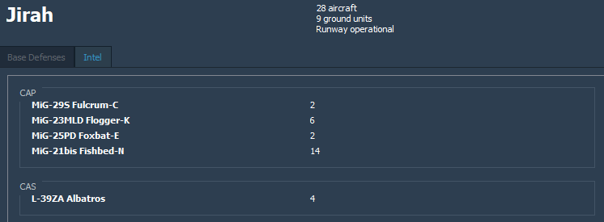

AIR to air threat
300 / 36nm
162 / 32nm

Slide 9
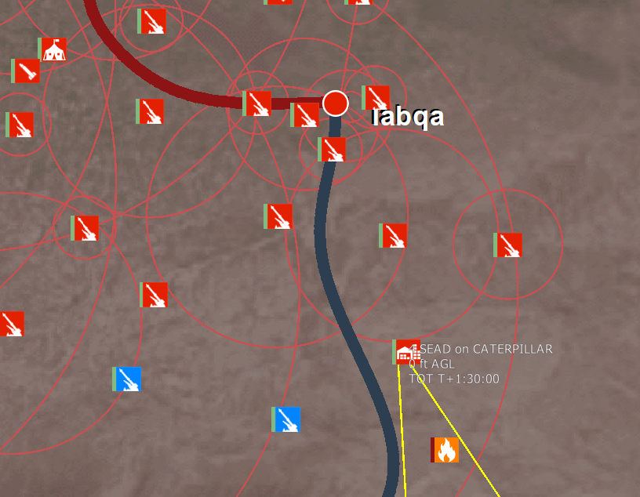
SURFACE
TO AIR
THREAT
HARRIER
SA-11
CASTOR
SA-11
SA-3
SA-10

Slide 10
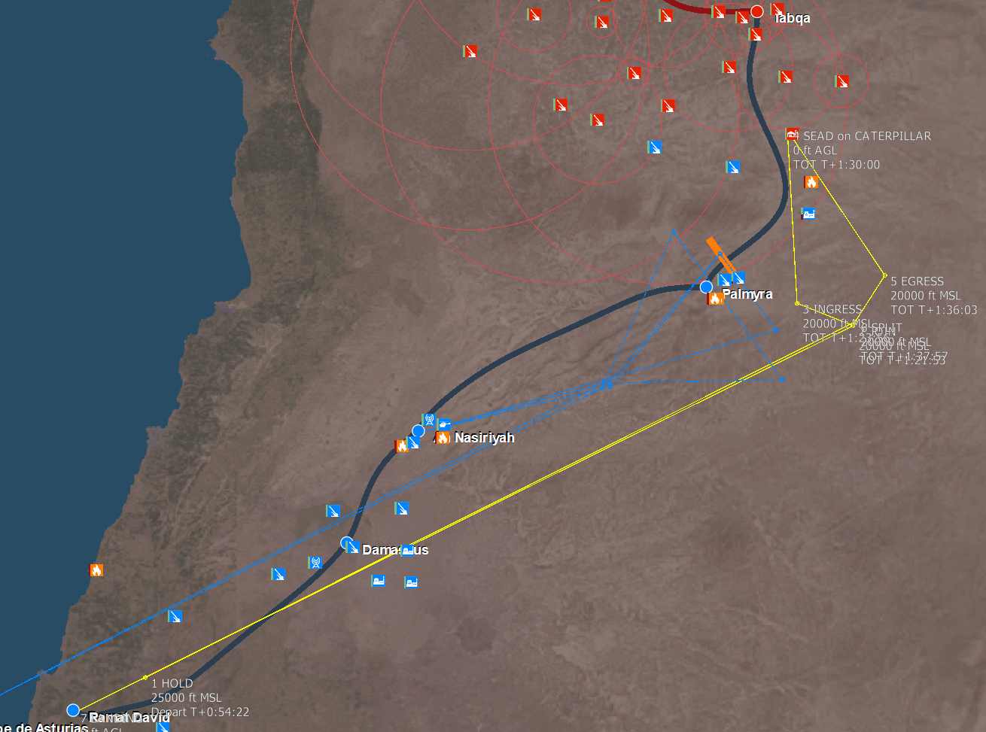
GAME PLAN

Slide 11
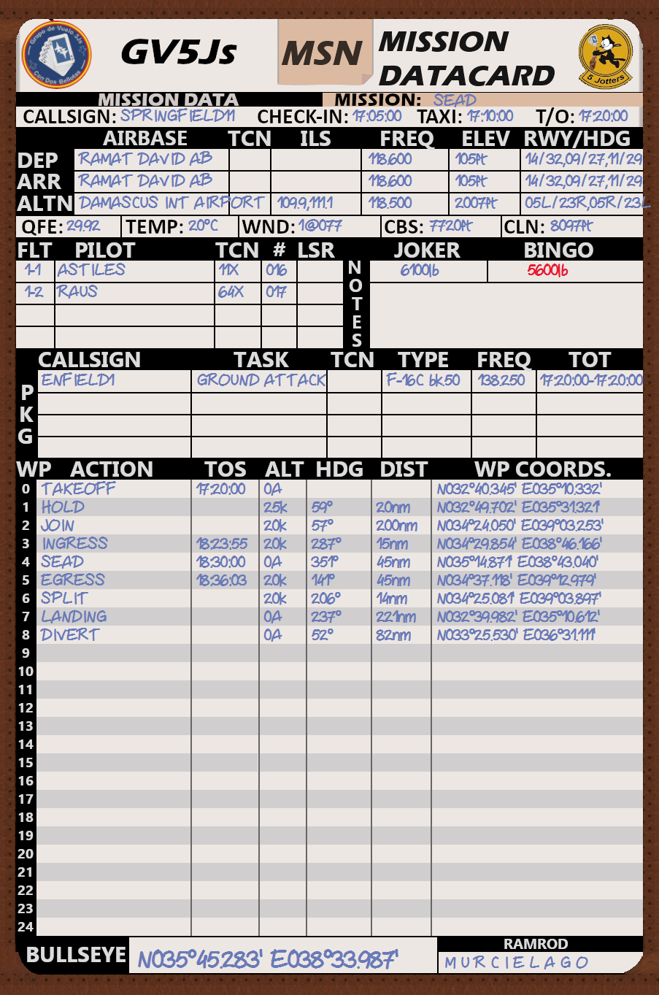
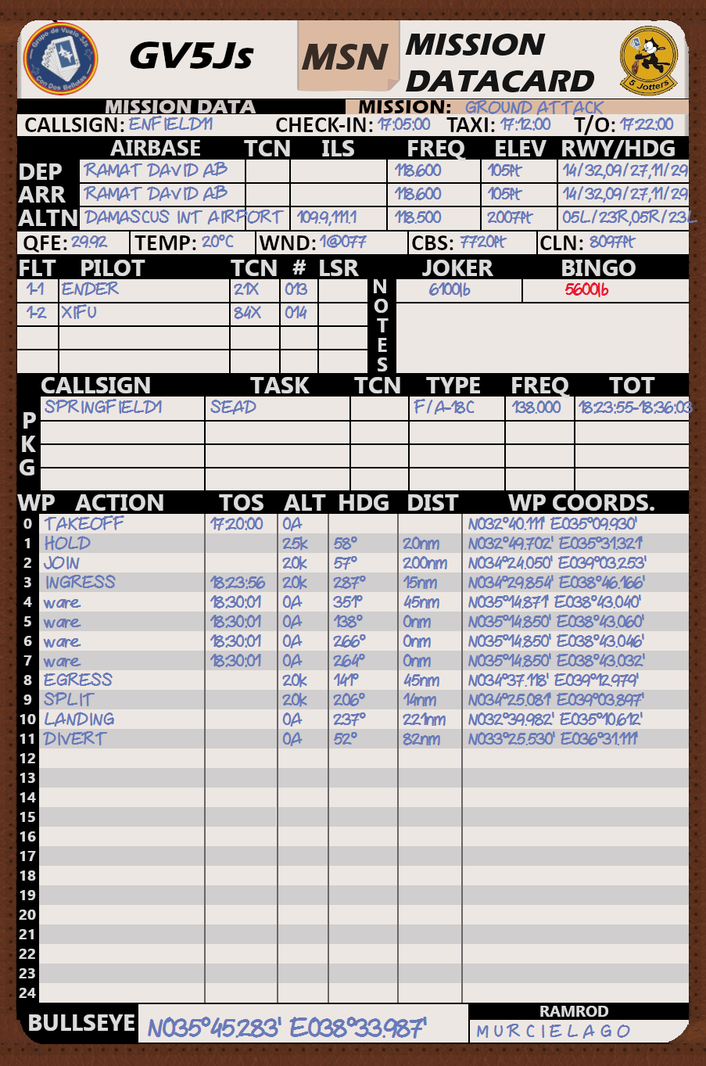
KNEEBOARD
INFO

Slide 12
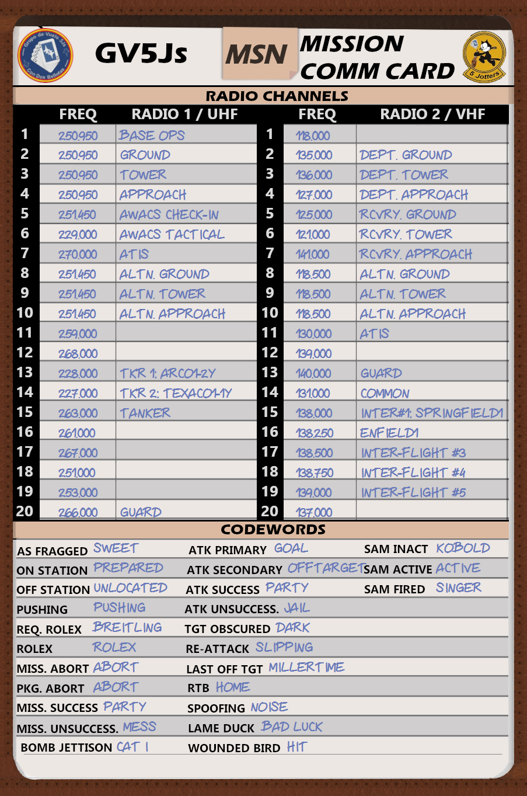
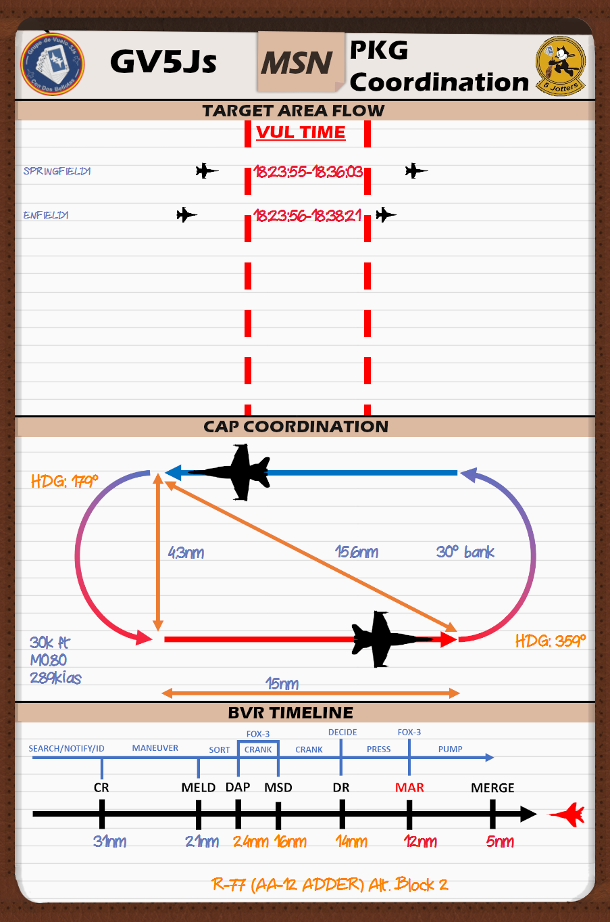
KNEEBOARD
INFO

Slide 13
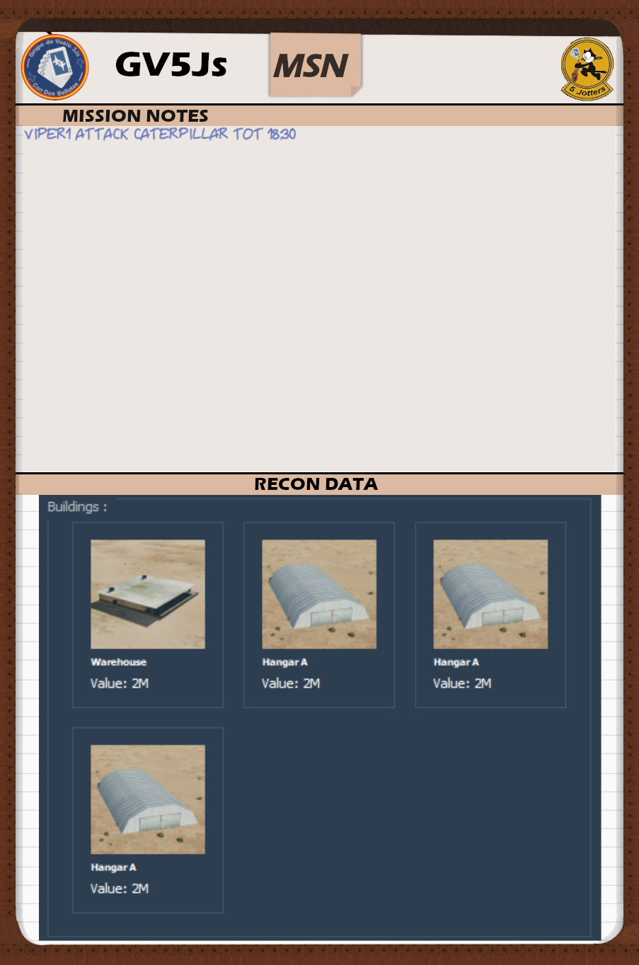
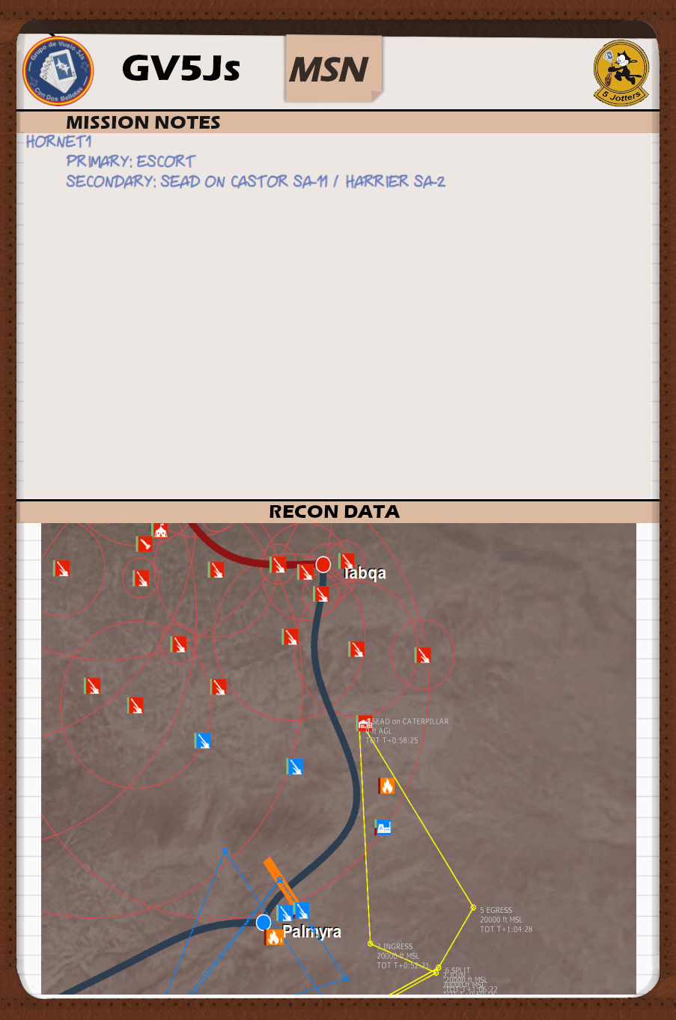
KNEEBOARD
INFO

Slide 14
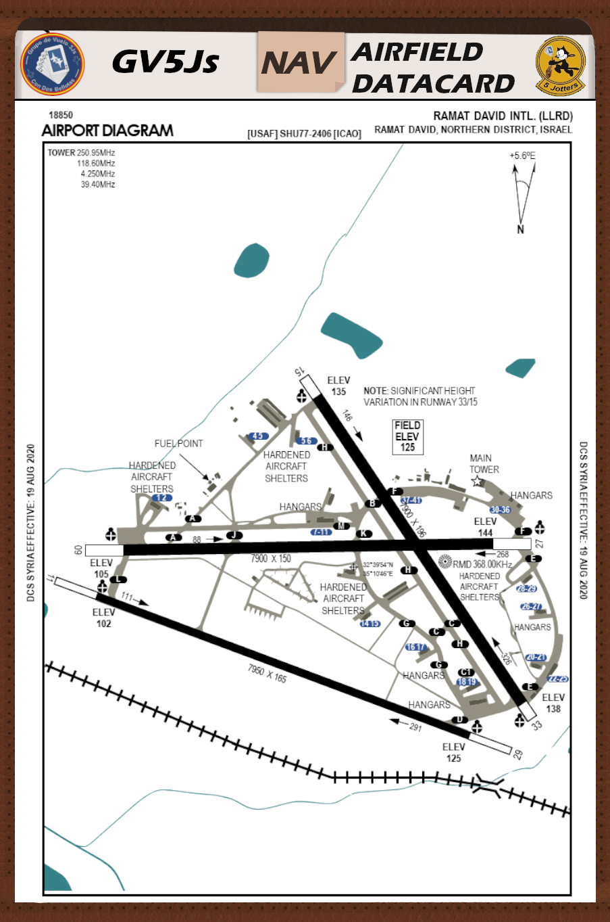
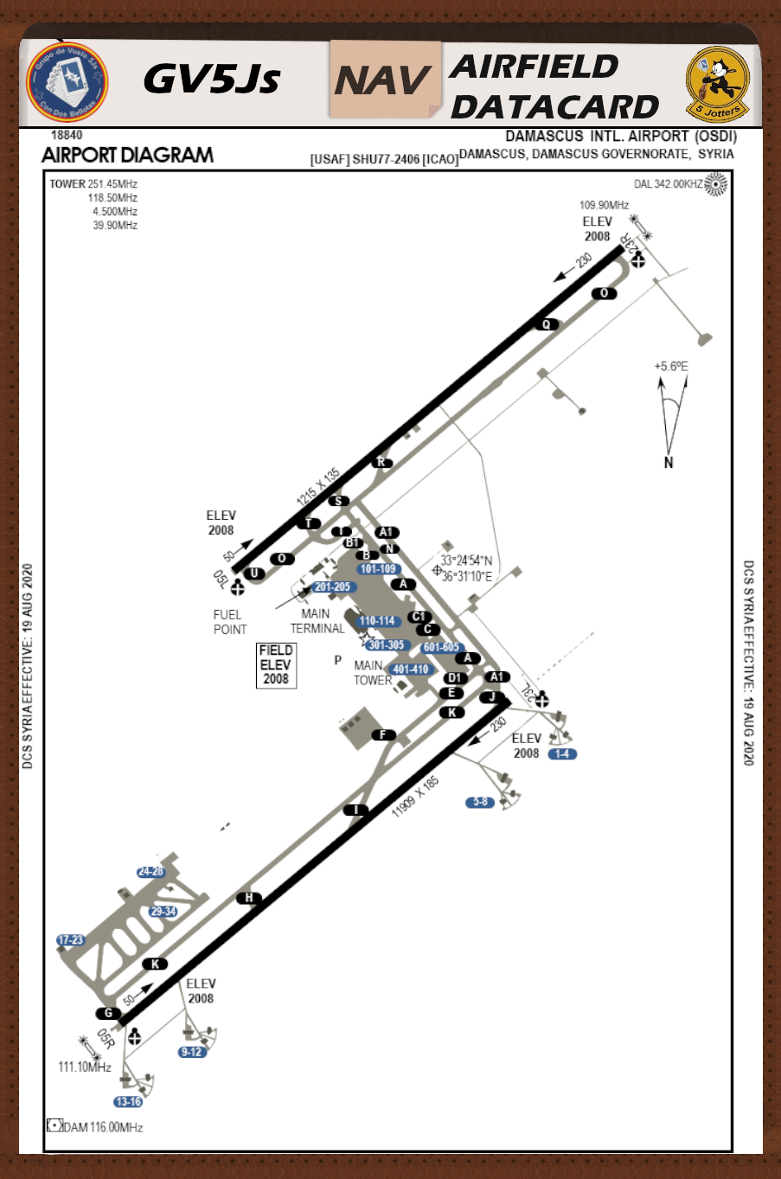
KNEEBOARD
INFO

Slide 15
QUESTIONS?

