Slide 1
Maven
By Arash Shadmani
March 2017

Slide 2
What/ Why Maven?
Maven is a
Build tool, Project Management tool
Before Maven it was Ant. The problem with Ant is you have to write everything manually. With maven you don’t need to do that.
Common problems when you want to write code:
Multiple jars
They are available, what they are…
Dependencies and versions
Project Structure
Building, Publishing and deploying

Slide 3
Maven Features
Dependency System
Multi-module builds
Consistent Project Structure
Consistent build model
Plugin oriented
Project Generated Sites

Slide 4
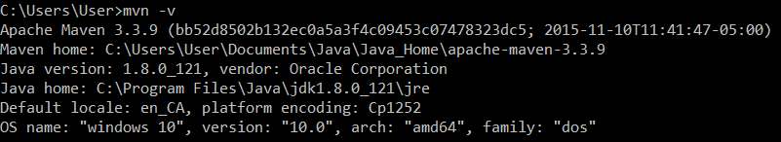
How to Install
Download zip file from http://maven.apache.org/download.cgi
and extract it where you want. the last version is 3.3.9
Add the bin directory of the created directory apache-maven-3.3.9 to the PATH environment variable
Add M2_HOME to environment variables and point to the place you saved it
In command prompt, test the installation with the following command:
mvn –v
you should see the following information:

Slide 5
Maven Conventions
src: All project source files go in this directory
src/main: All sources that go into primary artifact
src/test: All sources contributing to testing project
src/main/java: All java source files
src/main/webapp: All web source files
src/main/resources: All non compiled source files
src/test/java: All java test source files
src/test/resources: All non compiled test source files

Slide 6
Archetype:generate
Archetype
What kind of project: JAVA EE, Spring, Hibernate..
Group ID
It’s an ID for all the projects under one umbrella
Artifact ID:
is the output of our project. If it’s a web application it will be .war and it’s a Enterprise application it will be .ear
Version
Package
Maven uses a combination of three : Group ID, Artifact ID and Version to determine the Archetype.

Slide 7
Maven Build
In order to build a package you have to compile and test first.
Phases:
Validate: to see if everything is order
Compile
Test
Package
Install: installs the archetect in local Maven repository
Deploy: for publishing archefact in remote repository.

Slide 8
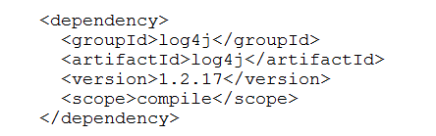
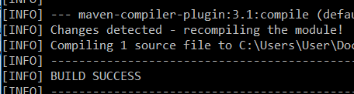
Add Log4j dependency to Pom.xml
From Maven repository
mvn clean
mvn compile

Slide 9
Maven POM
Stands for Project Object Model
Describes a project
Name and Version
Artifact Type
Source Code Locations
Dependencies
Plugins
Profiles (Alternate build configurations)
Pom files can inherit configuration
groupId, version
Project Config
Dependencies
Plugin configuration
Etc.

Slide 10

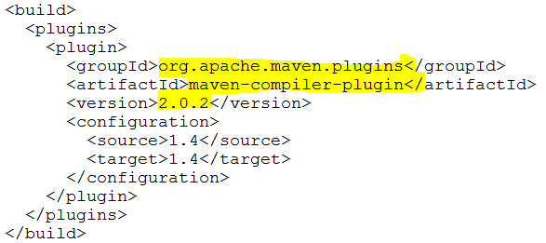
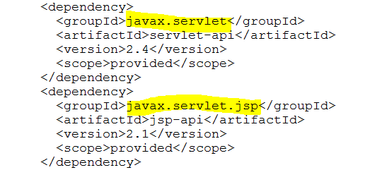
Pom.xml

Slide 11
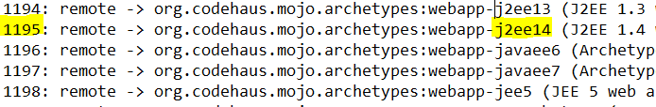
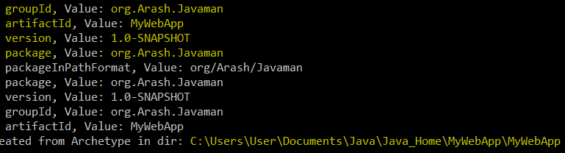
Adding web application with Maven
mvn archetype:generate

Slide 12
Add web application with Maven- Continue
Mvn compile
to download all the addins
Mvn package
Produces target folder and all the file and folders needed included the war file
Deploy

Slide 13
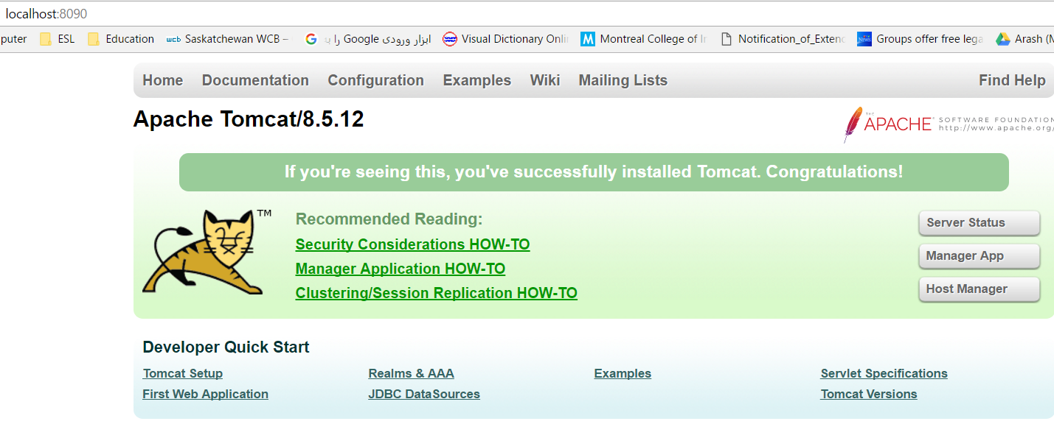

TomCat setting
Fixing issues- sample:
In Server. Xml,
changed 8080 port to 8090
In tomcat-users.xml added
<role rolename="manager-gui"/>
<user username="tomcat" password=“password" roles="manager-gui"/>
</tomcat-users>
Openned http://localhost:8090 and then opened “manage app” and then picked the war file and upload it there and then “deploy” it

Slide 14
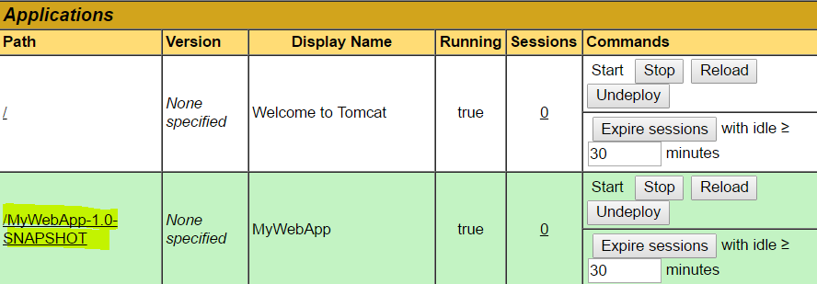
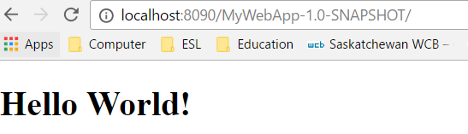
Calling the method which Shows the “Hello world” message
After the “deploy”, we will have
With clicking on “MyWebApp”:

Slide 15
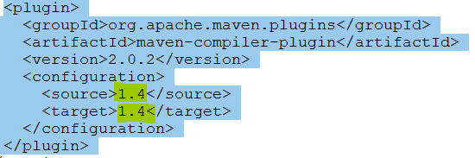
Maven Plugins
Maven is a modular architecture
Benefit: you can add plugins and configure it as you want
In pom.xml:
It is 1.4 because I chose “Java EE 1.4” in the time of generation

Slide 16
Maven Plugins - Eclipse
Mvn eclipse:eclipse
Import the project
Inside maven: help/ install software/ work with (--all available sites)
In filter text box type “maven”
choose “maven integration for eclipse”

Slide 17
Resources
https://tech.lds.org/wiki/images/4/44/IntroductionToMaven.ppt
http://maven.apache.org

