Slide 1
DSADojo
Elite Tactical DSA Practice Platform
System Prototype & Technical Analysis
Prathmesh Raghuvanshi | 23FE10ITE00092 | Manipal University Jaipur

Slide 2
The Problem: Static Learning Fatigue
Why existing platforms fail serious learners
Mindless Grind
Users solve hundreds of problems without understanding their actual weaknesses.
No Real Pressure
Isolated practice misses the competitive, high-stakes environment of actual interviews.
Binary Feedback
Platforms show pass/fail only — never explaining the 'Why?' behind a logic failure.
High Drop-Off Rate
Repetitive, static platforms lead to user burnout and loss of motivation.
TACTICAL OPERATION: DSADojo

Slide 3
The Solution: DSADojo
Three core pillars that transform DSA practice
Real-Time
Arena
AI Mentor
Engine
Brutalist
Workspace
Topic-segmented matchmaking using Socket.io to create live 1v1 coding duels.
Google Gemini delivers tactical conceptual hints — never the solution.
Monaco IDE in an immersive, full-focus environment to maximize retention.
TACTICAL OPERATION: DSADojo

Slide 4
System Architecture
Full-stack microservice-oriented design
Frontend
React + Vite + TailwindCSS V4 + Framer Motion
Backend API
Node.js + Express + Socket.io (REST & WebSocket gateway)
Database
Supabase (PostgreSQL) + Prisma ORM for ELO and proficiency tracking
Matchmaking
In-memory queues; designed for Redis ZSET scaling by rating band
AI Service
Google Gemini 2.5 Flash — secured prompt-engineered mentor persona
TACTICAL OPERATION: DSADojo

Slide 5
Matchmaking Engine
Real-time topic-based pairing lifecycle
1. User selects a DSA topic (Graphs, Arrays, DP, Trees, etc.)
2. Backend adds user to a topic-specific Socket.io queue.
3. Server scans for a second player in the same topic and ELO band.
4. On match: isolated room is created, both sockets join.
5. An algorithmic problem is dispensed and the countdown begins.
6. First user to reach ACCEPTED status wins the match.
7. ELO scores update; results written to Supabase DB.
TACTICAL OPERATION: DSADojo

Slide 6
AI Mentor Integration
Contextual diagnostics powered by Google Gemini
[ Trigger ]
Activates on every 'Wrong Answer' submission event.
[ Engine ]
Google Gemini 2.5 Flash via secure backend API proxy.
[ Prompt Design ]
identifies syntax errors or provides one conceptual hint.
[ Anti-Shortcut ]
System prompt explicitly forbids providing the full solution under any circumstances.
[ Fallback ]
Graceful offline handling if the API key is missing or rate-limited.
TACTICAL OPERATION: DSADojo

Slide 7
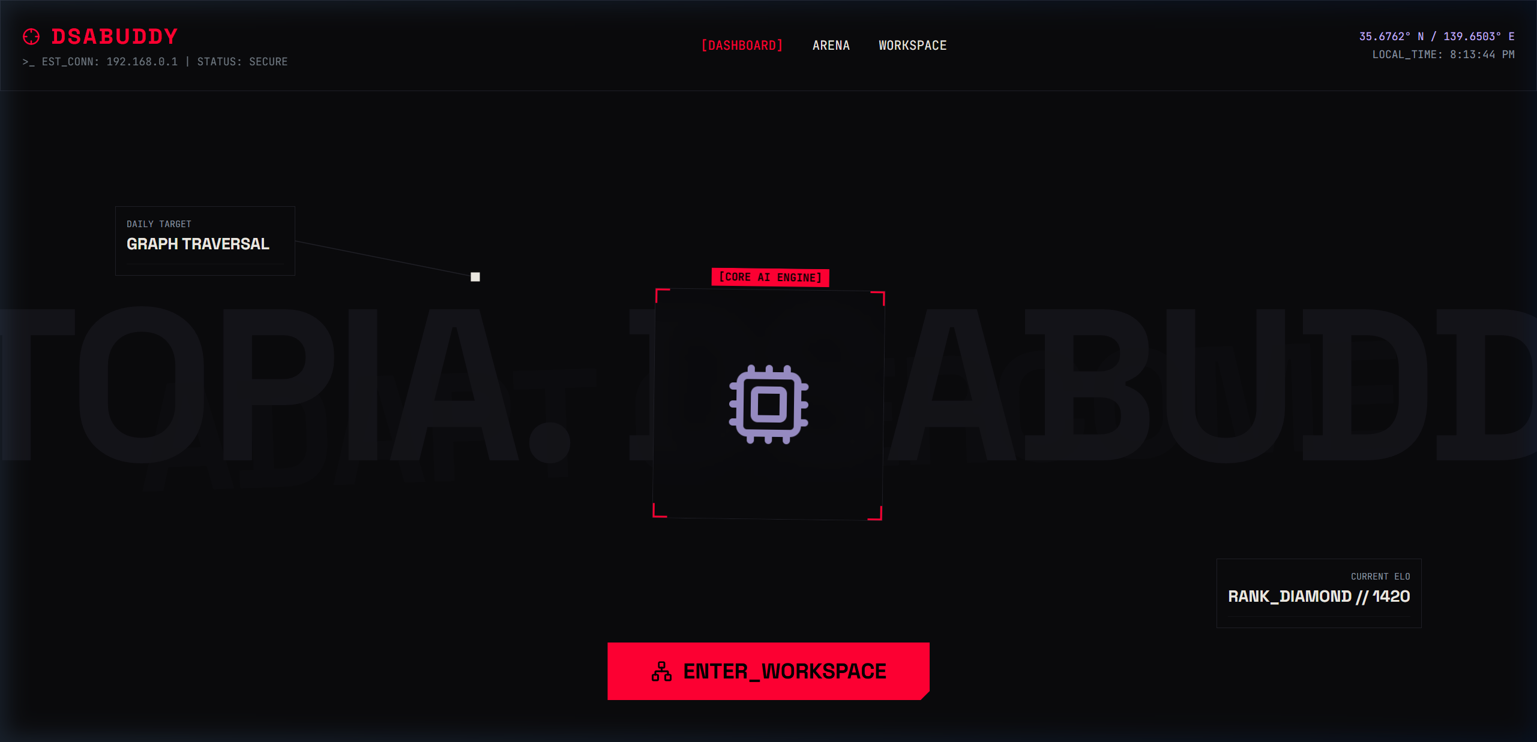
Operational Dashboard
Live ELO tracking, AI insights, match history
TACTICAL OPERATION: DSADojo

Slide 8
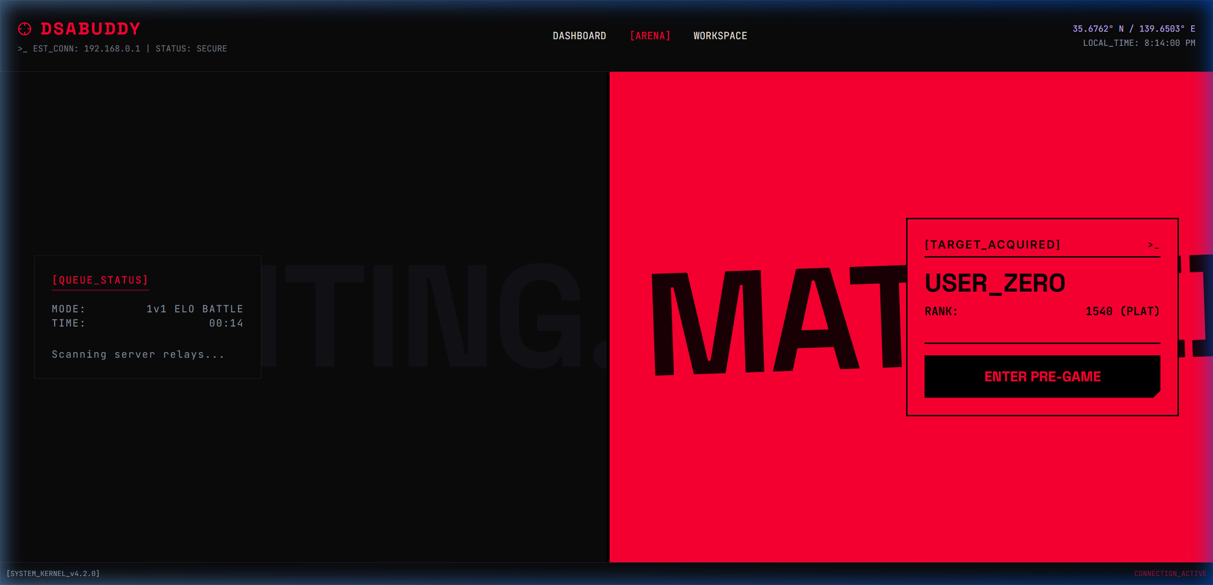
Real-Time Arena
Live matchmaking queue and opponent pairing
TACTICAL OPERATION: DSADojo

Slide 9
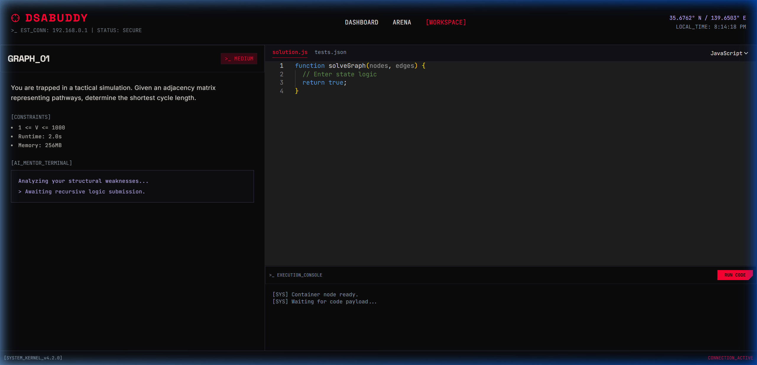
Brutalist Workspace
Monaco IDE integrated with the AI Mentor hint panel
TACTICAL OPERATION: DSADojo

Slide 10
Implementation Milestones
Key deliverables completed during PBL
Requirement Analysis
Identified critical pain points vs. platforms like LeetCode.
UI Architecture
Designed Tactical Dashboard, Arena, and Workspace components.
WebSocket Core
Built the Socket.io matchmaking lifecycle end-to-end.
AI Integration
Integrated the Gemini-powered mentor feedback loop.
Database Schema
Designed Prisma schema for ELO, proficiency, and match history.
End-to-End System
Full prototype running; matchmaking and AI Mentor verified.
TACTICAL OPERATION: DSADojo

Slide 11
Conclusion
Successfully transformed solo DSA practice into an engaging, competitive platform.
Built a scalable real-time infrastructure using WebSockets and an AI diagnostic loop.
Proven that an immersive UI/UX significantly improves user focus and session duration.
Integrated Google Gemini as an intelligent 'tactical mentor' — a first-of-its-kind approach.
Elite Practice. Tactical Logic. Mission Complete.

