Slide 1



CLAY Sharing Internet of Things (IoT) Versatility towards IoT, Embedded & Mobility
July, 2018

Slide 2
Content Section 1:Introduction to Internet of Things (IoT) •Basics of Internet of Things (IoT) Architecture •What is Open Source and Maker Culture •Open Source Electronic/IoT Development Boards •Wireless Technologies & Protocols - WiFi, BLE, Zigbee, LoRA, Sigfox ; HTTP, MQTT Section 2: Making your first IoT Device •Introduction to ESP8266 Hardware •Interfacing with Sensors and Actuators •Introduction to Analog and Digital •Basics of Arduino Software & IoT Programming •Use ESP8266, LED to make an IoT Device. •Project 1: Blinking LED (Electronic Hello World!)

Slide 3
Section 3: Control your IoT Device using an App •Connect your IoT Device using Wi-Fi to the Internet •Controlling your IoT Device with IoT App Project 2: Remotely Control LED using Mobile App over the internet Section 4: Remote Monitoring of Sensor Data from IoT Device •Introduction to Temperature & Humidity Sensor (DHT) •Connecting DHT to your IoT Device •Adding a Dashboard Widget in the App Project 3: Visualize Temperature & Humidity Readings on your App

Slide 4
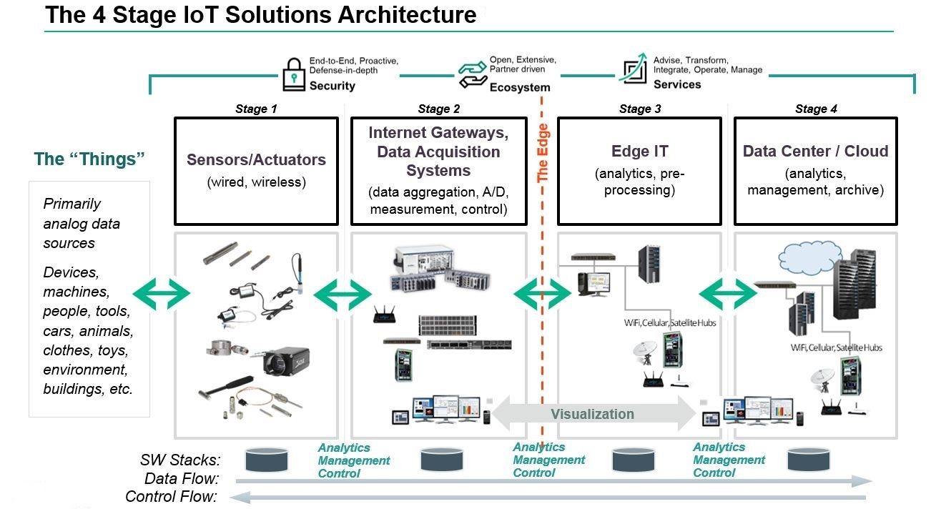
Basics of Internet of Things (IoT) Architecture

Slide 5
Open Source & Maker Culture
What are their relations?
Why they are matters?

Slide 6
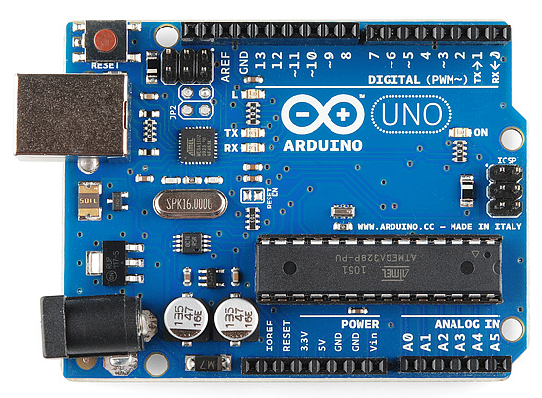
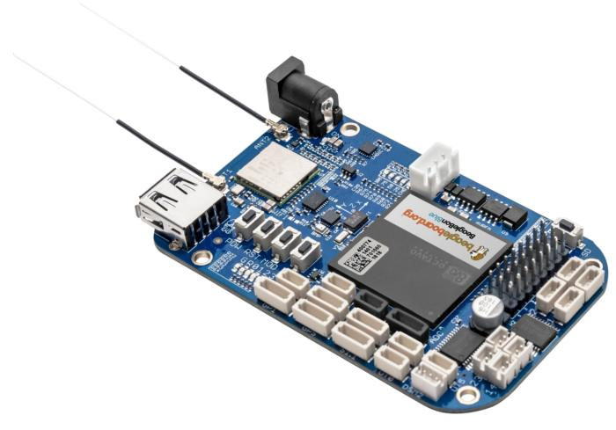
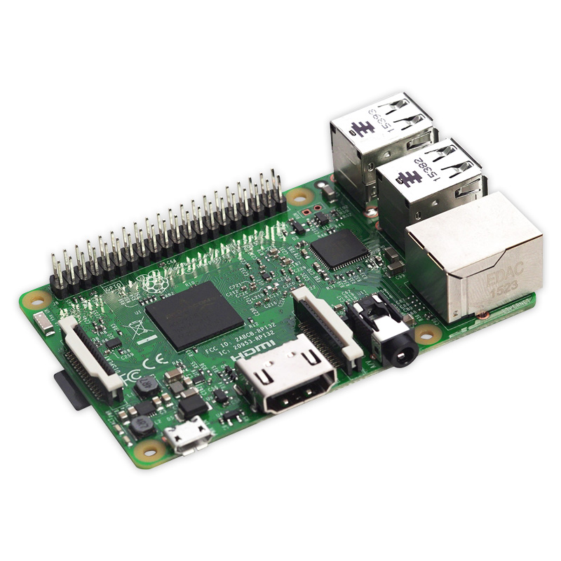
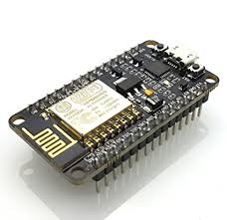
Open Source Electronic/IoT Development Boards

Slide 7




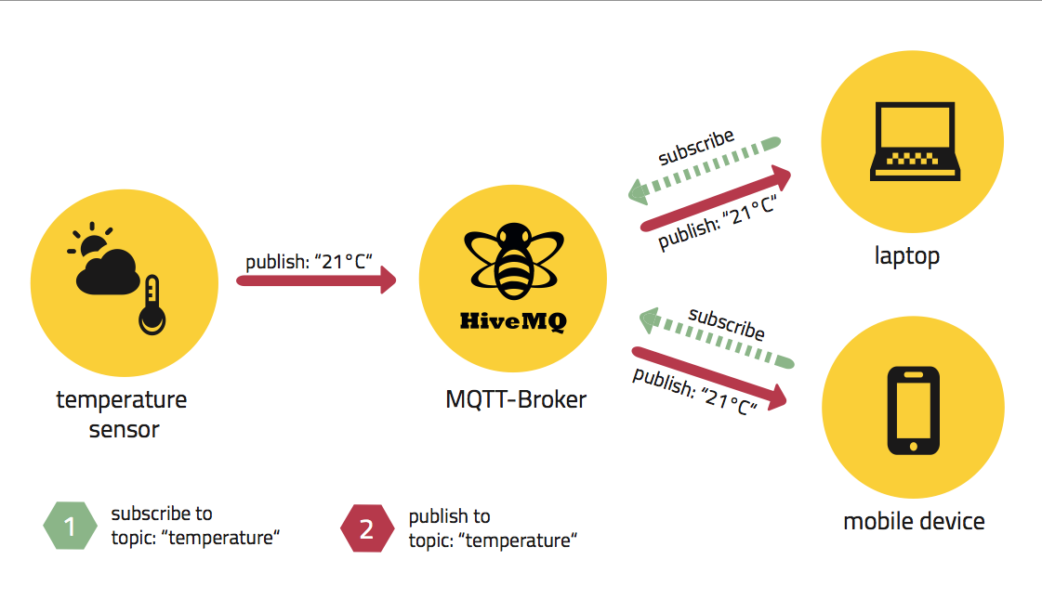



Wireless Technologies & Protocols - WiFi, BLE, Zigbee, LoRA, Sigfox ; HTTP, MQTT
Wireless Tech
Protocols

Slide 8
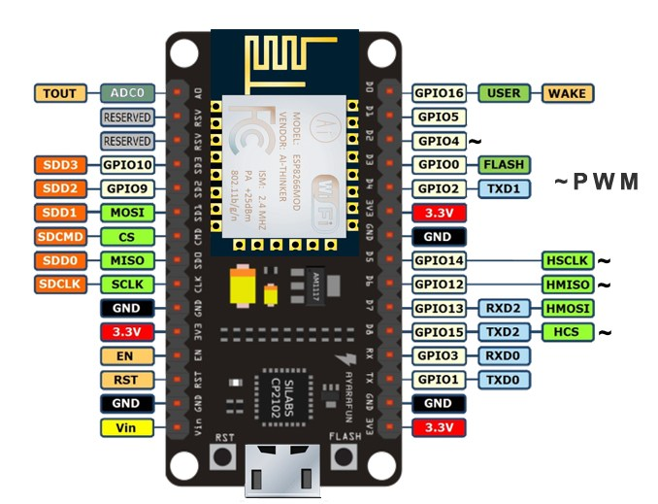
Introduction to ESP8266 Hardware

Slide 9
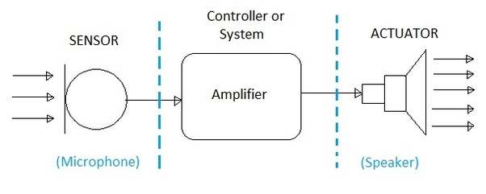
Sensors & Actuators

Slide 10
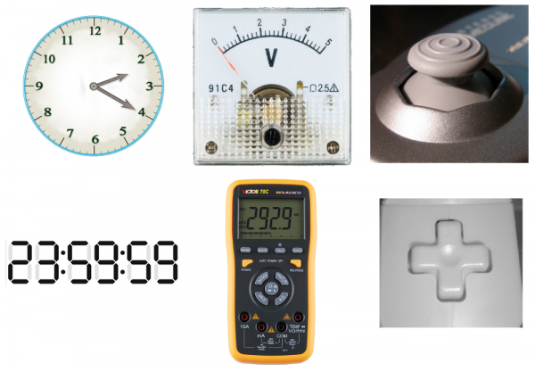
Analog & Digital

Slide 11
Arduino IDE
Setup your IDE in order to use your ESP8266 with it! :-D
https://goo.gl/eZEqy5

Slide 12
Project 1: Blink your LED!

Slide 13


Slide 14
Arduino IDE + ESP8266 + LED
1. Do your coding inside Arduino IDE
2. Connect to SSID & Password
3. Check the Serial Console
4. Copy the IP to browser

Slide 15
Project 2: Control LED using Apps

Slide 16

Connect ESP8266 to WiFi

Slide 17
Arduino IDE + ESP8266 + LED
Looking for source code?
Well work harder for it.. look around 🙃

Slide 18
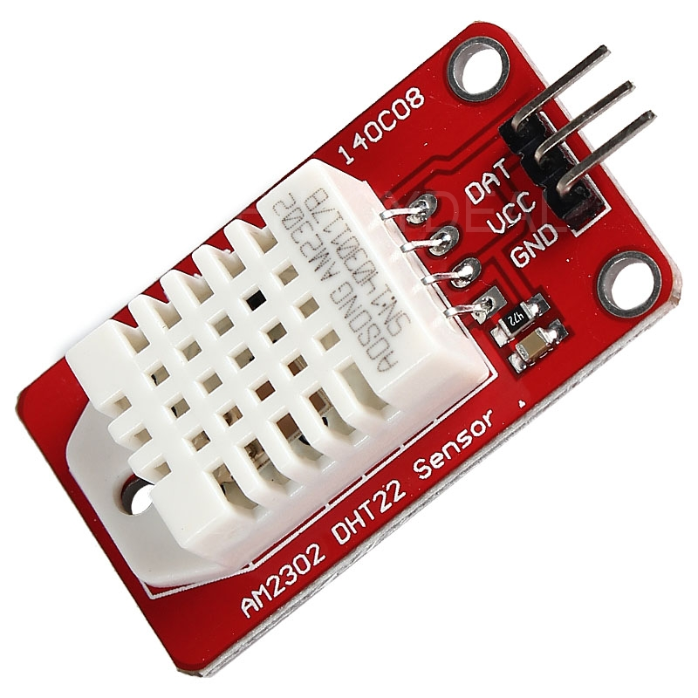
Temperature & Humidity Sensor DHT 22

Slide 19
Project 3: Visualize DHT22 readings on your apps

Slide 20
💎

