Slide 1
What is STG?
GHC compiler
Frontend
Lexer -> Parser -> Renamer -> Typechecker -> Desugar -> Core
Middle
Core -> Core (Optimization passes etc.)
Core -> STG
Backend
-> LLVM IR -> ASM
STG -> C-- -> ASM
-> NGC

Slide 2
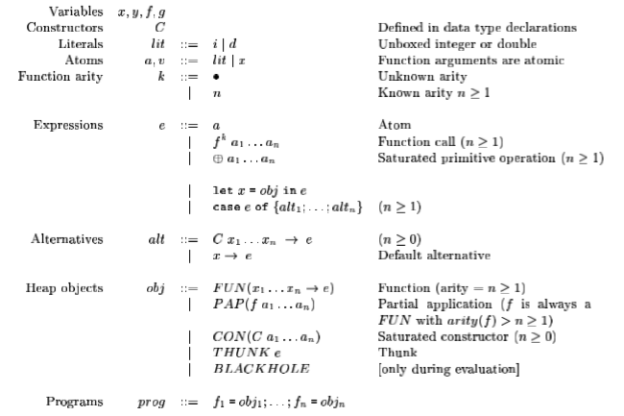
STG in one slide
Notes:
From: Making a Fast Curry: Push/Enter vs. Eval/Apply for Higher-order Languages. Simon Marlow and Simon Peyton Jones.
Constructors
Unboxed values
function calls
let
case
+ there is also data types

Slide 3
STG highlights
Boxed/Unboxed values
Let Expression: “allocation”
Only place heap allocation occurs
Let x = CON(I 1)
Let f = FUN(x ->…
Case Expression: “evaluation”
Only place evaluation occurs
Case e of …
Explicit Laziness: THUNK
Notes:
Let:
box an unboxed int
declare a function
flip back to 2 and show Heap Objs
Case:
evaulate sub-expression (scrutinee) and then perform case analysis

Slide 4
STG Example
Haskell
STG
multInt:: Int -> Int -> Int
multInt x y = x * y
multInt = FUN(x y ->
case x of {
I i# ->
case y of {
I j# -> case imul# i# j# of {
x# -> let { result = CON (I x#) }
in result }}});
Notes:
mult 2 ints in haskell and stg
stg:
unbox x and y
evaluate primitive unboxed multiply
rebox

Slide 5
STG Factorial
Haskell
STG
fac :: Int -> Int
fac 0 = 1
fac n = n * fac (n-1)
fac = FUN (x ->
case eqZero x of {
True -> one;
False -> let { s = THUNK(subInt x one);
r = THUNK(fac s) }
in multInt x r
});
Notes:
factorial in haskel and stg

Slide 6
Real STG
The STG from GHC is more complex
Demos: Compare ‘real’ and ‘simple’ STG
w/ and w/o optimization on.
Notes:
Now Real STG:
more Fac.hs
script:
more dump-stg.sh
./dump-stg.hs
ugly mess!
view Fac.stg
compare
not so different than example:
one pulled to top level
letrec -> nested lets
eqZero function
here is orig:
more fac.stg
run through our compiler
./stg-run.sh
cleanup naming:
more fac2.stg
./stg2-run.sh
yeah it is the same
--
Optimize!
script:
more dump-stg-o.sh
./dump-stg-o.sh
view Faco.stg
cleanup naming:
more faco.stg
./stgo-run.stg
--
ministg
more fac.mstg (slightly different syntax)
./ministg-run.sh
file:///Users/dpx/workspace/stg/trace/step0.html

Slide 7
STG Resources
Making a Fast Curry: Push/Enter vs. Eval Apply for Higher-order Languages. Simon Marlow and Simon Peyton Joneshttp://community.haskell.org/~simonmar/papers/evalapplyjfp06.pdf
Tracing the compilation of Hello Factorial E. Z. Yang http://blog.ezyang.com/2011/04/tracing-the-compilation-of-hello-factorial/
A Haskell Compiler. David Terei http://www.scs.stanford.edu/11au-cs240h/notes/ghc-slides.html
GHC (STG, CMM, ASM) illustrated for hardware persons. Takenobu T. https://takenobu-hs.github.io/downloads/haskell_ghc_illustrated.pdf
I know kung fu: learning STG by example. https://ghc.haskell.org/trac/ghc/wiki/Commentary/Compiler/GeneratedCode

