Slide 1



Amazon Review Helpfulness May 13, 2014
Kyle Hundman
Peter Schmidt

Slide 2
Full Analytics Lifecycle
Data Set Selection & Hypothesis
Data Pre-Processing
Model Development
Visualization
Results & Conclusions

Slide 3

Amazon Data Set

Slide 4
Hypothesis
The helpfulness of an Amazon review can be predicted by a set of characteristics inherent in the review itself.

Slide 5
Data Pre-processing
Subset
Products with > 15 reviews
Create additional predictor variables
Length of review
Review order
Unique words (TEXT_PARSER)
Unique punctuation
Counts helpful, unhelpful, total ratings
% helpful ratings
Splitting
Train (SAMPLE)
Test
Aster SQL-MR Function

Slide 6
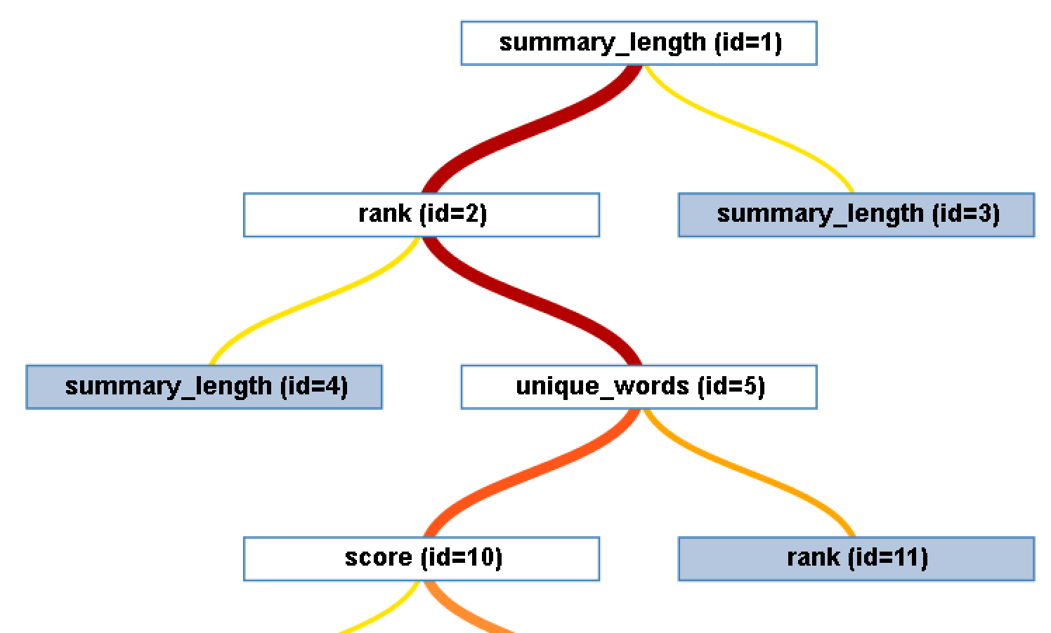
Model Development
Fit to training (forest_drive)
Visualize (GraphGen)
Predict test (forest_predict)
Analyzed results

Slide 7

Model Influencial Predictors
Rank – temporal component
Unique Words
Summary
Length

Slide 8
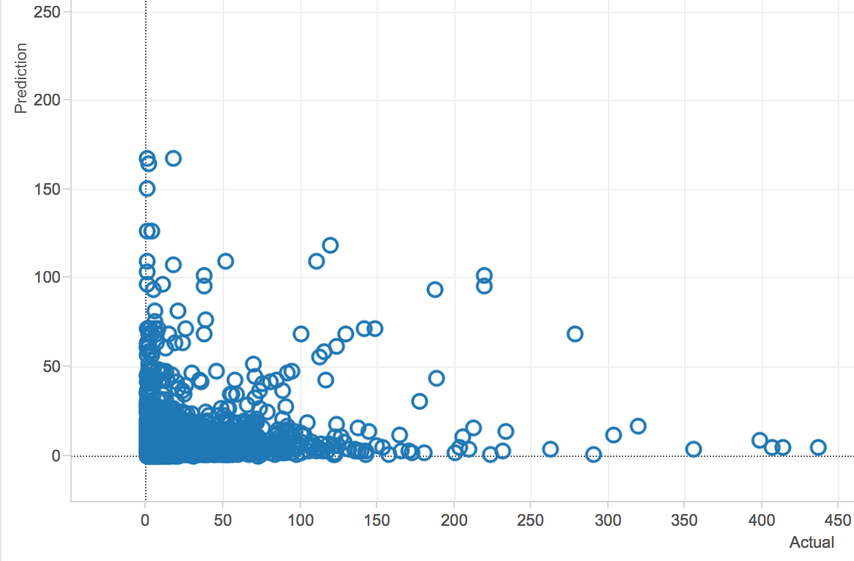
Model Performance Results
SD = 8.81

Slide 9
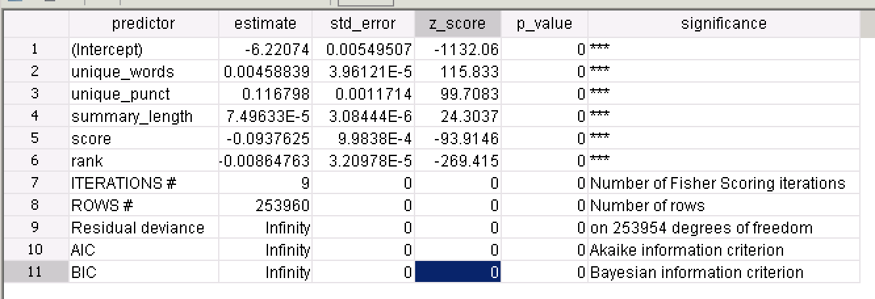
Model 2 - GLM

Slide 10

Conclusion
Amazon review helpfulness could be “predicted” using length, unique words, and rank as well as other useful predictors
Aster SQL-Map Reduce can be used for full analytics lifecycle development

