Slide 1
Part 11 : Project Risk Management
11.1 – Plan Risk Management
11.2 – Identify Risks
11.3 – Perform Qualitative Risk Analysis
11.4 – Perform Quantitative Risk Analysis
11.5 – Plan Risk Responses
11.6 – Monitor and Control Risks

Slide 2
Risk vs Opportunity…
Risk: (-) Any uncertain event or condition that might affect the project…
- Unexpected problems that might occur…
- Can be an event (earthquake) or a condition (missing part of a process)
- Something may or may not happen…
Opportunity: (+) Some events or conditions that can help the project.
- Event : Finding an easier way to do an activity.
- Condition : Lower prices for certain materials

Slide 3
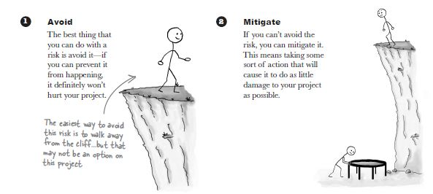
4 ways to deal (handle) with risk…

Slide 4
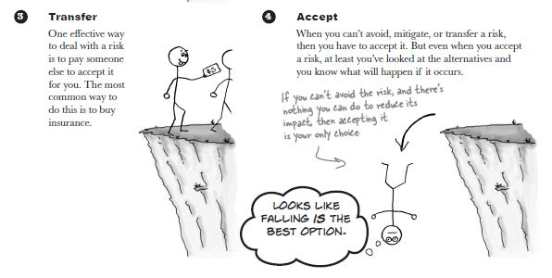
4 ways to deal (handle) with risk…

Slide 5
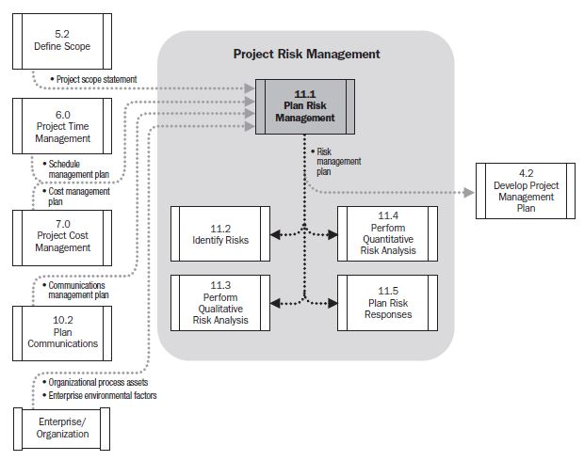
Plan Risk Management…
Project Scope Statement
Describes the project’s deliverables and the work required to create those deliverables in detail.
Process of defining how to conduct risk management activities for a project…

Slide 6
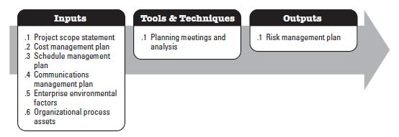
Plan Risk Management…
Process of defining how to conduct risk management activities for a project…
Planning Meetings and Analysis :
To develop RMP (Risk Management Plan)
PM ,Team & Stakeholders
High Level Plans to conduct risk management activities are defined.
Effects on Project Budget and Schedule :
Risk Management cost elements and schedule activities will be developed…
Risk management responsibilities will be assigned.
Organizational templates are formed (Risk Categories, Levels of Risk, Probability by type of Risk etc.)

Slide 7
Plan Risk Management…
Process of defining how to conduct risk management activities for a project…
Risk Management Plan :
Tells you how to handle and assess risk, who is responsible for the process and how often to do risk planning on the project.
- Risk Categories to classify risks such as Technical, External etc. Technical → A component that might turn out to be difficult to use. External → Market condition. A RBS (Risk Breakdown structure) is going to be built.
- Methodology → to describe methods and approaches for identifying and classifying risks of the project.
- Definitions of probability and impact. How big a risk’s impact and how likely a risk happens. Impact → How much damage the risk will cause to the project. Impacts are classified on a scale (very low to very high)

Slide 8
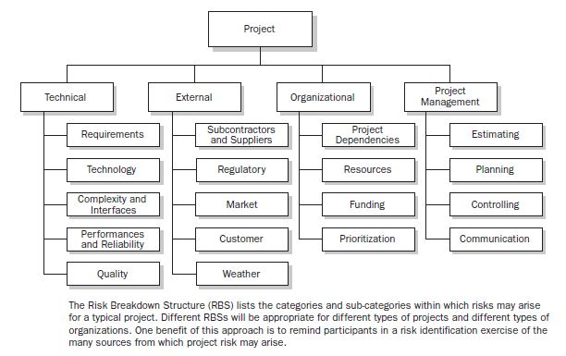
Plan Risk Management…
Risk management Plan : RBS & Impact Scales…

Slide 9
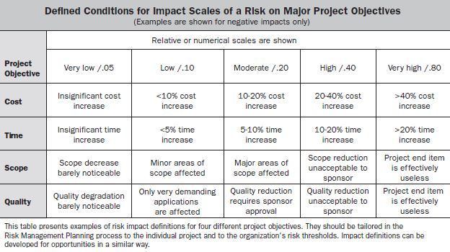
Plan Risk Management…
Risk management Plan : RBS & Impact Scales…

Slide 10
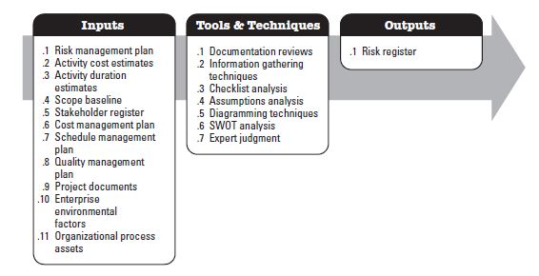
Identify Risks…
Process of determining which risks may effect the project and documenting their characteristics...
Figuring out every possible risk that might affect the project…
Iterative process: New risks may evolve or become known as the project progresses through its life cycle…
The goal here is producing the RISK REGISTER with the contribution of stakeholders…

Slide 11
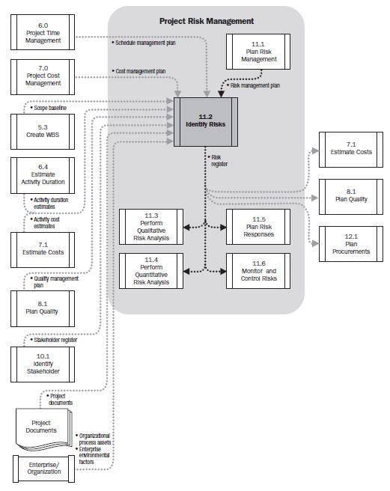
Identify Risks…
Process of determining which risks may effect the project and documenting their characteristics…

Slide 12
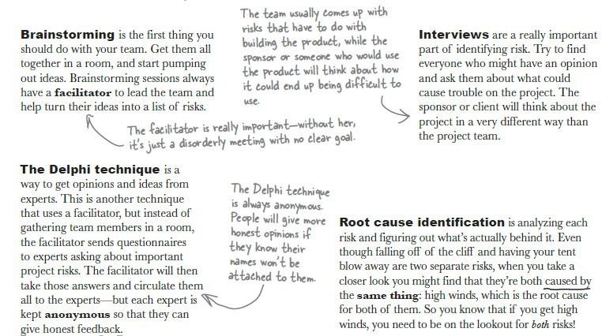
Identify Risks – Tools & Techniques
Process of determining which risks may effect the project and documenting their characteristics…
1) Information gathering techniques :

Slide 13
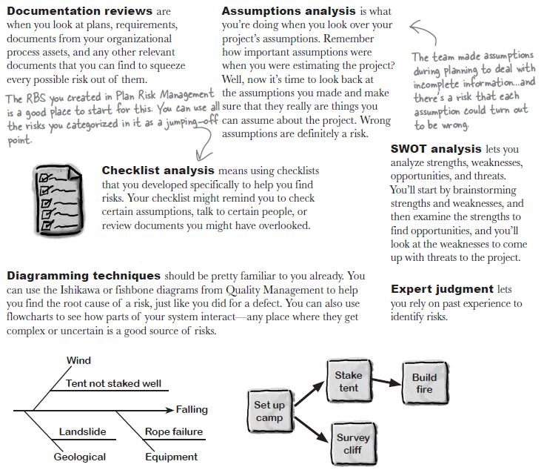
Identify Risks – Tools & Techniques
Process of determining which risks may effect the project and documenting their characteristics…
2) More ‘Identify Risks’ techniques:

Slide 14
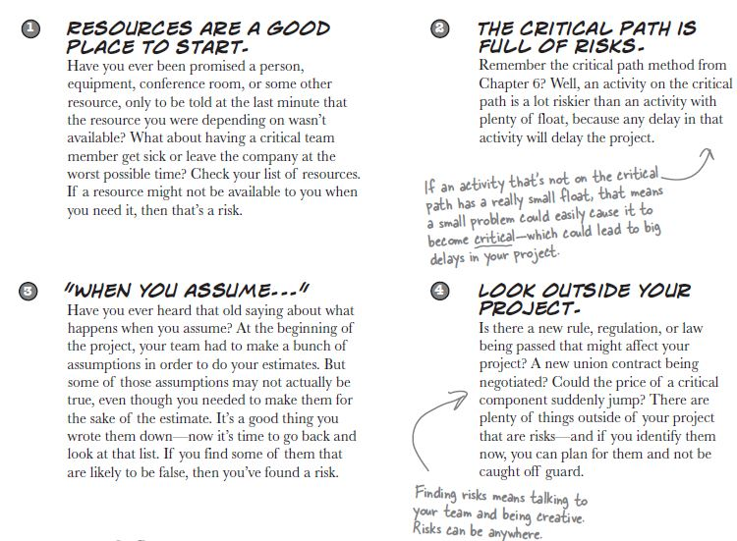
Identify Risks – Where to look for risks…
Process of determining which risks may effect the project and documenting their characteristics…

Slide 15
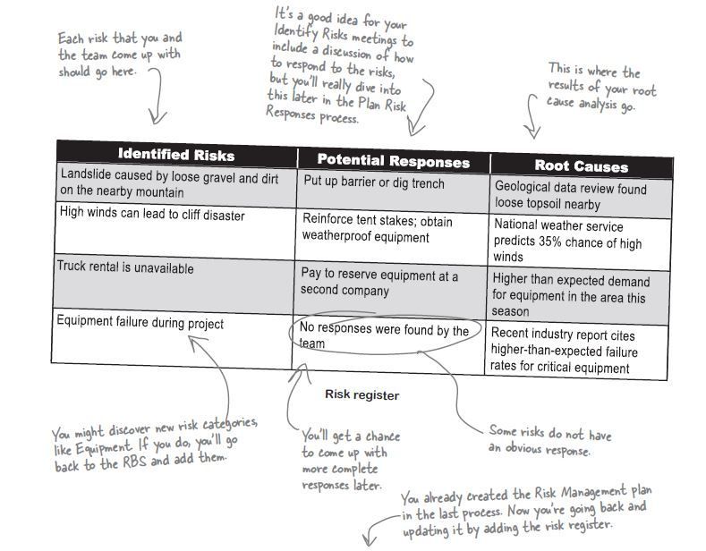
Identify Risks – Output : Risk Register!…
Process of determining which risks may effect the project and documenting their characteristics…

Slide 16
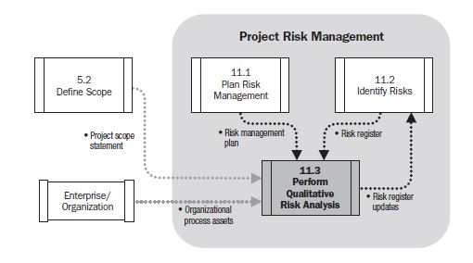
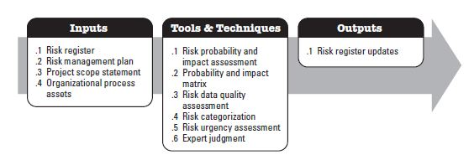
Perform Qualitative Risk Analysis…
Process of prioritizing risks for further analysis or action by assessing and combining their probability of occurrence and impact…
Ranking the risks!
Caring much more about the risks that will have a big impact…
Looking at each risk and figuring out how likely it is and how big its impact will be…

Slide 17
Perform Qualitative Risk Analysis Tools & Techniques…
Examine Each Risk in Register
Risk Data Quality Assessment :
- Make sure that the used info at risk assessment is accurate…
- Checking out the validity by outside experts…
- Checking out some samples…
Risk Categorization :
- Grouping out the risks to come up with a better strategy for dealing with them…
- Group them by the phase of the project or by the source of risk…
- Help you to deal with whole groups of risks in one response plan…
Risk Urgency Assessment :
- Checking out how soon to take care of a particular risk…
- If the risk is going to happen soon, then it is better to have a plan for how to deal with it soon…

Slide 18
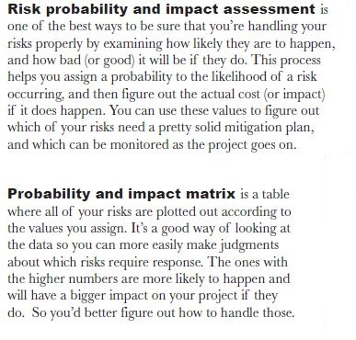
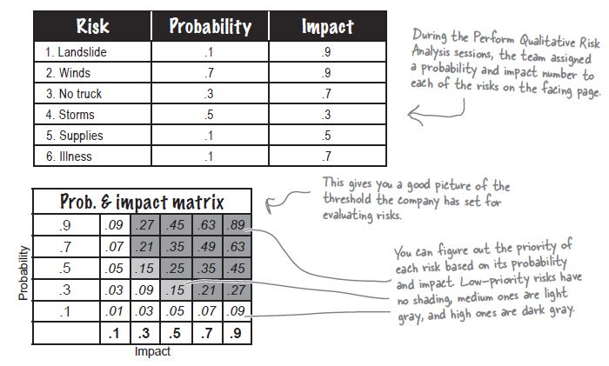
Perform Qualitative Risk Analysis Tools & Techniques…
Examine Each Risk in Register...

Slide 19
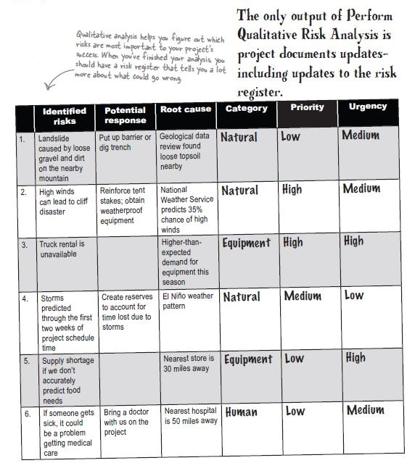
Perform Qualitative Risk Analysis - Output…

Slide 20
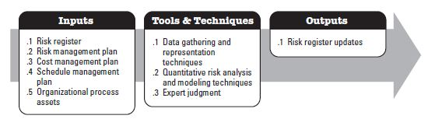
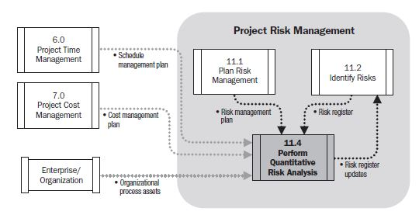
Perform Quantitative Risk Analysis…
Process of numerically analyzing the effect of identified risks on overall project objectives…
Performed on risks that have been prioritized by the perform qualitative risk analysis process!
Used to assign numerical rating to the risks…
At the end of this process, the initial assessment may need to be updated!…

Slide 21
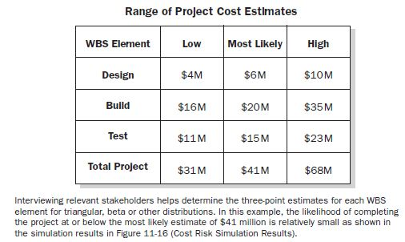
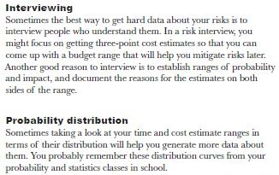
Perform Quantitative Risk Analysis Tools & Techniques…
Gather the data…
Quantitative tools are broken down into three categories…
The ones that help to get more info about risks…
The ones that help to analyze the info…
Expert Judgment to put them together…
Data gathering and representation techniques: (Get more info about risks)

Slide 22
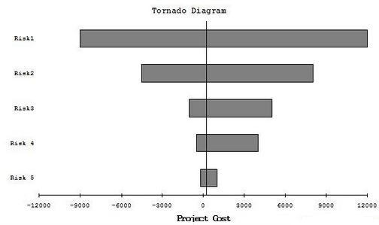
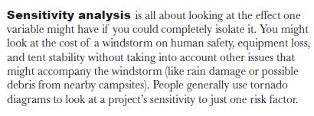
Perform Quantitative Risk Analysis Tools & Techniques…
Analyze the data…
Quantitative tools are broken down into three categories…
The ones that help to get more info about risks…
The ones that help to analyze the info…
Expert Judgment to put them together…
Quantitative Risk Analysis and Modeling Techniques: (Analyze the info)

Slide 23
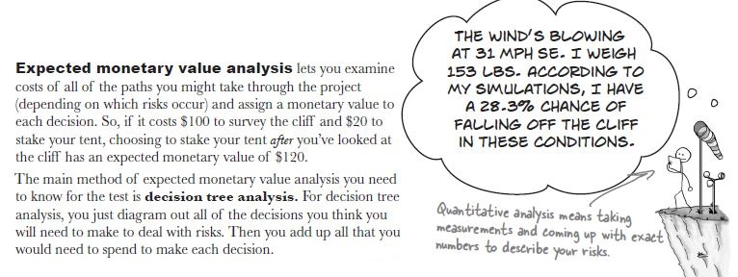
Perform Quantitative Risk Analysis Tools & Techniques…
Analyze the data…
Quantitative tools are broken down into three categories…
The ones that help to get more info about risks…
The ones that help to analyze the info…
Expert Judgment to put them together…
Quantitative Risk Analysis and Modeling Techniques: (Analyze the info)

Slide 24
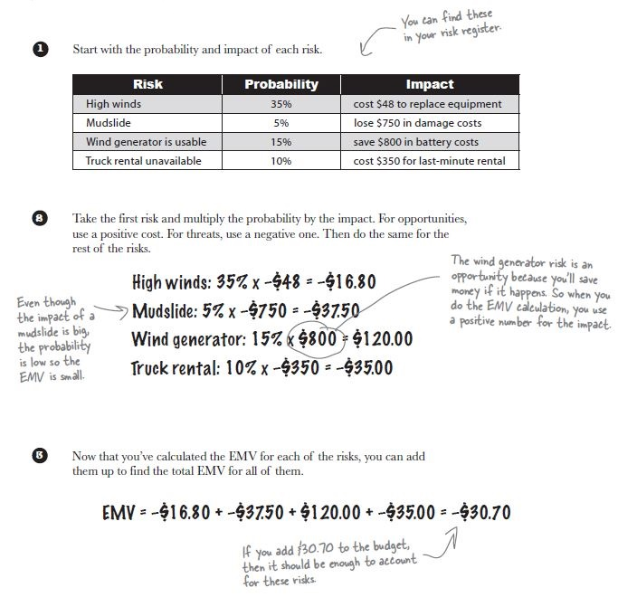
Perform Quantitative Risk Analysis Tools & Techniques…
Calculate the EMV of risks…
What’s wrong?

Slide 25
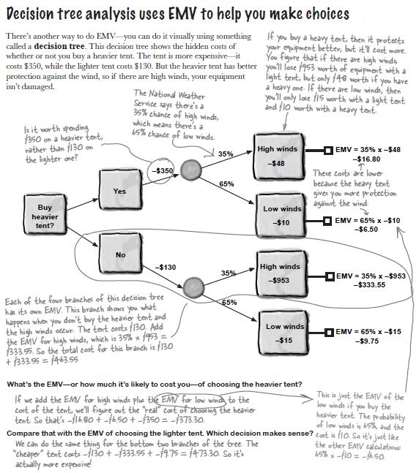
Perform Quantitative Risk Analysis – EMV Calculations

Slide 26
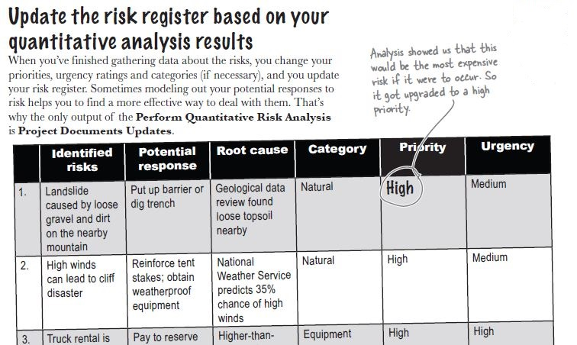
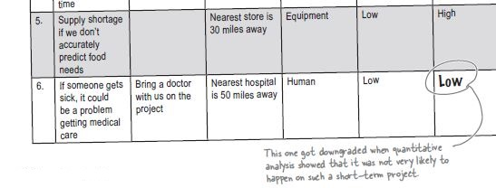
Perform Quantitative Risk Analysis – Output

Slide 27
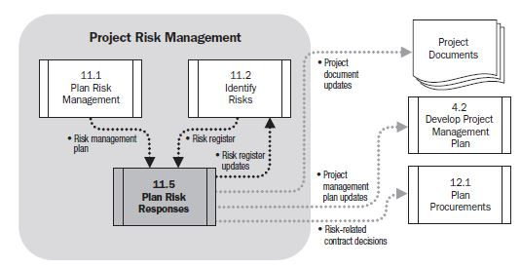
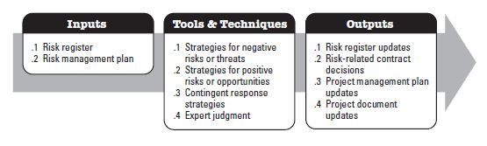
Plan Risk Responses…
Process of developing options and actions to enhance opportunities and to reduce threats to project activities …
How to respond to a risk?
- Keep a reserve of money to handle the cost of the most likely risks
- Transfer the risk with an insurance policy
Includes the identification and assignment of one person (the ‘risk response owner’) to take responsibility for each agreed-to and funded risk response.

Slide 28
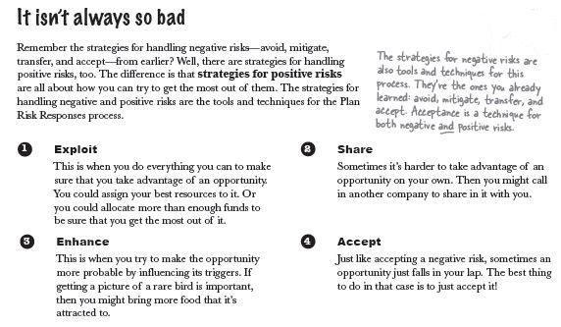
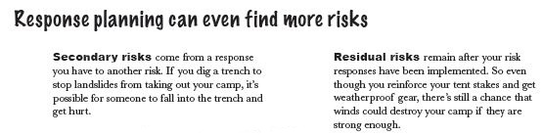
Plan Risk Responses – Tools & Techniques
Process of developing options and actions to enhance opportunities and to reduce threats to project activities …
( Use, take advantage of )
( Increase )

Slide 29
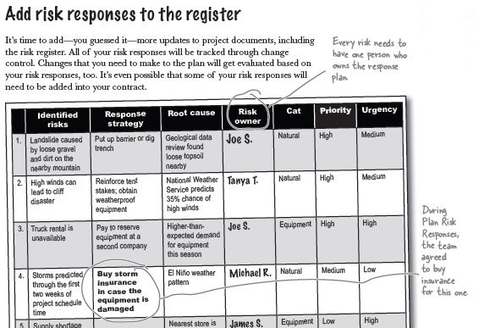
Plan Risk Responses - Output
Process of developing options and actions to enhance opportunities and to reduce threats to project activities …

Slide 30
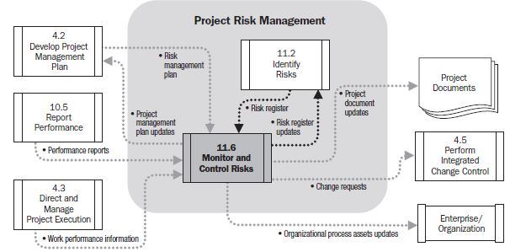

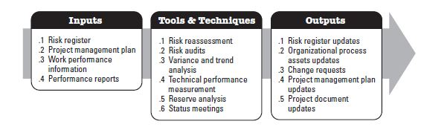
Monitor & Control Risks…
Process of implementing risk response plans, tracking identified risks, monitoring residual risks, identifying new risks and evaluating risk process effectiveness throughout the project...
Risk Monitoring by applying techniques such as variance and trend analysis (use of performance info. generated during project execution)...
Planned risk responses that are included in the PMP are executed during the life cycle of the project, but the project work should be continuously monitored for new, changing, and outdated risks...
Other purposes, to determine if :

