Slide 1
Part 1: Introduction and Key Concepts of Project Management

Slide 2
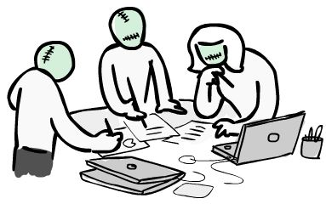
Project
A project is “a temporary endeavor (effort) undertaken to create a unique product or service.”
Begin & End
Temporary : Not means short
Product : a part, component or an end item...
Service : a capability to perform or a result with an outcome or document (renewal of network cabling system, painting a building etc.)
Development of a new product/service
Effecting a change in the structure, staffing, style of an organization
Developing a new IS
Constructing a building
Implementing a new business process (ex: adding a new branch)

Slide 3

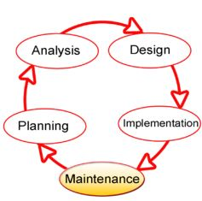
Project Management
“The application of knowledge, skills, tools and techniques to project activities in order to meet or exceed stakeholder needs and expectations from a project.” How? By...
- Initiating - Planning - Executing - Monitoring and Controlling - Closing
Systems Development LifeCycle (SDLC)

Slide 4

Project Manager
“The PM is the person assigned by the performing organization to achieve the project objectives in order to balance the project constraints by guiding a project team...” - Knowledge : PM understands and applies the knowledge, tools and techniques for managing projects... - Performance : PM is able to do or accomplish while applying the knowledge... - Personal skills: PM’s behaviour while performing the project. Ex : Attitudes, core personality characteristics and leadership...
SUCCESS

Slide 5
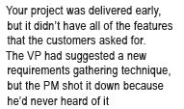
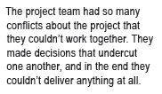

Project Manager
Which of the characteristics of a successful project manager was mainly neglected in the failed projects listed below?
Knowledge, Personal Skills or Performance?

Slide 6

Project Managing
- Identify Requirements... - Addressing various needs, concerns and expectations of the stakeholders during planning period... - Managing and balancing the project requirements by considering the project constraints (click to learn more) - Scope - Quality - Schedule - Budget - Resources - Risk
Alt. 2
What-If the Schedule is shortened :
Budget will increase to add some more resources...
If not, Scope & Quality will decrease in order to deliver a product in less time with same budget...
Change in project requirements → increase the risk of a desired product...
Alt. 1
Result

Slide 7

Portfolio Management
Portfolio : “ Collection of projects and/or programs, linked together by a business goal... ”
Prj & Prg in portfolio → not need to be directly related or interdependent.
Ex: Strategic objective of an architecture firm → “venturing into remodelling existing buildings as well as designing new ones...”
Projects : Re-constructing the kitchen of Sheraton Hotel, Renovating the entrance of JW Marriott Hotel, Painting the roof of JWM, Re-designing the parking lot of JWM, Designing XYZ Shopping Centre etc.
Managing related projects as a program : All the JWM Hotel activities → «JWM Program!».
Integrating and managing the projects, programs to satisfy the business goals by considering the project requirements (scope, budget, resource etc.) is portfolio management.

Slide 8

Program Management
Program : “ Group of projects that are closely linked, to the point where managing them together provides a benefit...”
A project may not be a part of a program but a program will always have projects.
Program managers focuses on dependencies of projects in a program.
Program example : A new communications satellite system.
Projects inside it: Design of the satellite/ground stations, construction process, integration of the whole system, launch of the satellite...

Slide 9

Project Management
Project : “ Any work that produces a specific result and is temporary. Has a beginning and end, can be a part of a portfolio or a program, but portfolios and programs can’t be a part of a project...”
Utilized as a means of achieving an organization’s strategic plan.
Market demand
Business need
Customer request
Technological advance
Legal requirements

Slide 10
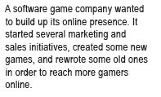
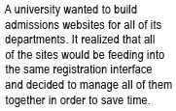

Portfolio, Program and Project Management Exercises
Portfolio, Program or Project?

Slide 11
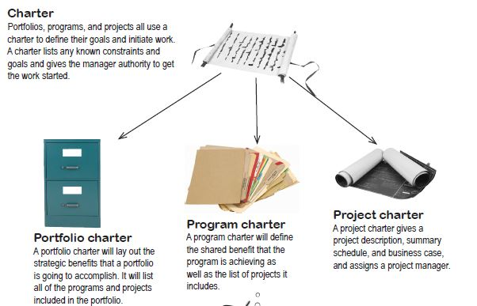
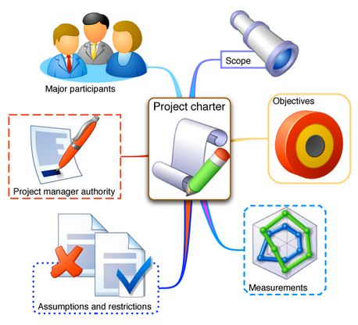
Portfolio, Program and Project Charter
- written rules & regulations -

Slide 12
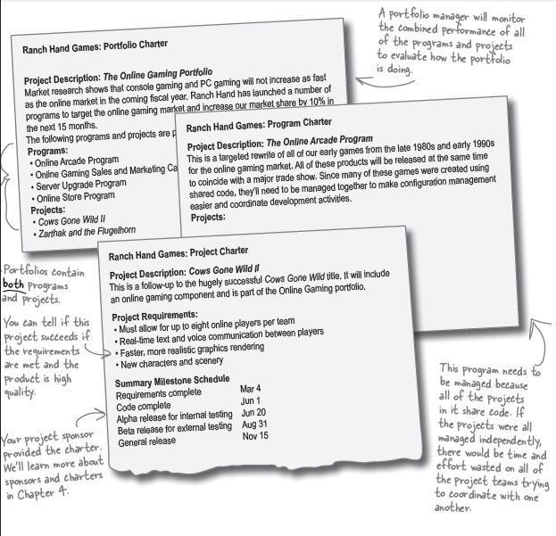
Portfolio, Program and Project Charter

Slide 13
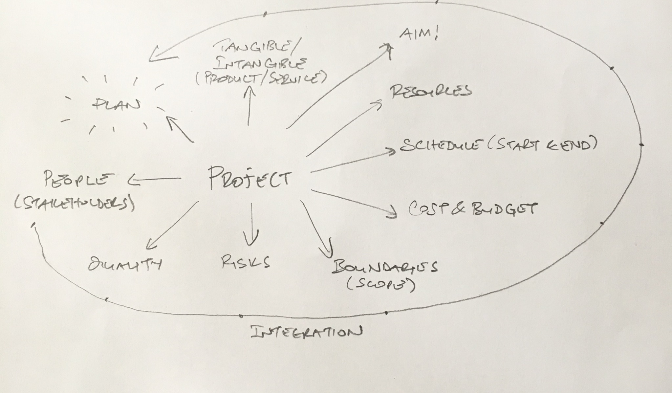
In-class Discussion...
Image 1
Think about your graduation from university. Can it be considered as a project? Why/Why not? Refer to our discussion (Image 1) about the components of a project.

Slide 14
Part 2: Project Life Cycle, Phases and Organizations

Slide 15

Projects vs Operational Work
Operations work supports the business environment where projects are executed.
Project manager may work with multiple operational managers to accomplish project tasks such as :
Determination of consumer preferences (H&R)
Deciding on technical specifications (H&R + R&D)
Building a prototype (R&D + PROD.)
Testing (All departments)
Different from projects (temporary), operational work does not have a start or end.
Daily, routine transactions of an organization is also a part of the operational work

Slide 16

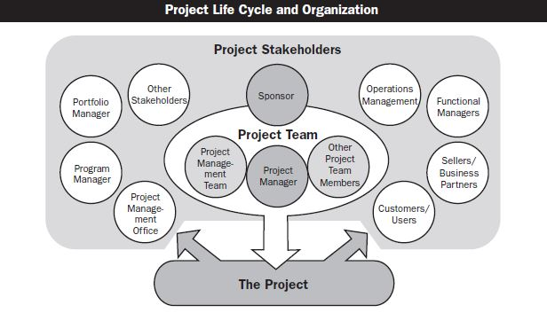
Stakeholders
Anyone who will be affected by the outcome of a project is a stakeholder.
PM’s duty : Determine & find all the stakeholders and keep them updated on the project.
Project’s success or failure depends on their expectations!
In order to keep updated on latest developments ! Source of documentation and guidance, define and maintain standarts & declare the latest news on project management...

Slide 17

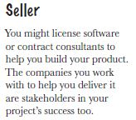
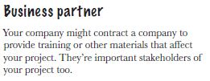
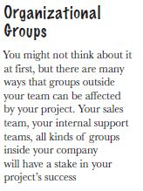

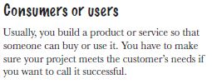
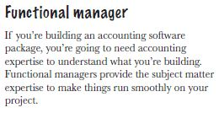
Identification of Stakeholders
Who are the stakeholders?
An assembly-line worker. His future employment depends on the outcome of a new product-design project.
What are their goals and expectations? (PM’s duty : manage & coordinate)

Slide 18
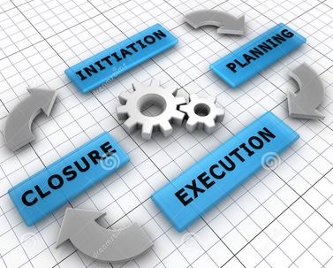
Project Life Cycle
Collection of sequential (generally) and overlapping (sometimes) project phases...
Projects vary in size and complexity but, all of them has to follow the life cycle structure :
Start of the project
Organizing and preparing
Carrying out the project work
Closing the project
Communicating with upper management (feedback system)
A common frame of reference for comparing projects (benchmarking)
Outputs, Templates, Guides, Histories etc.

Slide 19
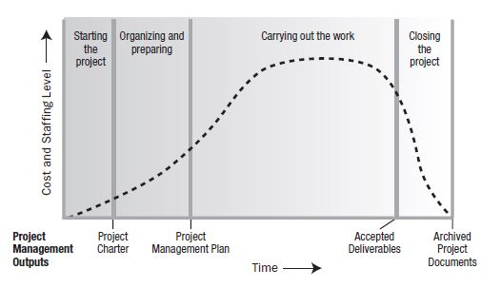
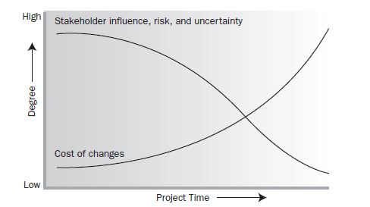
Project Life Cycle

Slide 20
Factory Construction Process
Project Phases
Break Ground
Excavation
Design
Foundation
Utilities
Framing
Roofing
Weather Resistant Barrier
Rough Plumbing
Mechanical Sytems
Lighting and Electrical
Air Sealing
Insulation
Drywall
Siding
Flooring
Tiling
Painting
Cabinets, Shelving
Finish Plumbing
Finish Electrical and Lighting
Certificate of Occupancy
Modifications
Moving In

Slide 21

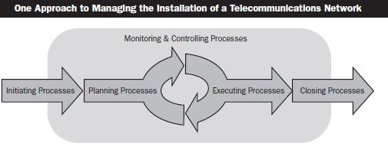
Project Phases
Single-Phase Project
Construction process of a new Factory!
* Every project starts in ‘Single-Phase Project’ format!

Slide 22
Project Phases
Single-Phase Project
Excavation Process
Excavation (breaking ground) process to establish a base for factory...
Initiate : Deciding on the starting point of excavation.
Plan : Obtaining a daily schedule & route for the digging work.
Execute : Implementing digging process by following the plan.
Close : Ending the excavation activities. (Cleaning up the digged area, Finishing the paper work, Making neceessary payments etc.)

Slide 23
Project Phases
Single-Phase Project
Pre-Excavation Activities
I: Getting the necessary permissions from the government in order to start construction.
P: Exploring the area and ground.
P: Deciding on the necessary machines (driller, crane etc.) & resources (workers) for excavation
P: Deciding on how to transport the sand & stones that are coming out from the ground
E: Making agreements, hiring workers and outsourcing the necessary pre-construction activities.
C: Finalising the pre-excavation charter.

Slide 24
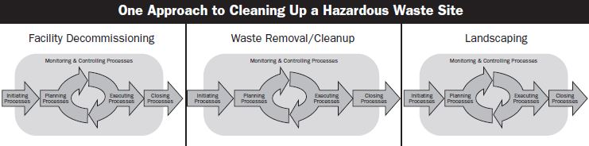
Project Phases
Multi-Phase Projects
Sequential
Pre-Excavation Phase
Excavation Phase
Design Phase
A phase can start when previous phase is completed
No uncertatinty
Eliminate options for reducing the schedule

Slide 25
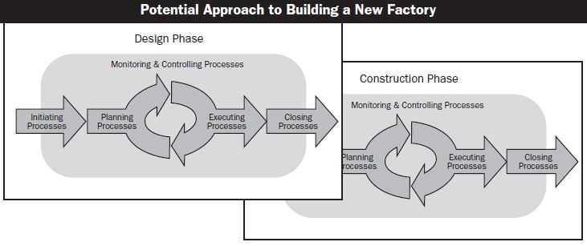
Project Phases
Multi-Phase Projects
Overlapping
Phase starts prior to completion of the previous one
Schedule compression technique → Fast Tracking
Overlapping may increase risk, can result in rework if a subsequent phase progresses before accurate info is available from the previous phase.

Slide 26
Project Phases
Multi-Phase Projects
Overlapping example
Ex 1) Assume that you start to design a factory building. In order to gain some time, you start the construction process (i.e: finish painting, cabling, placing the machines etc.) while design phase is still in progress but all of a sudden you notice that the reserved area for the production line is not enough, you need some extra place in order to place the production line what will you do?
Ex 2) Running the design process of electrical wiring & the construction phase of plumbing installation projects at the same time!
The design of wiring may not allow the water pipes placement...

Slide 27
Project Phases
Multi-Phase Projects
Iterative
Executing one phase while planning the next...
Only one phase is planned at any given time and the planning for the next is carried out as work progresses on the current phase and deliverables.
Useful in largely undefined, uncertain or rapidly changing environments.
Reduce the ability to provide long term planning.
Minimize project risks.
Maximize quality.
Ex : Deciding on the structure, quality of the tiles and the materials that are going to be used at factory roof while the overall construction process is in progress...
The daily changing currencies, the final status of construction project budget etc.
! Have a look at the example (Web Development Project) from Head_First_PMP, Chapter 3 - Pages 74 and 75.

Slide 28
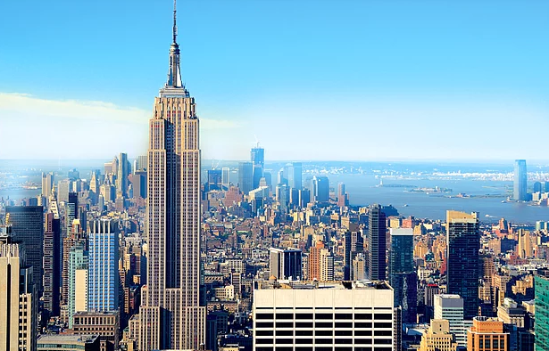
Summary of Project Phases
Deciding whether to use a single phase, multiple phase or layered multi-phase structure of a project can vary dramatically. Some organizations have policies on which structure to use and some leave it to the project team.
The structure might be applied based on common industry practice or based on the project team. In other words, a research study can be treated as pre-project work, the first phase of a project or as a stand-alone project. Similarly, one project team might elect to apply a multi-phase approach and another team may use a single phase for an identical project. In another words, the structure selection process is mostly depending on the complexity of the project!
With ~3400 laborers, the Empire State Building had a cost of around $41 million in 1931. The Empire State Building was a multi-phase overlapping project. (finished in 13 months!)
The Empire State Building contains 121 km of water mains, 232 km of electrical wiring, 1700 km of telephone cables, 129 km of radiator pipe, and 73 elevators in 18 km of shafts.

Slide 29
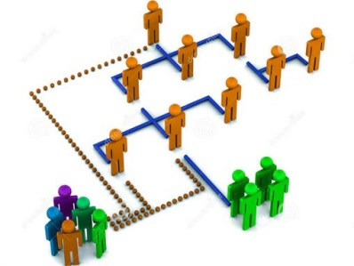
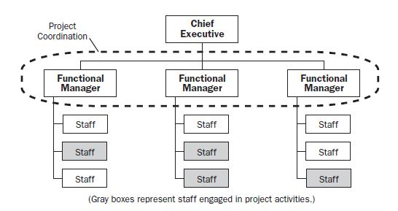
Organizational Structure Functional Organization
Each employee has one clear superior
Staff members are grouped by specialty : production, marketing, engineering, accounting
May be subdivided into functional organizations (ex: Mechanical Eng. Electrical Eng.)
Each department will do its project independent of other departments so, there are NO project based relations among departments.

Slide 30
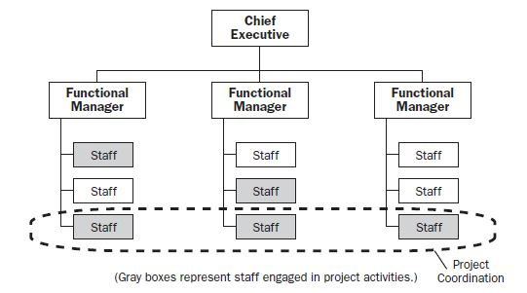
Organizational Structure Weak Matrix Organization
Ex : Accounting Dept.
Ex : R&D Dept.
Ex : Procurement dept.
Similar to functional organization
Instead of PM, there are project coordinators or expeditors.
Project coordination/expedition is provided by the project members

Slide 31
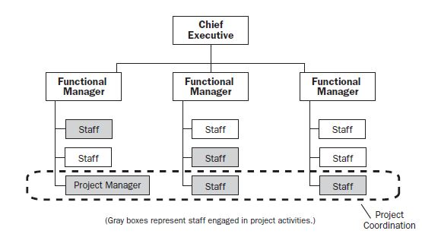
Organizational Structure Balanced Matrix Organization
Recognizes the need for a project manager and sets it.
The authority of the PM is limited. There is NO full authority over the project and project funding.

Slide 32
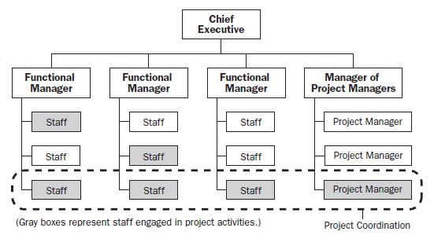
Organizational Structure Strong Matrix Organization
Similar and closer to Projectized organization.
Have full-time PMs (with considerable authority) & Project Administrative Staff.

Slide 33
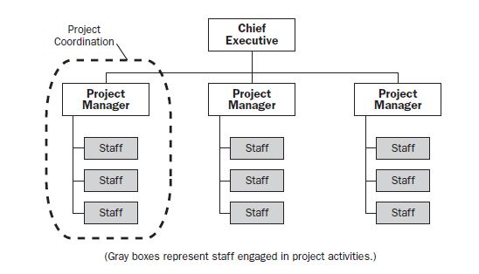
Organizational Structure Projectized Organization
Staffing, resources are involved in project work
PMs have independence and full authority
The main duty of the company is taking and implementing projects! (Ex: Bilkent Cyberpark, METU Teknokent firms)

Slide 34
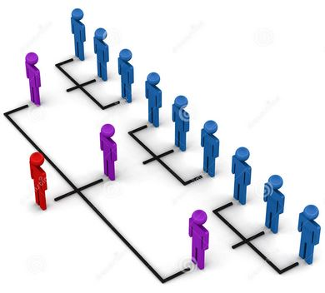
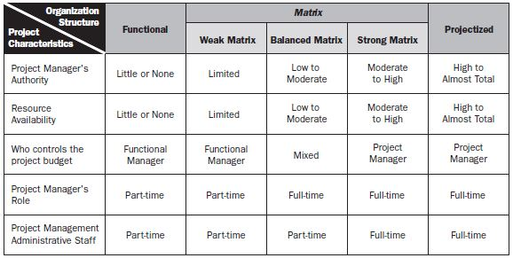
Organizational Influence
Cultures and styles (cultural norms) of organizations have a strong influence on a project’s ability to meet its objectives.
PM must understand the different cultural norms.
He/she must know the structure of the organization (decision makers!) and work with them for the success of the project.

