Slide 1
Part 3: Project Management Processes, Process Groups and Knowledge Areas...

Slide 2
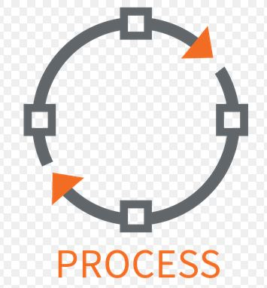
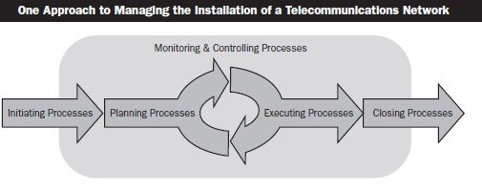
Process
A process is “a set of interrelated actions and activities performed to achieve a pre-specified product, result or service... ”
Characterized by its inputs, the tools and techniques that can be applied, and the resulting outputs.
PM consider organizational process assets and enterprise environmental factors for every process!
OPA provide guidelines and criteria for tailoring the organization’s processes to the specific needs of the project.
EEF may constrain the project management options.

Slide 3
Process vs Project
Projects are overseen by a principal authority, usually referred to as a Project Manager who leads the project towards its goal.
A project is defined by a fixed time, scope, and resources. When implementing a project, the goal is to execute change, usually drastic, and to incorporate that change into the day-to-day processes of the company.
Processes are run by all people involved in the ongoing operations of that workflow. In other words, they are day-to-day actions that are formalized with the goal of improving overall efficiency and productivity.
A process is defined by cycles. Similar to a project, a process also has a beginning, middle, and end; however, this cycle repeats itself over an average period of time.

Slide 4

Process vs Project
Projects | Processes
Never done before. | Do the same thing repeatedly, whenever necessary.
Goals are about creating something new or about implementing a change. | Goal is to create value by repeatedly performing a task.
Project objectives and plans can be changed by the influence or decision of stakeholders | Processes can be successfully changed only with significant planning and investment. Ex: A project is required to change a process...
Significant leadership is required to plan and execute a successful project. | Processes are managed, not led !

Slide 5
Process vs Project
Give examples for the projects and processes of a construction firm?
Projects | Processes
Painting outside of ABC shopping centre Breaking the ground in order to establish a base for XYZ working centre construction Landscaping of the National Park | Getting proposals from subcontractors Assigning project/team leaders and forming a team Hiring the trucks for the excavation work Scheduling the subcontractors for the excavation work Applying for the necessary permissions in order to start the work.

Slide 6
To obtain a successful project :
Project Team MUST :
Select appropriate processes required to meet the project objectives
Use a defined approach that can be adopted to meet requirements
Comply with requirements to meet stakeholder needs and expectations
Balance the demands of scope, time, cost, quality, resources and risk to produce the specified product service or result.

Slide 7

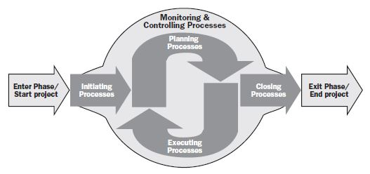
Project Management Process Groups:
Process Groups

Slide 8

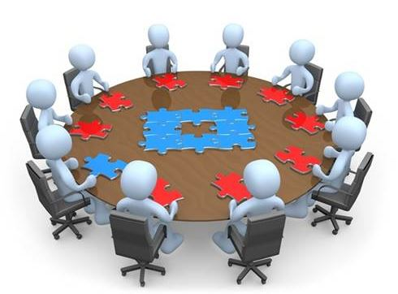
Project Management Process Groups:
All projects break down into process groups :
Initiating Process Group
Obtaining authorization for :
Definition of a new project or
New phase of an existing project
Planning Process Group
Determination of the scope of the project
Refining (Filter) the objectives
Action plan to attain objectives

Slide 9
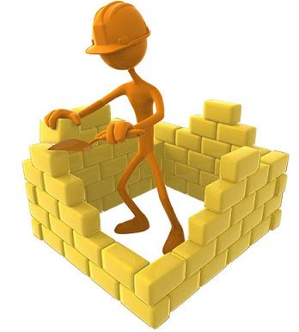


Project Management Process Groups:
All projects break down into process groups :
Executing Process Group
Performing the processes to complete the work that is defined in the PMP (Project Management Plan)
Monitoring and Controlling Process Group
Track, review and regulate the progress and the performance of the project.
Changes of the plan.
Closing Process Group
Finalize all activities.

Slide 10
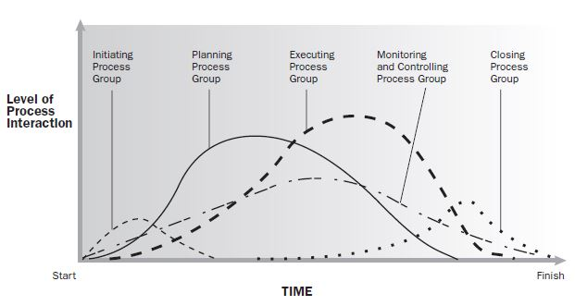
Project Management Process Groups:
Process Groups interact in a phase or a project

Slide 11
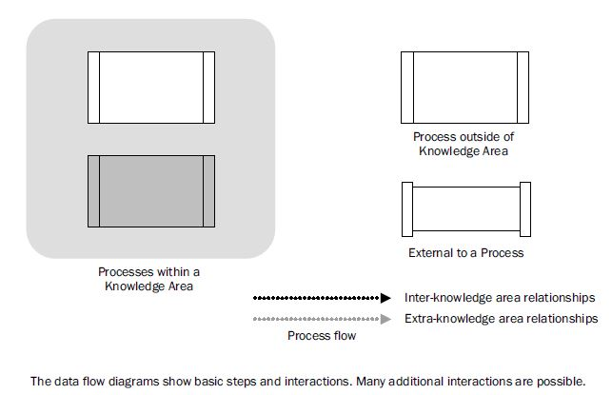
DATA FLOW DIAGRAMS :
Shows Process Inputs and Outputs that flow down through all the processes within a specific knowledge area...

Slide 12
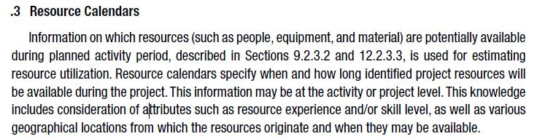
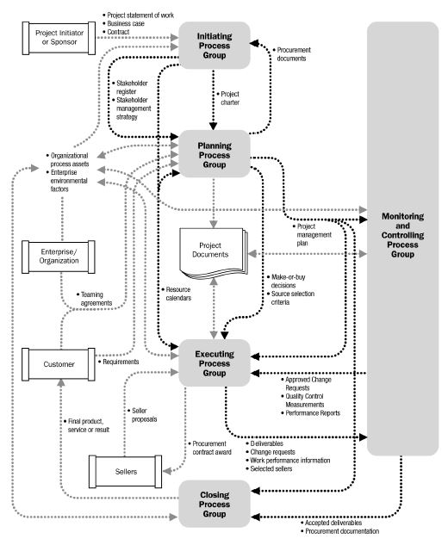
Project Management Process Interactions :
*
Project owner's notice to a bidding contractor of the acceptance of the submitted seller proposal. Also called award of contract.

Slide 13
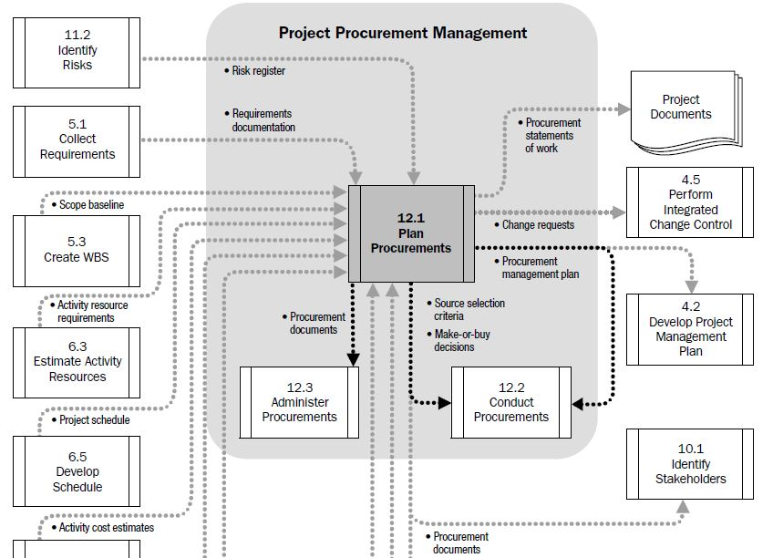
Project Management Process Interactions :

