Slide 1
Part 3/II: Project Management Processes, Process Groups and Knowledge Areas...

Slide 2
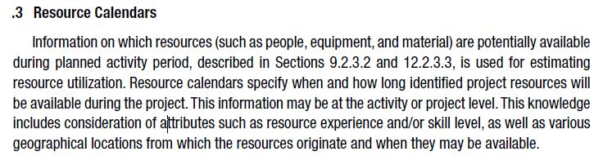
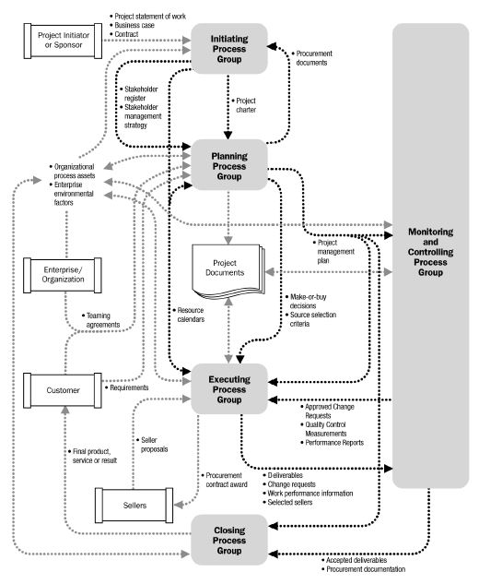
Project Management Process Interactions :
*
Why do we have two-sided arrows?
Why do they need it?
Project owner's notice to a bidding contractor of the acceptance of the submitted seller proposal. Also called award of contract.

Slide 3
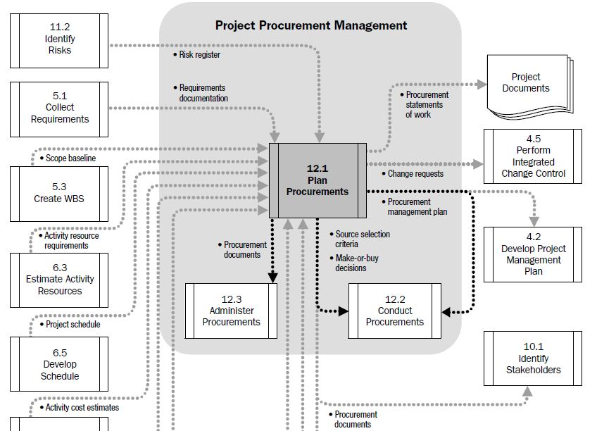
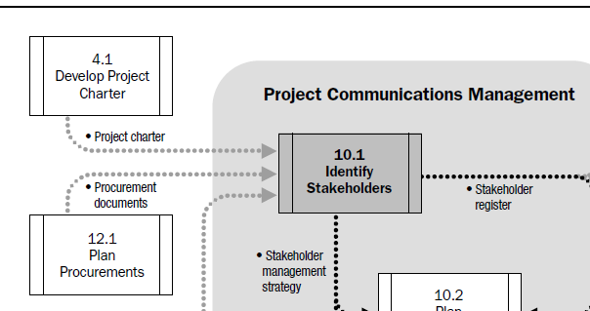
Project Management Process Interactions :

Slide 4



Project Management Process Groups: (Review)
All projects break down into process groups :
Initiating Process Group
Obtaining authorization for :
Definition of a new project or
New phase of an existing project
Planning Process Group
Determination of the scope of the project
Refining (Filter) the objectives
Action plan to attain objectives

Slide 5



Project Management Process Groups: (Review)
All projects break down into process groups :
Executing Process Group
Performing the processes to complete the work that is defined in the PMP (Project Management Plan)
Monitoring and Controlling Process Group
Track, review and regulate the progress and the performance of the project.
Changes of the plan.
Closing Process Group
Finalize all activities.

Slide 6

Knowledge Areas:
Integration Management :
Coordination of the work in order to apply processes correctly
Scope Management :
What work needs to be done for the project.
Making sure the end product has everything that is mentioned at the beginning.
Time Management :
Figuring out the time it will take to do the work and the order to do it.
Tracking the schedule and making sure that everything gets done on time.

Slide 7
Knowledge Areas:
Cost Management :
Knowing how much to invest in the project and making sure to spend it right.
Quality Management :
Making sure to work efficiently w/o adding defects into the product.
Human Resource Management :
Getting the people to work on the team and helping them to stay motivated
Rewarding them for a well done task and resolving the potential conflicts.

Slide 8
Knowledge Areas:
Communications Management :
Making sure that everybody knows what they need to know to do their job right.
Tracking how people talk to each other and dealing with misunderstandings or miscommunications if they happen.
Risk Management :
Figuring out how to protect the project from anything that could happen and give harm to it.
Also, dealing with the unexpected events when they happen.
Procurement Management :
Finding contractors and establishing the relationships of them with the company.
Processes necessary to purchase products.
Organization can be either the buyer or the seller of the products.
Supply chain issues.

Slide 9

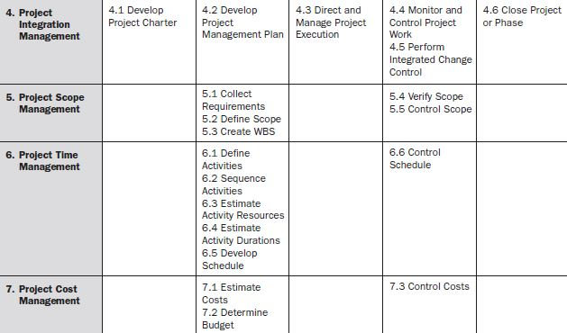
PM Process Groups and Knowledge Areas Mapping :

Slide 10
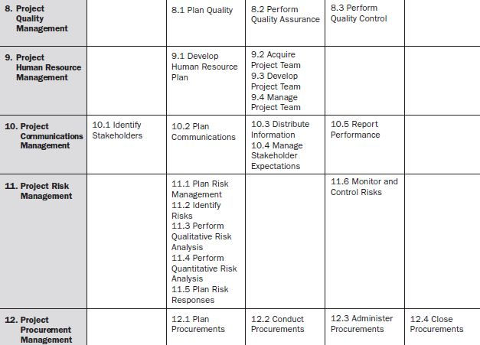
PM Process Groups and Knowledge Areas Mapping :

Slide 11
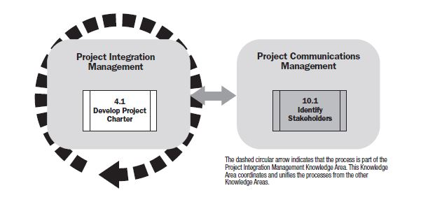
Initiating Process Group:

Slide 12
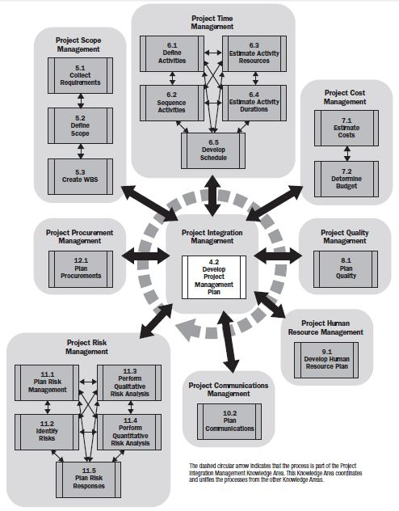
Planning Process Group:

Slide 13
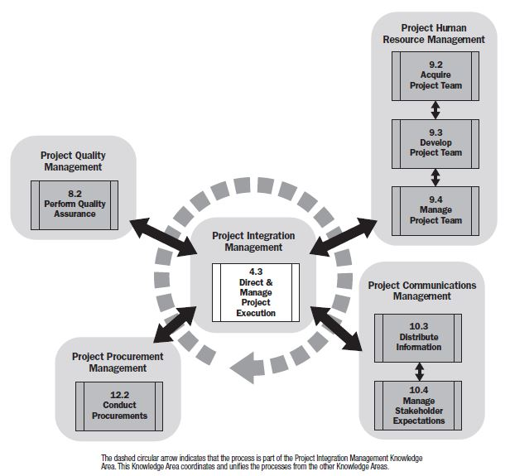
Executing Process Group:

Slide 14
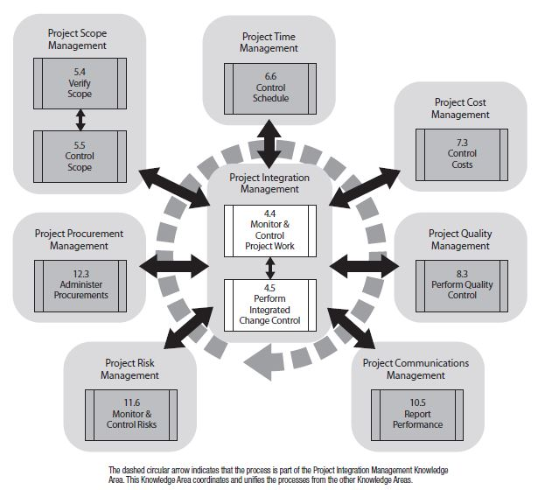
Monitoring & Control Process Group:

Slide 15
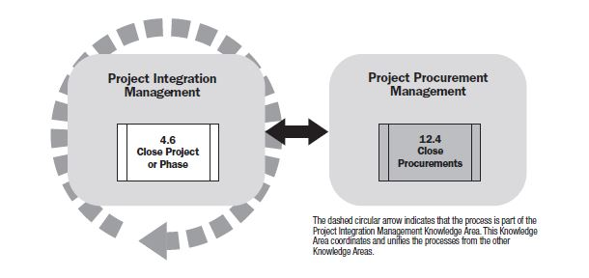
Closing Process Group:

Slide 16
Give the names of the Process Groups and Knowledge Areas. What is the relation between them? (10 mins)

