Slide 1
Part 4: Project Integration Management - 1
4.1 – Develop Project Charter

Slide 2
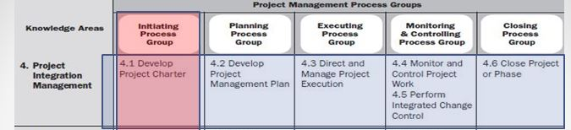
Part 4: Project Integration Management
Element of project management that coordinates all aspects of a project.
Project integration, when properly performed, ensures that all processes in a project run smoothly...

Slide 3
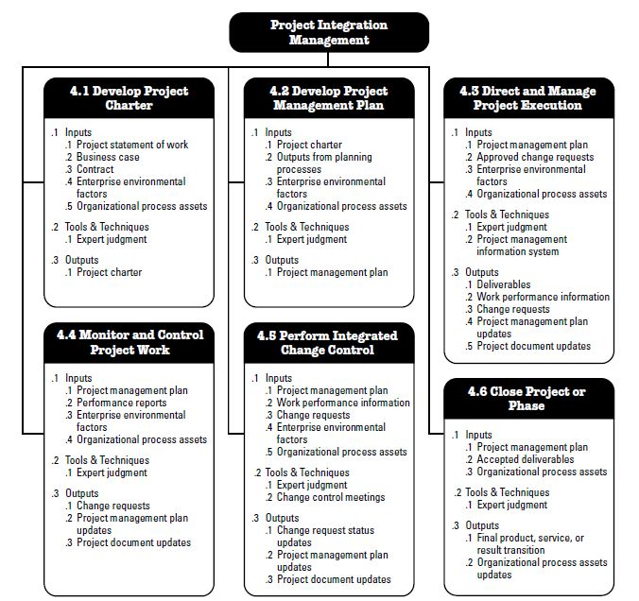
Project Integration Management Overview

Slide 4

6 Integration Management Processes
Initiate : Develop Project Charter (the authority to do the work!)
Very first step of a new project.
Identifies, Assigns & Authorizes a PM to do his/her work, after it the PM assigns the tasks to it’s team.
PM not involved during the development (but recommended, because he/she apply the resources!), it’s handled by the project sponsor mostly.
Plan : Develop Project Management Plan (get prepared for problems and changes)
One of the most important document.
Guides everything that happens on the project.
Spans almost all of the knowledge areas.

Slide 5
6 Integration Management Processes
Execute : Direct and Manage Project Work (manage to provide efficiency!)
After planning, time to DO the work.
Make sure that everybody is doing what they should be doing
Make sure the products/services that project creates meet the needs of the stakeholders.
Day-to-day work that the project team must do.
Monitor and Control : Monitor and Control Project Work (check the problems!)
Keep everyone satisfied by catching the problems as early as possible.
Control of every single thing that goes on in the project.
It’s very hard and expensive to fix a problem after time passes over it.

Slide 6
6 Integration Management Processes
Monitor and Control : Perform Integrated Change Control (solve the problems!)
After the problems appear, there must be negotiations with the stakeholders and sponsors to figure out how to deal with them.
The project management plan must be updated to reflect any extra steps to be considered and implemented to complete the project so, this step handles the determination and solving process of the problems.
Here, potential changes should be also considered!
Close : Close Project or Phase (take lessons!)
The documentation is very important.
Documentation : The lessons learned along the way!
They will help at later projects.

Slide 7
Sample Project Management Exam (Mid II) Questions :
Ex1: A project manager in a construction company has been authorized to apply the organizational resources to project activities. The authorization comes in the form of.
a) Project Management Plan
b) Project Charter
c) Justifications
d) Memos
Ex2: The process of defining, preparing and organizing all subsidiary plans along with integrating them into the comprehensive project plan is known as.
a) Develop Project Charter
b) Develop Project Management Plan
c) Project Process Groups
d) Strategic Management
Ex3: What is the term used for the area that entails processes and activities that define, combine, unify and coordinate the processes and project activities carried out within the various Project Management Process Groups?
a) Project Integration Management
b) Strategic Management
c) Operations Management
d) Project Process Management

Slide 8
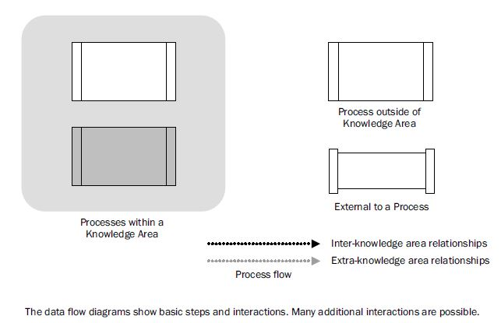
DATA FLOW DIAGRAMS :
Shows Process Inputs and Outputs that flow down through all the processes within a specific knowledge area...

Slide 9
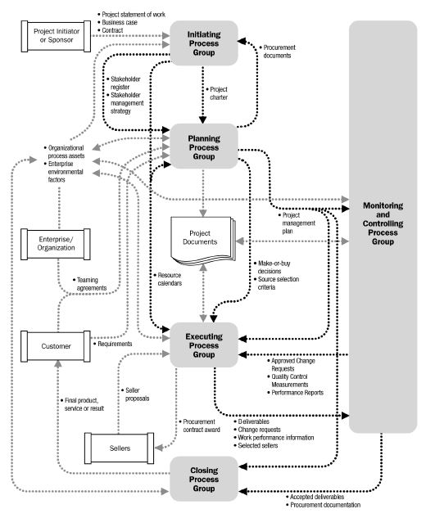
Project Management Process Interactions :

Slide 10
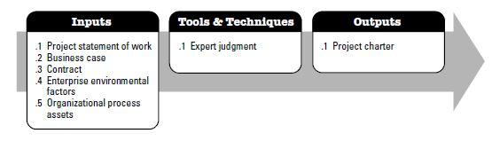
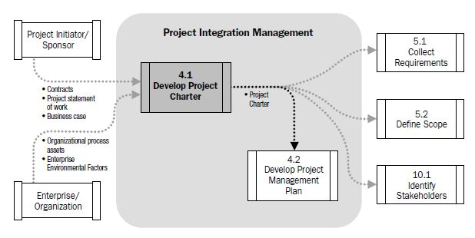
Project Charter Details...

Slide 11
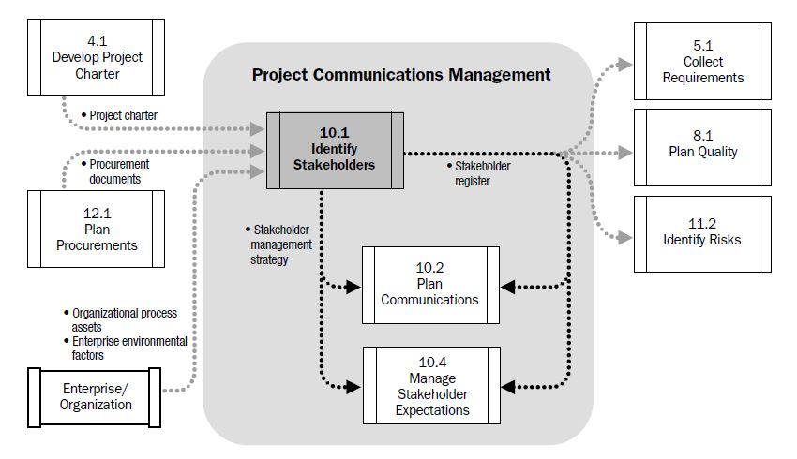
Chapter 10.1

Slide 12
Develop Project Charter Process
Matrix Organization → Team is reporting to functional managers!
In order to be the boss of the team, you need authorization.
Project Charter : What you are authorized to do (assign tasks to team members, use company/project resources), Why you have been assigned to it.
Inputs : Agreements (Contract), Business Case, Project Statement of Work, Organizational Process Assets, Enterprise Environmental Factors.

Slide 13
Develop Project Charter Process
Project Statement of Work (Lists the deliverables that the project manager and his/her team need to produce)
Internal : Project initiator or sponsor provides
External : Customer
Narrative description of products/services to be delivered by the project.
Product Scope Definition : Characteristics of the product/service. Relationship between the products/services and the business need.
Strategic Plan : Strategic goals of the organization.

Slide 14
Develop Project Charter Process
Business Case (why it’s worth to spend money on the project...)
Necessary information from a business standpoint (view) to determine whether or not the project is worth the required investment.
Contains the Business Need and the Cost-Benefit Analysis (CBA is defined as a systematic process for calculating and comparing benefits and costs of a decision, policy (with particular regard to government policy) or (in general) project.).
For external projects, requesting organization or customer writes the Business Case.
A Business Need is created as a result of one or more following items

Slide 15
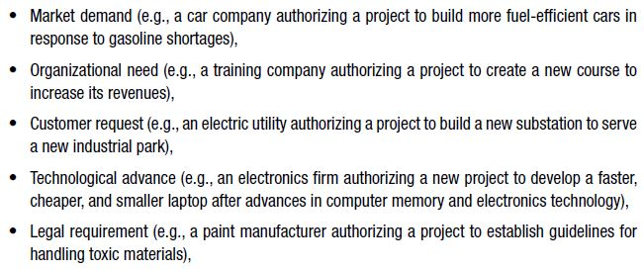
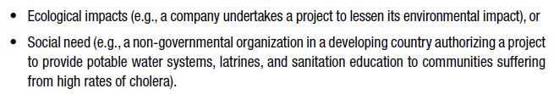
Develop Project Charter Process
Implementing ERP Softwares in order to increase the communication level both inside and outside of the company...
Business Need...
Nowadays car producers are running projects for downsizing the engines...
Obtaining New versions of mobile devices every year...
Landscaping of ABC shopping centre...
Factories that has outputs such as chemical wastes are running disposal projects in order to reduce the effects of wastes on environment...
Most Related!

Slide 16
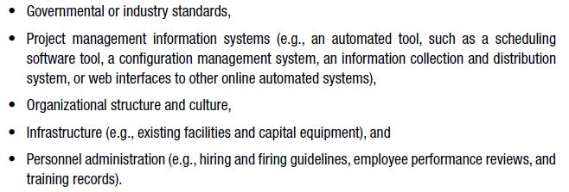
Develop Project Charter Process
Contract
What you agreed to do, an input if the project is being done for an external customer.
Enterprise Environmental Factors (how a company does business)
determines how work is assigned, and makes sure that the tasks are done in right order
common standarts as a result of interaction with similar companies

Slide 17
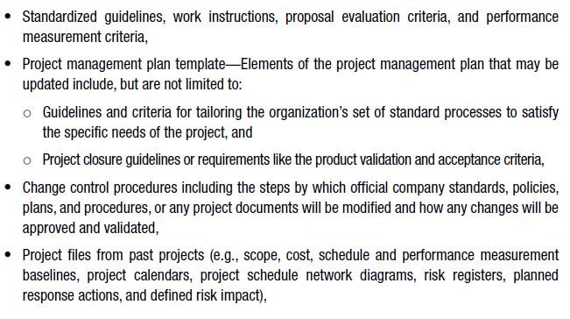

Develop Project Charter Process
Organizational Process Assets (how a company runs projects)

Slide 18
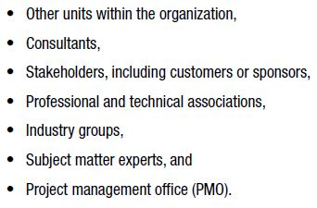
Develop Project Charter Process
Expert Judgment
Assessing the inputs (business case, contract, sow etc.) used to develop project charter
Provided by any group or individual with specialized knowledge or training :
is a group or department within a business, agency or enterprise that defines and maintains standards for project management within the organization. The source of documentation, guidance and metrics on the practice of project management and execution.

Slide 19
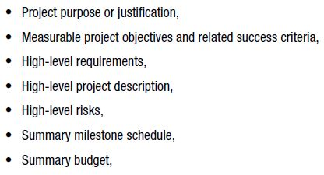
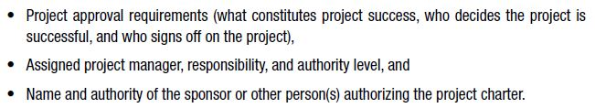
Project Charter
Summary :
Documents the business needs, current understanding of customer’s needs and the new product, service or result that is intended to satisfy :

Slide 20
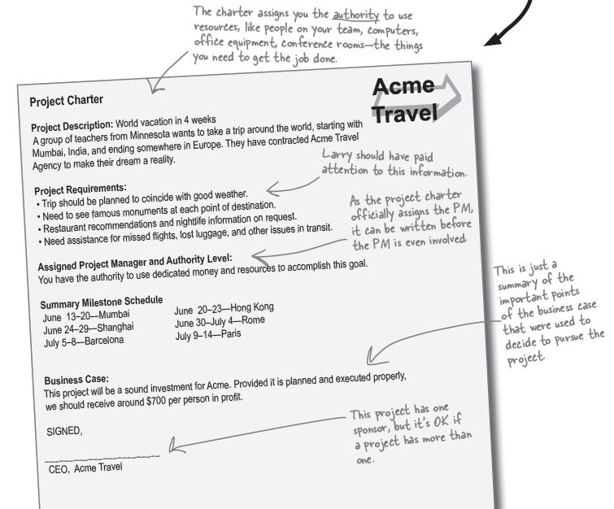
Project Charter Sample

