Slide 1
Part 4: Project Integration Management - 2
4.2 – Develop Project Management Plan
4.3 – Direct and Manage Project Execution
4.4 – Monitor and Control Project Work
4.5 – Perform Integrated Control
4.6 – Close Project or Phase

Slide 2
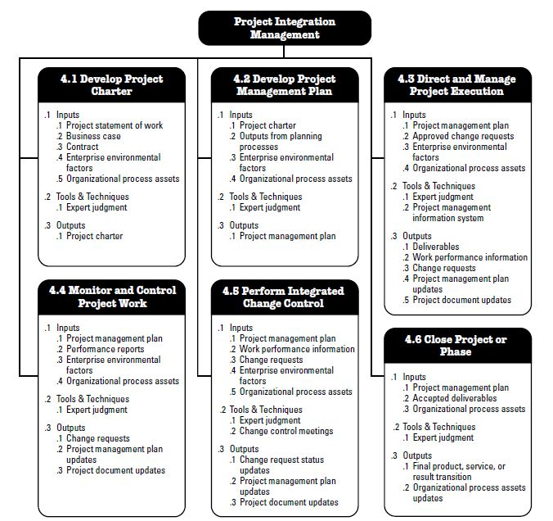
Project Integration Management Overview

Slide 3

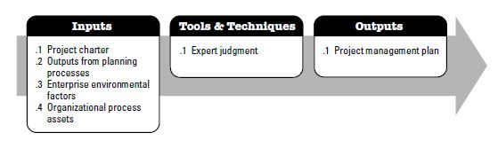
Develop Project Management Plan Process
Process of “documenting the actions necessary to define, prepare, integrate and coordinate all subsidiary plans...”
Defines how the project is executed, monitor + controlled and closed.
Content will vary depending on the application area and complexity of the project.
Organization of all info about the project into one place, so everyone knows exactly what needs to happen when they do the project work – no matter what their jobs are. (creating awareness)
A place to think about everything that will and may happen on the project.
A place to handle the changes.

Slide 4
Develop Project Management Plan Process:
Inputs :
Project Charter
Outputs of Planning Processes
Any baselines (snapshot of the scope, schedule or budget used for planning) and subsidiary management plans (dedicated to a knowledge area, problems/solutions of this area) that are an output from other planning processes are inputs to this process.
Enterprise Environmental Factors
Organizational Process Assets

Slide 5

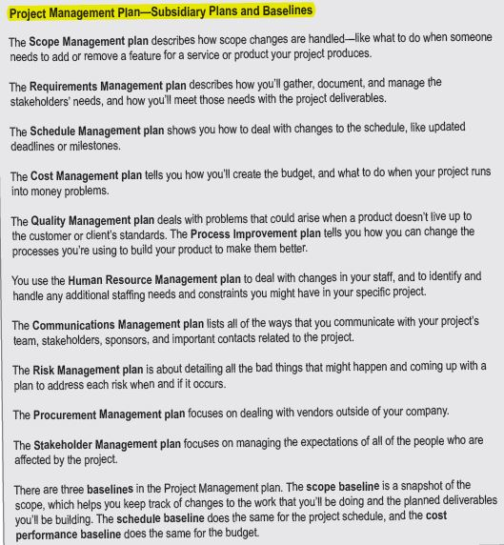
Develop Project Management Plan Process
Outputs of Planning Processes...

Slide 6

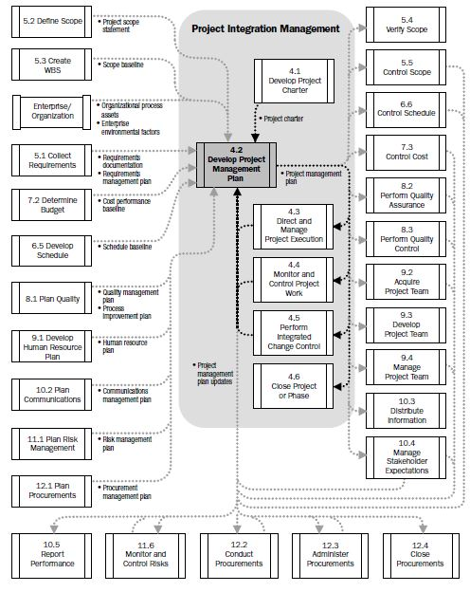
Develop Project Management Plan Process

Slide 7

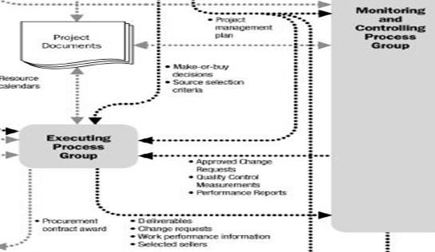
Direct and Manage Project Work Process:

Slide 8
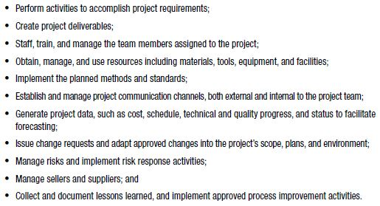
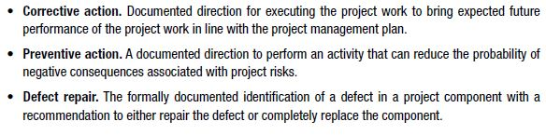
Direct and Manage Project Work Process:
Process of “performing the work defined in the PMP to achieve the project’s objectives...”
PM (with the team) directs planned project activities and manages the various technical and organizational interfaces that exists within the product.
Direct and Manage Project Execution also covers ‘Implementation of approved changes’
Are we with the plan?
Minimize the risks!
Repair or completely remove?

Slide 9
Direct and Manage Project Work Process:
Outputs :
Deliverables : Any unique and verifiable product, result or capability to perform a service by project team members... (Ex: A defect report) The Direct and Manage Project Work process is where the PM and his/her team actually do the work to produce deliverables.
Work Performance Info (Data) : How well the processes from each knowledge area are being performed? Information from project activities is routinely collected as the project progresses. Ex : Deliverable status, Schedule progress and Costs incurred.

Slide 10
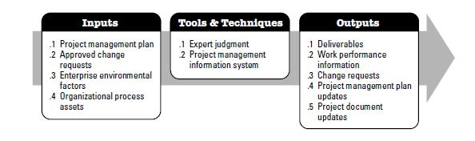
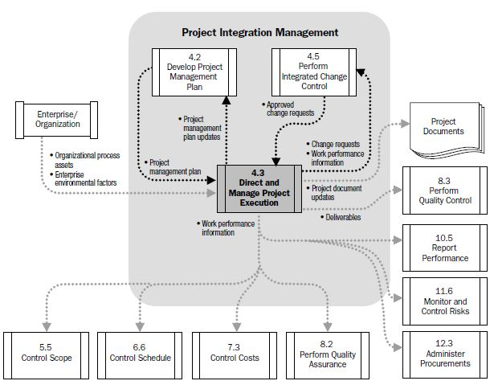
Direct and Manage Project Work Process:

Slide 11

Monitor and Control Project Work Process: Look for changes...
Process of “tracking, reviewing and regulating the progress to meet the performance objectives defined in the PMP...”
Collecting, measuring and distributing performance information and assessing measurements and trends to effect process improvements.
Loop between the executing and the monitoring+controlling processes. During execution and preperation of deliverables there may be problems.
When there is a problem you can’t make a change spontaneously. Cost analysis and scheduling of the solution may take a long time.
Effect of it on project requirements is necessary and should be analyzed. Is it worth making the change? → Perform Integrated Change Control (deal with the changes...)

Slide 12
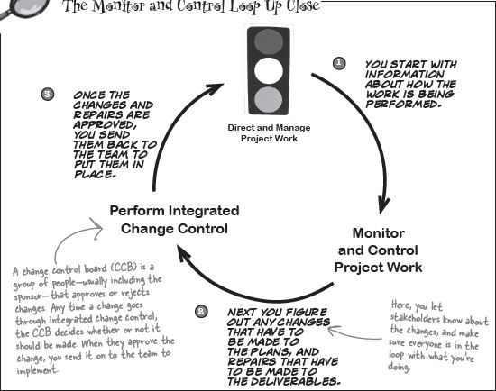
Monitor and Control Project Work Process:
?
If a defect is detected, is it possible to send it directly to Perform Integrated Change Control?

Slide 13

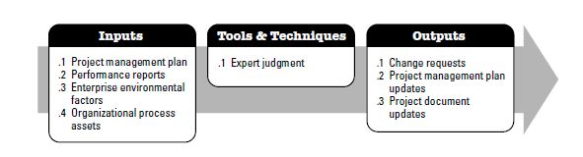
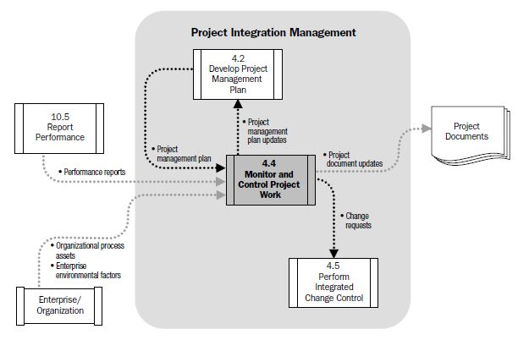
Monitor and Control Project Work Process:

Slide 14

Perform Integrated Change Control (Decide on the changes that are right for the project)
Process of reviewing all change requests, approving changes and managing changes to the deliverables, OPA, project documents and the PMP.
Monitor and Control Project Work : place where the PM find the changes that he/she may want to make
Change request : Document created by the person who requests the change.
Change control system : Set of procedures that lets you make the changes in an organized way.
Perform Integrated Change Control : Is it worth making the change? The place where the PM decides whether or not to make the changes.
Rejected changes and Approved changes.
?
What will happen to them...

Slide 15
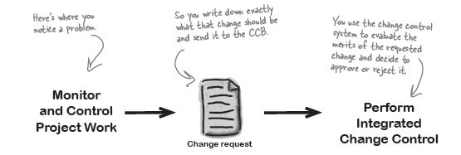
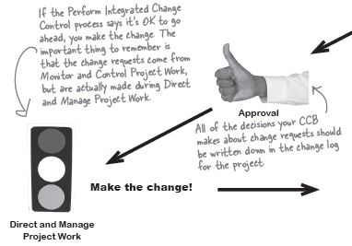
Perform Integrated Change Control (Make only the changes that are right for the project)
Go on with the project!

Slide 16

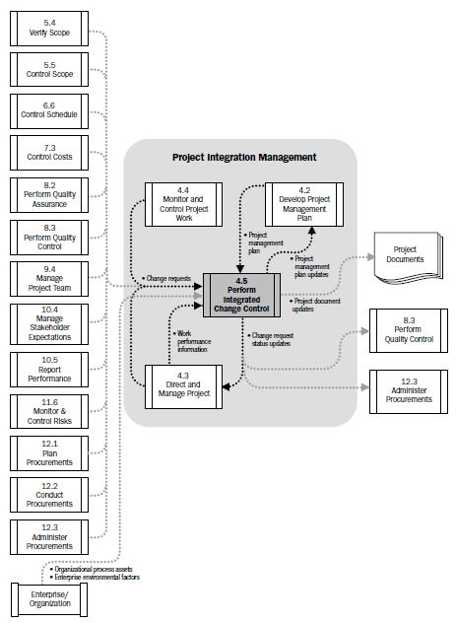
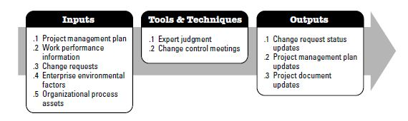
Perform Integrated Change Control
Approved or Rejected
OPA update at ‘Close Project’

Slide 17

Close Project or Phase Process
Process of finalizing all activities across all of the Project Management Process Groups to formally complete the project or phase.
All parts of the contract are met?
Create the lessons learned list? → ADD them in OPA!
Inputs : PMP, OPA, EEF, Work performance information and deliverables.
Output : FINAL PRODUCT/SERVICE!

Slide 18
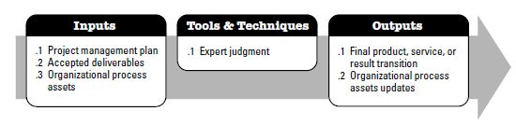
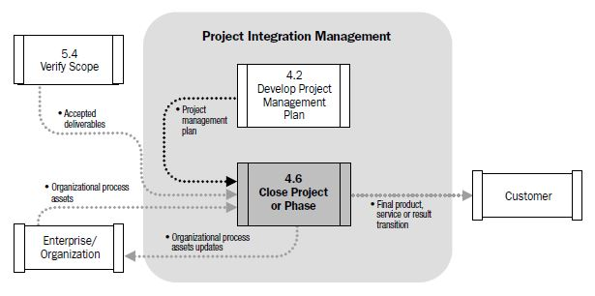
Close Project or Phase Process

