Slide 1
Part 5: Project Scope Management (Part 1)
5.1 – Collect Requirements
5.2 – Define Scope

Slide 2

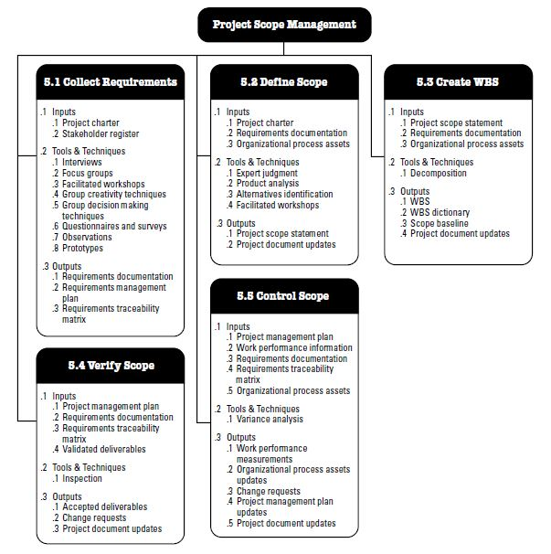
Project Scope Management Overview
*
*
*

Slide 3
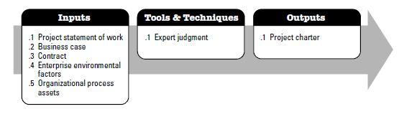
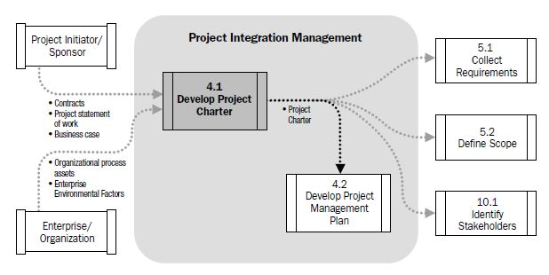
Let’s remember! Project Charter Details...

Slide 4
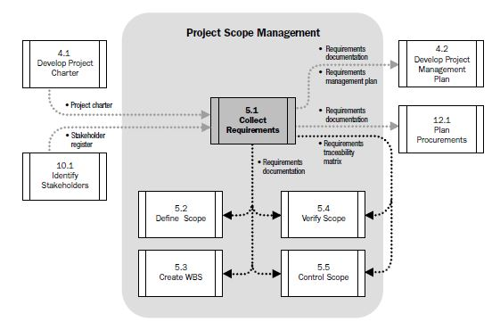
Collecting Requirements DFD :
Process of defining and documenting stakeholders’ needs to meet the project objectives.
Used to provide the high-level project requirements and product description of the project
4.1 is also needed for 10.1!
Identification of the stakeholders that can provide information on detailed project and product requirements

Slide 5
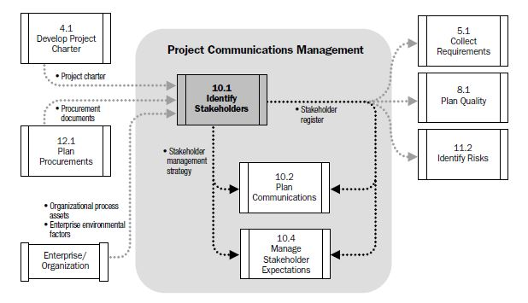
Project Communications Management / Identify Stakeholders
At Chapter 10....

Slide 6

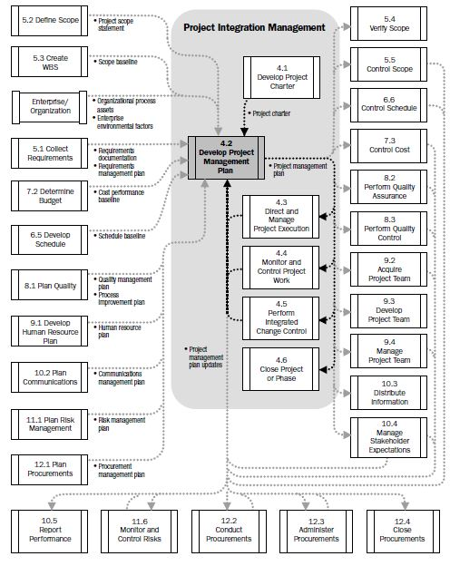
Develop Project Management Plan Process
Let’s remember !

Slide 7
Project Scope Management Steps :
5.1 Collecting Requirements : Process of defining and documenting stakeholders’ needs to meet the project objectives.
5.2 Define Scope : Process of developing a detailed description of the project and product.
Product Scope : features and functions of the product or service that the PM and his/her team are building.
Project Scope : All the work done to make the product!
5.3 Create WBS : Process of subdividing project deliverables and project work into smaller, more manageable components.
5.4 Verify Scope : Process of formalizing acceptance of the completed project deliverables
5.5 Control Scope : Process of monitoring the status of the project and product scope and managing changes to the scope baseline.

Slide 8
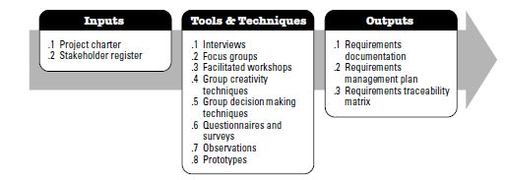
Collecting Requirements :
Process of defining and documenting stakeholders’ needs to meet the project objectives.
Getting together with all of the stakeholders of the project and working out to determine what their needs are,
Quantified and documented needs and expectations of the sponsor, customer and other stakeholders,
Defining and Managing customer expectations.
Forming WBS
Project Requirements : Business requirements, PM requirements, delivery requirements etc.
Product Requirements : Info. on technical requirements, security requirements, performance requirements etc.

Slide 9
Collecting Requirements DFD :
Process of defining and documenting stakeholders’ needs to meet the project objectives.
Used to provide the high-level project requirements and product description of the project
Identification of the stakeholders that can provide information on detailed project and product requirements

Slide 10
Tools and Techniques of collecting requirements:
Talking with stakeholders... HOW?
Interviews & Focus Groups :
Stakeholders & Subject matter (expert on a specific subject) experts interact.
How customers will use the product/get benefit from a service, functions, features of the end product or service.
One-to-one interaction is provided (by Interviews)
To be sure that the project can meet it’s goals!
Discussion of needs with groups.
Faciliated workshops
A moderator leads the group through brainstorming requirements.
Stakeholders work together.
Example : during software development process, end users and sw development team interact together.

Slide 11
Tools and Techniques of collecting requirements:
Making the project team creative - Group Creativity Techniques...
Brainstorming:
Collecting requirements by sitting with a group of people to think or discuss new ideas.
Nominal Group Technique:
A form of brainstorming.
Written down the ideas and the group vote on the ones that they like.
Ranking them and eliminate the ones that are less important.
The Delphi Technique :
Letting everyone in the group give their thoughts about what should be in the product while keeping them anonymous!
How? → Everybody writes down their answers to the same questions about what product needs to do and hands them into a moderator!

Slide 12
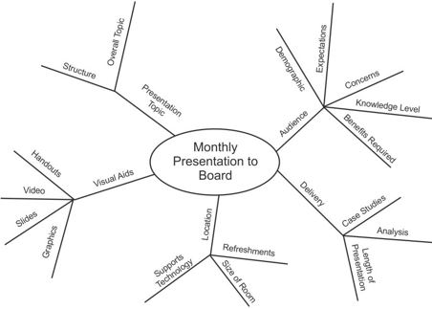
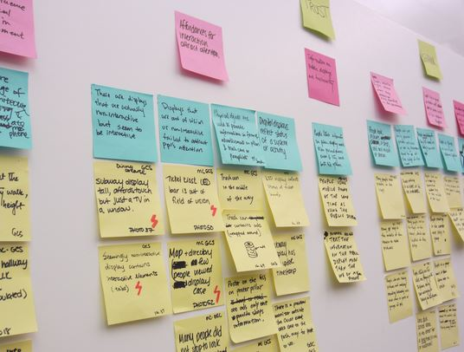
Tools and Techniques of collecting requirements:
Making the project team creative - Group Creativity Techniques...
Idea/Mind Maps:
Ideas and relations between them
Create a map of ideas and then group them
Affinity Diagram:
Lots of ideas and they need to be grouped.
Sticking Post-it notes on a wall is a way.
Move the ideas around and change groupings in order to reach a conclusion!
Ex : Putting requirements in categories help you to find new ones!

Slide 13

Tools and Techniques of collecting requirements:
Using questionnaires and making surveys to get requirements from a bigger group of people...
Written sets of questions/options about the feature of the product/service.
Analysis of results → Reaching a conclusion!
Laser pointer: Ease of use
Observations help to see things from a different point of view...
Observing a group of people who will use your product while they work with it will give you a better idea of how to solve their problems.
Sometimes it’s not easy for a user to give an answer to question related with the requirement so, watching him/her dealing with the problem may give you an idea to find requirements.
Prototyping
A method of obtaining early feedback on requirements by providing a working model of the expected product before actually building it.
Ex : Beta versions of softwares!

Slide 14
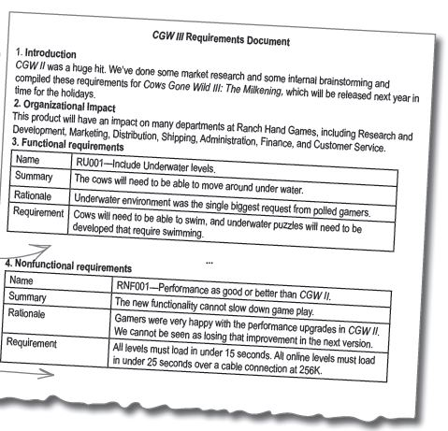
Collecting Requirements : Outputs
Requirements Documentation : descriptions of system properties, specifications for how the system should work, and constraints placed upon the development process.
How individual requirements meet the business need for the project. Lists all of the functional (new features, bug fixes etc.) and nonfunctional (quality attributes; performance, reliability, error handling, ease of use etc.) requirements of the project.

Slide 15
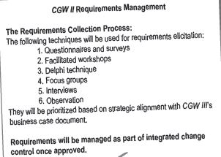
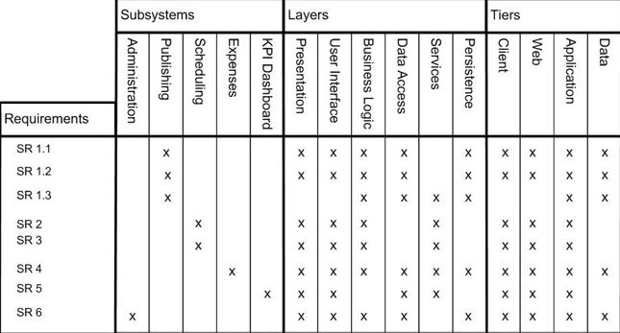
Collecting Requirements : Outputs
Requirements Management Plan :
How requirements will be gathered, planned, tracked, analyzed and reported.
Requirements Traceability Matrix :
A table shows where the requirements come from, how they get implemented and verified.
High – level look at all requirements and making sure they have mapped to specific test cases.

Slide 16
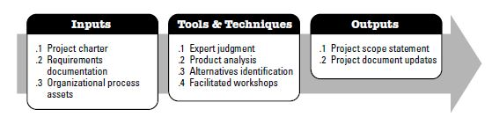
Define Scope:
Process of developing a detailed description of the project and product.
Critical for project success
Builds upon the major deliverables, assumptions and constraints that are documented during project initiation.
Existing risks, assumptions and constraints are analyzed for completeness; additional risks, assumptions and constraints are added to project documents as necessary.

Slide 17
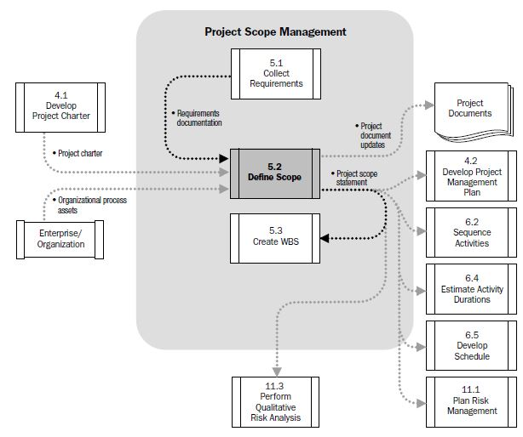
Define Scope DFD:

Slide 18
How to define Scope...
The initial step is Project Requirements...
All the work that the PM and his/her team will perform must be written down.
Tools/Techniques!
Faciliated Workshops :
Stakeholders’ needs written down in order to satisfy deliverables.
Setting quantifiable goals...
Writing down specific project goals that can be measured...
Product Analysis :
Done at the beginning → Satisfied stakeholders...
Projects that have a product at the end...
High-level product descriptions → Tangible deliverables
Deliverables match with requirements...
Preventing last minute problems

Slide 19
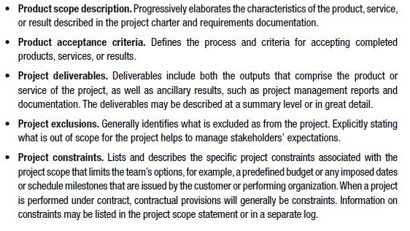

How to define Scope...
Continuously improving and detailing a plan as more detailed and specific information and more accurate estimates become available...
Tools/Techniques! (continue)
Alternatives Generation :
Other ways to do the work
Pick the most efficient one
Designing the graphics (Hiring a graphic designer or sending design work to an outside studio)
Expert Judgment
Outputs :
Project Scope Statement
Describes the project’s deliverables and the work required to create those deliverables in detail.
Project Document Updates

