Slide 1
Part 5: Project Scope Management
5.2 – Define Scope
5.3 – Create WBS
5.4 – Verify Scope
5.5 – Control Scope

Slide 2

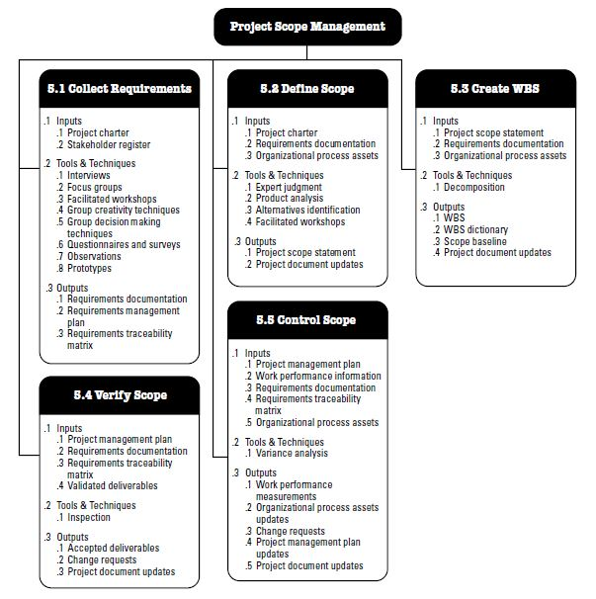
Project Scope Management Overview
*
*
*

Slide 3
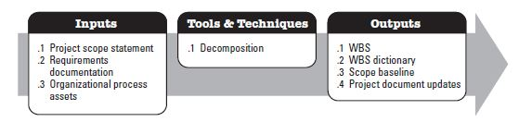
Create Work Breakdown Structure:
Process of subdividing project deliverables and project work into smaller, more manageable components...
Most important process in the Scope Management knowledge area.
Deliverable-oriented + hierarchical decomposition of the work.
Organizes and defines the total scope of the project and represents the work specified in the current approved project scope statement.
Every single thing (related to project) must be mentioned here!
Lowest level WBS components → Work Packages that are scheduled, cost estimated, monitored and controlled.

Slide 4

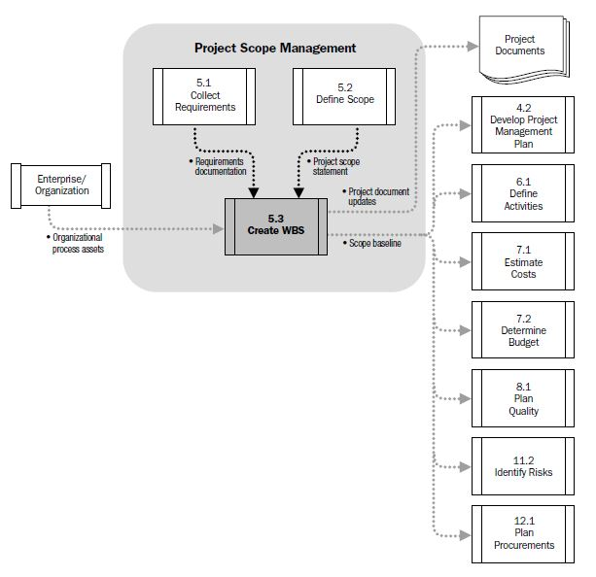
Create Work Breakdown Structure:

Slide 5
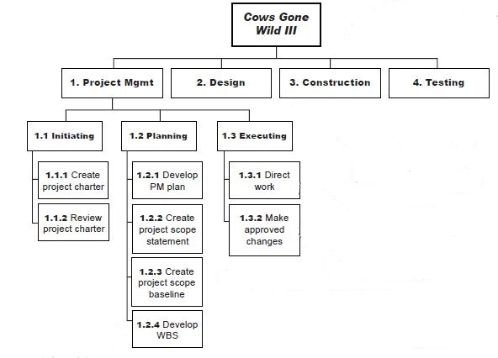
Create Work Breakdown Structure:
WBS doesn’t show the order of the work packages or any dependencies between them.
It shows the work involved in creating the product.
It may reflect the whole project (deliverables) or a phase of it.
Breaking down the work makes it easier to manage. By this way, there is NO chance to forget a work package.

Slide 6
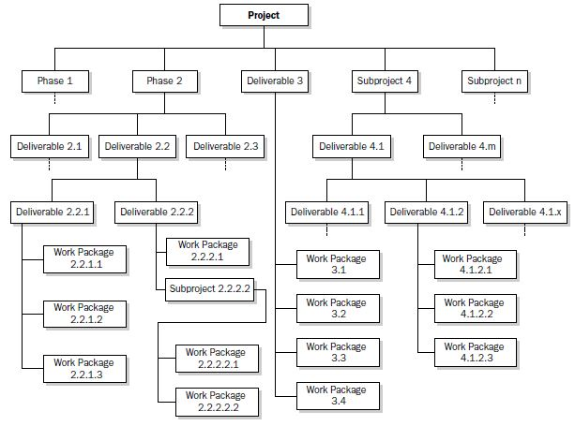
Create Work Breakdown Structure:
Decomposition : Taking deliverables and coming up with work packages that will create them.
WBS with some branches decomposed down through work packages...

Slide 7

Create WBS - Outputs
WBS
WBS Dictionary : A seperate output that mentions details of every work package. In another words, it provides more detailed descriptions of the components in the WBS.
Scope Baseline → Project Scope statement, WBS and WBS Dictionary.
When work gets added to the scope through change control, there is a need to change the baseline to include new work packages for that issue.
Project Document Updates : The changes that are mentioned above should be reflected to project documents.

Slide 8
Verify Scope:
Process of formalizing acceptance of the completed project deliverables.
Review of deliverables with stakeholders (especially with customer or sponsor) to ensure that they are completed satisfactorily and obtaining formal acceptance (written confirmation – deliverables match the requirements and the PMP) of deliverables by the customer or sponsor.
How ? : Tools & Techniques :
Inspection : measuring, examining and verifying to determine whether work and deliverables meet requirements and product acceptance criteria.
Quality control vs Scope verification :
Quality Control : Correctness! of the deliverables + meeting the quality requirements? Before scope verification!
Scope Verification : Acceptance! of deliverables!

Slide 9
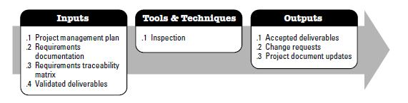
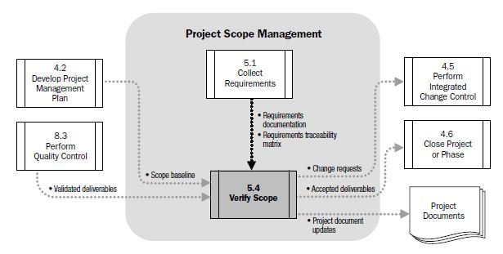
Verify Scope:

Slide 10
Control Scope:
Process of monitoring the status of the project and product scope and managing changes to the scope baseline.
Goal is : Updating the scope, plan, baseline and WBS info.
There is a need to make some changes → Changes will affect the scope baseline.
This activity ensures all requested changes and recommended corrective or preventive actions are processed through the Perform Integrated Change Control Process.
How ? : Tools & Techniques :
Variance Analysis : Take a look at the baseline and determine the effect of change on it. Apply a corrective action. Compare the baseline against the change. Next, replan the work and create a new baseline.
Anatomy of a change :
A change is needed
Create a change request
Get an approval
Make a variance analysis
Replan the work
Create a new baseline.

Slide 11
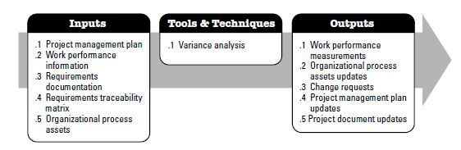
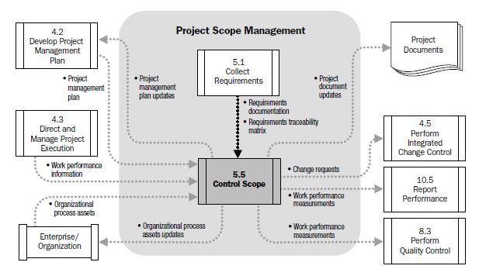
Control Scope:
Requirements documentation
Requirements traceability matrix
How well the processes from each knowledge area are being performed?

