Slide 1
Part 6: Project Time Management
6.1 – Define Activities
6.2 – Sequence Activities
6.3 – Estimate Activity Resources
6.4 – Estimate Activity Durations
6.5 – Develop Schedule
6.6 – Control Schedule

Slide 2

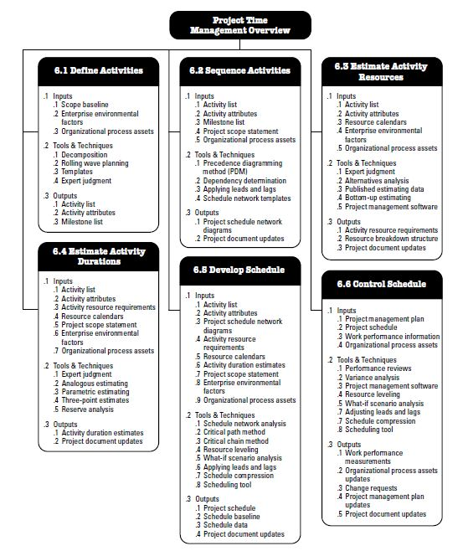
Project Time Management Overview
Decomposition : Taking deliverables and coming up with work packages that will create them.

Slide 3
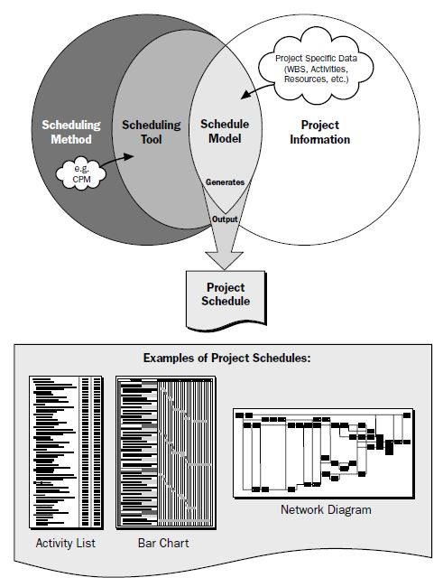
Scheduling Overview:

Slide 4
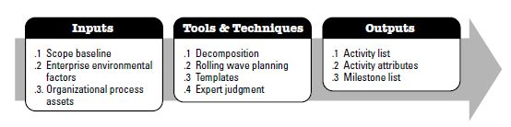
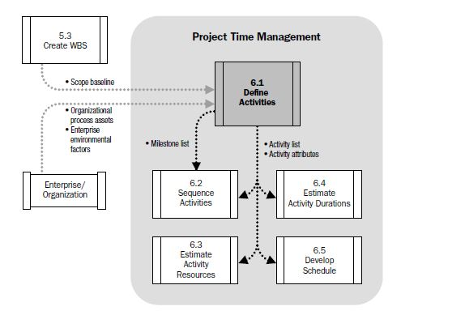
Define Activities:
Project Scope Statement
Describes the project’s deliverables, acceptance criteria, constraints etc. and the work required to create them in detail...
Project Scope Statement, WBS and WBS Dictionary...

Slide 5

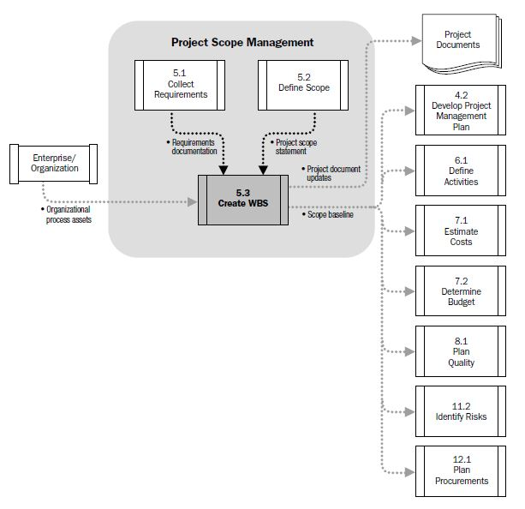
Create Work Breakdown Structure:
Chapter 5

Slide 6
Define Activities:
Inputs :
OPA : Scheduling Methodology (formal/informal activity planning-related policies, procedures and guidelines) + Lessons learned!
EEF : PMIS → Information about the activities are stored.
Scope Baseline : WBS + WBS Dict. + Project Scope Statement.
Tools & Techniques :
Decomposition : Taking the Work Packages (defined in Scope Management process) and breaking them down even further into activities that can be estimated...
Expert Judgment & Templates
Rolling Wave Planning : Plan and schedule only the stuff that you know enough. The work in the near term is planned in detail and future work is planned later at an other level of WBS.
Outputs:
Activity List: List of «everything to be done» to complete the project.
Activity Attributes: Description of each activity. Used to «create the order» of the work. *Predecessor/Successor activities or constraints should be listed in the attributes along with descriptions and any other info about resources or time that is necessary for planning * A predecessor ("pre-") comes before and a successor comes after...
Milestone List: All important checkpoints are tracked as milestones. May come from the contract as requirements or just significant points that are going to be tracked.

Slide 7
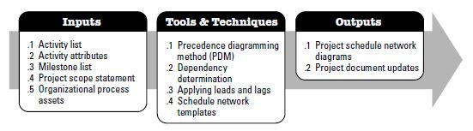
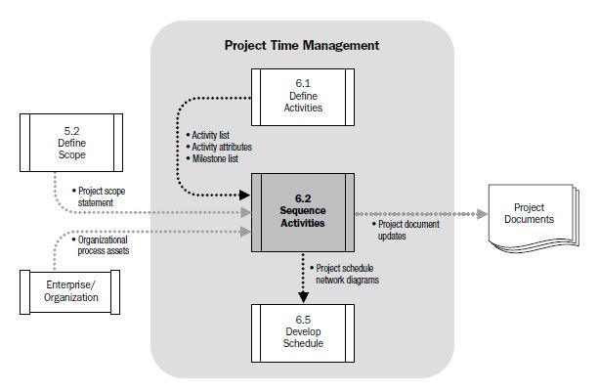
Sequence Activities:
Project Scope Statement
Describes the project’s deliverables, acceptance criteria, constraints etc. and the work required to create them in detail...

Slide 8
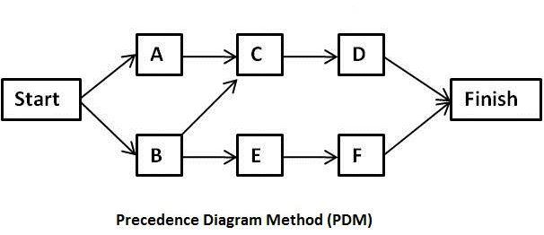
Sequence Activities:
Put everything in order…
Focusing on the order of the work!
Take the defined activities and decide on how they will happen.
Activity attributes and the activity list had most of the predecessors and successors. Milestone List has major pieces of work. → A project management software (Ex: MSProject).
Inputs :
Activity List
Activity Attributes
Milestone List
Project Scope Statement : Having the full scope of the project makes PM to be sure that he/she got all the activities needed to do work.
OPA
Tools & Techniques:
Create a Network Diagram!
Showing the activities in rectangles and their relationships as arrows is called a : Precedence Diagramming Method (PDM)
Network Diagrams put the tasks in perspective.
Dependencies help sequencing the activities.

Slide 9
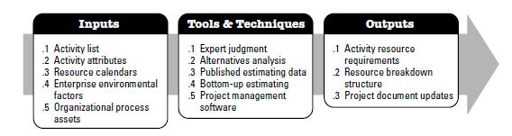
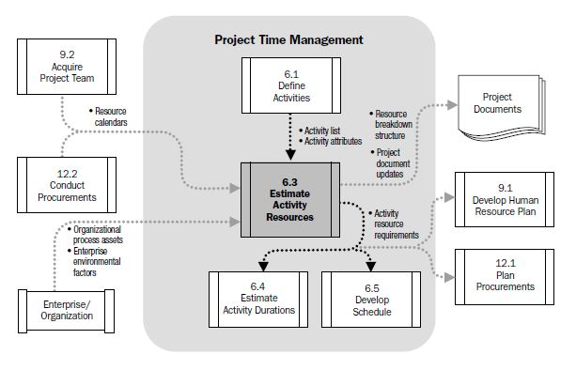
Estimate Activity Resources:
Resource calendar : Info about what resources needed for various activities and when they are available for the project. It includes availability, capability and skills of human resources...

Slide 10
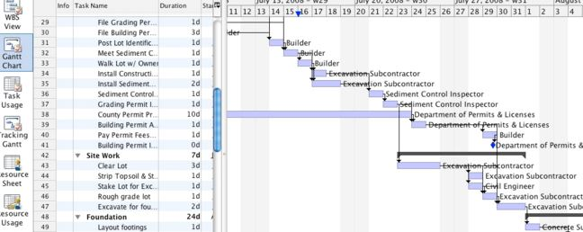
Estimate Activity Resources:
Process of estimating the type and quantities of material, people, equipment or supplies required to perform each activity.
Inputs :
Activity List, Activity Attributes
Resource Calendars
EEF &OPA
Tools & Techniques :
Expert Judgment
Published Estimating Data : Outputs from other companies and/or projects. Several companies routinely publish updated production rates, unit costs of resources etc.
Alternative Analysis : Considering several different options for assigning resources. Varying the number of resources as well as the kind of resources.
Bottom-up estimating : Breaking up complex activities into pieces and working out the resource assignments for each of those.
Project Management Software : MS Project helps PMs play around with resources and constraints to find the best combination of assignments for the project.

Slide 11
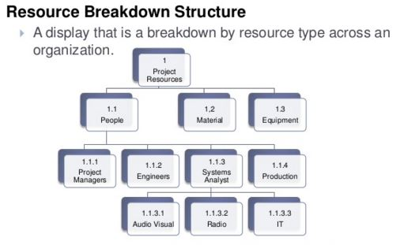
Estimate Activity Resources:
Outputs…
Activity Resource requirements: The documentation for each activity...
Basis of estimate for each resource
Assumptions for determining which type of resources are applied
Availability and the quantities of them
Resource Breakdown Structure : Ordered structure of the identified resources by resource category and resource type...
Includes labor, material, equipment and supplies...
Useful for organizing and reporting project schedule data with resource utilization information...
Project Document Updates

Slide 12
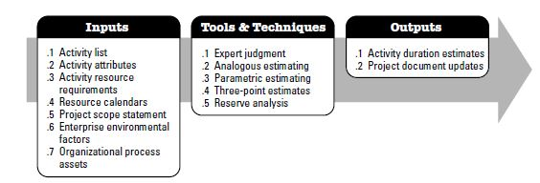
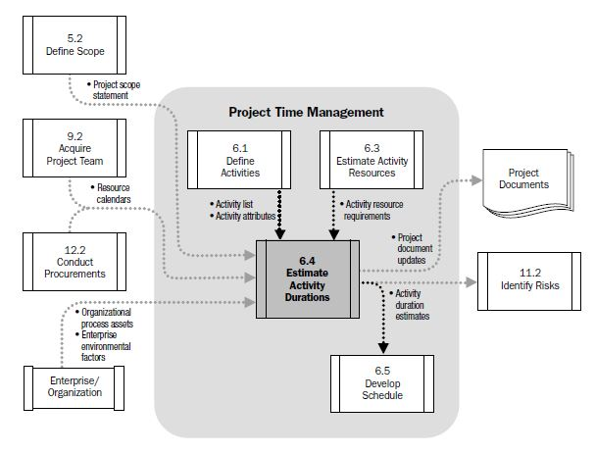
Estimate Activity Durations:
Process of approximating the number of work periods needed to complete individual activities with estimated resources.
Where the PM looks at each activity in the activity list, consider the scope and the resources and estimate how long it will take to perform.
NEXT

