Slide 1



Chapter 6 (continue)
Developing (6.5) & Controlling (6.6) Schedule

Slide 2

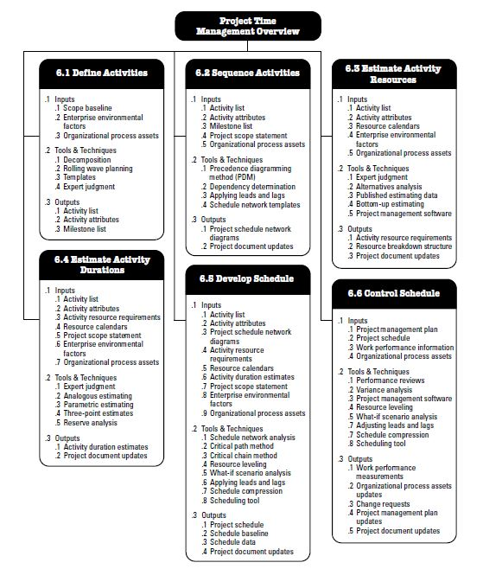
Project Time Management Overview
Decomposition : Taking deliverables and coming up with work packages that will create them.

Slide 3
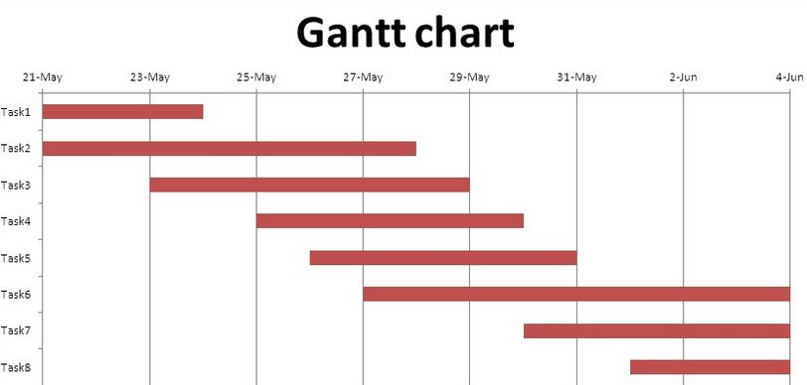
Representing & Scheduling Project Plans
Project Manager
Periodically review status of all ongoing project task activities (plans, reports etc.) in a graphical way.
Gantt Charts
Task → Begin & End
Durations
Overlapped tasks
Pert Charts
Ordered Tasks
Dependencies
Critical Path

Slide 4
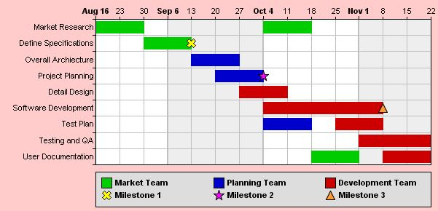
Gantt Charts
As mentioned before, planning and controlling are key aspects of project management.
A standard tool that allows managers to plan and control a project is a Gantt chart.
MS Project is a well known project management software tool but, MS Excel can also be used in order to create a Gantt chart. - Other Project Magement Softwares -
We can define a Gantt chart as ‘Graphical representation of a project that shows each task as a horizontal bar whose length is proportional to its time for completion’.
Gantt charts are frequently used in presentations and to communicate with stakeholders. The disadvantage of Gantt charts is that they may not contain all of the information needed by the project manager to make decisions during the project.
For each task, a time to completion needs to be estimated and the order of tasks needs to be determined.

Slide 5
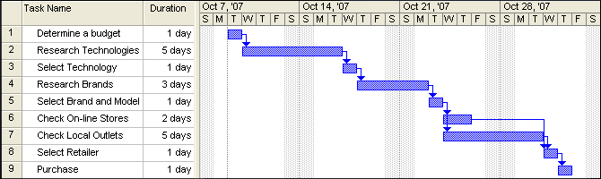
Example (Purchasing process) .
Let’s consider purchasing a new tv set as a project... Below, 9 tasks are listed for this project... For each task an estimated duration is mentioned... Finally, for every task after the first one, a predecessor for that task is selected (For example, the predecessor for Task 2 is Task 1 or Task 2 is the successor of Task 1)
Slack time : amount of time that a task can be extended without affecting other tasks.

Slide 6
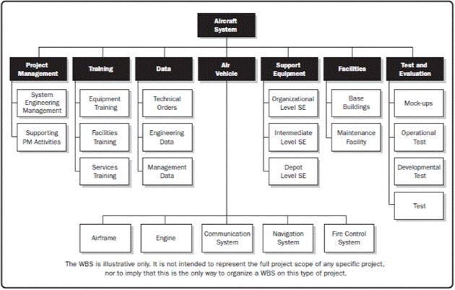
. 1) Work Break Down Structure (Determination of tasks → WBS)
Dividing the project into manageable tasks and logically placing them to ensure a smooth evaluation between tasks.
A pre-scheduling phase...
Ex:
Interviewing
Design interview form
Schedule appointments
Conduct interviews
Define Requirements
Review current reports
Collect reports
Review reports
Summarize reports

Slide 7
Interviewing
Design interview form
Schedule appointments
Conduct interviews
Define Requirements
Review current reports
Collect reports
Review reports
Summarize reports
2) Network (Logic) Diagram
(WBS → Network Diagram)
WBS
A flow chart showing the sequence of a project's tasks and their dependencies...
A great way for starting to understand and visualize how your project/plan will proceed.
A simple concept successfully used in applications to «map, order and understand work flows.»
1.0 Define Req.
2.0 Interviewing
3.0 Rev. Cur. Rep.
2.1 D.I.F
2.2 S.A.
2.3 C.I
3.1 C.R
3.2 R.R
3.3 S.R

Slide 8
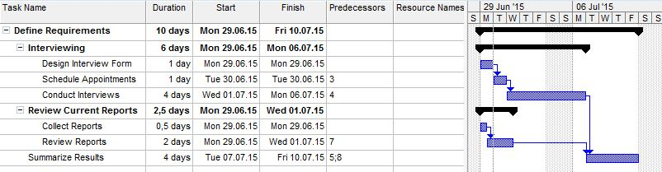
3) Network Diagram → Gantt Chart 1 (by MS Project)

Slide 9
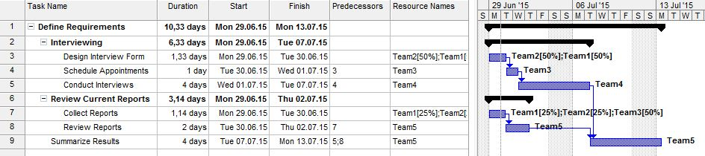
3) Network Diagram → Gantt Chart 2 (by MS Project)

Slide 10
3) Final Network Diagram
1.0 Define Req.
1.1 Interviewing
1.2 Rev. Cur. Rep.
1.1.1 D.I.F
1.1.2 S.A.
1.1.3 C.I
1.2.1 C.R
1.2.2 R.R
After deciding on the dependencies there may be some changes!
1.3 S.R

Slide 11
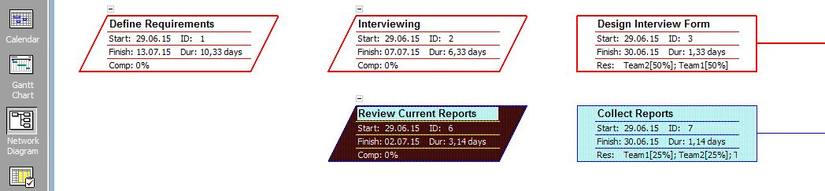
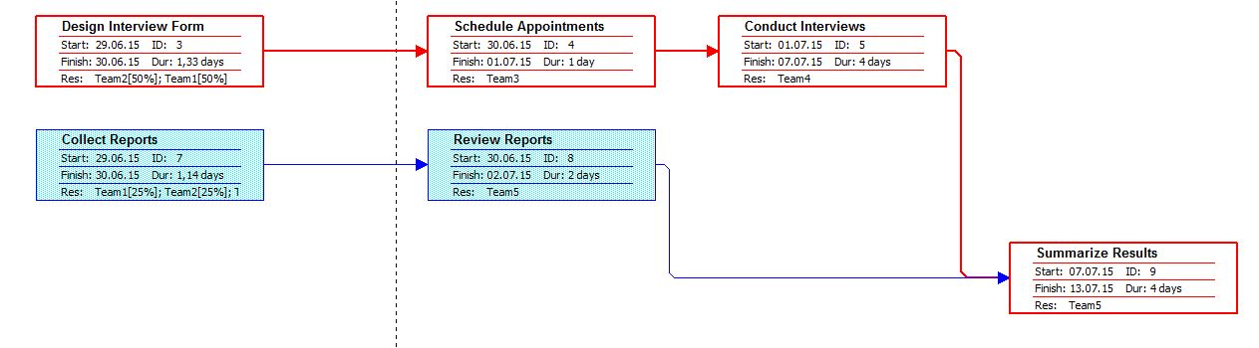
3) Final Network Diagram (MS Project)

Slide 12

Pine Valley Furniture Sales Promotion Tracking System (Moodle/Week 9/Reading Material)
Project Definition
Design, Develop and Implement a Tracking System.
Project Duration
Project is going to start by the end of July, 2019. (Development and Implementation phases) and ends at ???
Project Tasks
Requirements Collection,
Screen Design,
Report Design,
Database Construction,
User Documentation,
Software Programming,
System Testing and Installation.
- Assets are tracked repetitively reading e.g. a barcode, any passive and active RFID and feeding read data into Work in Progress models (WIP) or Warehouse Management Systems (WMS) or ERP software.

Slide 13
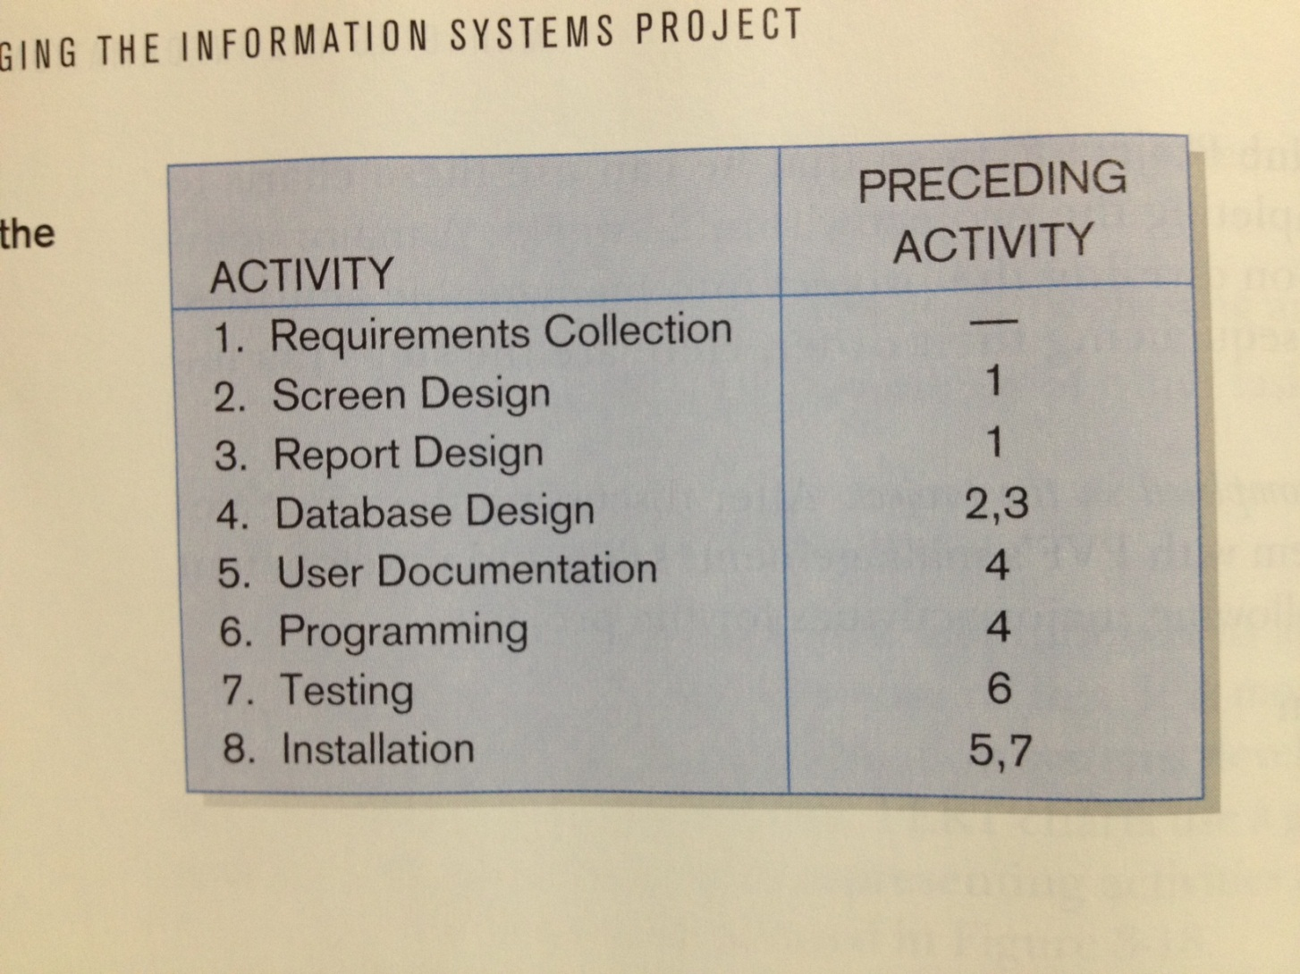
Sequence of Activities (determination process of the preceding activities)

Slide 14
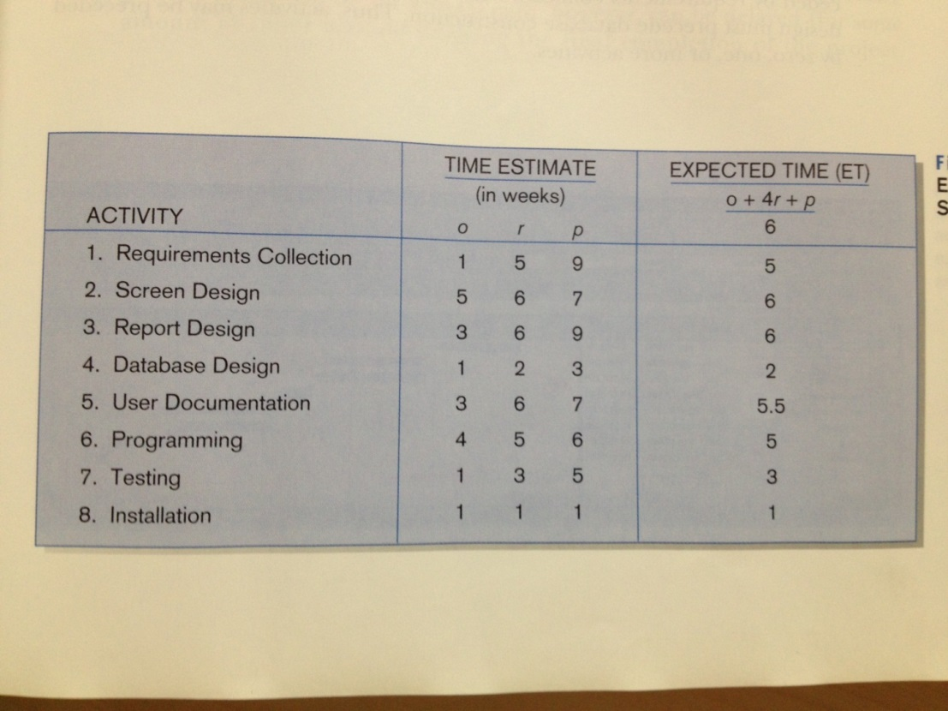

Expected Time Analysis
Tools & Techniques : 3 point estimates method (optimistic + 4 x realistic + pessimistic) / 6
Estimating activity durations for a project...

Slide 15
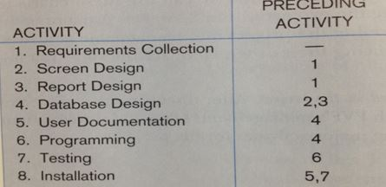
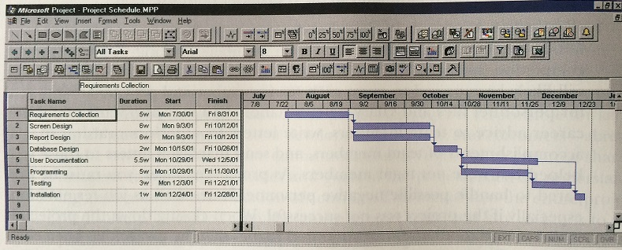
SPTS Gantt Chart by MS Project
Parallel Tasks : Their start, end, and preceding activities are same.
Slack time : amount of time that a task can be extended without affecting other tasks.

Slide 16
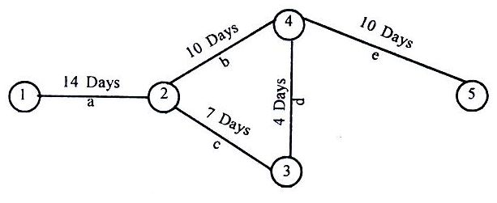
PERT / CPM Program Evaluation & Review Technique / Critical Path Method

Slide 17
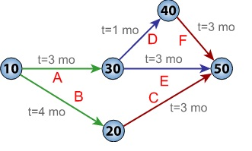
PERT
PERT (Program Evaluation and Review Technique)
critical path scheduling for controlling resources.
Critical Path
An important tool for effective project management in order to schedule a set of project activities.
Sequence of task activities order and durations directly affect the completion of a project.
Best-known scheduling method.
PERT network chart for a seven-month project with five milestones (10 through 50) and six activities (A through F).

Slide 18
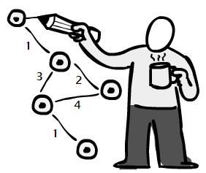
Critical Path Rules...
Sequence of connected activities that produce the longest overall period. (Begin to end that takes the longest time to complete)
It shows the shortest time that a project can be completed.
Any activity on a critical path that is delayed in completion delays the entire project!
Tasks that are not on the critical path may contain slack time and allow the project manager some flexibility in scheduling.

Slide 19
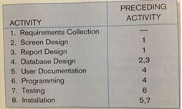
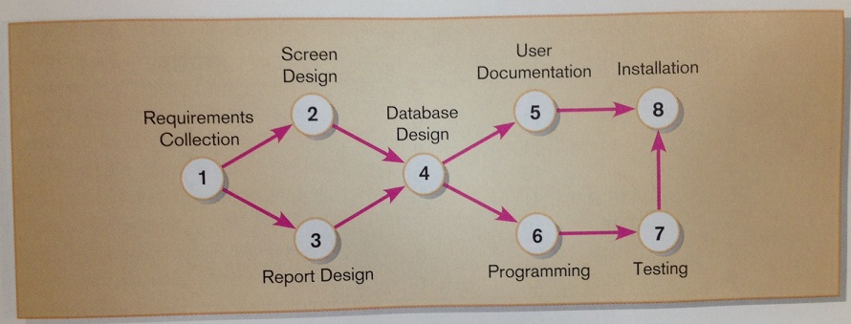
ACTIVITY NETWORK DIAGRAM FOR SPTS PROJECT

Slide 20
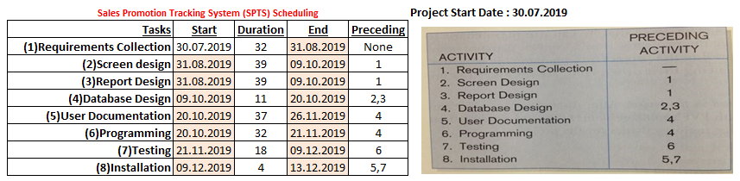
Pert Chart Data

Slide 21
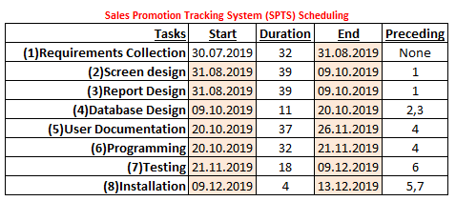
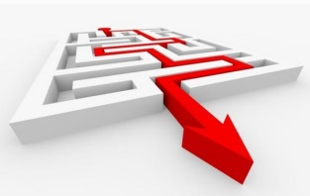
Finding critical path...
PATH ALTERNATIVES :
a) 1,2,4,6,7,8 = 32+39+11+32+18+4 = 136
b) 1,2,4,5,8 = 32+39+11+37+4 = 123
c) 1,3,4,5,8 = 32+39+11+37+4 = 123
d) 1,3,4,6,7,8 = 32+39+11+32+18+4 = 136
A and D are the critical paths…
5/37
8/4
2/39
1/32
4/11
3/39
6/32
7/18

Slide 22
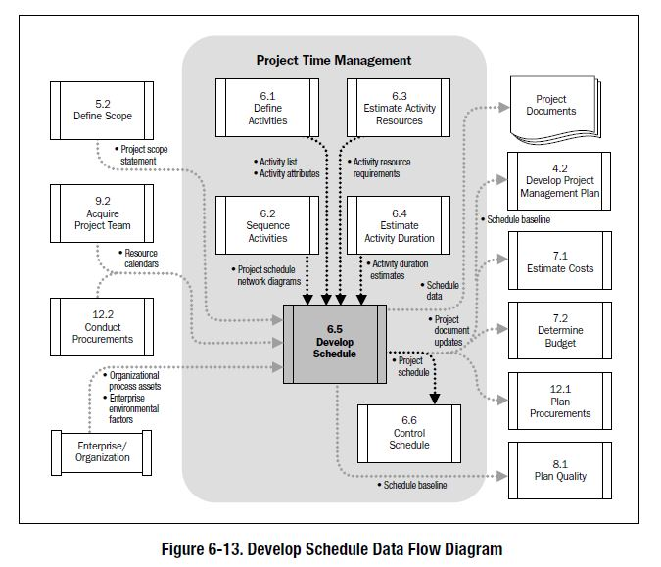
6.5 Develop Schedule

Slide 23
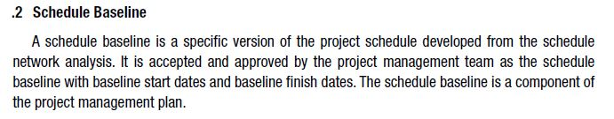
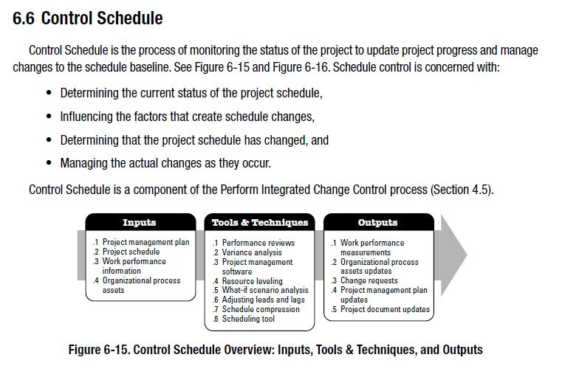
Schedule Baseline & Control Schedule

Slide 24
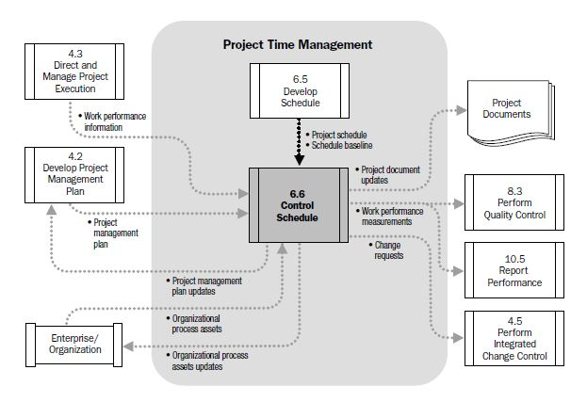
6.6 Control Schedule
WBS components, work packages and control accounts are documented in order to communicate with stakeholders.
Info about project progress, such as which activities have started, their progress, and which activities have finished
Accepted and approved by the PM team with baseline start and finish dates. Major component of PMP.

Slide 25
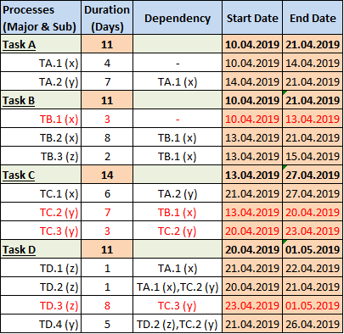
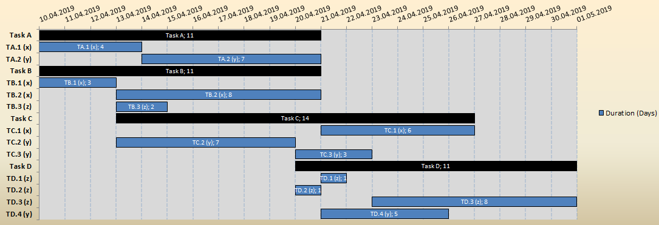
Time Management
Case Study 1
By making a PERT Analysis determine all the alternative paths and prove that the duration of the project is 21 days!
Mention the tasks that their duration MUST NOT be extended (if extends, the overall duration of the project is definitely effected!)

Slide 26
Case Study 1 - Solution
TD1/1
TD2/4
ALTERNATIVE PATHS :
TC1/6
TA1, TD1 = 5 days
TA1, TD2, TD4 = 10 days
TA1, TA2, TC1 = 17 days
TB1, TC2, TD2, TD4 = 16 days
TB1, TC2, TD4 = 15 days
TB1, TC2, TC3, TD3 = 21 days
TB1, TB2 = 7 days
TB1, TB3 = 5 days
TA1/4
TA2/7
TC2/7
TD4/5
TB1/3
TC3/3
TB2/4
TD3/8
TB3/2
Critical Path!

Slide 27
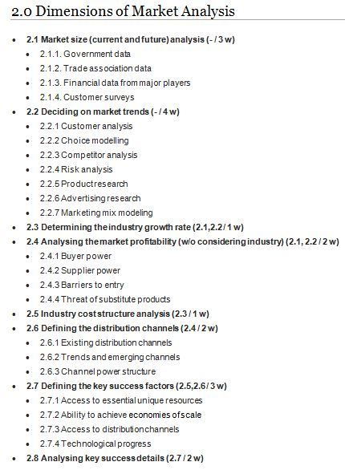
Time Management Case Study 2
You can find the WBS of a Market Analysis process of a specific project on the right side of this slide. The durations of the tasks and the preceding activities are also mentioned.
Mention alternative paths and the critical path by using PERT.
By using MS Project, generate a Gantt Chart and a Network Diagram. (After LAB!)
For the sub-tasks (2.1.1, 2.4.3 etc.) Think the allocation of durations and the sequence of them.
Milestone Durations & Preceding Activities
(-/3 w) means : no preceding activity / duration is 3 weeks...

