Slide 1
Part 7 : Project Cost Management
7.1 – Estimate Costs
7.2 – Determine Budget
7.3 – Control Costs

Slide 2

Estimating costs...
Process of “developing an approximation of the monetary resources needed to complete project activities”
A prediction that is based on the info. known at a given point of time.
Identification and consideration of costing alternatives to initiate and complete the project.
Cost trade-offs and risks must be considered; make vs buy, buy vs lease, sharing of resources in order to achieve optimal cost for the project.
Should be refined during the project life cycle. Iterative process. Project Initiation : ROM (Rough order of magnitude) = +-50% (between 10.000 & 20.000 $), as more info known, estimates could narrow to a range +-10% (between 10.000 $ & 12.000 $) .
Costs sould be estimated for all resources. Labor, materials, equipment, services, facilities etc.

Slide 3
Estimating costs...
Process of “developing an approximation of the monetary resources needed to complete project activities”
Inputs:
Scope Baseline : Scope Statement : All the deliverables, constraints, assumptions etc. of the project. WBS : All the work packages that are in the scope of the project. WBS Dict. : Detailed explanations of the components of WBS.
Project Schedule : Type and quantitiy of resources and the amount of time which those resources are applied to complete the work of the project are major factors in determining the project cost.
Human Resource Plan : Info. about the costs for specific resources (project staffing attributes, personnel rates, related rewards/recognition) making it possible for the PM to make overall cost estimates.
Risk Register : Risks (threats or opportunities) that might effect the project & project budget will help PM to know how much it will cost.
OPA & EEF

Slide 4
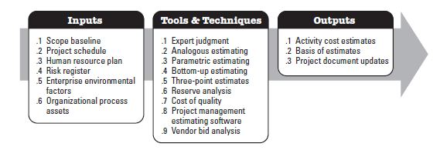
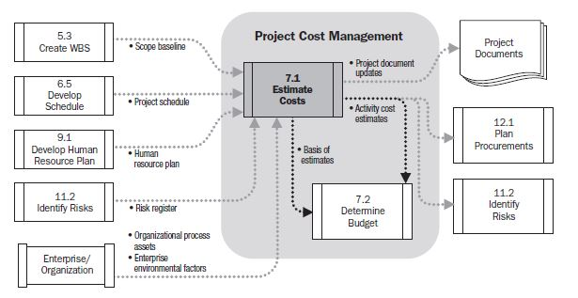
Estimating costs...

Slide 5
Estimating costs...
Basis of Estimate: a tool used in the field of project management by which members of the project team, usually estimators, project managers, or cost analysts, calculate the total cost of the project. Through carefully planned (by tools & techniques) equations, ordered list of elements, standard calculations, checklists of project elements and other methods, the project team adds in all expenses of a project, from labor to materials to administrative costs. These calculations formulate a Basis of Estimate which is, when completed, a number (risk factor in percentage, impact, weight, coefficient etc.) that can be used to determine the ability of the firm or company to carry out the project, or used as a tool in competing for a contract bid or otherwise proposing the project to another.

Slide 6
Estimating costs...
Process of “developing an approximation of the monetary resources needed to complete project activities”
Tools & Techniques:
Analogous Estimating: Considering the actual cost of previous, similar projects as the basis for estimating the cost of the current project.
Parametric Estimating: statistical relationship between historical data and current project’s numerical data to calculate an estimate for activity parameters such as cost, budget and duration.
Bottom-up Estimating: Starting at the lowest level and rolling up estimates to upper levels.
Three-Point Estimates: O+4*R+P/6
Expert Judgment.
Continue...

Slide 7
Estimating costs...
Process of “developing an approximation of the monetary resources needed to complete project activities”
Tools & Techniques:
Reserve Analysis : Putting, reserving some cash away just in case. Setting aside some money for cost overruns.
Cost of Quality : Cost of all quality related activities. How much money it takes to do the project right!
Project Management Estimating Software : Using spreadsheets (break-even calculation, optimization, sensitivity analysis etc.) or special software tools in order to make resource and labor/materials cost estimation by performing necessary calculations.
Vendor bid (proposal) analysis : Working with external contractors to get the project done. Evaluating the bids and choosing the one that fits to project requirements/criteria.

Slide 8
Estimating costs...
Process of “developing an approximation of the monetary resources needed to complete project activities”
Outputs:
Activity Cost Estimates : Cost estimate for all the activities in the activity list. It takes into account resource rates and estimated duration of the activities.
Basis of estimates : Supporting detail for activity cost estimates. (similar to WBS Dict.) Documentation of : Basis of the estimate, all assumptions, known constraints. Indication of the range of possible estimates (Ex: $10.000 +- 10%) and inclusion or exclusion of indirect costs in the project budget.
Updates to project documents

Slide 9
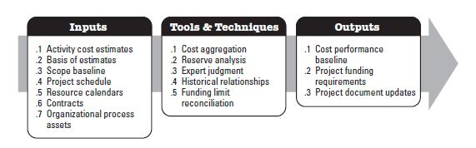
Determine Budget...
Process of “aggregating (collecting+combining) the estimated costs of individual activities or work packages to establish an authorized cost baseline...”

Slide 10
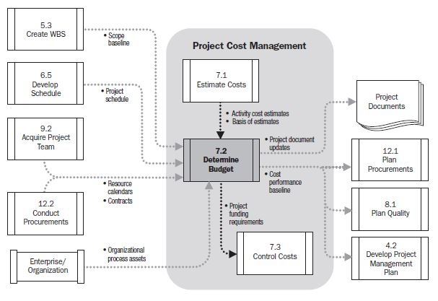
Determine Budget...
Process of “aggregating (collecting+combining) the estimated costs of individual activities or work packages to establish an authorized cost baseline”

Slide 11
Determine Budget...
Process of “aggregating (collecting+combining) the estimated costs of individual activities or work packages to establish an authorized cost baseline”
Tools & Techniques:
Cost Aggregiation : Rolling up estimates into control accounts (higher component levels of WBS). Cost estimates are aggregated by work packages in accordance with the WBS. Determination of the cost of each work package.
Reserve Analysis : Setting aside some cash reserve to deal with unplanned issues after evaluating the risks.
Expert Judgment & Historical Data : Compare the project’s historical data with previous projects’ historical data by applying expertise of yourself or others.
Funding limit reconciliation : Complete the project within the amount that the company is willing to spend. If not; replan by negotiating with the sponsor. A scope change or increase in funding limit may be the outputs.

Slide 12
Determine Budget...
Process of “aggregating (collecting+combining) the estimated costs of individual activities or work packages to establish an authorized cost baseline”
Outputs:
Cost Performance Baseline: Similar to scope and schedule baselines. A snapshot of the planned budget.
BAC : Budget at completion used to measure, monitor and control overall cost performance.
Project Funding Requirements: Planning out how and when to use budget and documentation of it. Is there money when needed? Is it enough to cover unexpected risks (cost increase) ?
Project Document Updates:
Risk Register
Cost Estimates
Project Schedule

Slide 13
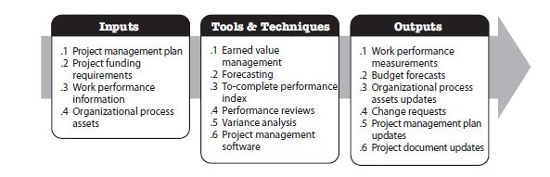
Control Costs...
Process of “monitoring the status of the project to update the project budget and managing changes to the cost baseline.”
When something unexpected comes up, understanding it’s impact on project budget and making sure to react in the best way for the project.
Knowing how the project is going with the plan and making adjustments when necessary.

Slide 14
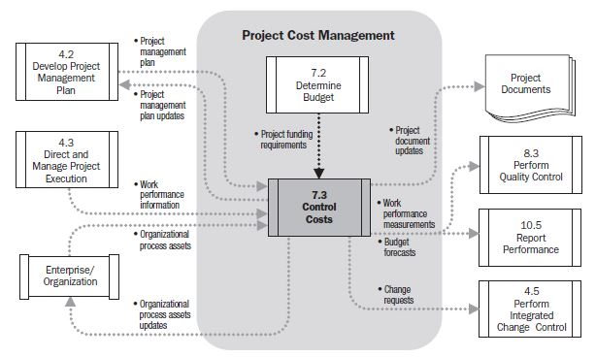
Control Costs...
Process of “monitoring the status of the project to update the project budget and managing changes to the cost baseline.”
Info about project progress, such as which deliverables have started, their progress and which deliverables have finished. + Authorized & incurred costs, estimates for completing project work

Slide 15
Control Costs...
Process of “monitoring the status of the project to update the project budget and managing changes to the cost baseline.”
Tools & Techniques:
EVM (Earned Value Management) : How the project is doing when compared to plan by using earned value formulas. Calculation and tracking process of the variance.
TCPI (To-complete performance index) : A calculation to figure out how well the project needs to perform in future in order to stay on budget.
Performance Reviews : Project team reviews performance data to examine the variance between actual performance and baseline.
Forecasting : Using the information you have about the project right now to predict how close it will come to its goals if it keeps going the way it has been.
Reserve Analysis : How you are spending versus the amount of reserve you have budgeted. You might use reserved money at a faster rate than you expected or that you need to reserve more as new risks are uncovered.

