Slide 1
Part 7 - II: Project Cost Management
7.3 Control Costs by EVM Calculations

Slide 2


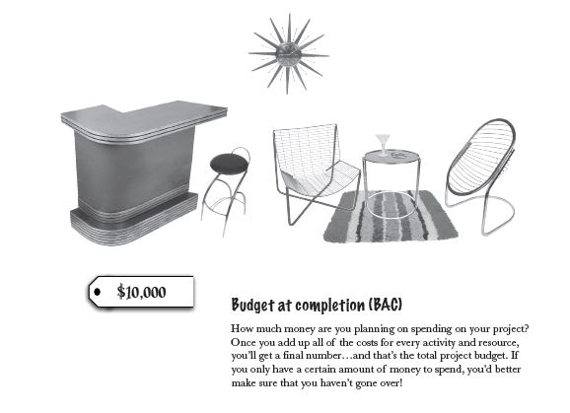
Control Costs (Earned Value Management)
Process of “monitoring the status of the project to update the project budget and managing changes to the cost baseline.”
How to stay in budget...

Slide 3
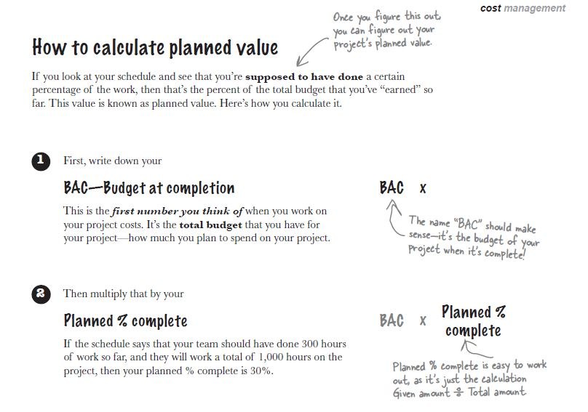
Control Costs – PV (Planned Value)
Process of “monitoring the status of the project to update the project budget and managing changes to the cost baseline.”
Hours worked (till now)
Total duration (of project)

Slide 4
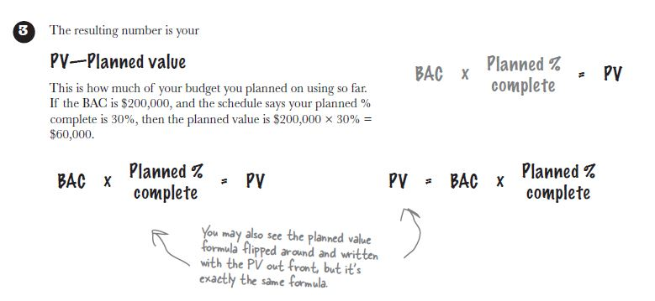
Control Costs – PV (Planned Value)
Process of “monitoring the status of the project to update the project budget and managing changes to the cost baseline.”

Slide 5
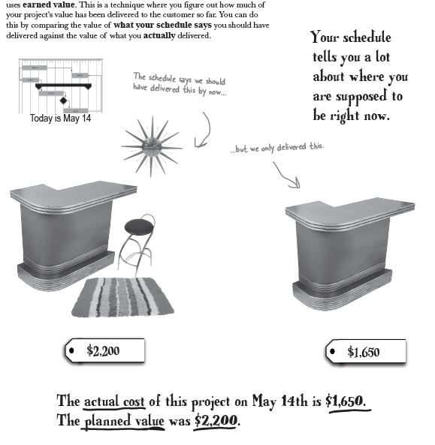
Control Costs – EV (Earned Value)
Process of “monitoring the status of the project to update the project budget and managing changes to the cost baseline.”

Slide 6
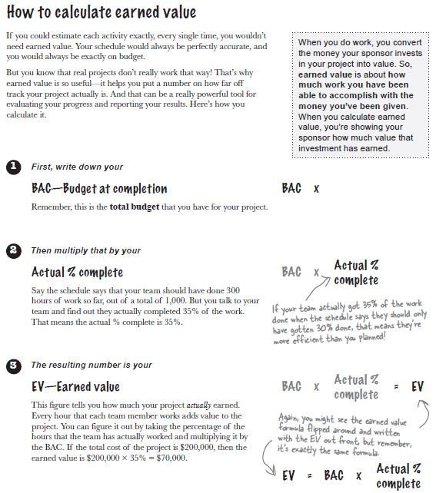
Control Costs – EV (Earned Value)
Process of “monitoring the status of the project to update the project budget and managing changes to the cost baseline.”
Earned Value vs Actual Cost?
EV, measures the work that has been done (in $) by looking at the schedule...
AC, tells how much you have spent so far... (You may need extra equipments, extra workers, you may be effected by currency changes etc.)

Slide 7
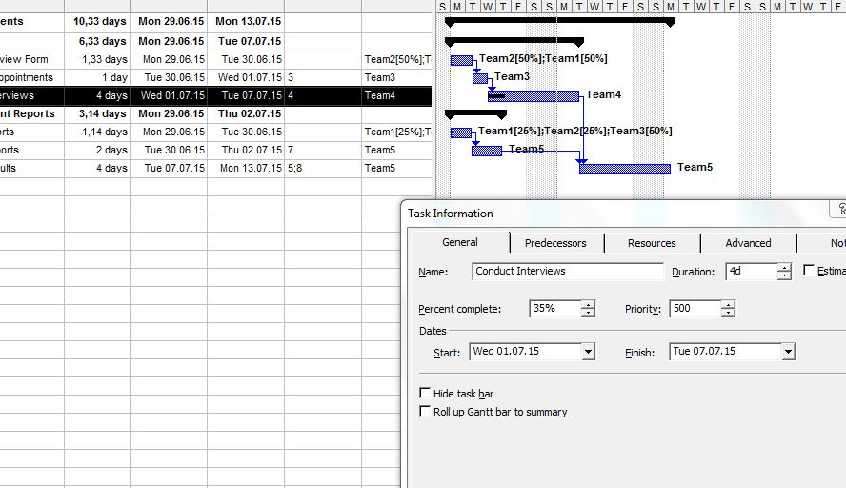
Control Costs – MS Prj. → PV & EV
Process of “monitoring the status of the project to update the project budget and managing changes to the cost baseline.”
How to show completed percentage at MS Project...

Slide 8
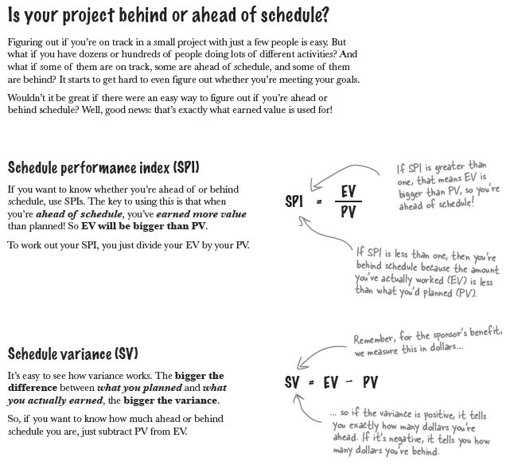
Control Costs – SPI & SV
Process of “monitoring the status of the project to update the project budget and managing changes to the cost baseline.”

Slide 9
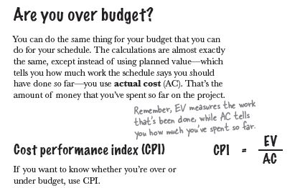
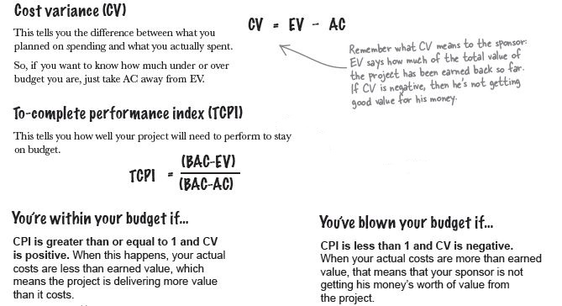
Control Costs – CPI, CV, TCPI
Process of “monitoring the status of the project to update the project budget and managing changes to the cost baseline.”
What schedule says vs what happened in real...

Slide 10
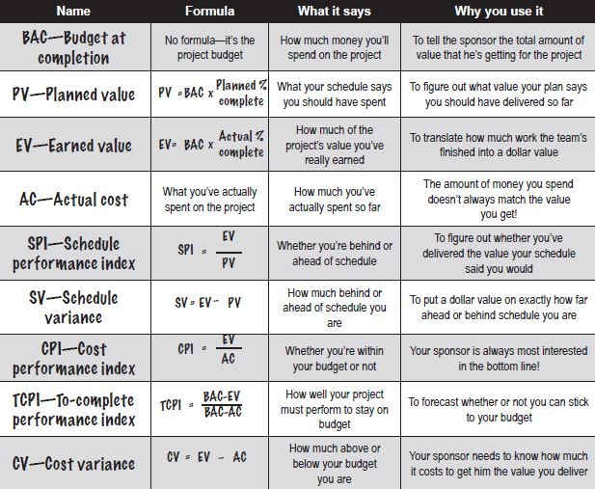
Control Costs – Summary
Process of “monitoring the status of the project to update the project budget and managing changes to the cost baseline.”

Slide 11
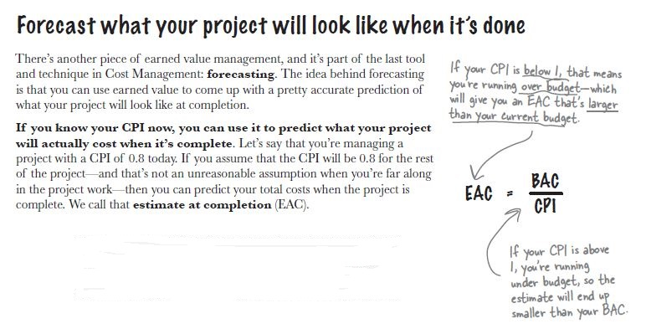
Control Costs – EAC (Estimate at completion)
Process of “monitoring the status of the project to update the project budget and managing changes to the cost baseline.”
20.000 0.8
= 25.000
20.000 1.1
= 18.181
EAC (schedule) =
Planned End Date SPI

Slide 12
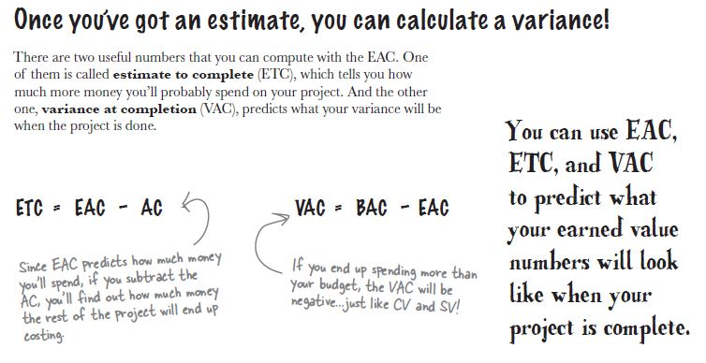
Control Costs – ETC & VAC
Process of “monitoring the status of the project to update the project budget and managing changes to the cost baseline.”
Remaining amount ($) that has to be spend to complete the project...

Slide 13
Control costs...
Process of “monitoring the status of the project to update the project budget and managing changes to the cost baseline.”
Outputs:
Work Performance Measurements: Calculated CV, SV, CPI and SPI values for WBS components, in particular the work packages and control accounts, are documented and communicated to stakeholders.
Budget Forecasts: Either a calculated EAC value or a bottom-up EAC value is documented and communicated to stakeholders.
OPA Updates
Change Requests
Project Management Plan Updates
Cost Performance Baseline
Cost Management Plan
Project Document Updates
Cost Estimates
Basis of Estimates

Slide 14
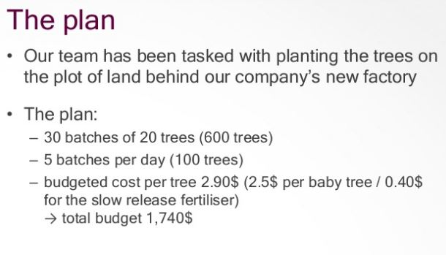

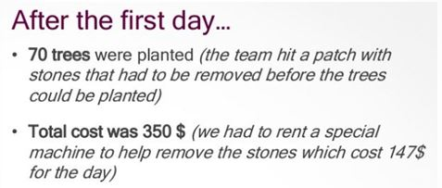
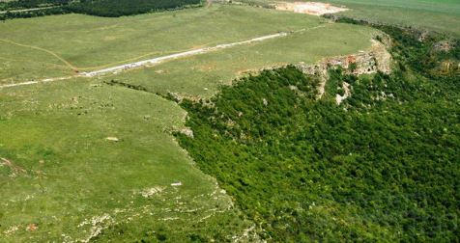
- Part 7: Control Costs / EVM Case Study -
By focusing on the outputs of first day and by applying EVM formulas (if necessary), decide on:
the duration of the project,
if we are above or below the project’s budget & schedule,
howmuch we are above or below the budget & schedule,
the estimated budget, cost overrun + schedule over run amounts (if exists) at completion, * Assume we are not modifying the performance of the project!
what to do, if we want to stay in budget (TCPI for cost & schedule).

Slide 15
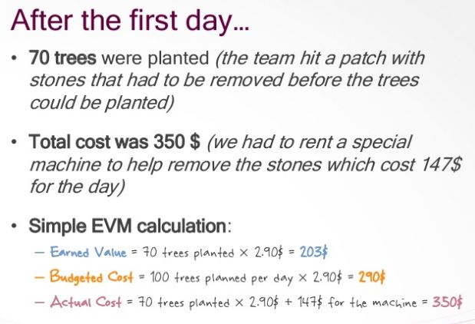
Solution
Planned Value

Slide 16
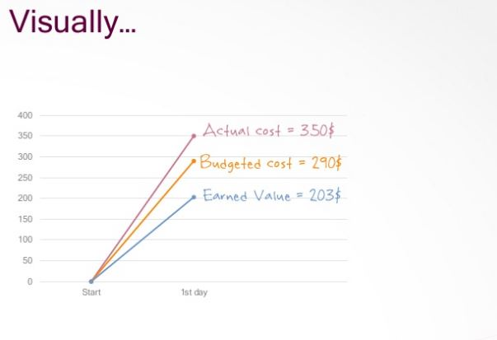
Solution

Slide 17
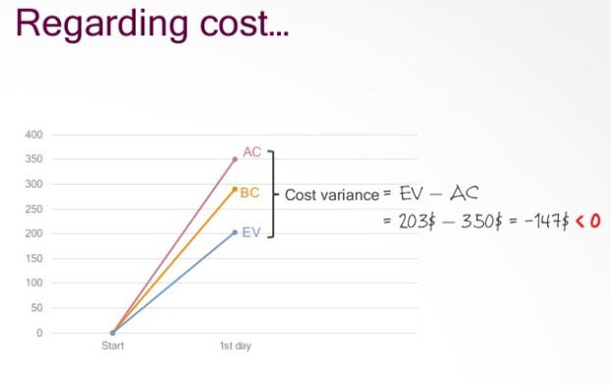
Solution

Slide 18
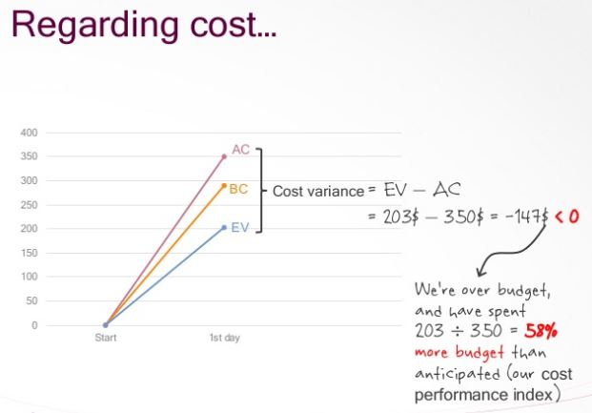
Solution
0,58

Slide 19
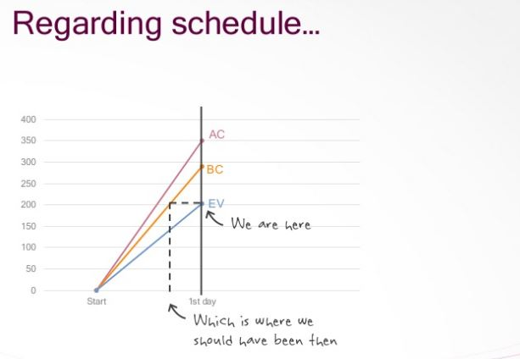
Solution

Slide 20
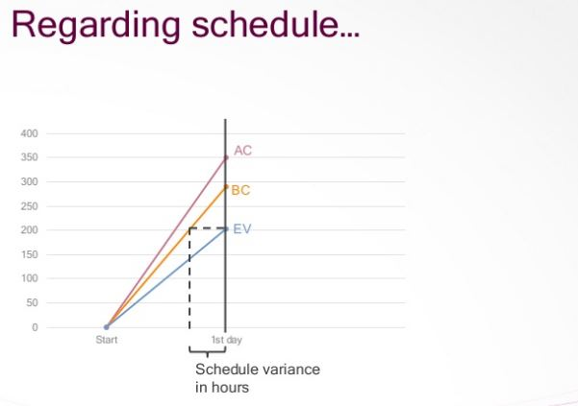
Solution

Slide 21
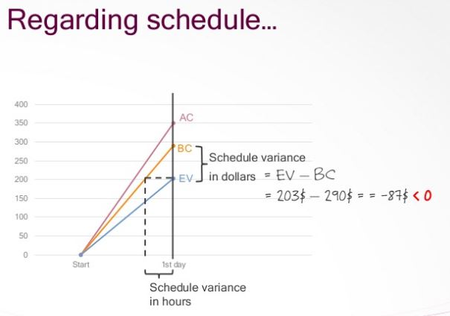
Solution
Planned Value

Slide 22
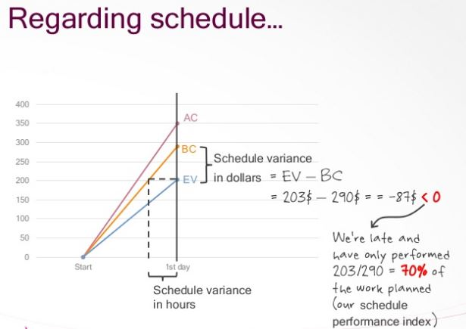
Solution

Slide 23
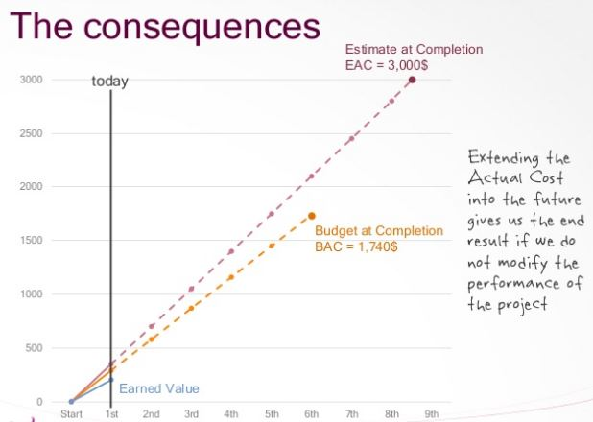
Solution
EAC = BAC / CPI
1740 / 0,58 = 3000

Slide 24
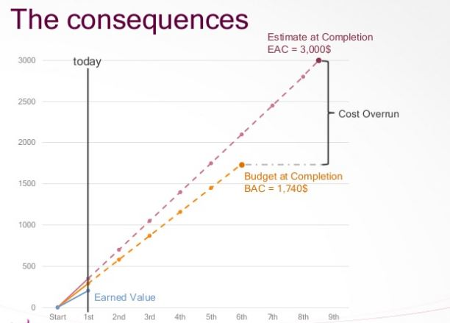
Solution
?
?

Slide 25
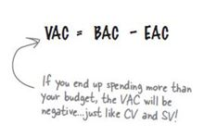
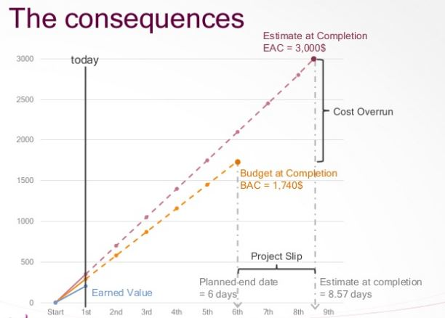
Solution
-1260$
6 Planned End Date 0,7 SPI
= 8.57 days

Slide 26
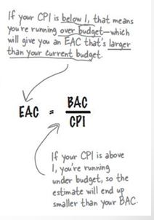
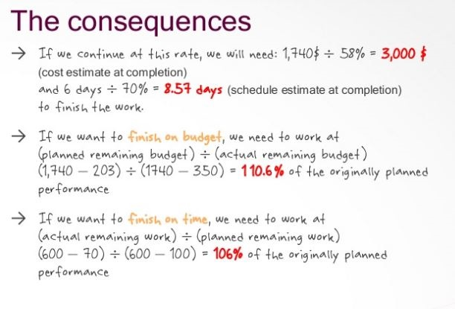
Summary :
8.57 * 350 (AC) =
TCPI for budget: 1.10
6 → 70
? → 100
TCPI for schedule: 1.06
A TCPI value greater than 1 indicates a need for increased performance for the remaining work of the project in order to stay within budget !

