Slide 1
Part 8 : Project Quality Management
8.1 – Plan Quality
8.2 – Perform Quality Control
8.3 – Perform Quality Assurance

Slide 2

QUALITY ISSUES How to Build?
8.1 – Plan Quality

Slide 3
Stakeholder Expectations must be satisfied : HIGH QUALITY BY BEST DESIGN! Ex: Ergonomy (shape, weight, ease of use etc.)
SATISFIED CUSTOMERS!
Identify Requirements (in order to understand & satisfy quality levels & issues)
Define & Set goals, Decide on Measurements etc.
TESTS! (in order to Judge Quality)
Generate a PLAN (QMP)
(Checklists, Metrics, Process Improvement issues etc.)
BE AWARE OF RISKS! Scope, Cost & Schedule may need to be customized!
SUSTAINABILITY (Guarantee, Promise, Improvements etc.)
8.1 – Plan Quality

Slide 4

Project Quality...
Project Quality : Setting goals and taking measurements
Understand the quality levels formed by stakeholders
Will the project meet those? How → More tests!
Is testing enough or it’s just a part of the process?
Testing : Checking to be sure that the product does what it is supposed to do → Judge it’s quality!
Requirements written for the project is very important to determine it’s quality. (They are coming from???)
High Quality = Fulfills the requirements completely!

Slide 5
Project Quality...
Customer Satisfaction : Make sure that the people who are paying for the end product are happy with what they get.
Fitness for use: Make sure that the product you build has the best design possible to fit the customer’s needs.
Ex: Ergonomic structure of a product
Conformance (get used to) to requirements: The product needs to do what is written in the requirements specification. Requirements must take into account both what will satisfy the customer and the best design possible for the job.

Slide 6
Planning Quality...
Process of “identifying quality requirements and/or standarts for the project and product, and documenting how the project will demonstrate compliance...”
Using all the info available for the project measure quality and prevent defects.
Quality Management Plan : guide the PM and team to follow the quality activities.
Relationship with other project planning processes. Ex: Proposed changes in the product to meet identified quality standarts may require cost or schedule adjustments and a detailed risk analysis of the impact to plans...

Slide 7
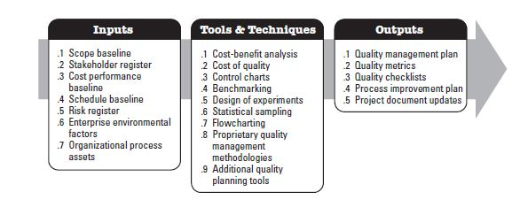
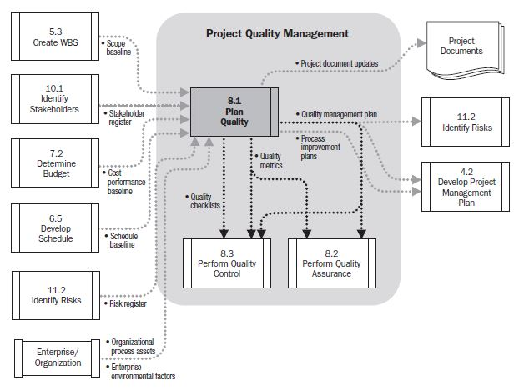
Planning Quality...

Slide 8
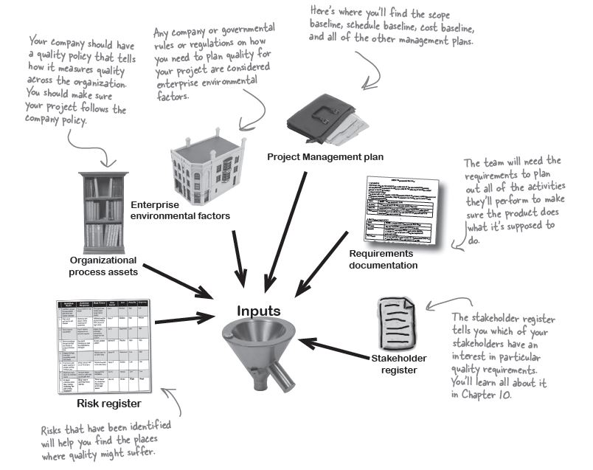
Planning Quality...

Slide 9
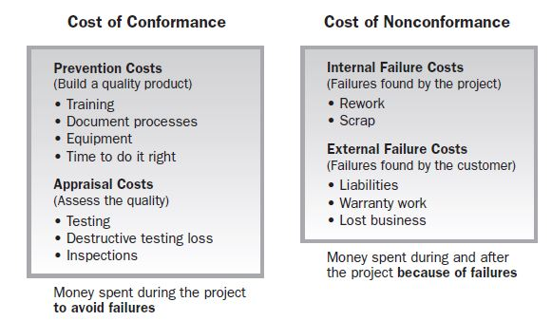
Planning Quality...
Tools & Techniques
Cost-Benefit Analysis : Looking at how much your quality activities will cost versus how much you will gain from doing them. Benefits : Less rework, higher productivity and efficiency and more satisfaction for the stakeholders (especially the team and the customer).
Cost of Quality : What you get when you add up the cost of all of the prevention and inspection activities for the project. Any time spent writing standarts, reviewing documents, meeting to analyze the root cause of defects, doing rework to fix the defects.
(That you think of...)
(That you don’t think of...)

Slide 10
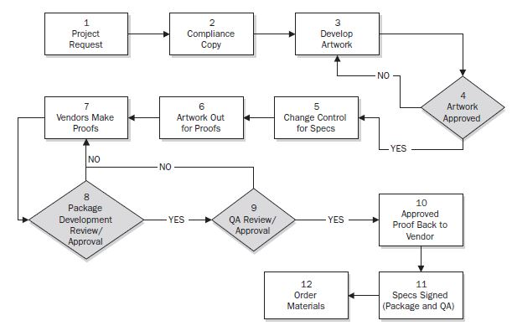
Planning Quality...
Tools & Techniques
Benchmarking : Using the results of Quality plan on other projects to set goals of the entire project. (Compare with the previous version...)
Design of Experiments : A statistical method - applying the scientific method to create a set of tests (i.e : crash tests, testing the quality of the material etc.) for the project deliverables. Analyze the results of experiments to determine how delivarables best meet the requirements.
Flowcharting : A graphical representation of a process showing the relationships among process steps. During quality planning, flowcharting can help the project team to anticipate quality problems that may occur.

Slide 11
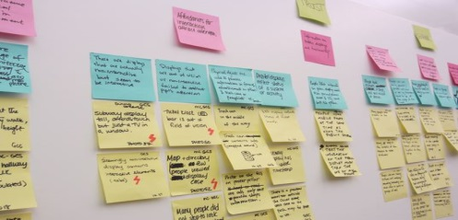
Planning Quality...
Tools & Techniques
Statistical Sampling : representative sample of something to make decisions.
Ex: Selecting 10 products from the production line randomly. Figure out which quality activities would help to prevent defects (if any) in them.
Additional Quality Planning Methods :
Brainstorming & Meetings : Team get together to discuss on QMP
Affinity Diagrams
Nominal Group Techniques : Brainstorming with small groups, and then working with larger groups to review and expand the results.
Matrix Diagrams : Tables, spreadsheets, pivot tables that helps to analyze complex relationships

Slide 12
Planning Quality...
Outputs
Quality Management Plan
How the PM & team will implement the performing organization’s quality policy.
A component or a subsidiary plan of the PMP.
Main tool for preventing defects of the project.
Style and detail is determined by requirements of the project.
Quality Metrics
Documentation of measurements that are used throughout the project to figure out its quality.
Tolerance values : allowable variations on the metrics
Formulas that are used for measurement process.
On-time performance, budget control, defect frequency, failure rate, availability, reliability etc.

Slide 13
Planning Quality...
Outputs
Forming Quality Checklists
Structured tool, usually component specific, used to verify that a set of required steps has been performed.
A major part of quality control process to avoid common errors.
Also used at inspection of products to be sure that they display specific characteristics.
Process Improvement Plan
A part of PMP.
Define strategies for finding inefficiencies and places where the work slows down or creating a low-quality product.
Set goals to monitor the process during the project and make recommendations to make it better.
Project Document Updates

